Slide 1
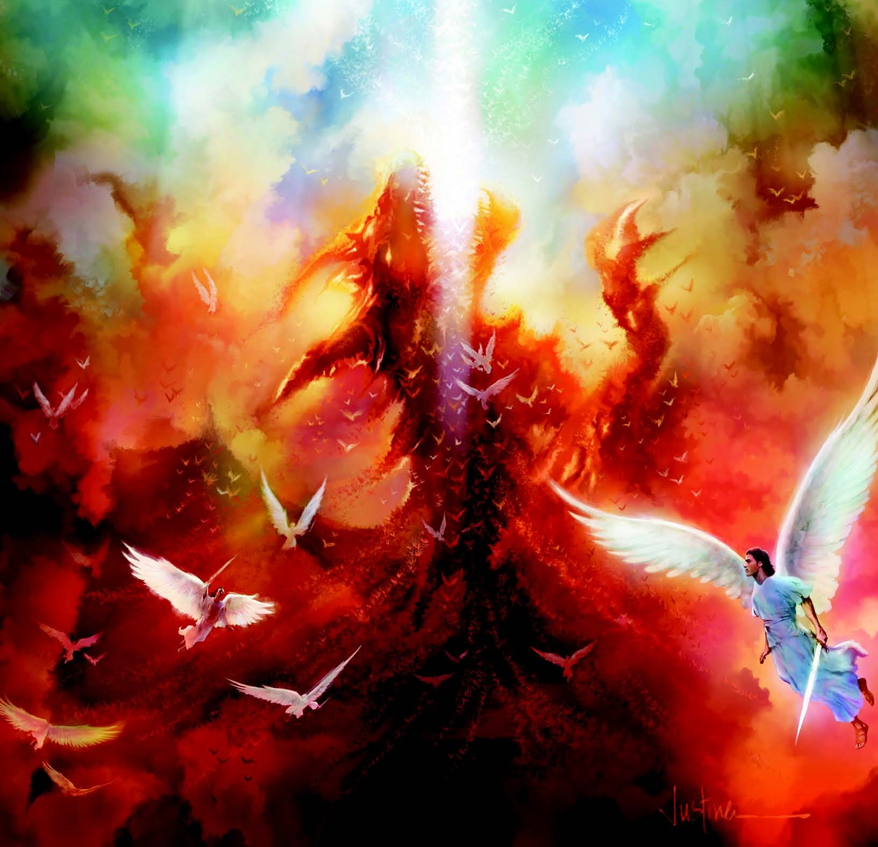
rfy Aj;jq;fSf;Fk; gpz;zdp Aj;jk;
ghlk; 1, 6 Vg;uy; 2024

Slide 2
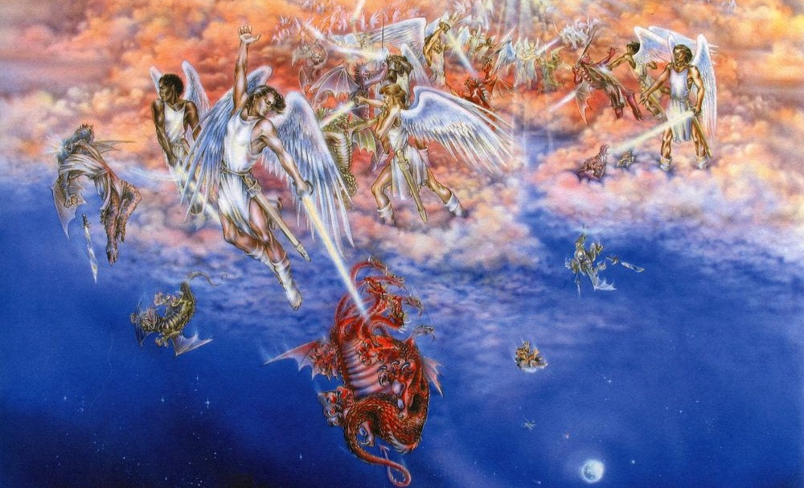
“thdj;jpNy Aj;jKz;lhapw;W@ kpfhNtYk; mtidr; Nrh;e;j J}jh;fSk; tYrh;g;gj;NjhNl Aj;jk;gz;zpdhh;fs;@ tYrh;g;gKk; mijr;Nrh;e;j J}jUk; Aj;jk;gz;zpAk; n[aq;nfhs;stpy;iy. thdj;jpy; mth;fs; ,Ue;j ,lKk; fhzg;glhkw;Nghapw;W.” (ntspg;gLj;jy; 12:7, 8)

Slide 3

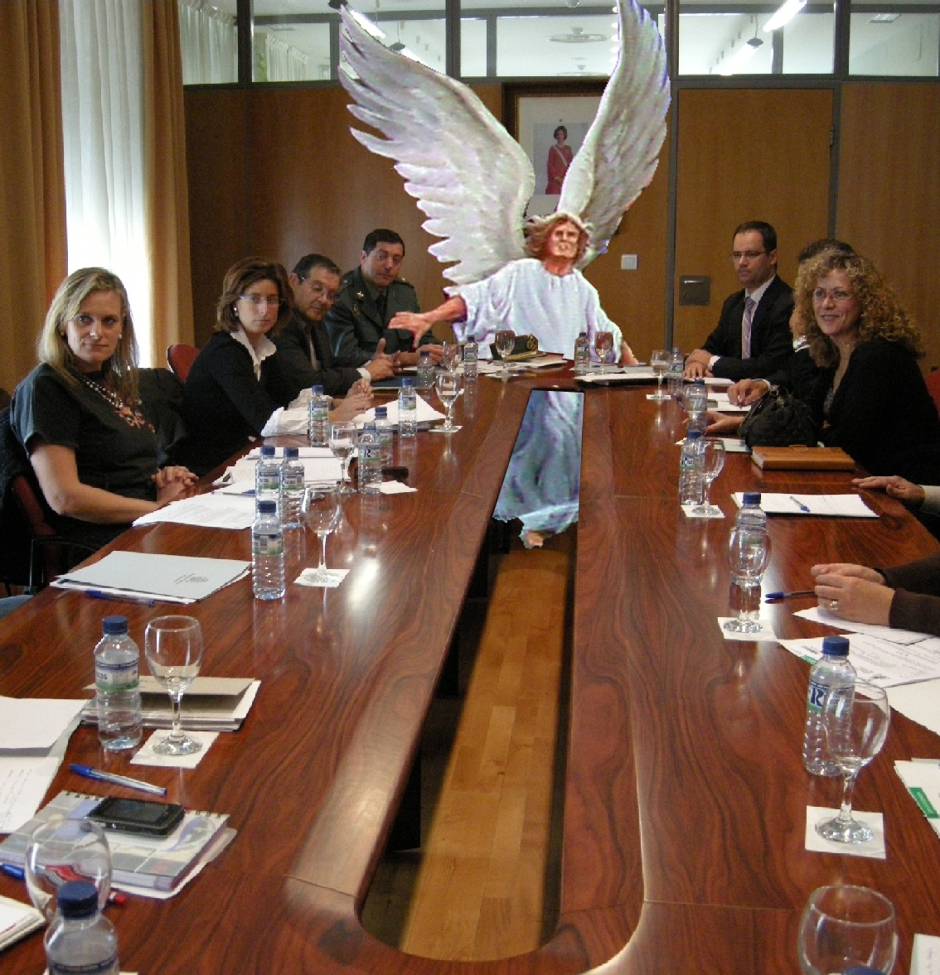
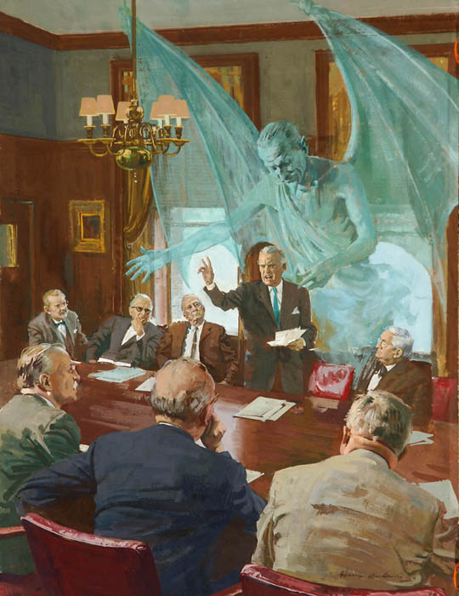
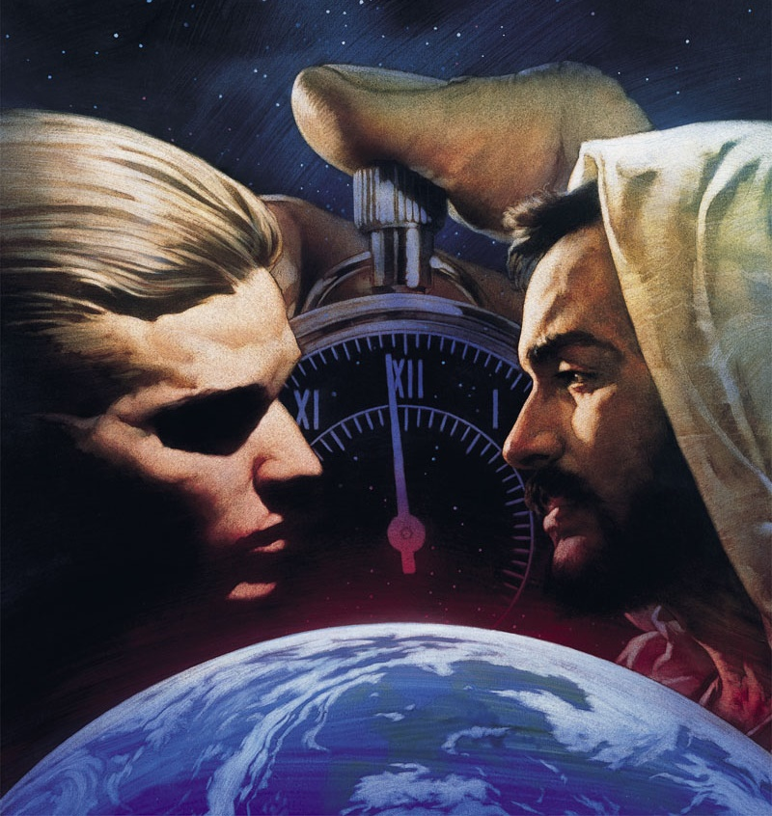
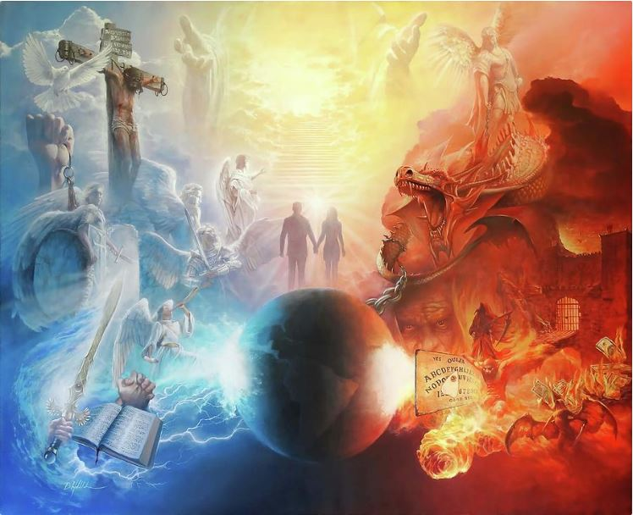





ehk; tpz;kPd; ghpkhzq;fspd; Nkhjypy; Ko;fp tho;fpNwhk;. ekf;F njhpahtpl;lhYk;> my;yJ ,J rhj;jpak; vd;W ek;ghtpl;lhYk;> Nkhjy; cz;ikahdJ.
Nkhjypy; cs;s ty;yikfs; Md;kPfk;> ek; fz;Zf;F njhpahjit
(vNg. 6:12). MdhYk; Nghhpd; tpisTfis ek;khy; czu KbfpwJ. NguopTfs;, xOf;ff;NfL, kuzk;…
Mgj;jpy; NjtDila murhq;fk;> NjtJ}jh;fs; kw;Wk; tPo;r;rpailahj cyfq;fspd; tpRthrk;. ,d;W cq;fs; tpRthrKk; vd;Dila tpRthrKk; Mgj;jpy; cs;sd.
Kuz;ghl;bd; Muk;gk;
guNyhfj;jpy; fpsh;r;rp
G+kpapy; fpsh;r;rp
md;G vjph;gLfpwJ
,d;Ws;s Kuz;ghL

Slide 4


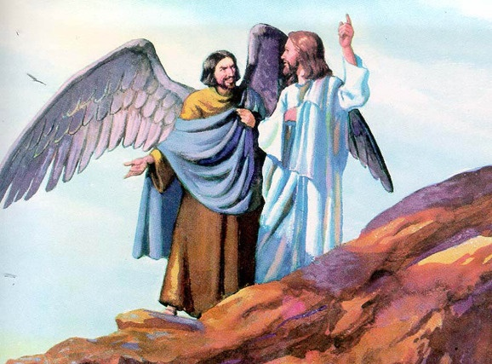
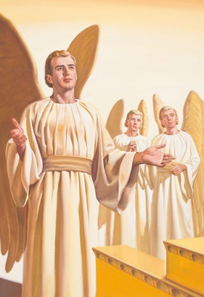
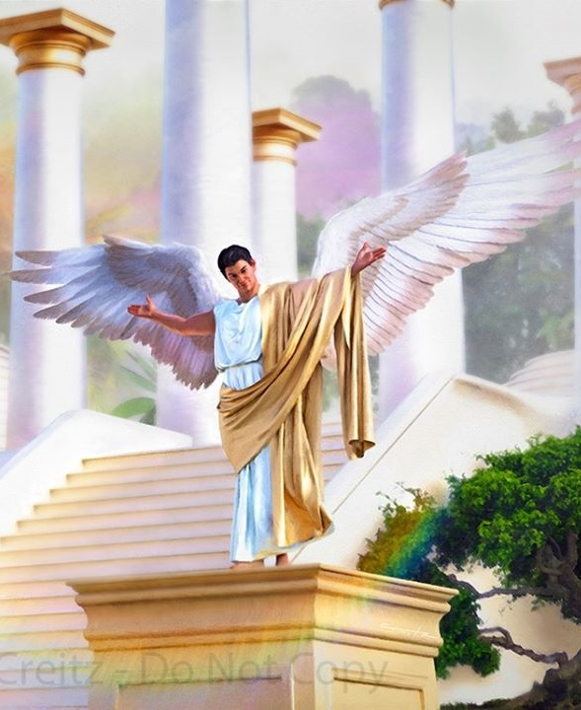
Kuz;ghl;bd; Muk;gk;
“eP rpU\;bf;fg;gl;l ehs;Jtf;fp cd;dpy; mepahak; fz;L gpbf;fg;gl;lJkl;Lk;> cd; topfspy; Fiwaw;wpUe;jha;.” (vNrf;fpNay; 28:15)
Vnjdpy;> Njtid mtek;gpf;if nfhs;s Vthis J}z;ba xU caphpdk; ,Ue;jJ vd;w cz;ik> kdpjFyk; ,Ug;gjw;F Kd;Ng NjtDf;F vjpuhd fpsh;r;rpiaf; Fwpf;fpwJ (Mjp. 3:1).
NjtDf;Fk; mtUila caphpdq;fSf;Fk; ,ilNa mtek;gpf;ifia tpijf;Fk; ,e;j caphpdj;ij ,NaR “vjphp” vd;W mioj;jhh;> mij mth; gprhR vd;W milahsk; fhl;bdhh; (kj;. 13:39).
ekf;F ehNk Nfl;Lf;nfhs;sf;$ba Kjy; Nfs;tp vd;dntd;why;: Njtd; gprhir gilj;jhuh? mjhtJ Njtd; xU jPa caphpdj;ij gilj;jhuh?
gprhR “Y}rpgh;” vd;W miof;fg;gLk; xU NjtJ}jd; vd;W Ntjk; nrhy;YfpwJ (Vrh. 14:12). ,e;j NjtJ}jd; G+uzkhfTk; mofhfTk; gilf;fg;gl;lhh; (vNr. 28:12). xU NjtJ}jd; tpUk;Gk; kpf cah;e;j gjtpf;F mth; cah;j;jg;gl;lhh;: ghJfhf;Fk; Nf&g; (vNr. 28:13-14).
Y}rpgh; rhpahdtuhf ,Ue;jhy; mth; vg;gb gprhrhf khwpdhh;? NjtDf;Fk; mtUf;Fk; ,ilNa Kuz;ghL vg;gb njhlq;fpaJ. Njtd; mth; gilj;j vy;yh caphpdq;fisAk; NghyNt> Njh;T nra;Ak; Rje;jpuj;ij mtUf;F toq;fpdhh;> NkYk; tpthpf;f Kbahj tifapy;> Y}rpgh; fpsh;r;rp nra;a KbT nra;jhh;> NkYk; NjtDila rpk;khrdj;ij Mf;fpukpf;f tpUk;gpdhh; (vNr. 28:15; Vrh. 14:13-14).

Slide 5

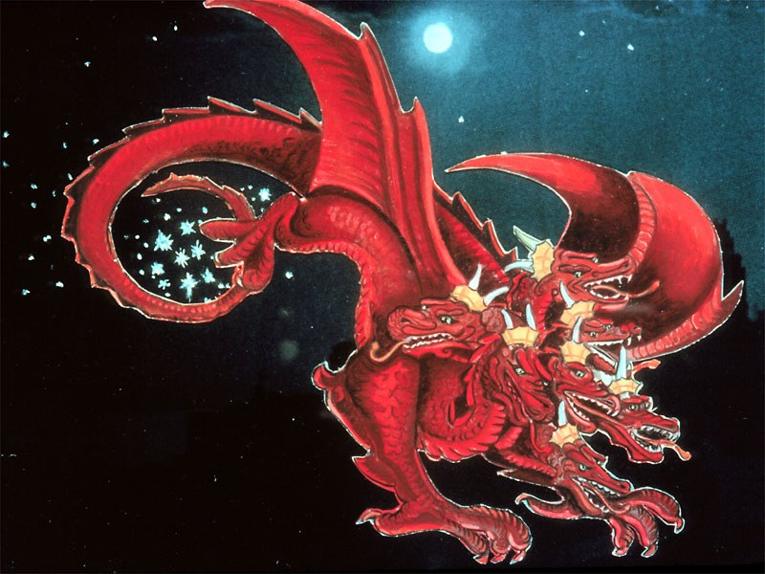
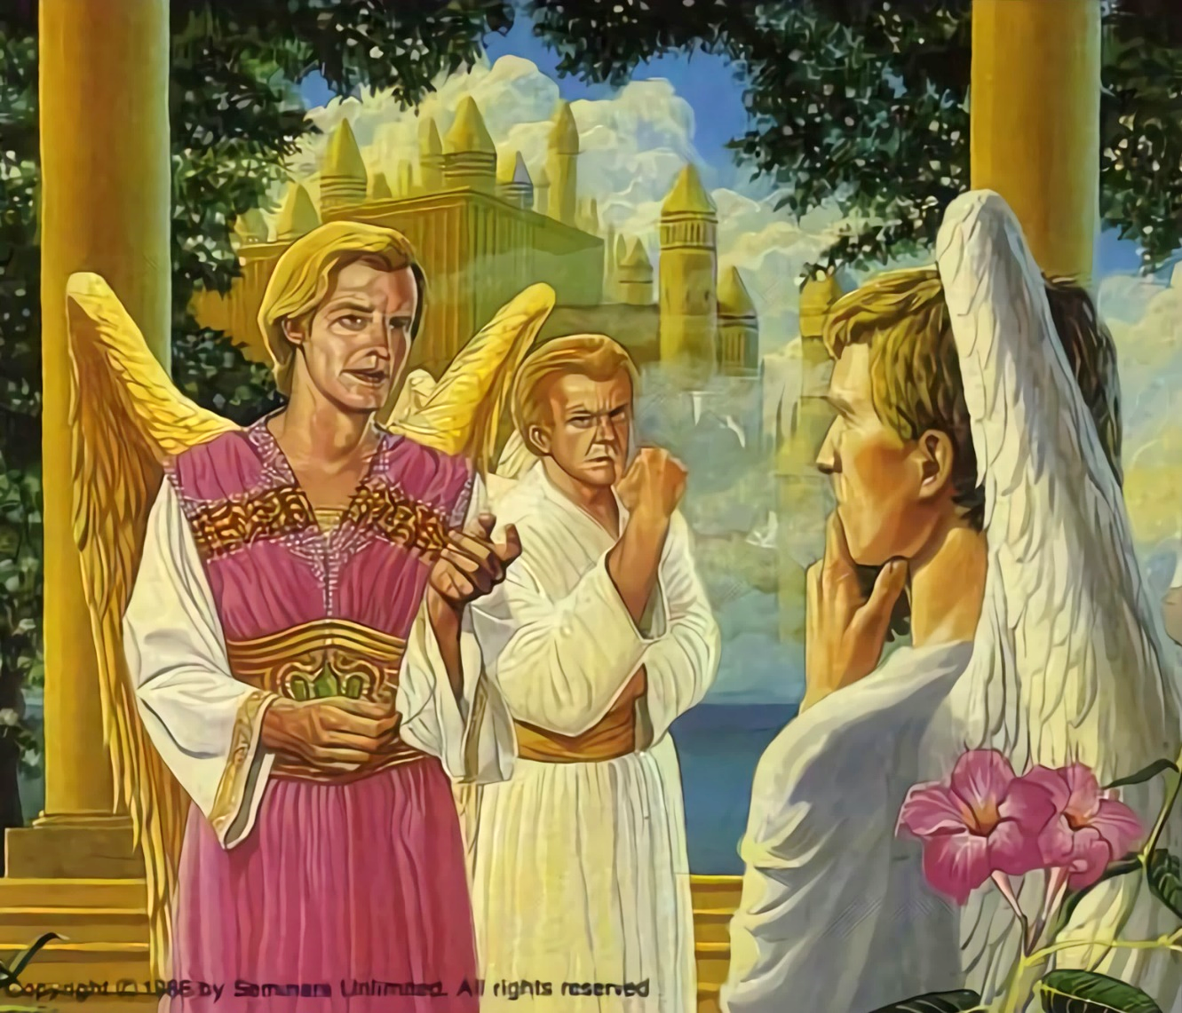
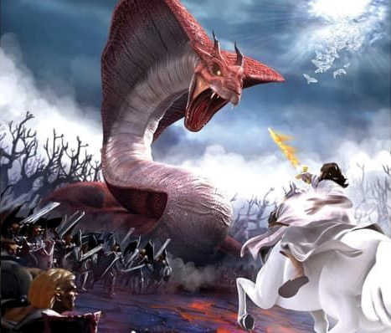

guNyhfj;jpy; fpsh;r;rp
“mjpd; thy; thdj;jpd; el;rj;jpuq;fspy; %d;wpnyhUgq;if ,Oj;J> mitfisg; g+kpapy; tpoj;js;spw;W@…” (ntspg;gLj;jy; 12:4)
guNyhfj;jpd; rpk;khrdj;ijf; ifg;gw;Wtjw;fhd jdJ tpUg;gj;jpy;> Y}rpgh; nja;tPf murhq;fj;jpd; ePjpiag; gw;wp NjtJ}jh;fsplk; Nfs;tp vOg;gpdhh;. mth;fs; midtUk; Rje;jpukhf ,Uf;ftpy;iyah? Vd; fLikahd kw;Wk; epahakw;w my;yJ cWjpaw;w rl;lq;fSf;F mbgzpa Ntz;Lk;?
Y}rpgh; Fw;wg;gLj;Jk; rhj;jhdhf khwpdhd; (ntsp. 12:10; NahG 1:6, 9-10). mtUila mZFKiwia khw;Wk;gb Njtd; nfhLj;j md;ghd miog;Gfs; midj;ijAk; epuhfhpj;jhh;.
fpsh;r;rp xU ntspg;gilahd Aj;jkhf khwpaJ> xt;nthU NjtJ}jUk; jq;fs; Kbit vLf;fNtz;ba xU Aj;jk;. 1/3 gq;F J}jh;fs; rhj;jhid gpd;gw;wpdhh;fs;, Mdhy; kw;wth;fs; NjtDf;F cz;ikahf ,Ue;jhh;fs; (ntsp. 12:4).
,d;Wk; me;j Aj;jk; njhlh;fpwJ. rhj;jhd; ,d;Wk; RWRWg;ghf ,Uf;fpwhd;. NjtDf;F vjpuhf fyfk; nra;a xt;nthU egiuAk; ,Of;f Kaw;rpf;fpwhd;. ,U gf;fq;fs; kl;LNk cs;sd. NjtDila rl;lq;fSf;F fPo;gbNthh; my;yJ mij epuhfhpg;Nghh;. KbT ek;KilaJ (cgh. 30:11, 16, 19; NahR. 24:15).

Slide 6

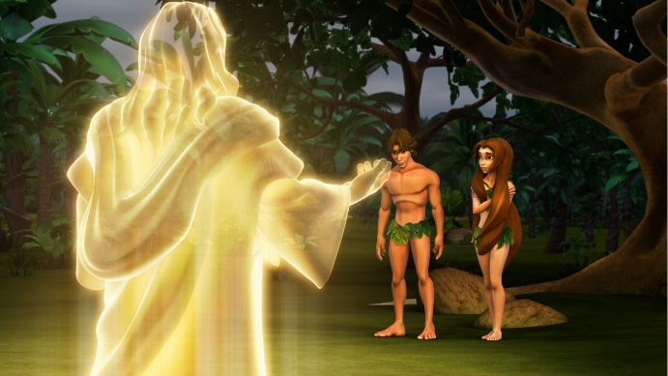



G+Nyhfj;jpy; fpsh;r;rp
“mg;nghOJ mth;: eP eph;thzp vd;W cdf;F mwptpj;jtd; ahh;? Grpf;fNtz;lhk; vd;W ehd; cdf;F tpyf;fpd tpUl;rj;jpd; fdpiag; Grpj;jhNah vd;whh;.” (Mjpahfkk; 3:11)
Njtd; xU ghtkw;w> rhpahd R+oypy; NjtJ}jh;fisg; gilj;jhh;. mNjNghy, Njtd; kdpjFyj;ij ghtk; ,y;yhj xU ghpG+uz R+oypy; gilj;jhh; (Mjp.1:31).
NjtJ}jh;fSf;F ele;jJNghyNt> Njtd; ek;ikAk; Rje;jpukhf Njh;e;njLf;Fk; rf;jpAld; gilj;jhh;. MfNt, MjhKk; VthSk; me;j Rje;jpuj;ij mDgtpj;jhh;fs;, xU vspa fl;lisNa Njtd; nfhLj;jhh;: “MdhYk; ed;ikjPik mwpaj;jf;f tpUl;rj;jpd; fdpiag; Grpf;fNtz;lhk;.” (Mjp. 2:17).
mJjhd; rhj;jhd; mth;fis re;Njfpf;f itf;Fk; xNu Gs;sp. tQ;rfkhf, mtd; jd; ,yf;if mile;jhd;. MjhKk; VthSk; Njtid re;Njfpj;jhh;fs;> mtUf;F fPo;gbahky;> tho;f;ifapd; %yj;jpypUe;J tpyfpdh; (Mjp.3:6, 9-13, 19). ghtk; Eiotjw;F Mjhk; fjit jpwe;jhh;> ,jdhy; kuzk; vy;yh kdpjh;fSf;Fk; nrd;wJ (Nuhkh;. 5:12).
mJKjy;, ehk; typ> Neha; kw;Wk; kuzj;jhy; R+og;gl;l cyfpy; tho;fpNwhk;. ehnky;yhUk; Mjhkpd; ghtj;Jf;fhd jz;lidia ngw;Wf;nfhs;fpNwhkh?
ehk; xt;nthUtUk; ek; ghtj;jpw;fhd jz;lidia ngw;Wf;nfhs;fpNwhk;: “vy;yhUk; ghtQ;nra;J> Njtkfpikaw;wth;fshfp>” (Nuhkh;. 3:23).

Slide 7

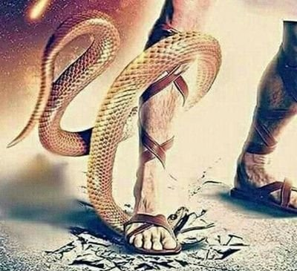
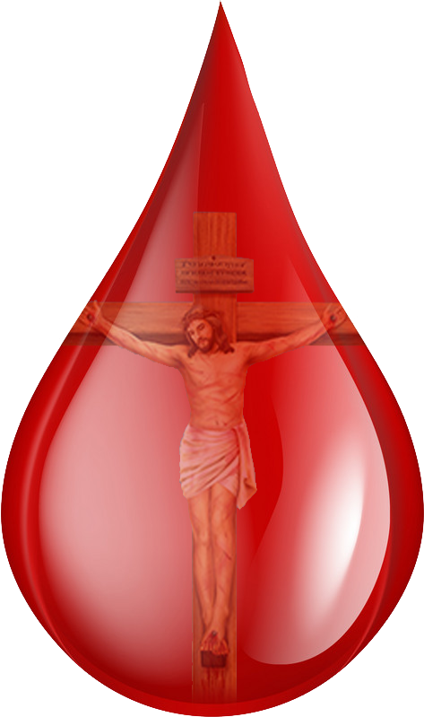
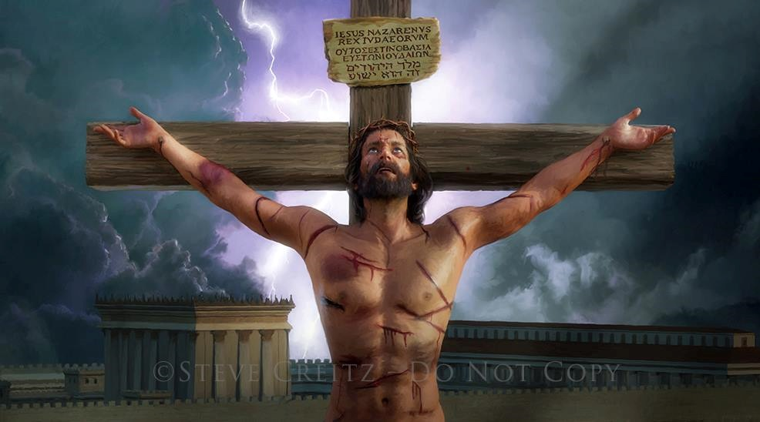
md;G vjph;gLfpwJ
“ehk; Njtdplj;jpy; md;G$h;e;jjpdhy; my;y> mth; ek;kplj;jpy; md;G$h;e;J> ek;Kila ghtq;fis eptph;j;jp nra;fpw fpUghjhugypahfj; jk;Kila Fkhuid mDg;gpdjpdhNy md;G cz;lhapUf;fpwJ.” (1Nahthd;. 4:10)
fPo;gbahikapd; tpisTfis mwptpg;gjw;F Kd;Ng> Njtd; Mjhk; kw;Wk; VthSf;F mth;fspd; kPl;gpw;fhd jpl;lk; ,Ug;gjhf njhptpj;jhh;(Mjp.3:15).
kdpjFyk; jhdhf Kd;te;J rpU\;bfhplkpUe;J jd;id gphpj;Jf; nfhz;lJ. Mdhy; ed;wpaw;w gps;isfis iftplhky;> Njtd; ek;gpf;iff;F mg;ghw;gl;L mtUila cz;ikahd Fzj;ij ntspg;gLj;jpdhh; (Nahthd; 3:16).
ghtpf;F kuzk; epj;jpa tpjpahf ,Uf;f Ntz;bajpy;iy. ghtj;jpd; tpiyia jd; capNuhL nrYj;jp ,NaR jk; md;ig fhl;bdhh; (Nuhkh;. 5:8).
NjtDila md;Gf;F jFjpAilath;fs; vd;W nrhy;tjw;F ek;kpy; xd;Wk; ,y;iy. vd;whYk;, fy;thhpapy; ,NaR rpe;jpa xt;nthU Jsp ,uj;jj;JlDk;, Njtd; ek;kplk; nrhy;fpwhh;: “ehd; cd;id Nerpf;fpNwd;.”

Slide 8
md;G vjph;gLfpwJ
“ehk; Njtdplj;jpy; md;G$h;e;jjpdhy; my;y> mth; ek;kplj;jpy; md;G$h;e;J> ek;Kila ghtq;fis eptph;j;jp nra;fpw fpUghjhugypahfj; jk;Kila Fkhuid mDg;gpdjpdhNy md;G cz;lhapUf;fpwJ.” (1Nahthd;. 4:10)
,NaR vt;thW jdJ md;ig ek;kplk; fhz;gpj;jhh;?
,Uf;Fk; midj;ijAk; ,NaR gilj;jhh; (Nah. 1:3)
mth; xU rpU\;bahf khwpdhh; (Nah 1:14)
mtUk; ek;ik NghyNt f\;lq;fisAk;> Jd;gq;fisAk;> grpiaAk;> NtjidiaAk; mDgtpj;jhh;(Vrh. 53:3; khw;F 11:12)
ek;ik NghyNt mtUk; Nrhjpf;fg;gl;lhh; (vgp. 4:15)
mth; ePjpAs;stuhf ,Ue;J> ek; ghtq;fSf;fhf kdg;G+h;tkhf Jd;gg;gl;lhh; (1 NgJ. 3:18; Nah 10:17-18)
khpj;J caph;njOe;jjd; %yk;> mth; jdJ ,uh[;aj;jpy; epj;jpa [Ptid ekf;F cWjpaspj;jhh;
(Nuh. 6:3-4)
,it midj;JNk mth; ek;Nky; itj;j md;Gf;fhf (1Nah. 4:10)

Slide 9

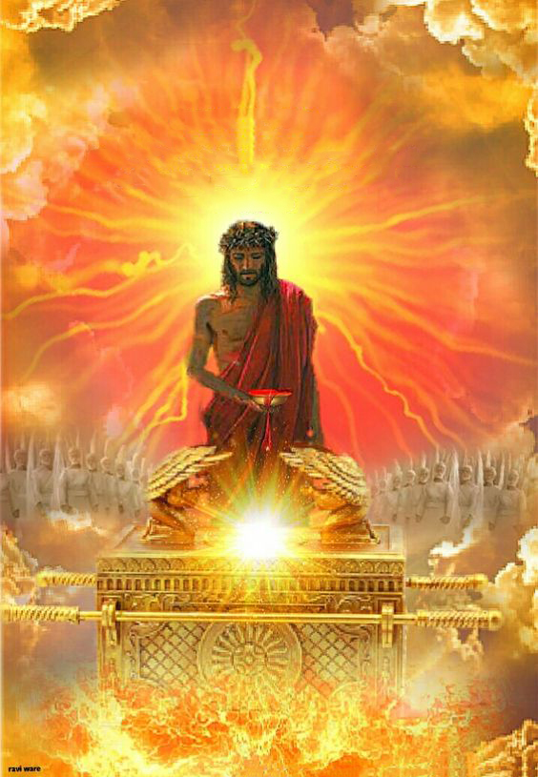
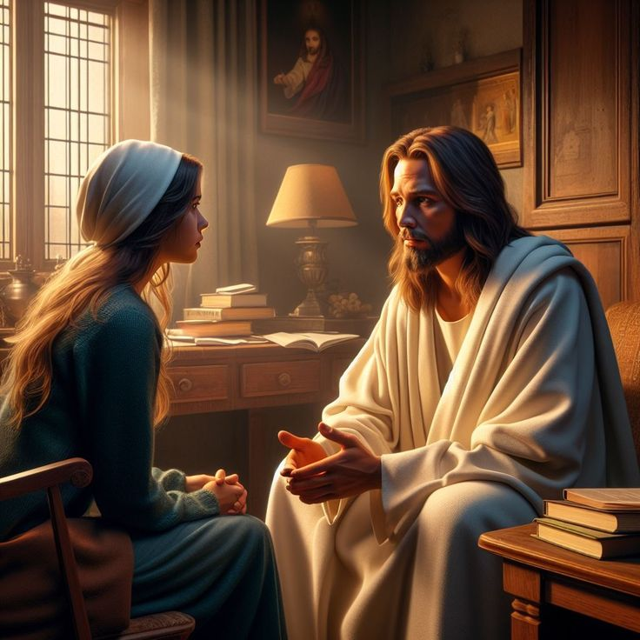
,d;Ws;s Nghuhl;lk;
“NkYk;> jkJ %ykha;j; Njtdplj;jpy; NrUfpwth;fSf;fhf Ntz;Ljy;nra;Ak;gbf;F mth; vg;nghOJk; capNuhbUf;fpwtuhifahy; mth;fis Kw;WKba ,ul;rpf;f ty;ytuhAkpUf;fpwhh;.” (vgpNuah; 7:25)
,d;W, ,NaR guNyhf Mrhpg;Gf; $lhuj;jpy; ekf;fhf ghpe;J Ngrpf;nfhz;bUf;fpwhh; (vgp. 9:24; 7:25).
rpYitapy; rpe;jg;gl;l ,uj;jj;jpd; %yk;> ,NaR ek;ikj; je;ijapd; Kd; - kw;Wk; gpugQ;rj;jpd; midj;J Fbkf;fs; Kd; - ePjpahd ghpG+uzkhd kdpjh;fshf> guNyhfj;jpy; xU ,lj;ijg; gpbf;f jFjpahdth;fshf ek;ik fhl;Lfpwhh;.
vdNt, ,NaRtpd; %yk; ek;gpf;ifAld; Njtid mZf miof;fg;gLfpNwhk; (vgp. 4:15-16).
ek; tho;tpd; xt;nthU Njitf;Fk; ehk; mtiu ek;gNtz;Lk; vd;W ,NaR tpUk;Gfpwhh; (Nah. 14:13-14). vq;F gak; ,Uf;fpwNjh> mq;Nf mth; rkhjhdj;ij nfhz;LtUfpwhh;; Fw;wk; ,Uf;Fk; ,lj;jpy;> mth; kd;dpg;igf; nfhz;L tUfpwhh;. gytPdk; ,Uf;Fk; ,lj;jpy; mth; gyj;ijf; nfhz;LtUfpwhh;.
epj;jpakhf ek;NkhL thoNtz;Lk; vd;gNj ,NaRtpd; kpfg;nghpa Mir (Nah. 17:24). ,Jjhd; cq;fspd; kpfg;nghpa thQ;irah?

