Slide 1
,Uspy; xsp gpufhrpf;fpwJ
ghlk; 3 Vg;uy; 20, 2024

Slide 2
“mjw;F ,NaR: ,d;Dk; nfhQ;rf; fhyk; xsp cq;fsplj;jpy; ,Uf;Fk;@ ,Uspy; ePq;fs; mfg;glhjgbf;F xsp cq;fNshbUf;ifapy; elTq;fs;@ ,Uspy; elf;fpwtd; jhd; Nghfpw ,lk; ,d;dnjd;W mwpahd;.”
(Nahthd; 12:35)

Slide 3
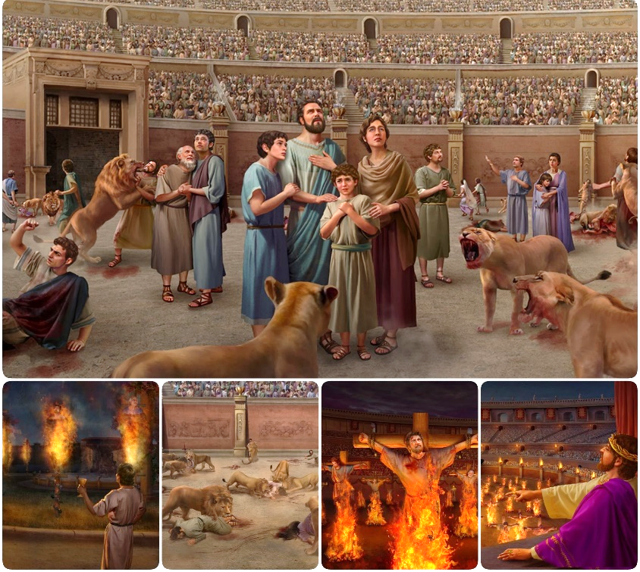
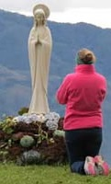
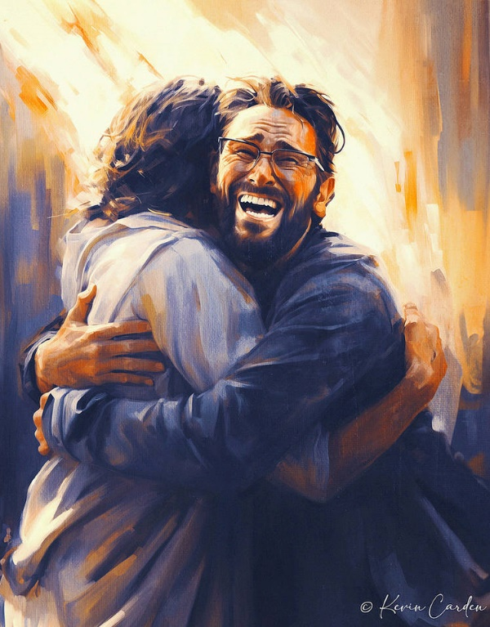
xU Nghhpy; ntw;wp my;yJ Njhy;tp Vw;gLk;.
Jd;GWj;jypd; Aj;jj;jpy; rhj;jhd; Njhw;w NghJ mtd; xU Gjpa jpl;lj;ij tFj;jhd;: rkurk;. cz;ik kw;Wk; ngha;apd; fyitahdJ fyg;glk; nra;ag;gl;l > capuw;w cz;ikia Vw;Wf;nfhs;s kpy;ypad; fzf;fhd kf;fis ,Oj;J nrd;wJ.
rj;jpaKk; [PtDk; mtUila ghpRj;j thh;j;ijAkhfpa ,NaR fpwp];Jit gw;wpf;nfhs;tJjhd;> ,e;j Nghhpy; ek;Kila xNu ghJfhg;G.
rj;jpaj;jpw;fhd Aj;jk;:
rj;jpaj;jpw;F vjpuhf ngha;
rigapd; rkurk;.
NjtDila thh;j;ijf;fhd Aj;jk;:
Ntjhfkj;jpy; ghJfhg;G.
kdpj gFj;jwpT.
kdjpy; Aj;jk;.

Slide 4
rj;jpaj;jpw;fhd Aj;jk;

Slide 5
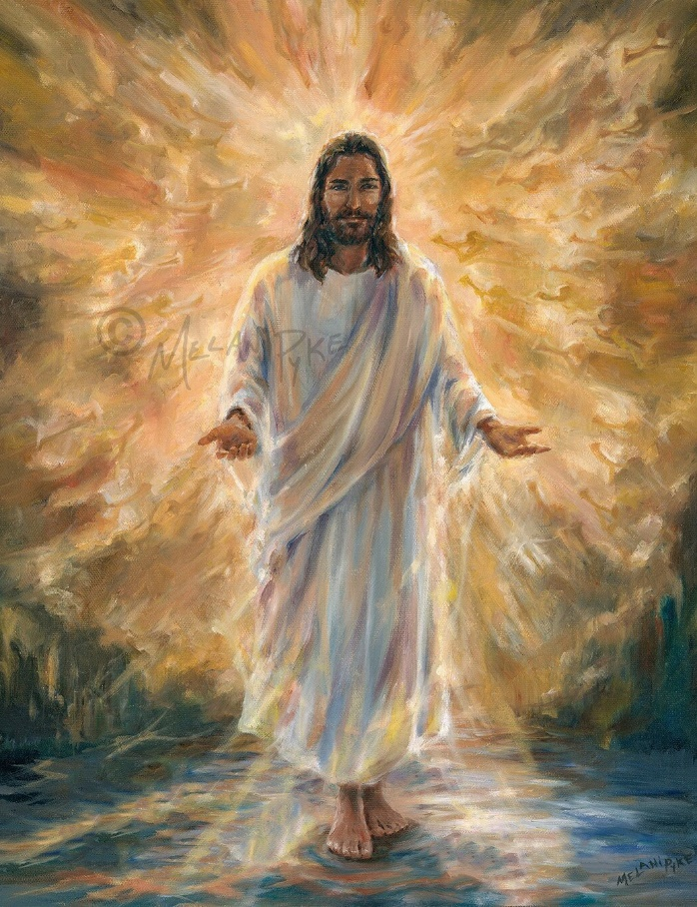
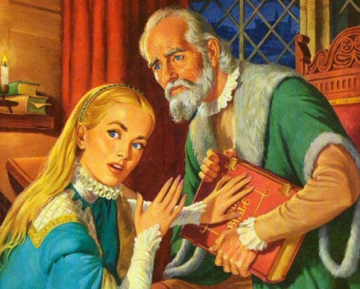
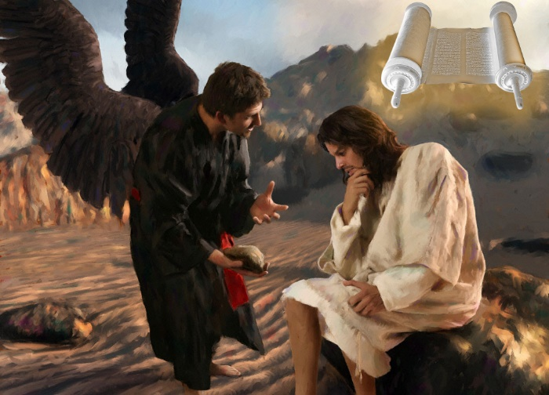
rj;jpaj;jpw;F vjpuhf ngha;
“mjw;F ,NaR: ehNd topAk; rj;jpaKk; [PtDkhapUf;fpNwd;@ vd;dhNyay;yhky; xUtDk; gpjhtpdplj;jpy; tuhd;. ” (Nahthd; 14:6)
,NaRNt rj;jpak;> vy;yh rj;jpaj;jpw;Fk; je;ij mtNu(Nahthd; 14:6). vy;yh cz;ikAk;, vy;yh ek;gfj;jd;ikAk;, vy;yh rj;jpaKk;, mthplkpUe;Nj tUfpwJ. NkYk; mtUila rj;jpak; ek;kpy; [Ptid cz;lhf;FfpwJ.
,jw;F Kuzhf, rhj;jhd; ngha;f;F gpjhtha; ,Uf;fpwhd; (Nah. 8:44). vy;yh tQ;rfKk;, vy;yh jPq;fpiof;Fk; EZf;fKk;, vy;yh fyg;glkhd cz;ikAk;, mtdplkpUe;Nj tUfpwJ. mtDila ngha;fs; ekf;Fs; kuzj;ij cz;lhf;FfpwJ.
vjphpAldhd mtuJ Nkhjypy;, vy;yh rj;jpaj;jpd; Mjhukhf Ntjhfkj;ij gad;gLj;jpdhh; ,NaR: “vOjpapUf;fpwNj” (kj;. 4:4; 21:13).
MfNt, Ntjhfkj;ij kiwf;fNth my;yJ rpijf;fNth my;y> mij mopf;f gprhR Ntiy nra;jhd;. ,ilf;fhyj;jpy; (“,Uz;l fhyk;” vd;Wk; miof;fg;gLk;), Nuhkd; fj;Njhypf;f jpUr;rig %ykhf, mij epiwNtw;wpdhd; (KOikahf my;y).

Slide 6
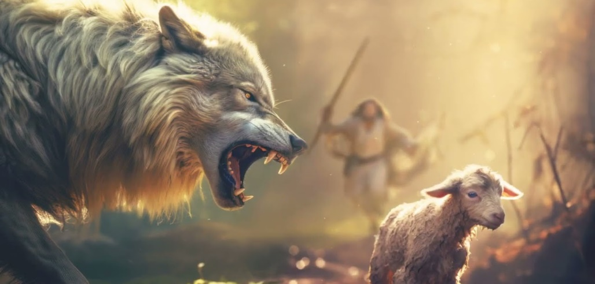
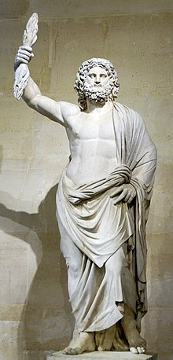
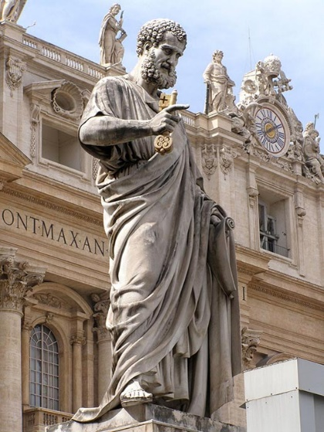
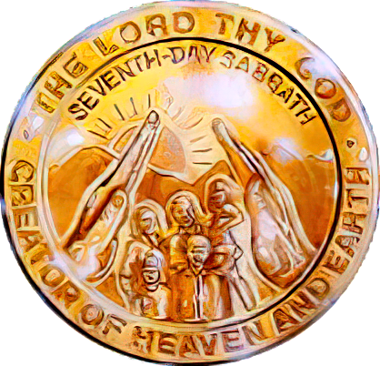
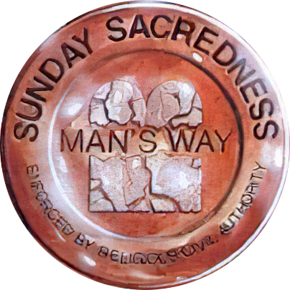
rigapd; rkurk;
“ehd; Nghdgpd;G ke;ijiaj; jg;gtplhj nfhbjhd Xeha;fs; cq;fSf;Fs;Ns tUk;. cq;fspYk; rpyh; vOk;gp> rP\h;fisj; jq;fsplj;jpy; ,Oj;Jf;nfhs;Sk;gb khWghlhditfisg; Nghjpg;ghh;fnsd;W mwpe;jpUf;fpNwd;.” (mg; 20:29-30).
vNgrpa %g;gh;fsplk; ,Ue;J tpilngWk;NghJ, vjph;fhyj;jpy; mth;fs; vjph;nfhs;Sk; ntspg;Gw kw;Wk; cs;Gw gpur;ridfSf;fhf gTy; jdJ ftiyia ntspg;gLj;jpdhh; ( mg; 20:29-30).
nfhbjhd Xeha;fs; . fpgp 64 Kjy; 311 tiu (nrh;bfh vbf;l; Mg; lhyud;]; ), Nuhkhdpa Nuurplk; ,Ue;J Njtyhak; fLikahd Jd;GWj;jYf;F MshdJ.
tpghPjkhd kdpjh;fs; . 4Mk; E}w;whz;L Jtq;fp, kde;jpUk;ghj kdpjh;fs; rigf;Fs;shf mwpKfg;gLj;jg;gl;lhh;fs;> mth;fs; jq;fs; mQ;Qhd kjj;ij fpwp];jtj;jpy; fyg;glk; nra;jhh;fs;.
Nuhkpy; cs;s NfgpNlhypd; kiyapy; cs;s Nuhkhdpa flTshd [_gplhpd; rpiy kPz;Lk; gad;gLj;jg;gl;L Gdpj NgJUtpd; rpiyahf khw;wg;gl;lJ
rhj;jhd; jd; “cs;” %Nyhghaj;ij gad;gLj;jp rj;jpaj;ij rpijj;J> jpUrigf;Fs; rpiy topghL kw;Wk; QhapW Mrhpg;G Mfpatw;iw mwpKfg;gLj;jpdhd;.
gTy; jPh;f;fjhprdk; ciuj;jgb, ,e;j jtWfnsy;yhk; Vw;Wf;nfhs;sg;gl;lJ, rj;jpaj;ij mwpa tpUk;ghjth;fsplj;jpy; ,Wjp tiu ,Uf;Fk; (2 njr. 2:7-12). ,Wjpg;Nghh; xa;TehSldhd rkurj;jpd; mbg;gilapy; mikAk;.

Slide 7
NjtDila thh;jijf;fhd Aj;jk;

Slide 8
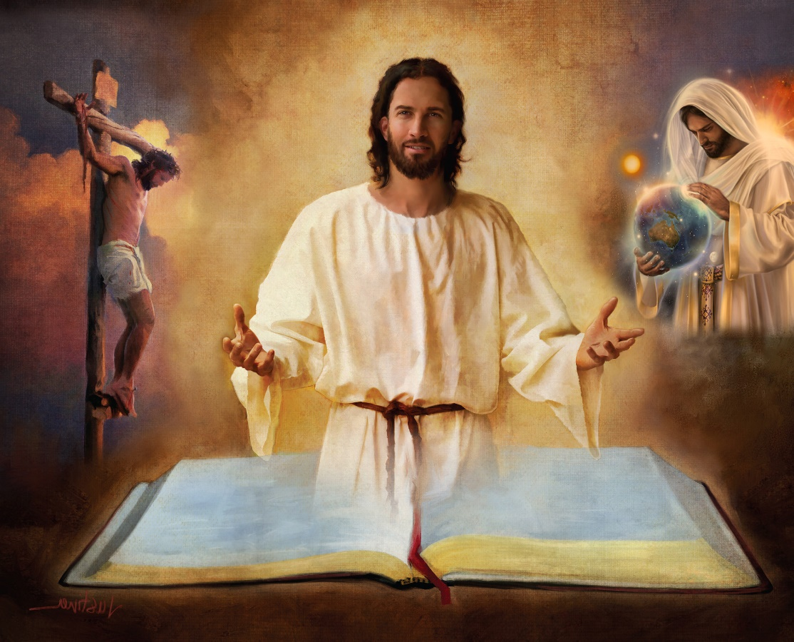
Ntjhfkj;jpy; ghJfhg;G
“ck;Kila rj;jpaj;jpdhNy mth;fisg; ghpRj;jkhf;Fk;@ ck;Kila trdNk rj;jpak;.” (Nahthd; 17:17)
Ntjhfkk; vd;gJ NjtDila rpj;jj;jpd; jtwpy;yhj ntspg;ghL. ,J kdpjFyj;jpd; ,ul;rpg;Gf;fhd guNyhfj;jpd; jpl;lj;ij Kd;itf;fpwJ.
MfNt, ek;Kila ghJfhg;G Ntjhkj;jpYk;> mjd; xt;nthU Gj;jfq;fspYk;> mj;jpahaq;fspYk;> trdq;fspYk; kl;LNk cs;sJ (2jPNkh. 3:16).
mjpy; gprhrpd; cj;jpia fhz;fpNwhk;; rpU\;bg;G; ,NaRtpd; gpwg;G, tho;f;if, kuzk;, caph;j;njOjy; kw;Wk; ghpe;J NgRjy;; ghtkd;dpg;G; ,uz;lhk; tUif; Gjpa G+kpapy; epj;jpa [Ptd;…
“ck;Kila trdk; vd; fhy;fSf;Fj; jPgKk;> vd; ghijf;F ntspr;rKkhapUf;fpwJ.”(rq;. 119:105)
mjpy; VjhtJ xU gFjpia ehk; epuhfhpg;Nghkhdhy;(cjhuzkhf, Mjpahfkk; 1 kw;Wk; 2y; cs;s rpU\;bg;gpd; fzf;F), mJ Nghjpf;fpw VjhtJ Nfhl;ghLfis epuhfhpg;gth;fsha; ,Ug;Nghk;. mjd; gpd;G... Ntjhfkj;jpd; kw;w gFjpfis ek;Gtjw;F vd;d ghJfhg;G ,Uf;f KbAk;?
“ck;Kila trdj;jpd; gpurpj;jk; ntspr;rk; je;J> Ngijfis czh;Ts;sth;fshf;Fk;.” (rq;. 119:130)

Slide 9
kdpj gFj;jwpT
“kD\Df;Fr; nrk;ikaha;j; Njhd;Wfpw topAz;L@ mjpd; KbNth kuz topfs;.” (ePjpnkhopfs; 16:25)
Njtd; Ntjhfkj;ij vOjpdhnud;why;> ahh; mij mh;j;jg;gLj;jKbAk; ? (2 NgJ. 1:20; Nahthd; 14:26)
Njt Mtpapdplj;jpypUe;J tUfpwitfis Mtpapy;yhj egh; Vw;Wf;nfhs;skhl;lhh; khwhf mitfis Kl;lhs;jdkhf fUJthh;> NkYk; mit Mtpapd; %yk; khj;jpuNk gFj;jwpag;gLtjhy; mtw;iw mtuhy; Ghpe;Jnfhs;sKbahJ (1nfhhp. 2:14 ).
kdpj gFj;jwpTf;F xU vLj;Jf;fhl;L, 18tJ E}w;whz;bypUe;J, Ntjhfkj;jpd; “fy;tp” tpsf;fj;ij Kd;nkhope;j cah; tpkh;rdk;.
mjd; mbg;gil mZFKiw mw;Gjq;fis kWg;gJ kw;Wk; vjph;fhyj;ij fzpf;fKbahjJ. ,e;j mZFKiwapd; fPo;, NjtDila thh;j;ijapd; ty;yikia my;yJ ekf;F fhj;jpUf;Fk; vjph;fhyj;ij mwpAk; jpwid kWj;jhy;> mjpypUe;J vd;d gyd;fis ngwg; KbAk;?
Re;NjfNkapy;yhky;, vjphp rhpahd ghijia cUthf;Ffpwhd;, Mdhy; mtw;wpd; KbT kuzk; (ePjp. 16:25).

Slide 10
kdjpd; Aj;jk;

Slide 11
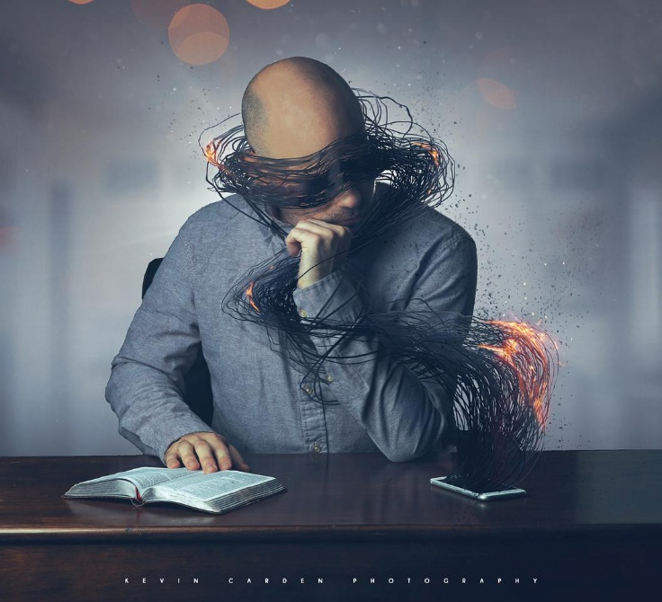
“NjtDila rhayhapUf;fpw fpwp];Jtpd; kfpikahd RtpNr\j;jpd; xsp> mtpRthrpfshfpa mth;fSf;Fg; gpufhrkhapuhjgbf;F> ,g;gpugQ;rj;jpd; Njtdhdtd; mth;fSila kdijf; FUlhf;fpdhd;.” (2 nfhhpe;jpah; 4:4)
xU ];ghdpa gonkhop $WfpwJ: “ghh;f;f tpUk;ghjtid tpl nghpa FUld; ,y;iy.” mjhtJ, xUtiu mth;fs; ghh;f;f tpUk;ghjij fhZk;gb rkhjhdg;gLj;JtJ gadw;wJ. MfNt jhd; mth;fis “,g;gpugQ;rj;jpd; Njtdhdtd;” mth;fSila kdijf; FUlhf;fpdhd; (2nfhhp. 4:4).
njhiye;J Nghdth;fspd; mwpTf;FiwT> mwpAk; jpwd; ,y;yhjjhy; my;y> mth;fs; njhpe;Jnfhs;s tpUk;ghjjhy; jhd;. gprhR mth;fspd; kdij gy tp\aq;fshy; Mf;fpkpj;Js;shd;> mit cz;ikapNyNa Kf;fpakhdit: mth;fspd; ,ul;rpg;igg; gw;wp rpe;jpf;ftplhky; jLf;fpwhd;.
Mdhy; ,e;j epiyapy; ahUk; ,Uf;f Ntz;bajpy;iy. kdk; Mtpf;Fhpa ,Uspy; ,Uf;Fk;NghJ, mjpy; xsp tprf;$ba kw;Wk; gpufhrpf;ff;$ba xU xsp ,Uf;fpwJ: “me;j xsp (,NaR) ,UspNy gpufhrpf;fpwJ@ ,UshdJ mijg; gw;wpf; nfhs;stpy;iy.” (Nahthd; 1:5).
,e;j xspia Vw;Wf;nfhs;gth;fshy; vjphpapd; Ntiyia nra;aKbahJ, NkYk; ,NaRtpd; xspia mth;fs; gpufhrpf;f nra;thh;fs;.

Slide 12
“guNyhf ghijapy; gazpf;Fk; midtUf;Fk; ghJfhg;ghd topfhl;b Njit. ehk; kdpj Qhdj;jpy; elf;ff;$lhJ. ehk; tho;f;if gazj;jpy; elf;Fk;NghJ fpwp];Jtpd; Fuiy Nfl;gJ ekJ ghf;fpak;, mtUila thh;j;ijfs; vg;NghJk; Qhd thh;j;ijfs;. ...
fpwp];Jit neUf;fkhf gpd;gw;WtJk;> mtUila Qhdj;jpy; elg;gJk;> mtUila rj;jpaj;ij filgpbg;gJk; kl;LNk ekJ ghJfhg;G. rhj;jhdpd; Ntiyia ehk; vg;NghJNk fz;lwpa KbahJ; mtd; jd; fz;zpfis vq;Nf itf;fpwhd; vd;gJ ekf;F njhpahJ. Mdhy; ,NaR vjphpapd; El;gkhd fiyfis Ghpe;Jnfhs;fpwhh;, NkYk; mth; ek; fhy;fis ghJfhg;ghd ghijapy; nfhz;L nry;fpwhh;."
vyd; [p citl; (mth; i` fhypq;, [dthp 10)

