Slide 1
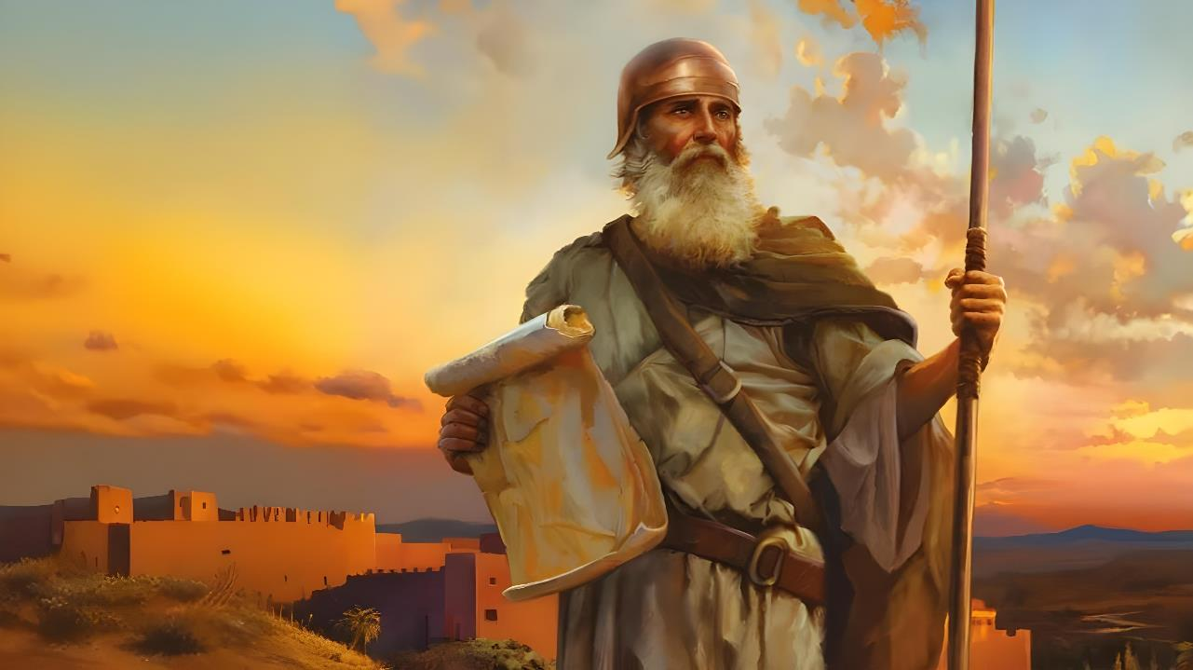

ntw;wpf;fhd nray;Kiw
ghlk; 1 mf;Nlhgu; 4, 2025

Slide 2
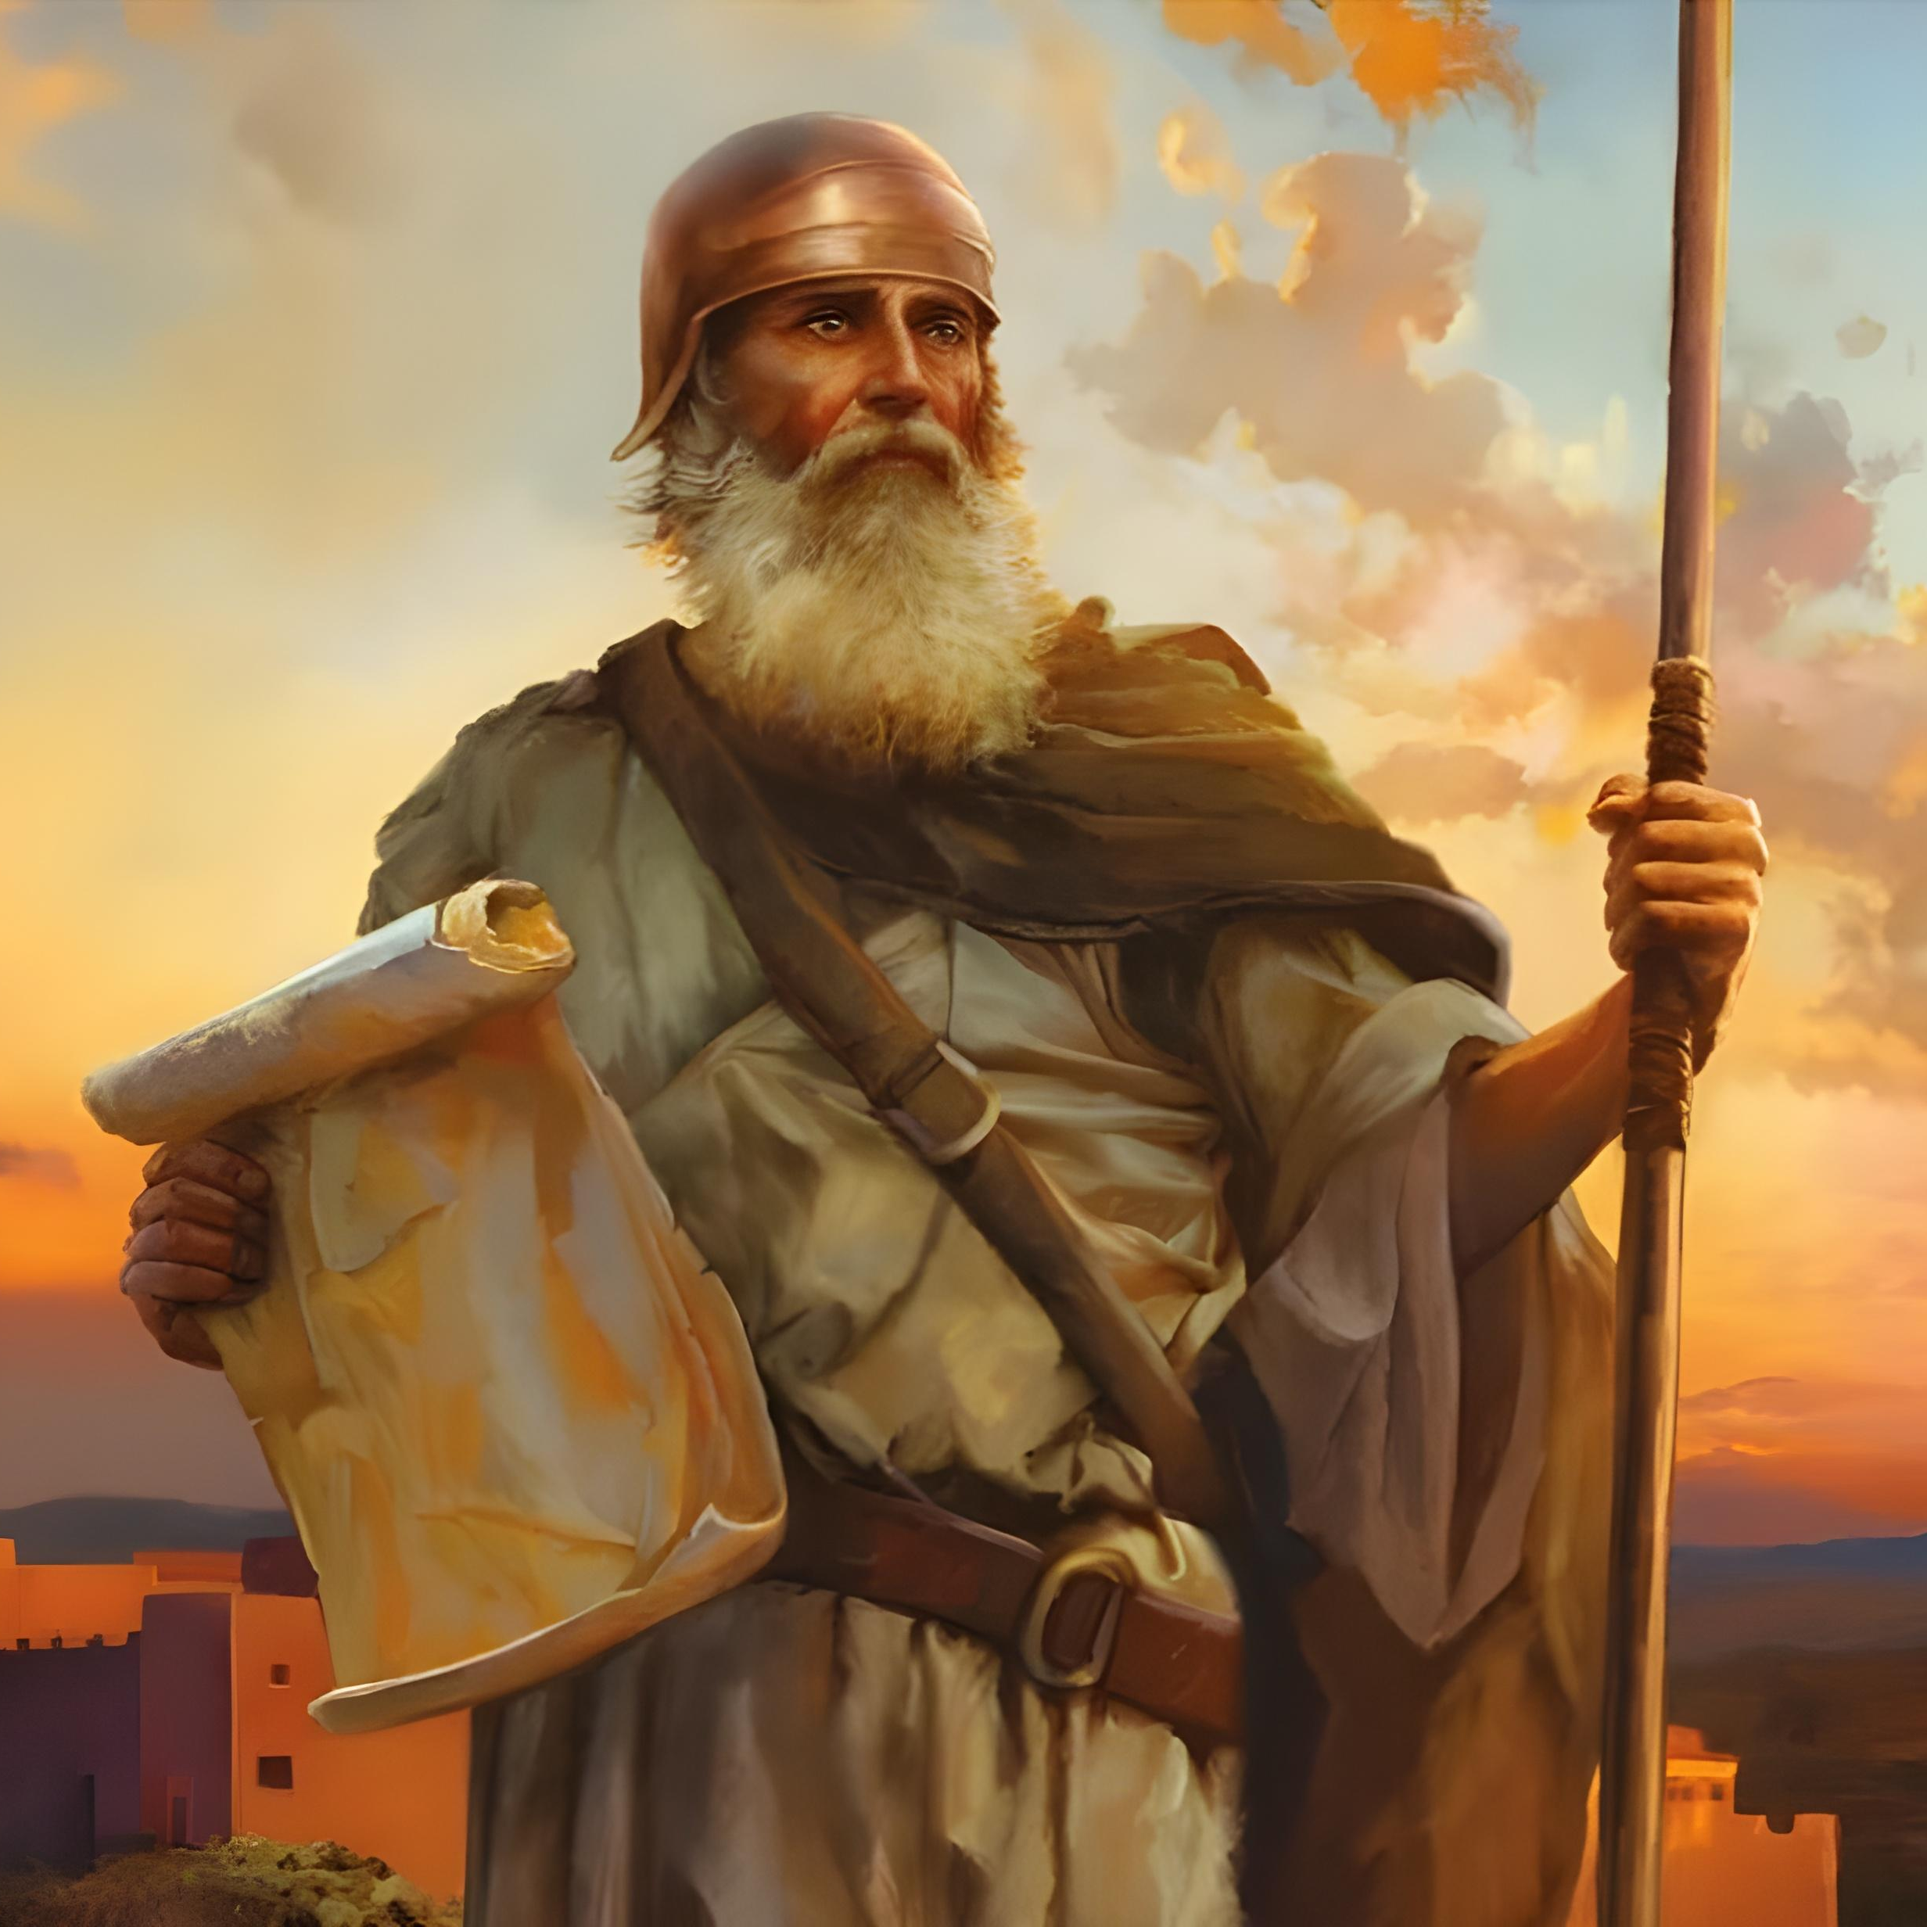
“vd; jhrdhfpa NkhNr cdf;Ff; fw;gpj;j epahag;gpukhzj;jpd;gb vy;yhk; nra;af; ftdkhapUf;f khj;jpuk; kpfTk; gyq;nfhz;L jplkdjhapU@ eP NghFk; ,lnky;yhk; Gj;jpkhdha; ele;J nfhs;Sk;gbf;F> mij tpl;L tyJ ,lJGwk; tpyfhjpUg;ghahf.” NahRth 1:7

Slide 3

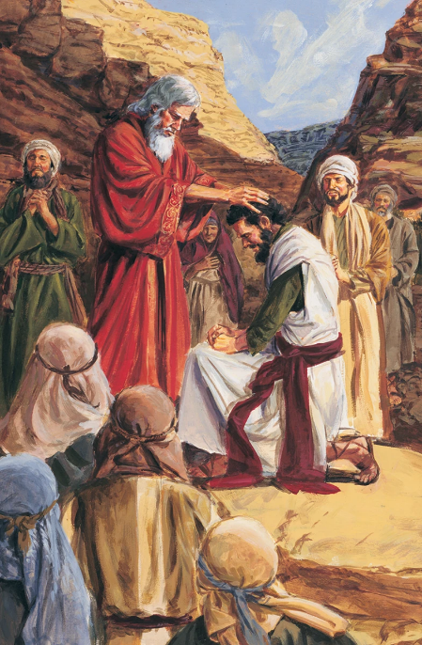
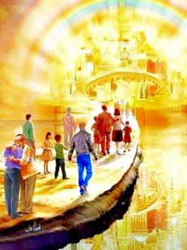


40 tUl miyr;ry;fSf;F gpd;, xU Gjpa jiyKiw vOe;Js;sJ, NkYk; thf;Fj;jj;jk; gz;zg;gl;l Njrj;ij ifg;gw;Wk; Neuk; te;Jtpl;lJ. NkhNr ,we;Jtpl;lhu;, ,e;j gzpf;fhf Njtdhy; xU Gjpa jiytu; Nju;e;njLf;fg;gl;Ls;shu;: NahRth.
ntw;wpia njhlq;Fk;Kd;> Gjpa jiytUk; Gjpa jiyKiwAk; Njtid KOikahf ek;g miof;fg;gLfpwhu;fs;.
jw;Nghija jiyKiw (ehk;) guNyhf fhdhdpd; vy;iyapy; epw;Fk;NghJ, nja;tPf miog;G ,d;Dk; ty;yikahf njhdpf;fpwJ: “kpfTk; gyq;nfhz;L jplkdjhapU@” (NahR. 1:7).
mwpKfk; (NahRth 1:1-3):
  NkhNrAk; NahRthTk;
  Gj;jfj;jpd; mikg;G
NahRthtpd; Copag;gzp (NahR 1:4-9):
  thf;Fj;jj;jq;fis ngWjy;
  gyk; kw;Wk; jplkdk;
  Copag;gzpapd; ntw;wp

Slide 4

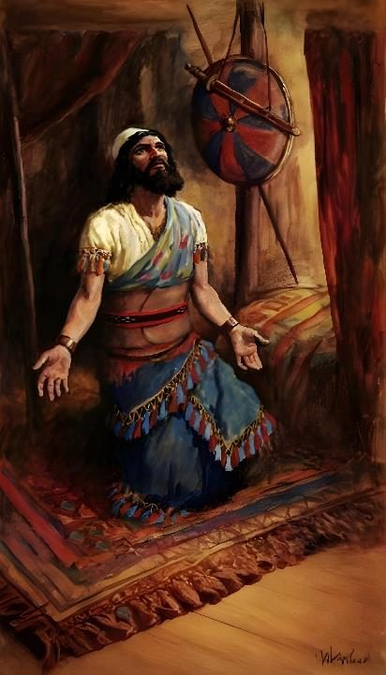
mwpKfk;
(NahRth 1:1-3)

Slide 5







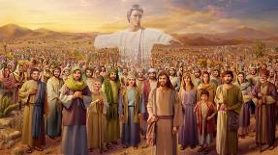
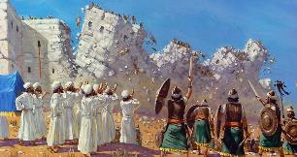








NkhNrAk; NahRthTk;
Njtd; mtu;fspilNa Njhd;wpdhu;
(ahj;. 3:2-4; NahR. 5:13-14)
,UtUila ghjul;irfSk; fow;w nrhy;yg;gl;lJ
(ahj;. 3:5 ; NahR. 5:15)
Njtd; mtu;fSlNd ,Ug;ghu; vd;W thf;fspf;fg;gl;lJ (ahj;. 3:12; NahR. 1:5)
,UtUk; g];fhit Mrupj;jdu;
(ahj;. 12:21-23; NahR. 5:10)
mtu;fs; cyu;e;j jiu topaha; jz;zPiu fle;J nrd;whu;fs;
(ahj;. 14:21-22; NahR. 3:14-17)
xUtNuhL kd;dh te;jJ> kw;nwhUtNuhL kd;dh epd;W NghdJ
(ahj; . 16:4-5, 31; NahR. 5:11-12)
mtu;fs; Njrj;ij csT ghu;f;f csthspfis mDg;gpdu;
(vz;. 13:1-3; NahR. 2:1)
“fh;j;jUila jhrdhfpa NkhNr khpj;jgpd;G> fh;j;jh; NkhNrapd; Copaf;fhuuhd E}dpd; Fkhud; NahRthit Nehf;fp:” (NahRth 1:1)
NahRthtpd; Kjy; mjpfhuj;jpy;, NkhNr 11 Kiw Fwpg;gplg;gLfpwhu;, NkYk; ,e;j Gj;jfk; KOtJk; mtuJ ngau; kPz;Lk; kPz;Lk; Njhd;WfpwJ.
,U jiytu;fSf;Fk; ,ilNa gy xw;Wikfs; cs;sd:
NahRthtpd; Kjy; mj;jpahak; ,];uNtypd; ,uz;L ngupa jiytu;fSf;F ,ilapyhd ngupa khw;wj;ij gjpT nra;jhYk;> Gj;jfj;jpd; cz;ikahd fjhehafd; ,UtUk; my;y. kpf Kf;fpakhd egu; Njtd; kl;LNk, mtUila thu;j;ijfNs Gj;jfj;ij jpwf;fpd;wd, NkYk; mtuJ jiyik> Mjpf;fk; nrYj;Jk; fUg;nghUshFk;. ,];uNtypd; cz;ikahd jiytu; ahu; vd;gjpy; ve;j re;NjfKk; ,y;iy.

Slide 6

Gj;jfj;jpd; mikg;G
“vd; jhrdhfpa NkhNr khpj;Jg; Nghdhd;@ ,g;nghOJ ePAk; ,e;j [dq;fs; vy;yhUk; vOe;J> ,e;j Nahh;jhidf; fle;J> ,];uNty; Gj;jpuUf;F ehd; nfhLf;Fk; Njrj;Jf;Fg; Nghq;fs;.” (NahRth 1:2)
Njtd; ,];uNtyiu vfpg;jpypUe;J ntspNa nfhz;L te;j NghJ> mjhtJ fhdhd; Njrj;ij nfhLg;gjhf mtu;fSf;F mspj;j thf;FWjpfspd; epiwNtw;wj;ij NahRth Gj;jfk; Kd; itf;fpwJ. Kd;Diu (mjpfhuk; 1) kw;Wk; Gj;jfk; ,uz;Lk; 4 Kf;fpa gpupTfshf gpupf;fg;gl;Ls;sd:
fhdhDf;F FWf;F top
NahRth 1:1-9
NahRth 1:1-5:12
fhdhid ifg;gw;Wjy;
NahRth 1:10-11
NahRth 5:13-12:24
Njrj;ij gpupj;jy;
NahRth 1:12-15
NahRth 13:1-21:45
epahag;gpukhzj;jpw;F fPo;gbtjd; %yk; Nrtpj;jy;
NahRth 1:16-18
NahRth 22:1-24:33

Slide 7
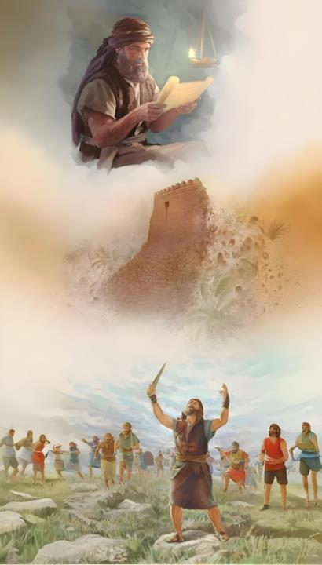
NahRthtpd; Copag;gzp
(NahRth 1:4-9)

Slide 8

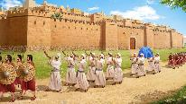
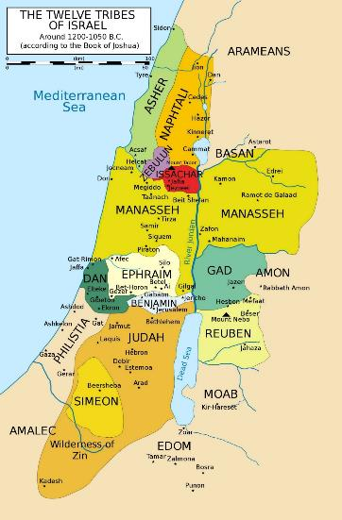
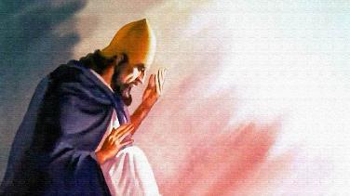

thf;Fj;jj;jq;fis ngWjy;
“ehd; NkhNrf;F nrhd;dgb cq;fs; fhyb kpjpf;Fk; vt;tplj;ijAk; cq;fSf;Ff; nfhLj;Njd;.” (NahRth 1:3)
NahRth 1:3y;, Njtd; jPu;f;fjuprd epfo;fhyj;jpy; NgRfpwhu;. fhdhd; Njrk; Vw;fdNt ,];uNtyUf;F nfhLf;fg;gl;lJ Nghy; mtu; NgRfpwhu;. ,jd; nghUs;> fhdhid ifg;gw;wpd ntw;wpia gw;wpa KOikahd cWjpia Njtd; mtu;fSf;F nfhLj;jhu; vd;gjhFk;.
Igpuhj;J
gpd;du; mtu; ntw;wpailAk; vy;iyfis mtu;fSf;F epidT+l;Lfpwhu; (NahR. 1:4): fpof;Nf Nahu;jhd; ejp kw;Wk; Nkw;Nf kj;jpa jiuf;fly; ,ilNaahd gFjp> njw;Nf ghiytdk; Kjy; tlf;Nf Igpuhj;J ejp tiu.
gpd;du; mtu; NahRthtplk; jpUk;gp> mtu; typikahfTk; ijupakhfTk; ,Ue;jhy;> mtiu vjpu;j;J ahUk; epw;f KbahJ vd;W cWjpaspf;fpwhu; (NahR. 1:5-6).
kj;jpa jiuf;fly;
Nahu;jhd; ejp
Mdhy; ntw;wp NahRthtpd; nrhe;j Kaw;rpfspy; ,y;iy> khwhf NjtDila gpurd;dj;jpy; ,Ue;jJ. mtu; ek; xt;nthUtUf;Fk; cWjp mspg;gJ Nghy;> mtUf;Fk; cWjpaspj;jhu;: "cd;NdhL ,Ug;Ngd;@" (NahR. 1:5; kj;. 28:20).
ghiytdk;

Slide 9

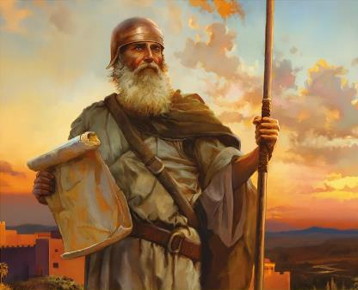
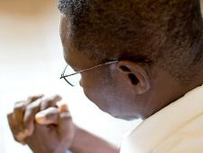
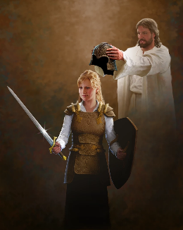
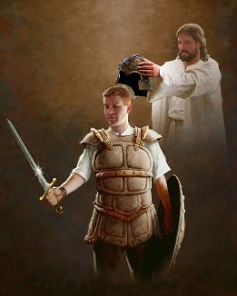
gyk; kw;Wk; jplkdk;
“ehd; cdf;Ff; fl;lisapltpy;iyah? gyq;nfhz;L jplkdjhapU@ jpifahNj> fyq;fhNj> eP NghFk; ,lnky;yhk; cd; Njtdhfpa fh;j;jh; cd;NdhNl ,Uf;fpwhh; vd;whh;.” (NahRth 1:9)
Nghupy; NahRthtplk; gyj;ijAk; ijupaj;ijAk; Nfl;gjw;F Kd; (NahR. 1:9), epahag;gpukhzj;jpw;F fPo;gba Njtd; NahRthtplk; gyijAk; ijupaj;ijAk; Nfl;lhu;(NahR. 1:7). ,d;Wk; mJNt epiyik. Njtd; jk;Kila epahag;gpukhzj;ij filgpbf;f ghLgLk;gb ek;kplk; Nfl;fpwhu;(ntsp. 14:12). ,jw;F ek; gq;fpy; kpFe;j ijupak; Njit.
mtUila gq;fpw;F, mtu; “eP NghFk; ,lnky;yhk; cd; Njtdhfpa fh;j;jh; cd;NdhNl ,Uf;fpwhh;” (NahR. 1:9) vd;W thf;FWjp mspf;fpwhu;, ehk; <Lg;gl;Ls;s Nghupy; Nghuhl ekf;F cjTfpwhu;. ,J cly; uPjpahd Nghu; my;y, Mdhy; “Jiuj;jdq;fNshLk;> mjpfhuq;fNshLk;> ,g;gpugQ;rj;jpd; me;jfhu NyhfhjpgjpfNshLk;> thdkz;lyq;fspYs;s nghy;yhj Mtpfspd; NridfNshLk;” (vNg. 6:12) cs;s Nghu;. ,ij nra;a, mtu; ekf;F Njitahd MAjq;fis toq;fpAs;shu;(vNg. 6:13-17).
ntw;wpf;fhd jpwTNfhy; Njtid KOikahf ek;GtjhFk;. mt;thW nra;a, ehk; xt;nthU ehSk; mtNuhL njhlu;G nfhs;s Ntz;Lk; (vNg. 6:18).

Slide 10


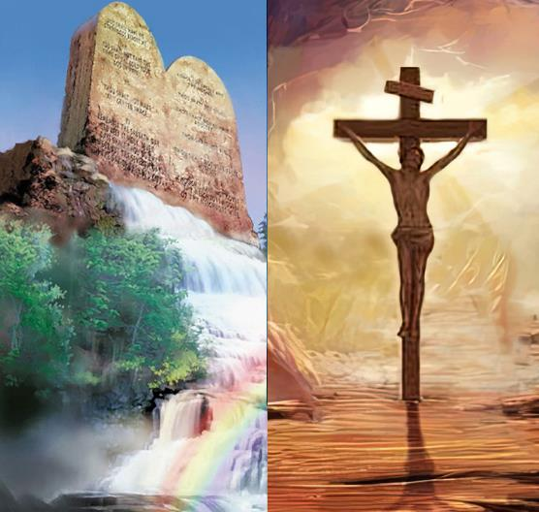
Copag;gzpapd; ntw;wp
“,e;j epahag;gpukhz G];jfk; cd; thiatpl;Lg; gphpahjpUg;gjhf@ ,jpy; vOjpapUf;fpwitfspd;gbnay;yhk; eP nra;af; ftdkhapUf;Fk;gb> ,uTk; gfYk; mijj; jpahdpj;Jf; nfhz;bUg;ghahf@ mg;nghOJ eP cd; topia tha;f;fg;gz;Ztha;> mg;nghOJ Gj;jpkhdhAk; ele;Jnfhs;Stha;.” (NahRth 1:8)
nja;tPf fz;Nzhl;lj;jpy; ntw;wp vd;gJ kdpj fz;Nzhl;lj;jpy; cs;s ntw;wpAld; xj;JNghtjpy;iy.
nja;tPf kw;Wk; kdpj tpjpfis kPWtjd; %yk; ,e;j cyfpy; tpiuthd ntw;wpia mila KbAk;. Mdhy; cz;ikahd kw;Wk; epj;jpa ntw;wpia mila KbahJ(NahR. 1:8).
NjtDila epahag;gpukhzj;jpy; ntspg;gLj;jgl;Ls;s nfhs;iffisAk; kjpg;GfisAk; gpd;gw;wpdhy; ehk; kjpg;G ntw;wp ngWNthk;. Mdhy; ,J nray;fshy; fpilf;Fk; ,ul;rpg;G ,y;iyah
,y;yNt ,y;iy. tpRthrKk; epahag;gpukhzKk; xd;iwnahd;W tpyf;Fgit my;y (Nuh. 3:31). epahag;gpukhzj;ijg; gw;wp NgRk; NghJ, ehk; vg;gb ,ul;rpf;fg;gLfpNwhk; vd;gijg; gw;wp my;y> ehk; vg;gb tho Ntz;Lk; vd;gijg; gw;wp NgRfpNwhk;. NjtDldhd ekJ cwT> mtUila rpj;jj;jpw;F fPo;gbtjd; %yk; ntspg;gLfpwJ.

