Slide 1
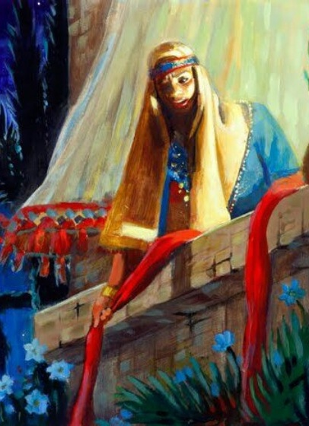
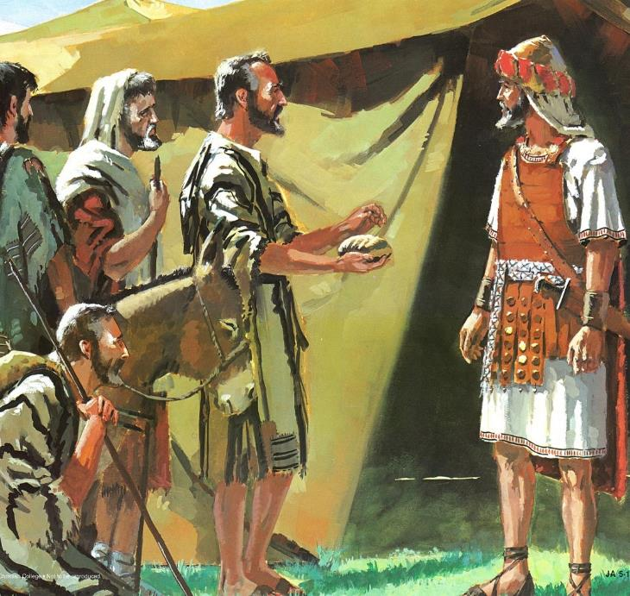
fpUigahy; cz;lhd tpag;G
ghlk; 2 mf;Nlhgu; 11, 2025

Slide 2

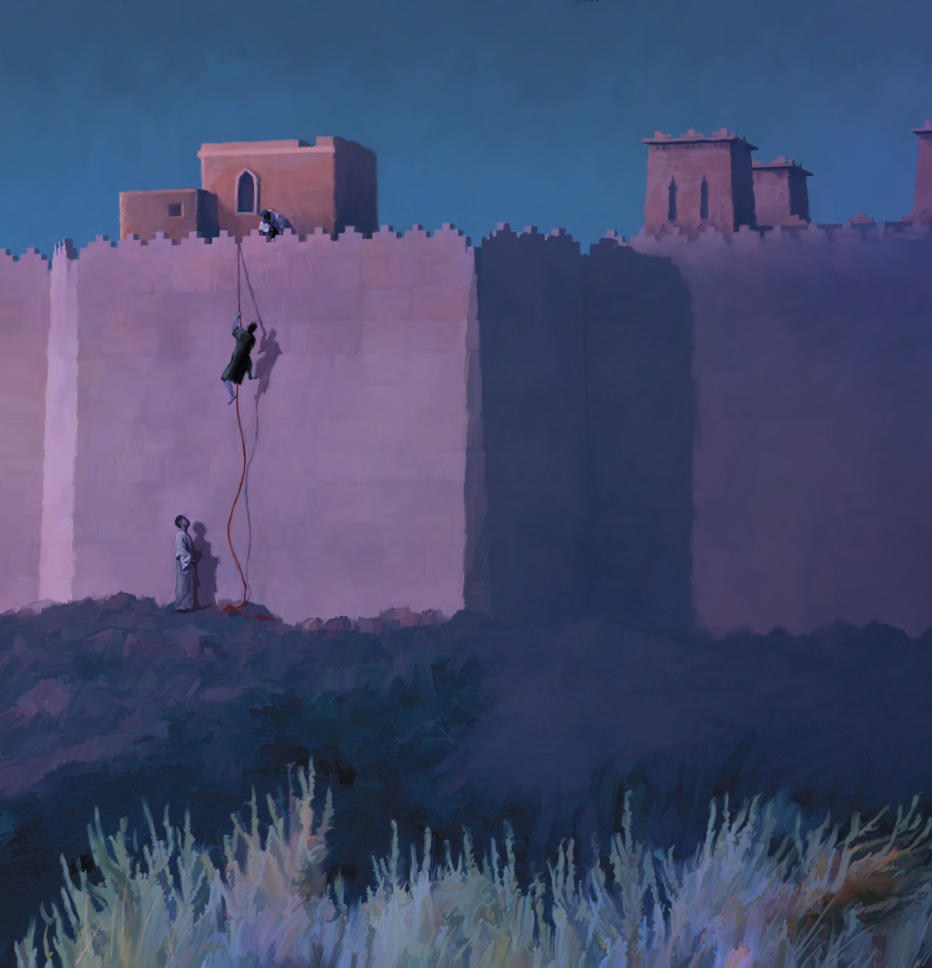
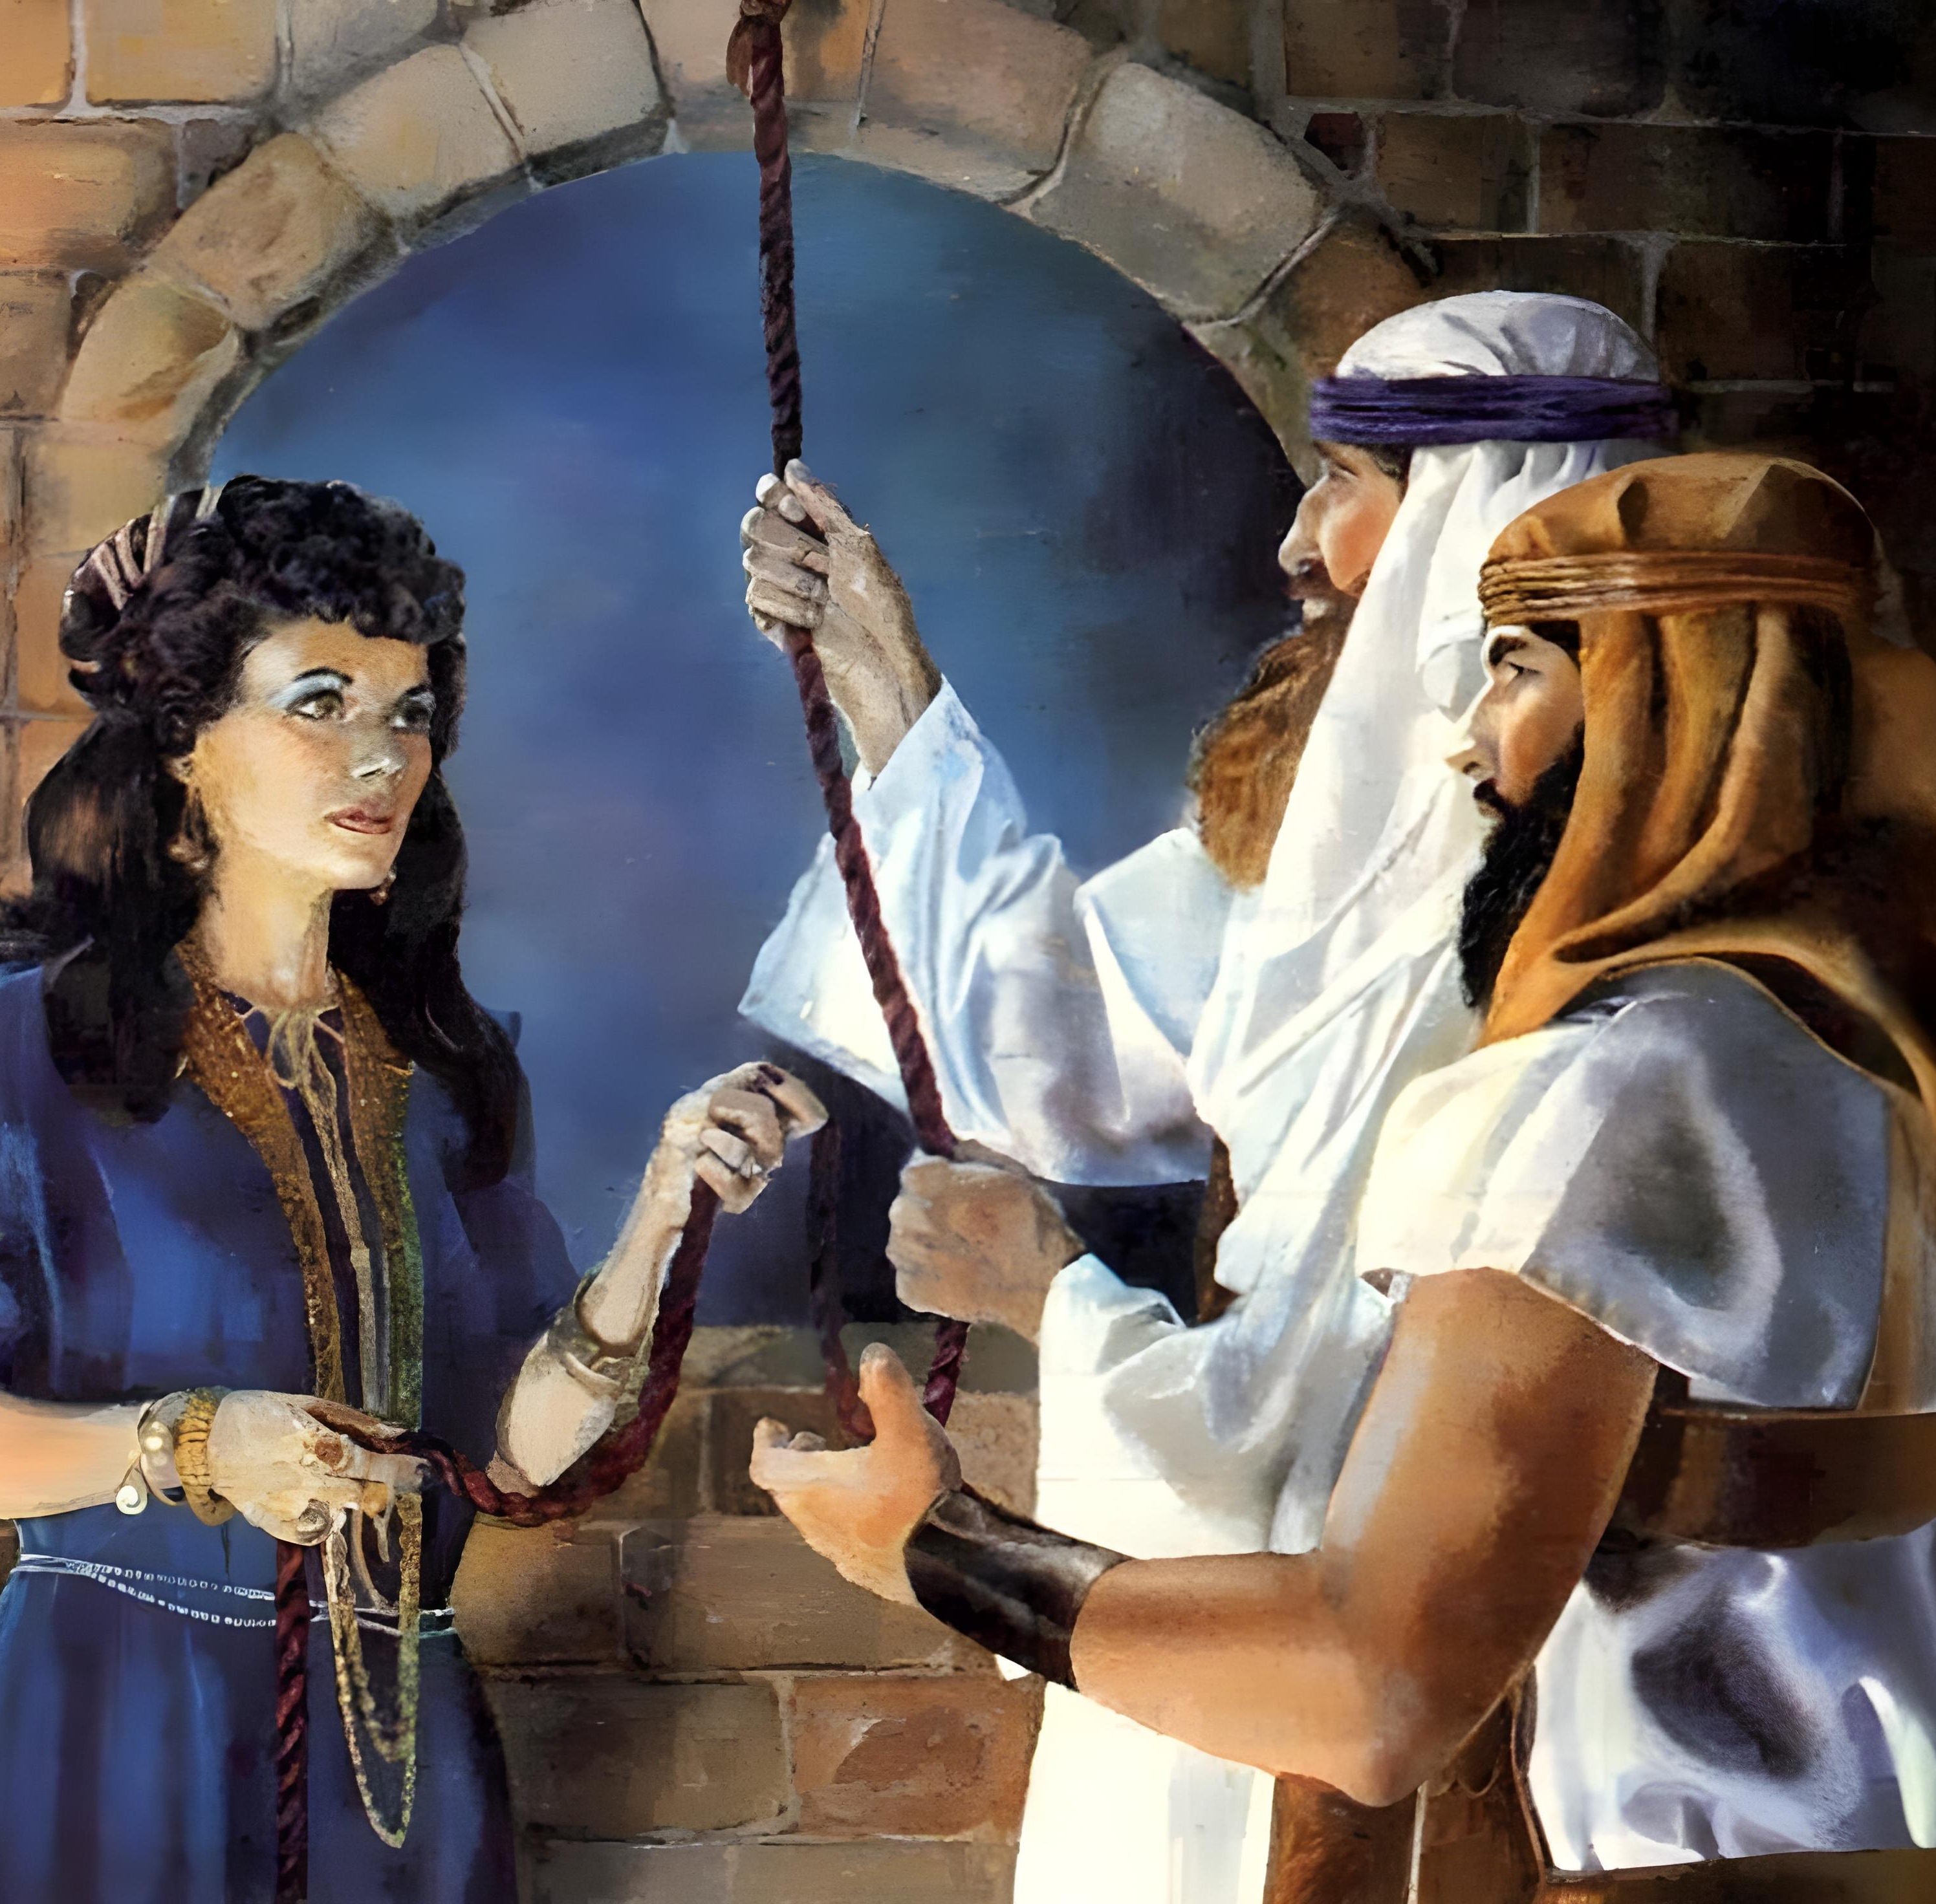
“tpRthrj;jpdhNy uhfhg; vd;Dk; Ntrp NtTfhuiur; rkhjhdj;NjhNl Vw;Wf;nfhz;L> fPo;g;gbahjth;fNshNl $lr; NrjkhfhjpUe;jhs;.”
(vgpNuau; 11:31)

Slide 3

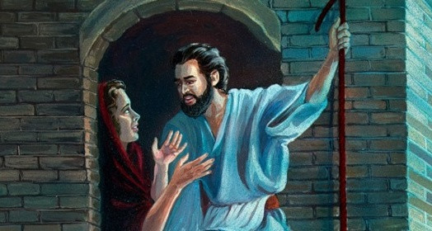
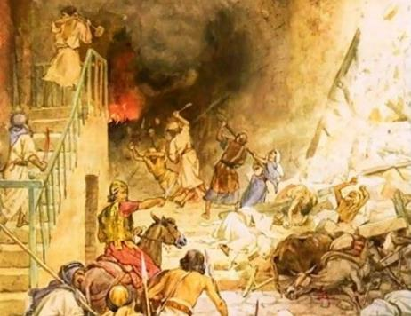



fhdhdpau;fs; fpUigapd; vy;iyfis kPwptpl;lhu;fs;. mjdhy;jhd;> ,];uNtyUf;F fl;lis: cs;Ns Ngha;> mtu;fs; midtiuAk; nfhd;W> mtu;fspd; cilikfis ifg;gw;Wq;fs;.
,Ug;gpDk;, me;j fpUigapd; vy;iyfis jhz;lhj kf;fs; fhdhdpy; ,d;Dk; ,Ue;jdu;. Njtd; jq;fSf;F toq;f tpUk;gpa fpUigia Vw;Wf;nfhs;s jahuhf ,Ue;j midtUk; moptpypUe;J fhg;ghw;wg;gl;ldu;.
,];uNty; [dq;fSf;fhd NjtfpUig (NahR 2:1, 22-24):
  ,uz;lhk; tha;g;G
,uhfhgpw;fhd NjtfpUig (NahR 2:2-21):
  fLF tpijasT tpRthrk;
  ,uhfhgpw;F ePl;bf;fg;gl;l cld;gbf;if
fpgpNahdpau;fSf;fhd NjtfpUig(NahRth 9):
  Vkhw;wpa J}Jtu;fs;
  MrPu;thjKk; rhgKk;

Slide 4
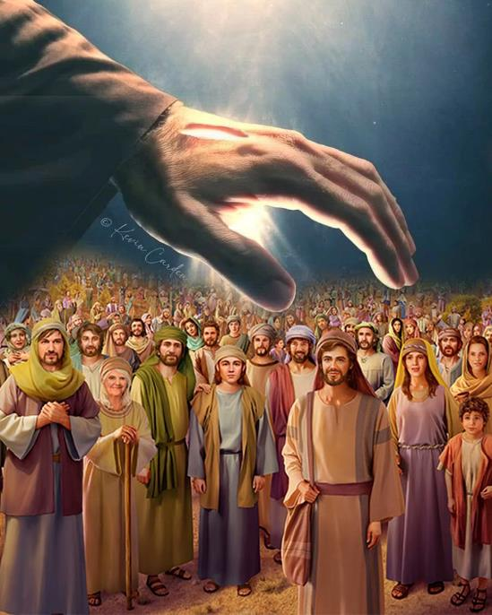
,];uNty; [dq;fSf;fhd NjtfpUig
(NahRth 2:1, 23-24)

Slide 5


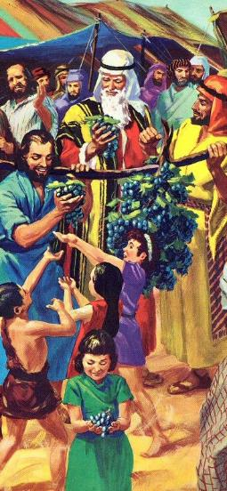
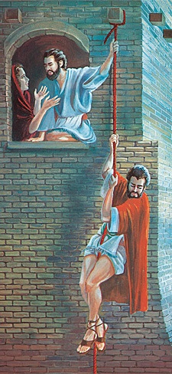
,uz;lhk; tha;g;G
“E}dpd; Fkhudhfpa NahRth rpj;jPkpypUe;J NtTfhuuhfpa ,uz;L kD\iu ,ufrpakha;NtTghh;f;Fk;gb mDg;gp: ePq;fs; Ngha; Njrj;ijAk; vhpNfhitAk; ghh;j;JthUq;fs; vd;whd;.” (NahRth 2:1K)
NkhNr fhdhid Ma;T nra;a csthspfis mDg;gpa NghJ> kf;fs; cs;Ns Eioa kWj;Jtpl;ldu;. 40 Mz;LfSf;F gpwF, Gjpa csthspfs; mDg;gg;gl;ldu;, ,jdhy; ntt;NtW tpisTfs; Vw;gl;ld.
csthspfs; nrd;wdu;
nghJ ntspapy; (12 csthspfs;)
,ufrpakhf (2 csthspfs;)
csthspfspd; nray;jpwd;
40 ehl;fs; Ma;T
3 ehl;fs; xspj;Jf; nfhz;ldu;
csthspfspd; Ma;twpf;if
mtu;fs; [dq;fis kdkbthf;fpdu;
mtu;fs; NahRthit Cf;fg;gLj;jpdu;
gpNyahkpd; Nrhjidapd; Kd; Gjpa jiyKiw gupjhgkhf Njhy;aile;ejpUe;jhYk;> Njtd; mtu;fSf;F ,uz;lhtJ tha;g;ig nfhLj;jhu; (vz;zh. 25:1-3, 31:16; NahR. 2:1).
,e;j Kiw jpuhl;irf; FiyfNsh> epyj;jpd; goq;fNsh ,y;iy, tpRthrf; fij khj;jpuNk (,uhfhig Nghy), thf;Fg;gz;zg;gl;l Njrj;ij nrhe;jkhf;fp nfhs;s Cf;Ftpj;jJ.

Slide 6
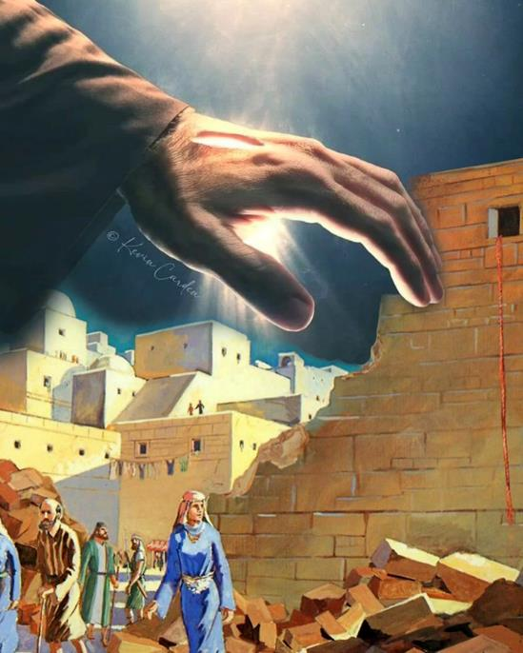
,uhfhgpw;fhd NjtfpUig
(NahRth 2:2-21)

Slide 7

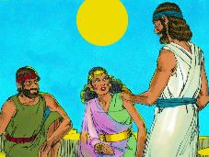
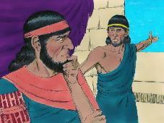
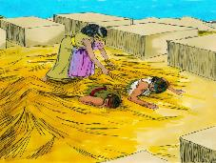
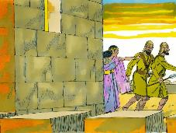
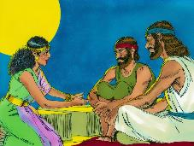
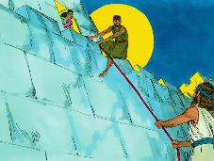
fLF tpijasT tpRthrk;
“tpRthrj;jpdhNy uhfhg; vd;Dk; Ntrp NtTfhuiur; rkhjhdj;NjhNl Vw;Wf;nfhz;L> fPo;g;gbahjth;fNshNl$lr; NrjkhfhjpUe;jhs;.” (vgpNuau; 11:31)
,uhfhgpd; tpRthrk; vjd; mbg;gilapy; ,Ue;jJ (NahR. 2:9-11)?
,uhfhg;> nrq;fliy fle;jJ Nghd;w midtUk; mwpe;j epfo;Tfis gw;wp NgRtij ftdpAq;fs;. Mdhy; kw;wtu;fs; vgpNuau;fspd; NjtDf;F gae;jhYk;> mts; mtUila ,wFfspd; fPo; jQ;rk; GFe;jhs; (NahR. 2:12-13).
Vd;, mts; Njtid ek;gpapUe;jhy;, csthspfSf;F cjt mts; ngha;ia gad;gLj;jpdhs;?
mtSila ,sk; tpRthrk; NjtDila rpj;jj;ij KOikahf Gupe;Jnfhs;tij Fwpf;ftpy;iy. csthspfSf;F cjtTk;> jd; capiuAk; jd; FLk;gj;jpdupd; capiuAk; fhg;ghw;wTk; mts; jd;dhy; Kbe;j midj;ijAk; nra;jhs;. mwpT gpd;du; tUk;.
mts; vLj;j Kbtpw;fhfTk;> NjtDila nray;ghl;L Kiwiag; gw;wpa GupjYf;fhfTk;> jd; thu;j;ijfSf;F cWjpahd nray;fshy; Mjutspj;jj;jw;fhfTk; Ntjk; mtis ghuhl;LfpwJ;(ahf;NfhG 2:25).
Njtdplk; ruzile;j ve;j vupNfh FbapUg;ghsUf;Fk; vd;d ele;jpUf;Fk; vd;gjw;F ,uhfhg; xU cjhuzk;.

Slide 8

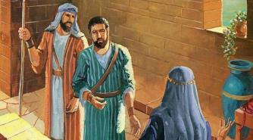
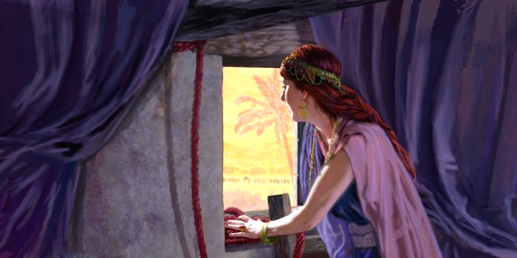
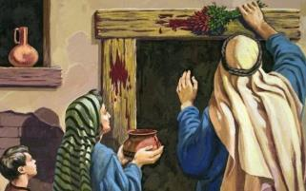
,uhfhgpw;F ePl;bf;fg;gl;l cld;gbf;if
“vtdhfpYk; cd; tPl;L thry;fspypUe;J ntspNa Gwg;gl;lhy;> mtDila ,uj;jg;gopmtd; jiyapd;Nky; ,Uf;Fk;. vq;fs;Nky; Fw;wk; ,y;iy@ cd;NdhNl tPl;by; ,Uf;fpwvtd;NkyhfpYk; ifNghlg;gl;lNjahfpy;> mtDila ,uj;jg;gop vq;fs; jiyapd; Nky; ,Uf;Fk;.” (NahRth 2:19)
g];fhtpy; ,];uNtyu;
mtu;fs; jq;fs; epiyf;fhy;fspd; Nkw;rl;lj;ij ,uj;jj;jhy; mgpN\fk; nra;a Ntz;bapUe;jJ
(ahj;. 12:7)
mtu;fs; tPl;il tpl;L ntspNawpdhy; ,we;JtpLthu;fs; (ahj;. 12:13)
vupNfhtpy; ,uhfhg;
mts; [d;dypy; rptg;G fapw;iw fl;b itf;f Ntz;bapUe;jJ(NahR. 2:18)
mts; tPl;il ntspNawpdhy;> mts; ,we;JtpLths;
(NahR. 2:19)
,uhfhgpd; jhf;fk; kWf;fKbahjJ: ehd; cq;fsplk; jathf (N`]l;) ele;Jnfhz;L cq;fis fhg;ghw;wpNdd;; ,g;NghJ ePq;fs; jathf vd;idAk; vd; cwtpdu;fisAk; fhg;ghw;Wq;fs;. (NahRth. 2:12-13).
,uhfhg; mij mwpe;jpUf;ftpy;iy vd;whYk;, Njtd; jhNk ,];uNtyplk; jaTld; ele;J nfhz;lJ Nghy, mjhtJ, jd;Dld; jaTld; ele;J nfhs;Sk;gb ,];uNtyplk; Nfl;Lf; nfhz;lhs; [N`]l;;] (cgh. 7:12).
vfpg;jpy; kuzj;jpypUe;J jg;gpf;f mtu;fs; epiwNtw;wpa mNj epge;jidfis epiwNtw;WkhW NtTfhuu;fs; ,uhfhgplk; Nfl;lhu;fs;. ,e;j topapy;, ,];uNtYldhd NjtDila cld;gbf;ifapy; mtSk; Nru;j;Jf; nfhs;sg;gl;lhs;.

Slide 9
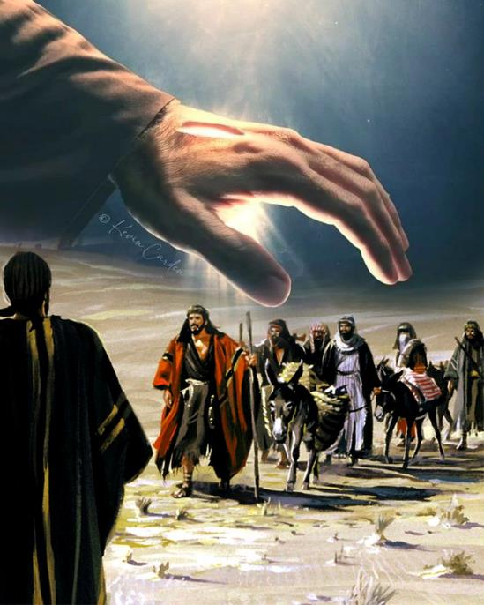
fpgpNahdpau;fSf;fhd NjtfpUig
(NahRth 9)

Slide 10


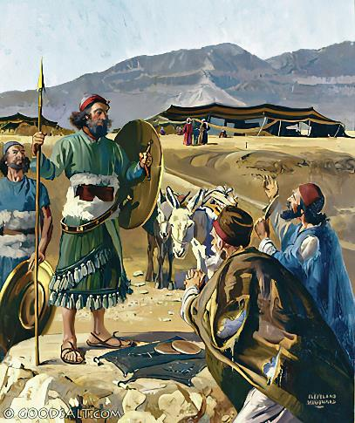
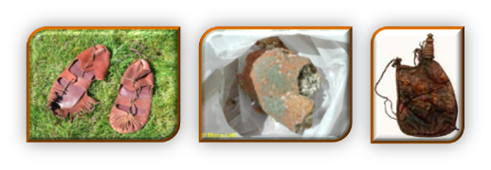
Vkhw;wpa J}Jtu;fs;
“mth;fs; fpy;fhypy; ,Uf;fpw ghsaj;Jf;F NahRthtpdplj;jpy; Ngha;> mtidAk; ,];uNty; kD\iuAk; Nehf;fp: ehq;fs; J}uNjrj;jpypUe;J te;jth;fs;> vq;fNshNl cld;gbf;ifgz;Zq;fs; vd;whh;fs;.” (NahRth 9:6)
,uhfhGf;Fk; fpgpNahdpau;fSf;Fk; ,ilapyhd xw;Wikfs; kw;Wk; Ntw;Wikfs; ftdpAq;fs;:
tpRthr %yf;$Wfs; | ,uhfhg; | fpgpNahdpau;fs;
mbg;gil | Nfl;ly; (2:10) | Nfl;ly; (9:3)
mu;j;jk; | ngha; (2:4-5) | ngha; (9:4)
,yf;F | ,ul;rpf;fg;gLjy; (2:13) | ,ul;rpf;fg;gLjy; (9:24)
cldb tpisT | kPl;G (6:23) | kPl;G (9:26)
ePz;l fhy tpisT | KO FbAupik (6:25) | gzptpil (9:27)
csthspfis tpLtpg;gjw;fhf ,uhfhg; jd;dpr;irahf ngha; nrhd;dhs;. ,Ug;gpDk;, fpgpNahdpau;fs; Vkhw;Wk; Nehf;fj;Jld;, je;jpukhf> Ntz;Lnkd;Nw ngha; nrhd;dhu;fs;, (ghu;f;f Mjp 3:1K). NkYk;, ,];uNtypd; jiytu;fs; Njtdplk; MNyhrid Nfl;fhky; Njhy;tpaile;jdu; (NahR. 9:14).
,J mtu;fis xU rpf;fypy; Mo;j;jpaJ: fpgpNahdpau;fis mopf;fTk;, my;yJ mtu;fNshL cld;gbf;if gz;zTk; (NahR. 9:18).

Slide 11

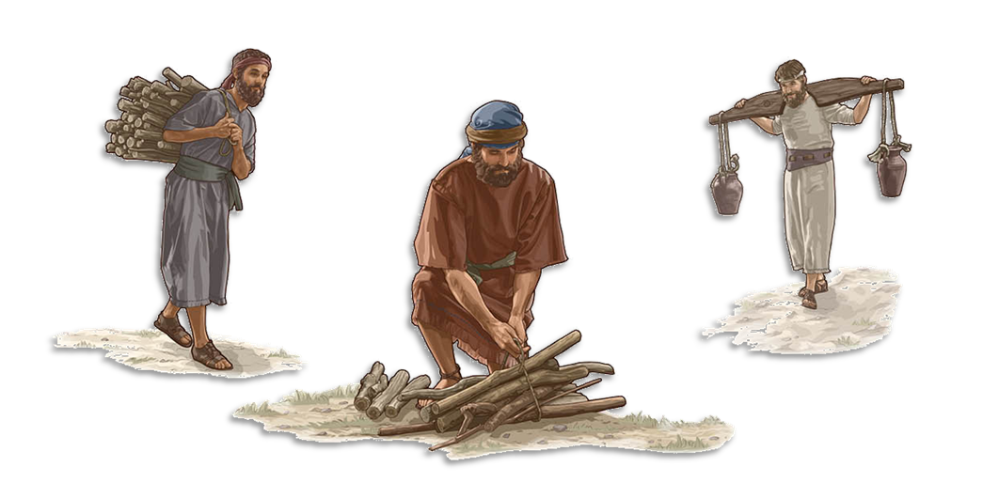
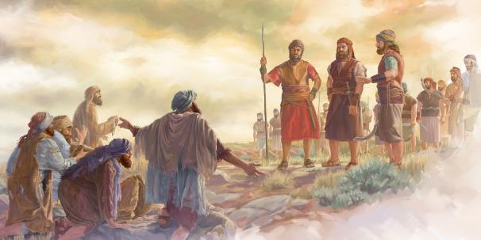
MrPu;thjKk; rhgKk;
“,g;NghJk; ePq;fs; rgpf;fg;gl;lth;fs;@ vd; NjtDila Myaj;Jf;F tpwFntl;Lfpwth;fSk;> jz;zPh; vLf;fpwth;fSkhd gzptpilf;fhuuhapUg;gPh;fs;@ ,e;j Copak; cq;fistpl;L ePq;fkhl;lhJ vd;whd;.” (NahRth 9:23)
fpgpNahdpau;fspd; capiu fhg;ghw;WtJ NjtDila Neub fl;lisia kPWtjhf ,Uf;Fk; (cgh. 7:1-2). mtu;fSf;F cld;gbf;if nra;jij Nghy cld;gbf;ifia kPWtJk; ghtkhf fUjg;gl;lJ (NahR. 9:19; rq;. 15:4gp). ,e;j gpur;rid vg;gb jPu;f;fg;gl;lJ?
mtu;fspd; capu; fhg;ghw;wg;gl;lJ> Mdhy; mtu;fs; xU rhgj;jpd; fPo; itf;fg;gl;ldu; (NahR. 9:20-23). jiyKiw jiyKiwahf Copau;fshf ,Ug;gJ jhd; rhgk;. ,J mtu;fis NjtDila kf;fSld; neUq;fpa cwtpy; itj;jJ> mtu;fsplkpUe;J mtu;fs; xU NghJk; gpupf;fg;gltpy;iy (neNf. 7:6, 25).
NkYk;, NjtDila tPl;bw;F jz;zPu; vLj;J nry;gtu;fshTk;> tpwF ntl;Lgtu;fshfTk; ,Ug;gJ mtu;fis NjtDld; njhlu;gpy; itj;jpUf;fpwJ. NjtDila fpUigahy;, rhgk; MrPu;thjkhf khwpaJ. “ehd; Jd;khh;f;fDila kuzj;ij tpUk;ghky;> Jd;khh;f;fd; jd; topiatpl;Lj; jpUk;gpg; gpiog;gijNa tpUk;GfpNwd;” (vNr. 33:11).

Slide 12

Njtd; mtu;fSf;F epakpj;j vy;yh gpuNjrq;fisAk; ,];uNty; Gj;jpuu; vLj;Jf; nfhs;s Ntz;bapUe;jJ. me;j ehLfs; cz;ikahd NjtidAk; mtUila topghl;ilAk; epuhfupj;j fhuzj;jpdhy; mitfs; ntspNaw;wg;gl Ntz;Lk;. Mdhy; ,];uNty; Gj;jpuu; %yk; mtUila Fzhjpraj;ij ntspg;gLj;jp> mjd; %yk; kdpju;fs; Njtdplk; <u;f;fg;gl Ntz;Lk; vd;gJ NjtDila Nehf;fkhf ,Ue;jJ. cyfk; KOtJk; ew;nra;jp miog;G toq;fg;gl ,Ue;jJ. […] fhdhdpa ,uhfhg;, Nkhthgpa &j;, Nghd;wtu;fs;, rpiy topg;ghl;bypUe;J cz;ikahd NjtDila topg;ghl;bw;F jpUk;gpa midtUk;> mtuJ Nju;e;njLf;fg;gl;l kf;fSld; jq;fis xd;wpizj;J nfhs;s Ntz;Lk;.”
vyd; [p citl; (f;iw];l; Mg;[f;l; nyrd;];, gf;. 290)

