Slide 1

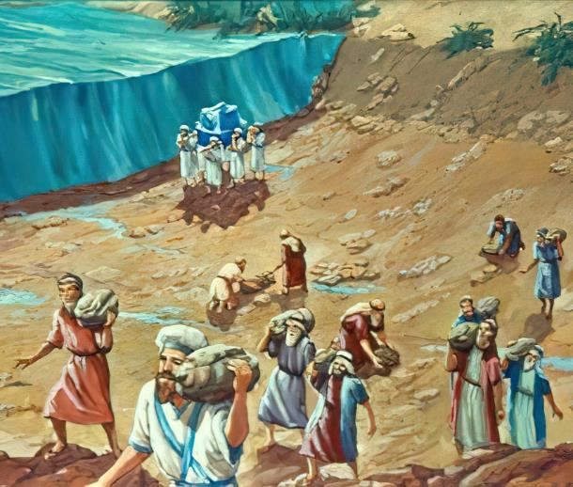
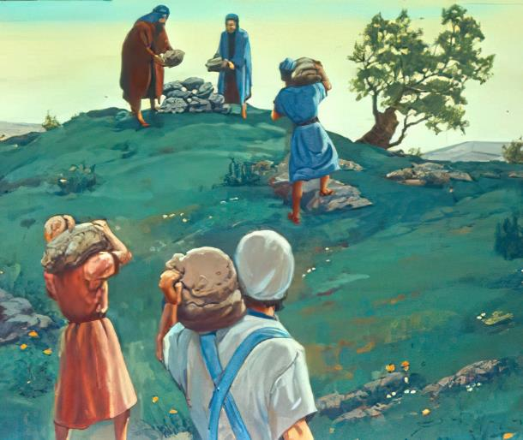

ghlk; 3 mf;Nlhgu; 18, 2025
fpUigapd; epidTrpd;dq;fs;

Slide 2

“g+kpapd; rfy [dq;fSk; fh;j;jUila fuk; gyj;jnjd;W mwpAk;gbf;F> ePq;fs; rfy ehSk; cq;fs; Njtdhfpa fh;j;jUf;Fg; gag;gLk;gbf;Fk;> cq;fs; Njtdhfpa fh;j;jh; rpte;j rKj;jpuj;jpd; jz;zPiu ehq;fs; fle;J jPUkl;Lk; vq;fSf;F Kd;ghf tw;wpg; Nghfg;gz;zpdJNghy> cq;fs; Njtdhfpa fh;j;jh; Nahh;jhdpd; jz;zPUf;Fk; nra;J> mij cq;fSf;F Kd;ghf ePq;fs; fle;J jPUksTk; tw;wpg;Nghfg;gz;zpdhh; vd;W mwpaf;fltPh;fs; vd;whd;.”
NahRth 4:23, 24

Slide 3

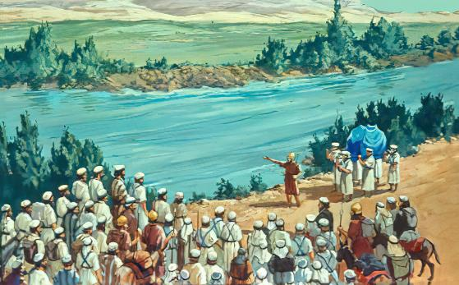
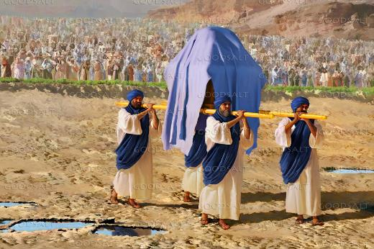







tre;j fhyk;. kioAk; cUFk; gdpAk; Nahu;jhd; ejpia epuk;gp topAk; msTf;F epug;gpAs;sd. mjd; ePu; rhTf;fliy Nehf;fp Ntfkhf gha;e;J nfhz;bUe;jJ. Mokw;w gFjpfspy; $l—Nahu;jhid flf;fpwJ—my;yJ ejpia fle;J nry;tJ kpfTk; Mgj;jhdJ.
tajhdtu;fs;, fu;g;gpzpg; ngz;fs;, Foe;ijfs;, kw;Wk; fhy;eilfis Rke;Jnfhz;L> xU KO fpuhkKk; mij vg;gb fle;J nry;y KbAk;?
kdpjDf;F, ,J rhj;jpakw;wJ. NjtDf;F, ,J kpfTk; vspjhdJ: “cq;fisg; ghpRj;jk; gz;zpf; nfhz;L Nahu;jid fle;J nry;Yq;fs;.”
Nahu;jhid fle;Jnry;Yjy; (NahRth 3):
  gupRj;jj;jpd; Njit
  NjtDila mw;Gjq;fs;
epidj;Jg;ghu; kwf;fhNj (NahRth 4):
  epidT$Utjw;fhd rpd;dq;fs;
  kwjpapd; Mgj;Jf;fs;
Nahu;jhd; ejpapd; iky;fw;fs;

Slide 4

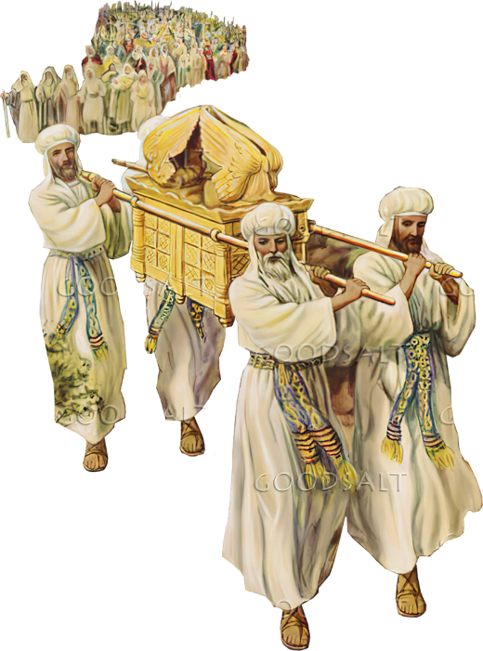
Nahu;jhid fle;J nry;Yjy;
(NahRth 3)

Slide 5

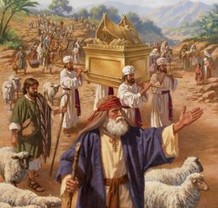
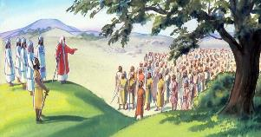
gupRj;jj;jpd; Njit
“NahRth [dq;fis Nehf;fp: cq;fisg; ghpRj;jk;gz;zpf;nfhs;Sq;fs;. ehisf;Ff; fh;j;jh; cq;fs; eLtpNy mw;Gjq;fisr; nra;thh; vd;whd;.” (NahRth 3:5)
40 Mz;Lfshf, Nkf];jk;gk; Mrupg;Gf;$lhuj;ij tpl;L Gwg;gLtjw;fhd Neuj;ij Fwpj;jJ, NkYk; cld;gbf;if ngl;b mjd; Gjpa ,lj;jpw;F topelj;jpaJ(vz;. 9:17; 10:33).
cld;gbf;if ngl;bia gpd;njhlu;tJ
NjtDf;F fPo;gbtJ(10 fl;lisfs;)
NjtDila guhkupg;gpy; ek;gpf;if itg;gJ (kd;dh itj;jpUe;j ghj;jpuk;)
Njtdhy; epakpf;fg;gl;l jiytu;fis kjpg;gJ (MNuhDila Nfhy;)
Gwg;glNtz;ba Neuk; te;Jtpl;lJ. mtu;fs; rpj;jPkpy; Kfhkpl;L Nahu;jhDf;F FWf;Nf #d;W ehl;fs; Kfhkpl;ldu;. gpd;du; mtu;fs; thf;Fg;gz;zg;gl;l Njrj;jpw;Fs; cld;gbf;if ngl;bia gpd;njhlu cj;juit ngw;wdu; (NahR. 3:1-3).
Mdhy; xU Kd;epge;jid ,Ue;jJ: mtu;fs; gupRj;jg;gLj;jgl Ntz;Lk; (NahR. 3:5). ,e;j jw;gpujp\;il Rj;jpfupg;gpd; rlq;ifAk; (ruPuj;ijAk; MilfisAk; Rj;jfupj;jy;), ghtj;ij iftpLjy;, kw;Wk; NjtDila fl;lisfSf;F fPo;gbtjw;F Vw;Wf;nfhs;Sk; kdg;ghd;ikiaAk; nfhz;bUe;jJ.

Slide 6

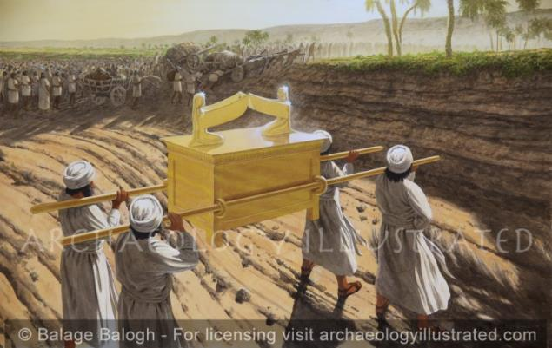
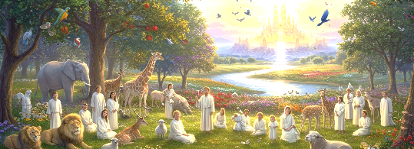
NjtDila mw;Gjq;fs;
“NkNyapUe;J XbtUfpw jz;zPh; epd;W rhh;jhDf;fLj;j Mjhk; Ch; tiuf;Fk; xU Ftpayhff; Ftpe;jJ@ cg;Gf;fly; vd;Dk; rkdhd ntspapd; flYf;F XbtUfpw jz;zPh; gphpe;J Xbw;W@ mg;nghOJ [dq;fs; vhpNfhTf;F vjpNu fle;JNghdhh;fs;.” (NahRth 3:16)
NjtNd “mjpraq;fisr; nra;fpwth;.” (rq;. 72:18). vdNt jhd;, ehk; mtiu xNu Njtdhf mq;fpfupf;fpNwhk; (rq;. 86:10); fh;j;jUila nray;fis epidT$UfpNwhk;>(rq;. 77:11); mtUila mjpraq;fisAk; tpthpj;Jr; nrhy;Nthk;(rq;. 96:3).
vy;yhtw;iwAk; gilj;j mtUf;F vJTNk kpfTk; fbdkhdNjh my;yJ Mr;ru;akhdNjh my;y(vNu. 32:17; Y}f;fh 1:37). vdNt mtu; ek; tho;f;ifapYk; mw;Gjq;fis nra;a KbAk; vd;W ehk; ek;gyhk; (rq;. 107:8).
Nahu;jhd; ejpiaf; flg;gJ NjtDila mjpraq;fspy; xd;whFk;, ,J jPu;f;fjuprdkhf Njtd; ek;kpy; epfo;j;Jtjhf thf;FWjpaspj;j kw;nwhU ngupa mjpraj;ij Rl;bf;fhl;LfpwJ: guNyhf fhdhDf;Fs; Eiojy; (rfupah. 8:6-8).

Slide 7


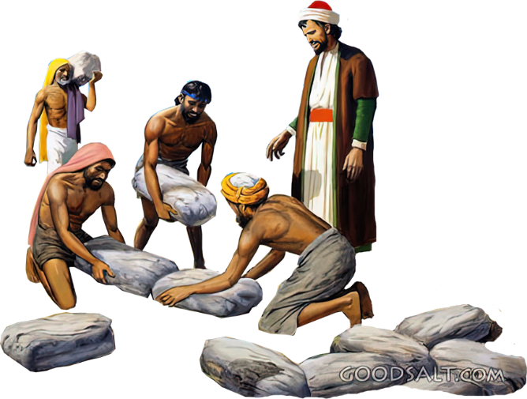
epidj;Jg;ghu; kwf;fhNj
(NahRth 4)

Slide 8

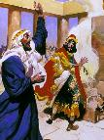
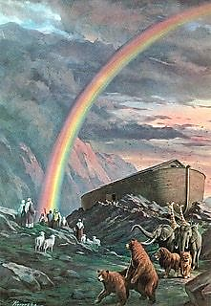
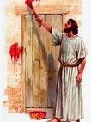

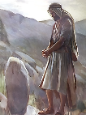
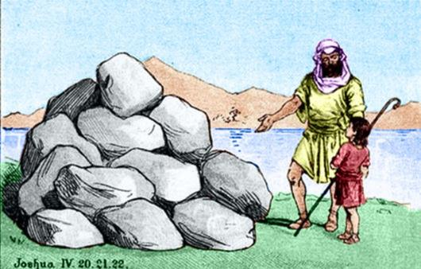
epidT$Utjw;fhd rpd;dq;fs;
“ehis ,e;jf; fw;fs; Vnjd;W cq;fs; gps;isfs; cq;fisf; Nfl;Fk;NghJ> ePq;fs;:… nrhy;Yq;fs; ” (NahRth 4:6-7K)
Ntjhfkj;jpy;, xU milahsj;jpw;F gy mu;j;jq;fs; ,Uf;fyhk;:
xU mw;Gjkhd nray;(1 ,uh[h 13:3)
VNjh xU rpd;dk;
(Mjp. 9:13)
xU vr;rupf;fiapd; milahsk;(ahj;. 12:13)
xU jdpj;Jtkhd milahsk;(vNr. 20:20)
xU epidTr; rpd;dk;(Mjp. 28:18)
Nahu;jhdpypUe;J vLf;fg;gl;l 12 fw;fis> NahRth xU milahskhf mikj;jJ> mit gpe;ija tifia Nru;e;jJ: xU epidTrpd;dk;.
,e;j epidTfis jhz;b, ,e;j fw;fis mikf;Fk;gb Njtd; Nfl;lNghJ mtu; kdjpy; itj;jpUe;j Nehf;fk; vd;d (NahR. 4:6-7)?
Gjpa jiyKiwapdu; Njtd; vd;d nra;jhu; vd;gij mwpa Ntz;bapUe;jJ. mtu;fSila ek;gpf;if NjtDila mw;Gjq;fis mbg;gilahf nfhz;bUf;f Ntz;Lk;. ,e;j mwpit jq;fs; gps;isfSf;F njupag;gLj;JtJ ngw;Nwhupd; nghWg;ghFk; (cgh. 4:9). ,e;j mwpitf; nfhz;L, ehk; xt;nthUtUk; ek; nrhe;j ek;gpf;ifapd;gb tho Ntz;Lk;.

Slide 9

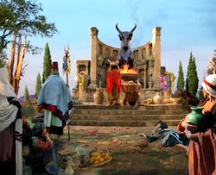
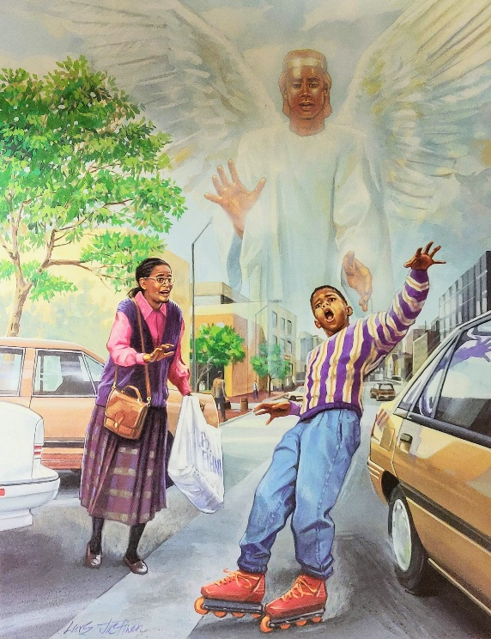
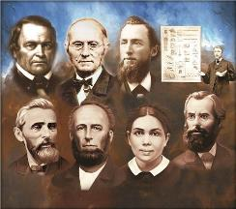
kwjpapd; Mgj;Jf;fs;
“,g;gb ,];uNty; Gj;jpuh; fh;j;jhpd; ghh;itf;Fg; nghy;yhg;ghdijr; nra;J> jq;fs; Njtdhfpa fh;j;jiu kwe;J> ghfhy;fisAk; Njhg;G tpf;fpufq;fisAk; Nrtpf;fpwNghJ>” (epahajpgjpfs; 3:7)
fpy;fhypy; 12 epidTfw;fis epWTtjpy;> NahRth ,uz;L tp\aq;fis typAWj;jpdhu; (NahR. 4:23):
Njtd; ekf;F Kd;ghf nrq;fliy tw;w nra;jhu; (NahRth, fhNyg;, vfpg;jpypUe;J te;j jiyKiwapypUe;J ,d;Dk; capUld; ,Ue;j rpyu;)
cq;fSf;F Kd;ghfNt Njtd; Nahu;jhd; ejpia tw;w nra;jhu; (ghiytdj;jpy; gpwe;J> fhdhid ifg;gw;w tpjpf;fg;gl;l Gjpa jiyKiw)
Gjpa jiyKiwapdu; jq;fs; ngw;Nwhu; nra;Ak; mNj jtiw nra;Ak; mghaj;jpy; ,Ue;jdu;: NjtDila kfj;jhd nray;fis kwj;jy;. Jujp\;ltrkhf, mtufs;; kwe;Jtpl;lhu;fs;, mjd; tpisTfisAk; mtu;fs; mDgtpj;jhu;fs; (epah. 3:7-8).
mg;gbahdhy;> Njtd; ek; Kd;Ndhu;fis vt;thW guhkupj;jhu; vd;gijAk;> NjtDila typikkpf;f fuj;ij ek; fz;fshy; fz;l jUzq;fisAk; ek; kdjpy; gRikahf itj;jpUg;gJ vt;tsT Kf;fpak;!

Slide 10

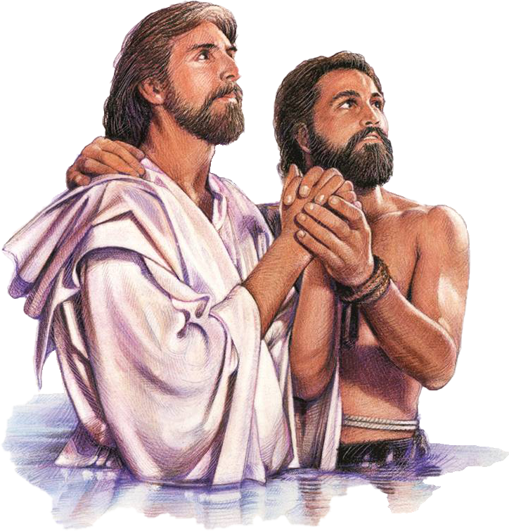
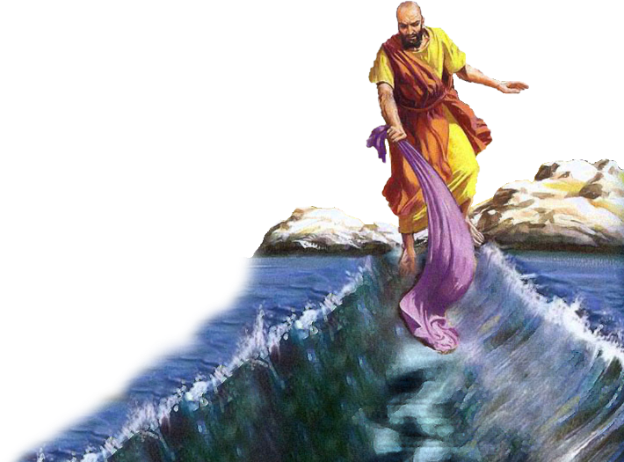
Nahu;jhd; ejpapd; iky;fw;fs;

Slide 11

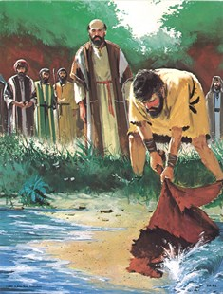
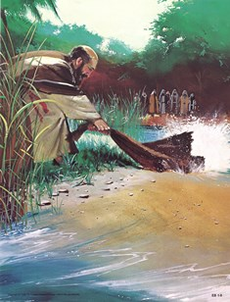
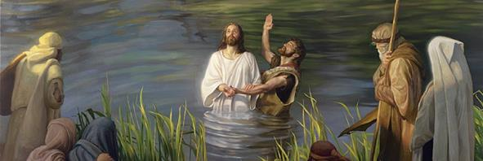
“fliy cyh;e;j jiuahf khw;wpdhh;@ Mw;iwf; fhy;eilaha;f; fle;jhh;fs;@ mq;Nf mthpy; fsp$h;e;Njhk;.!” (rq;fPjk; 66:6)
“fly; fz;L tpyfp Xbw;W@ Nahh;jhd; gpd;dpl;Lj; jpUk;gpdJ.” (rq;fPjk; 114:3)
nrq;fliyAk; Nahu;jhidAk; fle;J nrd;wJ kPl;gpd; tuyhw;wpy; iky;fw;fshfTk; gpd;dp gpize;j ,uz;L tuyhw;W epfo;TfshFk; (rq;. 66:6; rq;. 114). Xd;whf, mit ghtj;jpypUe;J ekJ tpLjiyiaAk; epj;jpa [Ptid miltijAk; Fwpf;fpd;wd.
mw;Gjkhf Nahu;jhd; ejpia fle;J> Njt gpurd;dj;jpw;F nfhz;L tug;gl;lJ vypahTf;F xU ajhu;j;jkhf ,Ue;jJ (2 ,uh[h 2:1, 7, 8, 11).
,Ug;gpDk; vyprhTf;F> mNj epfo;T gupRj;j Mtpapd; tuNtw;gpd; milahskhf ,Ue;jJ. ,J mtuJ gzpia epiwNtw;w mtUf;F cjtpaJ (2 ,uh[h 2:14-15).
Nahu;jhd; ejpf;Fs; EiotJ ,NaRtpd; kPJ mNj tpisit Vw;gLj;jpaJ> mtu; gupRj;j Mtpahy; mjpfhuk; ngw;wtuhf> ghtj;jpypUe;J ek;ik tpLtpj;J epj;jpa [Ptid nfhLg;gJ vd;w jdJ gzpia epiwNtw;wdhu;(khw; 1:9-11;Nah 1:29; 3:16).

Slide 12

“vdNt> fu;j;jUila md;Gs;s jaitAk;> mtUila Vuhskhd fdpthd ,uf;fq;fisAk; epidtpy; nfhs;Nthk;. ,];uNty; kf;fisg; NghyNt, ehKk; ekJ rhl;rpfisf; fw;fshf ehl;b, mtw;wpy; Njtd; ekf;fhf nra;jtw;wpd; mUikahd fijia nghwpg;Nghk;. ek;Kila gpuahzj;jpy; mtu; ek;Kld; ele;J nfhz;l tpjj;ij ehk; kWguprPyid nra;Ak; NghJ, ed;wpAzu;Tld; cUfpa ,jaq;fspypUe;J, fh;j;jh; vdf;Fr; nra;j vy;yh cgfhuq;fSf;fhfTk;> mtUf;F vd;dj;ijr; nrYj;JNtd;. ,ul;rpg;gpd; ghj;jpuj;ij vLj;Jf;nfhz;L> fh;j;jUila ehkj;ijj; njhOJnfhs;SNtd;. ehd; fh;j;jUf;Fr; nra;j nghUj;jidfis mtUila [dq;fnsy;yhUf;F Kd;ghfTk; nrYj;JNtd;." rq;fPjk; 116:12-14 vd;W mwptpg;Nghk;”
vyd; [p citl; (Afq;fspd; thQ;ir, gf;. 348)

