Slide 1
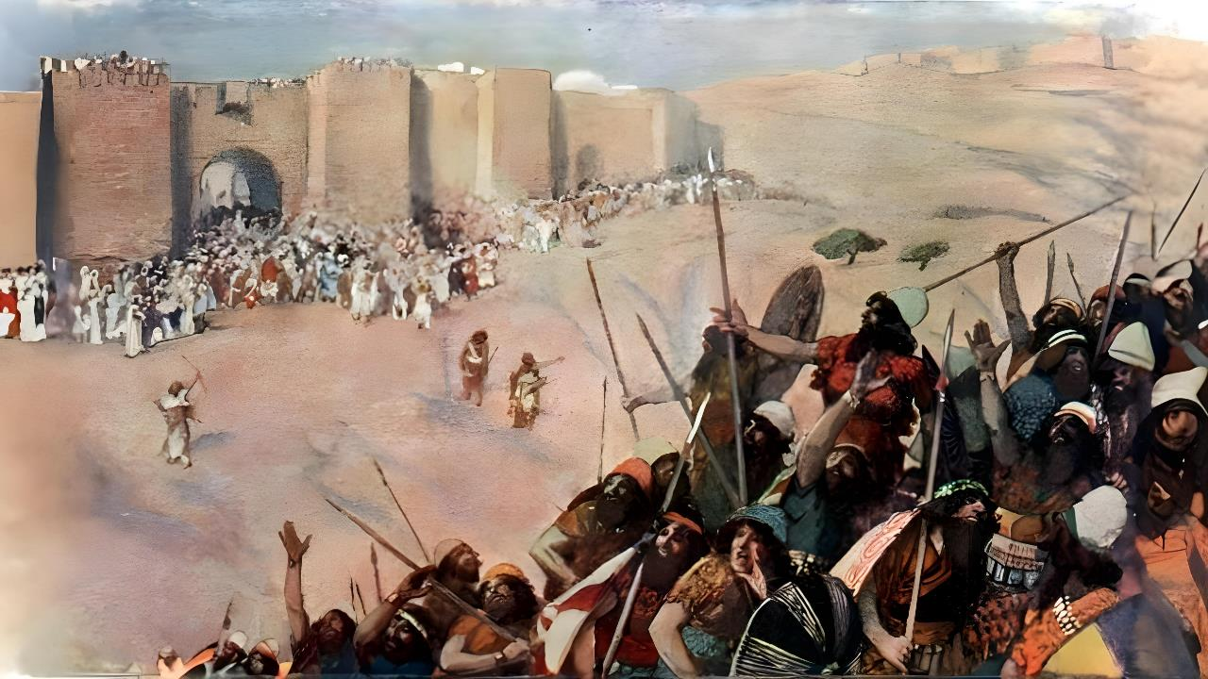
fu;j;ju; cdf;fhf Aj;jk; gz;Zthu;
ghlk; 5
etk;gu; 1, 2025

Slide 2

“me;j uh[hf;fs; vy;yhiuAk; mth;fs; Njrj;ijAk; NahRth xUkpf;fg; gpbj;jhd;@ ,];uNtypd; Njtdhfpa fh;j;jh; ,];uNtYf;fhf Aj;jk;gz;zpdhh;.”
NahRth 10:42

Slide 3

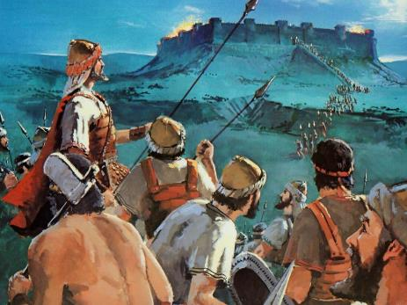
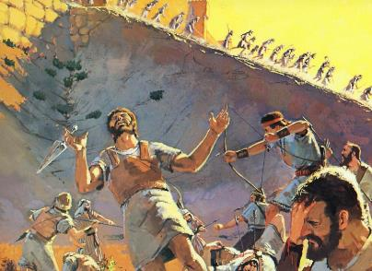
fhdhd; Njrj;ij ,];uNtyu; ifg;gw;w toptFj;j Nghiu Gupe;Jnfhs;tJ vspjhd fhupaky;y.
ghtk; ,Uf;f Ntz;Lk; vd;W Njtd; xUNghJk; Nehf;fk; nfhz;ljpy;iy vd;gJ Nghy> Nghu; ,Uf;f Ntz;Lk; vd;Wk; mtu; Nehf;fk; nfhz;ljpy;iy.
mg;gbahdhy; Vd; ,t;tsT Ngu; ,we;jhu;fs;? me;j Nghiu “GdpjkhdJ” vd;W fUj KbAkh?
,e;j gpur;ridia Gupe;Jnfhs;s, tuyhw;wpd; Kf;fpakhd jUzj;jpy; Nghiu gw;wpa Ntjj;jpd; fUj;ijAk; Mgj;jpy; cs;s jhu;kPf kjpg;GfisAk; ehk; Muha Ntz;Lk;.
mf;fpukk; gw;wpa tp\ak;
ePjp njhlu;ghd tp\ak;
Nghu; gw;wpa Ntjj;jpd; fUj;J
mtu;fspd; nrhe;j tpUg;gj;jhy; mopf;fg;gl;lJ
mikjpia NjLjy;

Slide 4

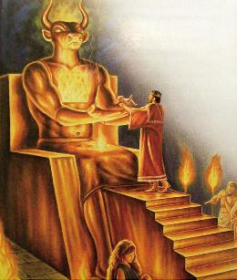
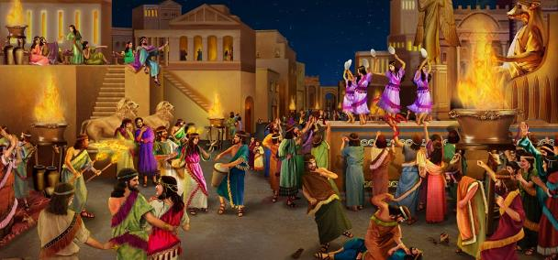
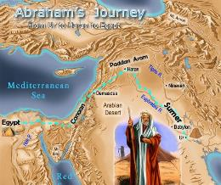
mf;fpukk; gw;wpa tp\ak;
“ehyhk; jiyKiwapNy mth;fs; ,t;tplj;Jf;Fj; jpUk;g tUthh;fs;@ Vndd;why; vNkhhpaUila mf;fpukk; ,d;Dk; epiwthftpy;iy.” (Mjpahfkk; 15:16)
fhdhdp;d; kjk; Ntjk; nrhy;tJ NghyNt ,Ue;jJ vd;gij njhy;nghUs; Muha;r;rp ntspg;gLj;jpAs;sJ: gpy;ypR+dpak;, Fwpnrhy;Yjy;, ,we;jtu;fSld; njhlu;G nfhs;Sjy;, Mtp khu;f;fk;... kw;Wk; gps;isfis gyp nfhLf;fpwtd;! (cgh. 18:9-12).
,jDld;> Gdpjj;jd;ikAld; kpff; Fiwe;j msNt njhlu;Gila “Gdpj tpgr;rhu” rlq;ifAk; Nru;f;f Ntz;Lk; - ,J ghjpupahu;fs; kw;Wk; ghjpupak;khf;fs; ,UtuhYk; filgpbf;fg;gLfpwJ
Mgpufhkpd; fhyj;jpy; ,e;j gof;ftof;fq;fs; Vw;fdNt nghJthdjhf ,Ue;j NghjpYk;> mtu;fSila elj;ijia rupnra;a Njtd; mtu;fSf;F 100 Mz;LfSf;Fk; Nkyhf mtfhrk; nfhLj;jhu;.
,Wjpahf, kdpj xOf;fj;ij Fiwj;J, vy;yh tifahd jPikfisAk; tsu;j;j ,e;j KiwNflhd rlq;FfSf;F Kw;Wg;Gs;sp itf;f Ntz;bapUe;jJ. fhdhdpau;fis mopg;gJ—Fiwe;j gl;rk; xU fhyj;jpw;F—kdpj Fyj;jpd; xOf;f rPuopit jLf;Fk;.

Slide 5

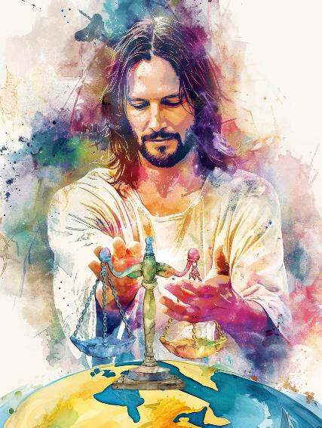
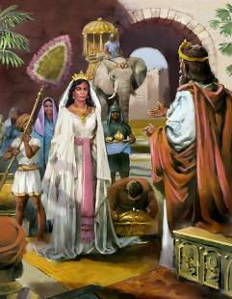
ePjp njhlu;ghd tp\ak;
“Njtd; ePjpAs;s epahahjpgjp@ mth; ehs;NjhWk; ghtpapd;Nky; rpdq;nfhs;Sfpw Njtd;.
mtd; kde;jpUk;ghtpl;lhy; mth; jk;Kila gl;laj;ijf; fUf;fhf;Fthh;@ mth; jk;Kila tpy;iy ehNzw;wp> mij Maj;jg;gLj;jpapUf;fpwhh;.” (rq;fPjk; 7:11-12)
md;Gk; ePjpAk; NjtDila Fzj;jpd; mbj;jskhFk;. ,J mtiu xU ePjpAs;s kw;Wk; ghugl;rkw;w ePjpgjpahf Mf;FfpwJ. mtu; ghtp kde;jpUk;Gtjw;fhf jz;lidia xj;jp itf;fpwhu;. Mdhy; jPikia vd;nwd;Wk; nghWj;Jf; nfhs;skhl;lhu;.
fhdhid ifg;gw;Wtjw;fhf Vfhjpgj;jpa fhuzq;fSf;fhf elj;jg;gltpy;iy, khwhf mjd; nghy;yhj kf;fSf;F jFjpahd jz;lidia epiwNtw;Wtjw;fhd nja;tPf cj;jutpd; Ngupy; elj;jg;gl;lJ.
me;j gpuNjrj;jpy; xU ePjpahd murhq;fj;ij epWTtNj NjtDila tpUg;gkhf ,Ue;jJ> mJ midj;J ehLfSf;Fk; xU Kd;khjpupahf ,Uf;Fk;> mtu;fspd; jhu;kPf fUj;Jf;fis cau;j;j mtu;fis Cf;Ftpf;Fk;> ,jd;%yk; cyfstpy; mikjp kw;Wk; ePjp epiyia mila Ntz;Lk; (cgh. 4:5-6).
xU khtPudhfTk; ePjpgjpahfTk;> NjtDila rl;lj;jpd; Ml;rpia nray;gLj;Jtjw;Fk;> epiyg;gLj;Jtjw;f;Fk;> guhkupg;gjw;Fk;> cWjpG+z;Ls;shu;> ,J mtuJ Fzj;jpd; gpujpgypg;ghFk; .

Slide 6

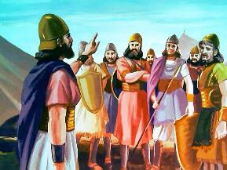
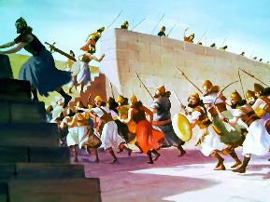
Nghu; gw;wpa Ntjj;jpd; fUj;J
“cd; Njtdhfpa fh;j;jh; cdf;F Kd;ghff; fle;JNghfpwth; vd;gij ,d;W mwpaf;fltha;@ mth; gl;rpf;fpw mf;fpdpiag;Nghy mth;fis mopg;ghh;@ mth;fis cdf;F Kd;ghf tpog;gz;Zthh;@ ,t;tpjkha;f; fh;j;jh; cdf;Fr; nrhd;dgbNa> eP mth;fisr; rPf;fpukha;j; Juj;jp> mth;fis mopg;gha;.” (cghfkk; 9:3)
Ntjhfkj;jpd;gb, Nghu;fs; Fwpg;gpl;l R+oepiyfSf;F kl;LNk tiuaWf;fg;gl Ntz;Lk;> NkYk; mit Njtdhy; tiuaWf;fgl;ld. ,it Njtdhy; mq;fPfupf;fg;gl;l Nghu;fis epu;tfpf;Fk; tpjpfs;:
xU njhopy;Kiw ,uhZtk; mDkjpf;fg;gltpy;iy
tPuu;fSf;F rk;gsk; toq;fg;gltpy;iy> rpy rkaq;fspy; nfhs;isabj;j nghUl;fis $l vLf;fKbatpy;iy
me;j Fwpg;gpl;l tuyhw;W jUzj;jpy;> thf;Fg;gz;zg;gl;l Njrj;ij ifg;gw;Wtjw;Nfh my;yJ ghJfhg;gjw;Nfh kl;LNk Nghu; mDkjpf;fg;gl;lJ
mtu;fs; Njtdhy; Vtg;gl;l jPu;f;fjuprpfshy; topelj;jg;gl;ldu; (NkhNr kw;Wk; NahRth Nghd;wtu;fs;)
NghUf;F Kd; Mtpf;;Fupa Maj;jk; Njitg;ggl;lJ
Nghu; tpjpfSf;F fPo;gbahj ve;j ,];uNtyDk; vjpupahf elj;jg;gl;lhd;
gy re;ju;g;gq;fspy;, Njtd; Neubahf Nghupy; jiyapl;lhu;

Slide 7

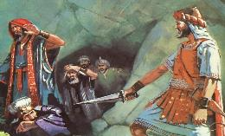
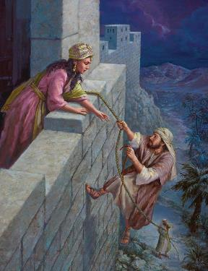
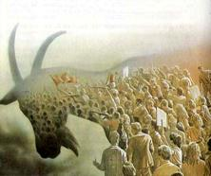
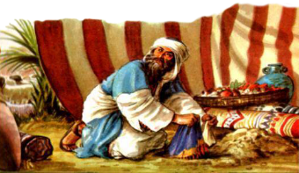
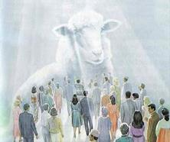
mtu;fspd; nrhe;j tpUg;gj;jhy; mopf;fg;gl;lJ
“,g;gbNa NahRth kiyj;Njrk; midj;ijAk; njd;Njrj;ijAk; rkg+kpiaAk; ePh;g;gha;r;ryhd ,lq;fisAk; mitfspd; vy;yh uh[hf;fisAk;> xUtiuAk; kPjpahf itf;fhky; mopj;J> ,];uNtypd; Njtdhfpa fh;j;jh; fl;lisapl;lgbNa> RthrKs;s vy;yhtw;iwAk; rq;fhuk;gz;zp>(NahRth 10:40)
fhdhd; gpuNjrk; KOtJk; rgpf;fg;gl;ljhf mwptpf;fg;gl;lJ, mjhtJ, mopTf;F mw;gzpf;fg;gl;lJ. Xt;nthU capupdKk; ,wf;f Ntz;Lk; (cgh . 20:16-18; NahR. 10:40).
mopTf;F tpjpf;fg;gl;ltu;fs; NjtDf;F fPo;gbe;jhy; capu;tho KbAk;(c.jh., ,uhfhg;)
NjtDf;F fPo;gbahj ,];uNtyu;fs; mopf;fg;gl Ntz;bapUe;jJ (c.jh., Mfhd;).
vd;whYk;, tpjptpyf;Ffs; ,Ue;jd:
NjtDf;F Kd;ghf, fhdhdpau;fSk; ,];uNtyu;fSk; rkkhf ghu;f;fg;gl;ldu;: ghugl;rkpd;wp. tpj;jpahrk; vd;dntd;why;> rpyu; NjtDf;F vjpuhd jq;fs; fyfj;jpy; njhlu;e;J <Lglj; Nju;e;njLj;jdu;> kw;wtu;fs; mtUf;F fPo;gba Nju;e;NjLj;jdu;.
,g;NghJk;, KbT ek;KilaJjhd;. ,NaR tUk;NghJ, ehk; ek;Kila nrhe;j tpUg;gj;jpdhNy ,ul;rpf;fg;LNthk; my;yJ mopf;fg;gLNthk;.

Slide 8

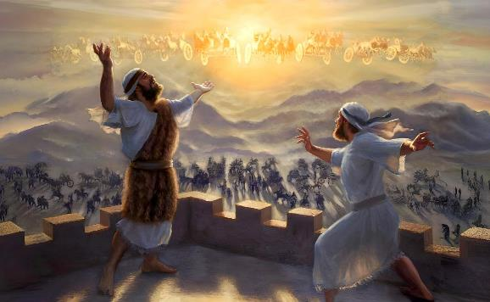
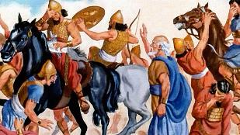
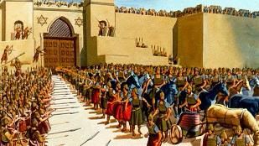
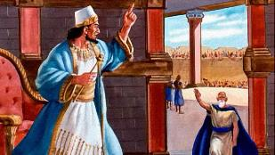
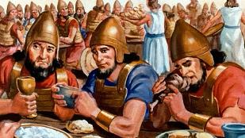
mikjpia NjLjy;
“cd; fz;fhzpfisr; rkhjhdKs;sth;fSk;> cd; jz;lw;fhuiu ePjpAs;sth;fSkhf;FNtd;.” (Vrhah 60:17gp)
,NaRNt rkhjhdj;jpd; gpuG vd;W miof;fg;gLfpwhu; (Vrhah 9:6). mtu; rkhjhdj;ij nfhz;L tu te;jhu;, mtu; rkhjhdj;NjhL Ml;rp nra;thu;(Nah 14:27; Vrh 60:17).
Mdhy; mtUila rkhjhd ,uh[;ak; xU ajhu;j;jkhf khWk;tiu> ehk; Nghupy; <Lgl;Ls;s xU gpuNjrj;jpy;> ed;ikf;Fk; jPikf;Fk; ,ilapyhd gpugQ;r Nkhjypy; Ko;fp ,Uf;fpNwhk;.
jPu;f;fjuprp vyprhit gpbf;f rPupag;gil Njhj;jhid Kw;Wifapl;lNghJ, jd;id Rw;wpAs;s guNyhfg; gil rPupau;fis mopf;Fk;gb Njtdplk; mtu; Nfl;ftpy;iy. mjw;F gjpyhf, ghu;itaw;w rPupa ,uhZtj;ij rkhupahtpw;F mioj;J nry;Yk;gb Nfl;lhu;, mq;F nrd;wJk;, NghupLk; ,uz;L ehLfSf;F ,ilNa mikjpia Vw;gLj;j KbAk; (2 ,uh 6:12-23).
,JNt ,NaR ekf;F fw;Wf; nfhLj;j cjhuzk;;: Nkhjypy; vg;NghJk; mikjpia NjLq;fs;. jPikia ed;ikahy; nty;Yq;fs; (Nuh. 12:20-21).

