Slide 1
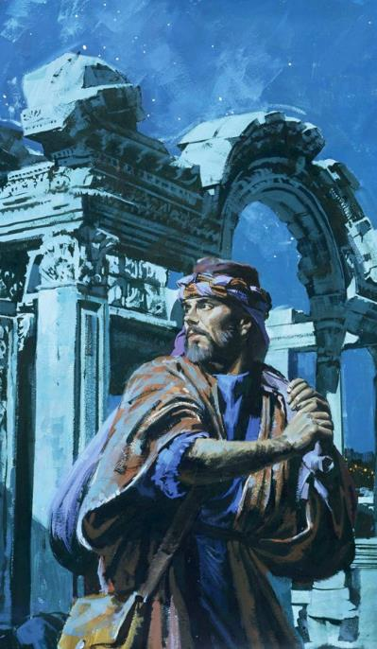
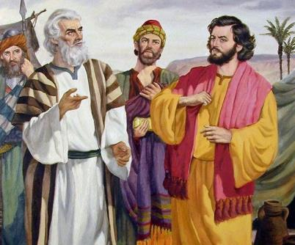
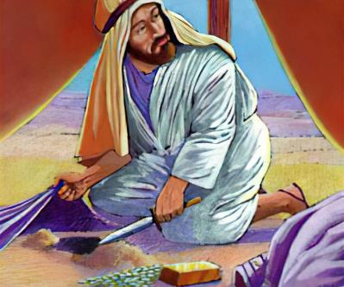
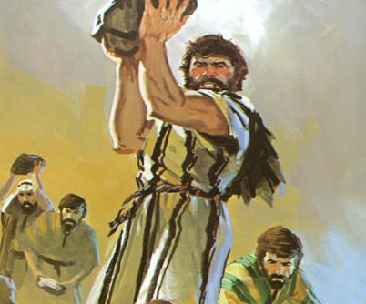
ghlk; 6 etk;gu; 8, 2025
cs;Ns ,Ue;j vjpup

Slide 2


“fh;j;juhfpa ehNd xt;nthUtDf;Fk;> mtdtd; topfSf;Fk; nra;iffspd; gyd;fSf;Fk; jf;fijf; nfhLf;Fk;gbf;F> ,Ujaj;ij Muha;fpwtUk; cs;spe;jphpaq;fisr; Nrhjpj;jwpfpwtUkhapUf;fpNwd;.”
vNukpah 17:10

Slide 3


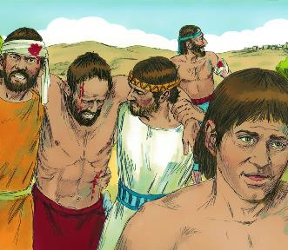
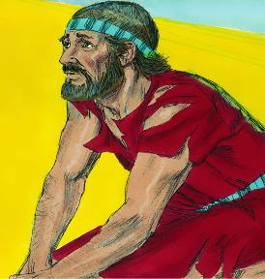





epahakw;w ,uhZt je;jpNuhghaj;jpw;F gpwF> vupNfhtpd; Rtu;fs; ,be;J tpOe;jd. ,];uNty; efuj;jpw;Fs; Eioe;J mij jiukl;lkhf;fpaJ. ntw;wp! ahUilaJ? NjtDilaJ, Vndd;why; ,];uNtYf;F mjpy; ve;j rk;ke;jKk; ,y;iy.
ed;F jpl;lkpl;l ,uhZt je;jpuj;jpw;F gpwF, Map ntw;wp ngw;wJ. Njhy;tp! ahuhy;? ,];uNty; kf;fshy;, Vndd;why; mtu;fs; Njtid ek;gtpy;iy.
,Wjpahf mtu;fs; Njtdplk; Nfs;tp Nfl;l NghJ, kpfTk; cWjpahd gjpy; te;jJ: ,];uNty; ghtk; nra;J tpl;lJ> ,dp mjd; vjpupfis nty;y KbahJ. mJ vt;thW kPz;Lk; nja;tPf jait ngw KbAk;?
Njhy;tpf;fhd fhuzk; (NahRth 7:1-5, 10-13)
jpifg;G kw;Wk; Jauk; (NahRth 7:6-9)
ghtk; nra;jtiu fz;lwpjy; (NahRth 7:14-19)
Mfhdpd; ghtk; (NahRth 7:20-26)
kPz;Lk; n[ak; (NahRth 8:1-29)

Slide 4

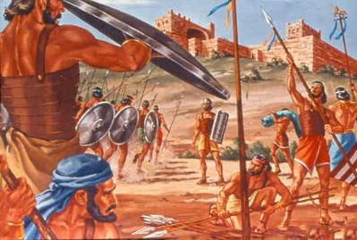
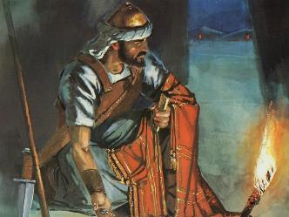
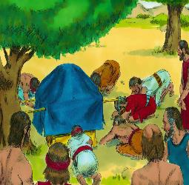
Njhy;tpf;fhd fhuzk;
“,];uNtyh; ghtQ;nra;jhh;fs;@ ehd; mth;fSf;Ff; fl;lisapl;l vd; cld;gbf;ifia kPwpdhh;fs;@ rhgj;jPlhdjpy; vLj;Jf;nfhz;lJk;> fsTnra;jJk;> tQ;rpj;jJk;> jq;fs;gz;lk;ghbfSf;Fs;Ns itj;jJk; cz;Nl.(NahRth 7:11)
vupNfhtpw;F mDg;gg;gl;l csthspfsplkpUe;J rhjfkhd mwpf;iff;F gpwF, NahRth Njtdplk; MNyhrid Nfl;L> efuj;ij ifg;gw;Wtjw;fhd je;jpuj;ij mtuplkpUe;J ngw;whu;.
Mapf;F mDg;gg;gl;l csthspfsplkpUe;J mwpf;ifiag; ngw;w gpwF> NahRth mijNa nra;jpUe;jhy;> 36 Ngupd; kuzj;ij jtpu;j;jpUf;fyhk;(NahRth 7:1-5).
Mdhy; cz;ikahd fhuzk; vd;d, my;yJ Mapia jhf;f Ntz;lhk; vd;W NahRthtplk; Njtd; $wpajw;fhd fhuzk; vd;d (NahR. 7:11)?
“,];uNtyu;fs; ghtk; nra;jhu;fs;” vd;gij Njtd; ghu;j;jhu;. Ntjj;jpy; vq;Fk; ghtk; ,t;tsT Ezf;fq;fSld; tptupf;fg;gltpy;iy: “mtu;fs; kPwpdhu;fs;… mtu;fs; vLj;Jf;nfhz;lhu;fs;… mtu;fs; fsT nra;jhu;fs;… mtu;fs; tQ;rpj;jhu;fs;… jq;fs; gz;lk;ghbfSf;Fs;Ns itj;jJf;nfhz;lhu;fs;.”
gd;ikia ftdpAq;fs;. ghtk; xU kdpjdhy; nra;ag;gl;lJ, Mdhy; Njtd; vy;yh kf;fisAk; nghWg;ghf;Ffpwhu;. mtu;fs; cld;gbf;ifia kPwpdhu;fs;; ghtj;ij ,];uNtypypUe;J vLg;gjw;F mij NtNuhL gpLq;f Ntz;bapUe;jJ.

Slide 5

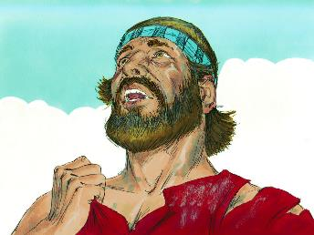
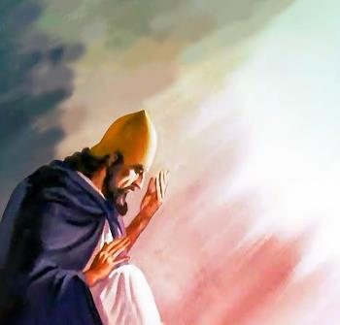
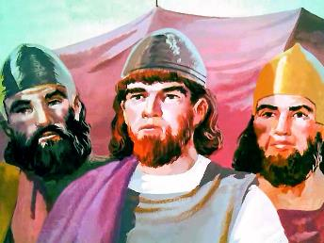
jpifg;G kw;Wk; Jauk;
“NahRth: M> fh;j;juhfpa Mz;ltNu> vq;fis mopf;Fk;gbf;F vNkhhpah; iffspy;xg;Gf;nfhLg;gjw;fhfth NjthPh; ,e;j [dj;ij Nahh;jhidf; flf;fg;gz;zpdPh;? ehq;fs;Nahh;jhDf;F mg;Gwj;jpy; kdj;jph;g;jpahf ,Ue;Jtpl;Nlhkhdhy; eykhapUf;Fk;. ” (NahRth 7:7)
Mapapy; Vw;g;gl;l Njhy;tpahy; NahRthTk; %g;gu;fSk; fyf;fkile;jdu;. NkYk; mtu;fs; Jf;fj;jpd; njspthd mwpFwpfis fhl;bdu; (NahR. 7:6).
,];uNtyu; 40 tUlq;fshf miye;J jpupe;jNghJ kPz;Lk; kPz;Lk; nra;jij Nghd;w xU Nfhgj;Jld; NahRth gpd;du; vjpu;tpidahw;Wfpwhu;: “NahRth: M> fh;j;juhfpa Mz;ltNu> vq;fis mopf;Fk;gbf;F vNkhhpah; iffspy;xg;Gf;nfhLg;gjw;fhfth NjthPh; ,e;j [dj;ij Nahh;jhidf; flf;fg;gz;zpdPh;? ehq;fs;Nahh;jhDf;F mg;Gwj;jpy; kdj;jph;g;jpahf ,Ue;Jtpl;Nlhkhdhy; eykhapUf;Fk;.” (NahR. 7:7).
,Ug;gpDk;, NahRthtpd; kdg;ghd;ik ghiytdj;jpy; ,];uNtyu;fis NghyNt ,y;iy. mtuJ Gfhu; Vkhw;wj;jhy; J}z;lgltpy;iy> khwhf Gw[hjpapdupilNa NjtDila ngau; mtkjpf;fg;gLk; vd;w gaj;jhy; J}z;lg;gl;lJ (NahR. 7:8-9).
NjtDila kf;fs; vt;thW nray;gl;lhu;fs; vd;gijg; nghWj;J> mtpRthrpfs; NjtDila Fzhjpraq;fis tpsf;Fthu;fs; vd;gij mtu; njspthff; fz;lhu;fs;. ,d;W ehk; cyfpy; NjtDila rhl;rpahf njhlu;e;J ,Uf;fpNwhk;. vd;d xU ngupa nghWg;G!

Slide 6

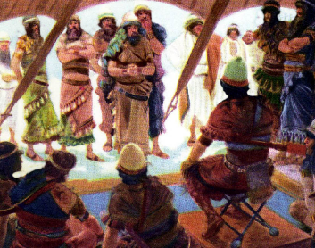
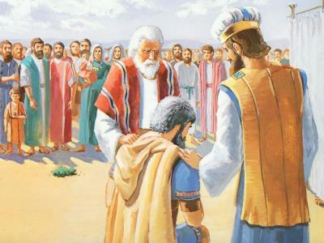
ghtk; nra;jtiu fz;lwpjy;
“fhiyapy; ePq;fs; Nfhj;jpuk; Nfhj;jpukhf tuNtz;Lk;@ mg;nghOJ fh;j;jh; Fwpf;fpw Nfhj;jpuk; tk;rk; tk;rkhf tuNtz;Lk;@ fh;j;jh; Fwpf;fpw tk;rk; FLk;gk; FLk;gkhf tuNtz;Lk;@ fh;j;jh; Fwpf;fpw FLk;gk; Ngh;Nguhf tuNtz;Lk; vd;W nrhy;.” (NahRth 7:14)
$l;Lg; ghtj;ij (KO kf;fspd; ghtj;ijAk;) ePf;f, ghtp ePf;fg;glNtz;Lk; (NahR. 7:15). ePf;fg;glNtz;Lkh? mtd; kde;jpUk;gpdhy; mtDf;F kd;dpg;G fpilf;fhjh? epr;rakhf mtd; kd;dpf;fg;gLthd;! Mdhy; Mfhd; cz;ikahd kde;jpUk;Gjypd; ve;j mwpFwpiaAk; fhl;ltpy;iy (NkYk; mt;thW nra;a mtDf;F Vuhskhd tha;g;Gfs; ,Ue;jd).
tprhuiz nray;Kiw mwptpf;fg;gl;L kWehs; tiu xj;jpitf;fg;gl;lJ (NahR. 7:14-15)
A+jh Nfhj;jpuk; Fwpf;fg;gl;lJ (NahR. 7:16)
Nruhtpd; FLk;gk; Fwpf;fg;gl;lJ (NahR. 7:17K)
jiytu; rg;jp Fwpf;fg;gl;lhu; (NahR. 7:17gp)
Mfhd; Fwpf;fg;gl;lhd; (NahR. 7:18)
Mfhd; nksdk;
Mfhd; nksdk;
Mfhd; nksdk;
Mfhd; nksdk;
Mfhd; nksdk;
nja;tPf jaitAk; md;igAk; gpujpgypj;J> NahRth Mfhid jd; ghtj;ij mwpf;ifapl nrhd;dhu; (NahR. 7:19).
Mfhdpd; tof;F Njhw;wJ. mtu; xg;Gf;nfhz;lhu;, Mdhy; kd;dpg;G Nfl;ftpy;iy (NahR. 7:20). Mdhy; Njtd; mtDila ,Ujaf; fbdj;ij fz;L Jf;fkile;jhu;> kde;jpUk;GjYf;fhd xt;nthU miog;gpYk; mij ntspg;gLj;jpdhu;.

Slide 7

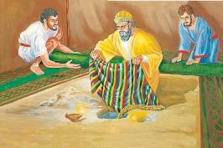

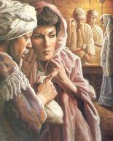
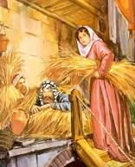
Mfhdpd; ghtk;
“nfhs;isapNy Neh;j;jpahd xU ghgpNyhdpa rhy;itiaAk;> ,UE}W nts;spr;Nrf;ifiyAk;> Ik;gJ Nrf;fy; epiwahd xU nghd;ghsj;ijAk; ehd; fz;L> mitfis ,r;rpj;J vLj;Jf;nfhz;Nld;@ ,Njh> mitfs; vd; $lhuj;jpd; kj;jpapy; g+kpf;Fs; Gijj;jpUf;fpwJ. nts;sp mjpd; mbapypUf;fpwJ vd;whd;.” (NahRth 7:21)
NahRth Mfhdplk; NjtDf;F kfpik nrYj;jp> jd; ghtj;ij mwpf;ifapLk;gb Nfl;lhu; (NahR. 7:19). mJ mtUf;F filrp tha;g;G. mtu;, xg;Gf;nfhz;l NghJ, kd;dpg;G Nfl;bUe;jhy;… Mdhy; mtu; mg;gb nra;atpy;iy, mtUf;F kd;dpg;Gk; ,y;iy (vz;. 15:30-31).
,uhfhg;
mtu; csthspfis $iuapy; kiwj;J itj;jhu;
mtu; ,];uNtyplk; ,uf;fj;Jld; ele;Jnfhz;lhu;
Mfhd;
mtd; nfhs;isg; nghUis jiuapy; kiwj;J itj;jhd;
mJ ,];uNtYf;F rpf;fiy nfhz;L te;jJ
mtu; jdJ ek;gpf;ifapd; fhuzkhf ntw;wpia tpUk;gpdhu;
mtd; jd; nray;fshy; Njhy;tpia Vw;gLj;jpdhd;
mtu; ,];uNtYld; xU cld;gbf;if nra;jhu;
mtd; ,];uNtypd; cld;gbf;ifia kPwpdhd;
mtu; jdJ capiuAk; jdJ FLk;gj;jpdupd; capiuAk; tpLtpj;jhu;
mtd; jd; FLk;gj;Jld; kupj;jhd;
Vthisg; NghyNt, MfhDk; “ghu;j;jhd;,” “tpUk;gpdhd;,” “vLj;Jf;nfhz;lhd;,” mtDila ghtk; gyiu ghjpj;jJ (Mjp. 3:6). mddpah kw;Wk; rg;gpuhisg; NghyNt, Mfhd; NjtDf;F mw;gzpf;fg;gl;l rgpf;fg;gl;l rpy nghUl;fis vLj;J mtw;wpw;F gzk; nrYj;jpdhd; (mg; 5:1-2).
vupNfhtpy; Mfhd; vLj;j KbTfs; ,uhfhgpd; KbTfSf;F Kw;wpYk; vjpuhdit:

Slide 8

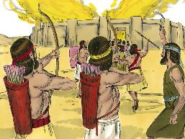
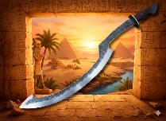
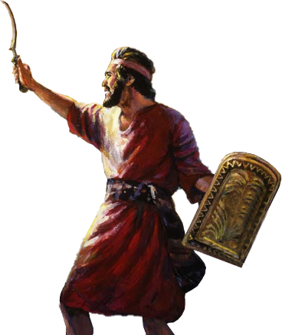
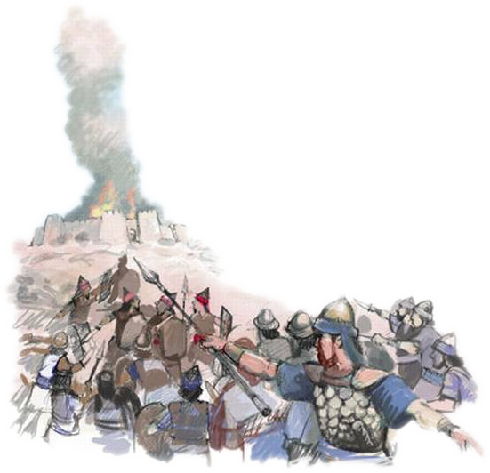
kPz;Lk; n[ak;
“mg;nghOJ fh;j;jh; NahRthit Nehf;fp: eP gag;glhkYk; fyq;fhkYk; ,U@ eP Aj;j [dq;fs; ahtiuAk; $l;bf;nfhz;L vOe;J> Mapgl;lzj;jpd;Nky; Ngh> ,Njh> Mapapd; uh[hitAk; mtd; [dj;ijAk; mtd; gl;lzj;ijAk; mtd; ehl;ilAk; cd; ifapy; xg;Gf;nfhLj;Njd;. ” (NahRth 8:1)
vupNfhit NghyNt, Mapia nty;y NahRthTf;F Njtd; xU cj;jpia nfhLj;jhu; (NahR. 8:1-2).
,utpy;, efuj;jpw;F gpd;dhy; xU gJq;fpapUe;J jhf;Fjy; elj;jg;gl;lJ. tpbaw;fhiyapy;, ,uhZtk; Mapia neUq;fp> kPz;Lk; mtu;fSf;F Kd;ghf jg;gp xLtJ Nghy; ebj;jJ.
NkhNr mkNyf;fpau;fis nfhy;Yk;tiu jdJ Nfhiy cau;j;jpa NghJ, NjtDila fl;lisg;gb, NahRth jdJ “MAjj;ij” (mNefkhf vfpg;jpau;fshy; gad;gLj;jg;gl;l mupths;), KOikahd ntw;wp ngWk;tiu mij cau;j;jp itj;jpUe;jhu; (NahR. 8:18-22, 26).
Njtd; kPz;Lk; xUKiw jk; kf;fSf;F ntw;wpiaf; nfhLj;jhu;. MfhDk; mtd; FLk;gj;jpdUk; nfhy;yg;gl;l MNfhu; gs;sj;jhf;F, ntw;wpf;fhd fjitj; jpwe;jJ, xU “ek;gpf;ifapd; fjT” (xrpah 2:15).
ehk; tpRthrj;jpdhy; nja;tPf kd;dpg;ig Vw;Wf;nfhs;Sk;NghJ> Njtd; ek; ghtj;ij MNfhupy; Gijj;J> ek;gpf;iffhd fjitj; jpwf;fpwhu;.

