Slide 1

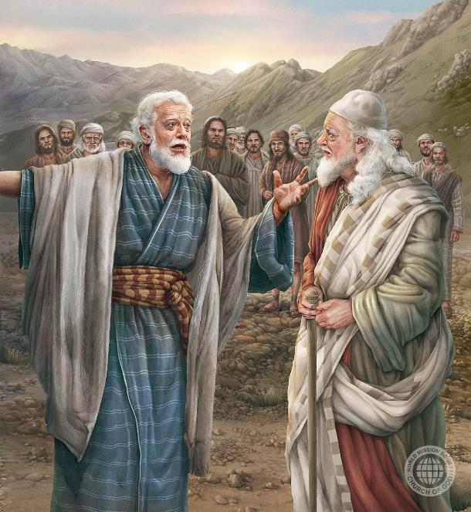
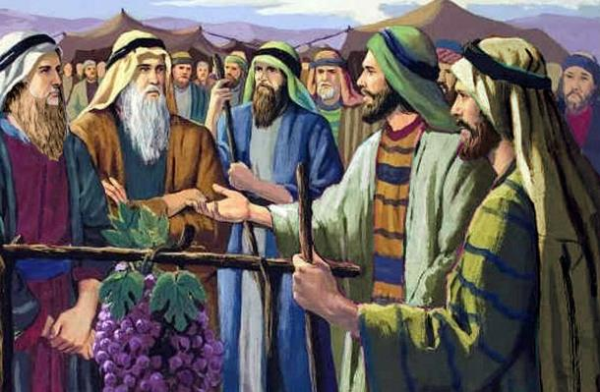
tpRthr [hk;gthd;fs;: NahRthTk; fhNyGk;
ghlk; 8 etk;gu; 22, 2025

Slide 2
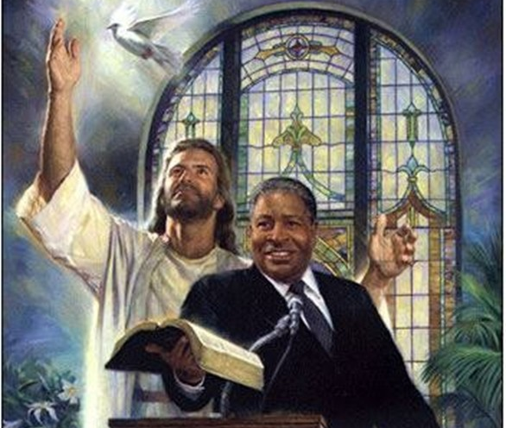
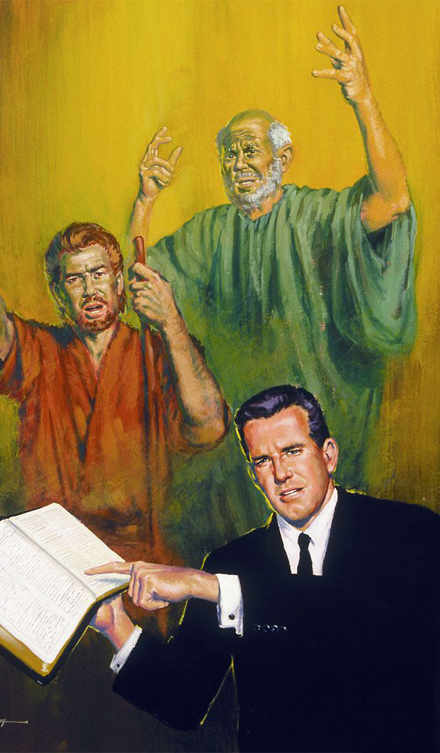

“Njttrdj;ij cq;fSf;Fg; Nghjpj;J cq;fis elj;jpdth;fis ePq;fs; epidj;J> mth;fSila elf;ifapd; Kbit ed;wha;r; rpe;jpj;J> mth;fSila tpRthrj;ijg; gpd;gw;Wq;fs;.”
(vgpNuau; 13:7)

Slide 3


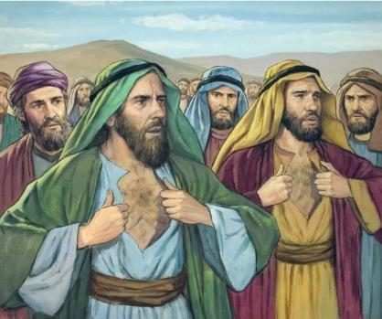




,e;j gj;J Ngiu cq;fSf;F njupAkh: rk;Kth, rhg;ghj;, <fhy;, gy;j;jp, fhjpNay;, fhjp, mk;kpNay;, Nrj;J}u;, ehfgp kw;Wk; $Nty;?
,tu;fSila “Gfo;” vd;gJ NjtDila ty;yikia mtek;gpf;if nfhs;tjpYk;, mjd; %yk; mtUf;Fk; xU KO jiyKiwapdUf;Fk; kuzj;ij Vw;g;gLj;JtjpYk; ,Ue;jJ. (vz;. 14:36-37).
Mdhy; ePq;fs; ,e;j ,uz;L Ngiu gw;wp Nfs;tpg;gl;bUf;fyhk;: NahRth kw;Wk; fhNyg;. mtu;fs; cWjpahf epd;wdu;, NjtDila thf;FWjpfis ek;gpdu;, NkYk; mit epiwNtWtij fhz capu; gpioj;jdu; (vz;. 14:38).
mtu;fSila tpRthrj;ij gpd;gw;wp> mtu;fisg; NghyNt Njtidf;nfhz;L Kbahjij nra;a KbAk; vd;gij ehk; vt;thW KOikahf ek;GtJ?
fhNygpd; tpRthrk;:
rhj;jpakw;wij rhj;jpakhf;Fjy;.
tpRthrk; nraypy;.
N[hjpia mDg;Gjy;.
NahRthtpd; tpRthrk;.
tpRthrj;ij vg;gb ngWtJ.

Slide 4

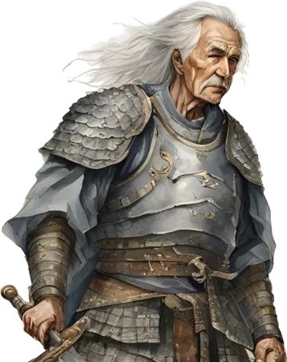
fhNygpd; tpRthrk;

Slide 5

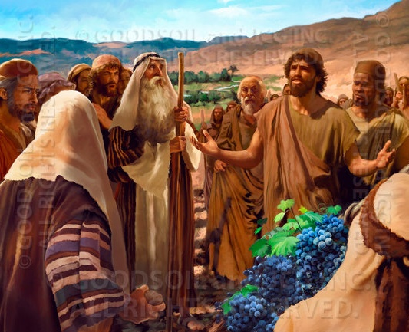
rhj;jpakw;wij rhj;jpakhf;Fjy;
“MdhYk; vd;NdhNl$l te;j vd; rNfhjuh; [dj;jpd; ,Ujaj;ijf; fiuag;gz;zpdhh;fs;@ ehNdh vd; Njtdhfpa fh;j;jiu cj;jkkha;g; gpd;gw;wpNdd;.” (NahRth 14:8)
fhNyg; vd;w ngaUf;F “eha;” vd;W mu;j;jk;. mtuJ tho;f;if ep&gpj;jgb, mtu; me;j ngaiu xU mtkhdfukhd thu;j;ijahf ngwtpy;iy, Mdhy; mtuJ tpRthrj;jpd; fhuzkhf. kw;wtu;fs; tpRthrkw;w ,lq;fspy; mtu; cz;ikAs;stuhf ,Ue;jhu;. kw;wtu;fs; jaq;fpa ,lq;fspYk; mtu; NjtDf;F cz;ikAs;stuhf ,Ue;jhu;.
gj;J csthspfs;> efuq;fis nty;y KbahJ vdTk; ,uhl;rju;fis ehk; nty;y KbahJ vd;W fz;l ,lj;jpy;> fhNyg; efuq;fs; ifg;gw;wgl;lijAk; ,uhl;rju;fs; mg;gj;ij Nghy cz;zg;gLtijAk; fz;lhu;(vz;. 13:28-33; 14:6-9).
NahRthTld; (mtiu tpl rw;W ,isatu;), $l;lk; mtu;fis fy;nywpa tpUk;gpa NghJk;, mtu; jdJ fUj;jpy; cWjpahf epd;whu; (vz;. 14:10).
ek;khy; Kbahjij rhj;jpakhf;ff;$ba Njtd; kPJ ehk; cWjpahd ek;gpf;ifia NgZtjw;F mtUila cjhuzk; ek;ik Cf;Ftpf;fpwJ.

Slide 6

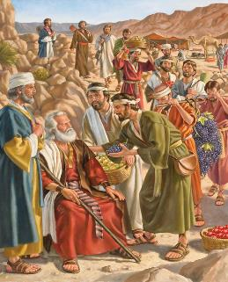
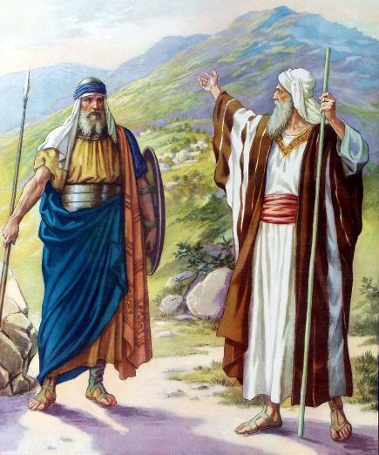

nraypy; tpRthrk;
“Mifahy; fh;j;jh; me;ehspNy nrhd;d ,e;j kiyehl;il vdf;Fj; jhUk;@ mq;Nf Vdhf;fpaUk;> muzpg;ghd nghpa gl;lzq;fSk; cz;nld;W ePh; me;ehspNy Nfs;tpg;gl;BNu@ fh;j;jh; vd;NdhbUg;ghuhdhy;> fh;j;jh; nrhd;dgb> mth;fisj; Juj;jptpLNtd; vd;whd;.” (NahRth 14:12)
fhNygpd; $w;Wg;gb, NkhNr xU fzf;if Nfl;lNghJ, “vd; ,Ujaj;jpYs;sgbNa mtUf;F kWnra;jp nfhz;Lte;Njd;.” (NahR. 14:7), NkYk; “ehNdh vd; Njtdhfpa fh;j;jiu cj;jkkha;g; gpd;gw;wpNdd;.” (NahR. 14:8). mtUila cz;ikj;jd;ikapd;gbNa, csTghu;j;j NghJ mtu; fhy; gjpj;j ,lj;ij mtu; Rje;jupj;Jf;nfhs;thu; vd;W mtUf;F thf;fspf;fg;gl;lJ (NahR. 14:9).
fhNyg; csthspahf mDg;gg;gLk;NghJ mtu; 40 tajhapUe;jhu;. 5 tUl ntw;wpf;F gpd;, mtu; ,g;NghJ 85 tajhapUe;jhu; (NahR. 14:10). mtuJ clYk; kdJk; ,d;Dk; Jbg;Gld; ,Ue;jd, mtuJ vz;zq;fs; ,d;Dk; mg;gbNa ,Ue;jd (NahR. 14:11).
thf;FWjpia NfhuTk;> mtuJ thu;j;ijfs; tPz;Nghftpy;iy vd;gij ep&gpf;fTk; Neuk; te;Jtpl;lJ. NjtDila cjtpAld;, mtu; ,uhl;ju;fis tpOq;fp mtu;fspd; efuj;ij ifg;gw;w Nghfpwhu; (NahR. 14:12-14).

Slide 7

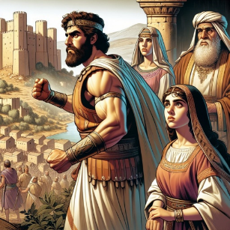
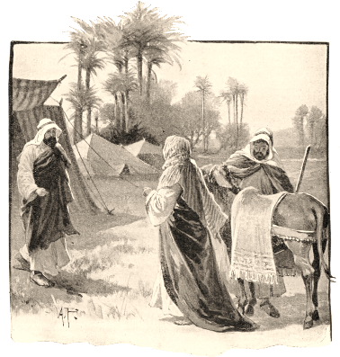
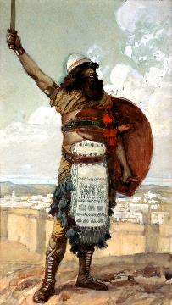
N[hjpia mDg;Gjy;
“fPhpahj;nrg;Ngiur; rq;fhuk;gz;zpg; gpbf;fpwtDf;F> vd; Fkhuj;jpahfpa mf;rhis tpthfk;gz;zpf;nfhLg;Ngd; vd;W fhNyg; nrhd;dhd;. ” (NahRth 15:16)
jdf;F nrhe;jkhd xU ,lj;jpd; xU gFjpia ifg;gw;wpa gpwF, fhNyg; jhd; tpl;L nry;Yk; kuig gw;wp Nahrpj;jhu;. mtu; itj;jpUe;jJ Nghy; mtuJ re;jjpapdu; njhlu;e;J Njtid ek;Gthu;fsh?
Njtid ek;gyhk; vd;W mtu; ep&gpj;jpUe;jhu;, ,g;NghJ mNj ek;gpf;if nfhz;l xUtiu fz;Lgpbf;f tpUk;gpdhu;, mjdhy; mtu; mtu;fSf;F N[hjpia nfhLf;fKbAk;.
,e;j fhuzj;jpdhy;, njgPu; vd;wiof;fg;gLk; fPupahj; nrg;Ngiu ifg;gw;wpatDf;F jd; kfis mspg;gjhf mtu; thf;FWjp mspj;jhu; (NahR. 15:15-16).
mtuJ kUkfd; xj;dpNay; efuj;ij ntd;w typikkpf;f kdpju;> ,];uNtypd; Kjy; ePahajpgjp Mdhu; (NahR. 15:17; epah 3:9-11).
fhNygpd; kfs; mf;rhis kze;j gpwF, mts; jd; je;ijia tw;GWj;jp> ifg;gw;wg;gl;l gFjpia tpupTg;gLj;j mDkjpf;f nrhd;dhs; (NahR. 15:18-19), ,jd; %yk; jhd; fhNyGf;F jFjpahd thupR vd;gij ep&gpj;jhs;.

Slide 8

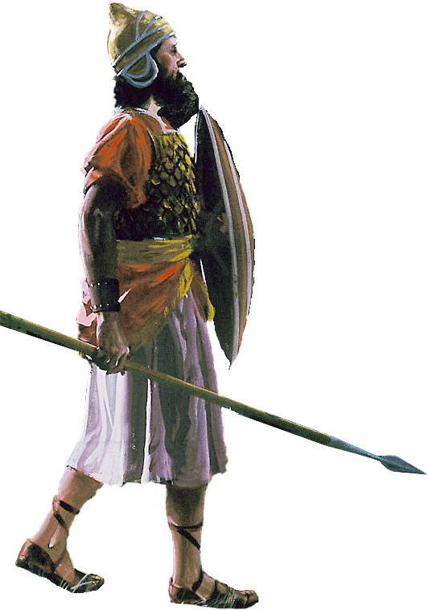
NahRthtpd; tpRthrk;

Slide 9

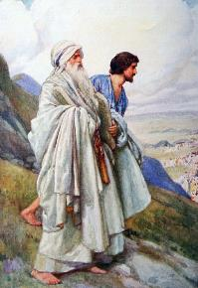
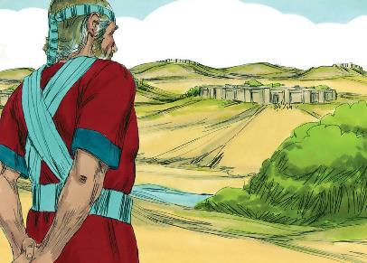
“Njrj;ij mjpd; vy;iyfspd;gb Rje;jukhfg; gq;fpl;Lj; jPh;e;jNghJ> ,];uNty; Gj;jpuh; E}dpd; Fkhudhfpa NahRthTf;Fj; jq;fs; eLtpNy xU Rje;juj;ijf; nfhLj;jhh;fs;.” (NahRth 19:49)
xU ,isQdhf, NahRthit NkhNr jdJ cjtpahsuhf Nju;e;njLj;jhu;. mtu; fPo;gbjYs;stuhfTk;, ijupaKs;stuhfTk;, cz;ikAs;stuhfTk;, cjtp nra;gtuhfTk;, NjtDila fhupaq;fis Nerpg;gtuhfTk; ep&gpj;jhu; (ahj;. 33:11).
jd;Dila nrhe;j gpuNjrj;ij NfhUk; Neuk; te;jNghJ, vy;yh Nfhj;jpuq;fSk; jq;fs; Rje;jpuj;ij ngWk;tiu mtu; fhj;jpUe;jhu;, NkYk; mtu; “kPjKs;s gFjpia” [jpk;dhj;-Nruh] Nju;e;njLj;jhu;(NahR. 19:50), ,J rPNyhTf;F mUfpYs;s xU efukhFk;, mq;Fjhd; Mrupg;Gf;$lhuk; mikf;fg;gl;lJ.
mtUila fijapypUe;J ehk; fw;Wf;nfhs;tJ vd;dntd;why;:
tpRthrk; cz;ikfis Gwfzpg;gjpy;iy; mJ ntWkNd ntWg;gl;l Gupjiy toq;FfpwJ
Fiw $Wtjw;F gjpyhf, NjtDila jpl;lq;fis ek;gp> mjw;F fPo;gba ehk; miof;fg;gLfpNwhk;
KOikahf fu;j;jUf;Fs; epiyj;jpUg;gtu;fSf;F MrPu;thjq;fs; tUk;
tho;f;if mjd; midj;J gupkhzq;fspYk; Njtdhy; epWtg;gl;l jpl;lq;fspd;gb thog;gl Ntz;Lk;
NjtDf;F mUfpy; tho;tJ kjpg;Gf;FupaJ (rq;. 84:10)

Slide 10

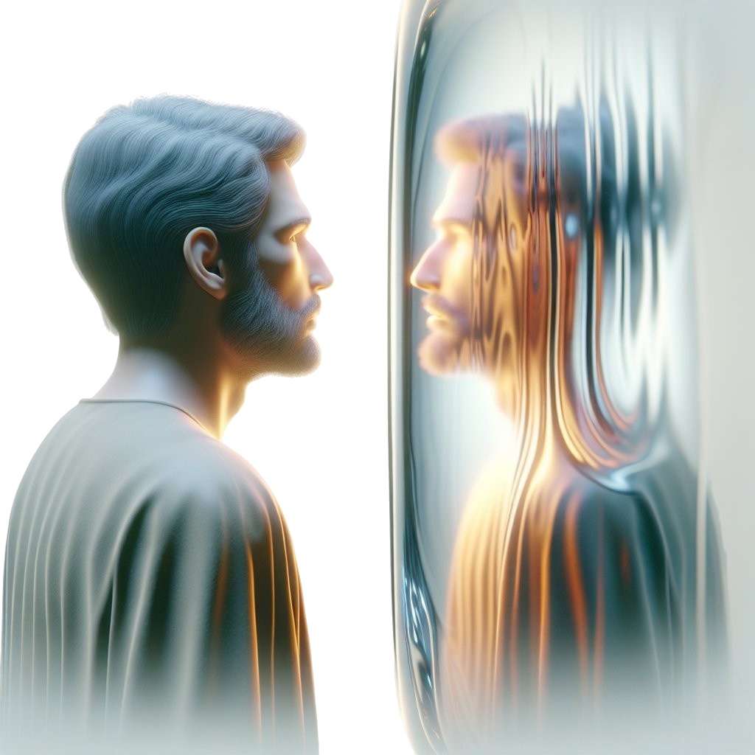
tpRthrj;ij vg;gb ngWtJ

Slide 11

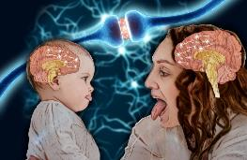


“Mifahy;> Nkfk;Nghd;w ,j;jid jpushd rhl;rpfs; ek;ikr; #o;e;Jnfhz;bUf;f> ghukhd ahtw;iwAk;> ek;ikr; Rw;wp neUf;fpepw;fpw ghtj;ijAk; js;sptpl;L> tpRthrj;ijj; Jtf;FfpwtUk; Kbf;fpwtUkhapUf;fpw ,NaRit Nehf;fp> ekf;F epakpj;jpUf;fpw Xl;lj;jpy; nghWikNahNl Xlf;flNthk;@ mth; jkf;FKd; itj;jpUe;j re;Njh\j;jpd;nghUl;L> mtkhdj;ij vz;zhky;> rpYitiar; rfpj;J> NjtDila rpq;fhrdj;jpd; tyJghhprj;jpy; tPw;wpUf;fpwhh;.” (vgpNuau; 12:1-2)
ekJ elj;ij ehk; ghu;g;gij gpujpgypf;fpwJ. “fz;zhb epAuhd;fs;” vd;W miof;fgLgit $l cs;sd> mit vijahtJ ftdpg;gjw;Fk; mij nra;tjw;Fk; cs;s NtWghl;il kOq;fbf;fpd;wd.
tpRthrj;jpd; kfj;jhd fjhehafu;fspd; Kd;khjpupia ftdpf;f Ntjk; ek;ik miof;fpwJ, ,NaRtpd; kPJ rpwg;G ftdk; nrYj;Jq;fs;> mtu;jhd; cau;e;j Kd;khjpup (vgp. 12:1-2).
tpRthrtPuu;fshd fhNyg; kw;Wk; NahRthtpd; tho;f;ifia gbg;gjd; %yk;, mtu;fisg; Nghy ehk; Njtid ek;g Ntz;Lk;; mtu;fisg; Nghy jho;ikaha; ,Uf;f Ntz;Lk;; mtu;fisg; Nghy cz;ikahAk; ijupakhAk; ,Uf;f Ntz;Lk;.
vt;thW ehk; khw KbAk;? Ntjk; njspthf $WfpwJ: ghpRj;j Mtpahdtiu ekf;Fs; fpupia nra;a mDkjpf;Fk;NghJ (2 nfhup. 3:18). ,Jjhd; xU nray;gLk; fpupia. fhNyig Nghy nray;gLtjw;F khw;wg;gl ehk; Nju;e;njLf;f Ntz;Lk;. ek;ik NjtDf;F [Pt gypfshf xg;GnfhLf;fg;gLtjw;F ehk; miof;fg;gl;bUf;fpNwhk; (Nuh. 12:1-2).

