Slide 1
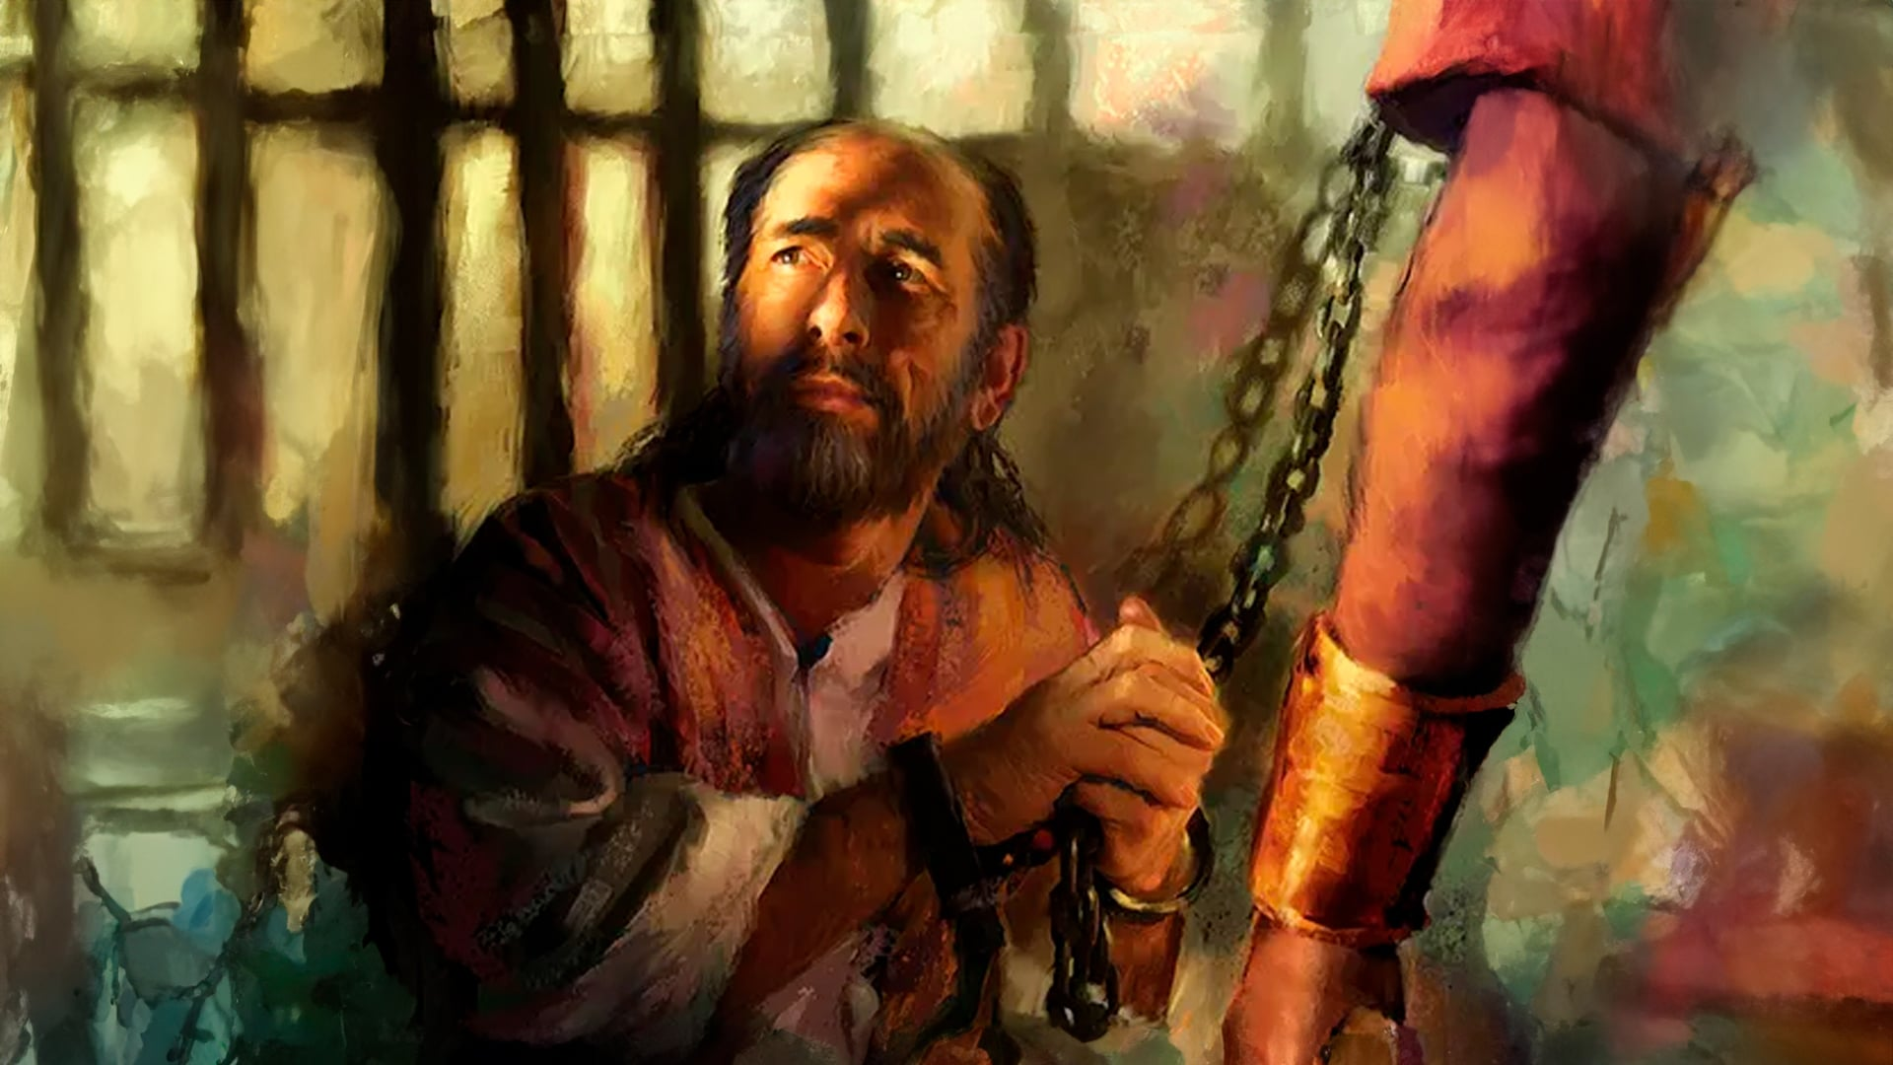
Jd;gg;gl;Lk; iftplg;gLfpwjpy;iy
ghlk; 1, 3 [dtup 2026

Slide 2
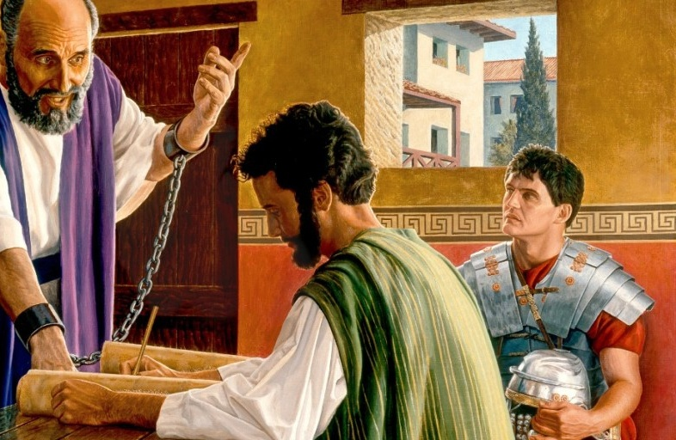
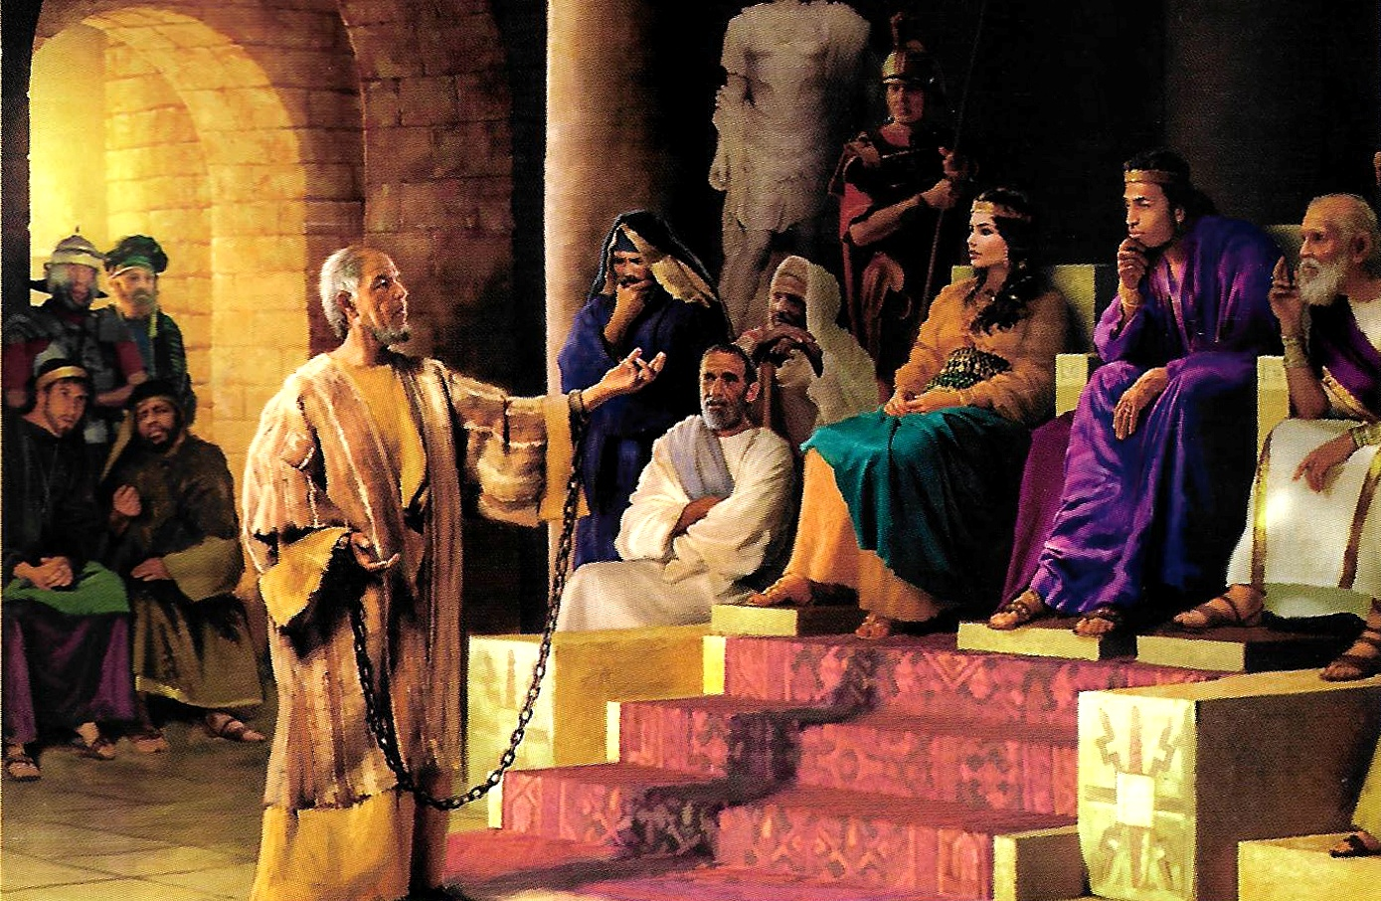
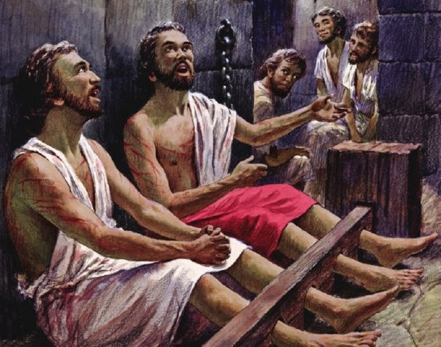
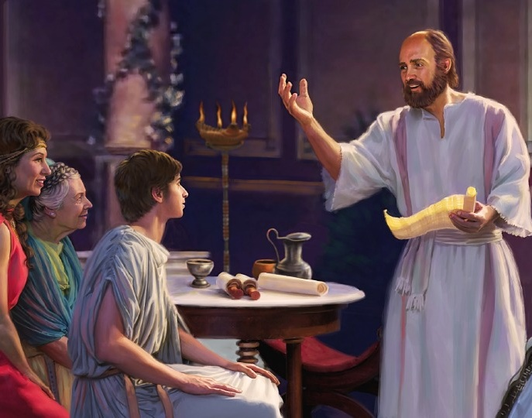
“fh;j;jUf;Fs; vg;nghOJk; re;Njh\khapUq;fs;@ re;Njh\khapUq;fs; vd;W kWgbAk; nrhy;YfpNwd;!”
gpypg;gpau; 4:4

Slide 3

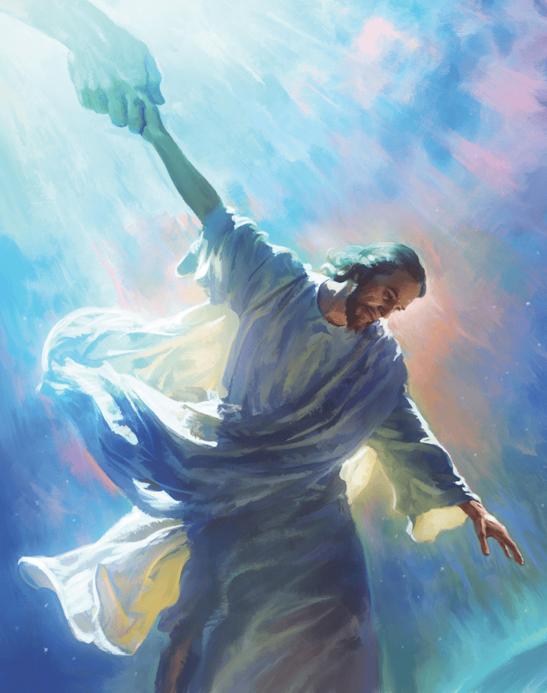







gTy; jdJ Copak; KOtJk; Nfl;Nghu; midtUf;Fk; thdj;ijAk; G+kpiaAk; ,izf;ff;$ba xNu xUtiu - ,ul;fuhfpa ,NaR fpwp];Jit – Kd; itf;f njhlq;fpdu;.
gpyp;g;gpau; kw;Wk; nfhNyhnrau;fSf;F vOjpa fbjq;fspy;> jpUr;rigia guNyhfj;jpw;F neUf;fkhfTk;> fpwp];jtu;fis xUtUf;nfhUtu; neUf;fkhfTk; nfhz;L tu jd;dhy; Kbe;j midj;ijAk; nra;jhu;
mt;thW nra;tjd; %yk;, ,NaR ekf;F xg;gilj;j Mizia G+kpapy; epiwNtw;w NjtDila jpUr;rig ,d;W guNyhfj;Jld; vt;thW xd;wpiza KbAk; vd;gij ekf;F fhl;bdhu;.
epUgq;fspd; Mrpupau;:
gTy; rpiwapy; milf;fg;gl;lhu;.
rq;fpypahy; fl;lg;gl;bUf;fpw ];jhdhgjp.
epUgq;fis ngWeu;fs;
gpypg;gpapd; tuyhW.
nfhNyhnrapd; tuyhW.
gpypg;gp kw;Wk; nfhNyhnrapd; jpUr;rigfs;.

Slide 4
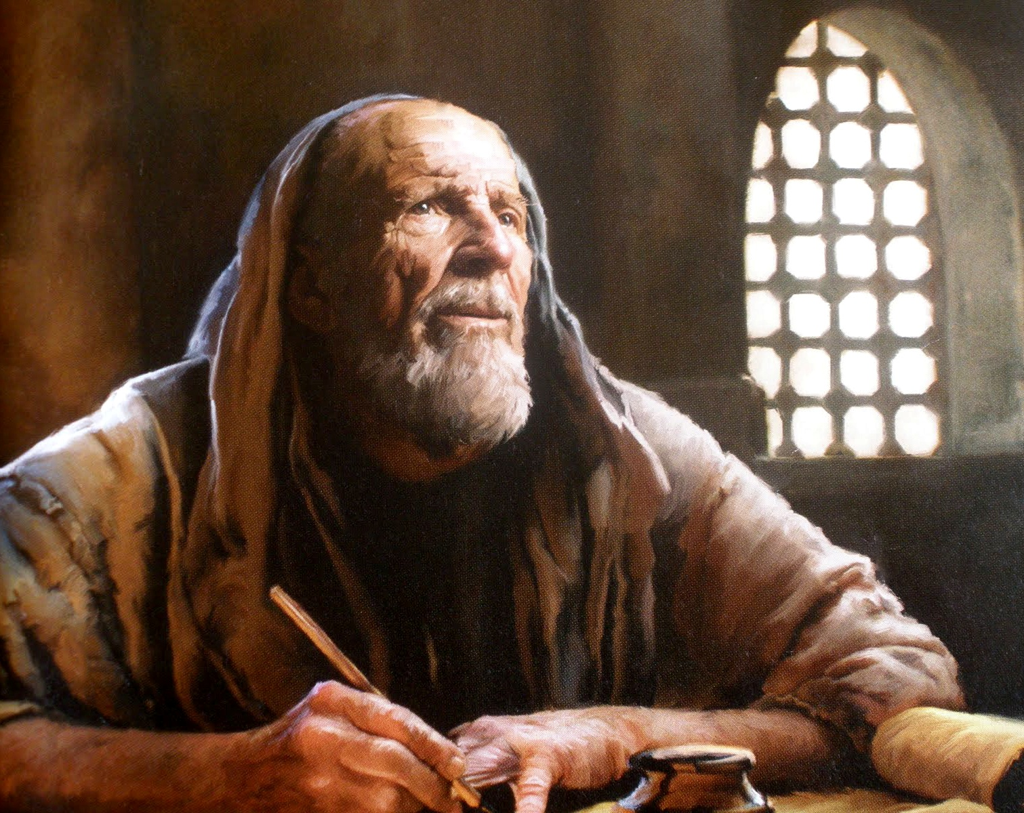

epUgq;fspd; Mrpupau;

Slide 5

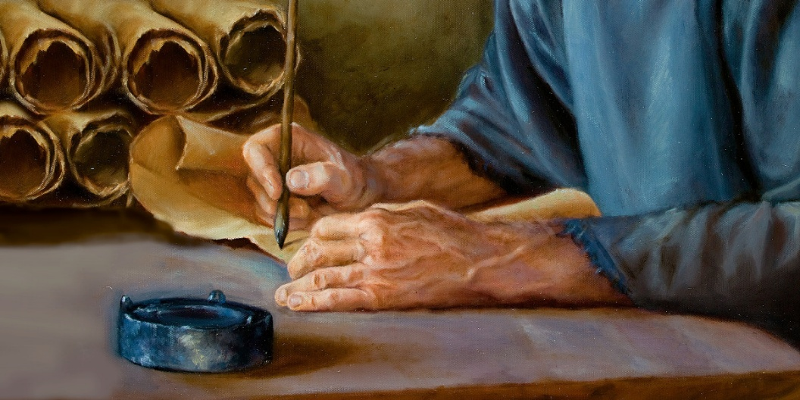
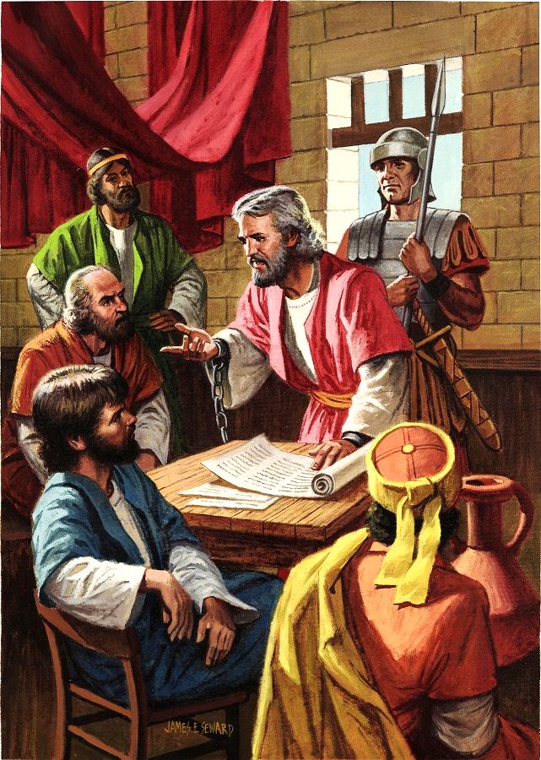
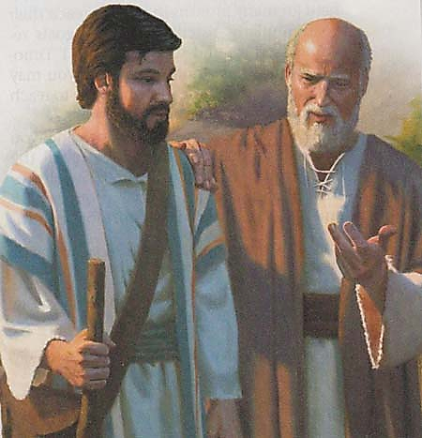
gTy; rpiwapyilf;fg;gl;lhu;
“fpwp];J ,NaRtpdpkpj;jk; fl;lg;gl;ltdhapUf;fpw gTYk;> rNfhjudhfpa jPNkhj;NjAk;> vq;fSf;Fg; gphpaKs;stDk; cld;NtiyahSkhapUf;fpw gpNyNkhDf;Fk;>” (gpNyNkhd; 1:1)
Nuhkpy; jdJ Kjy; rpiwthrj;jpd; NghJ–fp.gp. 60 Kjy; fp.gp. 62 tiu–, gTy; Fiwe;jJ 5 epUgq;fis vOjpdhu;: vNgrpau;, gpypg;gpau;, nfhNyhnrau;, gpNyNkhd;, kw;Wk; yNthjpNfah jpUr;rigf;F (,J ,d;W tiu fpilf;ftpy;iy).
mtu; kPJ fLikahd Fw;wr;rhl;Lfs; vJTk; ,y;yjgbahy;> mtu; xU thlif tPl;by; jq;f mDkjpf;fg;l;lhu;. vg;NghJk; xU Nuhk giltPuupd; fhtypy; ,Ue;jhu;(mg;. 28:16). ,J mtu; njhlu;e;J ew;nra;jpia gpurq;fpf;f mDkjpj;jJ> gpupl;Nlhupad; fhty;gilapdUf;Fk; $l(gpypg;. 1:13).
epUgq;fis Muha;tjd; %yk;> gTYf;F gy xj;Jiog;ghsu;fs; ,Ue;jij ehk; fhzyhk;(nfhNyh. 4:7-14; gpNy. 1:23-24). mtu; rPrupd; tPl;lhuplKk; njhlu;gpy; ,Ue;jhu; (gpypg;. 4:22).
gTy; tpiutpy; tpLjiy ngWthu; vd;W ek;gpapUe;jhu; (gpNy. 1:22), ,uz;lhtJ rpiwthrj;jpd; NghJ mtUf;F ,dp me;j ek;gpf;if ,y;iy (2jPNkh. 4:6).

Slide 6

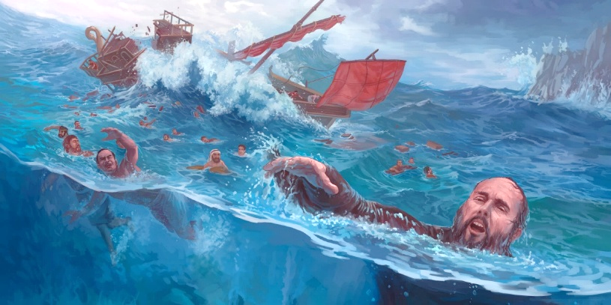
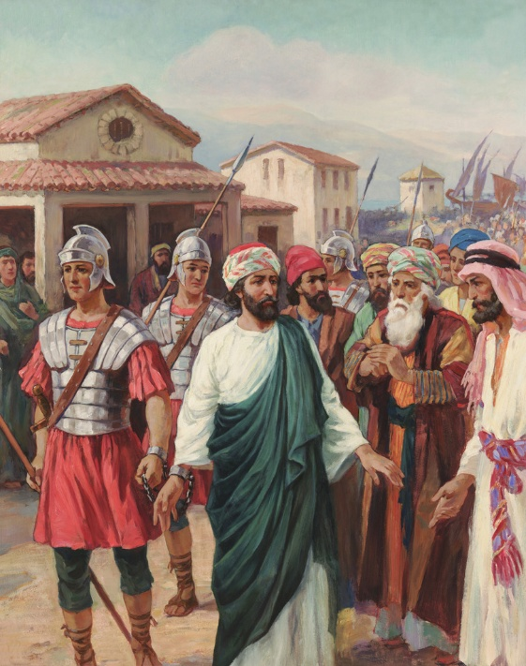
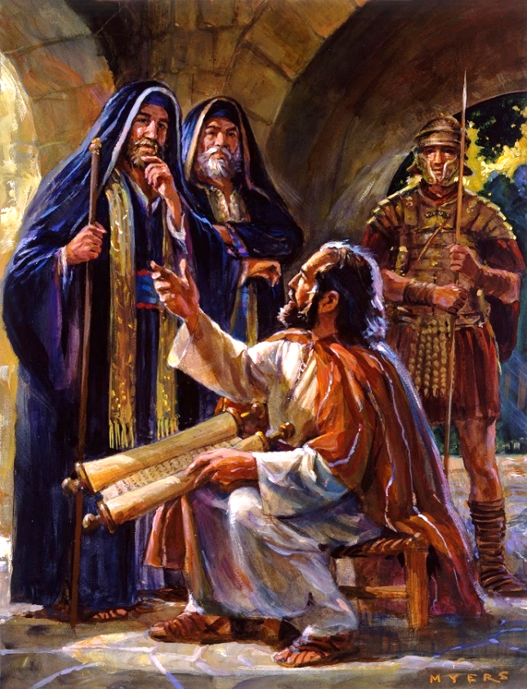

rq;fpypahy; fl;lg;gl;bUf;fpw ];jhdhgjp
“RtpNr\j;jpw;fhfr; rq;fpypahy; fl;lg;gl;bUf;fpw ];jhdhgjpahfpa ehd; mijg;gw;wpg; NgrNtz;bagb ijhpakha;g; Ngrj;jf;fjhf>” (vNgrpau; 6:19)
fpwp];Jtpd; J}juhf ,Uf;f KbT nra;j jUzj;jpypUe;J> gTypd; tho;f;if mt;tsT vspjhf ,y;iy(2nfhup. 6:4-5).
gTy; NuhKf;F nfhz;L nry;yg;gLtjw;F Kd;G %d;W Kiw kl;LNk rpiwapy; milf;fg;gl;ljhf Ntjk; gjpT nra;jpUf;fpwJ: gpypg;gpapy;(mg;. 16:22-24); vUrNykpy; (mg;. 23:10); kw;Wk; nrrupahtpy; (mg;. 23:33-35). Mdhy; epr;rakhf ,d;Dk; gy ,Ue;jd (2nfhup. 11:23).
,e;j vy;yh rpukq;fspYk;> gTy; jd;id xUNghJk; cjtpaw;wtuhf fUjtpy;iy(2nfhup. 4:7-9). Rje;jukhf gpurq;fpf;f Kbahky;, mtu; “rq;fpypahy; fl;lg;gl;bUf;fpw ];jhdhgjpahdhu;” (vNg. 6:19).
RtpNr\j;ij gpurq;fpf;Fk; NghJk; ehk; Jd;gq;fis re;jpf;Fk; NghJk;, ehk; Njtd; kPJ KO ek;gpf;if itf;f Ntz;Lk;, mtUila thu;j;ijia vg;NghJk; kdjpy; nfhs;s Ntz;Lk;; (2jPNkh. 2:15); NkYk;> ekf;F gyj;ijAk; ijupaj;ijAk; mspf;Fk; MWjyspg;gtuhfpa gupRj;j Mtpiag; gw;wpf;nfhs;s Ntz;Lk; vd;gij gTypd; kdg;ghd;ik ekf;F fw;gpf;fpd;wJ (rfup. 4:6).

Slide 7
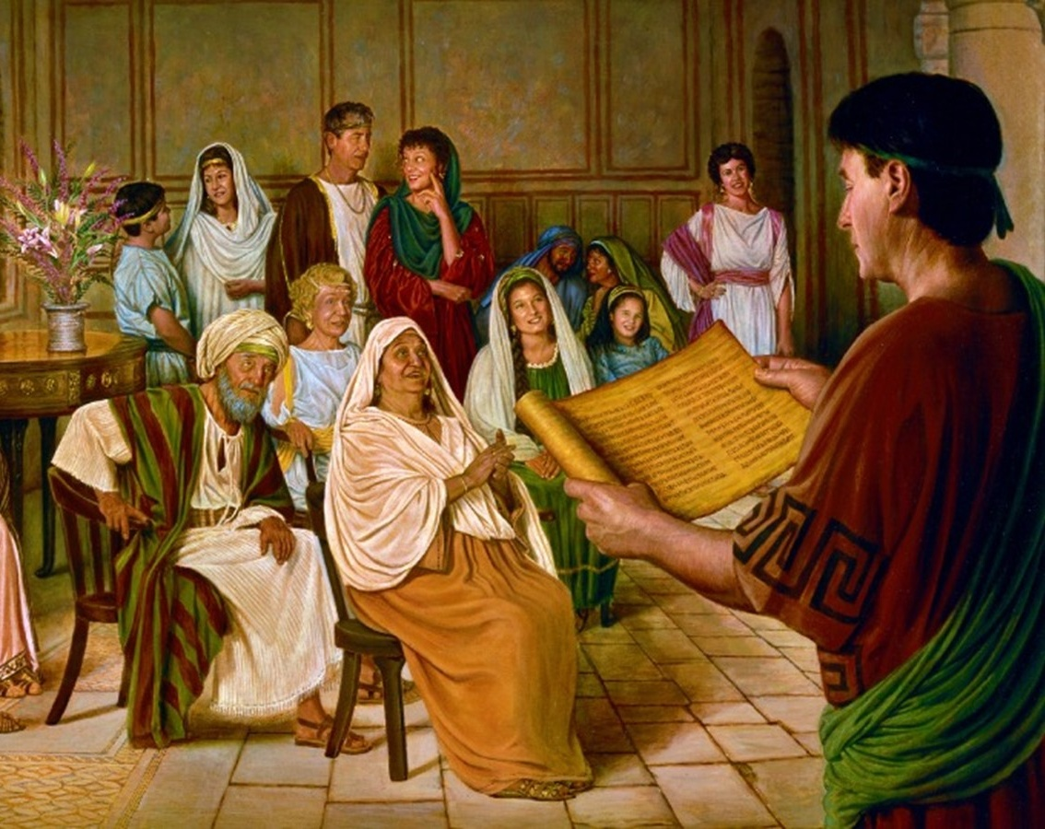

epUgq;fis ngWgtu;fs;

Slide 8

“gTy; mg;Ngh];jyd; jdJ ciog;gpd; %yk; kde;jpUk;gpatu;fSf;F Mo;e;j nghWg;ig czu;e;jhu;. vy;yhtw;wpw;Fk; Nkyhf> mtu;fspd; cz;ikj;jd;ikf;fhf mtu; Vq;fpdhu;, “fpwp];Jtpd; ehspy; ehd; tPzhf xltpy;iy my;yJ ciof;ftpy;iy vd;W ngUik NgRNtd;” gpypg;gpau; 2:6 vd;W mtu; $wpdhu;. jdJ Copaj;jpd; tpisit fz;L mtu; eLq;fpdhu;. jdJ flikia epiwNtw;w jtwpdhy;> Md;khf;fis ,ul;rpf;Fk; gzpapy; jpUr;rig jd;Dld; xj;Jiof;ftpy;iy vd;why;> jdJ nrhe;j ,ul;rpg;G $l Mgj;jpy; ,Uf;ff;$Lk; vd;W mtu; czu;e;jhu;”
vyd;. [p. citl;. (mg;Ngh];jyUila elgbfs;, gf;. 168)

Slide 9

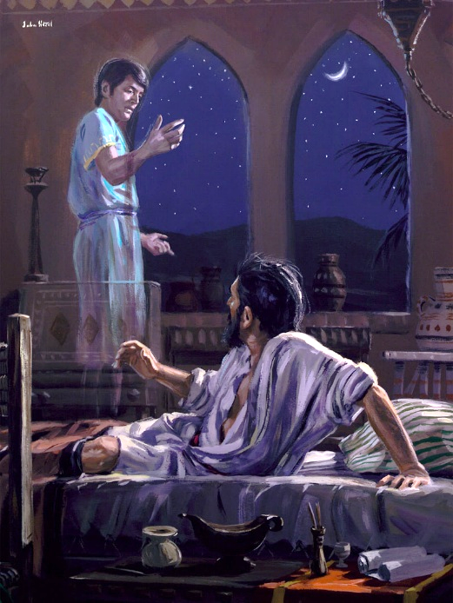
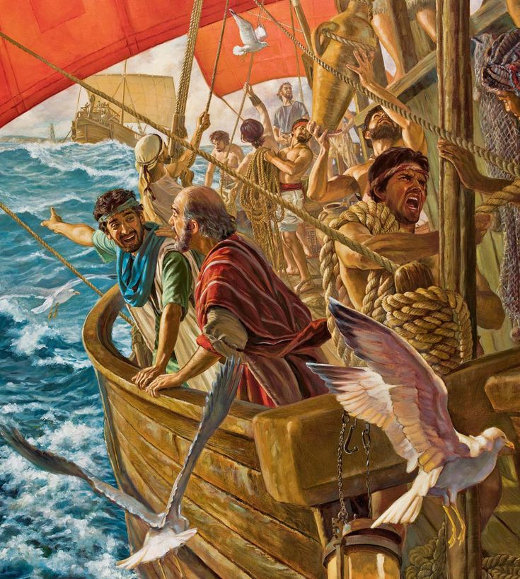
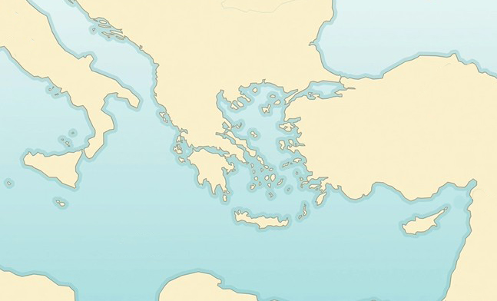

gpypg;gpapd; tuyhW
“mq;Nf ,uhj;jphpapNy gTYf;F xU jhprdk; cz;lhapw;W@ mnjd;dntdpy;> kf;nfNjhdpah Njrj;jhd; xUtd; te;Jepd;W: ePh; kf;nfNjhdpahTf;F te;J vq;fSf;F cjtpnra;a Ntz;Lnkd;W jd;id Ntz;bf;nfhz;ljhf ,Ue;jJ.” (mg; 16:9)
kf;nfhnjhdpah kfhdhk;
gpypg;gp
neahNghyp
gpj;jpdpah
rhNkhj;jpuhf;Nf
X
gTypd; ,uz;lhtJ kp\dup gazj;jpd; NghJ, mtUila jpl;lq;fs; jpUg;gj;ij Vw;g;gLj;jpd. gupRj;j Mtpahdtu; mtUila mbfis topelj;jp nrd;whu; (mg;. 16:6-12):
kPrpah
JNuhth
fyhj;jpah
gpupfpah
gTy; gpupfpahTf;F nrd;whu; (6K)
mq;NfAk; rup fyhj;jpahtpYk; rup mtuhy; gpurq;fpf;f Kbatpy;iy (6gp)
mtu; kPrpahTf;F te;jhu; (7K)
mtu; gpj;jpdpahTf;F nry;y Kad;whu;> Mdhy; mtuhy; Kbatpy;iy (7gp)
mtu; JNuhthTf;F nrd;whu;> mq;F mtUf;F xU juprdk; fpilj;jJ(8-10)
mtu; rhNkhj;jpuhf;Nff;F gazk; nra;jhu;(11K)
mq;fpUe;J neahNghypf;Fk; (11gp)
,Wjpahf mtu; gpypg;gpf;F te;jhu; (12)
mg; 16:6-12
INuhg;ghtpy; ew;nra;jpia gpurq;fpf;f njhlq;f gupRj;j Mtpahy; Nju;e;njLf;fg;gl;l ,lk; gpypg;gp. KO Nuhkhdpa efukhf ,Ue;jjhy;> gpypg;gpau;fs; tup nrYj;JtjpypUe;J tpyf;F mspf;fg;gl;ldu; kw;Wk; gpwg;ghy; Nuhkhdpa FbAupikia ngw;wpUe;jdu;.

Slide 10

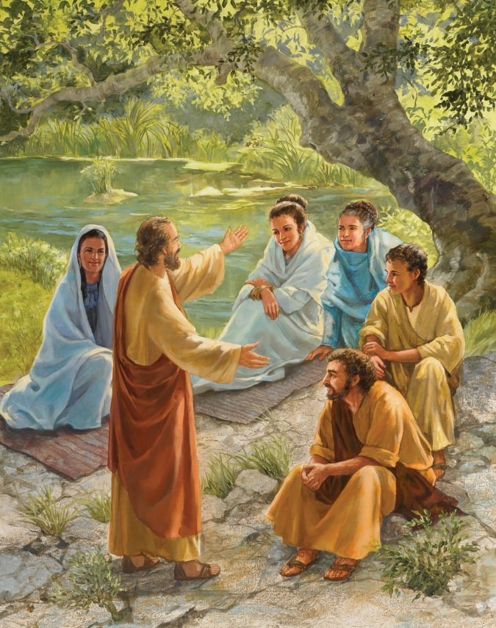
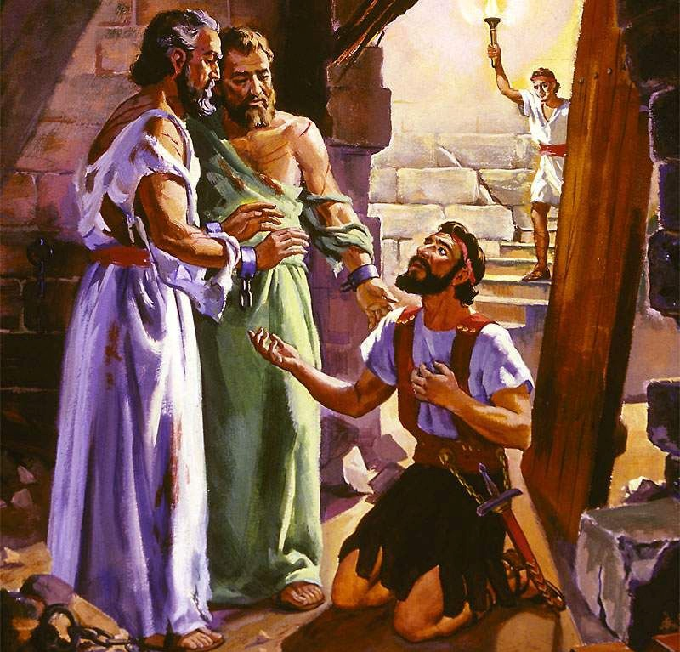
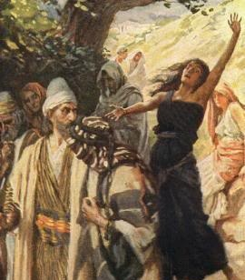
gpypg;gpapd; tuyhW
“mq;Nf ,uhj;jphpapNy gTYf;F xU jhprdk; cz;lhapw;W@ mnjd;dntdpy;> kf;nfNjhdpah Njrj;jhd; xUtd; te;Jepd;W: ePh; kf;nfNjhdpahTf;F te;J vq;fSf;F cjtpnra;a Ntz;Lnkd;W jd;id Ntz;bf;nfhz;ljhf ,Ue;jJ.” (mg; 16:9)
xU Gjpa efuj;jpw;F gTy; te;jTld; n[g Myaj;jpw;F nry;tJ mtUila tof;fk;. Mdhy; gpypg;gpapy; n[g Myak; ,y;iy! Xa;Tehspy; mtu;fs; topghl;Lf;fhd xU ,lj;ij fz;Lgpbj;J> mq;F $bapUe;j ngz;fSf;F gpurq;fpj;jhu;fs; (mg;. 16:13).
,e;j $l;lj;jpypUe;Jjhd; Kjy; INuhg;gpa kjk; khwpa yPjpahs; Njhd;wpdhu;. mtSk; mtSila KO FLk;gKk; Qhd];ehdk; ngw;wdu; (mg;. 16:14-15).
Mdhy; vjpup Rk;kh ,Uf;ftpy;iy. gTiy Mjupg;gJ Nghy; ebj;J kf;fspd; kdij Fog;g xU Fwpnrhy;Yfpw ];jpupia mtd; J}z;bdhd; (mg;. 16:16-17). me;j ngz; tpLtpf;fg;gl;lNghJ> gTYf;Fk; rPyhTf;Fk; gpur;rid njhlq;fpd (mg;. 16:18-24).
tpisT: rpiwr;rhiyf;fhud; kw;Wk; mtuJ FLk;gj;jpdupd; kjkhw;wk; (mg;. 16:25-33). gupRj;j Mtpapd; ty;yikAlDk; topfhl;LjYlDk; ew;nra;jp INuhg;ghtpy; Eioe;jJ vd;gjpy; ve;j re;NjfKk; ,y;iy.

Slide 11

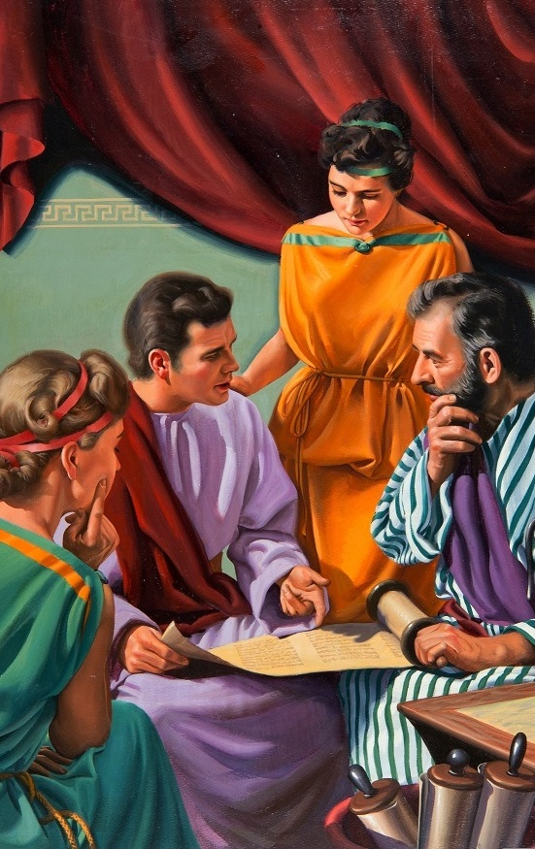
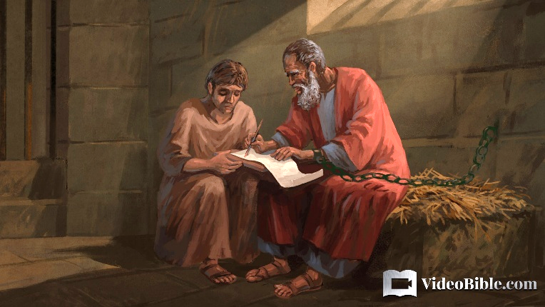
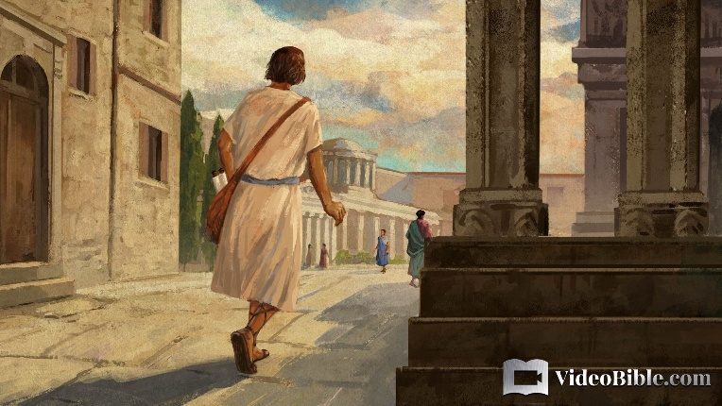
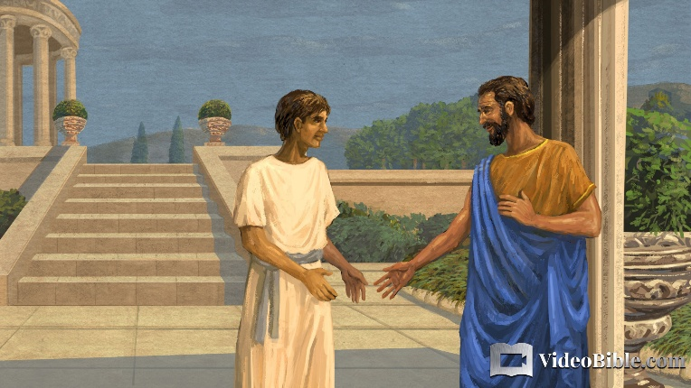
nfhNyhnrapd; tuyhW
“mij vq;fSf;Fg; gphpakhd cld;NtiyahSk;> cq;fSf;fhff; fpwp];Jtpd; cz;ikahd Copaf;fhuDkhapUf;fpw vg;ghg;gpuhtpdplj;jpy; ePq;fs; fw;wwpe;jpUf;fpwPh;fs;@” (nfhNyhnrau; 1:7)
gTy; Nuhkpy; rpiwapy; ,Ue;jNghJ vg;ghg;gpuh mtUila Njhouhf ,Ue;jhu; (gpNy. 1:23). nfhNyhNria Nru;e;j ,tu; (nfhNyh. 4:12), me;j efuj;jpw;F ew;nra;jpia mwpKfg;gLj;jpatu; (nfhNyh. 1:7).
yhNthjpf;Nfah kw;Wk; neahNghypf;F mUfpYs;s gpupfpah khfhzj;jpy; nfhNyhnr xU efukhf ,Ue;jJ> mq;F vg;ghg;gpuhTk; gpurq;fpj;jhu;(nfhNyh. 4:13). mq;F xU ngupa A+j kf;fs; njhif ,Ue;jJ>. mq;F tho;e;j kpf Kf;fpakhd A+ju;fspy; xUtu; gTypd; xj;Jiog;ghsuhd gpNyNkhd; Mthu;> mtUila tPl;by; xU Njthyak; $baJ (gpNy. 1-2).
gpNyNkhdpd; mbikfspy; xUtuhd xNdrpK NuhkhGupf;F xbg;Nghdhu;> mq;F mtu; gTy; %yk; ,NaRit Vw;Wf;nfhz;lhu; (gpyp. 10-11). xNdrpKit jdJ v[khduplk; jpUg;gp mDg;Gtjd; %yk;> v[khdu;fSf;Fk; mbikfSf;Fk; my;yJ Nkyjpfhupfs; kw;Wk; fPo;epiy mjpfhupfSf;Fk; ,ilapyhd cwT vg;gb ,Uf;f Ntz;Lk; vd;gijf; fhl;bdhu; (gpNy. 12-17).

Slide 12

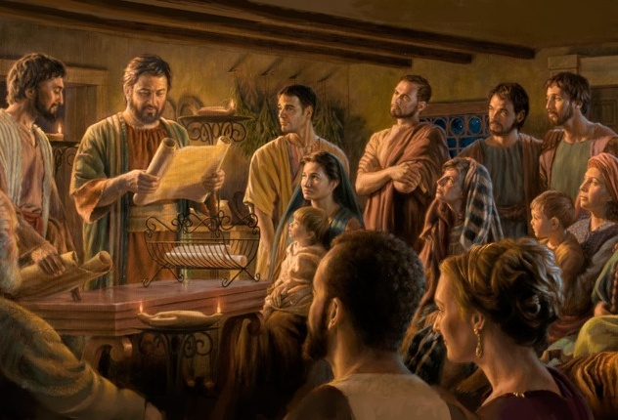
gpypg;gp kw;Wk; nfhNyhnrapd; jpUr;rigfs;
“,NaRfpwp];Jtpd; Copaf;fhuuhfpa gTYk; jPNkhj;NjAk;> gpypg;gp gl;lzj;jpy; fpwp];J ,NaRTf;Fs;shd ghpRj;jthd;fs; midtUf;Fk;> fz;fhzpfSf;Fk;> cjtpf;fhuUf;Fk; vOJfpwjhtJ:” (gpypg;gpau; 1:1)
gpypg;gpau; kw;Wk; nfhNyhnrau; fbjq;fSf;fhd mwpKfq;fs;> kpfTk; xj;jit> ,uz;L Kf;fpakhd mk;rq;fis ekf;F fhl;Lfpd;wd (gpNy. 1:1; nfhNyh. 1:1-2)
NjtDila ghu;itapy;> jpUr;rig cWg;gpdu;fs; jtWfs; nra;jhYk; gupRj;jkhfTk; cz;ikahfTk; ,Uf;fpwhu;fs;
Njthyaj;jpy; xU xOq;F cs;sJ. mjd; cWg;gpdu;fspy; rpyu; kw;wtu;fis tpl mjpf mjpfhuj;ijAk; nghWg;igAk; nfhz;Ls;sdu;:
gTy; xU mg;Ngh];jyd;> xU cau;kl;l jiytu;
jPNkhj;NjA mtUila $l;Lgzpahsu; (Nghjfu;)
Mau;fs; cs;Su; jiytu;fs;(%g;gu;fs;)
cjtpahsu;fs; Myaj;ij epu;tfpf;fpwhu;fs;
gpypg;gpau;fs; jdf;F cjtpajw;fhf rpiwapy; ,Ue;J gTy; mtu;fSf;F ed;wp $Wfpwhu;(gpNy. 4:18).
mtu; jdJ $l;lhspfis nfhNyhnrau;fSf;F MWjy; $w mDg;gfpwhu;(nfhNyh. 4:7-9).

