Slide 1
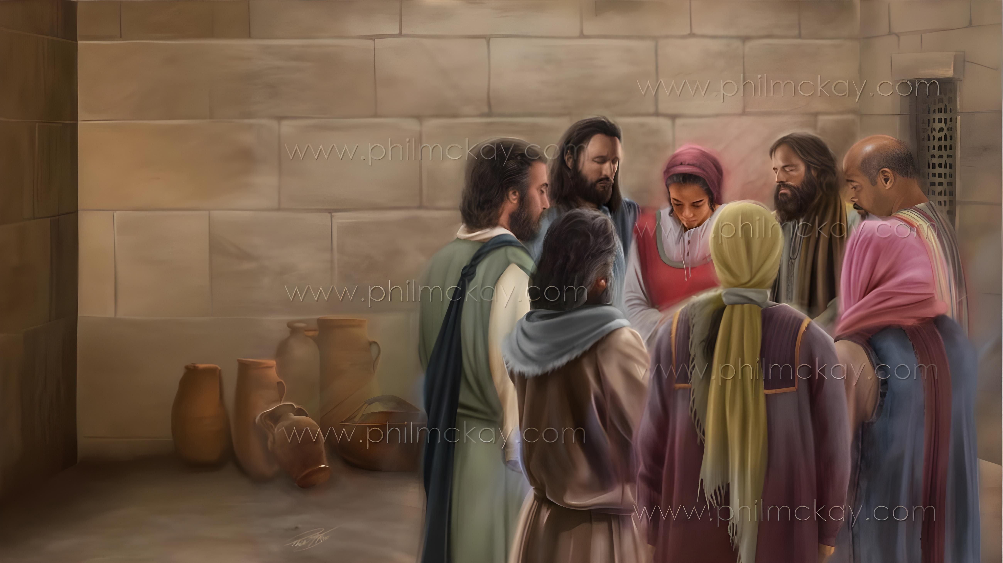
ed;wp nrYj;jTk; n[gpf;fTk; fhuzq;fs;
ghlk; 2 [dtup 10, 2026

Slide 2


“cq;fspy; ew;fphpiaiaj; njhlq;fpdth; mij ,NaRfpwp];Jtpd; ehs; ghpae;jk; Kba elj;jp tUthnud;W ek;gp>”
gpypg;gpau; 1:6

Slide 3

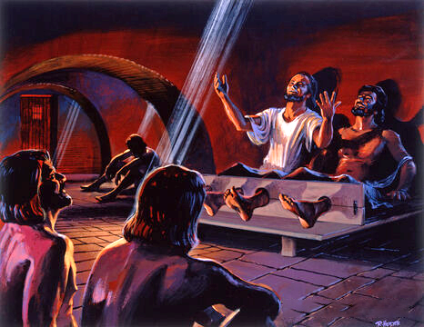
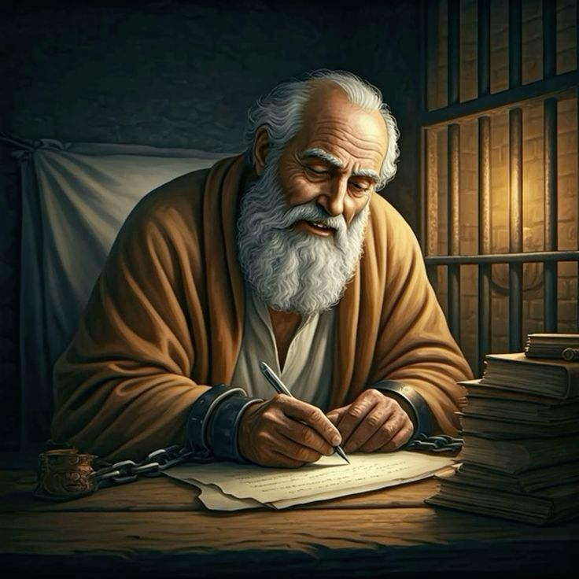







gTYf;F ,J vspjhd fhyq;fs; my;y. jdJ Rje;juj;ij ,oe;jjhy; tpuf;jpapy; %o;FtJ vspjhf ,Ue;jpUf;Fk;.
,Ug;gpDk;, gpypg;gp efu rpiwapy; Jjpghly;fis ghbaijg; Nghy, gpypg;gpapYk; nfhNyhnrapYk; cs;s jdJ rNfhju rNfhjupfSf;F ed;wp njuptpf;f gTy; fhuzq;fis fz;lhu;.
mtuJ rpiwthrk; mtuJ je;ijAld; njhlu;e;J njhlu;G nfhs;tjpypUe;Jk;> n[gj;jpd; %yk; kw;wtu;fSf;fhf gupe;J NgRtjpypUe;Jk; mtiu jLf;ftpy;iy.
gpypg;gpau;fSf;F vOjpa fbjj;jpy; ed;wp nrYj;Jtjw;Fk; n[gpg;gjw;Fk; fhuzq;fs;:
ed;wpAld; ,Ug;gjw;F fhuzq;fs; (gpypg;gpau; 1:3-8)
n[gf; Fwpg;Gfs; (gpypg;gpau; 1:9-11)
fbdkhd fhyq;fspy; ed;wp nrYj;Jjy; kw;Wk; n[gpj;jy; (gpypg;gpau; 1:12-18)
nfhNyhnrau;fSf;F vOjpa fbjj;jpy; ed;wp nrYj;Jtjw;Fk; n[gpg;gjw;Fk; fhuzq;fs;:
ed;wpAld; ,Ug;gjw;F fhuzq;fs; (nfhNyhnrau; 1:3-8)
n[gf;Fwpg;Gfs; (nfhNyhnrau; 1:9-12)

Slide 4
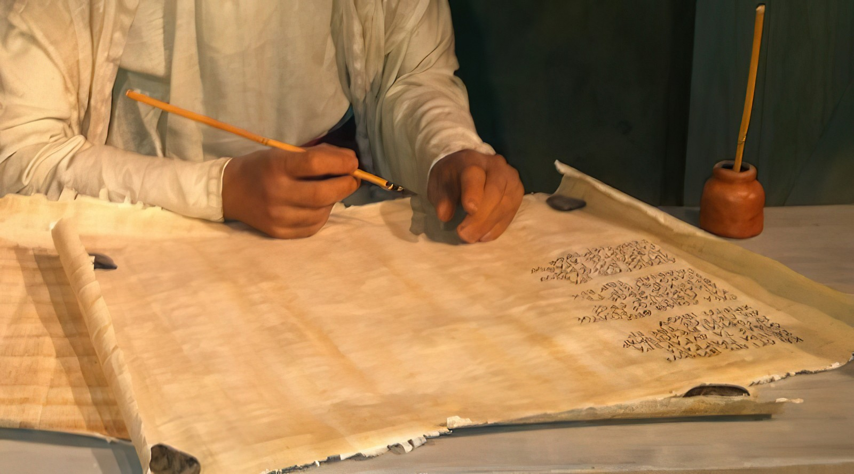
gpypg;gpau;fSf;F vOjpa fbjj;jpy; ed;wp nrYj;Jtjw;Fk; n[gpg;gjw;Fk; fhuzq;fs;

Slide 5

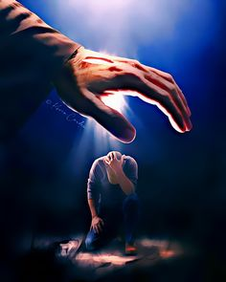
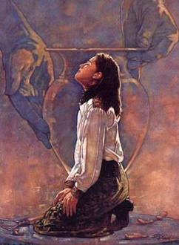
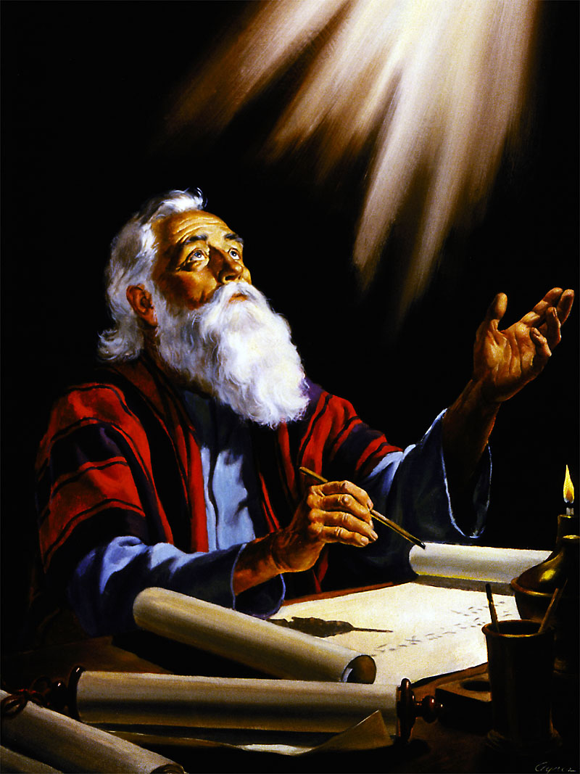
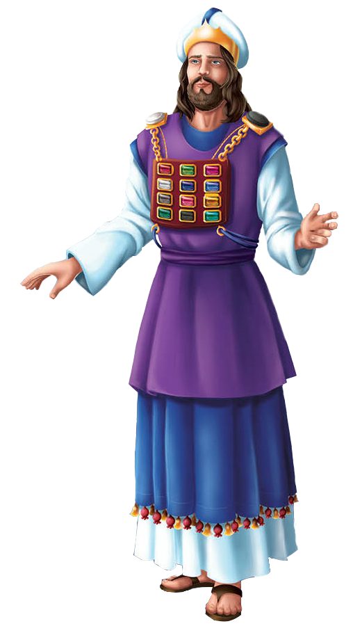
ed;wpAld; ,Ug;gjw;F fhuzq;fs;
“cq;fspy; ew;fphpiaiaj; njhlq;fpdth; mij ,NaRfpwp];Jtpd; ehs; ghpae;jk; Kba elj;jptUthnud;W ek;gp>” (gpypg;gpau; 1:5)
gpypg;gpapYs;s, jhd; kpfTk; Nerpj;j (gpypg;. 1:8) tpRthrpfSf;fhf NjtDf;F ed;wp nrYj;jp gTy; jdJ fbjj;ij njhlq;Ffpwhu;(gpypg;. 1:3).
gpujhd Mrhupad; NjtDf;F Kd;ghf epw;Fk;NghJ, ,];uNty; Nfhj;jpuq;fspd; ngau;fs; ,uj;jpd fw;fspy; nghwpf;fg;gl;bUe;jd, gpujhd Mrhupad; jdJ khu;Gf; ftrj;jpy;> ,Ujaj;jpw;F mUfpy; mzpe;jpUe;jij Nghy, gTYk; NjtDf;F Kd;ghf epw;Fk;NghJ> mtu;fSf;fhf gupe;JNgRk;gb jpUr;rigapd; xt;nthU cWg;gpdiuAk; “jd; ,Ujaj;jpy;” Rke;J nrd;whu; (gpypg;. 1:7).
gpypg;gpau;fs; RtpNr\j;jpw;F cz;ikAs;stu;fshf ,Ue;jhu;fs; vd;gijAk;> Njtd; mtu;fis xt;nthU ehSk; G+uzgLj;jpf; nfhz;bUe;jhu; vd;gijAk; mtu; ed;wpAzu;Tld; Fwpg;gpl;bUe;jhu; (gpypg;. 1:5-6).
ed;wpAzu;tpw;fhd %d;whtJ fhuzk;> gpypg;gpau;fs; “vd; fl;LfspYk;> ehd; RtpNr\j;jpw;fhf cj;juTnrhy;yp mijj; jplg;gLj;jptUfpwjpYk;>” (gpypg;. 1:7) mtUld; gfpu;e;J nfhz;ldu;.

Slide 6


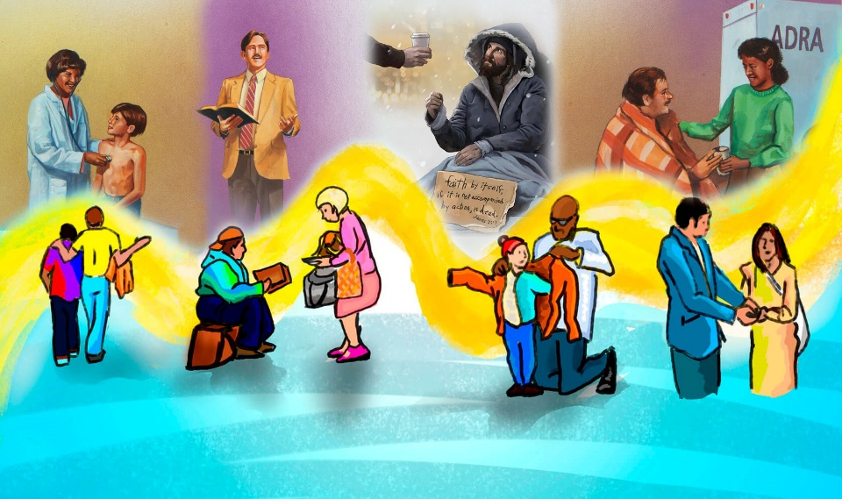
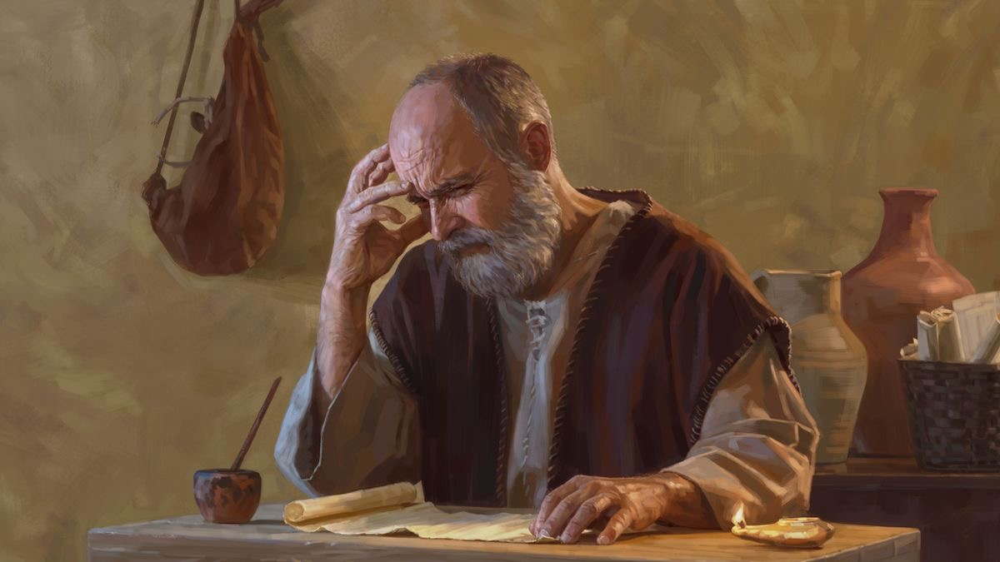
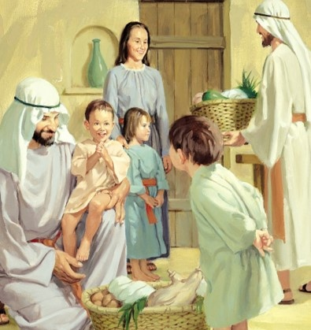
n[gf;Fwpg;Gfs;
“NkYk;> cj;jkkhditfis ePq;fs; xg;Gf;nfhs;sj;jf;fjhf cq;fs; md;ghdJ mwptpYk; vy;yh czh;tpYk; ,d;Dk; mjpfkjpfkha;g; ngUfTk;> NjtDf;F kfpikAk; JjpAk; cz;lhFk;gb ,NaRfpwp];Jtpdhy; tUfpw ePjpapd; fdpfshy; epiwe;jth;fshfp> ePq;fs; fpwp];Jtpd; ehSf;nfd;W Jg;guthdth;fSk; ,lwyw;wth;fSkhapUf;fTk; Ntz;Ljy;nra;fpNwd;.” (gpypg;gpau; 1:9-11)
gTypd; n[g ce;Jjiy xU “rq;fpypahy; gpizf;fg;gl;l fhuzk;” vd;W ehk; fUjyhk;(gpypg;. 1:9-11):
cq;fspy; md;G ngUfl;Lk;
mJ cq;fis Qhdpahf;Fk;
ePq;fs; rpwe;jij fhz;gPu;fs;
ePq;fs; gupRj;jkhfTk; cj;jkkhfTk; ,Ug;gPu;fs;
ePq;fs; ,NaR fpwp];Jtpd; %yk; fdp nfhLg;gPu;fs;
,J NjtDf;F kfpikiaAk; JjpiaAk; cz;lhf;Fk;
ek; md;G vg;gb “,d;Dk; NkYk; NkYk; ngUf” KbAk;? fpwp];jt tho;f;iff;F mJ Vd; kpfTk; Kf;fpakhdJ?

Slide 7
fbdkhd fhyq;fspy; ed;wp nrYj;Jjy; kw;Wk; n[gpj;jy;

Slide 8


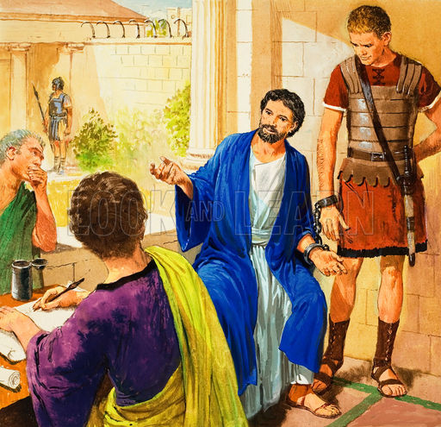
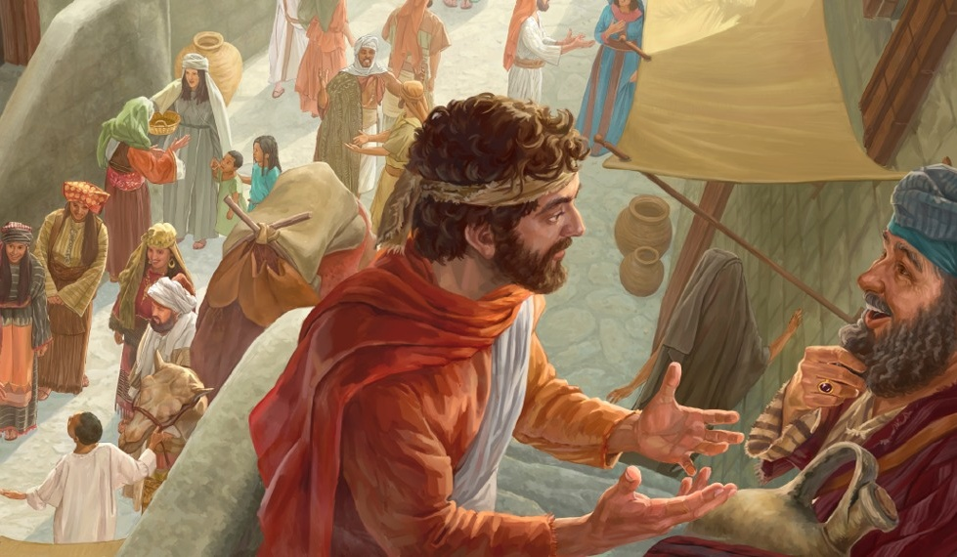
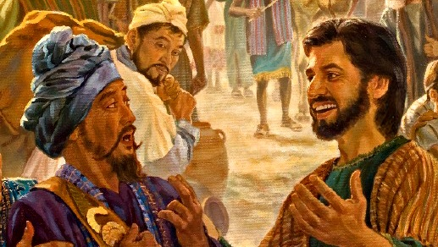
ew;nra;jpf;fhf epw;f xU tha;g;G
“rNfhjuNu> vdf;Fr; rk;gtpj;jitfs; RtpNr\k; gpugykhFk;gbf;F VJthapw;nwd;W ePq;fs; mwpa kdjhapUf;fpNwd;.”(gpypg;gpau; 1:12)
gTy; Nuhkpy; rpiwapy; milf;fg;gl;bUg;gij gpypg;gpau; mwpe;jNghJ> mtu;fs; kpfTk; tUj;jkile;J> mg;Ngh];jyUf;F cjtp nra;a vg;ghgpuhj;Jit mDg;gpdhu;fs;(gpypg;. 4:18).
gTy; tUj;jg;gLtjw;F gjpyhf, jhd; rpiwapyilf;fg;gl;ljw;fhf NjtDf;F ed;wp nrYj;jpdhu;. Vd; ed;wp nrYj;j Ntz;Lk;? Vndd;why; ,e;j topapy; mtu; ahiuahtJ gpurq;fpf;f Kbe;jJ> ,y;iynadpy;> mtu; xUNghJk; nrd;wila KbahJ (gpypg;. 1:13).
NkYk;, mg;Ngh];jyupd; kdg;ghd;ikiaf; fz;L kw;w cz;ikAs;s rNfhjuu;fs; Cf;ftpf;fg;gl;L, rk;ke;jg;gl;l rpukq;fis nghUl;gLj;jhky;, ew;nra;jpia gpurq;fpf;f njhlq;fpdu;(gpypg;. 1:14).
kw;wtu;fs;, RtpNr\j;ij gw;wp ntspg;gilahf NgRtJ rpukq;fis nfhz;L tUk; vd;W epidj;J> mij - jw;nrayhf – gug;gTk; tpUk;gpdhu;fs; (gpypg;. 1:15-18).

Slide 9
nfhNyhnrau;fSf;F vOjpa fbjj;jpy; ed;wp nrYj;Jtjw;Fk; n[gpg;gjw;Fk; fhuzq;fs;

Slide 10


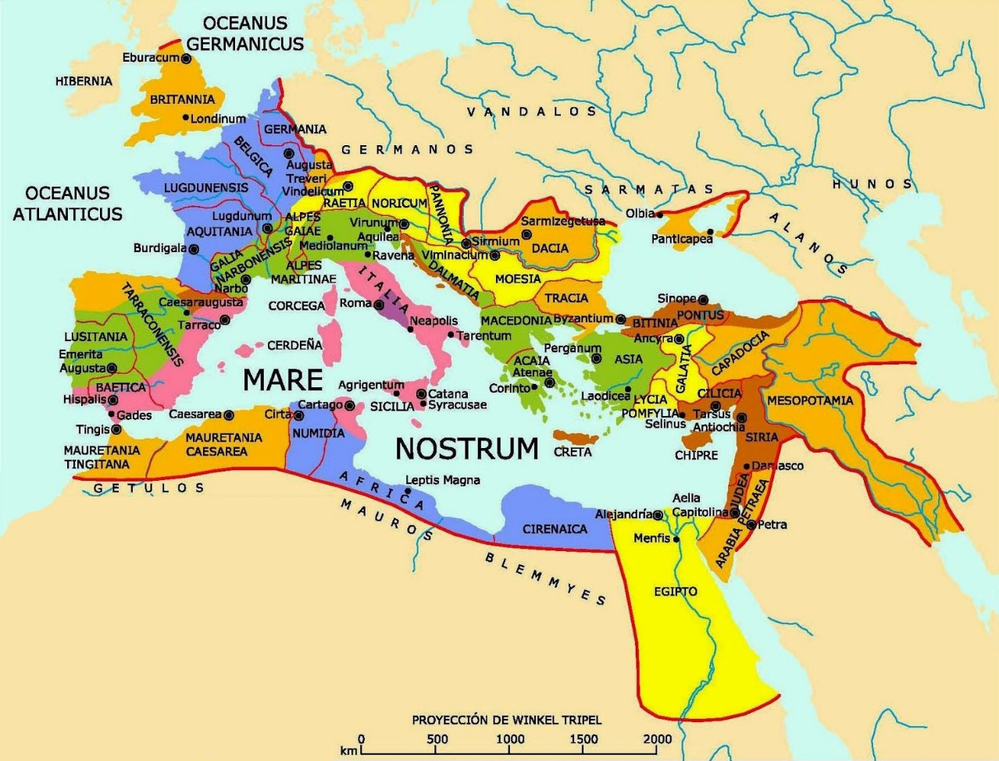
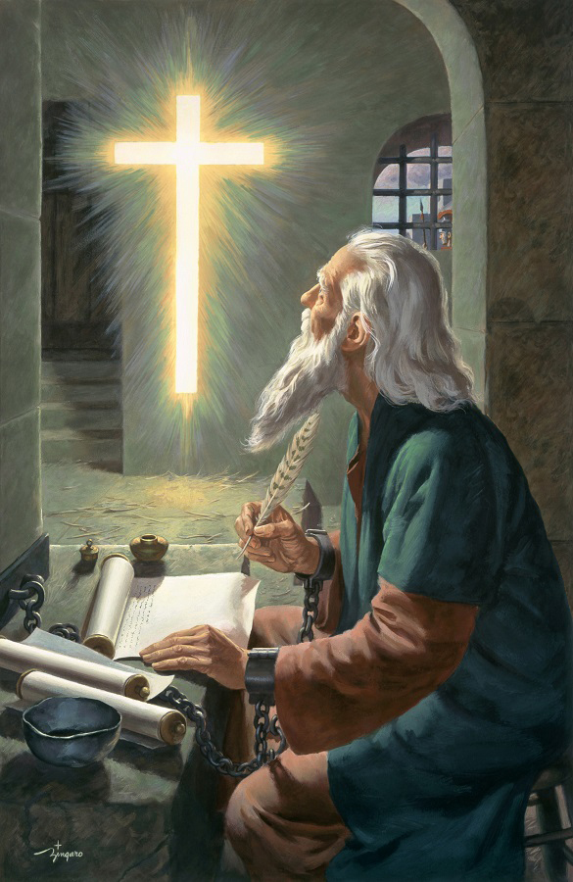

ed;wpAld; ,Uf;f fhuzq;fs;
“fpwp];J ,NaRtpd;NkYs;s cq;fs; tpRthrj;ijAk;> ghpRj;jthd;fnsy;yhh;NkYKs;s cq;fs; md;igAq;Fwpj;J ehq;fs; Nfs;tpg;gl;L>” (nfhNyhnrau; 1:3)
1 nfhhupe;jpau; 13:13d; thu;j;ijfis vjpuhypf;Fk; gTy;> nfhNyhnrau;fsplk; ,e;j %d;W fpwp];jt ew;gz;Gfs; ,Ug;gjhy; NjtDf;F ed;wp $Wfpwhu;: tpRthrk;> ek;gpf;if kw;Wk; md;G(nfhNyh. 1:4-5).
,e;j ew;gz;Gfs; “fpwp];J ,NaRtpy;” vOfpd;wd, “midj;J gupRj;jthd;fSlDk;” ekJ cwit ghjpf;fpd;wd, NkYk; RtpN\rj;jpd; cz;ikahd thu;j;ij %yk; ekf;F flj;jg;gLfpd;wd.
,e;j RtpNr\k; nfhNyhnraUf;F kl;Lky;y, “cyfnkq;Fk;” (nfhNyh. 1:6)... ntWk; 30 Mz;Lfspy; gpurq;fpf;fg;gl;lJ vd;gij gTy; typAWj;Jfpwhu;!
gupRj;j Mtpapd; fpupiaahy; RtpNr\j;jpd; %yk; guTk; NjtDila ty;yik, Ntjhfkj;ij, “[Pt thu;j;ijahf” Mf;FfpwJ (gpypg;. 2:16). ,jd; nghUs;> RtpNr\j;ij Vw;Wf;nfhs;tjd; %yk;> ehk; epj;jpa [PtidAk; “guNyhfj;jpy; cq;fSf;fhf Nrkpj;J itf;fg;gl;l” xU Rje;juj;ijAk; ngWfpNwhk; (nfhNyh. 1:5).

Slide 11



n[gf;Fwpg;Gfs;
“,jpdpkpj;jk;> ehq;fs; mijf; Nfl;l ehs;Kjy; cq;fSf;fhf ,iltplhky; n[gk;gz;ZfpNwhk;@ ePq;fs; vy;yh Qhdj;NjhLk;> Mtpf;Fhpa tpNtfj;NjhLk; mtUila rpj;jj;ij mwpfpw mwptpdhNy epug;gg;glTk;>” (nfhNyhnrau; 1:9)
gTypd; n[g Ntz;LNfhspy; nfhNyhnraUf;F gy ey;y tp\aq;fs; cs;sd(nfhNyh. 1:9-11):
mtu;fs; Njtidg; gw;wpa mwpit ngwl;Lk;> mJ mtu;fSf;F Qhdj;ijAk; Md;kPf GupjiyAk; jUk;
NjtDila gps;isfshf tho;e;J> vy;yh tifapYk; mtiu gpupag;gLj;Jq;fs;
mtu;fs; fdp je;J mwptpy; tsul;Lk;
mtu;fs; nghWikahf ,Uf;Fk;gb NjtDila ty;yikahy; gyg;gLj;jg;gLthu;fshf
,e;j n[gk; “gpjhTf;F kfpo;r;rpahd ed;wp nrYj;Jtjhf” nra;ag;gLfpwJ (nfhNyh. 1:12).
gTypd; n[gj;ij ek;kpy; cz;ikahf;f Njtd; nray;gLk; 4 topfs; cs;sd:
Ntjhfkk; (rq;fPjk; 119:105)
vyd; [p citl; My; ntspg;gLj;jg;gl;l, jPu;f;fjuprd Mtp (ntsp. 19:10)
NjtDila nja;tPf topelj;Jjy; (nfhNyh. 4:3)
gupRj;j Mtpahdtu; (Vrh. 30:21)

