Slide 1
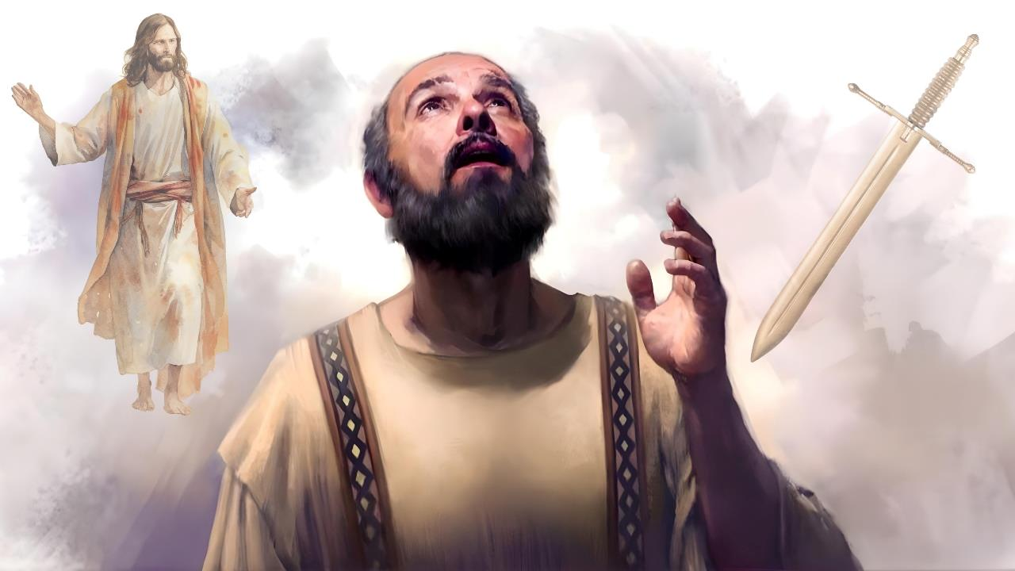
[PtDk; kuzKk;
ghlk; 3 [dtup 17,2026

Slide 2

“fpwp];J vdf;F [Ptd;> rhT vdf;F Mjhak;.”
gpypg;gpau; 1:21

Slide 3


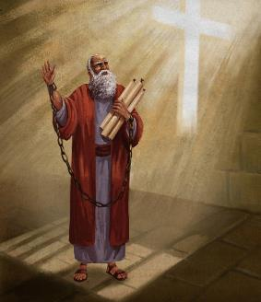


,uf;fkpy;yhj ePNuhthy; epahae;jPu;f;fg;gLk;gb gTy; fhj;jpUf;fpwhu;. mtUila vjpu;fhyk; ePjpia rhu;e;J my;y> rPrupd; vz;znthl;lq;fis nghWj;Nj ,Ue;jJ.
Mdhy; mtUf;F njupAk; cz;ikapNyNa jd;Dila KbT ePNuhtpd; iffspy; my;y, NjtDila fuj;jpypUf;fpwJ vd;W. MfNt, rigfspy; jdf;fhf VNwLf;fg;Lk; n[gq;fspdhy; jhd; tpLjiyahNtd; vd;W mtu; cWjpahf ,Ue;jhu;.
vd;whYk;, RtpN\rj;jpw;fhf mtu; kupf;f Neu;e;jhYk; (mjw;fhf jhd; mtUila rpiwapUg;G), fpwp];JTf;fhf jd; [Ptid nfhLg;gjw;Fk; mtu; tpUg;gkhf ,Ue;jhu;.
fpwp];JTf;fhf tho;tjh my;yJ kupg;gjh?
gTYf;Fs; fpwp];J cau;j;jg;gl;lhu; (gpypg; 1:10-20, 25-26)
fpwp];Tf;fhf tho;tJ my;yJ kupg;gJ (gpypg; 1:21-22)
gTypd; ,UNtWghL (gpypg; 1:23-24)
fpwp];JTf;fhf tho;tJ vd;why; vd;d mu;j;jk;?
RtpNr\j;jpw;F ghj;jpuuhf ele;Jnfhs;Sjy; (gpypg; 1:27gp)
RtpNr\j;jpw;fhf ,ize;J NghuhLjy; (gpypg; 1:27K-30)

Slide 4

fpwp];JTf;fhf tho;tjh kupg;gjh?

Slide 5



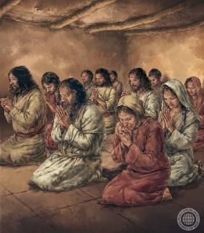
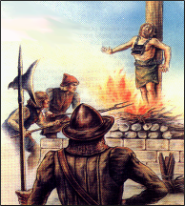
gTYf;Fs; fpwp];J cau;j;jg;gLfpwhu;
“ehd; xd;wpYk; ntl;fg;gl;Lg;Nghfhky;> vg;nghOJk;Nghy ,g;nghOJk;> kpFe;j ijhpaj;NjhNl [PtdhyhfpYk;> rhtpdhyhfpYk;> fpwp];J vd; rhPuj;jpdhNy kfpikg;gLthnud;W vdf;F cz;lhapUf;fpw thQ;irf;Fk; ek;gpf;iff;Fk; jf;fjha;> mg;gb KbAk;.” (gpypg;gpau; 1:20)
mtu; mile;j gy ghLfspdpkpj;jk; gTy; re;Njh\g;gl;lhu;(nfhNyh. 1:24K; 2 nfhup. 11:23-27). Mk;, ghLgLk;NghJ khj;jpuk; mtu; re;Njh\g;gltpy;iy, jhd; mile;j me;j ,f;fl;Lfspd; fhuzq;fSf;fhfTk; mtu; re;Njh\g;gl;lhu;, Vndd;why; mitfspd; xd;wpdhy; fpwp];Jtpd; rigf;F gyd; fpilj;jJ (nfhNyh. 1:24gp;2 nfhup. 11:28).
mtUila ghLfspYk; kuzj;jpYk;—gTy; fpwp];JitNa gpujpgypj;jhu;—MfNt fpwp];J gTYf;Fs; cau;j;jg;gl;lhu;(gpypg;. 1:20).
gpypg;gpaUf;F vOjpd epUgj;jpy;, gTy; mij njspTg;gLj;Jfpwhu;, me;j jUzj;jpy;, jd;Dila kuzj;jpdhy; fpwp];Jit cau;j;j mtu; vjpu;ghu;f;ftpy;iy, Mdhy;, rigapd; n[gq;fspdhYk; gupRj;j Mtpahdtupd; fpupiaapdhYk;, tpLjiyahf;fg;gl;L jd; [Ptidf; nfhz;L fpwp];JTf;fhf jhd; Copak; nra;ag;Nghtjhf mtu; ek;gpdhu;(gpypg;. 1:19, 25-26).
ek; cyfpy; epyTk; jPikapd; fhuzkhf, fpwp];J tho;e;jJ Nghy; ehk; tho;tJ vd;gJ ngUk;ghYk; fpwp];J mDgtpj;jJ Nghy; Jd;gg;gLtijAk;, rpy rkaq;fspy;, fpwp];J kupj;jJ Nghy; kupg;gijAk; cs;slf;fpaJ (2 jPNkh. 3:12).

Slide 6



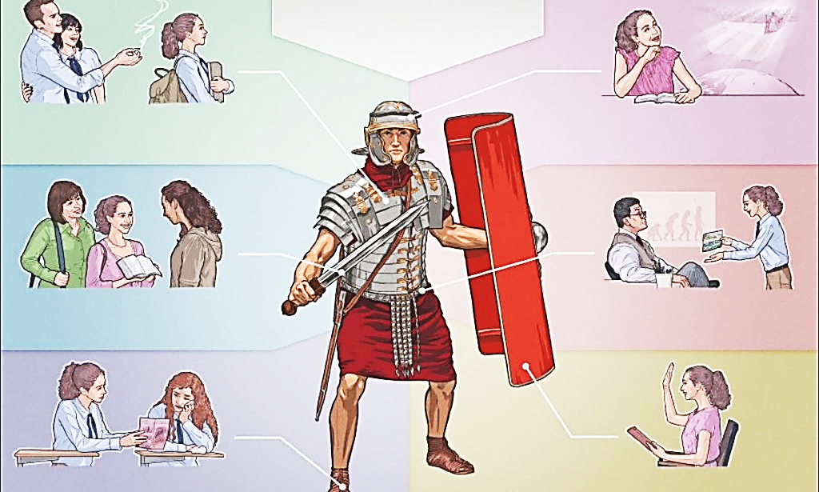

fpwp];JTf;fhf tho;tJ my;yJ kupg;gJ
“fpwp];J vdf;F [Ptd;> rhT vdf;F Mjhak;..” (gpypg;gpau; 1:21)
vy;yh Jd;gq;fSf;Fkhd %y fhuzk;> ed;ikf;Fk; jPikf;Fk; ,ilapy;> fpwp];JTf;Fk; rhj;jhDf;Fk; ,ilapy; ,d;W eljjg;gLk; gpugQ;r Nghupy; cs;sJ.
,J xU Md;kPfg; Nghu;, ,J Md;kPf MAjq;fis nfhz;L Nghuhlgl Ntz;Lk;. vjpupapd; rPlu;fs; fpwp];jtu;fSf;F vjpuhf rl;ltpNuhjkhd MAjq;fis gad;gLj;Jfpwhu;fs; (ngha;fs;, tpku;rdk;, rfhf;fspd; mOj;jk;, Nghd;wit.).
Mdhy; ehk; cz;ik> ePjp Nghd;w MAjq;fis gad;gLj;JfpNwhk; (2 nfhup. 6:4-7). “muz;fis ,bj;J js;sf;$ba” typikkpf;f MAjq;fs; (2 nfhup. 10:3-5).
Mdhy; Nghupy; ePjpkhd;fs; kupj;Jtpl;lhy; vd;d elf;Fk;? gTypd; $w;Wg;gb> ,J ekf;F xU Mjhaj;jpy; KbfpwJ (gpypg;. 1:21).
fpwp];JTf;F cz;ikAs;stu;fshf ,Uf;fpw ekf;F> kuzk; ek;ik vjpupapd; iff;F vl;lhjgbf;F nfhz;L nrd;W> vy;yh Jd;gq;fspypUe;Jk; ek;ik tpLtpf;fpwJ (ePjp. 14:32; Vrh. 57:1).

Slide 7



gTypd; ,UNtWghL
“MfpYk; rhPuj;jpy; gpioj;jpUf;fpwjpdhNy vd; fphpiaf;Fg; gyDz;lhapUg;gjhy;> ehd; njhpe;Jnfhs;sNtz;baJ ,d;dnjd;W mwpNad;. Vnddpy; ,t;tpuz;bdhYk; ehd; neUf;fg;gLfpNwd;@ Njfj;ijtpl;Lg; gphpe;J> fpwp];JTlNd$l ,Uf;f vdf;F MirAz;L> mJ mjpf ed;ikahapUf;Fk;@.” (gpypg;gpau; 1:23-24)
mtuhy; KbntLf;fKbahtpl;lhYk;, gTy; ,uz;L rhj;jpaf;$WfSf;F ,ilapy; rpf;fpnfhs;fpwhu; (gpypg;. 1:23-24):
Njfj;ij tpl;L gpupjy;
fpwp];JTlNd ,Uj;jy;
ruPuj;jpy; gpioj;jpUj;jy;
rigf;F gpuNahdkhapUf;Fk;
,e;j trdj;ij jdpj;jdpahf vLj;Jf;nfhz;lhy;> ehk; ,we;jTld; ,NaRNthL ,Uf;f guNyhfj;jpw;F VWfpNwhk; vd;W gTy; ekf;F fw;gpf;fpwhu;. ,J Ntj gFjpfSf;F KuzhdJ vd;W ehk; Cfpf;fyhk;(gpu. 9:5; rq;. 6:5).
gpypg;gpaUf;F vOjpa mNj fbjj;jpy;> fpwp];JNthL KOikahf ,Uf;f> capu;njOjypd; jUzj;jpw;fhf fhj;jpUf;f Ntz;Lk; vd;W mtu; $Wfpwhu; (gpypg;. 3:8-11).
kw;nwhU re;ju;g;gj;jpy;> gTy; cly; mopahikia mzptjw;fhf mopf;fg;gl;l(kupf;Fk;) xU $lhuj;Jld; xg;gpLfpwhu;(2 nfhup 5:1-4). ,Ug;gpDk; ,e;j Mil ,uz;lhk; tUifapd; NghJ epfo;fpwJ> kuzj;jpd; NghJ my;y vd;gij mtu; njspTg;gLj;Jfpwhu; (1 nfhup. 15:42, 51-54).

Slide 8

fpwp];JTf;fhf tho;tJ vd;why; vd;d mu;j;jk;?

Slide 9


RtpNr\j;jpw;F ghj;jpuuhf ele;Jnfhs;Sjy;
“… vt;tpjj;jpYk; ePq;fs; fpwp];Jtpd; RtpNr\j;jpw;Fg; ghj;jpuuhf khj;jpuk; ele;Jnfhs;Sq;fs;.” (gpypg;gpau; 1:27gp)
“cq;fs; elj;ij” vd;w nrhw;nwhlu; fpNuf;f thu;j;ijahd nghypNahLik vd;gjd; nkhopngau;g;ghFk;> ,jd; nghUs; “Fbkf;fshf tho;tJ”. gpypg;gpau;fSk; (ehk; midtUk;) guNyhf Fbkf;fSf;F ghj;jpukhd Kiwapy; ele;J nfhs;s Ntz;Lk; vd;W gTy; typWj;Jfpwhu; (gpypg; . 3:20).
Mtpapy; vspikAs;stu;fs;
rhe;jFzKs;stu;fs;
ePjpapd; Nky; grpjhfk; cs;stu;fs;
,uf;fKs;stu;fs;
,Ujaj;jpy; Rj;jKs;stu;fs;
rkhjhdk; gz;Zfpwtu;fs;
kW fd;dj;ij fhl;l kdJs;stu;fs;
rj;JUf;fis rpNefpg;gtu;fs;
jd;id rgpg;gtu;fis MrPu;tjpg;gtu;fs;
jd;id gifg;gtu;fSf;F ed;ik nra;gtu;fs;
md;ghfTk; G+uz rw;FzuhfTk; ,Ug;gtu;fs;
jho;ikahfTk; ,uf;fkhfTk; ,Ug;gtu;fs;
Nghd;Nwhu;.
kiy gpurq;fj;jpy;> guNyhf Fbkf;fs; vt;thW tho Ntz;Lk; vd;gij ,NaR ekf;F fw;W nfhLj;jhu;.
,ij gpd;tUkhW RUf;fkhf $wyhk;: “epahaQ; nra;J> ,uf;fj;ijr; rpNefpj;J> cd; NjtDf;F Kd;ghf kdj;jho;ikaha; elg;gJ…” (kPfh 6:8).
gTy; ,e;j MNyhridapy; jd;idg; gw;wpa xU jiyg;Gf;F mwpKfkhfg; gad;gLj;Jfpwhu;: jpUr;rigapy; xw;Wik.
ngUikapdhYk; xUtUf;nfhUtu; jfhj Kiwapy; ele;J nfhs;tjhYk; xw;Wikapd;ik ngUk;ghYk; cUthfpwJ vd;gij mtu; mwpe;jpUe;jhu;. vdNt, ehk; fz;zpakhf ele;J nfhs;s Ntz;Lk; vd;W mtu; ek;ik Cf;Ftpf;fpwhu;.

Slide 10



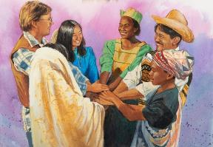
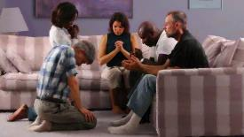
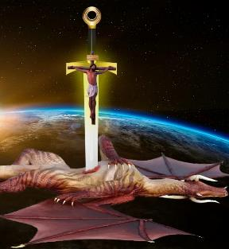

RtpNr\j;jpw;fhf ,ize;J NghuhLjy;
“ehd; te;J cq;fisf; fz;lhYk;> ehd; tuhkypUe;jhYk;> ePq;fs; xNu MtpapNy cWjpaha; epd;W> xNu Mj;JkhtpdhNy RtpNr\j;jpd; tpRthrj;jpw;fhff; $lg;Nghuhb> vjph;f;fpwth;fshy; xd;wpYk; kUshjpUf;fpwPh;fnsd;W cq;fisf;Fwpj;J ehd; Nfs;tpg;gLk;gb>…” (gpypg;gpau; 1:27K)
ePjpkhdhfTk; Neu;ikahfTk; ,Ug;gJ Jd;gkpy;yhj tho;f;iff;F cj;juthjk; mspf;fhJ (gpypg;. 1:30). khwhf> “cj;jkDk; rd;khh;f;fDk;> NjtDf;Fg; gae;J> nghy;yhg;Gf;F tpyFfpwtDkhfpa mtidg;Nghyg; G+kpapy; xUtDk; ,y;iy” (NahG 1:8), vd;W Njtdhy; mwptpf;fg;gl;l NahGNt> xU gaq;fukhd Jd;gj;ij re;jpj;jhu;> mJ rhj;jhdpd; Ntiy.
ehk; <Lg;gl;Ls;s Nghupy;> xw;Wik xU Kf;fpa gq;F tfpf;fpwJ. ew;nra;jpia ghJfhf;f xd;whf Nghuhl Ntz;Lnkd;W gTy; ek;ik Cf;Ftpf;fpwhu;(gpypg;. 1:27K).
,e;j Nehf;fj;jpd; xw;Wik n[gj;JlDk; Ntjj;ij gbg;gJlDk; ,izf;fg;gl Ntz;Lk;(vNg. 6:18; gpypg;. 2:16).
jPikAld; ehk; NkhjYf;F tUk;NghJ> ek;ik vjpu;g;gtu;fisf; fz;L ehk; gag;glf;$lhJ (gpypg;. 1:28). rhj;jhd; Njhw;fbf;fg;gl;l vjpup vd;gij epidtpy; nfhs;Nthk;, Vndd;why; Vw;fdNt ,e;j Nghupy; fpwp];J rpYitapy; ntw;wp ngw;Ws;shu; (Y}f;fh 10:18; nfhNyh. 2:15).

