Slide 1

jho;ikapdhy; tUk; xw;Wik
ghlk; 4 [dtup 24, 2026

Slide 2

“ePq;fs; Vf rpe;ijAk; Vf md;G cs;sth;fshapUe;J> ,ire;j Mj;Jkhf;fsha; xd;iwNa rpe;jpj;J> vd; re;Njh\j;ij epiwthf;Fq;fs;.”
gpypg;gpau; 2:2

Slide 3







fpwp];jt tho;f;ifapd; rthy;fis vjpu;nfhz;L cWjpahf epw;Fk;gb gpypg;gpapYs;s tpRthrpfis gTy; rkPgj;jpy; Cf;Ftpj;jhu;. Xw;Wikia typAWj;jp> guNyhf Fbkf;fSf;F ghj;jpukhd Kiwapy; jq;fis elj;jpf; nfhs;Sk;gb mtu; mtu;fsplk; Nfl;Lf;nfhz;lhu;.
“Mifahy;” vd;w nrhw;nwhUld;> gTy; xU Gjpa gFjpia njhlq;Ffpwhu;. mjpy; me;j gupG+uz xw;Wikia vt;thW miltJ vd;gij Gupe;Jnfhs;tjw;fhd jpwTNfhy;fis mtu; ekf;F nfhLf;fpwhu;: ,NaRtpd; Kd;khjpupia gpd;gw;Wtjd; %yk;.
Xw;Wikapd;ikapd; Njhw;wk; (gpypg;gpau; 2:1-3K)
jho;ikapdhy; tUk; xw;Wik (gpypg;gpau; 2:3gp-4)
,NaRitg; Nghy; rpe;jpj;jy; (gpypg;gpau; 2:5)
,NaRtpd; kdg;ghd;ik (gpypg;gpau; 2:6-8)

Slide 4





Xw;Wikapd;ikapd; Njhw;wk;
“xd;iwAk; thjpdhyhtJ> tPz;ngUikapdhyhtJ nra;ahky;>” (gpypg;gpau; 2:3K)
gpypg;gpau;fspilNa fhzg;gl;l xw;Wikapd;ikf;fhd fhuzq;fis Rl;bf;fhl;b> Gz;gl;l ,lj;jpy; tpuy; itg;gjw;F Kd;> xw;Wikia mila mtu; mtu;fSf;F toq;Fk; Kjy; mwpTiufs; vd;d> mtuJ kfpo;r;rpia epiwT nra;tJ?(gpypg;. 2:1-2)?
fpwp];JTf;Fs; MWjy;
md;gpd; MWjy;
Mtpapd; xw;Wik
neQ;rhu;e;j Nerk;
fpUig
md;G kw;Wk; czu;Tfspd; xw;Wik
fpwp];Jtpd; khjpup tho;f;ifia gbj;J gpd;gw;Wk;gb mtu; mtu;fis Cf;Ftpf;fpwhu;
fpwp];Jtpd; kPjhd mtu;fspd; kdjpy; xU J}z;Ljy; rf;jpia nrYj;JfpwJ
mtu;fs; Mtpahdtupd; fl;Lg;ghl;bw;F fPo;gba Ntz;Lk;
mtu;fs; kdpj Nerj;jpd; nkd;ikahd kw;Wk; md;ghd czu;Tfis gpujpgypf;f Ntz;Lk;
jdpg;gl;l ,uf;f nray;fs; %yk; cz;ikahd ghrj;jpd; ,Ug;ig mtu;fs; ep&gpf;fl;Lk;.
gu];gu md;G xj;j vz;zq;fis cUthf;fp xd;Wgl;l nraYf;F toptFf;fpwJ
ngUik kw;Wk; thf;Fthjq;fis xJf;fp itj;jhy; kl;LNk mtu;fshy; ,ijnay;yhk; mila KbAk;(gpypg;. 2:3K).
,e;j ,uz;L gpur;ridfSk; Y}rpgupd; fyfj;jpy; ,Ue;jd> NkYk; mit cwTfspy; kpfTk; fLikahd gpur;ridfspy; xd;whFk;(fyh. 5:26; ahf;. 3:16).

Slide 5




jho;ikapdhy; tUk; xw;Wik
“…kdj;jho;ikapdhNy xUtiunahUth; jq;fspYk; Nkd;ikahdth;fshf vz;zf;fltPh;fs;.
4. mtdtd; jdf;fhditfisay;y> gpwUf;fhditfisAk; Nehf;Fthdhf.” (gpypg;gpau; 2:3gp-4)
gTy; Kd;itf;Fk; xw;Wikf;fhd R+j;jpuk; ntspg;GwkhdJ my;y> khwhf mJ cs;kdg;ghd;ik: jho;ik. ,NaRtpd; rpwg;gpay;G gz;ghf ,Ug;gij jtpu> mtu; jk;ik Nfl;gtu;fis kdj;jho;ikAld; ,Uf;f Cf;Ftpj;jhu; (kj;. 11:29; 18:4; 23:12).
,e;j kdj;jho;ikia mila, kw;wtu;fis ek;ik tpl Kf;fpakhdtu;fshf fUj Ntz;Lk; vd;W gTy; Kd;nkhopfpwhu;(gpypg;. 2:3). NjtDf;F Kd;ghf ehk; vy;yhUk; rkk; ,y;iyah? Xw;Wik ,Uf;f Ntz;Lnkd;why; rkj;Jtk; ,Uf;f Ntz;lhkh?
gTy;> ehk; kw;wtu;fis tpl ehk; jho;e;jtu;fs; vd;W $wtpy;iy, khwhf ek;ik ehNk mg;gb fUjpf; nfhs;s Ntz;Lk; $Wfpwhu;. xU Ntiyf;fhud; jd; v[khdupd; ed;ikia NjLtJ Nghy> ek;ik tpl cau;e;jtu;fs; vd;W ehk; fUJgtu;fspd; ed;ikia ehl Ntz;Lk; (gpypg;. 2:4).
kw;wtu;fSf;F cjt> ehk; mtu;fSf;F nrtprha;f;fTk; mtu;fspd; ghu;itia Gupe;J nfhs;sTk; fw;Wf;nfhs;s Ntz;Lk;.,it midj;Jk; re;Njfj;jpw;F ,lkpd;wp gupRj;j Mtpahdtupd; nray;.

Slide 6

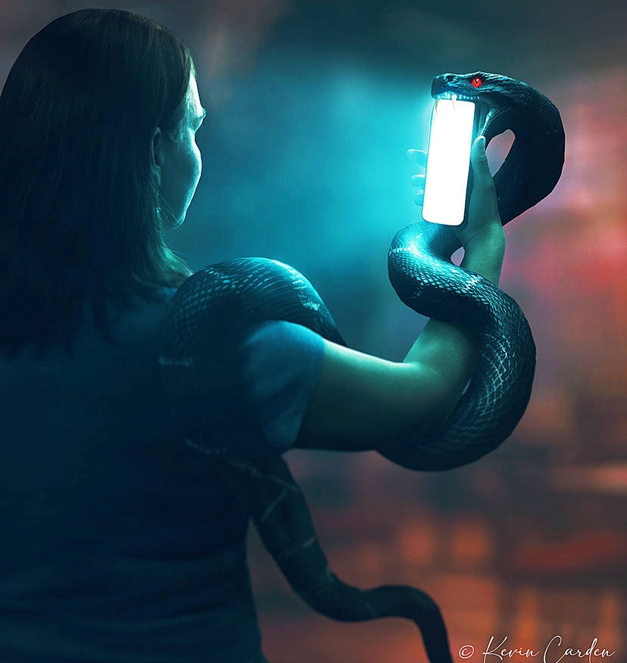


,NaRit Nghy; rpe;jpj;jy;
“fpwp];J ,NaRtpypUe;j rpe;ijNa cq;fspYk; ,Uf;ff;fltJ@” (gpypg;gpau; 2:5)
ekJ vz;zq;fs; vt;thW tbtikf;fg;gLfpd;wd? “Md;khtpd; topfs;” %yk; mjhtJ ekJ Gyd;fs; %yk;. ehk; gbf;Fk;> ghu;f;Fk; my;yJ Nfl;Fk; midj;Jk; VNjh xU tifapy; ek;ik tbtikf;fpd;wd. NkYk;, epr;rakhf, rhj;jhd; ek; kdij jd; nrhe;j rpe;jid Kiwf;F Vw;g tbtikf;f ek; Gyd;fis jhf;Ffpwhd;.
gTy; xU jPtpukhdtu;. mtu; ek; vz;zq;fis ftdpf;f miog;gJ kl;Lky;yhky;> fpwp];J epidj;jJ Nghy; rpe;jpf;fTk; ek;ik Nfl;fpwhu; (gpypg;. 4:8; 2:5).
xU Ntis, kpFe;j Kaw;rpAld;, ehk; KjyhtJ epiyia mila Ntz;Lk;. Mdhy;> ,NaRtpd; kdjpw;F ,zq;f ek; kdij khw;WtJ gupRj;j Mtpahdtuhy; kl;LNk ek;kpy; nra;a KbAk;.
Vndd;why;> ek;Kila vz;zq;fs; ruPuj;Jf;Fupait> ek;Kila ,Ujaq;fs; tQ;rfj;Jf;Fupit (vNukpah 17:9). Mtpahdtu; ekJ ruPu kdij fpwp];Jit Nghy Md;kPf kdkhf khw;Wthu; (Nuhku; 8:1, 5).

Slide 7

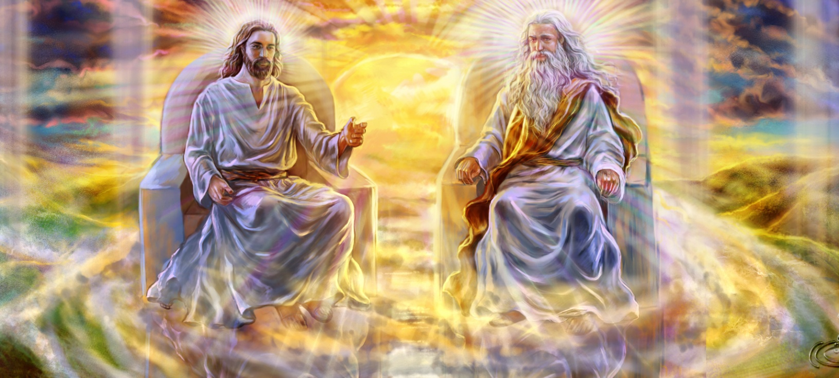


,NaRtpd; kdg;ghd;ik (1)
“mth; NjtDila &gkhapUe;Jk;> NjtDf;Fr; rkkhapUg;gijf; nfhs;isahbd nghUshf vz;zhky;>”
(gpypg;gpau; 2:6)
,NaRtpd; %d;W Fzq;fis gTy; rpwg;gpj;Jf; fhl;Lfpwhu;:
mtu; jdJ nja;tPf rpwg;Gupikfis Jwe;Jtpl;lhu; (gpypg;. 2:6)
mtu; ekf;F Nrit nra;a xU kdpjuhdhu; (gpypg;. 2:7)
mtu; vy;yhtw;wpYk; jho;ikAld; fPo;gbe;jhu;> mtUila kuzk; tiu $l (gpypg;. 2:8)
gilg;ghsuhf ,Ue;jjhy;, mtu; xU capupdkhdhu;. ek;ik kPl;gjw;fhf mtu; Jd;GWj;jg;gl;L rpYitapy; kupj;jij Vw;Wf;nfhz;lhu;.
NjtDila kw;w ,uz;L egu;fSld; rkkhd epiyapy; ,Ue;jNghjpYk;> gpjhtpd; rpj;jj;jpw;F ,NaRtpd; fPo;gbjy; vg;NghJk; rupahdjhf ,Uf;Fk;. mtu; fPo;gba kWj;j xU jUzKk; ,y;iy
,ijg; gw;wp ehk; rpe;jpf;Fk;NghJ> ek; mw;Gjkhd ,ul;rfiu tzq;fp tho;j;j kl;LNk KbAk;.
mtu; ekf;F Kd;khjpup. kw;wtu;fspd; ed;ikf;fhf ek;ik jho;j;jpf;nfhs;sTk;> jpahfk; nra;aTk; ehk; jahuhf ,Uf;f Ntz;Lk;.

Slide 8


,NaRtpd; kdg;ghd;ik (2)
“md;wpAk;> Njtgf;jpf;Fhpa ,ufrpakhdJ ahtUk; xg;Gf;nfhs;SfpwgbNa kfhNkd;ikAs;sJ. Njtd; khk;rj;jpNy ntspg;gl;lhh;> MtpapNy ePjpAs;stnud;W tpsq;fg;gl;lhh;> NjtJ}jh;fshy; fhzg;gl;lhh;> Gw[hjpfsplj;jpy; gpurq;fpf;fg;gl;lhh;> cyfj;jpNy tpRthrpf;fg;gl;lhh;> kfpikapNy VnwLj;Jf;nfhs;sg;gl;lhh;.” (1 jPNkhj;NjA 3:16)
kdpjdhf khWtjpy; fpwp];Jtpd; mw;Gjkhd kdj;jho;ik> epj;jpak; KOtJk; kPl;fg;gl;ltu;fSf;F xU Ma;Tg;nghUshf ,Uf;Fk;.
vy;iyaw;wtu; kw;Wk; epj;jpakhdtu; kuzj;jpw;F cl;g;gl;l xU tiuaWf;fg;gl;l kdpjuhf khwpaJ ek;gKbahjJ. ,ij;jhd; gTy; “Njtgf;jpapd; ,ufrpak;” vd;W miof;fpwhu;(1 jPNkh. 3:16).
,NaR cyfshtpa Nkyhjpf;fj;jpypUe;J> KOikahd mbikj;jdj;jpw;F nrd;whu;. ,J Y}rpgu; tpUk;gpajw;F Neu; vjpuhdJ> mtd; xU Ntiyf;fhudhf ,Ue;J cyfshtpa Nkyhjpf;fij tpUk;gpdhd;
,e;j cjhuzk;> ekJ Raeyj;ijAk;> Nrit nra;ag;gl Ntz;Lk; vd;w ekJ tpUg;gj;ijAk; iftpl;L, mtw;iw kdj;jho;ikahYk;> kw;wtu;fSf;F Nrit nra;Ak; tpUg;gj;jhYk; khw;w Ntz;Lk; vd;W ek;ik miof;fpwJ.

