Slide 1
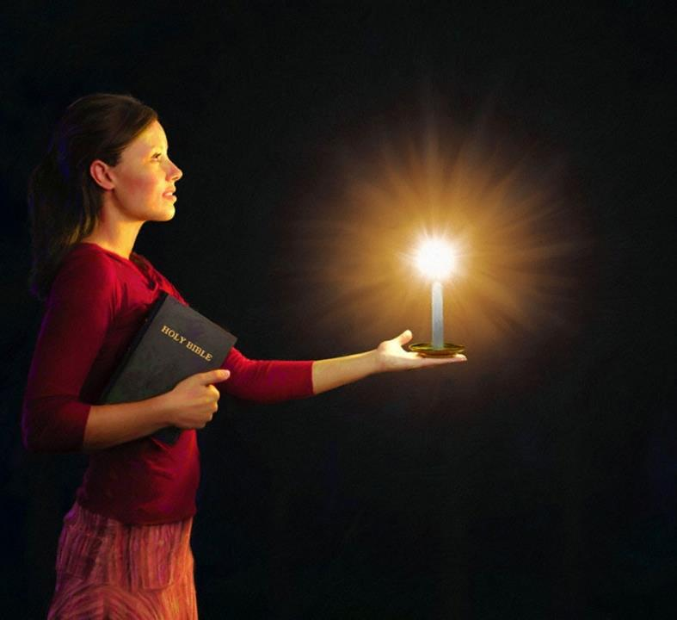
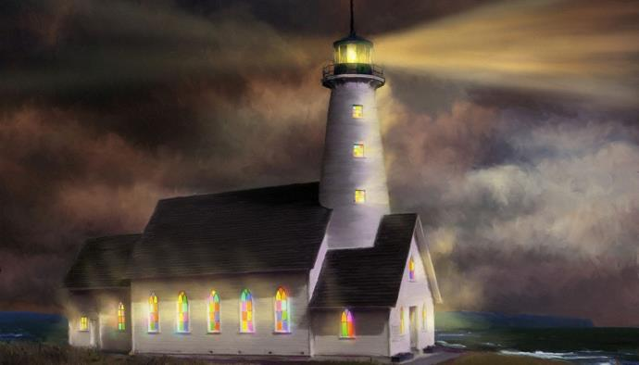

ghlk; 5 [dtup 31, 2024
,utpy; gpufhrpf;fpw Rlu;fshf

Slide 2

“ehd; tPzhf XbdJk; tPzhfg; gpuahrg;gl;lJkpy;iynad;fpw kfpo;r;rp fpwp];Jtpd; ehspy; vdf;F cz;lhapUg;gjw;F> [Pttrdj;ijg; gpbj;Jf;nfhz;L> cyfj;jpNy Rlh;fisg;Nghyg; gpufhrpf;fpw ePq;fs;> NfhzYk; khWghLkhd re;jjpapd; eLtpNy Fw;wkw;wth;fSk; fglw;wth;fSk;> NjtDila khrw;w gps;isfSkha; ,Uf;Fk;gbf;F>”
gpypg;gpau; 2:14, 15

Slide 3

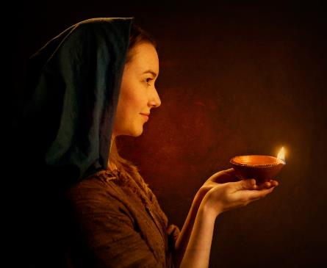



“,t;tpjkha;> kD\h; cq;fs; ew;fphpiafisf; fz;L> guNyhfj;jpypUf;fpw cq;fs; gpjhit kfpikg;gLj;Jk;gb> cq;fs; ntspr;rk; mth;fs; Kd;ghfg; gpufhrpf;ff;fltJ.” (kj;. 5:16).
gpypg;gpau; 2:12-18y;> ,NaRtpd; ,e;j fl;lisapd; gTypd; gjpg;ig ehk; gbf;fyhk;.
NjtDila rl;lk; njhlu;e;J fhybapy; kpjpf;fg;gLk; cyfpy; thOk; ehk;> mjd;gb tho;tjd; %yk; NjtDf;F Nrit nra;a tpUk;Gk; fpwp];jtu;fs;> ,Uspy; gpufhrpf;Fk; tpsf;Ffs;.
cyfj;jpd; ntspr;rq;fs;:
  NjtDila gpujpgypg;G (gpypg;gpau; 2:12-13)
  cyfpd; xsp (gpypg;gpau; 2:14-16)
  [Pt gyp (gpypg;gpau; 2:17-18)
ntspr;rj;jpd; cjhuzq;fs;:
  jPNkhj;NjA (gpypg;gpau; 2:19-24)
  vg;ghg;gpNuhjPj;J (gpypg;gpau; 2:25-30)

Slide 4

cyfj;jpd; ntspr;rqfs;

Slide 5

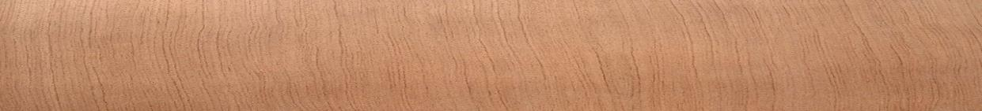


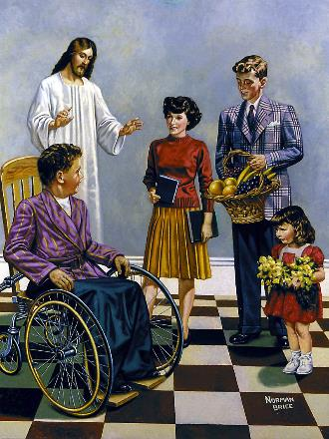
NjtDila gpujpgypg;G
“Vnddpy; NjtNd jk;Kila jaTs;s rpj;jj;jpd;gb tpUg;gj;ijAk; nra;ifiaAk; cq;fspy; cz;lhf;FfpwtuhapUf;fpwhh;.” (gpypg;gpau; 2:13)
,NaRtpd; mtkhdj;ijAk; Nkd;ikiaAk; jpwikahf tptupj;j gpwF> gTy; “Mifahy;” vd;w nrhw;nwhliu Nru;f;fpwhu;. mjhtJ, ,NaR jd;id jho;j;jp cau;j;jg;gl;ljhy;> “gpjhthfpa NjtDf;F kfpikahf ,NaRfpwp];J fh;j;jnud;W ehTfs; ahTk; mwpf;ifgz;Zk;gbf;Fk;>” (gpypg;. 2:11), gpypg;gpa tpRthrpfs; (NkYk;, ePl;bg;G %yk; Nru;f;fg;gl;l, ehk; midtUk;) mijg; gw;wp VjhtJ nra;aNtz;Lk;.
ekJ Kjy; gzp “gaj;NjhLk; eLf;fj;NjhLk;” ekJ ,ul;fpg;ig epiwNtw;WtjhFk;(gpypg;. 2:12). Njtd; ek;ik ,ul;rpg;gtu; vd;why; (jPj;J 2:11), ehk; Vd; mijg; gw;wp ftiyg;gl Ntz;Lk;?
gak; kw;Wk; eLf;fk; Mfpait Njtid Nrtpg;gjw;F xj;j nrhw;fshf gad;gLj;jg;gLfpd;wd(rq;fPjk; 2:11). vdNt, ed;ik nra;tjw;fhd tpUg;gj;ij ek;kpy; cUthf;FtJk;> mij edthf;Ftjw;fhd gyj;ij ekf;Fj; jUtJk; NjtNd vd;gij gTy; typAWj;Jfpwhu;.(gpypg;gpau; 2:13).

Slide 6




cyfpd; xsp
“cyfj;jpNy Rlh;fisg;Nghyg; gpufhrpf;fpw ePq;fs;> NfhzYk; khWghLkhd re;jjpapd; eLtpNy Fw;wkw;wth;fSk; fglw;wth;fSk;> NjtDila khrw;w gps;isfSkhapUf;Fk;gbf;F>” (gpypg;gpau; 2:14gp, 15)
tpRthrpfis cyfpy; gpufhrpf;fr; nra;Ak; %d;W mk;rq;fis gTy; Kd;nkhopfpwhu;:
Xw;Wikiag; NgZq;fs; (gpypg;. 2:14)
Xd;whf Ntiy nra;Ak;NghJ, ekf;Fs; ve;jtpjkhd tje;jpfNsh> tpku;rdq;fNsh> Nghl;bfNsh thf;Fthjq;fNsh ,Uf;ff;$lhJ.
Fw;wkw;wtuhf ele;Jnfhs;Sq;fs; (gpypg;. 2:15)
ek; gpjhTf;F vspikahf fPo;gbtJ> ek;ik Rw;wpYk; epyTk; jPik kw;Wk; gutYf;F Kw;wpYk; khWg;gl;lJ.
NjtDila thu;j;ijf;F cz;ikahf ,Ujjy; (gpypg;. 2:16)
ekJ nray;fSk; vz;zq;fSk; Ntjk; fw;gpf;Fk; tp\aq;fSf;F ,irthf ,Uf;f Ntz;Lk;
,Us; mjpfkhf ,Uf;Fk; ,lj;jpy;, xsp gpufhrkhf gpufhrpf;fpwJ. Njtd; Kiwahf epuhfupf;fg;gLk; ,t;Tyfpy;, fpwp];jtu;fshfpa ehk; fpwp];Jtpd; xspahy; gpufhrpf;f Ntz;Lk;.

Slide 7




[Pt gyp
“NkYk;> cq;fs; tpRthrkhfpa gypapd; NkYk; Copaj;jpd; NkYk; ehd; thh;f;fg;gl;Lg;NghdhYk;> ehd; kfpo;e;J> cq;fsidtNuhLq;$lr; re;Njh\g;gLNtd;.” (gpypg;gpau; 2:17)
gTy; tpLjiy ngw tpUk;gpdhYk;, mtu; fz;ldk; nra;ag;gLtjw;fhd tha;g;G ,Ue;jJ. mtu; ,e;j rhj;jpaj;ij ,t;thW Kd;itf;fpwhu; “ehd; thh;f;fg;gl;Lg;NghdhYk;>” (gpypg;. 2:17).
ghdgyp vd;gJ gypapd; Nky; xU jputj;ij Cw;Wtij cs;slf;fpaJ (ahj;. 29:39-40). ,e;j tp\aj;jpy;, Nfs;tpf;Fupa gyp gpypg;gpau; jhd;.
gpypg;gpau; ,wf;f Nghfpwhu;fsh? ,y;yNt ,y;iy. mtu;fSila gyp> “cq;fs; tpRthrkhfpa gyp” vd;W fUjg;gl;lJ. mJ xU [Pt gyp, ehk; midtUk; NjtDf;F nrYj;j Ntz;ba xU gyp (Nuh. 12:1).
gTy; ,wg;gij gw;wp ftiyg;gltpy;iy> Vndd;why; mtUila rhl;rpak; Vw;fdNt ew;nra;jpapd; cz;ikAs;s rhl;rpfshfTk;> mijg; gw;wp ijupakhf NgRgtu;fshfTk;> NjtDila jFjpahd Foe;ijfshf ele;Jnfhs;gtu;fshfTk; ,Ue;j tpRthrpfSf;F ,d;Dk; gyj;ij jUk;.

Slide 8

ntspr;rj;jpd; cjhuzq;fs;

Slide 9

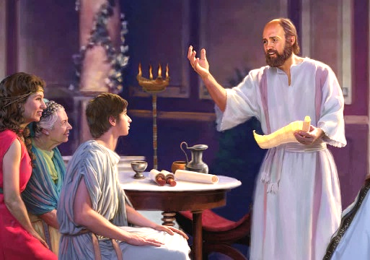


jPNkhj;NjA
“jfg;gDf;Fg; gps;is CopaQ;nra;tJNghy> mtd; vd;DlNd$l RtpNr\j;jpdpkpj;jk; CopaQ;nra;jhndd;W mtDila cj;jkFzj;ij mwpe;jpUf;fpwPh;fs;.” (gpypg;gpau; 2:22)
jPNkhj;NjA gTypd; jPtpu xj;Jiog;ghsuhfTk; MW epUgq;fspd; ,iz MrpupauhfTk; (2 nfhupe;jpau;, gpypg;gpau; , nfhNyhnrau;, 1 njrNyhdpf;Nfau;, 2 njrNyhdpf;Nfau;, gpNyNkhd;). gTy; jhd; mtiu xU RtpNr\fuhf Nju;e;njLj;jhu; (mg; 16:1-3). ,e;j ,isQdplk; gTy; fz;l rpwg;G vd;d?
Kjyhtjhf, vy;yhUk; “mtiug; gw;wp ed;whfg; Ngrpdhu;fs;.” Copaj;jpw;F mtu; jFjpahdtu; vd;gJ jPu;f;fjuprd thu;j;ijfshy; cWjpg;gLj;jg;gl;lJ (1 jPNkh. 1:18). xU ,isQdhf> gTy; mtiu xU kfdhf fUjpdhu;, (1jPNkh. 1:2; 4:12). jPNkhj;NjA nghUj;jtiu, xU kfd; jd; je;ijaplk; itj;jpUf;Fk; kupahijAlDk; ghrj;JlDk; gTiy elj;jpdhu; (gpypg;. 2:22).
gTy; mtiu jd;idg; NghyNt jpwikahd njhopyhspahf fUjpdhu; (1 nfhup. 6:10). gpypg;gp (gpypg;. 2:19); kw;Wk; njrNyhdpf;Nf (1 njr. 3:2), nfhupe;J Nghd;w gy rigfspd; Nkw;ghu;itia ehd; mtuplk; xg;gilj;Js;Nsd; (1 nfhup. 4:17) . gTiyg; NghyNt mtUk; rpiwthrk; mDgtpj;jhu; (vgp. 13:23).

Slide 10

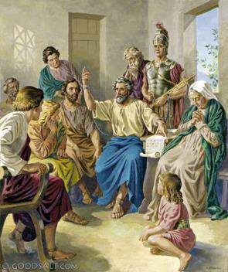


“NkYk;> vd; rNfhjuDk;> cld;NtiyahSk;> cld;NrtfDk;> cq;fs; ];jhdhgjpAk;> vd; Fiwr;rYf;F cjtpnra;jtDkhd vg;ghg;gpNuhjPj;Jit cq;fsplj;jpy; mDg;gNtz;Lnkd;W vz;zpNdd;.” (gpypg;gpau; 2:25)
vg;ghg;gpNuhjPj;J
gTy; Nuhkpy; rpiwapy; milf;fg;gl;bUg;gij gpypg;gpau;fs; mwpe;jJk;> mtUila Njitfis G+u;j;jp nra;a (thlif, czT, cil, Nghd;tw;iw nrYj;j) mtUf;F cjtp mDg;g KbT nra;jdu;. ,e;j cjtpia mg;Ngh];jyUf;F nfhz;L tUtjw;F vg;ghg;gpNuhjPj;J nghWg;Ngw;whu; (gpypg;. 4:18; 2:25).
vg;ghg;gpNuhjPj;J cjtpfis toq;FtNjhL kl;Lky;yhky;> gTYld; Nru;e;J> mtUila NjitfSf;F cjtpdhu;> ew;nra;jpiag; gug;Gtjpy; mtUld; xj;Jioj;jhu;.
ew;nra;jpapd; kPjhd ituhf;fpaj;jpy;> mtu; jdJ nrhe;j capiug; gzak; itj;J fLikahf Neha;tha;g;gl;lhu; (gpypg;. 2:27, 30). gpypg;gpau; ,ij Nfl;lNghJ> mtu;fs; mtUf;fhf ftiyg;gl;ldu;. gTy; epUgj;ij mtu;fsplk; xg;gilf;f mtiu mDg;g KbT nra;jjw;F ,JNt Kf;fpa fhuzk; (gpypg; . 2:26, 28).
gTy; “mtiu Nghd;wtu;fis kjpf;f Ntz;Lk;” vd;W Nfl;fpwhu;(gpypg;. 2:29). vg;ghg;gpNuhjPj;J re;Njfj;jpw;F ,lkpd;wp xU cz;ikAs;s fpwp];jtu;.

