Slide 1

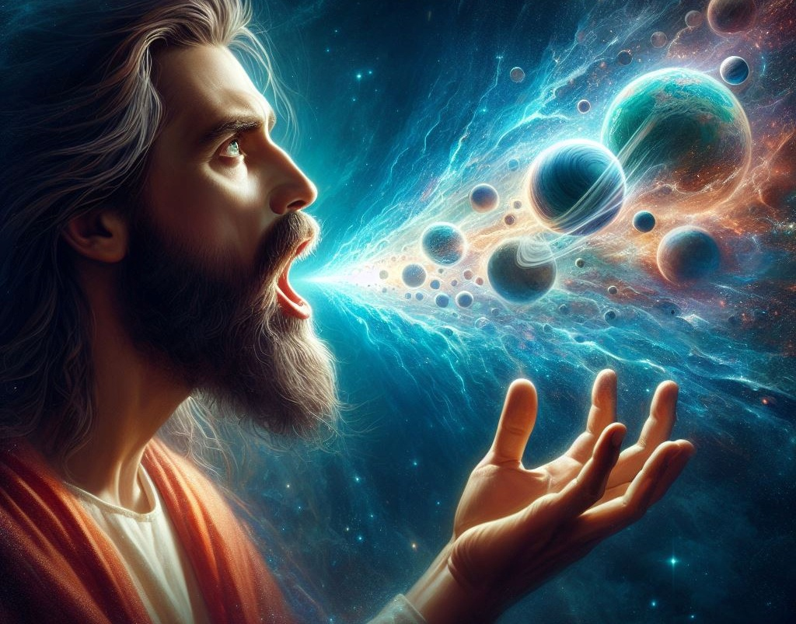
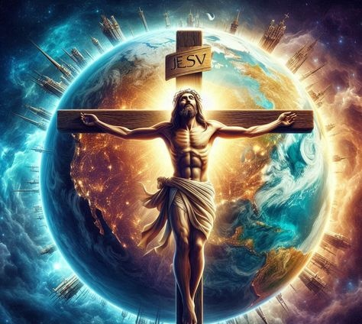
ghlk; 8 gpg;utup 21, 2026
fpwp];Jtpd; gpujhdj;jd;ik

Slide 2

“mth; mjhprdkhd NjtDila jw;R&gKk;> rh;t rpU\;bf;Fk; Ke;jpd NgWkhdth;. Vndd;why; mtUf;Fs; rfyKk; rpU\;bf;fg;gl;lJ@ guNyhfj;jpYs;sitfSk; g+Nyhfj;jpYs;sitfSkhfpa fhzg;gLfpwitfSk; fhzg;glhjitfSkhd rfy t];Jf;fSk;> rpq;fhrdq;fshdhYk;> fh;j;jj;Jtq;fshdhYk;> mjpfhuq;fshdhYk;> rfyKk; mtiuf;nfhz;Lk;> mtUf;nfd;Wk; rpU\;bf;fg;gl;lJ. mth; vy;yhtw;wpw;Fk; Ke;jpdth;> vy;yhk; mtUf;Fs; epiyepw;fpwJ.” nfhNyhnrau; 1:15–17

Slide 3


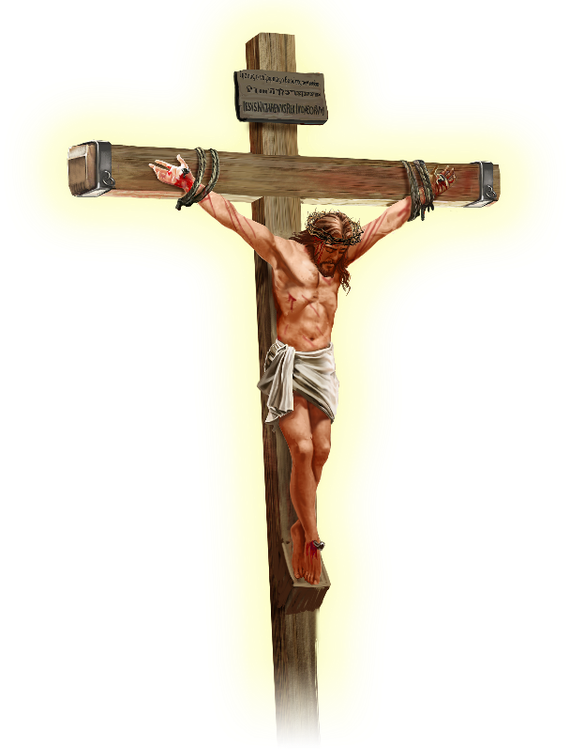






,NaR KO gpugQ;rj;jpw;Fk; mikjpia nfhz;L te;jhu; vd;W gTy; mwptpf;fpwhu; “…g+Nyhfj;jpYs;sitfs; guNyhfj;jpYs;sitfs; ahitAk;…” (nfhNyh. 1:20).
,e;j $w;Wf;F tUtjw;FKd;, ,NaR cz;ikapy; ahu; vd;gij mg;Ngh];jyd; ekf;F nrhy;fpwhu;. mtu; xU rpwe;j NghjfNuh, jj;Jt QhdpNah, jPu;f;fjuprpah, gpurq;fpNah, ew;nra;jpapd; J}jNuh my;y.
,NaR fpwp];J…
NjtDila jw;R&gk; (nfhNyhnrau; 1:15K)
vy;yhtw;wpw;Fk; Ke;jpdth; (nfhNyh 1:15gp-17)
rigahfpa rhPuj;jpw;Fj; jiyahdth; (nfhNyhnrau; 1:18K)
mtNu MjpAk;… (nfhNyhnrau; 1:18gp)
Xg;Guthf;Fgtu; (nfhNyhnrau; 1:19-20)

Slide 4





NjtDila jw;R&gk;
“mth; mjhprdkhd NjtDila jw;R&gKk;>” (nfhNyhnrau; 1:15K)
xU glk; ajhu;jj;jpd; efyhf ,Uf;fyhk; (xU Gifg;glk;, Kg;gupkhz gbkk;, rpiy), my;yJ fw;gidahd xd;W(tiuglk;). Mdhy; tptpypaj;jpd; cUtf; fUj;J mjw;F mg;ghw;g;gl;lJ.
Njtd; MjhikAk; VthisAk; jdJ rhaypy; gilj;jhu; (mjp. 1:27), Mjhk; jdJ rhaypy; xU kfid ngw;nwLj;jhu;(Mjp. 5:3).,it ajhu;jj;jpd; gpujpfs;> Nghypfs;, my;yJ mtu;fspd; fw;gidapd; cUtq;fs; my;y. mit cly;, cstpay;, kw;Wk; r%f xw;Wikfs;…
rlq;fhr;rhu gpukhzk; xU epoyhf ,Ue;jJ, “nghUl;fshf rhayhf my;y” (vgp. 10:1) vd;W gTy; $Wfpwhu;, ,J “cUtk; = ajhu;j;jk;” vd;gijf; Fwpf;fpwJ.
Nfs;tp vd;dntd;why;: ,NaR Njtidg; NghyNt ,Ue;jhuh> my;yJ NjtDf;F rkkhf ,Ue;jhuh? “ehd; ,Uf;fpwtuhfNt ,Uf;fpNwd;”, vd;w nja;tPf ngaiu jpUk;g jpUk;g jdf;F fhuzk; fhl;bf; nfhz;lNjhL> ,NaR ntspg;gilahfNt $Wfpwhu;: “ehDk; gpjhTk; xd;whapUf;fpNwhk;” (Nahthd; 10:30); “vd;idf; fz;ltd; gpjhitf; fz;lhd;@” (Nahthd; 14:9).

Slide 5




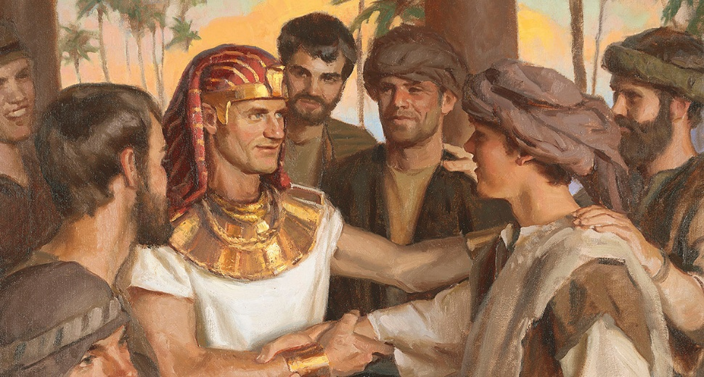
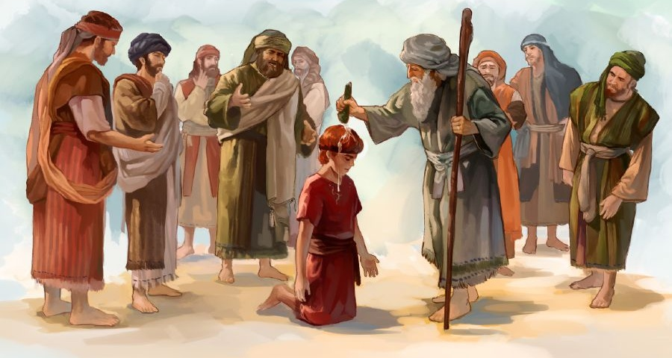


vy;yhtw;wpw;Fk; Ke;jpdth;
“mth; vy;yhtw;wpw;Fk; Ke;jpdth;> vy;yhk; mtUf;Fs; epiyepw;fpwJ.” (nfhNyhnrau; 1:17)
“Ke;jpdtu;” vd;why; Kjw;Ngwhdtu; vd;W nghUs;. MfNt, Njtdhy; Kjy; cUthf;fg;gl;ltu; ,NaR vd;W rpyu; fw;gpf;fpd;wdu; (nfhNyh. 1:15). Mdhy;, “cUtk;” vd;w thu;j;ijiag; NghyNt, “Kjw;Ngwhdtu;” vd;w thu;j;ijAk; xU gue;j Ntjhfk mu;j;jj;ij nfhz;Ls;sJ.
,];kNtYf;F gjpyhf <rhf;F Kjw;Ngwhdtu;; VrhTf;F gjpyhf ahf;NfhG Kjw;Ngwhdtu;; &gDf;F gjpyhf NahNrg;G Kjw;Ngwhdtu;; vypahGf;F gjpyhf jhtPJ Kjw;Ngwhdtu; (rq;fPjk; 89:27). mtu;fs; midtUk; Kjw;Ngwhdtu;fs;> mtu;fs; Kjypy; gpwe;jjhy; my;y> jq;fs; rNfhjuu;fis tpl Kjd;ikahd ,lj;ij gpbj;jjhy;.
nfhNyhnraupy; gTy; ,e;j Kf;fpaj;Jtj;ij Fwpg;gpLfpwhu;. mtUila ,ay;ig gw;wpa ve;j re;Njfj;ijAk; jtpu;f;f> mtu; mtUf;F ,uz;L nja;tPf Fzq;fis $Wfpwhu;:,Uf;Fk; midj;ijAk; rpU\;bj;jhu; (nfhNyh. 1:16; Vrh. 45:18); mitfs; midj;ijAk; ghJfhf;fpwhu;(nfhNyh. 1:17; rq;. 119:91).

Slide 6




rigahfpa rhPuj;jpw;Fj; jiyahdth;@
“mtNu rigahfpa rhPuj;jpw;Fj; jiyahdth;@” (nfhNyhnrau; 1:18K)
rpy nkhopfspy; (fhl;lyhd; kw;Wk; Mq;fpyk;) “jiy” vd;w thu;j;ij “jiyik” my;yJ “Kjy;tu;” vd;W nkhopngau;f;fg;gLk;, Vndd;why; mJjhd; “jiy” vd;w thu;j;ijapd; cUtf mu;j;jk;. vgpNua nkhopapYk; ,JNt cz;ik. cjhuzkhf, “jq;fSf;F xNu mjpgjpia Vw;gLj;jp” (xrpah. 1:11) vd;gJ “mtu;fs; xU jiytiu epakpj;jhu;fs;” vd;W nkhopngau;f;fg;gLk;.
ehnky;yhUk; Njit (1 nfhup. 12:15)
Xt;nthUtUf;Fk; mtutu; nrhe;j Ntiy cz;L(1 nfhup. 12:17)
ehk; ahiuAk; ntWf;f KbahJ(1 nfhup. 12:21)
“jho;e;j” tpRthrpfs; vd;W ahUk; ,y;iy(1 nfhup. 12:22-24)
ehk; xUtiunahUtu; ftdpj;Jf; nfhs;s Ntz;Lk;(1 nfhup. 12:25-26)
gTy; ,e;j thu;j;ijia fpwp];JTf;F gad;gLj;Jk;NghJ> me;j mu;j;jj;jpy; jhd; gad;gLj;Jfpwhu; (nfhNyh. 1:18K).
Mdhy; gTy; ruPuj;jpw;F xU cUtf mu;j;jj;ijAk; Nru;f;fpwhu;. fpwp];J jiyahf ,Ue;jhy;, ehk;—rig—ruPuk;. ,e;j fUj;jpypUe;J mJ gpd;tUkhW:

Slide 7


mtNu MjpAk;…
“vy;yhtw;wpYk; Kjy;tuhapUf;Fk;gb> mtNu MjpAk; khpj;NjhhpypUe;J vOe;j Kjw;NgWkhdth;” (nfhNyhnrau; 1:18gp)
“Mjp” vd;W nkhopngau;f;fg;gl;l thu;j;ij Mu;fp (ἀρχή), vd;w fpNuf;f thu;j;ijapypUe;J te;jJ> njhlf;fk;, Njhw;wk;, Kjy; fhuzk; my;yJ nfhs;if vd;W nghUs;gLk;, Mdhy; Ml;rpahsu;> ty;yik> mjpfhuk; my;yJ Kjd;ik vd;Wk; nghUs;gLk;> ,J ngUk;ghYk; R+oiy nghWj;jJ.
fpwp];JTf;F gad;gLj;jg;gLk; ,e;j thu;j;ijf;F ,e;j mu;j;jq;fs; midj;Jk; ,Uf;fyhk; vd;W ehk; $wyhk; (nfhNyh. 1:18). ,NaRNt vy;yhtw;wpd; Njhw;wKk; [NjtDila jw;R&gKk;], midj;Jk; rpU\;bf;fg;gl;ljw;fhd fhuzKk; [rh;t rpU\;bf;Fk; Ke;jpd NgWkhdth;], cr;rgl;r Ml;rpahsu; [jiy]. ,it midj;Jk; mtUf;F Kd;Dupik mspf;fpd;wd.
gTy; ,q;Nf “khpj;NjhhpypUe;J vOe;j Kjw;NgWkhdth;” vd;w gl;lj;ij nrhUFfpwhu; (capu;njOg;gg;gl;l Kjy; egu; ,NaR my;y, Mdhy; NkhNr). kuzj;jpd; kPjhd mtuJ ntw;wp> ghtj;jpd; kPjhd mtuJ ntw;wpiaAk;> mtuJ rhaypy; ek;ik kPz;Lk; cUthf;Ftjw;fhd mtuJ ty;yikiaAk; Fwpf;fpwJ.

Slide 8

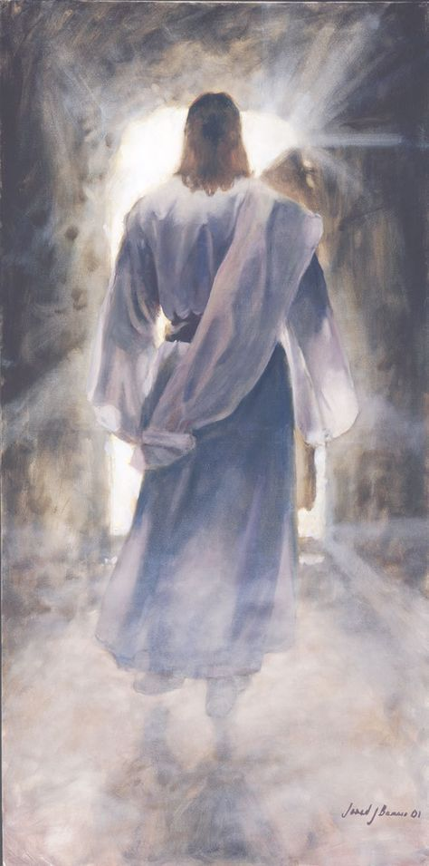



Xg;Guthf;Fgtu;
“mth; rpYitapy; rpe;jpd ,uj;jj;jpdhNy rkhjhdj;ij cz;lhf;fp> g+Nyhfj;jpYs;sitfs; guNyhfj;jpYs;sitfs; ahitAk; mth; %ykha; jkf;F xg;Guthf;fpf;nfhs;sTk; mtUf;Fg; gphpakhapw;W.” (nfhNyhnrau; 1:20)
,NaR nra;j fhupak; vy;yhtw;wpYk; mtiu Kjyplj;jpy; nfhz;L te;jJ. gTypd; $w;Wg;gb, fpwp];J ,e;j vy;yh gl;lq;fSf;Fk; jFjpahdtu; “rfy ghpg+uzKk; mtUf;Fs;Ns thrkhapUf;fTk;>” (nfhNyhnrau; 1:19). NtW thu;j;ijfspy; $Wtjhdhy;, ,NaR KOikahf NjtdhfTk; KOikahf kdpjuhfTk; ,Ue;jhu;. “mtUila kfpikiaf; fz;Nlhk;@, […] fpUigapdhYk; rj;jpaj;jpdhYk; epiwe;jtuha;>” (Nahthd; 1:14).
rpYitapy; kupj;J kPz;Lk; capu;njOe;jjd; %yk;, kdpjFyj;ij NjtDld; xg;Guthf;f Njitahd midj;ijAk; ,NaR G+u;j;jp nra;jhu; (nfhNyh. 1:20).
mtu; “G+kpapYs;sitfis” Njtdplk; xg;Guthf;fptpl;lhu; vd;gij ehk; vg;gb Gupe;Jnfhs;s KbAk;? Mdhy; guNyhfj;jpy; ,Ug;gtu;fis mtu; vt;thW jk;kplk; xg;Guthf;fp nfhz;lhu;?
KO gpugQ;rKk; jPikapd; jd;ikia njspthf fhz Kbe;jJ. ,jdhy;, NjtDila jd;ik guNyhfj;jpYk; G+Nyhfj;jpYk; ep&gpf;fg;gLfpwJ.

