Slide 1

fpwp];JTf;Fs; gupG+uzKs;stu;fs;
ghlk; 10 khu;r; 7, 2026

Slide 2
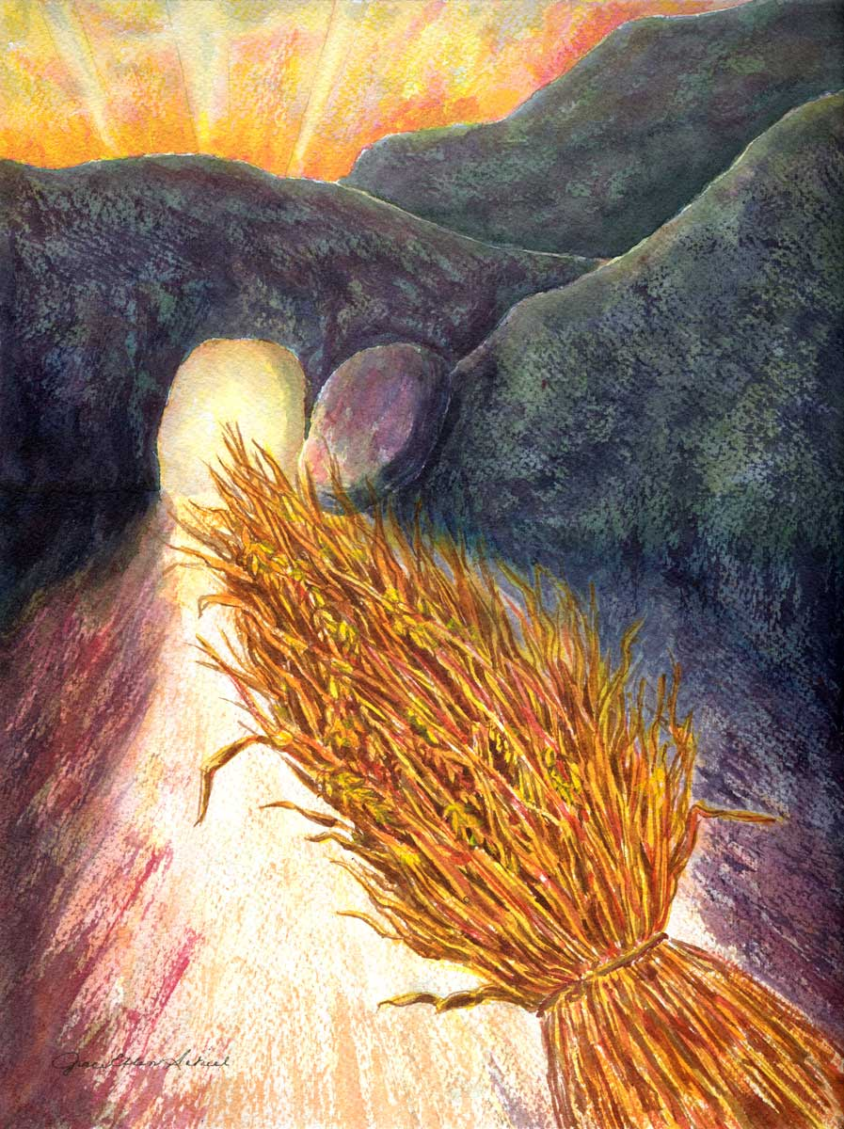
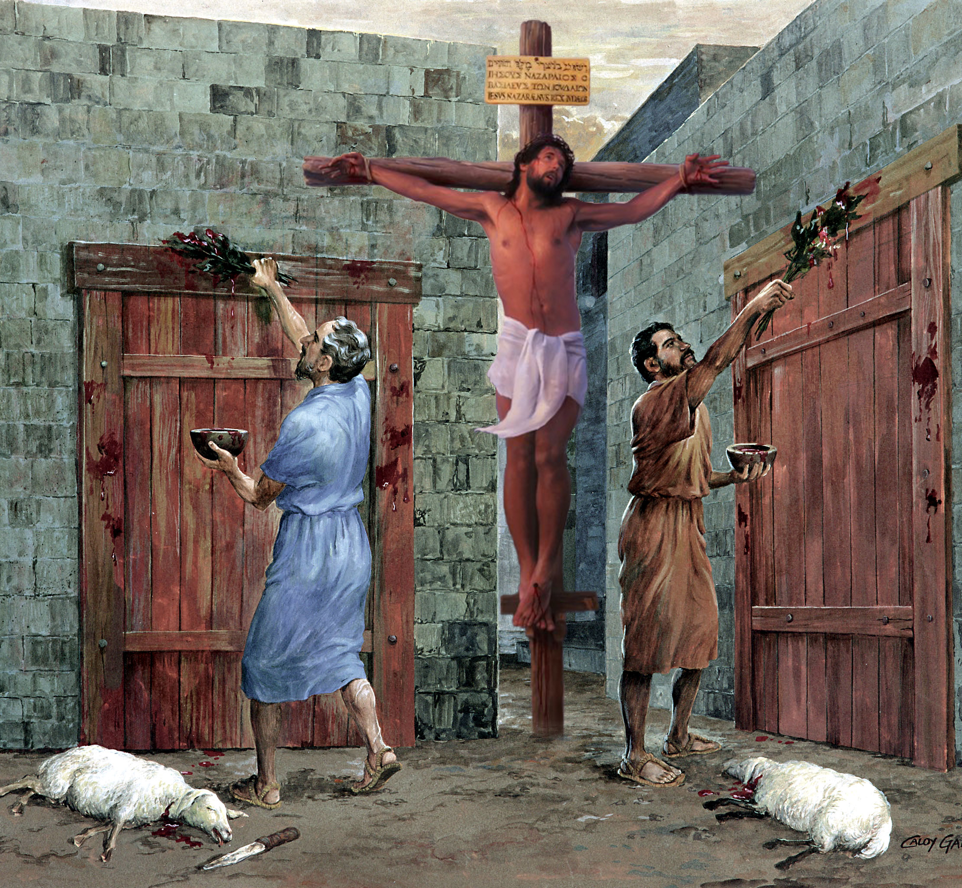
“Mifahy;> Ngh[dj;ijAk; ghdj;ijAk; Fwpj;jhtJ> gz;bif ehisAk; khjg;gpwg;igAk; Xa;Tehl;fisAq;Fwpj;jhtJ> xUtDk; cq;fisf; Fw;wg;gLj;jhjpUg;ghdhf. mitfs; tUq;fhhpaq;fSf;F epoyhapUf;fpwJ@ mitfspd; nghUs; fpwp];Jitg;gw;wpdJ.” nfhNyhnrau; 2:16, 17

Slide 3





,NaRtpy; tpRthrk; itg;gJ ekf;F kpFe;j ed;ikfisj; jUfpwJ. ekJ ght kd;dpg;Gld;> MWjy;> Qhdk; kw;Wk; ,d;Dk; gytw;iwg; ngWfpNwhk;.
NjtDila ,uh[;aj;jpw;fhf ey;y fdpfis nfhLf;Fk; kuq;fshf ehk; ,Uf;f> me;j tpRthrj;jpy; Nt&d;w gTy; ek;ik miof;fpwhu;.
kdpj jj;Jtq;fs; kw;Wk; Nfhl;ghLfspd; mbg;gilapy; my;y> khwhf NjtDila capUs;s thu;j;ijapd; mbg;gilapy; kl;LNk ehk; vt;thW Nt&d;w Ntz;Lk; vd;gJ gw;wpAk; ,J ek;ik vr;rupf;fpwJ.
tpRthrj;jpd; gad;fs;:
MWjy;, Jjp, kw;Wk; xOq;F (nfhNyhnrau; 2:1-5)
fpwp];Jtpy; Nt&d;Wjy; (nfhNyhnrau; 2:6-8)
mtUila rpYitapy; Mzpabf;fg;gl;l gpukhzq;fspd; ifnaOj;J (nfhNyhnrau; 2:9-15)
tpRthrj;ij mirf;ff;$ba gpur;ridfs;:
gz;bif ehs;, khjg; gpwg;G, xa;Tehl;fs; (nfhNyhnrau; 2:16-19)
kD\Uila fw;gidfs; (nfhNyhnrau; 2:20-23)

Slide 4


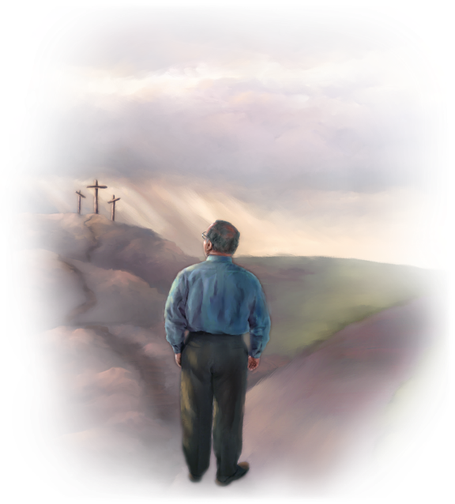
tpRthrj;jpd; gad;fs;

Slide 5

MdhYk; Qhdk; fz;nlLf;fg;gLtJ vq;Nf? Gj;jp tpisfpw ,lk; vJ?
(NahG 28:12)
mtUf;Fs; Qhdk; mwpT vd;gitfshfpa nghf;fp\q;fnsy;yhk; mlq;fpapUf;fpwJ.
(nfhNyhnrau; 2:3)

Slide 6

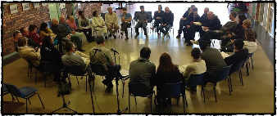
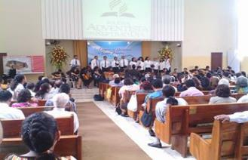
MWjy;, Jjp kw;Wk; xOq;F
“rhPuj;jpd;gb ehd; J}ukhapUe;Jk;> Mtpapd;gb cq;fSlNd$l ,Ue;J> cq;fs; xOq;ifAk;> fpwp];Jtpd;NkYs;s cq;fs; tpRthrj;jpd; cWjpiaAk; ghh;j;Jr; re;Njh\g;gLfpNwd;.” (nfhNyhnrau; 2:5)
nfhNyhnrapy; cs;s jpUr;rigia gTy; Neubahf mwpe;jpUf;ftpy;iy vd;whYk;, mJ ngha;ahd Nghjidfshy; mr;RWj;jg;gLtij mtu; mwpe;jpUe;jhu; (nfhNyh. 2:1, 4).
,e;j fhuzj;jpw;fhf, ,e;j Mgj;ij re;jpf;f cjTk; %d;W njspthd Nehf;fq;fSld; mtu; mtu;fSf;F vOJfpwhu; (nfhNyh. 2:2 ):
mth;fSila ,Ujaq;fs; Njw;wg;gl;L>
mth;fs; md;gpdhy; ,izf;fg;gl;L>
mwpe;J nfhs;Sfpw czh;tpd; g+uz epr;raj;jpDila vy;yh IRthpaj;jpw;Fk; chpath;fshf Ntz;Lk;
mtu;fs; NjtDila kiwnghUis, mjhtJ fpwp];Jit, mwpe;Jnfhs;Sk;gbf;F
jtwhd Nfhl;ghLfis milahsk; fhz;gjw;F Kd;, nfhNyhnrau;fSf;F ,ul;il ghuhl;L cs;sJ; mtu;fs; ey;y xOq;if nfhz;Ls;sdu;> mtu;fs; tpRthrj;jpy; cWjpahf ,Ue;jdu; (nfhNyh. 2:5).
gTy; ,q;Nf Fwpg;gpLk; “xOq;F” vd;gJ topghl;bYk; jpUr;rigapd; gy;NtW nray;ghLfspYk; cs;s xOq;if Fwpf;fpwJ. jiyikj;JtKk; nghWg;Gfis gpupj;J toq;FtJk; mtrpak;; eltbf;iffs; cupa kupaijAld; Nkw;nfhs;sg;gl Ntz;Lk;; kw;Wk; gy. ,J ew;nra;jpia rpwg;ghf mwptpf;f toptFf;Fk; kw;Wk; rpy jtWfspypUe;J mtu;fis ghJfhf;Fk;.

Slide 7



fpwp];Jtpy; Nt&d;Wjy;
“ePq;fs; Nghjpf;fg;gl;lgbNa> tpRthrj;jpy; cWjpg;gl;L> ];Njhj;jpuj;NjhNl mjpNy ngUFtPh;fshf.” (nfhNyhnrau; 2:7)
Nfhl;ghLfis Vw;Wf;nfhs;tjd; %yk; my;y> xU egiu Vw;Wf;nfhs;tjd; %yk; ehk; ,ul;rpg;ig ngWfpNwhk; (nfhNyh. 2:6). vd;whYk;, ,it mtrpak;. “ePq;fs; Nghjpf;fg;gl;lgbNa” fpwp];Jtpy; elf;f gTy; ek;ik Cf;Ftpf;fpwhu;(nfhNyh. 2:7gp).
ehk; ,NaRtpy; elf;Fk; NghJ, ehk; mtupy; Nt&d;WfpNwhk;. ehk;, cUtfkhf, “mth;fs; fh;j;jh; jk;Kila kfpikf;nfd;W ehl;bd ePjpapd; tpUl;rq;fnsd;dg;gLthh;fs;.” (Vrhah 61:3) . ehk; ,NaRitAk; mtUila NghjidfisAk; gw;wpf; nfhz;bUf;Fk; “kuq;fs;” (rq;fPjk; 1:3).
,g;NghJ, ,uz;L tifahd Nfhl;ghLfs; cs;sd
fpwp];Jtpd; gbAk; mtUila Ntjj;jpy; gjpT nra;ag;gl;Ls;s mtUila Nghjidfspd;gbAk;
ekJ tpRthrj;jpy; gyg;gLj;jg;gl;L> ed;wp nrYj;Jtjpy; kpFjpahf ,Uf;fpNwhk; (nfhNyh. 2:7)
jj;Jtq;fs; kw;Wk; ntw;W EZf;fq;fspd;gb> kdpju;fspd; kuGfspd;gb
ehk; Vkhw;wg;gLfpNwhk;, epahae;jPu;f;fg;gLfpNwhk;, ekJ ntFkjpia ,of;fpNwhk; (nfhNyh. 2:8, 16, 18)

Slide 8

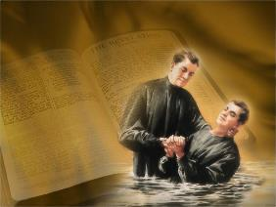

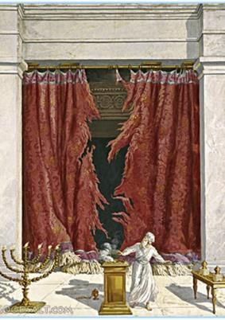
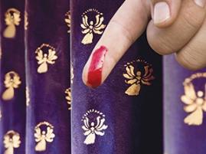
mtUila rpYitapy; Mzpabf;fg;gl;l gpukhzq;fspd; itnaOj;J
“ekf;F vjphpilahfTk; fl;lisfshy; ekf;F tpNuhjkhfTk; ,Ue;j ifnaOj;ijf; Fiyj;J> mij eLtpypuhjgbf;F vLj;J> rpYitapd;Nky; Mzpabj;J@” (nfhNyhnrau; 2:14)
Mgpufhk; tpUj;jNrjdk; %yk; NjtDldhd jdJ cld;gbf;ifia cWjpg;gLj;jpdhu; (Mjp. 17:11). Qhd];ehdk; %yk; ,NaRTldhd ekJ cld;gbf;ifia ehk; cWjpg;gLj;JfpNwhk;, mjhtJ “fpwp];Jitg;gw;Wk; tpUj;jNrjdj;jpdhNy” (nfhNyh. 2:11–12). ,jd; nghUs; cly; tpUj;jNrjdk; ,dp Njitapy;iy vd;gjhFk;. ,e;j fUj;ij njspTg;gLj;jpa gTy;, ,NaR rpYitapy; nra;j Ntiyiag; gw;wp NgRfpwhu;. ,NaR rpYitapy; vd;d rhjpj;jhu;?
mtu; ek; ghtq;fis kd;dpf;f jd; capiu nfhLj;jhu; (nfhNyh. 2:13)
vq;fSf;F vjpuhf ,Ue;j vq;fs; rl;lG+u;t fld; Fw;wr;rhl;il mtu; uj;J nra;jhu; (nfhNyh. 2:14)
mtu; jPa rf;jpfisAk; mjpfhuq;fisAk; ntd;whu;(nfhNyh. 2:15)
vNgrpau; 2:14-15y; cs;s “ifnaOj;J” kw;Wk; “fl;lisfs;”> njspTg;gLj;jg;gLfpwJ> ,J A+ju;fSf;Fk; Gw[hjpapdUf;Fk; ,ilapy; xU gpuptpid Rtiu cUthf;fpaJ.
,e;j fhuzj;jpw;fhf, gioa Vw;ghl;bd; rlq;fhr;rhu gpukhzq;fis filgpbg;gJ gw;wp ,dp ehk; ftiyg;gl Njitapy;iy, mit fpwp];Jtpy; epiwNtwp Kbtile;jd.

Slide 9
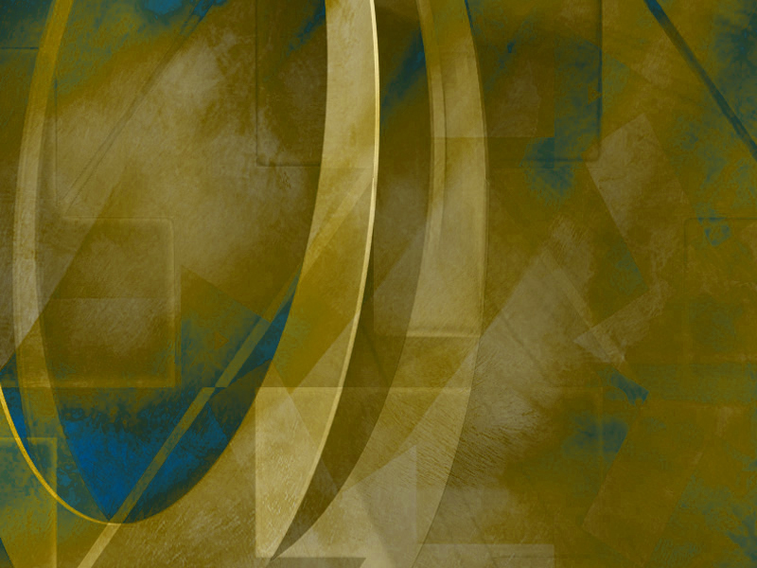
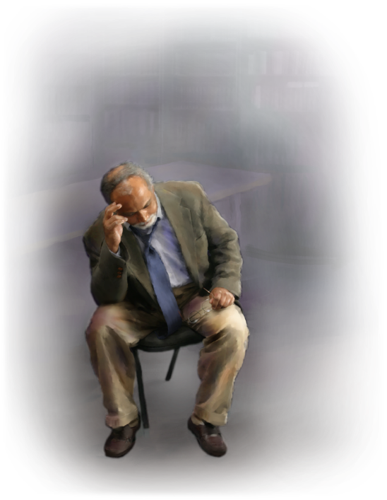
tpRthrj;ij mirf;ff;$ba gpur;ridfs;

Slide 10


gz;bif ehs;, khjg;gpwg;G, xa;Tehl;fs;
“Mifahy;> Ngh[dj;ijAk; ghdj;ijAk; Fwpj;jhtJ> gz;bif ehisAk; khjg;gpwg;igAk; Xa;Tehl;fisAq;Fwpj;jhtJ> xUtDk; cq;fisf; Fw;wg;gLj;jhjpUg;ghdhf.” (nfhNyhnrau; 2:16)
tpUj;jNrjdj;Jld;, A+ju;fisAk; Gw[hjpfisAk; NtWg;gLj;jpf; fhl;ba gpw mk;rq;fSk; ,Ue;jd: kjr; rlq;Ffs; kw;Wk; gz;biffs;.
tpUj;jNrjdj;ijf; Fwpj;J gTy; Vw;fdNt njspTg;gLj;jpapUe;jhu;. ,g;NghJ, “tpLq;fs;” vd;w nrhw;nwhlUld;, ifnaOj;J(rlq;fhr;rhu gpukhzq;fs;) uj;J nra;ag;gl;ljd; jhf;fq;fis gTy; Rl;bf;fhl;Lfpwhu;: ,NaR rpYitapy; kupg;gjd; %yk; epiwNtw;wpa rlq;Ffs; kw;Wk; gz;biffis ,ul;rpg;Gf;F ,dp filgpbf;f Njitapy;iy (kj;. 27:51; nfhNyh. 2:16).
gupRj;j ];jyj;jpd; KO rlq;FKiwiaAk; xNu thf;fpaj;jpy; RUf;fkhf nrhy;y gTy; xrpah 2:11I Nkw;Nfhs; fhl;Ltjhf njupfpwJ. ,jd; nghUs;> ,q;F Fwpg;gplg;gLs;s xa;Tehl;fs;> VO rlq;F xa;Tehl;fs; (mit ve;j thuj;jpy; te;jhYk; filg;gpbf;fg;gLk;), thue;jpu xa;Tehl;fs; my;y (gj;J fl;lisfspy; Nru;f;fg;gLs;sJ> cyfshtpaJ kw;Wk; midtUf;Fk;> A+ju;fs; kw;Wk; Gw[hjpapdu; midtUf;Fk; nghUe;Jk;).

Slide 11


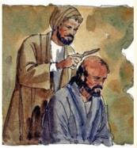

kD\Uila fw;gidfs;
“,itnay;yhk; mEgtpf;fpwjpdhy; mope;JNghFNk.” (nfhNyhnrau; 2:22)
gTy; jdJ epUgq;fspy; gyKiw Fwpg;gpLk; fs;s Nghjfu;fs;”, ,ul;rpg;ig ngw A+j rl;lj;ij filgpbf;f Ntz;ba mtrpaj;ij fw;gpj;j A+ju;fs; (mg; 15:1, 5). ,e;j rl;lq;fspy; ugpf;fshy; tFf;fg;gl;l gy tpjpfSk; mlq;Fk;.
gTypd; gFj;jwpitg; gpd;gw;WNthk;. Qhd];ehdj;jpy; ehk; “cyf mbg;gilfSf;F” kupf;fpNwhk;> fpwp];JTf;fhf tho;fpNwhk;. cjhuzkhf, rlq;fpd; mRj;jq;fis Fwpj;J ehk; njhlu;e;J ftiyg;gLfpNwhk; vd;why;, ehk; ,d;Dk; cyfpy; tho;fpNwhk;, NkYk; gad;ghl;bdhy; kiwe;J NghFk; tp\aq;fis gw;wp ehk; ftiyg;gLfpNwhk; (nfhNyh. 2:20-22).
vd;whYk;, ,e;j rlq;FfSf;F gof;fg;gl;l A+ju;fSf;F, ,it xU Fwpg;gpl;l xOf;f kjpg;ig nfhz;Ls;sd, ,Ug;gpDk; mit ,jaj;ij khw;Wtjw;F gaDs;sjhf ,y;iy vd;W gTy; njspTg;gLj;Jfpwhu; (nfhNyh. 2:23).
RUf;fkhf, ehk; Ntjj;jpy; cs;s Nghjidfshy; topelj;jg;gl Ntz;Lk;> Vnddpy; Ntjk; – kdpj jj;Jtq;fs; my;yJ gFj;jwpthy; my;y – mJ nja;tPfkhf Vtg;gl;L vOjg;gl;lJ.

Slide 12

“fpwp];jtu; yPghNdhdpd; NfJUNthL xg;gplg;gLfpwhu;. ,e;j kuk; tpisr;ry; jUk; fspkz;zpy; rpy FWfpa Ntu;fis ,wf;Ftij tpl mjpfkhf nra;fpwJ vd;W ehd; gbj;jpUf;fpNwd;. ,J G+kpf;Fs; Mokhf tYthd Ntu;fis mDg;GfpwJ, NkYk; ,d;Dk; tYthd gpbia Njb NkYk; NkYk; fPNo jhf;FfpwJ. Gaypd; fLikahd fhw;wpy;> mJ cWjpahf epw;fpwJ. fPNo cs;s mjd; Ntu;fspd; tiyaikg;ghy; gpbf;fg;gLfpwJ.
vdNt fpwp];jtu; fpwp];Jtpy; Mokhf Nt&d;Wfpwhu;. mtu; jdJ kPl;gu; kPJ ek;gpf;if itj;jpUf;fpwhu;. mtu; ahiu ek;Gfpwhu; vd;gij mtu; mwpthu;. ,NaR NjtDila Fkhud; vd;Wk; mtu; ghtpfspd; kPl;gu; vd;Wk; mtu; KOikahf ek;Gfpwhu;. ... .... tpRthrj;jpd; Ntu; Mokhf jhf;Ffpd;wd. cz;ikahd fpwp];jtu;fs;, yPgNdhdpd; NfJU kuj;ijg; Nghy, nkd;ikahd Nkw;gug;G kz;zpy; tsutpy;iy, Mdhy; Njtdpy; Nt&d;wp, kiyg; ghiwfspd; gpsTfspy; rha;e;Js;sdu;..”
vyd; [p citl; (mtu; i` fhypq;, etk;gu; 21)

