Slide 1
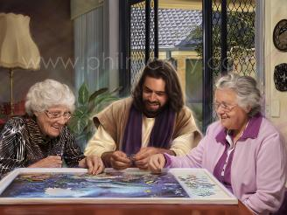
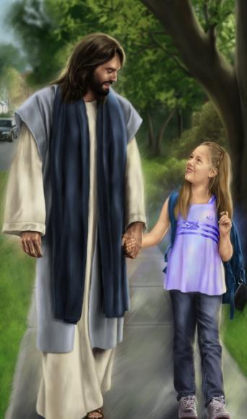
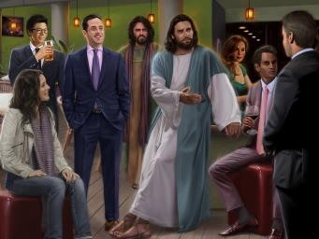
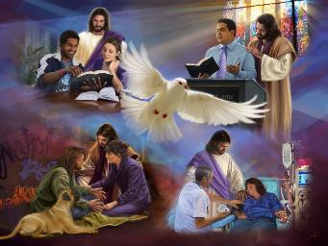
fpwp];JTld; [Ptpj;jy;
ghlk; 11 khu;r; 14, 2026

Slide 2

“,it vy;yhtw;wpd;NkYk;> g+uz rw;Fzj;jpd; fl;lhfpa md;igj; jhpj;Jf;nfhs;Sq;fs;.”
nfhNyhnrau; 3:14

Slide 3








ehk; Qhd];ehdj;jpd; ePupy; mlf;fk; nra;ag;ggLk;NghJ> ekJ gioa ght tho;f;iff;F ,wf;fpNwhk;. ehk; jz;zPupypUe;J ntspNa tUk;NghJ> Gjpa capupdq;fshf vOfpNwhk;.
ehk; ekJ gioa tho;f;ifKiwiaAk; rpe;jidiaAk; iftpl;Nlhk;. md;wpypUe;J, ehk; tpj;jpahrkhf tho;e;Njhk;> tpj;jpahrkhf rpe;jpj;Njhk;. G+kpf;Fhpa kdepiyia tpl;Ltpl;L> guNyhf kdepiyia ngw;Nwhk;.
VNjh xU fhuzj;jpw;fhf, ek;Kila gioa topfs; kPz;Lk; kPz;Lk; jiyJ}f;f Kaw;rpf;fpd;wd. mjdhy; jhd; mg;Ngh];jydfpa gTy;> guNyhfj;jpd; kPJ ek; ghu;itia itj;J> G+kpf;Fupa tp\aq;fis tpl;LtpLkhW ek;ik typAWj;Jfpwhu;.
G+kpf;Fupa kdepiy my;yJ guNyhf kdepiy?
  ek; ftdk; (nfhNyhnrau; 3:1-4)
  G+kpf;Fupa tp\aq;fSf;F kupj;jy; (nfhNyhnrau; 3:5-6)
  nja;tPf moif mzpe;Jnfhs;Sjy; (nfhNyh 3:7-11)
fpwp];Jtpy; Gjpa tho;f;ifapd; Fzeyd;fs;:
  gupG+uzj;jpd; gpizg;G (nfhNyhnrau; 3:12-14)
  guNyhf czT (nfhNyhnrau; 3:15-17)

Slide 4

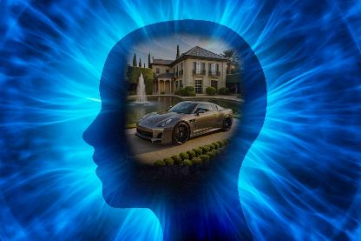
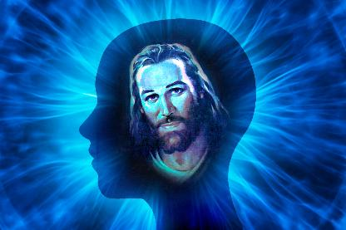
G+kpf;Fupa kdepiy my;yJ guNyhf kdepiy?

Slide 5

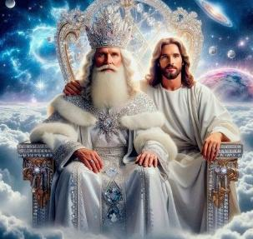
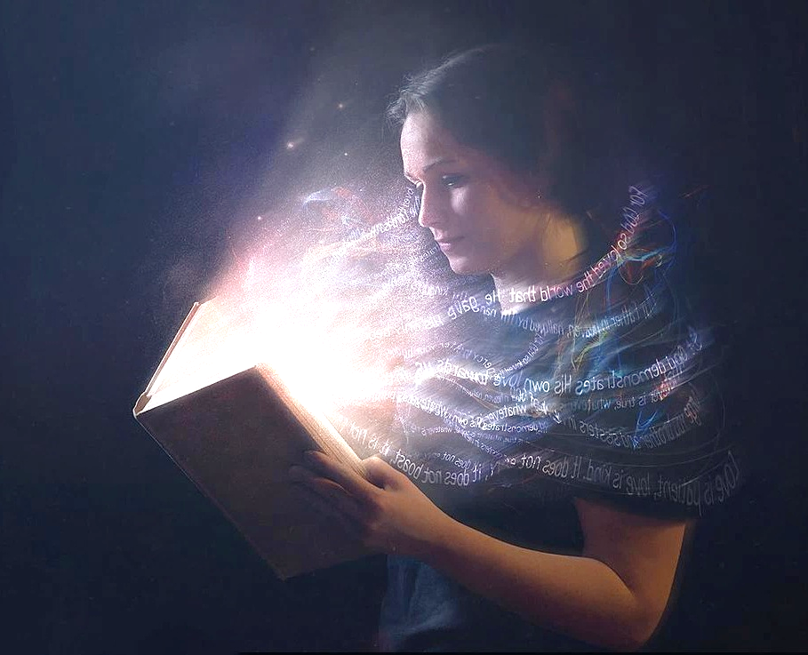
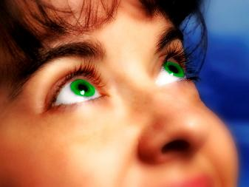
ek; ftdk;
“g+kpapYs;sitfisay;y> NkyhditfisNa ehLq;fs;.” (nfhNyhnrau; 3:2)
Qhd];ehdj;jpy; ehk; fpwp];JNthL vOg;gg;gl;Nlhk; vd;w fhuzj;jpypUe;J njhlq;fp (nfhNyh. 2:12), ,NaR capu;njOe;j gpwF mtu; nrd;w ,lj;jpw;F – NjtDila rpq;fhrdj;jpw;F – mtiu gpd;gw;Wk;gb gTy; ek;ik typAWj;Jfpwhu; (nfhNyh. 3:1).
epr;rakhf, ,NaR jk;Kila ,uz;lhk; tUifapd; NghJ ek;ik mq;F mioj;Jr; nry;Yk;NghJ kl;LNk ehk; ,ij cly;uPjpahf nra;a KbAk; (nfhNyh. 3:4). ,jw;fpilapy;, ehk; ekJ ghu;itfis—ekJ ,yf;if—guNyhf fhupaq;fspy; mikf;f Ntz;Lk; (nfhNyh. 3:2).
ehk; “kupj;Jtpl;Nlhk;”> NkYk; ekJ [Ptd; “fpwp];JTlNd NjtDf;Fs; kiwe;jpUf;fpwJ” (nfhNyh. 3:3). ,q;Nf Ngrg;gLk; [Ptd;> ehk; fpwp];Jit Vw;Wf;nfhs;Sk;NghJ ngWk; [PtdhFk;.
Mdhy; me;j [Ptd;, [PtDld; ,Uf;f, mDjpdKk; Ngh\pf;fg;gl Ntz;Lk; (2 nfhup. 4:16). Xt;nthU ehSk; ehk; “Nkyhditfis” Njl Ntz;Lk;, “,NaRtpd; kPJ ek;Kila fz;fis gjpa itf;f Ntz;Lk;” (vgp. 12:2).

Slide 6






G+kpf;Fupa tp\aq;fSf;F kupj;jy;
“Mifahy;> tpgrhuk;> mRj;jk;> Nkhfk;> Jh;,r;ir> tpf;fpufhuhjidahd nghUshir Mfpa ,itfisg; G+kpapy; cz;Lgz;Zfpw cq;fs; mtatq;fis mopj;Jg;NghLq;fs;.” (nfhNyhnrau; 3:5)
ehk; fpwp];JNthL capu;njOe;J guNyhfj;ijg; gw;wp rpe;jpj;J tho;tjhy;> ekJ ,yf;if epiwNtw;Wtij jLf;Fk; G+kpf;Fupa fhupaq;fis ehk; nfhy;y Ntz;Lk;.
ahUk; jtwhf Gupe;Jnfhs;sf;$lhJ vd;gjw;fhf, G+kpf;Fupa rpe;jidapd; mbg;gil J}z;fis Rl;bf;fhl;Lfpwhu; (mtw;iw mtu; gpd;du; ,d;Dk; cWjpahd Gs;spfspy; thu;g;ghu;): “tpgrhuk;> mRj;jk;> Nkhfk;> Jh;,r;ir> tpf;fpufhuhjidahd nghUshir” (nfhNyh. 3:5).
gTypd; fhyj;jpypUe;J kdpj ,ay;G ngupjhf khwtpy;iy, Vnddpy; gj;J fl;lisfspd; vOj;J kw;Wk; czu;T ,uz;ilAk; kPWk; mNj czu;r;rpfshy; ehk; ,d;Dk; R+og;gl;bUf;fpNwhk;.
ehk; Vd; ,tw;iw ek; vz;zq;fspypUe;Jk; nray;fspypUe;Jk; “nfhy;y” Ntz;Lk; - iftpl Ntz;Lk; - ePf;f Ntz;Lk;? Vndd;why; mit NjtDila Nfhgj;ij nfhz;L tUfpd;wd> vdNt mit ekJ guNyhf ,ay;Gf;F nghUe;jhJ (nfhNyhnrau; 3:6). G+kpf;Fupaitfs; cd;id nfhy;tjw;F Kd;G> eP G+kpf;Fupaitfis nfhy;Y!

Slide 7




nja;tPf moif mzpe;Jnfhs;Sjy;
“jd;idr; rpU\;bj;jtUila rhaYf;nfhg;gha;g; g+uz mwptilAk;gb Gjpjhf;fg;gl;l Gjpa kD\idj; jhpj;Jf;nfhz;bUf;fpwPh;fNs.” (nfhNyhnrau; 3:10)
cz;ikahd gonkhop ghzpapy;, gTy; G+kpf;Fupa rpe;jidapd; Ie;J J}z;fSld; jtpu;f;f Ntz;ba Ie;J G+kpf;Fupa nray;fis Nru;f;fpwhu;: “NfhgKk; %h;f;fKk; nghwhikAk;> cq;fs; thapy; gpwf;fyhfhj J}\zKk; tk;G thh;j;ijfSkhfpa” (nfhNyh. 3:8), NkYk; MwhtJ nraYld; KbtilfpwJ—vy;yhtw;wpYk; NkhrkhdJ—: “xUtUf;nfhUth; ngha; nrhy;Yjy;@” (nfhNyh. 3:9).
“gioa kD\idAk; mtd; nra;iffisAk; fise;JNghl;L>” ,ij ehk; Vw;fdNt nra;Jtpl;ljhf gTy; fUJfpwhu;(nfhNyh. 3:9). ,NaR ek; ghtq;fis ePf;f ehk; mDkjpj;jNghJ> ehk; ekJ “mOf;F t];jpuq;fisAk;” fise;Jtpl;Nlhk; (rfupah. 3:4).
me;j mOf;F t];jpuq;fis ehk; fise;JNghl;L, “rpwe;j t];jpuq;fis” ehk; mzpa Ntz;Lk;. ,e;j Gjpa t];jpuq;fis ehk; mzpe;Jnfhs;tjhy;, ehk; njhlu;e;J GJg;gpf;fg;gLfpNwhk;, ehSf;F ehs; gupRj;jj;jpy; tsu;fpNwhk; (nfhNyh. 3:10).
gupRj;j Mtpapd; fpupiaahYk;> thu;j;ijia gbg;gjhYk; ehk; GJg;gpf;fg;gLk;NghJ, ek;ik xUtiunthUtu; gpupf;Fk; jilfs; kiwe;JtpLk;(nfhNyh. 3:11).

Slide 8
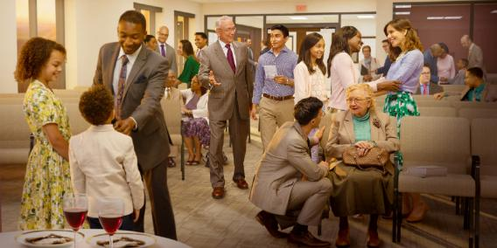

fpwp];Jtpy; Gjpa tho;f;ifapd; Fzeyd;fs;

Slide 9
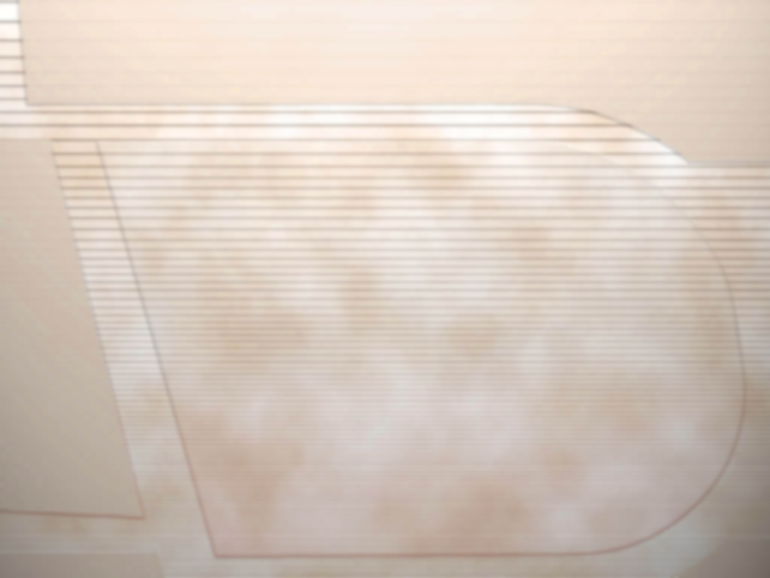
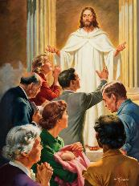


gupG+uzj;jpd; gpizg;G
“,it vy;yhtw;wpd;NkYk;> g+uz rw;Fzj;jpd; fl;lhfpa md;igj; jhpj;Jf;nfhs;Sq;fs;.” (nfhNyhnrau; 3:14)
ehk; “Njtdhy; njhpe;Jnfhs;sg;gl;l ghpRj;jUk; gphpaUkha;>” (nfhNyh. 3:12) ,Uf;fpNwhk;. ,J ekf;F kpFe;j ed;ikfisAk; ngUk; nghWg;GfisAk; jUfpwJ vd;W NgJU ekf;F nrhy;fpwhu; (1 NgJ. 2:9). Mdhy; Njtdhy; Nju;e;njLf;fg;gl;ltu;fspy; xUtu; vg;gb ele;J nfhs;fpwhu; (nfhNyh. 3:12-13)?
1
2
3
4
cUf;fkhd ,uf;fk;
jaT
kdj;jho;ik
rhe;jk;
ePba nghWik
xUtiunahUtu; jhq;Fjy;
xUtiunahUtu; kd;dpj;jy;
5
6
7
“,it vy;yhtw;wpd;NkYk;> g+uz rw;Fzj;jpd; fl;lhfpa md;igj; jhpj;Jf;nfhs;Sq;fs;.” (nfhNyh. 3:14). gpd;tUgit ek; ed;ikfs; kw;Wk; nghWg;Gfs;:
ed;ik
nghWg;G
,e;j tifapy; ehk; ele;Jnfhs;tjd; %yk; ehk; kw;wtu;fSf;Fk; ekf;Fk; xU MrPu;thjkhf ,Uf;fpNwhk;
ekJ elj;ij Njtid kfpikg;gLj;jl;Lk;, NkYk; mJ kw;wtu;fis ,NaRit ek;gTk; gpd;gw;wTk; Cf;Ftpf;fpwJ

Slide 10

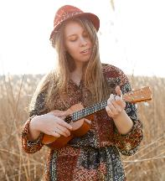
guNyhf czT
“fpwp];Jtpd; trdk; cq;fSf;Fs;Ns rfy Qhdj;NjhLk; ghpg+uzkhf thrkhapUg;gjhf@ rq;fPjq;fspdhYk; fPh;j;jidfspdhYk; Qhdg;ghl;LfspdhYk; xUtUf;nfhUth; Nghjpj;Jg; Gj;jpnrhy;ypf;nfhz;L> cq;fs; ,Ujaj;jpNy fh;j;jiug; gf;jpAld; ghb@” (nfhNyhnrau; 3:16)
nfhNyhnrau; 3:15-17, ekJ guNyhf ,ay;ig vt;thW Ngh\pg;gJ vd;gijf; fhl;LfpwJ (Mdhy; ,J vg;gb khWfpwJ vd;why;> ehk; mij jdpikapy; Ngh\pf;fKbahJ> ,jw;F ekJ jpUr;rigapd; $l;LwT mtrpak; vd;W):
NjtDila rkhjhdk; ek;ik Ms mDkjpj;jy;
xNu mikg;ghf xUkdjhf ,Uj;jy;
ed;wpAld; ,Uj;jy;
Ntjj;ij tpupthf gbj;jy;
ehk; fw;Wf;nfhz;lij xUtUf;nfhUtu; fw;gpj;jy;
rq;fPjq;fs; fPh;j;jidfs; kw;Wk; Qhdg;ghl;Lfs; ghLjy;
,NaRtpd; ehkj;jpy; vy;yhtw;iwAk; nra;jy;
“ghly; vd;gJ ehk; vg;NghJk; kdr;Nrhu;Tf;F vjpuhf gad;gLj;jf;$ba xU MAjk;. ,t;thW ek; ,ul;rfupd; gpurd;dj;jpd; R+upa xspf;F ek; ,jaj;ij jpwf;Fk;NghJ, ekf;F MNuhf;fpaKk; mtUila MrPu;thjKk; fpilf;Fk;” (vyd; [p. citl;, “jp kpdp];l;up Mg; `pypq;,” gf;. 254) .

