Slide 1
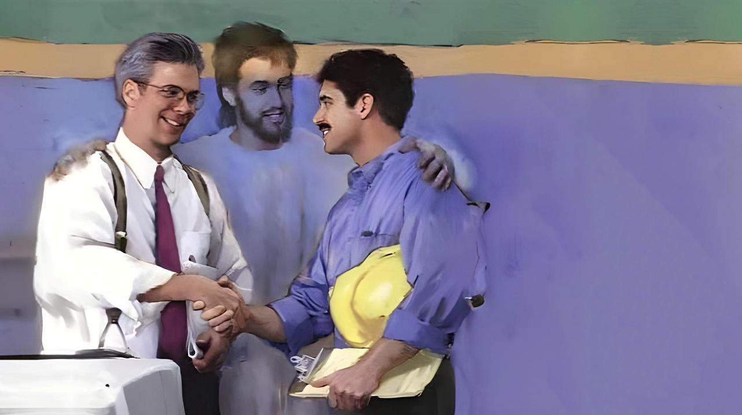
ghlk; 12 khu;r; 21, 2026
xUtNuhL xUtu; Nru;e;J tho;jy;

Slide 2
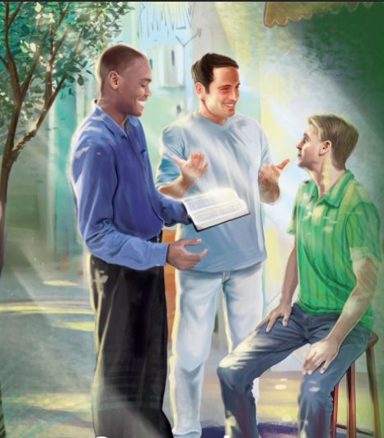

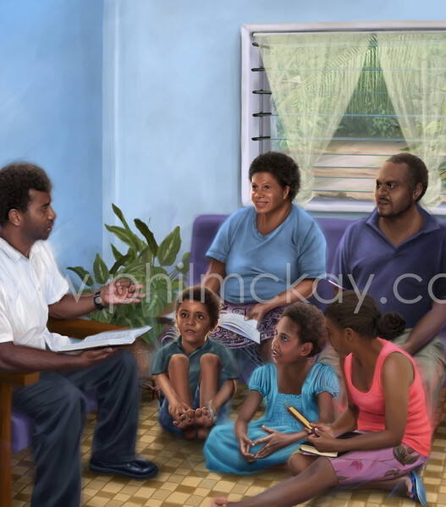

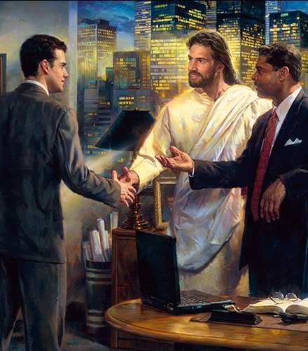

“mtdtDf;F ,d;dpd;dgb cj;juT nrhy;yNtz;Lnkd;W ePq;fs; mwpAk;gbf;F> cq;fs; trdk; vg;nghOJk; fpUig nghUe;jpdjhAk; cg;ghy; rhuNkwpdjhAkpUg;gjhf.” nfhNyhnrau; 4:6

Slide 3




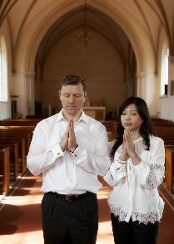

epUgj;jpd; kpfTk; eilKiwg; gFjpapy;, gy;NtW nry;thf;F tl;lq;fspy; cs;s jdpg;gl;l cwTfs; vs;w jiyg;igg; gw;wp gTy; Fwpg;gpLfpwhu;.
cwTfs; gjw;wj;ijAk; thf;Fthjq;fisAk; Vw;g;gLj;Jfpd;wd. vdNt> kjpg;Gfs;> Fwpf;Nfhs;fs; kw;Wk; Nehf;fq;fs; gw;wpa nghJthd cld;ghL> ey;ypzf;fk; ,Uf;f Ntz;Lk;.
tho;f;if Jiztu;fSf;Fk;> ngw;NwhUf;Fk; Foe;ijfSf;Fk; ,ilNa> v[khdu;fSf;Fk; mbikfSf;Fk; ,ilNa> jpUr;rig rNfhju rNfhjupfSf;F ,ilNa> tpRthrpfSf;Fk; mtpRthrpfSf;Fk; ,ilNaahd cwTfis Nk;k;gLj;Jtjw;F gTy; gaDs;s mwpTiufis ekf;F toq;Ffpwhu;.
tho;f;ifj; Jiztu;fSf;F ,ilapyhd cwTfs; (nfhNyh. 3:18-19)
ngw;NwhUf;Fk; gps;isfSf;Fk; ,ilapyhd cwTfs; (nfhNyh. 3:20-21)
KjyhspfSf;Fk; njhopyhsu;fSf;Fk; ,ilapyhd cwTfs; (nfhNyh. 3:22-25; 4:1)
jpUr;rigapy; cs;s cwTfs; (nfhNyh. 4:2-4)
mtpRthrpfSldhd cwTfs; (nfhNyh. 4:5-6)

Slide 4




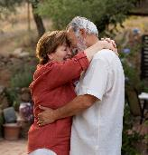
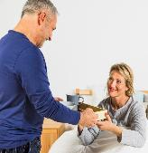

tho;f;ifj; Jiztu;fSf;F ,ilapyhd cwTfs;
“kidtpfNs> fh;j;jUf;Nfw;Fk;gb> cq;fs; GU\Uf;Ff; fPo;g;gbAq;fs;. GU\h;fNs> cq;fs; kidtpfspy; md;G$Uq;fs;> mth;fs;Nky; fre;Jnfhs;shjpUq;fs;.” (nfhNyhnrau; 3:18-19)
xNu Neuj;jpy; vOjg;gl;l nfhNyhnrau; kw;Wk; vNgrpau; epUgq;fs; tho;f;ifJiztu;fs; Fwpj;J xj;j (kw;Wk; epiwthd) MNyhridfis nfhz;Ls;sd (nfhNyh. 3:18-19; vNg. 5:21-33).
kidtpfs; jq;fs; fztu;fSf;F fPo;gba Ntz;Lk;(nfhNyh. 3:18; vNg. 5:22-24)
,e;j mw;g;gzk; gu];gu rku;g;gzj;jpw;Fs; cs;sJ(vNg. 5:21), “fh;j;jUf;Ff; fPo;g;gbfpwJNghy.”
fztu;fs; jq;fs; kidtpfis Nerpf;f Ntz;Lk;(nfhNyh. 3:19; vNg. 5:28)
fpwp];J ek;ik Nerpj;j mNj md;ghy; mtu;fis NerpAq;fs; (vNg. 5:25)
mtutu; eyDf;F mtu;fNs nghWg;G (vNg. 5:29)
“fLikahf” ,Uf;fhjPu;fs; (mtu;fis vupr;ryila nra;ahjPu;fs;> fLikahfNth my;yJ td;KiwahfNth ele;J nfhs;shjPu;fs;> nfhLq;Nfhd;ikahf ,Uf;fhjPu;fs;)
Jiztu; ,UtUk; xU FOthf nray;gl Ntz;Lk;, xUtUf;nfhUtu; fye;jhNyhrpj;J, xUkdjhf KbTfis vLf;f Ntz;Lk;, fztNd FLk;gj;jpd; rpwe;j FLk;g jiytuhf ,Uf;f Ntz;Lk;. Xt;nthUtUk; vg;NghJk; kw;wtupd; eyidNa ehl Ntz;Lk;.

Slide 5

“xt;nthUtUk; md;ig vjpu;g;ghu;f;fhky;> md;ig nfhLf;fl;Lk;. cq;fSf;Fs; cau;e;jij tsu;j;Jf; nfhs;Sq;fs;. xUtUf;nfhUtu; ey;y Fzq;fis tpiuthf milahsk; fhZq;fs;. ghuhl;lg;gLfpNwhk; vd;w czu;T xU mw;Gjkhd J}z;LjyhfTk; jpUg;jpahfTk; ,Uf;fpwJ. mDjhgKk; kupahijAk; rpwg;ghdij NjLtij Cf;Ftpf;fpd;wd. NkYk; mJ cau;e;j Nehf;fq;fisj; J}z;Lk; NghJ md;Gk; mjpfupf;fpwJ. […]
kidtp jd; fztid kjpf;f Ntz;Lk;. fztd; jd; kidtpia Nerpf;f Ntz;Lk;> Nghw;w Ntz;Lk;: mtu;fSila jpUkz cWjpnkhop mtu;fis xd;whf ,izg;gJ Nghy> fpwp];Jtpd; kPjhd mtu;fspd; ek;gpf;if mtu;fis mtupy; xd;whf;f Ntz;Lk;. jpUkz cwtpy; Eiogtu;fs; ,NaRitg; gw;wp fw;Wf;nfhs;sTk;> mtUila Mtpahy; NkYk; NkYk; epug;gg;glTk; xd;whf Kaw;rpg;gijf; fhz;gij tpl NjtDf;F gpupakhdjhf NtW vd;d ,Uf;f KbAk;?
vyd; [p citl; (jp f;wp];bad; N`hk;, gf;. 107, 114)

Slide 6




ngw;NwhUf;Fk; gps;isfSf;Fk; ,ilapyhd cwTfs;
“gps;isfNs> cq;fisg; ngw;NwhUf;F vy;yhf; fhhpaj;jpNyAk; fPo;g;gbAq;fs;@ ,J fh;j;jUf;Fg; gphpakhdJ. gpjhf;fNs> cq;fs; gps;isfs; jpldw;Wg;Nghfhjgb> mth;fSf;Ff; Nfhg%l;lhjpUq;fs;. (nfhNyhnrau; 3:20-21)
,d;iwa r%fj;jpy;, epWtg;gl;l jpUkzq;fs; kw;Wk; xw;iw ngw;Nwhu; vd ,U FLk;gq;fSf;Fk; “ngw;Nwhu;” vd;w thu;j;ij gad;gLj;jgl Ntz;Lk;. gTypd; $w;Wg;gb, MNuhf;fpakhd cwT vd;gJ ngw;Nwhupd; nghWg;G kl;Lky;y> Foe;ijfspd; nghWg;ghFk;.
kfd;fs; kw;Wk; kfs;fspd; nghWg;Gfs; (nfhNyh. 3:20; vNg. 6:1-3)
gps;isfspd; fPo;gbjy; mtu;fspd; njupT my;y
,e;j fPo;gbjy; 5Mk; fw;gidia mbg;gilahf nfhz;lJ
NkYk;> fPo;gbjy; mjd; nrhe;j ntFkjpAld; tUfpwJ
ngw;Nwhupd; nghWg;Gfs; (nfhNyh. 3:21; vNg. 6:4)
gps;isfis Nru;tila nra;ahky;> mtu;fis Nfhgg;gLj;jhky;> vupr;rY}l;lhky; mtu;fSf;F fy;tp nfhLq;fs;
nghWikapoe;J my;yJ Nftykhf ele;J nfhz;L mtu;fis Nfhgg;gLj;jhjPu;fs;
fu;j;jUf;Nfw;w topapNy mtu;fis fw;gpAq;fs;(cgh. 6:6-7; ePjp. 22:6)
ek; Foe;ijfs; Njtidg; gw;wpAk; epj;jpa [PtDf;fhf vLf;Fk; KbTfisg; gw;wpAk; fw;Wf;nfhs;s fhiy kw;Wk; khiy FLk;g n[gk; Kf;fpak;. NkYk; ekJ Kd;khjpupNa Foe;ijfSf;F kpf rpwe;j fy;tpahsu; vd;gij kwe;Jtplf; $lhJ.

Slide 7

“ngw;Nwhu;fNs, cq;fs; gps;isfs; cq;fis Nerpf;fpwhu;fs; vd;gijAk;> mtu;fis kfpo;tpf;f cq;fshy; Kbe;j midj;ijAk; nra;tPu;fs; vd;gijAk; fhzl;Lk;. ePq;fs; mt;thW nra;jhy;, cq;fSf;F Njitahd fl;Lg;ghLfs; mtu;fspd; ,sk; kdjpy; kpf mjpf vilia nfhz;bUf;Fk;. cq;fs; gps;isfis nkd;ikAlDk; ,uf;fj;JlDk; Ml;rp nra;Aq;fs;, “mth;fSf;Fhpa NjtJ}jh;fs; guNyhfj;jpNy vd; gukgpjhtpd; rKfj;ij vg;NghJk; jhprpf;fpwhh;fs;”, vd;gij epidtpy; nfhs;Sq;fs;. NjtJ}ju;fs; cq;fs; gps;isfSf;F Njtd; nfhLj;j Ntiyia nra;a Ntz;Lk; vd;W ePq;fs; tpUk;gpdhy;> cq;fs; gq;if nra;tjd; %yk; mtu;fSld; xj;Jiof;f Ntz;Lk;.”
vyd; [p citl;(jp fwp];bad; N`hk;, gf;. 193)

Slide 8



KjyhspfSf;Fk; njhopyhsu;fSf;Fk; ,ilapyhd cwTfs;
“Ntiyf;fhuNu> rhPuj;jpd;gb cq;fs; v[khd;fshapUf;fpwth;fSf;F vy;yhf; fhhpaj;jpNyAk; fPo;g;gbe;J> ePq;fs; kD\Uf;Fg; gphpakhapUf;f tpUk;Gfpwth;fshfg; ghh;itf;F CopaQ;nra;ahky;> NjtDf;Fg; gag;gLfpwth;fshff; fglkpy;yhj ,Ujaj;NjhNl CopaQ;nra;Aq;fs;.” (nfhNyhnrau; 3:22)
gTypd; fhyj;jpy; ,Ue;j mbikj;jdj;jpd; cwT> Jujp\;ltrkhf> ,d;W ,Uf;Fk; mbikj;jdj;jpd; tiffSld; rpwpJk; rk;ge;jg;gltpy;iy. vdNt ,e;j MNyhridia xU Kjyhsp kw;Wk; Ntiyahs; cwtpd; R+oypy; ehk; Gupe;Jnfhs;s Ntz;Lk;.
Ntiyahl;fspd; elj;ij(nfhNyh. 3:22-25; vNg. 6:5-8)
ahUk; ghu;f;fhtpl;lhYk; $l> vg;NghJk; cq;fshy; rpwe;jij nra;Aq;fs;
cq;fs; Ntiyia NjtDf;fhf nra;tJ Nghy;> mjpy; rpwe;J tpsq;f ghLgLq;fs;
epahakhdjhf ,Uf;Fk;NghJ f;z;ldj;ij Vw;Wnfhs;Sq;fs;
ey;y Ntiy epr;rak; gadspf;Fk;
xU Nkhrkhd Kjyhsp ek;ik fPo;gbjypy; ,Ue;J tpyf;Ftjpy;iy (1Ng 2:18)
Kjyhspfspd; elj;ij (nfhNyh. 4:1; vNg. 6:9)
cz;ikNahLk; ePjpNahLk; topelj;j Ntz;Lk;
mr;RWj;jy;fs; kw;Wk; ryd Gj;jpNahL Nfhupf;iffis gad;gLj;j Ntz;lhk;
xt;nthU Kjyhspf;Fk; Kjyhsp ,Uf;fpwhu;> mtUf;F mtu; fzf;F nfhLf;f Ntz;Lk;
ehk; midtUk;, Kjyhspfs; my;yJ Ntiyf;fhuu;fs;, vy;yhUNk fpwp];Jtpd; Copau;fs; (mbikfs;), Vndd;why; ehk; mtUf;F Nrit nra;fpNwhk;.

Slide 9

“r%fj;jpd; epWtg;gl;l xOq;if jd;dpr;irahfNth my;yJ jpbnudNth ftpo;g;gJ mg;Ngh];jyupd; Ntiy my;y. ,ij Kaw;rpg;gJ ew;nra;jpapd; ntw;wpia jLg;gjhFk;. Mdhy; mbikj;jdj;jpd; mbj;jsj;ijNa jhf;Fk; nfhs;iffis mtu; fw;gpj;jhu;. NkYk; mit eilKiwf;F te;jhy;> epr;rakhf KO mikg;igAk; Fiwkjpg;gpw;F cl;g;gLj;Jk;. […]
fpwp];jtk; v[khdUf;Fk; mbikf;Fk;> ,uh[hTf;Fk; FbkfDf;Fk;> RtpN\r CopaUf;Fk;> fpwp];Jtpy; ghtj;jpypUe;J Rj;jpfupf;fg;gl;l ghtpf;Fk; ,ilNa xU tYthd If;fpa gpizg;ig cUthf;FfpwJ. mtu;fs; xNu ,uj;jj;jpy; fOtg;gl;L> xNu Mtpahy; capu;gpf;fg;gl;Ls;sdu;: mtu;fs; fpwp];J ,NaRtpy; xd;whf;fg;gLfpwhu;fs;.
vyd; [p citl; (mg;Ngh];jyUila elgbfs;, gf;. 460)

Slide 10


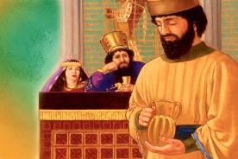
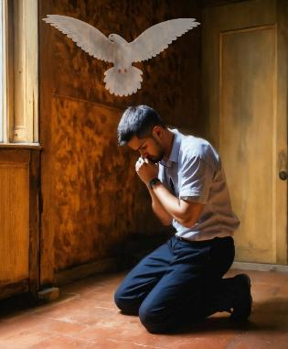
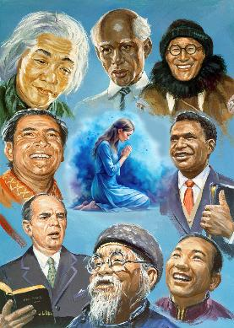
jpUr;rigapy; cs;s cwTfs;
“,iltplhky; n[gk;gz;Zq;fs;> ];Njhj;jpuj;Jld; n[gj;jpy; tpopj;jpUq;fs;.” (nfhNyhnrau; 4:2)
“xUtUf;nfhUtu; n[gpf;f Ntz;Lk;” vd;W typAWj;jg;gLfpNwhk; Vndd;why; “ePjpkhd; nra;Ak; Cf;fkhd Ntz;Ljy; kpfTk; ngyDs;sjhapUf;fpwJ.” (ahf; 5:16).
fhiy kw;Wk; khiy n[gq;fSf;F mg;ghy;, vy;yh Neuj;jpYk; n[gpf;f Ntz;Lk; vd;W gTy; Kd;nkhopfpwhu; (nfhNyh. 4:2; vNg. 6:18; 1 njr. 5:17). neNfkpah> ,uh[hTf;F Kd;ghf nksdkhf n[gpj;jJ Nghy (neNf. 2:4), ve;j ,lj;jpYk; vy;yh R+o;epiyapYk; n[gpf;Fk; ghf;fpak; ekf;F cz;L.
NkYk;, gupRj;j Mtpahdtu; ekJ n[gj;ij gaDs;sjhf khw;Wthu; vd;w cWjp ekf;F cs;sJ (Nuh. 8:26).
ew;nra;jpia mwptpg;gtu;fSf;fhf n[gpf;f gTy; xU rpwg;G Ntz;LNfhs; tpLf;fpwhu;(nfhNyh. 4:3-4; vNg. 6:19). gpurq;fk; nra;gtu;f;F RtpN\r gzpapy; rpwpjsT my;yJ mjpf mDgtk; ,Ue;jhYk; guthapy;iy; ,e;j gzpf;F ahUk; NghJkhdtu;fs; my;y. gTy; jhNd n[gpj;jJ kl;Lky;yhky;, jdJ thu;j;ijfs; rupahdjhf ,Uf;f rNfhjuu;fis jdf;fhf n[gpf;Fk;gbAk; Nfl;Lnfhz;lhu;.

Slide 11

“rj;jpak; mwpKfg;gLj;jg;gLk; xt;nthU ,lj;jpYk; xt;nthU Kaw;rpapYk;> ntt;NtW kdq;fs;> ntt;NtW jpl;lq;fs; kw;Wk; ciog;G Kiwfs; xd;wpizf;fg;gl Ntz;ba mtrpak; cs;sJ. midtUk; xd;whf MNyhrid toq;FtijAk;> xd;whf n[gpg;gijAk; xU FwpNfhshf nfhs;s Ntz;Lk;. fpwp];J nrhy;fpwhu;, “my;yhkYk;> cq;fspy; ,uz;L Ngh; jhq;fs; Ntz;bf;nfhs;sg;Nghfpw ve;jf; fhhpaj;ijf; Fwpj;jhfpYk; g+kpapNy xUkdg;gl;bUe;jhy;> guNyhfj;jpy; ,Uf;fpw vd; gpjhtpdhy; mJ mth;fSf;F cz;lhFk; vd;W cq;fSf;Fr; nrhy;YfpNwd;.” (kj;NjA 18:19)”
vyd; [p citl; (nryf;ll; nkrN][];, mjp. 3, gf;. 24)

Slide 12

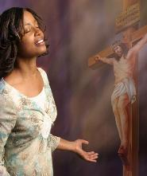
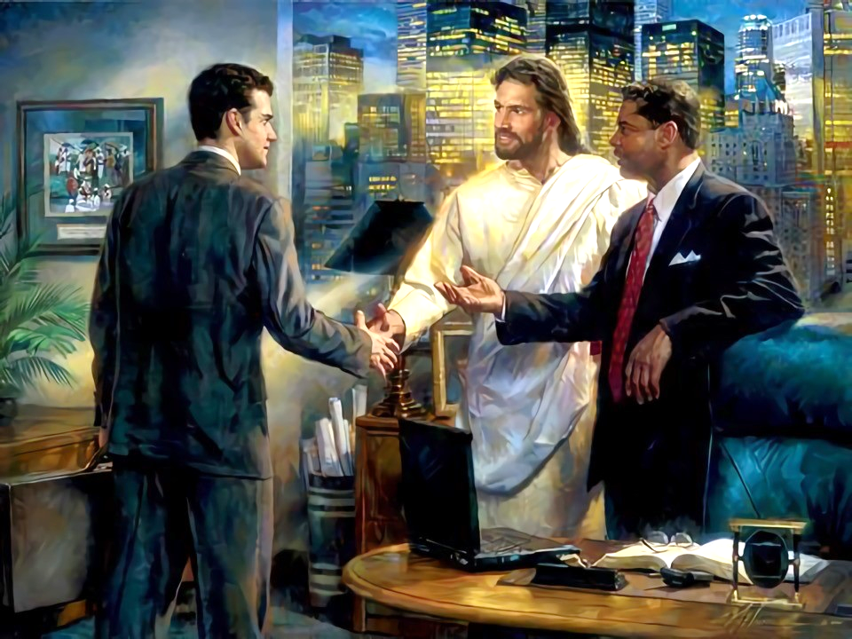
mtpRthrpfSldhd cwTfs;
“Gwk;NgapUf;fpwth;fSf;F Kd;ghf Qhdkha; ele;J> fhyj;ijg; gpuNah[dg;gLj;jpf;nfhs;Sq;fs;.” (nfhNyhnrau; 4:5)
ekf;F ngUk; ed;ikfs; cz;L: ,NaR ekf;fhf nra;jijf; fw;Wnfhz;Nlhk;; mij Vw;Wf;nfhz;Nlhk;; ,ul;rpg;gpd; epr;raKk; ekf;F cz;L.
ahNuh xUtu; ekf;F nrhd;dhy; mij ehk; mwpNthk;. mNj Nghy, ehk; mij kw;wtu;fSld; gfpu;e;J nfhs;s Ntz;Lk;. ,NaRit ,d;Dk; mwpahj “ntspahl;fSld;,” ehk; vt;thW njhlu;G nfhs;s Ntz;Lk; vd;W gTy; $Wfpwhu; (nfhNyh. 4:5-6)?
Qhdj;Jld;
,NaRit mwpahjtu;fSldhd ekJ cwtpy;> “guj;jpypUe;J tUfpw Qhdk;” ekf;F Njit(ahf;NfhG 3:17)
fdpthd thu;j;ijfSld;
ek; thu;j;ijfs; vg;NghJk; gzpthf ,Uf;f Ntz;Lk;. mg;NghJ jhd; mtu;fs; ek; Ngr;ir kfpo;r;rpAld; Nfl;ghu;fs;.
“cg;ghy; rhuNkwpd thu;j;ijfSld;”
ciuahly; nghUj;jkhdjhfTk;> me;j egUf;Fk; mtu;fis Rw;wpAs;s R+oYf;Fk; Vw;wjhfTk; ,Uf;f Ntz;Lk;.
Xt;nthd;wpw;Fk; nghUj;jkhd Kiwapy; gjpyspg;gJ
xt;nthU egUk; tpj;jahrkhf ,Ug;gjhy;, xt;nthU jUzj;jpYk; vd;d gjpyspf;f Ntz;Lk; vd;gij gupRj;j Mtpahdtu; ekf;F topfhl;Lthu;

Slide 13

vyd; [p citl; (,d; `td;yp g;Nsr];, [_d; 22)
“cz;ikAk; ePjpAk; fye;j kupahij tho;f;ifia gaDs;sjhf kl;Lky;yhky; mofhfTk; kzk;kpf;fjhfTk; Mf;FfpwJ. fdpthd thu;j;ijfs;> ,dpikahd ghu;itfs;> kfpo;r;rpahd Kfk;> fpwp];jtiug; gw;wp xU trPfuj;ij tPRfpd;wd> ,J mtuJ nry;thf;if fpl;lj;jl;l jtpu;f;f Kbahjjhf Mf;FfpwJ. jd;id kwg;gjpy;> mtu; njhlu;e;J kw;wtu;fSf;F toq;Fk; xsp> mikjp kw;Wk; kfpo;r;rpapy;> mtu; cz;ikahd kfpo;r;rpia fhz;fpwhu;.
ehk; Raj;ij kwg;Nghkhf, vg;NghJk; tpopg;Gld; ,Ue;J kw;wtu;fis cw;rhfg;gLj;JNthk;, nkd;ikahd fUiz kw;Wk; jd;dykw;w md;gpd; nray;fshy; mtu;fspd; Rikfis ,yFthf;FNthk;.”

