Slide 1
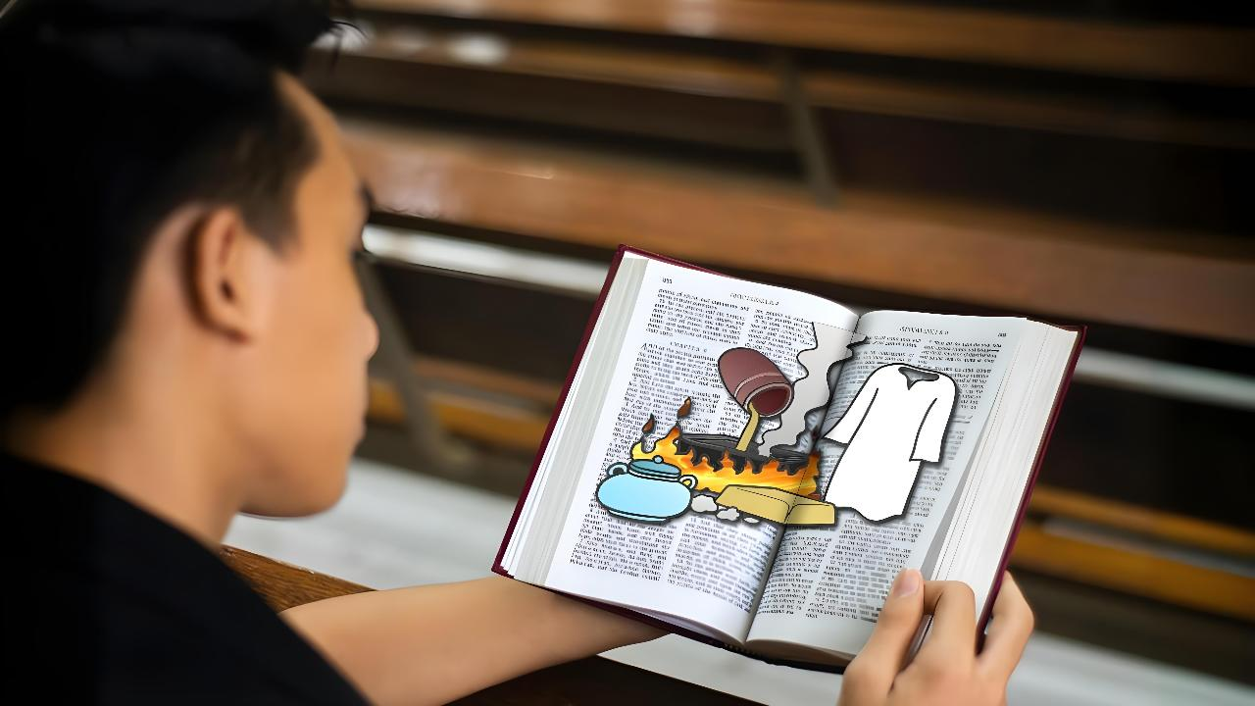
cz;ikepiy mwpjy;
ghlk; 1 Vg;uy; 4, 2026

Slide 2
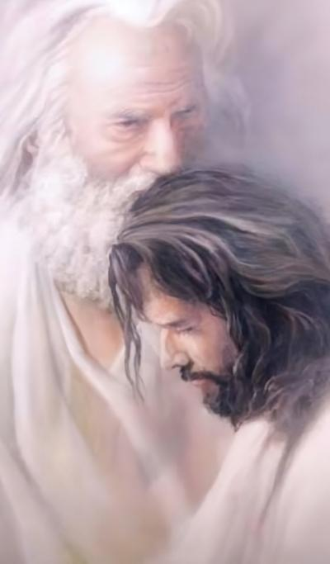
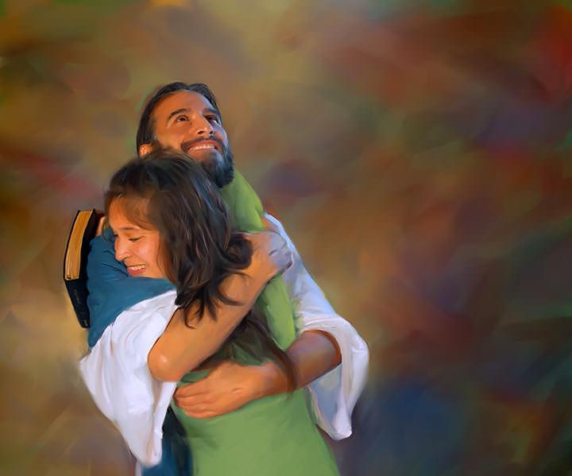
“gpjh vd;dpy; md;ghapUf;fpwJ Nghy ehDk; cq;fspy; md;ghapUf;fpNwd;@ vd;Dila md;gpNy epiyj;jpUq;fs;..”
(Nahthd; 15:9)

Slide 3

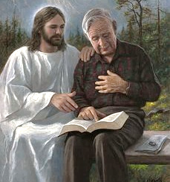
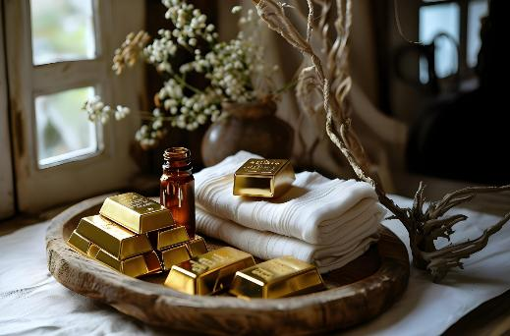


ek;kpy; xt;nthUtUf;Fk; NjtDld; xU tpj;jpahrkhd cwT mike;jpUf;fpwJ. Mdhy;> xU tp\aj;jpy; ehk; midtUk; cld;gLfpNwhk;: ,e;j cwT tsu KbAk; (tsuTk; Ntz;Lk;).
ehk; tsu;r;rp miltjw;F vLf;f Ntz;ba Kjy; gb> ekJ jw;Nghija epiyia czu;e;J nfhs;tNj MFk;.
tho;tpd; ,e;j ,Wjpf; fl;lj;jpy; jpUr;rigapd; Md;kPf epiy Fwpj;J Njtd; ekf;F xU nghJthd nra;jpia je;Js;shu;. ,g;NghJ> me;j nra;jpapd; ve;j gFjp ekf;F nghUe;JfpwJ vd;gijAk;> NjtDldhd ekJ cwit vt;thW gyg;gLj;jp Mo;g;gLj;JtJ vd;gijAk; mwpe;Jnfhs;s> ek;ik ehNk Muha;e;J ghu;g;gJ ekJ nghWg;ghFk;.
NjtDila nra;jp (ntspg;gLj;jy; 3:14-22):
  kjpg;gPL (t. 14-17)
  jPu;T (t. 18)
  tpisT (t. 19-20)
  jpUg;jp (t. 21-22)
cz;ikepiy mwpjy; (Nahthd; 15:1-11):
  nfhbAk; nrbAk;
  rhW

Slide 4

NjtDila nra;jp
(ntspg;gLj;jy; 3:14-22)

Slide 5




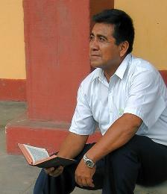
kjpg;gha;T
“eP eph;g;ghf;fpaKs;stDk;> ghpjgpf;fg;glj;jf;ftDk;> jhpj;jpuDk;> FUlDk;> eph;thzpAkhapUf;fpwijmwpahky;> ehd; IRthpathndd;Wk;> jputpark;gd;dndd;Wk;> vdf;F xU FiwTkpy;iynad;Wk;> nrhy;Yfpwgbahy;@” (ntspg;gLj;jy; 3:17)
VO rigfSf;F mspf;fg;gl;l nra;jpahdJ> mg;Ngh];jyu;fspd; fhyk; Kjy; ,d;W tiu cyf jpUr;rigapd; epiyia vLj;Jiuf;fpwJ.
(ntsp. 2-3). ek;Kila ehSf;fhd nra;jpia (yNthjpf;Nfah) mspf;Fk;NghJ, ,NaR jk;ik “MNkd; [rj;jpak;], cz;ikAk; rj;jpaKKs;s rhl;rp” (ntsp. 3:14) vd;fpwhu;.
ehk; ek;ik ghu;f;Fk;NghJ ek;Kila cz;ikia ghu;f;fpNwhk; : “ehd; IRthpathndd;Wk;> jputpark;gd;dndd;Wk;> vdf;F xU FiwTkpy;iynad;Wk;>” (ntsp. 3:17K) vd;W nrhy;fpNwhk;.
Mdhy; ,NaRNth cz;ikia> ekJ ajhu;j;jj;ij fhz;fpwhu;: “eP eph;g;ghf;fpaKs;stDk;> ghpjgpf;fg;glj;jf;ftDk;> jhpj;jpuDk;> FUlDk;> eph;thzp” (ntsp. 3:17gp) vd;W $Wfpwhu;.
,g;NghJ ek;ik ehNk kjpg;gPL nra;a Ntz;ba Neuk;. cz;ikahfNt vd;dplk; vd;d ,Uf;fpwJ> vdf;F ,d;Dk; vd;d Njit vd;gij ehd; czu;e;jpUf;fpNwdh? ,NaRTldhd vdJ cwtpy; ehd; vt;tsT tsu;e;jpUf;fpNwd;? ehd; ey;ytpjkhf khwpf; nfhz;bUf;fpNwdh?

Slide 6


jPu;T
“ehd;: eP IRthpathdhFk;gbf;F neUg;gpNy Glkplg;gl;l nghd;idAk;> cd; eph;thzkhfpa mtyl;rzk; Njhd;whjgbf;F eP cLj;jpf;nfhs;tjw;F ntz;t];jpuq;fisAk; vd;dplj;jpNy thq;fpf;nfhs;sTk;> eP ghh;itailAk;gbf;F cd; fz;fSf;Ff; fypf;fk;NghlTk; Ntz;Lnkd;W cdf;F MNyhrid nrhy;YfpNwd;.” (ntspg;gLj;jy; 3:18)
ekJ R+o;epiyapy; jpUg;jpahf ,Ug;gJ mf;fiwapd;ikia (ntJntJg;ig) cz;lhf;Ftjhy;> %d;W fhupaq;fis nra;AkhW ,NaR ekf;F mwpTWj;Jfpwhu;:
Glkplg;gl;l nghd;id thq;f Ntz;Lk;
miuFiw cz;ikfSlNdh my;yJ Ntjhfkj;jpd; NkNyhl;lkhd Ma;TfSlNdh ehk; jpUg;jp mile;Jtplf;$lhJ. kdpju;fspd; Nghjidfis (gsg;gsg;ghd myq;fhuq;fis) ehk; epuhfupj;J> Ntjhfkj;ij gw;wpa ekJ Gupjypy; cs;s vy;yh FiwghLfisAk; (frLfisAk;) ePf;Ftjw;fhf> mjidf; Fwpj;j ekJ Ma;tpy; ehk; Mokhf Ko;f Ntz;Lk;.
ntz;t];jpuq;fis thq;f Ntz;Lk;
ekJ nrhe;j ePjpahd nray;fshy; ek;ik NjtDf;F Kd;ghf fhl;l Kaw;rpg;gJ> mtUf;F Kd;ghf ek;ik epu;thzkhf fhl;Ltjw;F rkk;. ,ul;rpg;ig miltjw;fhd xNu topahf ,NaRtpd; ePjpia Vw;Wf;nfhs;s Ntz;Lk;
fz;fSf;Ff; fypf;fk; Nghl Ntz;Lk;
gupRj;j Mtpiag; ngw;Wf;nfhs;Sq;fs;. mtuhy; kl;LNk ekf;F Mtpf;Fupa gFj;jwpit je;J> ekJ cz;ikahd epiyia ekf;F czu;j;j KbAk; (Nahthd; 16:8).

Slide 7

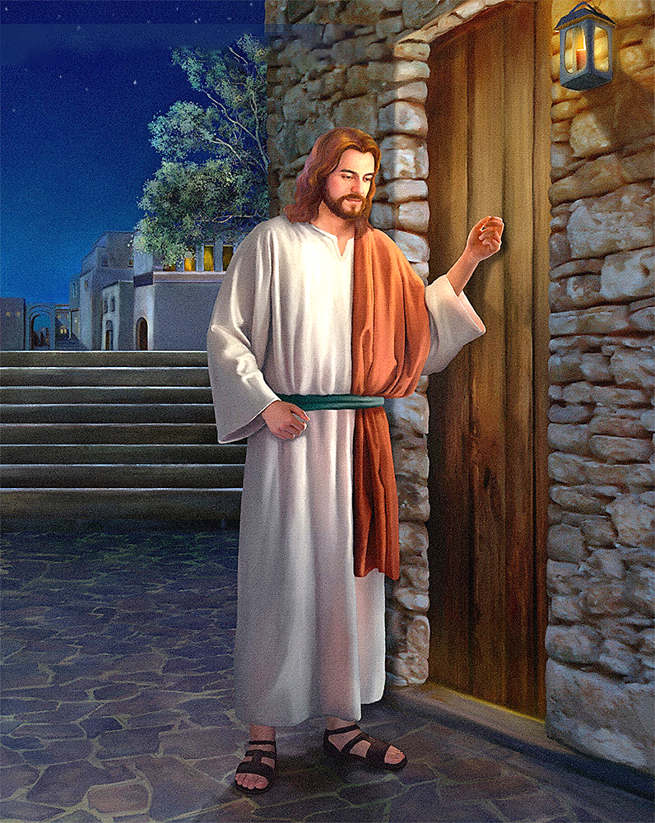
tpisT
“,Njh> thrw;gbapNy epd;W jl;LfpNwd;@ xUtd; vd; rj;jj;ijf;Nfl;L> fjitj; jpwe;jhy;> mtdplj;jpy; ehd; gpuNtrpj;J> mtNdhNl Ngh[dk;gz;ZNtd;> mtDk; vd;NdhNl Ngh[dk;gz;Zthd;.” (ntspg;gLj;jy; 3:20)
xU gpur;rid ,Uf;fpwJ. Md;kPf uPjpahf ehd; ed;whf ed;whfNt czu;fpNwd;> Mdhy; ehd; Nkk;gl Ntz;Lk; vd ,NaR tpUk;Gfpwhu;. ,Ug;gpDk;, vdf;F khw;wk; Njit vd;gij czuhtpl;lhy;> ehd; xUNghJk; khw khl;Nld;. vd;dplk; Vw;fdNt ,Ug;gjhf ehd; epidf;Fk; xd;iw kPz;Lk; thq;f ehd; xUNghJk; tpUk;gkhl;Nld;.
,ij jPu;f;f, ,NaRtplk;> mtUf;Nf cupa topKiwfs; cs;sd: “ehd; Nerpf;fpwth;fnsth;fNsh mth;fisf; fbe;Jnfhz;L rpl;rpf;fpNwd;@”, NkYk; mtu;: “kde;jpUk;G” vd;fpwhu; (ntsp. 3:19).
,NaRtpd; fz;ldKk; jz;lidAk; vjpu;kiwahdit my;y. mtu; ciuahly; ghijiaNa tpUk;Gfpwhu;. mtu; ek;Kld; mikjpahf mku;e;J Ngr tpUk;Gfpwhu;… “,Njh> thrw;gbapNy epd;W jl;LfpNwd;@ xUtd; vd; rj;jj;ijf;Nfl;L> fjitj; jpwe;jhy;> mtdplj;jpy; ehd; gpuNtrpj;J> mtNdhNl Ngh[dk;gz;ZNtd;> mtDk; vd;NdhNl Ngh[dk;gz;Zthd;.” (ntsp. 3:20).
,NaR vd; ,ja fjit jl;b nghWikAld; fhj;jpUf;fpwhu;. mtUld; xU cwit Vw;g;gLj;jpf;nfhs;Sk;gb vd;id fl;lhag;gLj;Jtjw;fhf mtu; vd; tho;tpy; FWf;fpLtjpy;iy. mij jpwf;Fk; KbT vd;DilaJ

Slide 8


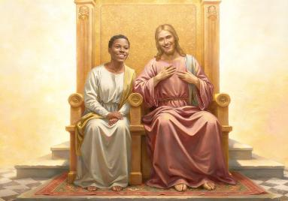
jpUg;jp
“ehd; n[aq;nfhz;L vd; gpjhtpDila rpq;fhrdj;jpNy mtNuhNl$l cl;fhh;e;jJNghy> n[aq;nfhs;SfpwtndtNdh mtDk; vd;Dila rpq;fhrdj;jpy; vd;NdhNl$l cl;fhUk;gbf;F mUs;nra;Ntd;.” (ntspg;Lj;jy; 3:21)
,e;j ghij vspjhdjy;y vd;gij ,NaR mwpthu;. nghd;id thq;Ftjw;Fk;> ntz;t];jpuk; thq;Ftjw;Fk;> fz;fis fhg;gjw;Fk; ehk; nra;Ak; Kaw;rpfis mtu; mwpthu;. ntJntJg;giltjw;Fk; fjitf; jpwg;gjw;Fk; mtUld; ,iztjw;Fk; ehk; gLk; Nghuhl;lq;fisAk; mtu; mwpthu;. mjdhy; jhd; mtu; ek;kplk;: ehd; n[ak; nfhz;lJ Nghy ePq;fSk; n[ak; nfhs;s KbAk; (ntsp. 3:21).
ehk; xUNghJk; Kjy; mbia vLj;J itf;f khl;Nlhk; vd;gJk; mtUf;F njupAk;> Njtd; jhk; vg;NghJNk Kd;Kaw;rp vLj;jpUf;fpwhu;.
mtu; ek;ik gilf;f jPu;khdpj;jhu;
(Mjp. 2:7)
ehk; ghtk; nra;jpUf;Fk; NghJ mtu; ek;ik Njb tUfpwhu; (Mjp. 3:8-9)
ek;ik fhg;ghw;w jk;ikNa mtu; jpahfk; nra;jhu; (Nahthd; 3:16)
mtu; ekf;F xU ntFkjpia mspf;f tpUk;Gfpwhu;: mtUld; mku;e;J> mtUila JizAld; epj;jpaj;ij mDgtpg;gNj mJ (ntsp. 3:21)
,e;j nja;tPf elj;ijf;fhd jpwTNfhy; jhd; (ehk; jFjpahdtu;fs; my;y) md;G: “mehjp rpNefj;jhy; cd;idr; rpNefpj;Njd;@” (vNukpah 31:3). mtu; ek;Kld; xU cwit itj;Jf; nfhs;s tpUk;Gfpwhu;. ehk; mtUld; xU cwit Vw;gLj;jpf; nfhs;s tpUk;GfpNwhkh? mtu; ek;ik Nerpg;gJ Nghy> ehKk; ek; ,jaj;ij mtUf;F jpwe;J mtiu Nerpg;Nghkh?

Slide 9

cz;ikepiy mwpjy;
(Nahthd; 15:1-11)

Slide 10

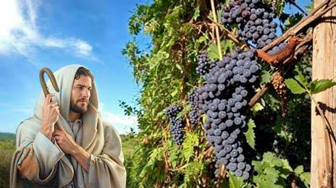
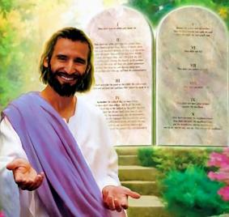

nrbAk; nfhbAk;
“ehNd jpuhl;rr;nrb> ePq;fs; nfhbfs;. xUtd; vd;dpYk; ehd; mtdpYk; epiyj;jpUe;jhy;> mtd; kpFe;j fdpfisf; nfhLg;ghd;@ vd;iday;yhky; cq;fshy; xd;Wk; nra;af;$lhJ.” (Nahthd; 15:5)
jkJ kuzj;jpw;F rw;W Kd;G, ,NaR jk;ik “jpuhl;ir nrb,” vd;Wk; jk; rPlu;fs; “fpisfs;” vd;Wk; mwptpj;jhu;. ,jd; %yk; mtu; vd;d $w tpUk;gpdhu;?
xU nfhbahdJ nrbAld; ,izf;fg;lhky; rpwpJ fhyk; tho KbAk;> Mdhy; mJ ,Wjpapy; thbtpLk;. ehk; epj;jpa [Ptid ,oe;Jtplhjgbf;F> ,NaR ek;kplk; xU kd;whl;L itf;fpwhu;: “vd;dpy; epiyj;jpUq;fs;” (Nahthd; 15:4). jpuhl;irnrb kw;Wk; mjd; nfhbfis Fwpj;j ,e;j ctikia ,NaR nrhy;Yk; 11 trdq;fspy;> 10 Kiw “epiyj;jpUq;fs;” vd;w tpidnrhy;iy gad;gLj;Jfpwhu;. mJ epr;rakhf kpfTk; Kf;fpakhd xd;whf ,Uf;f Ntz;Lk;.
yNthjpf;Nfahtpd; ke;jkhd kdg;ghd;ikf;F ,NaRtpy; epiyj;jpUg;gJ xU khw;W kUe;jhFk;. NkYk;, mJ kfpo;r;rpapd; Cw;whFk; (Nahthd; 5:11). Mdhy; ehk; vg;gb ,NaRtpy; epiyj;jpUf;fKbAk;?
mtUf;F gpupakhdij nra;tjd; %yk;, mjthJ, mtUila fl;lisfis ifnfhs;tjd; %yk; (Nahthd; 15:10). ,J> Njtd; ekf;F fhl;ba md;Gf;F ehk; nfhLf;Fk; md;ghd gjpyhFk; (1 Nahthd; 4:19).

Slide 11


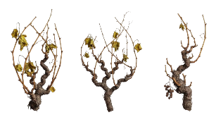

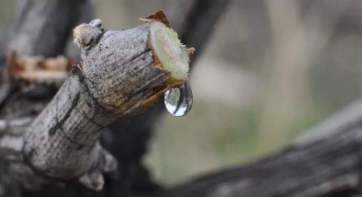
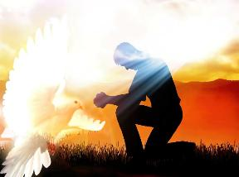
rhW
“vd;dpy; epiyj;jpUq;fs;> ehDk; cq;fspy; epiyj;jpUg;Ngd;@ nfhbahdJ jpuhl;rr;nrbapy; epiyj;jpuhtpl;lhy; mJ jhdha;f; fdpnfhLf;fkhl;lhjJ Nghy> ePq;fSk; vd;dpy; epiyj;jpuhtpl;lhy;> fdpnfhLf;fkhl;Bh;fs;.” (Nahths; 15:4)
Fspu; fhyj;jpy;, nfhbfs; nrbAld; ,ize;jpUf;Fk;, Mdhy; mit goq;fis jUtjpy;iy. Vd;? Vndd;why; mtw;Wf;F rhW fpilg;gjpy;iy.
tre;j fhyk; tUk;NghJ kl;LNk ,it jpuhl;ir nrbapypUe;J rhw;iw ngWfpd;wd. mjd; gpwF jspu;fs; (jz;Lfs;) tUfpd;wd. Nahthd; gad;gLj;jpa fpNuf;f nrhy;yhdJ> Kwpj;J vLf;fg;gl;L kPz;Lk; jpuhl;ir nrbapy; xl;Lf;fl;lg;gl;l nfhbfisAk; Fwpf;fyhk;.
ehk; ,se;jspu;fshf ,Ue;jhYk; rup> Kwpe;j fpisfshf ,Ue;jhYk; rup> xU tp\ak; njspthfpwJ: ekf;F nrbapd; rhW Njit. ,e;j rhw;iw ehk; vjDld; xg;gplyhk;?
mNj gpurq;fj;jpy; (Nahthd; 14-17), ,NaR ekf;F ,t;thW tpsf;Ffpwhu;: ehk; tpUk;gpdhy;> ekf;F [Ptid nfhLg;gjw;fhf gupRj;j MtpahdtNu ekf;Fs;Ns fpupia nra;fpwhu;.
mtu; ekJ Njw;wuthsd; (Nahthd; 14:16-17)
mtu; ekf;F ,NaRit ntspg;gLj;Jthu; (Nahthd; 15:26)
ghtj;ijf; Fwpj;J czu;j;Jthu; (Nahthd; 16:8)
rfy rj;jpaj;jpw;Fs;Sk; ek;ik elj;Jthu; (Nahthd; 16:13)

