Slide 1



md;gpd; cUtg;glk;
ghlk; 7 Mf];l; 15, 2026

Slide 2

“,g;nghOJ tpRthrk;> ek;gpf;if> md;G ,k;%d;Wk; epiyj;jpUf;fpwJ@ ,itfspy; md;Ng nghpaJ.”
(1 nfhupe;jpau; 13:13)

Slide 3


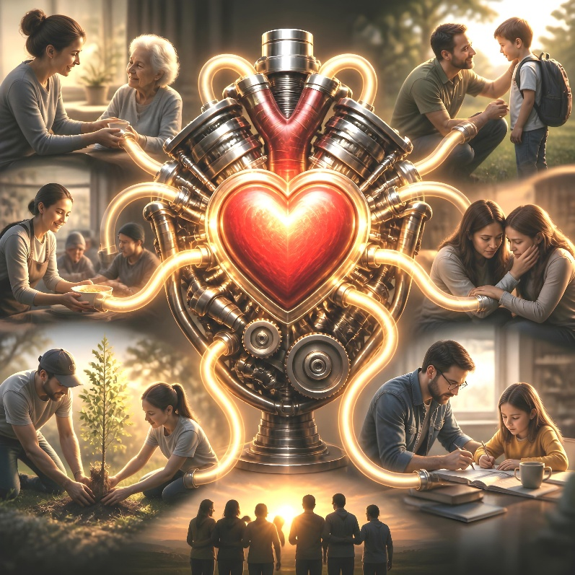
1 nfhupe;jpau; 13 “md;gpd; mjpfhuk;” vdg;gLk;. ,J fhjy; md;ig tiuaWf;ftpy;iy, mijtpl Mokhd xU tifahd md;igNa tiuaWf;fpwJ: mJNt nja;tPf md;G.
ek; ,Ujaq;fspy; Cw;wg;gl;bUf;Fk; NjtDila md;ig ek; tho;tpy; vt;thW ntspg;gLj;JtJ nd;gijg; gTy; kpf rpwg;ghf tpsf;Ffpwhu; (Nuh. 5:5).
ekJ midj;J nray;fSf;Fk; gpd;dhy; cs;s ce;Jrf;jp md;Ng, ehk; goFk; kdpju;fSf;Fg; gadspf;Fk; tifapyhd nray;fis nra;tjw;F mJNt fhuzkhf mikfpwJ.
md;gpd; cUtg;glk;
md;gpd; Nkd;ik
kpfTk; rpwe;j top
md;gpd; Fzq;fs;
md;G vd;d nra;Ak;
md;G vd;d nra;ahJ
,NaRtpd; rpj;jpuk;
md;gpd; tplhKaw;rp
kpfr; rpwe;j Fzq;fs;

Slide 4


md;gpd; Nkd;ik

Slide 5




kpfr; rpwe;j top
“,g;gbapUf;f> Kf;fpakhd tuq;fis ehLq;fs;@ ,d;Dk; mjpf Nkd;ikahd topiaAk; cq;fSf;Ff; fhz;gpf;fpNwd;.” (1 nfhupe;jpau; 12:31)
1 nfhupe;jpau; 13-y; gTy; ve;j tpjkhd md;ig Kd;itf;fpwhu;? mJ Mtpf;Fupa ve;j tuj;ijAk; Vd; tpQ;rp epw;fpwJ? (1 nfh. 12:31-13:3)
fpNuf;f nkhopapy; md;igf; Fwpf;f gy nrhw;fs; cz;L. gTy; mfhNg vd;gijj; Nju;e;njLf;fpwhu; (Raeykw;w> epge;jidaw;w> Nerpf;fg;gLfpwtupd; ed;ikia kl;LNk ehLfpw md;G)@ “Njtd; md;ghfNt ,Uf;fpwhu;” (1 Nahthd; 4:8) vd;W Nahthd; nrhy;Yk;NghJ gad;gLj;Jfpw mNj nrhy; ,JNt.
,e;j tpjkhd md;gpdhy; Vtg;gl;L gad;gLj;jg;glhtpl;lhy;> Mtpf;Fupa ve;j tuKk; gadw;wJ. cz;ikapy;> ekJ vy;yhr; nray;fSk; vz;zq;fSk; mfhNg md;gpdhy; epiwe;jpUf;f Ntz;Lk;.
mf;fpukk; ngUFtjhy; ,e;j md;G jzpe;JNghFk; vd;W ,NaR vr;rupj;jhu;
(kj;NjA 24:12). Mdhy; ek;kpNyh> ek; tPLfspNyh> ek; rigfspNyh ,J epfo ,lq;nfhLf;fyhfhJ.

Slide 6

md;gpd; Fzq;fs;

Slide 7


md;G vd;d nra;Ak;?
“md;G ePba rhe;jKk; jaTKs;sJ@ md;Gf;Fg; nghwhikapy;iy@ md;G jd;idg; GfohJ> ,Wkhg;ghapuhJ> mNahf;fpakhdijr; nra;ahJ> jw;nghopit ehlhJ> rpdkilahJ> jPq;F epidahJ> mepahaj;jpy; re;Njh\g;glhky;> rj;jpaj;jpy; re;Njh\g;gLk;. rfyj;ijAk; jhq;Fk;> rfyj;ijAk; tpRthrpf;Fk;> rfyj;ijAk; ek;Gk;> rfyj;ijAk; rfpf;Fk;.” (1 nfhupe;jpau; 13:4-7)
ePba rhe;jk; cs;sJ
jaTs;sJ
rj;jpaj;jpy; re;Njh\g;gLk;
kf;NuhijNkNah: ePz;l MtpAs;stuha; ,Uj;jy;> rfpj;jy;> nghWikaha; ,Uj;jy;
nghWik fhl;b> kw;wtu;fspd; jtWfisr; rfpj;Jf;nfhs;Sq;fs;
,u];bANka; : ed;ikaha; ele;Jnfhs;Sjy;
,uf;fKk; kdJUf;fKk; cs;sJ
rpd;i[Nuh: mDjhgk; njuptpj;jy;> tho;j;Jjy;
rj;jpaj;ij Mjupf;fpwtu;fNshL Nru;e;J re;Njh\g;gLk;
rfyj;ijAk; jhq;Fk;
];bN[h: mikjpahy; kiwj;jy; (nghWikaha;r; rfpj;jy;)
kw;wtu;fspd; Fiwfis ntspg;gLj;jhky; kiwj;J> mikjp fhj;J nfhs;Sq;fs;
rfyj;ijAk; tpRthrpf;Fk;
gp];bNah: tpRthrk; itj;jy;> ek;Gjy;> rhu;e;jpUj;jy;
Fw;wk; jPu;f;fhky;> re;Njfj;jpd; gaid mspf;Fk;
rfyj;ijAk; ek;Gk;
vy;gpN]h: vjpu;ghu;j;jpUj;jy; my;yJ ek;Gjy;
ey;yJ elf;Fk; vd;W vg;NghJk; vjpu;ghUq;fs;
rfyj;ijAk; rfpf;Fk;
`pg;NghnkNdh: vjpu;j;J epw;wy;> rfpj;jy;> kdcWjp nfhs;Sjy;> epiyj;jpUj;jy;
f\;lq;fisAk; NrhjidfisAk; cgj;jputq;fisAk; rfpAq;fs;

Slide 8


md;G vd;d nra;ahJ?
nghwhikg; glhJ
]pY: vupr;ryhd
czu;T nfhs;Sjy;
NtW tuq;fNsh ew;Fzq;fNsh cs;stu;fs;Nky; nghwhik nfhs;shJ
jd;idg; GfohJ
Ngu;ngNuAnka; : jw;ngUik NgRjy;> tPk;G NgRjy;
kw;wtu;fshy; Gfog;gl tpUk;ghJ
,Wkhg;ghapuhJ
gp]pA: ,Wkhe;J ngUkpjk; nfhs;Sjy;
jd;idf; Fwpj;J kpifg;gLj;jpa vz;zk; nfhs;shJ
mNahf;fpakhdijr; nra;ahJ
M];[pnkNdA: Kiwaw;w tpjkha; elj;jy;
r%f> xOf;f newpfSf;F vjpuhf elf;fhJ
jw;nghopit ehlhJ
]pbA: NjLjy;
kw;wtu;fspd; ed;ikf;fhfj; jd; cupikfis tpl;Lf;nfhLf;Fk;
rpdkilahJ
Nguf;]pNdh : vupr;riyAk; Nfhgj;ijAk; cz;lhf;Fjy;> rpdj;ij vOg;Gjy;
rPf;fpuk; Nfhgg;gLtJkpy;iy> kpFe;j czu;r;rptrg;gLtJkpy;iy
jPq;F epidahJ
NyhfpN]hnka; : fzf;F itj;jy;
nra;ag;gl;l mepahaq;fis kd;dpj;J kwe;JtpLk;
mepahaj;jpy; re;Njh\g;glhJ
i[Nuh: kfpo;r;rpaha;> re;Njh\kha; ,Uj;jy;
jtWfspy; re;Njh\g;glhky;> mtw;iwj; jpUj;j ehLk;
“[…] md;G ePba rhe;jKk; jaTKs;sJ@ md;Gf;Fg; nghwhikapy;iy@ md;G jd;idg; GfohJ> ,Wkhg;ghapuhJ> mNahf;fpakhdijr; nra;ahJ> jw;nghopit ehlhJ> rpdkilahJ> jPq;F epidahJ> mepahaj;jpy; re;Njh\g;glhky;> rj;jpaj;jpy; re;Njh\g;gLk;. rfyj;ijAk; jhq;Fk;> rfyj;ijAk; tpRthrpf;Fk;> rfyj;ijAk; ek;Gk;> rfyj;ijAk; rfpf;Fk;. […]” (1 nfhupe;jpau; 13:4-7)

Slide 9

,NaRtpd; rpj;jpuk;
“ehd; cq;fspy; md;ghapUf;fpwJNghy ePq;fSk; xUthpnyhUth; md;ghapUf;fNtz;Lnkd;gNj vd;Dila fw;gidahapUf;fpwJ. ” (Nahthd; 15:12)
mbfisAk; epe;ijfisAk; mtkhdj;ijAk; rfpj;jhu;
(kj;. 27:27-31)
mtu; jaTs;stu;
Jd;gg;gl;l xt;nthUtiuAk; mtu; ftdpj;jhu;
mtu; ePba rhe;jKs;stu;
mtu; rj;jpaj;jpy; re;Njh\g;gLfpwhu;
njspNthLk; cWjpNahLk; rj;jpaj;ijg; Nghjpj;jhu;
mtu; rfyj;ijAk; jhq;Ffpwhu;
ghtpahd ];jpuPiaf; Fw;we;jPu;f;fhky; kd;dpg;G mspj;jhu; (Nahthd; 8:10-11)
mtu; rfyj;ijAk; tpRthrpf;fpwhu;
rNfAtpd; cz;ikj; jd;ikia ek;gpdhu;
(Y}f;. 19:8-9)
mtu; rfyj;ijAk; ek;Gfpwhu;
“rhj;jpakw;w” xU gzpf;fhf 12 Ngiu Maj;jg;gLj;jpdhu;
mtu; rfyj;ijAk; rfpf;fpwhu;
grpiaAk; Gwf;fzpg;igAk; NtjidiaAk; cgj;jputj;ijAk; rfpj;jhu;

Slide 10

,NaRtpd; rpj;jpuk;
“ehd; cq;fspy; md;ghapUf;fpwJNghy ePq;fSk; xUthpnyhUth; md;ghapUf;fNtz;Lnkd;gNj vd;Dila fw;gidahapUf;fpwJ. ” (Nahthd; 15:12)
mtu; nghwhikg;gLtjpy;iy
fdq;fis ehlhky;> jho;ikahdtu;fNshL Nru;e;jpUe;jhu;
mtu; jk;ikg; Gfo;tjpy;iy
gpugQ;rj;jpd; uh[hthapUe;Jk;> mijf;Fwpj;J ngUik ghuhl;ltpy;iy
mtu; ,Wkhg;ghapUg;gjpy;iy
kpfj; jho;ikahd NtiyfisAk; nra;a kdjhapUe;jhu;
mtu; mNahf;fpakha; elg;gjpy;iy
xt;nthUtiuAk; kupahijNahLk; KiwNahLk; elj;jpdhu;
mtu; jw;nghopit ehLtjpy;iy
vg;NghJk; jk; gpjhtpd; rpj;jj;ijNa nra;jhu; (Nahthd; 6:38)
mtu; rpdkiltjpy;iy
mtiu mbj;jNghJk;> kupahijNahL gjpyspj;jhu;
(Nahthd; 18:22-23)
mtu; jPq;F epidg;gjpy;iy
jk;ikr; rpYitapy; miwe;jtu;fSf;fhf kd;dpg;G Nfl;lhu;
(Y}f;. 23:34)
mtu; mepahaj;jpy; re;Njh\g;gLtjpy;iy
mePjpAs;s gupNraNuhL fbdkha;g; Ngrpdhu;
(kj;. 23:27-28)

Slide 11


md;gpd; tplhKaw;rp

Slide 12




kpfr; rpwe;j Fzq;fs;
“,g;nghOJ tpRthrk;> ek;gpf;if> md;G ,k;%d;Wk; epiyj;jpUf;fpwJ@ ,itfspy; md;Ng nghpaJ.”
(1 nfhupe;jpau; 13:13)
nfhupe;jpau; jq;fs; elj;ijahy; md;G vijr; nra;ahJ vd;gijf; fhl;bdhu;fs;: mtu;fs; nghwhik nfhz;lhu;fs;@ jw;ngUik ghuhl;bdhu;fs;@ ,Wkhg;Gs;stu;fsha; ,Ue;jhu;fs;@ mNahf;fpakha; ele;jhu;fs;@ Raeykha; ,Ue;jhu;fs;@ rPf;fpuk; rpdkile;jhu;fs;@ jPq;F epidj;jhu;fs;@ ghtj;ijr; rfpj;Jf;nfhz;lhu;fs;
mtu;fisg;Nghy; my;yhky;> Mtpf;Fupa tuq;fisr; rupahfg; gad;gLj;j> gTy; fw;gpf;fpwgb ,e;jf; Fiwfis tpl;Ltpl;L md;gpd; ew;Fzq;fspy; ngUf Ntz;Lk;. tpRthrk;> ek;gpf;if vd;Dk; kw;w ,uz;L ew;Fzq;fspYk; epiyj;jpUf;f mtu; miof;fpwhu;.
,NaR tUk;NghJ ghtk; xope;JNghFk;@ mtNuhL epj;jpa [Ptid mDgtpg;Nghk;. mg;nghOJ jPu;f;fjuprdk;> ghi\fs;> kw;w tuq;fs;> tpRthrk;> ek;gpf;if Mfpait Njitapy;yhky; NghFk;. Mdhy; md;Ngh vd;nwd;Wk; epiyj;jpUf;Fk;
(1 nfhupe;jpau; 13:8).

Slide 13

“Njtd; md;ghfNt ,Uf;fpwhu;. gpjhtpDila md;Gk; FkhuDila md;Gk; xt;nthU tpRthrpapd; FzhjprakhFk;. Njt md;G kdpjDf;F mwptpf;fg;gLfpw top NjtDila thu;j;ijNa. NjtDila rj;jpaNk mwpit vl;Lfpw topahFk;. Njt fUtpfNshL ,ize;J nray;gLfpw kdpjDf;Fg; gupRj;j Mtpahdtu; mspf;fg;gLfpwhu;. mJ kdijAk; Fzj;ijAk; khw;wp> mjuprdkhdtiuf; fhz;fpwJNghy kdpjd; rfpj;jpUf;fg; ngyg;gLj;JfpwJ. rj;jpaj;ij tpRthrpg;gjd; %yKk; gupRj;j Mtpahdtiug; ngWtjd; %yKNk epiwthd md;ig mDgtpf;f KbAk;.”
vyd;.[p.citl; (mtu; .ghju; Nfu;];, mf;Nlhgu; 9)

