Slide 1
KO E TAU ’I HE PUIPUITU’A ’O E NGAAHI TAU
Lesoni 1 ki he ʻaho 6 ʻo ʻEpeleli 2024

Slide 2
“Pea naʻe fai ʻa ʻetau ʻi he langi: ko Maikeli mo ʻene kau ʻāngelo naʻa nau tauʻi ʻae fuʻu ngata; pea naʻe tau ʻae fuʻu ngata mo ʻene kau ʻāngelo.Ka naʻe ʻikai te nau ikuna; pea naʻe ʻikai kei ʻilo hanau potu ʻi he langi.” (Fakahā12:7, 8)

Slide 3
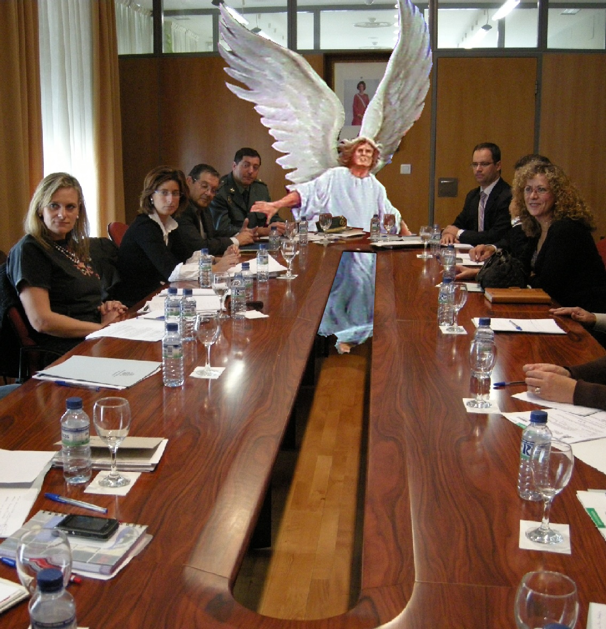
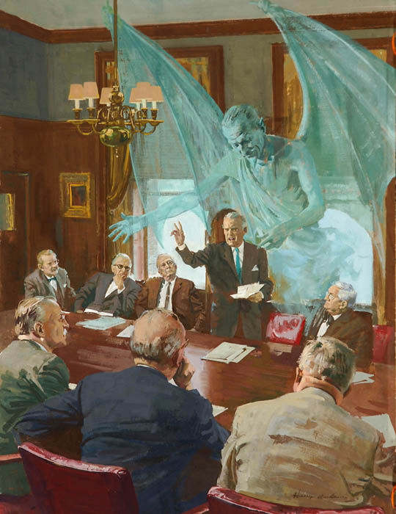
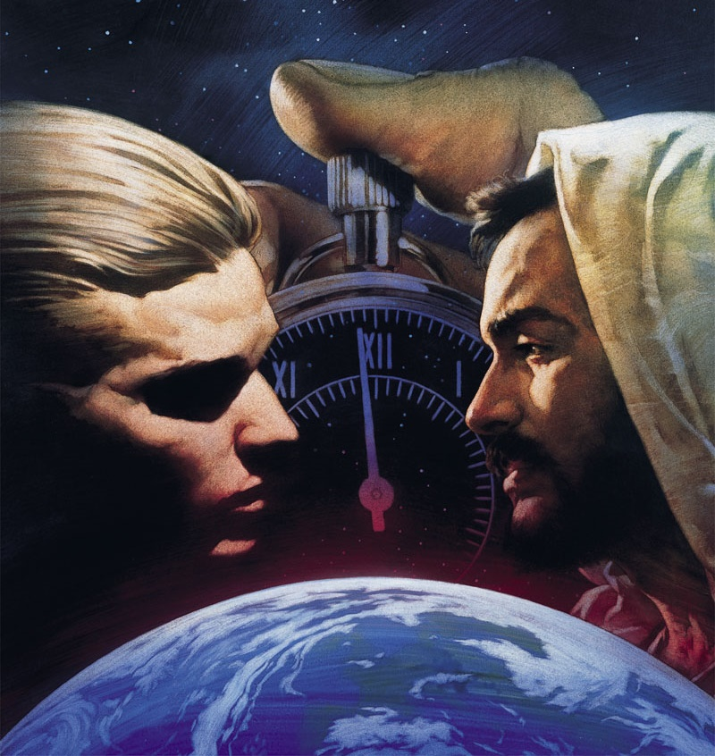
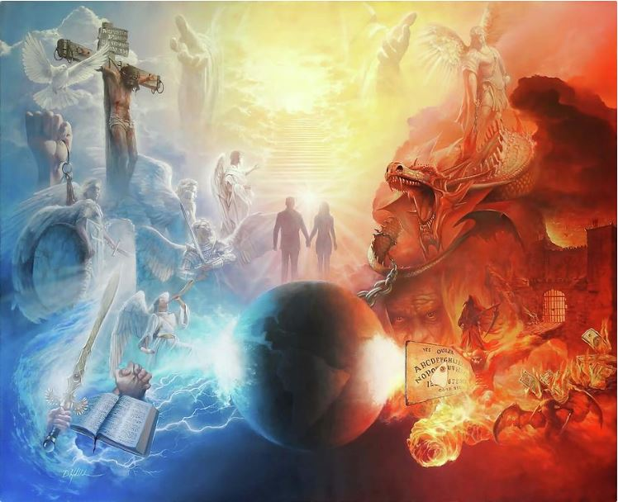
ʻOku tau moʻui ʻi ha fepakipaki lahi. Tatau ai pē kapau ʻoku ʻikai ke tau ʻiloʻi, pe ʻikai ke tau tui ʻoku malava ʻeni
ʻOku fakalaumālie ʻa e ngaahi mālohi ʻoku fepakipakí, ʻoku ʻikai ke tau fakatokangaʻi (ʻEfesō 6:12). Kae kehe, ʻ oku lava ke tau ongoʻi ʻ a e ngaahi nunuʻa ʻ o e taú. Ngaahi fakatamaki, angaʻuli, mate ...
Naʻe ʻ i he tuʻunga fakatuʻuní ʻ a e founga - pule tonu ʻ a e ʻ Otuá, ʻ a e mateaki ʻ a e kau ʻ āngeló mo e ngaahi māmani taʻelavameʻá. ʻOku ʻi he tuʻunga fakatuʻi hoʻomou mateaki mo au he ʻaho ni.
Ko e kamataʻanga ʻo e fepakipaki
Angatuʻu ʻi he Langí
Angatuʻu ʻi he Māmaní
toe foki mai ʻa e ʻofa
Ko e fepakipaki he ʻaho ni

Slide 4
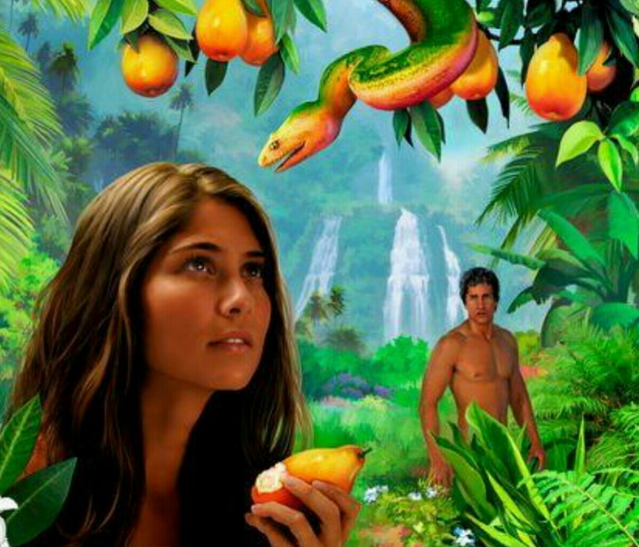
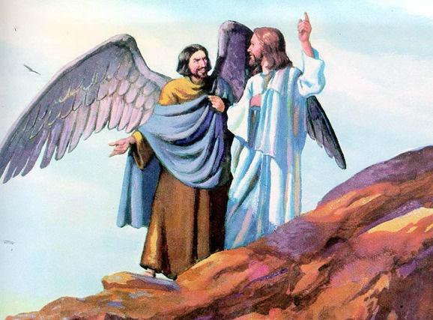
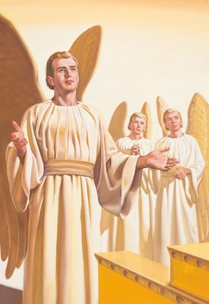
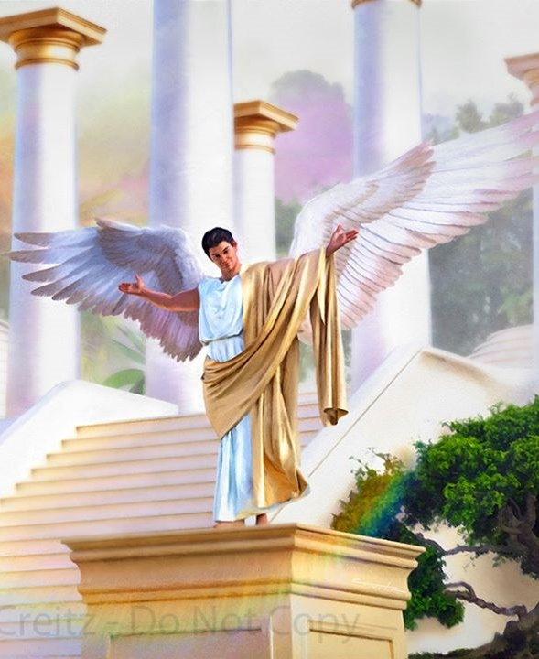
KO E KAMATAʻANGA ʻO E FEPAKIPAKI
“Naʻa mou taʻehalaia ʻi homou ngaahi halá talu mei he ʻaho naʻe fakatupu ai ʻa kimoutolú, ʻo aʻu ki hono ʻilo ʻo e fai angahalá ʻiate kimoutolu" (ʻIsikeli 28:15)
Ko e moʻoniʻi meʻa ko ia, ʻ i ʻ Ītení, naʻe ʻ i ai ha tokotaha naʻá ne fakaʻaiʻai ʻ a ʻ Ivi ke taʻefalala ki he ʻ Otuá, ʻ oku fakahuʻunga ai ha angatuʻu ki he ʻ Otuá ki muʻa ke ʻ i ai ʻ a e faʻahinga ʻ o e tangatá (Sēnesi. 3:1).
Naʻe ui ʻ e Sīsū ʻ a e tokotaha ko ení ʻ a ia ʻ okú ne tūtuuʻi ʻ a e taʻefalala ʻ i he vahaʻa ʻ o e ʻ Otuá mo ʻ ene ngaahi meʻamoʻuí "ko ha fili," ʻ a ia naʻá ne fakahaaʻi ko e tēvoló (Matiu 13;39)
Ko e ʻuluaki fehuʻi ʻoku totonu ke tau fai kiate kitautolú: Naʻe fakatupu nai ʻe he ʻOtuá ʻa e tēvoló, ʻa ia, naʻe fakatupu nai ʻe he ʻOtuá ha tokotaha kovi?
Kapau naʻe haohaoa ʻa Lusifā, naʻe anga fēfē ʻene hoko ko e tēvoló? Naʻe kamata fēfē ʻa e fepaki ʻi he vahaʻa ʻo e ʻOtuá mo iá? Naʻe foaki ange ʻe he ʻOtuá kiate ia, ʻo hangē ko e kotoa ʻo ʻene ngaahi meʻa naʻe fakatupú, ʻa e tauʻatāina ke filí, pea naʻe fili ʻa Lusifā ke angatuʻu, pea feinga ke nofoʻi ʻa e taloni ʻo e ʻOtuá (ʻIsikeli 28:15; Is. 14:13-14).

Slide 5
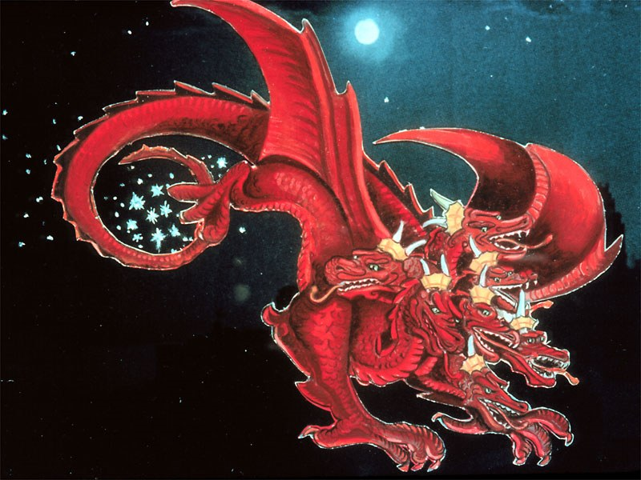
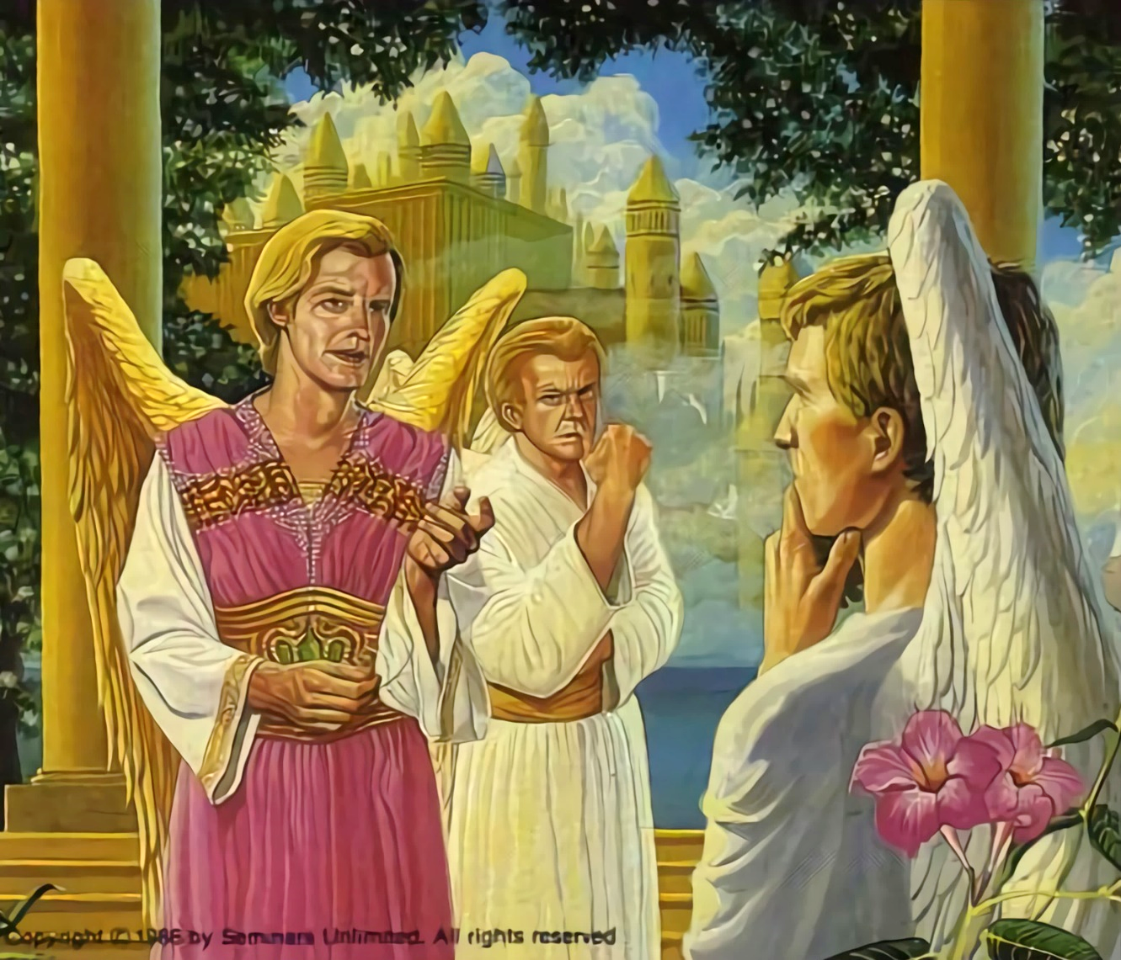
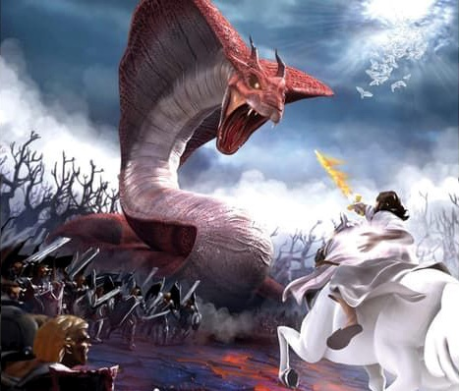
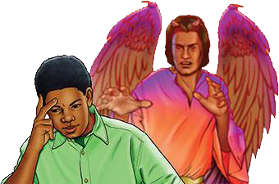
ANGATUʻU ʻI HE LANGÍ
"Naʻe tafiʻi ʻe hono hiku ha vahe tolu ʻe taha ʻo e ngaahi fetuʻu mei he langi ʻo tolongi kinautolu ki he mamani ..." (Fakaha 12:4)
Naʻe hoko ʻa Lusifa ko Setane, ko e fakakovi (Fakaha 12:10; Siope 1:6, 9-10). Naʻá ne talitekeʻi ʻ a e ngaahi ui anga - ʻ ofa kotoa ʻ a e ʻ Otuá ke liliu ʻ ene fakakaukaú.
ʻI he holi ko ia ʻa Lusifā ke ne faʻao ʻa e taloni ʻo e Langí, naʻá ne ʻohake ai ha veiveiua ki he kau ʻāngeló fekauʻaki mo e fakamaau totonu ʻa e puleʻanga fakalangí. ʻIkai naʻa nau tauʻataina kotoa? Ko e hā ʻ oku fakamoʻulaloa ai ki he ngaahi lao kovi, pea mahalo, taʻetotonu pe taʻeʻuhinga?
Naʻe hoko ʻ a e angatuʻú ko ha fepaki tauʻatāina, ko ha tau ʻ a ia naʻe pau ke fai ai ʻ e he ʻ āngelo taki taha ʻ enau filí. 1/3 ʻo e kau ʻangelo naʻe muimui ʻia Setane, kae kei faivelenga pe ʻa e toenga ki he ʻOtua (Fakaha 12:4).
ʻOku kei hokohoko atu pē he ʻahó ni ʻa e taú. ʻOku kei mālohi pē ʻa Sētane. ʻOkú ne feinga ke toho ʻa e tokotaha kotoa pē ke angatuʻu ki he ʻOtuá. ʻOku ua pe ʻa e tafaʻaki. Ko e faʻahinga ʻ oku nau loto ke talangofua ki he Lao ʻ a e ʻ Otuá, pe ko e faʻahinga ʻ oku nau talitekeʻi iá. ʻOku ʻatautolu ʻa e fili (Teutalonome. 30:11, 16, 19; Sosiua 24:15).

Slide 6
"Naʻe mei lava pē ʻe he ʻOtua Māfimongá ʻo lī hifo ʻa e tokotaha foaki ko ʻení mei he langí; ka naʻe ʻikai ko ʻEne taumuʻá ʻeni. Te Ne foaki ki he kau angatuʻú ha faingamālie tatau ke fakafuofuaʻi ʻa e mālohí mo e mālohí ʻaki Hono ʻAló mo ʻEne kau ʻāngelo mateakí. ʻE fili ʻe he ʻāngelo kotoa pē hono tafaʻakí ʻi he tau ko ʻení pea ʻe fakahā ia ki he kakai kotoa pē. [...] Kapau naʻe fakaʻaongaʻi ʻe he ʻOtuá Hono mālohí ke tauteaʻi ʻa e angatuʻu lahí ni, naʻe ʻikai mei fakahā ʻa e kau ʻāngelo taʻe fiefiá; ko ia, naʻe toe fou ʻa e ʻOtuá ʻi ha hala ʻe taha, he te Ne fakahā mahino ki he tokotaha kotoa pē ʻi he langí ʻa ʻEne fakamaau totonú mo ʻEne fakamāú."
EGW (Ko e Talanoa ʻo e Huhuʻí, p. 17)

Slide 7
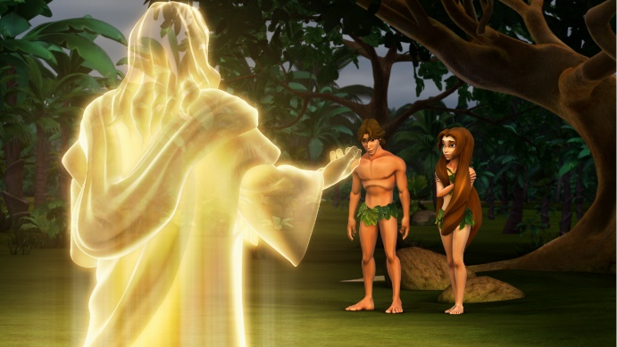
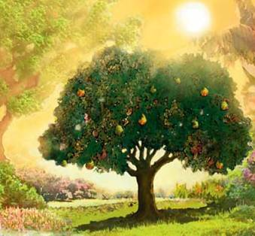
ANGATUʻU ʻI HE MĀMANÍ
"Pea ne pehe ange, ʻKo hai naʻa ne talaatu ʻoku ke telefua? Kuó ke kai mei he fuʻu ʻakau ʻa ia naʻá ku fekau kiate koe ke ʻoua naʻá ke kai mei aí?ʻ " (Sēnesi 3:11)
Naʻe fakatupu ʻ e he ʻ Otuá ʻ a e kau ʻ āngeló ʻ i ha ʻ ātakai taʻehalaia mo haohaoa. Ko e meʻa tatau pe, naʻe fakatupu ʻe he ʻOtua ʻa e faʻahinga ʻo e tangata ʻi ha ʻatakai haohaoa, ʻo ʻataʻata mei he angahala (Senesi 1:31).
Hangē ko ia naʻe hoko ki he kau ʻ āngeló, naʻe toe fakatupu kitautolu ʻ e he ʻ Otuá ʻ aki ʻ a e mālohi ke fili tauʻatāina. Ko ia, naʻe lava ke fakaʻaongaʻi ʻe ʻĀtama mo ʻIvi ʻa e tauʻatāina ko iá, naʻá ne ʻoange kiate kinaua ha kiʻi fokotuʻutuʻu faingofua: "ka ʻe ʻikai te mo kai mei he ʻakau ʻo e ʻilo ʻo e leleí mo e koví" (Sēnisi 2:17).
Ko e tuʻunga pē ia ʻ e taha ʻ e lava ke ʻ ai ai kinautolu ʻ e Sētane ke nau veiveiua. ʻ I he kākaá, naʻá ne lavaʻi ai ʻ ene taumuʻá. Naʻe veiveiua ʻa ʻĀtama mo ʻIvi ki he ʻOtuá, talangataʻa kiate Ia, ʻo na tafoki mei he tupuʻanga ʻo e moʻuí (Sēnisi 3:6, 9-13, 19). Naʻe fakaava ʻe ʻĀtama ʻa e matapā ke hū ai ʻa e angahalá, pea naʻe hoko pehē ʻa e maté ki he kakai fulipē (Loma 5:12).
Talu mei ai, ʻ oku tau moʻui ʻ i ha māmani ʻ oku fakaʻilongaʻi ʻ aki ʻ a e mamahi, puke mo e mate. ʻOku tau totongi kotoa nai e angahala ʻa ʻĀtamá?
ʻOku tau takitaha totongi pē ʻetau angahalá: "he kuo faiangahala kotoa pē pea tōnounou ʻi he fakamālō mei he ʻOtuá" (Loma 3:23).

Slide 8
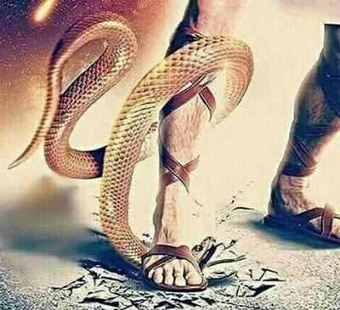
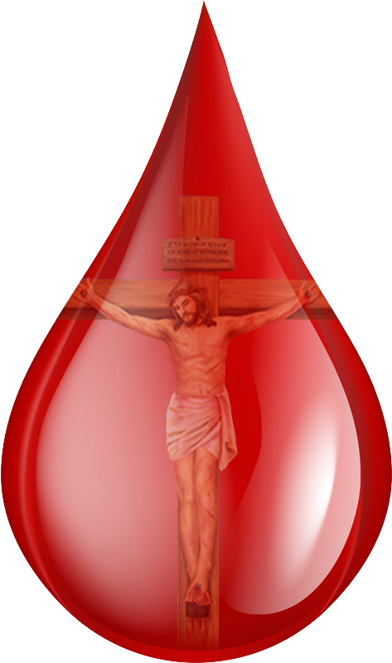
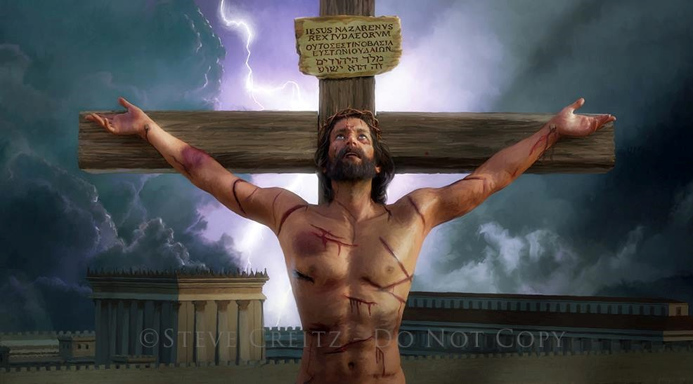
ʻOFA ʻI HE FUNGA KANITA
"Ko ʻeni ʻa e ʻofá: naʻe ʻikai ko ʻetau ʻofa ki he ʻOtuá, ka ko ʻene ʻofa kiate kitautolu peá ne fekau hono ʻAló ko e feilaulau fakalelei koeʻuhí ko ʻetau ngaahi angahalá" (1Sione 4:10)
Naʻa mo e ki muʻa ke fanongonongo ʻa e ngaahi nunuʻa ʻo e talangataʻá, naʻe fakahā ʻe he ʻOtuá kia ʻĀtama mo ʻIvi ʻoku ʻi ai ha palani ki hona huhuʻí (Sēnesi 3:15).
Naʻe fakamavaheʻi loto - lelei ʻ e he faʻahinga ʻ o e tangatá ia mei he Tokotaha - Fakatupú. Ka naʻe ʻikai ke liʻaki ʻe he ʻOtuá ʻene fānau taʻehoungaʻiá, ka naʻá Ne fakahā hono ʻulungāanga totonú ʻaki ʻEne ʻofa kiate kinautolu ʻo mahulu atu ʻi he tuí (Sione 3:16).
Naʻe ʻikai fie maʻu ʻa e maté ia ke hoko ko e ikuʻanga taʻengata ki he taha faiangahalá. Naʻe fakahāhā ʻ e Sīsū ʻ a ʻ ene ʻ ofá ʻ aki hono totongi ʻ a e totongi ʻ o e angahalá ʻ aki ʻ ene moʻuí (Loma 5:8).
ʻOku ʻikai ha meʻa ʻiate kitautolu te ne ngaohi kitautolu ke tau taau mo e ʻofa ʻa e ʻOtuá. Kae kehe, ʻ i he tulutā kotoa ʻ o e toto naʻe lilingi ʻ e Sīsū ʻ i Kalevalé, ʻ oku tala mai ai ʻ e he ʻ Otuá: "ʻ Oku ou ʻ ofa ʻ iate koe."

Slide 9
ʻOFA ʻI HE FUNGA KANITA
"Ko ʻeni ʻa e ʻofá: naʻe ʻikai ko ʻetau ʻofa ki he ʻOtuá, ka ko ʻene ʻofa kiate kitautolu peá ne fekau hono ʻAló ko e feilaulau fakalelei koeʻuhí ko ʻetau ngaahi angahalá" (1Sione 4:10)
Naʻe anga - fēfē hono fakahaaʻi mai ʻ e Sīsū kiate kitautolu ʻ a ʻ ene ʻ ofa?
Naʻe fakatupu ʻe Sīsū ʻa e meʻa kotoa pē ʻoku ʻi aí (Sione 1:3)
Naʻá Ne foua e ngaahi faingataʻá, mamahí, fiekaiá mo e mamahí, hangē ko kitautolú
(Senesi 53:3; Maʻake 11:12)
Naʻe ʻahiʻahiʻi Ia ʻo hangē pē ko kitautolú (Hepelū 4:15)
Naʻá Ne hoko ko ha meʻamoʻui (Sione 1:14)
Pea naʻe hoko kotoa ʻeni koeʻuhi ko e ʻofa (1Sione 4:10)
ʻI heʻene maté mo toetuʻú, naʻá ne fakapapauʻi mai ai kiate kitautolu ʻa e moʻui taʻengata ʻi heʻene feohí
(Loma 6:3-4)
ʻI Heʻene angatonú, naʻá Ne loto fiemālie ke mamahi koeʻuhí ko ʻetau ngaahi angahalá (1 Pita 3:18; Sione 10:17-18)

Slide 10
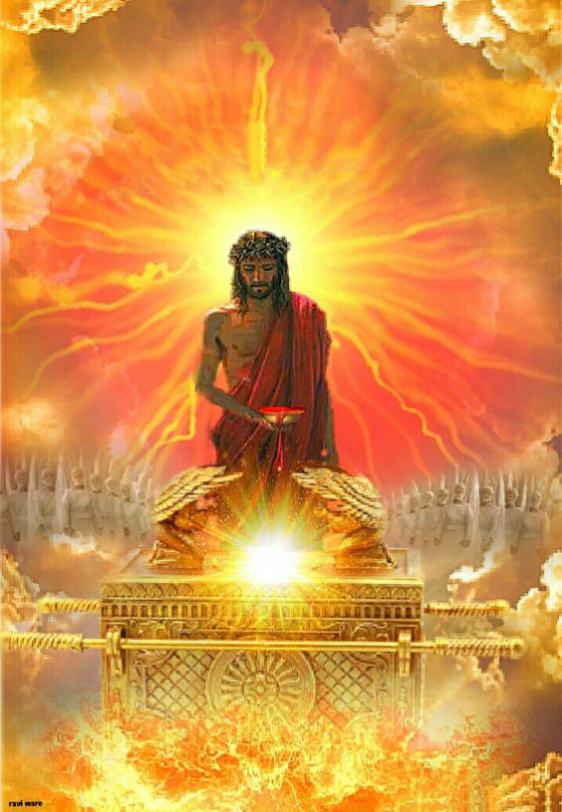
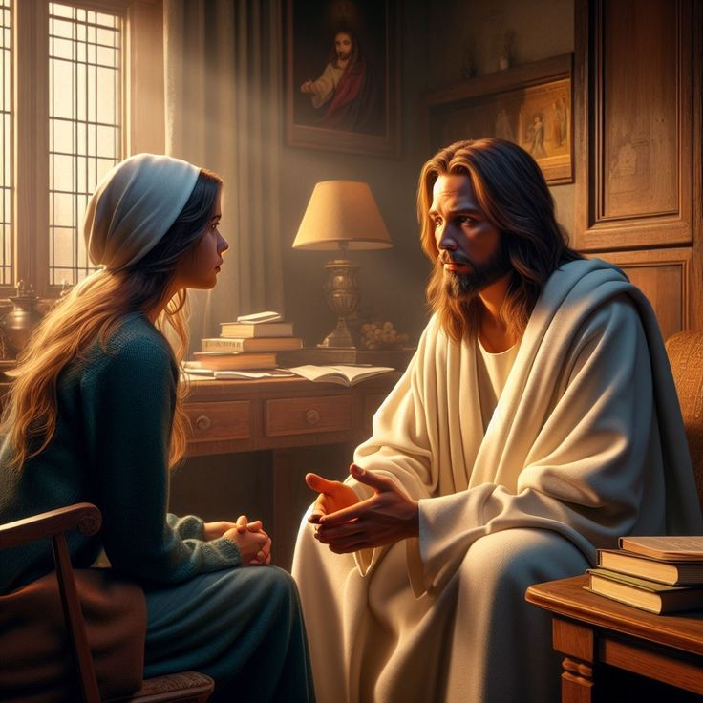
KO E FEPAKIPAKI HE ʻAHO NI
"Ko ia ʻokú ne faʻa fakamoʻui kakato ai ʻa kinautolu ʻoku haʻu ki he ʻOtuá ʻiate iá, koeʻuhí he ʻokú ne moʻui maʻu ai pē ke taukapoʻi ʻa kinautolu" (Hepelū 7:25)
ʻI he ʻaho ni, ʻoku huki ʻa Sisu maʻatautolu ʻi he Fale Hufangaʻanga Fakalangi (Hepelu 9:24; 7:25).
ʻI he malumalu ʻo hono taʻataʻa naʻe lilingi ʻi he kolosi, ʻoku foaki ai kitautolu ʻe Sisu ʻi he ʻao ʻo e Tamai – pea ʻi he ʻao ʻo e kakai kotoa ʻo e ʻunivesi – ko ha kakai angatonu mo haohaoa, ʻoku nau taau ke maʻu ha nofoʻanga ʻi he Langi.
Ko ia ai, ʻ oku fakaafeʻi kitautolu ke tau fakaofiofi ki he ʻ Otuá ʻ i he loto - falala fakafou ʻ ia Sīsū (Hep. 4:15-16).
ʻOku finangalo ʻa Sīsū ke tau falala kiate ia ʻi heʻetau fie maʻu kotoa pē ʻi heʻetau moʻuí (Sione 14:13-14). Ko e feituʻu ʻoku ʻi ai ʻa e manavaheé, ʻokú ne ʻomi ai ʻa e melinó; ko e feituʻu ʻoku ʻi ai ʻa e ongoʻi halaiá, ʻokú ne ʻomi ai ʻa e fakamolemolé; ʻi he feituʻu ʻoku ʻi ai ʻa e vaivai, ʻoku ne ʻomi ʻa e malohi.

Slide 11
EGW (Ko e Ngāue ʻo e Fakamoʻuí, p. 193)
"ʻI he taimi ʻoku lōmekina ai koe ʻe he ngaahi ʻahiʻahí, ʻi he taimi ʻoku hanga ai ʻe he tokangá, puputuʻú, mo e fakapoʻulí ʻo ʻākilotoa ho laumālié, hanga ki he feituʻu naʻá ke mamata fakamuimui ai ki he māmá. Malolo ʻi he ʻofa ʻa Kalaisi pea ʻi Heʻene tokanga. ʻI he taimi ʻoku fefaʻuhi ai ʻa e angahalá mo e taukei ʻi he lotó, ʻi he taimi ʻoku ngaohikoviʻi ai ʻe he ongoʻi halaiá ʻa e laumālié mo fakamafasiaʻi ʻa e konisēnisí, ʻi he taimi ʻoku kapusi ai ʻe he taʻetuí ʻa e ʻatamaí, manatuʻi ʻoku feʻunga ʻa e ʻaloʻofa ʻa Kalaisí ke ne fakavaivaiʻi ʻa e angahalá mo tekeʻi ʻa e fakapoʻulí. ʻI heʻetau feohi mo e Fakamoʻuí, ʻoku tau hū ai ki he potu ʻo e melinó."

