Slide 1
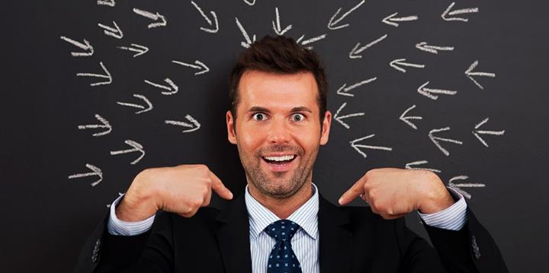
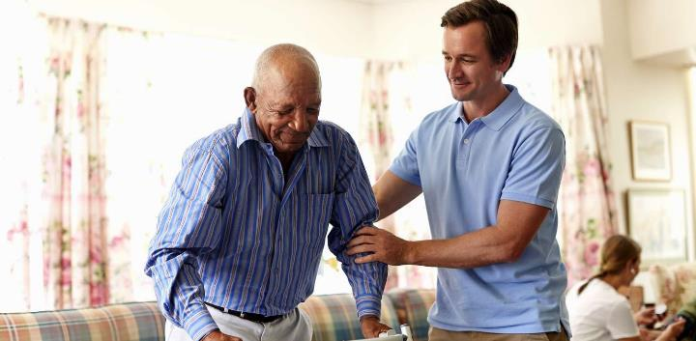
KO E TEFITOʻI KAVEINGA:
ʻOFA PE SIOKITA?
Lesoni 2 ki he ʻaho 13 ʻo ʻEpeleli 2024

Slide 2
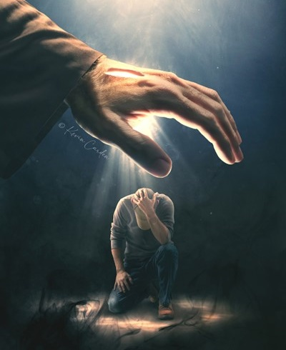
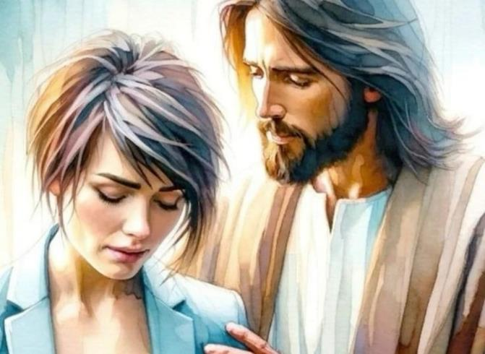
“‌ʻOua naʻa ke manavahē; he ʻoku ou ʻiate koe:ʻoua ʻe loto vaivai; he ko au ko ho ʻOtua,te u fakamālohi koe;”
(‘Isaia 41:10)

Slide 3

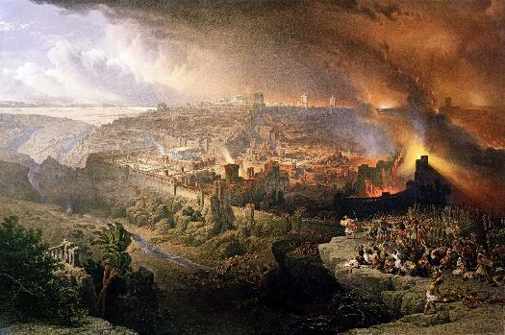
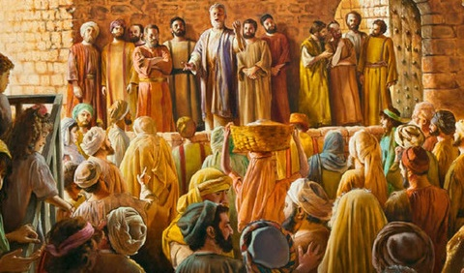


Naʻe fakaʻilongaʻi ʻe he taʻu 70 ʻa e ngataʻanga ʻo ʻIsileli ko ha puleʻanga. Neongo ko Loma naʻá ne maumauʻi ʻ a Selusalema mo e Temipalé, naʻe kau ʻ a e ngaahi mālohi kehe ʻ i he tau ko iá.
ʻI he tafaʻaki ʻ e tahá, naʻe fakaʻaiʻai ai ʻ e Sētane ʻa ʻIsileli ke nau talitekeʻi ʻ a e Mīsaiá, pea taukaveʻi leva ʻa ʻene totonu ke fakaʻauha ʻa e puleʻangá.
ʻI he tafaʻaki ʻe tahá, naʻe toutou fakatokanga ʻa e ʻOtuá ki he ngaahi nunuʻa ʻo hono fakafisingaʻi iá; fakatoloi hono fakahoko ʻo e setesi; pea teuteuʻi ha kakai, ʻa e Siasí, ke nau toʻo hake ʻa e tūhulu ʻo e moʻoní pea fakamaama ʻa māmani ʻaki ʻa e pōpoaki ʻo e ʻofa ʻa e ʻOtuá.
:Ngaahi lēsoni mei hono fakaʻauha ʻo Selusalemá
  Ko hono fakafisingaʻi ʻo e ʻofa ʻa e ʻOtuá.
  ʻOku tokangaʻi ʻe he ʻOtuá ʻa hono kakaí.
Ngaahi lēsoni mei he ʻuluaki kau Kalisitiané:
  Anganofo ʻi he tulifua.
  Tokoniʻi e faingataʻaʻiá.
  ʻOfa, ko ʻetau fakaʻilonga ia.

Slide 4
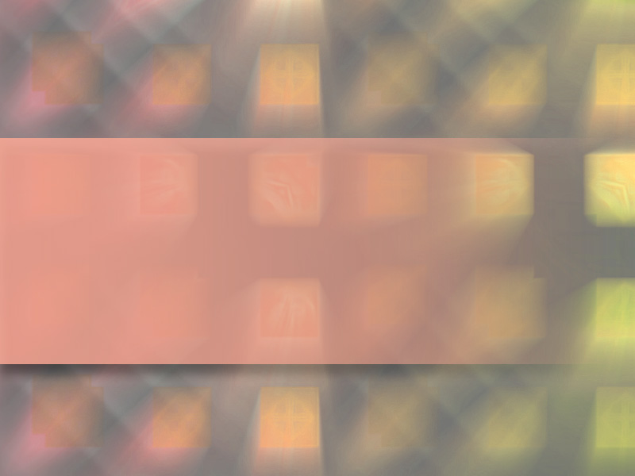
NGAAHI LĒSONI MEI HONO FAKAʻAUHA ʻO SELUSALEMÁ

Slide 5
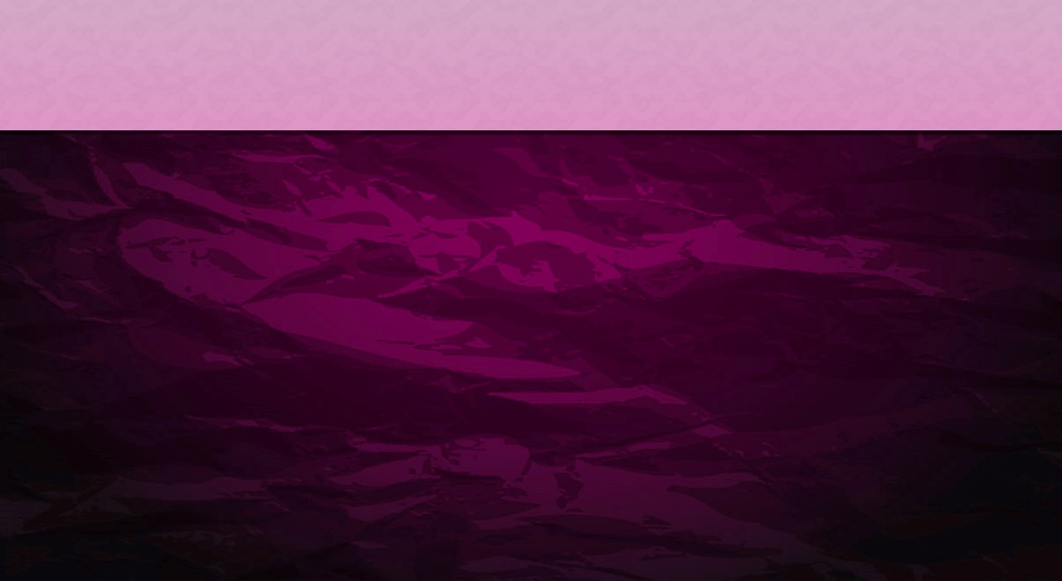
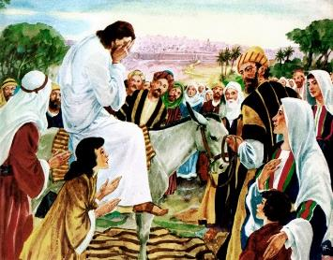
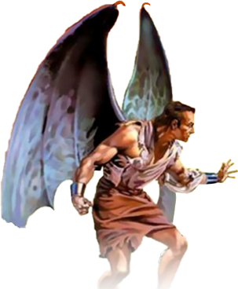
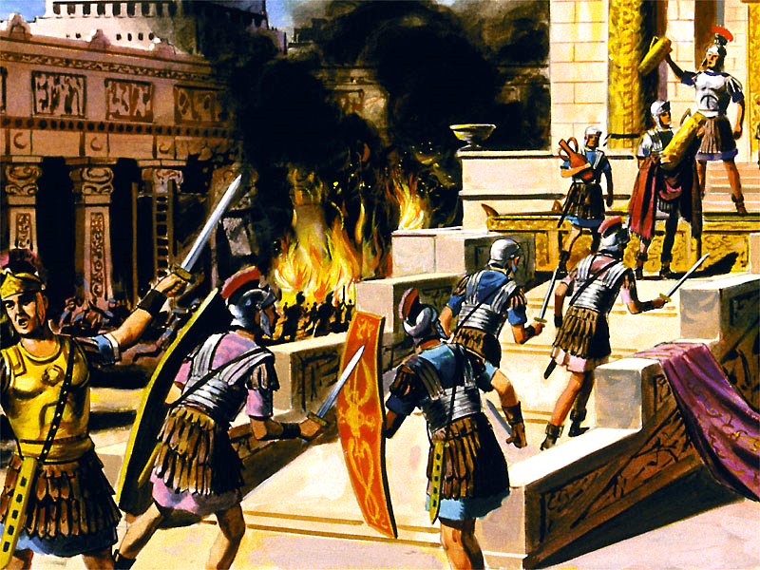
KO HONO FAKAFISINGAʻI ʻO E ʻOFA ʻA E ʻOTUÁ
"Selusalema, Selusalema, ʻa kimoutolu ʻoku tāmateʻi ʻa e kau palōfitá mo tolomakaʻi ʻa kinautolu naʻe fekau kiate kimoutolú, hono ʻikai tuʻo lahi ʻeku fakaʻamu ke tānaki fakataha hoʻomou fānaú, ʻo hangē ko hono tānaki ʻe he motuʻa moá ʻa hono fanga ʻuhikí ʻi hono lalo kapakaú, ka naʻe ʻikai te mou loto ki aí!" (Matiu 23:37)
Naʻe tangi ʻa Sīsū ʻi heʻene fakaofi atu ki Selusalemá (Luke 19:41-44). Naʻá ne ʻiloʻi te nau faingataʻaʻia ʻi he ngaahi nunuʻa totonu ʻo ʻenau fakafisingaʻi fefeka ʻa e ngaahi uiuiʻi ʻofa ʻa e ʻOtuá (Mātiu 23:37).
Naʻa ne tangi koeʻuhi he naʻe mei lava pe ke fakaʻehiʻehi mei he meʻa fakamamahi. Koeʻuhi ʻoku ʻofa lahi ʻa e ʻOtua ʻiate kitautolu ʻo ʻikai ai ke ne loto ke mate ha taha, ka ke maʻu ʻe he tokotaha kotoa pe ʻa e moʻui taʻengata (Sione39-40; 'Isikeli 18:31-32).
ʻOku tala mai ʻe he hisitōliá naʻe angatuʻu ʻa e kau Siú ʻi he taʻu 66 ki he ngaohikovia ʻo Lomá. Naʻe tau ʻa e kau Siu kehekehe ʻi honau lotolotongá, lolotonga ia naʻe ʻākoloʻi ʻe he kau Lomá ʻa e koló. ʻI he taʻu 70 naʻe ʻosi ai e meʻa kotoa. Naʻe fakaʻauha ʻe Taitusi ʻa Selusalema mo e Temipalé. Naʻe mate ha kau Siu ʻe toko taha miliona.
Ka ʻoku ʻikai tala mai ʻe he hisitōliá ʻa e founga naʻe fakaʻaiʻai ai ʻe Sētane ʻa e kau Siú ke nau angatuʻú, pea mo e kau Lomá ke nau sāuní. Ko hono fakaʻauha ʻo Selusalemá ko e ngāue fakahangatonu ia ʻa e tēvoló. ʻI he tafoki mei he matavai ʻo e moʻuí, naʻe hoko ai ʻa ʻIsileli ko e meesi ʻo ha fili ʻa ia ʻokú ne kumi pē ki he fakaʻauhá mo e maté.

Slide 6

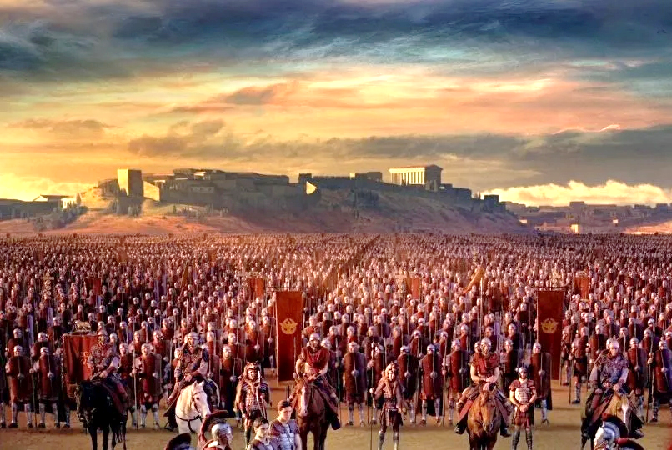
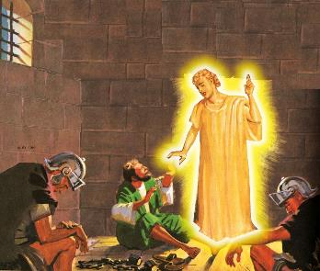
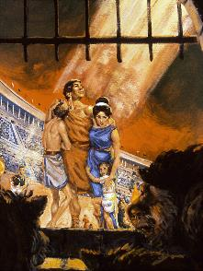
TOKANGAʻI ʻE HE ʻOTUÁ ʻA HONO KAKAÍ
“Ko ia ʻ oua ʻ e manavahē, he ʻ oku ou ʻ iate koe; ʻoua naʻá ke loto-foʻi, he ko au ko ho ʻOtuá. Te u fakamālohia mo tokoniʻi koe; Te u poupou hake koe ʻaki hoku nima toʻomataʻu māʻoniʻoní" (ʻĪsaia 41:10)
ʻ I heʻene ʻ ofá, naʻe ʻ oange ai ʻ e he ʻ Otuá ha faingamālie ki he tokotaha kotoa pē naʻa nau loto ke hao mei he fakaʻauhá. Naʻá Ne ʻomi ha fakaʻilonga: ʻOku takatakaiʻi ʻa Selusalema ʻe ha kau tau (Luke 21:20).
Naʻe fakahoko ʻ e Keio Sestius Gallus ʻ a e fakaʻilonga ko iá ʻ i he taʻu 66. Naʻe toʻo atu ʻ a e ʻ ākoloʻí, pea naʻe tuli ʻ e he taki Sēloti ko ʻ Elesi Saimoné ʻ a e kau Lomá ʻ o ikunaʻi kinautolu.
Ko e tokotaha kotoa pē naʻe tui ki he ngaahi folofola ʻ a Sīsuú naʻa nau ngāueʻaongaʻaki ʻ a e mōmeniti ko ia naʻe tuku ai ʻ a Selusalema ke hola mei aí.
Hili ha ngaahi māhina siʻi mei ai, naʻe fekauʻi atu ʻ e Nelo ʻ a Vespasian ke tukuhifo ʻ a e angatuʻú. Mei he taʻu 67 ki he 70, naʻe tuʻumaʻu ai ʻ a e ʻ ākoloʻí.
ʻOku lava pea ʻoku finangalo ʻa e ʻOtuá ke maluʻi ʻEne fānaú, ʻo aʻu ai pē ki he ngaahi taimi faingataʻa tahá (Saame 46:1; Is. 41:10). Neongo ia, kuo mole e moʻui ʻa ha tokolahi koeʻuhi ko ʻenau faivelenga ki he ʻOtua (Hepelu 11:35-38).
Ko e hā ʻ oku maluʻi ai ʻ a e niʻihi mo e niʻihi kehe, ʻ oku hā mahino, ʻ oku liʻaki ʻ e he ʻ Otuá?

Slide 7
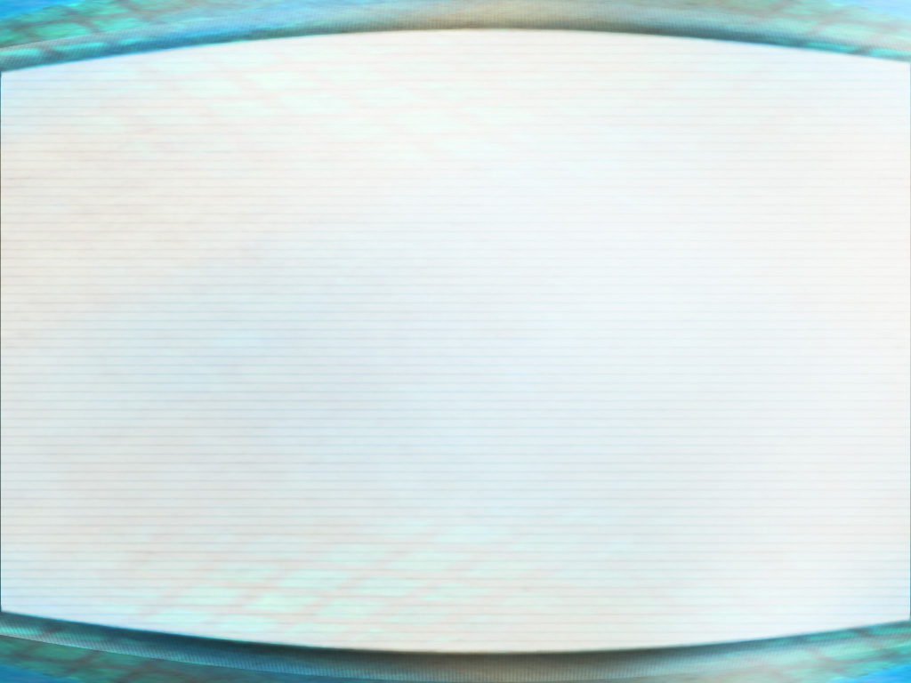
“Ko e ʻotua fakamisiteli ko ia ʻokú ne fakaʻatā ʻa e kau māʻoniʻoní ke nau tofanga ʻi he fakatangá koeʻuhí ko e kau faiangahalá, ko e tupuʻanga ia ʻo e puputuʻu lahi ʻa e tokolahi ʻoku vaivai ʻi he tuí. ʻOku ʻi ai foki mo ha niʻihi ʻoku nau mateuteu ke liʻaki ʻenau falala ki he ʻOtuá koeʻuhí he ʻokú Ne tuku ke tuʻumālie ʻa e tangatá, ka ʻoku fakamamahiʻi mo fakamamahiʻi ʻa e lelei tahá ʻe honau mālohi fakamamahi tahá. ʻ Oku anga - fēfē hono ʻ eke, ʻ e lava fēfē ke kātakiʻi ʻ e he Tokotaha ʻ oku angatonu mo mohu meesi, pea ʻ okú ne toe taʻefakangatangata ʻ i he mālohí, ʻ o kātakiʻi ʻ a e fakamaau taʻetotonu mo e fakafeʻātungia peheé? Ko ha fehuʻi ʻeni ʻoku ʻikai ha meʻa ke tau fai. Kuo ʻosi foaki mai ʻe he ʻOtuá ha fakamoʻoni feʻunga ki Heʻene ʻofá, pea ʻoku ʻikai totonu ke tau taʻetui ki Heʻene leleí koeʻuhí he ʻoku ʻikai mahino kiate kitautolu ʻa e ngaahi ngāue ʻa ʻEne māfimafí."
EGW (Ko e fakakikihi lahi, p. 47)

Slide 8

NGAAHI LĒSONI MEI HE MUʻAKI KAU KALISITIANÉ

Slide 9
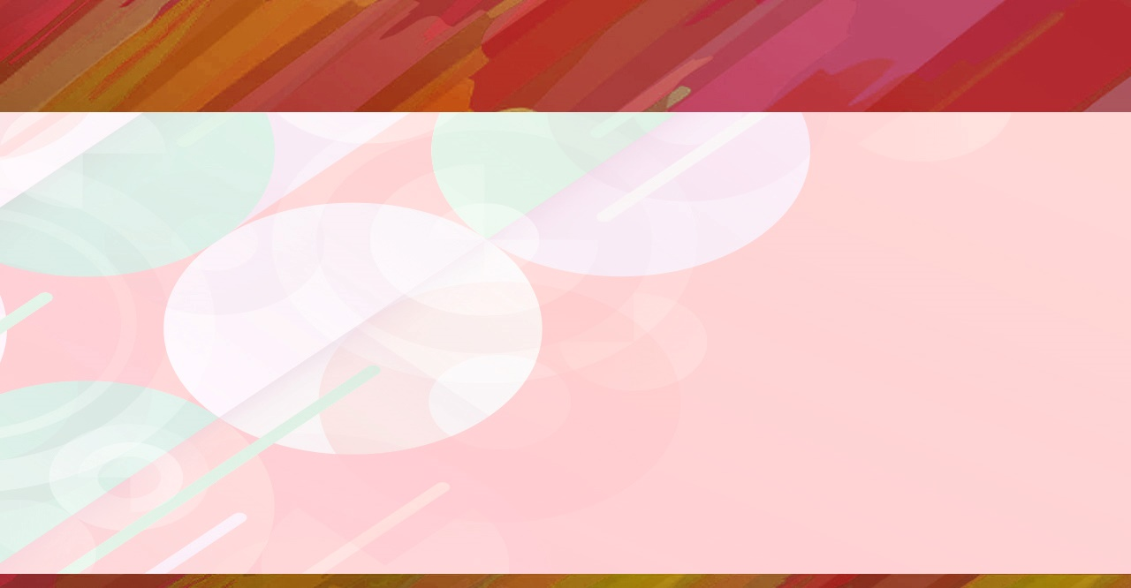
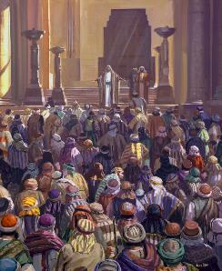
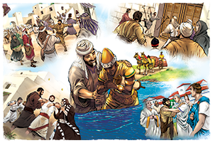
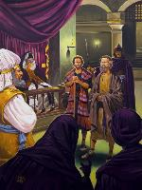
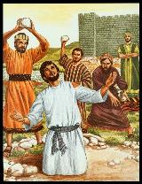
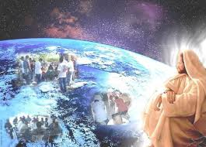
FAIVELENGA ʻI HE FAKATANGA
"Ka naʻe kamata ke fakaʻauha ʻe Saula ʻa e siasi. ʻI heʻene ʻalu mei he fale ki he fale, naʻa ne toho ʻa e tangata mo e fefine fakatouʻosi ʻo tuku kinaua ki he fale fakapopula" (Ngaue 8:3)
Naʻe ʻamanaki lelei moʻoni ʻa e kamataʻanga: ko e fakaului ʻoku lau ʻi he toko lauiafe(Ngaue 2:41; 4:4); naʻe malanga ʻa e kakai tui ʻi he malohi (Ngaue 4:31; 5:42).
Ka naʻe taʻemanonga ʻa e fili. ʻUluaki fakamanamana (Ngaue 4:17-18); pea, ko e ngaahi tautea (Ngaue 5:40); ko hono fakaʻosí, ko e maté (Ngāue 7:59).
Koeʻuhí ko e fakatanga naʻe fai ʻe Saulá, naʻe fakamoveteveteʻi ai ʻa e kau ākongá (Ngāue 8:1). Kae mālō mo e faivelenga ʻa e kakai tuí, ʻo mamaʻo mei he māmá, pea naʻe ulo ia ʻo toe maama ange ʻi he māmani kotoa ʻoku ʻiloʻí (Ngāue 8:4; 11:19-21; Loma 15:19; Kol. 1:23).
Naʻe ʻoange ʻe Sīsū ki hono Siasí ha fekau mo ha mālohi ke ʻave ia ki muʻa (Ngāue 1:8). He ʻikai lava ʻe ha mālohi, fakatuʻasino pe fakalaumālie, ʻo taʻofi e laka ki muʻa ʻa e ongoongoleleí (Mātiu 16:18). "Kapau ʻoku kau ʻa e ʻOtuá maʻatautolu, he ʻikai lava ke fakafepaki mai ha taha kiate kitautolu!" (Loma 8:31)

Slide 10

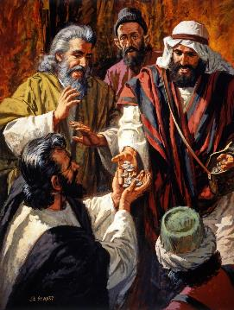
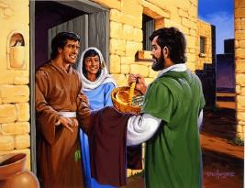
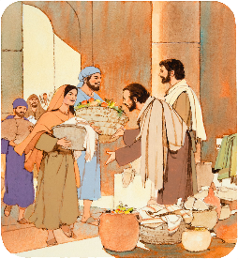
TOKONIʻI ʻA KINAUTOLU ʻOKU FAINGATAʻAʻIÁ
"Pea naʻa nau fakatau atu ʻenau koloá mo ʻenau koloá, ʻo tufaki ia ki he kakai kotoa pē ʻo fakatatau mo e fie maʻu ʻa e tokotaha taki taha" (Ngāue 2:45)
Ko e hā e ola ʻo e ongoongoleleí ki he kau fuofua Kalisitiané (Ngāue 2:42-47)?
Naʻa nau tui ki he tokāteline ʻa Sīsuú
Naʻe fakamoʻui ʻe kinautolu naʻa nau maʻu ʻa e meʻaʻofá ʻa e mahakí.
Naʻá na faitatau ʻi he meʻa kotoa pē
Naʻa nau vahevahe ʻa e meʻa naʻa nau maʻú mo kinautolu naʻe faingataʻaʻiá.
Naʻa nau maʻu ha ngaahi fakataha fakapuleʻanga
Naʻa nau fai ha ngaahi fakataha ʻi he ngaahi ʻapí, ʻa ia naʻa nau fakamanatu ai ʻa e ʻOhomohe ʻa e ʻEikí
Naʻa nau moʻui ʻi he fiefia mo e loto faingofua
Naʻa nau fakahīkihikiʻi ʻa e ʻOtuá
ʻI he tuʻunga ko e kau fakafofonga ʻo Kalaisí, naʻa nau faʻifaʻitaki kia Sīsū. ʻI hono tokangaʻi ʻa e ngaahi fiemaʻu ʻ a e faʻahinga takatakai ʻ iate kinautolú, naʻa nau maʻu ai ʻ a e leleiʻia ʻ a e koló kotoa.
ʻI he taimi ko iá, kuo pau ke ʻulungāanga ʻaki ʻe he Siasí ʻa e feʻofaʻaki ʻa e kau Kalisitiané, pea mo e tokanga ki honau koló.

Slide 11
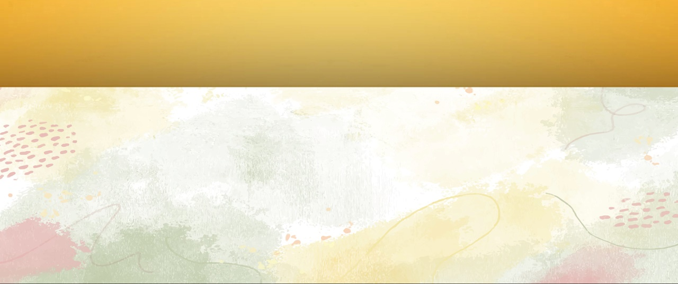
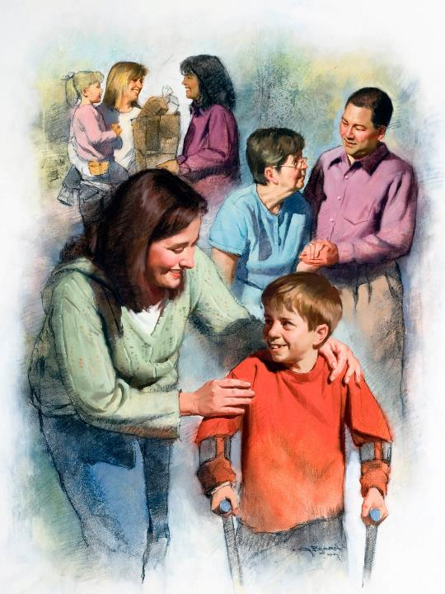
ʻOFA, KO ʻETAU FAKAʻILONGA ʻO E ʻILOʻANGA
"ʻI he meʻá ni ʻe ʻilo ai ʻe he tokotaha kotoa pē ko ʻeku kau ākonga ʻa kimoutolu, ʻo kapau te mou feʻofaʻaki kiate kimoutolu" (Sione 13:35)
ʻOku ʻi ai e ngaahi ʻulungāanga ʻo e faʻahi takitaha ʻoku kau ʻi he fepaki vavaá: ʻOku fehiʻa mo fakaʻauha ʻe Sētane; ʻOku ʻofa mo fakafoki mai ʻe he ʻOtuá.
Ko e kau muimui ʻo ha faʻahi ʻe taha pe ko ha ngaue ʻe taha ʻo fakatatau ki he ngaahi sipinga ko ʻeni. Kapau te tau muimui ki he ʻOtuá, te tau fakahaaʻi ia ʻi he ʻofa ʻoku fakahā ki he niʻihi kehé (1Sione 4:20-21).
Ko e kau Kalisitiane ʻ o e senituli hono 2 mo e 3 naʻa nau ngāueʻaki ʻ a e ʻ ofa taʻesiokitá. Lolotonga ha pandemics lalahi ʻe ua (ʻi he taʻu 160 mo e 265), naʻa nau fakatapui kinautolu ke tokangaʻi ʻa kinautolu naʻe uesia, ʻo ʻikai ke nau fai ha fakamatala ki heʻenau malu.
Naʻa nau foaki kinautolu ʻ i he ʻ ofa, pea naʻa nau maʻu ʻ aonga mei he kakai ʻ e laui miliona. Ka naʻe ʻikai ke nau tohoakiʻi ʻenau tokangá kiate kinautolu, ka ki he tokotaha naʻa nau loto fiemālie ke foaki ʻenau moʻuí, ko honau Fakamoʻuí: ʻa Sīsū.

Slide 12

“Ko e faingamālie ia ʻo e laumālie kotoa pē ke hoko ko ha founga moʻui ʻe lava ke fakahā ai ʻe he ʻOtuá ki māmani ʻa e koloa mahuʻinga ʻo ʻEne ʻaloʻofá, ʻa e ngaahi koloa taʻe-faʻa-hakule ʻa Kalaisí. ʻOku ʻikai ha meʻa ia ʻe fakaʻamu lahi ange ki ai ʻa Kalaisi ka ko ha kau fakafofonga te nau fakafofongaʻi ki he māmaní Hono Laumālié mo Hono ʻulungāangá. ʻOku ʻikai ha meʻa ia ʻe fie maʻu lahi ange ʻe he māmaní ʻo hangē ko hono fakahā mai ʻo e ʻofa ʻa e Fakamoʻuí ki he faʻahinga ʻo e tangatá. ʻOku tatali ʻa langi kotoa ki ha ngaahi founga ʻe lava ke lilingi ai ʻa e lolo māʻoniʻoní ke hoko ko ha fiefia mo ha tāpuaki ki he loto ʻo e tangatá."
EGW (ʻ Aloʻofa Fakaofo ʻ a e ʻ Otuá - Ngaahi Koloa Taʻeʻamanekina, Sune 28)

