Slide 1

ULO ‘A E MAAMA ‘I HE FAKAPO’ULI
Lesoni 3 ki he ʻaho 20 ʻo ʻEpeleli 2024

Slide 2
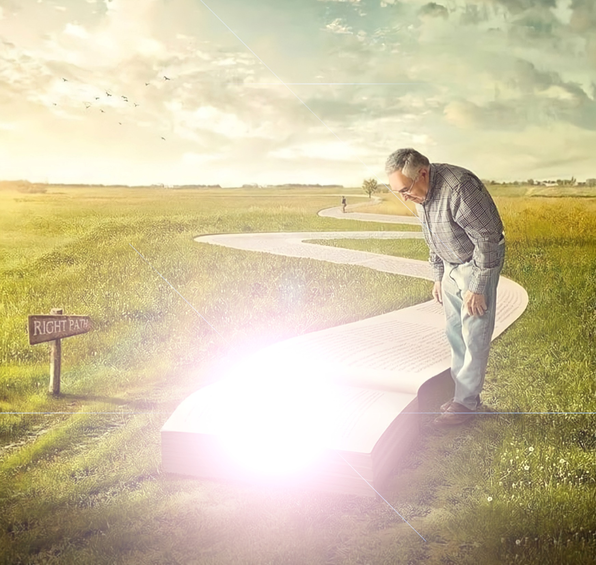
“Pea talaange ʻe Sisu kiate kinautolu, “ʻE toetoe siʻi pe ʻene ʻiate kimoutolu ʻae maama. ʻEveʻeva lolotonga hoʻomou maʻu ʻae maama telia naʻa tō ʻae poʻuli kiate kimoutolu: he ko ia ʻoku ʻeveʻeva ʻi he poʻuli, ʻoku ʻikai ʻilo ʻe ia pe ko ʻene ʻalu ki fē. ”
(Sione 12:35)

Slide 3

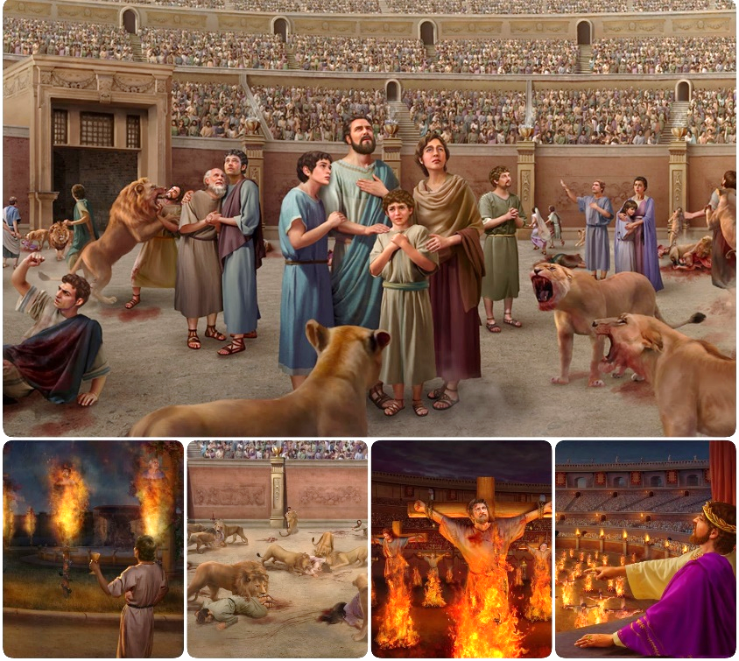
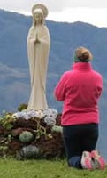

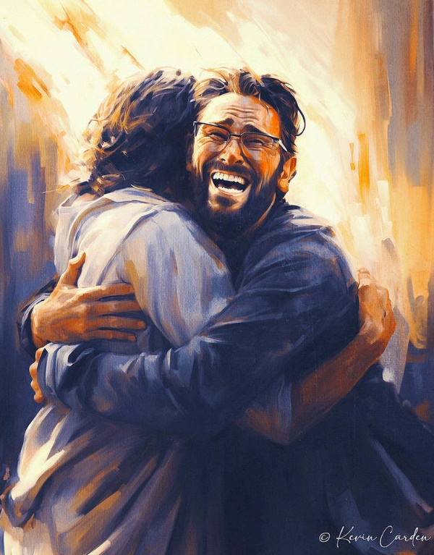








ʻOku ikunaʻi pe mole ha tau ʻi he tau.
ʻI he taimi naʻe mole ai meia Sētane ʻa e tau ʻo e fakatangá, naʻá ne faʻu leva ha palani foʻou: ko ha meʻa ke fetongi ʻaki. Ko hono fio ʻ o e moʻoní mo e loí kuó ne toho ʻ a e laui miliona ke nau tali ha moʻoni tono mo taʻeʻaonga.
Ko hotau maluʻi pē ʻ i he faitau ko ení ko e pīkitai kia Sīsū, ʻ a ia ko e Moʻoní mo e Moʻuí, pea mo ʻ ene Folofola Māʻoniʻoní.
Tau maʻá e moʻoní:
  Ko e moʻoni vs. ko e loi.
  Ko e feveitokaiʻaki ʻa e Siasi.
Tau maʻá e Folofola ʻa e ʻOtuá:
  Malu ʻi he Tohi Tapú.
  Fakaʻuhinga ʻa e tangatá.
Tau maʻa e ʻatamai.

Slide 4

TAU MAʻA E MOʻONI

Slide 5


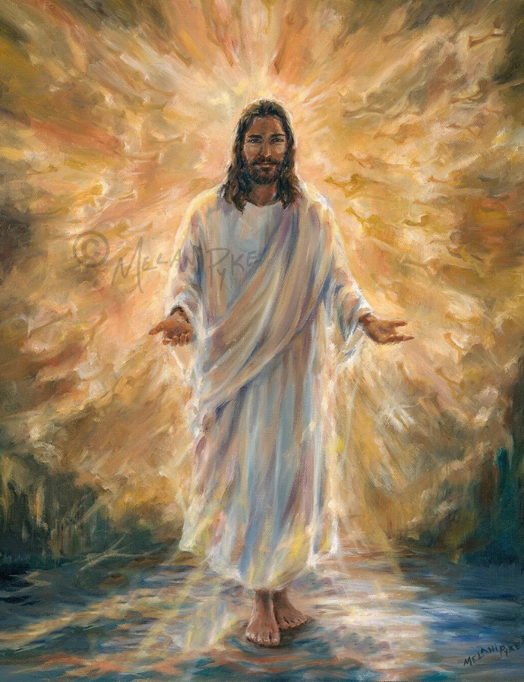
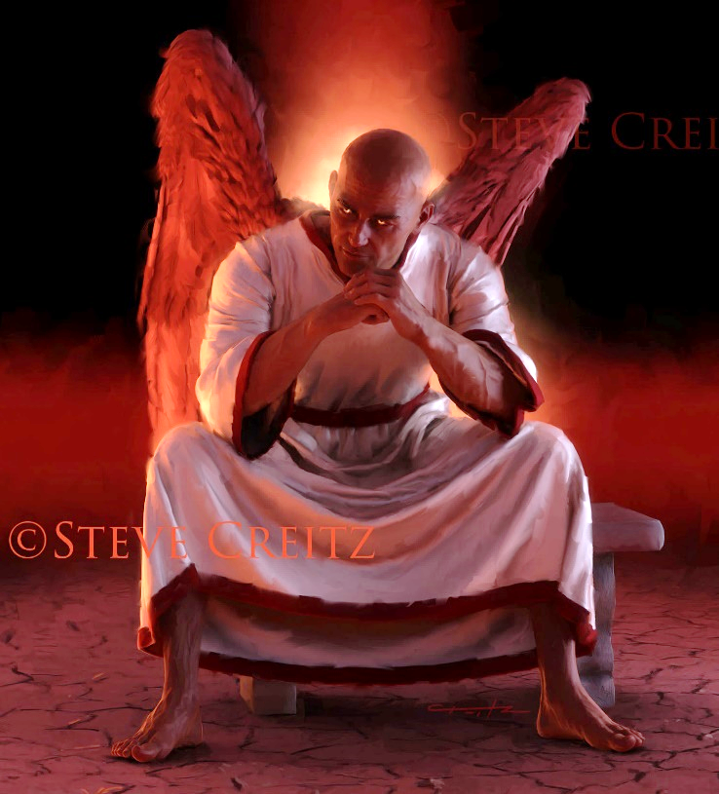
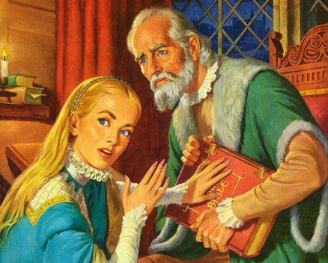
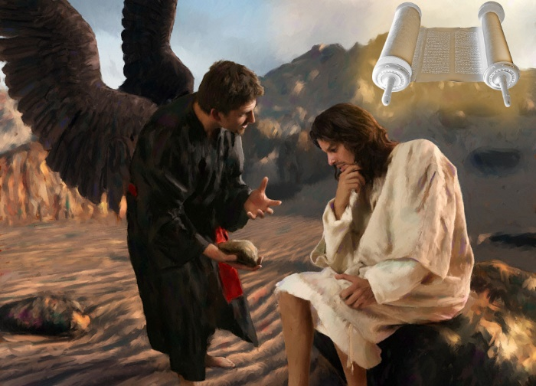
KO E MOʻONI VS. KO E LOI
"Pea tali ʻe Sīsū, ʻKo au ko e hala, mo e moʻoni, pea mo e moʻui. ʻOku ʻikai haʻu ha taha ki he Tamaí tuku kehe pē ʻiate auʻ “
(Sione 14:6)
Ko Sīsū ʻa e Moʻoní pea ko ia ai ko e tamai ia ʻa e moʻoni kotoa pē (Sione 14:6). Ko e meʻa kotoa pē ʻoku moʻoni, falalaʻanga, mo e meʻa kotoa pē ʻoku moʻoní, ʻoku haʻu ia meiate Ia. Pea ʻoku fakatupu ʻe Heʻene moʻoní ʻa e moʻuí ʻiate kitautolu.
ʻI hono kehé, ko Sētané ko e tamai ia ʻa e ngaahi loí (Sione 8:44). Ko e kākā kotoa pē, ʻ a e kākā kākā kotoa pē, ʻ a e moʻoni kotoa pē ʻ oku tonoʻí, ʻ oku haʻu ia meiate ia. Pea ʻoku fakatupu ʻe heʻenau ngaahi loí ʻa e maté ʻiate kitautolu.
ʻI heʻene fehangahangai mo e filí, naʻe fakaʻaongaʻi ʻe Sīsū ʻa e Tohi Tapú ko ha tupuʻanga ʻo e moʻoni kotoa pē: "Kuo tohi" (Matiu 4:4; 21:13).
Ko ia ai, kuo ngāue ʻ a e tēvoló ke fakaʻauha ʻ a e Tohi Tapú, ʻ aki hono fufuuʻi pe mioʻi ia. Pea naʻa ne lavaʻi ia (Neongo naʻe ʻikai ke kakato) ʻi he Siasi Loma, lolotonga e kuonga Lotoloto (naʻe toe ui foki ko e "kuonga fakapoʻuli")

Slide 6


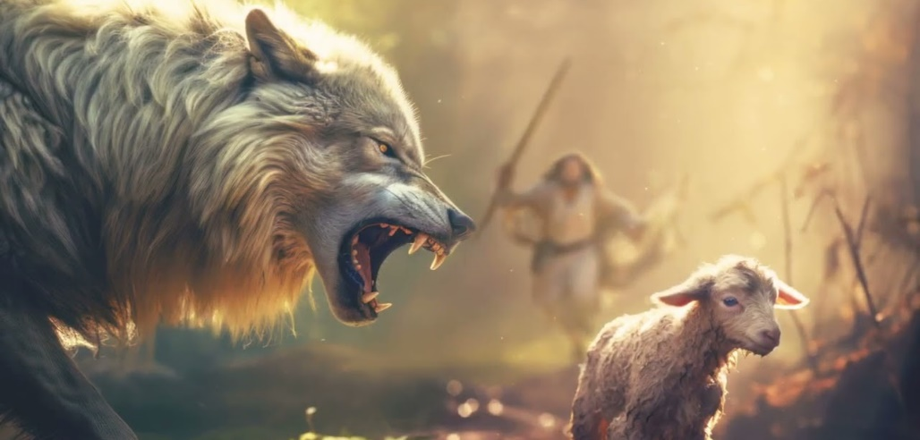
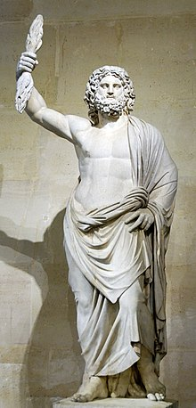
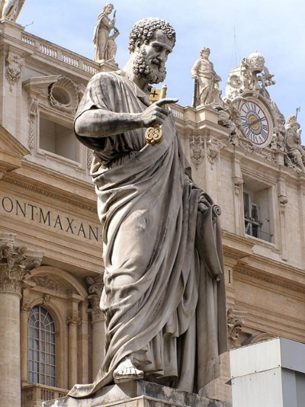
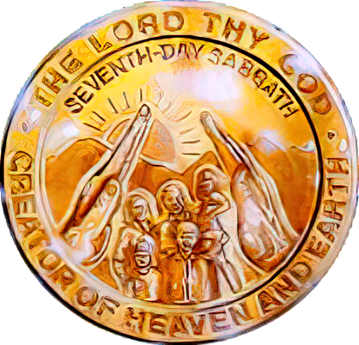

KO E LILIU ʻO E SIASÍ
" ʻOku ou ʻiloʻi ka hili ʻeku mavahé, ʻe hū mai ʻa e fanga ulofi fītaʻá kiate kimoutolu pea ʻe ʻikai te nau fakahaofi ʻa e tākangá. Naʻa mo e kau tangata tokolahi te nau tuʻu hake pea fakakeheʻi ʻa e moʻoní koeʻuhí ke tohoakiʻi atu ʻa e kau ākongá ke muimui ʻiate kinautolu" (Ngāue 20:29-30).
ʻI he kole fakamāvae ki he kau mātuʻa ʻEfesoó, naʻe fakahaaʻi ai ʻe Paula ʻa ʻene hohaʻa ki he ngaahi palopalema ʻi tuʻa mo fakalotofonua te nau fehangahangai mo ia ʻ i he kahaʻú ( Ngāue 20:29 - 30).
Fekai fanga ulofi . Mei he taʻu 64 ki he 311 , naʻe tofanga ai ʻa e Siasí ʻi he fakatanga kakaha mei he Puleʻanga Lomá.
Kau tangata paongataʻa . Kamata ʻ i he senituli hono 4, naʻe fakafeʻiloaki ai ʻ a e kau tangata naʻe ʻ ikai ke uluí ki he Siasí ʻ a ia naʻa nau fio ʻ enau tui fakapanganí mo e moʻoní.
Naʻe toe fakaʻaongaʻi ʻa e ʻimisi ʻo e ʻOtua Loma Jupiter ʻi he moʻunga Capitoline ʻi Loma pea liliu ki ha ʻimisi ʻo e Siasi ko Pita
Naʻe fakaʻaongaʻi ʻe Sētane ʻene founga "ʻi lotó" ke fakameleʻi ʻaki ʻa e moʻoní mo fakafeʻiloaki ʻa e tauhi tamapuá mo e tauhi ʻo e Sāpaté ki he Siasí.
Hangē ko e kikite ʻa Paulá, naʻe tali ʻa e ngaahi fehālaaki ko ʻení, pea ʻe kei tuʻu pē ia ʻo aʻu ki he ngataʻangá ʻiate kinautolu ʻoku ʻikai ke nau fie ʻilo ki he moʻoní (2 Tes. 2:7-12). ʻE makatuʻunga ʻa e tau fakaʻosi ʻi he feveitokaiʻaki ʻa e Sapate.

Slide 7

TAU KI HE FOLOFOLA ʻA E ʻOTUÁ

Slide 8

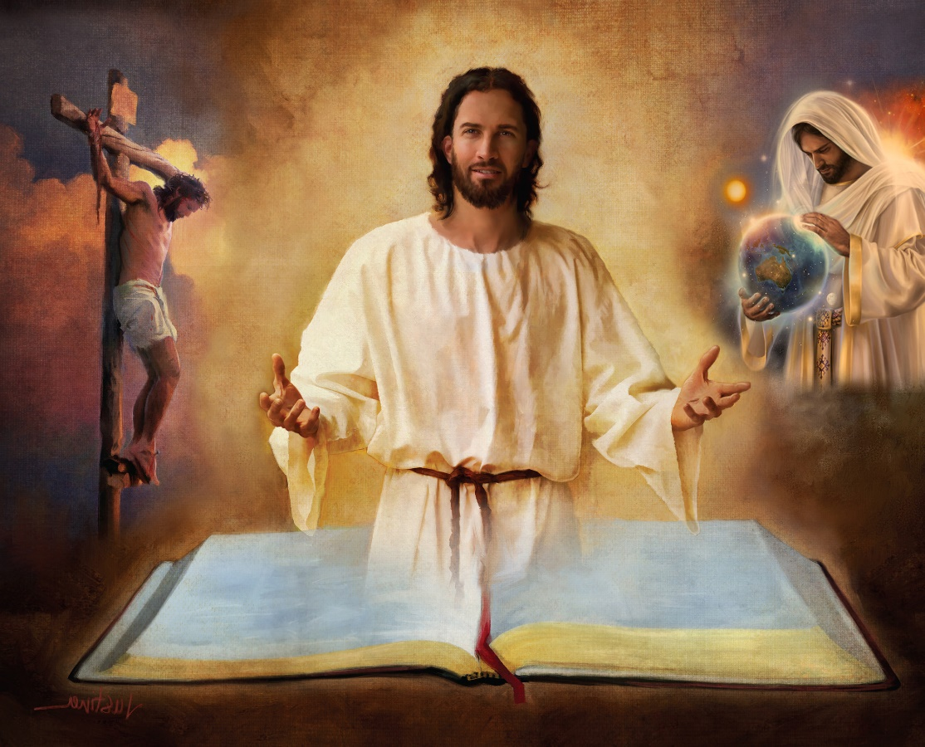
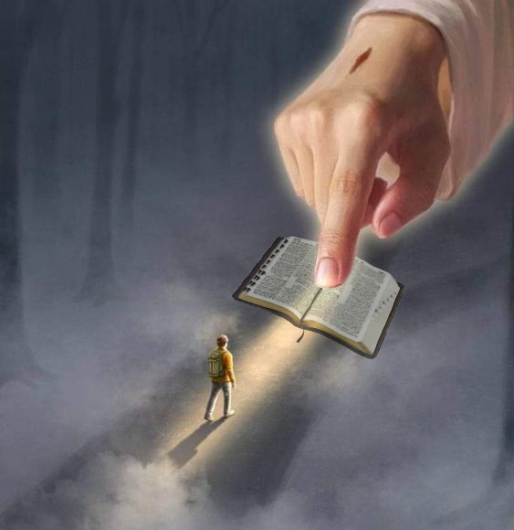
MALUʻI ʻ I HE TOHI TAPÚ
"Fakamāʻoniʻoniʻi ʻa kinautolu ʻaki ʻa e moʻoní; ko hoʻo folofola ko e moʻoni ia" (Sione 17:17)
Ko e Tohi Tapú ko e fakahā taʻealafakalava ia ʻo e finangalo ʻo e ʻOtuá. ʻOkú ne ʻomi e palani ʻa e Langí ki he fakamoʻui ʻo e faʻahinga ʻo e tangatá.
Ko ia ai, ʻoku toki maʻu pe hotau maluʻi ʻi he Tohi Tapu, pea ʻi hono ngaahi tohi takitaha, vahe mo e ngaahi veesi (2Tim. 3:16).
ʻOku tau maʻu ai ʻa e founga ʻa e tevolo; ʻa e fakatupu; ko e ʻaloʻi, moʻui, mate, toetuʻu mo e taukapo ʻa Sisuu; fakamolemoleʻi ʻo e ngaahi angahalá; ko e Hāʻele ʻAngauá; moʻui taʻengata ʻi he mamani foʻou ...
"Ko hoʻomou leá ko e tūhulu ki hoku vaʻé, ko e maama ʻi hoku halá" (Saame 119:105)
Kapau te tau fakasītuʻaʻi hano konga (hangē ko ʻení, ko e fakamatala ki he Fakatupú ʻi he Sēnesi 1 mo e 2), ʻe lava ke tau fakafisingaʻi ha taha ʻo e ngaahi tokāteline ʻokú ne akoʻí. Pea ... ko e hā ʻ a e maluʻanga ʻ e lava ke tau maʻu ke falala ai ki he toenga ʻ o e Tohi Tapú?
“ʻOku hanga ʻe hono fakahā ʻo hoʻo ngaahi leá ʻo ʻomi ha maama; ʻoku ne ʻomi ʻa e mahino ki he faingofua"
(Saame 119:130)

Slide 9

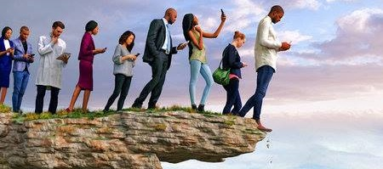


FAKA’UHINGA ʻA E FAʻAHINGA
"ʻOku ʻi ai ha founga ʻoku ngali totonu,
ka ʻi he ikuʻangá ʻoku fakatau ia ki he maté" (Lea Fakatātā 16:25)
Kapau ko e ʻOtua ʻa e tokotaha naʻa ne ueʻi fakalaumalie ʻa e Tohi Tapu, te ne lava ʻo fakaʻuhingaʻi ia (2 Pita 1:20; Sione 14:26)?
ʻOku ʻikai tali ʻe he tokotaha ʻoku ʻikai ke ne maʻu ʻa e Laumālié ʻa e ngaahi meʻa ʻoku haʻu mei he Laumālie ʻo e ʻOtuá ka ʻokú ne lau ia ko e vale, pea ʻoku ʻikai mahino ia kiate ia he ʻoku toki ʻilo pē ia ʻi he Laumālié (1Ko. 2:14 ).
Ko ha sīpinga ʻ o e fakaʻuhinga ʻ a e tangatá ko e fakaanga māʻolunga angé ia, talu mei he senituli hono 18, mo hono fokotuʻu mai ha fakaʻuhinga "fakaʻatamai" ʻ o e Tohi Tapú.
Ko ʻene tefitoʻi founga ko hono fakaʻikaiʻi ʻo e ngaahi mana mo e taʻemalava ke predicting ʻa e kahaʻu. ʻ I he founga ko ení, ko e hā ʻ a e ʻ aonga ʻ e lava ke tau maʻu mei he folofola ʻ a e ʻ Otuá kapau ʻ oku tau fakaʻikaiʻi ʻ a hono mālohí pe ko ʻ ene malava ke ʻ iloʻi ʻ a e kahaʻu ʻ oku fakatatali mai kiate kitautolú?
ʻOku ʻikai ha toe veiveiua, ʻoku filioʻi ʻe he filí ʻa e ngaahi hala ʻoku ngali totonú, ka ko honau ikuʻangá ko e mate (LeaFktata 16:25).

Slide 10

EGW (Ngaahi Pōpoaki Kuo Filifili, voliume 1, peesi 17)
“Kuo ʻufiʻufi ʻe he fakapoʻuli fakalaumālié ʻa e māmaní mo e fakapoʻuli matolu ʻo e kakaí. ʻOku lahi ha ngaahi siasi ʻoku nau veiveiua mo taʻe-anganofo ʻi hono fakaʻuhingaʻi ʻo e Folofolá. Ko e tokolahi ʻ aupito, ʻ oku nau fehuʻia ʻ a e moʻoni mo e moʻoni ʻ o e Tohi Tapú. Ko e fakaʻuhinga ʻ a e tangatá mo e ngaahi fakakaukauloto ʻ a e loto ʻ o e tangatá ʻ okú ne fakavaivaiʻi ʻ a e fakamānavaʻi ʻ a e Folofola ʻ a e ʻ Otuá [...]
Kuo matuʻuaki ʻe he Tohi Māʻoniʻoní ni ʻa e ngaahi ʻohofi ʻa Sētané, ʻa ia kuó ne fakatahaʻi mo e kau tangata koví ke ngaohi ʻa e ʻulungāanga fakalangi kotoa pē ke ʻufiʻufi ʻe he ngaahi ʻaó mo e fakapoʻulí. Ka kuo fakatolonga mai ʻe he ʻEikí ʻa e Tohi Māʻoniʻoní ni ʻaki Hono mālohi fakaofo ʻi hono fōtunga lolotongá—ko ha saati pe tohi fakahinohino ki he fāmili ʻo e tangatá ke fakahā kiate kinautolu ʻa e hala ki he langí.

Slide 11
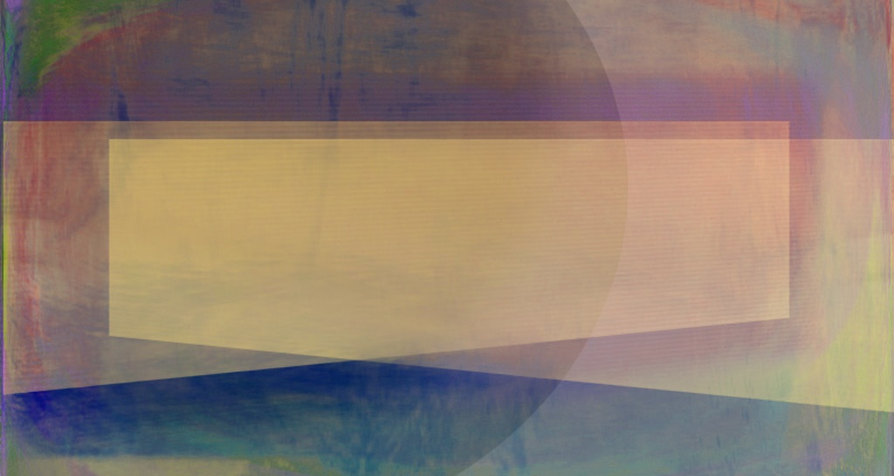
TAU MAʻA E ʻATAMAI

Slide 12

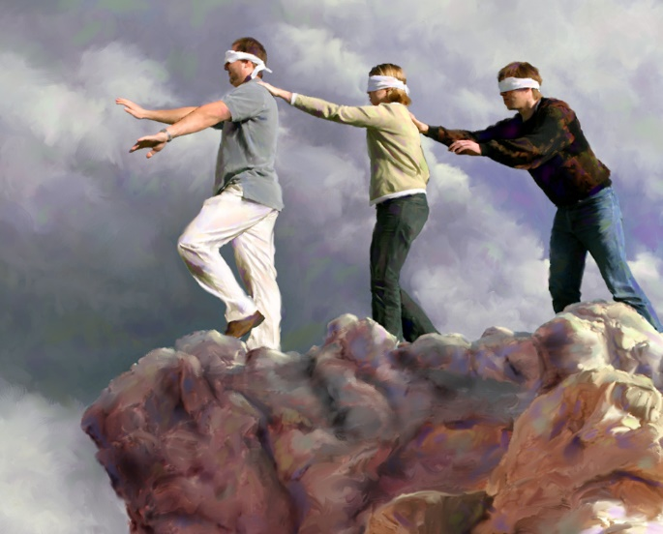
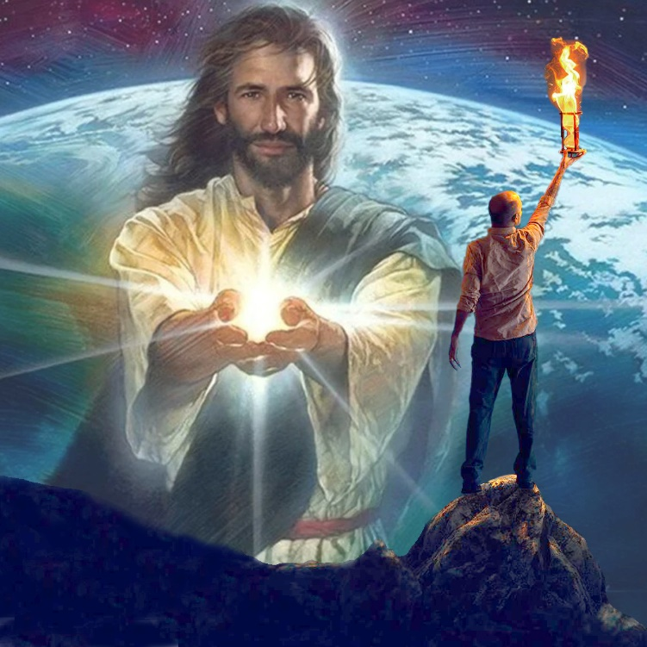

“Kuo fakakuihi ʻe he ʻotua ʻo e kuonga ko ʻeni ʻa e ʻatamai ʻo e kau taʻetui, koeʻuhi ke ʻoua naʻa nau lava ʻo mamata ki he maama ʻo e ongoongolelei ʻa ia ʻoku ne fakaʻaliʻali ʻa e naunau ʻo Kalaisi, ʻa ia ko e ʻimisi ʻo e ʻOtua" (2 Kolinito 4:4)
ʻOku pehe ʻe ha lea faka-Sipeini: "ʻoku ʻikai ha tangata kui ʻe toe kovi ange, ʻi he tokotaha ʻoku ʻikai fie sio." ʻA ia, ʻoku taʻeʻaonga ke fakalotoʻi ha taha ke sio ki he meʻa ʻoku ʻikai ke nau fie sio ki ai. ʻOku pehē pē mo kinautolu kuo fakakuihi "ʻa e ʻotua ʻo e māmaní" (2Ko. 4:4).
ʻOku ʻikai tupu ʻa e siʻi ʻa e ʻiló ʻiate kinautolu ʻoku molé koeʻuhí he ʻoku ʻikai ke nau lava ʻo ʻiloʻi. Ko hono ʻuhinga he ʻoku ʻikai ke nau fie ʻilo. Kuo nofoʻia ʻe he tēvoló honau ʻatamaí ʻaki ha ngaahi meʻa lahi ʻokú ne taʻofi kinautolu mei haʻanau fakakaukau ki he meʻa ʻoku mahuʻinga moʻoní: ʻa honau fakamoʻuí.
Ka ʻoku ʻikai fie maʻu ke nofo ha taha ʻi he tuʻunga ko ʻeni. ʻI he taimi ʻoku ʻi he fakapoʻuli fakalaumālie ai ʻa e ʻatamaí, ʻoku ʻi ai ha maama ʻe lava pea ʻe ulo ai: "ʻOku ulo atu ʻa e māmá [ʻa Sīsū] ʻi he fakapoʻulí, pea naʻe ʻikai ikuna ia ʻe he fakapoʻulí" (Sione 1:5).
ʻE lava ʻe kitautolu ʻoku tau tali ʻa e maama ko ʻení ʻo veteange ʻa e ngāue ʻa e filí, pea ʻai ʻa e maama ʻo Sīsuú ke ulo atu ʻi he fakapoʻulí.

Slide 13

“ʻOku fie maʻu ʻe kinautolu kotoa pē ʻoku fononga he hala ki hēvaní ha fakahinohino ʻoku malú. Kuo pau ke ʻoua naʻa tau ʻaʻeva ʻi he poto ʻo e tangatá. Ko hotau faingamālie ke fakafanongo ki he leʻo ʻo Kalaisi ʻoku folofola mai kiate kitautolú ʻi heʻetau fononga ʻi he fononga ʻo e moʻuí, pea ʻoku hoko maʻu pē ʻEne folofolá ko ha ngaahi lea ʻo e poto. ...
Ko ʻetau maluʻangá pē ʻoku maʻu ia ʻi he muimui ofi kia Kalaisí, ʻaʻeva ʻi Hono potó, mo fakahoko ʻEne moʻoní. He ʻikai lava ke tau ʻiloʻi maʻu pē ʻa e ngāue ʻa Sētané; ʻoku ʻikai ke tau ʻilo pe ʻokú ne fakatoka ʻi fē ʻene ngaahi tauhelé. Ka ʻoku mahino kia Sisu ʻa e ngaahi faiva olopoto ʻa e fili, pea te Ne lava ʻo fokotuʻu hotau vaʻe ʻi ha ngaahi hala ʻoku malu."
EGW (Ko Hotau Uiuiʻi Māʻolungá, 10 Sānuali)

