Slide 1
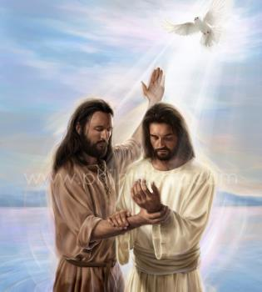
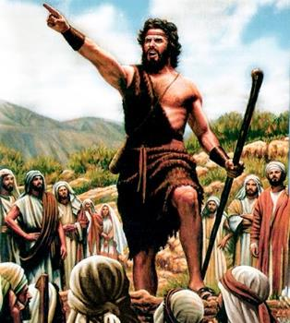
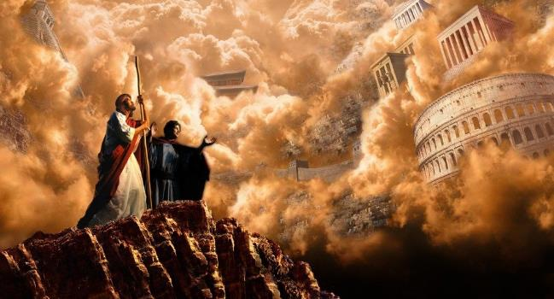
KO E KAMATAʻANGA ʻO E ONGOONGOLELEÍ
Lesoni 1 ki he ʻaho 6 ʻo Siulai 2024

Slide 2
“Pea kuo fakahū ʻa Sione ki he fale fakapōpula, pea haʻu ʻa Sisu ki Kaleli, ʻo malangaʻaki ʻae ongoongolelei ʻoe puleʻanga ʻoe ʻOtua,‌ʻo ne pehē, “Kuo hokosia ʻae kuonga, pea ʻoku ofi ʻae puleʻanga ʻoe ʻOtua: mou fakatomala, pea tui ki he ongoongolelei.” (Ma’ake 1:14, 15)

Slide 3
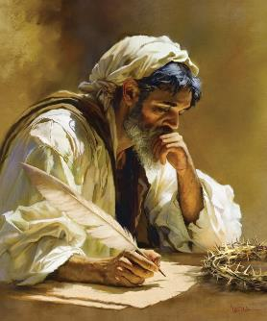
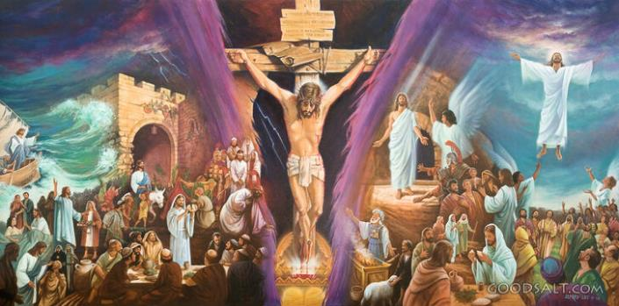
Ko e ongoongolelei ʻa Maʻake ko e nounou taha ia ʻi he kosipeli ʻe fa ʻoku ne fakamatalaʻi e moʻui ʻa Sisuu.
Ko ha talanoa ʻaukai, longomoʻui, mo fakasiʻisiʻi. ʻOku ʻasi mai e ngaahi ʻata ʻi hotau ʻao. He ʻikai lava ke mole meiate koe ha faʻahinga fakaikiiki, he ko e ngaahi meʻa mahuʻinga moʻoni pe ʻoku fakakau atu.
Ko hono fakanounou, ko Maʻake ʻa e ongoongolelei ʻi he senituli 21, ʻa ia ʻoku hoko vave mo vave ai ʻa e meʻa kotoa pe, ʻi he taimi ʻoku paʻanga ai ʻa e taimi. Tau fakaʻaongaʻi muʻa ʻa e taimi ko iá ke ako ai ʻa e meʻa mahuʻinga tahá: "Ko e ongoongolelei ʻo Sīsū Kalaisí, ko e ʻalo ʻo e ʻOtuá" (Maʻake 1:1).
Ko e tupuʻanga ʻo e ongoongoleleí:
ʻIkai lava ʻo ngāuefakafaifekau.
ʻ Aonga ki he ngāuefakafaifekaú.
Ko e kamataʻanga ʻo eongoongoleleí:
Ko e teuteu. Maʻake 1:1-8.
Ko e papitaisó. Maʻake 1:9-13.
Ko e popoaki. Maʻake 1:14-15.

Slide 4
KO E TOKOTAHA NAʻÁ NE FAʻU ʻA E ONGOONGOLELEÍ

Slide 5
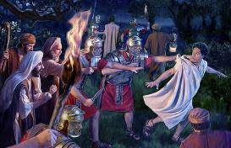
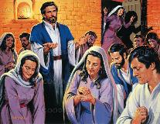
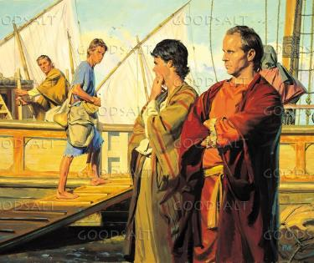
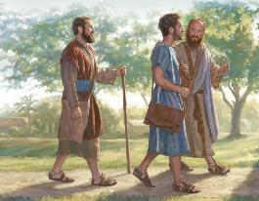
FAIFEKAU NAʻE ʻIKAI LAVA
"ʻI he ʻosi e ngāue ʻa Panepasa mo Saulá, naʻá na foki mei Selusalema, ʻo ʻave mo kinaua ʻa Sione, naʻe ui foki ko Maʻake" (Ngāue 12:25)
ʻI he hangē ko e toenga ʻ o e kau ʻevangelioó, ʻoku ʻikai lave ʻa Maʻake ia ki hono hingoá. Naʻá ne kei siʻi ʻi he taimi naʻe hoko ai ʻa e ngaahi meʻa naʻá ne fakamatalaʻí, ʻ a ia naʻá ne ako fekauʻaki mo ia fakafou ʻi hono vahaʻangatae fekoekoeʻi mo e ʻapositolo ko Pitá (1 Pita 5:13).
Ko e faʻe ʻa Sione Maʻake ko e tokotaha ia naʻe ʻaʻana ʻa e feituʻu ʻi Selusalema ʻa ia naʻe fakataha ai ʻa e Siasi ke lotu ʻi he taimi naʻe tuku popula ai ʻa Pita (Ngaue 12:12).
Hili ha taimi nounou mei ai, naʻe ʻave ʻe Panepasa mo Saula (ʻa ia naʻa na o ki Selusalema ke ʻomi ha feilaulau) ʻa Sione Maʻake ki ʻAniteoke (Ngaue 12:25).
ʻI ʻAniteoke, ʻi he taimi naʻe ui ai ʻe he Laumālie Māʻoniʻoní ʻa Panepasa mo Saula ke na hoko ko e ongo misinale ʻi he lotolotonga ʻo e kau Senitailé, naʻá na ʻave ai ʻa Sione Maʻake mo kinaua ko ha tokotaha ngāue fakataha (Ngāue 13:2-5).
Ka naʻe matuʻaki faingataʻa ʻa e moʻui fakafaifekau ki he talavou ko Maʻake, ʻa ia naʻa ne fili ke foki ki Selusalema (Ngaue 13:13).

Slide 6
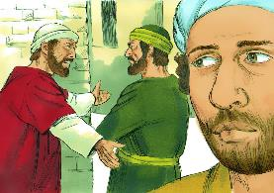
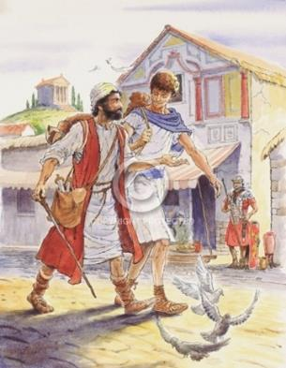
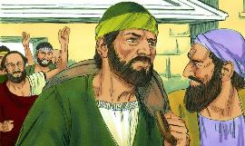
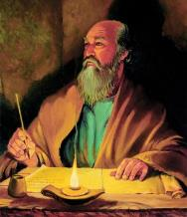
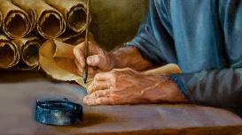
ʻAONGA KI HE NGĀUE FAKAFAIFEKAÚ
"Ko Luke pe ʻoku ʻiate au. ʻOmi ʻa Maʻake pea ʻomi ia mo koe, koeʻuhí he ʻokú ne tokoni kiate au ʻi heʻeku ngāue fakafaifekaú" (2 Tīmote 4:11)
ʻI he taimi naʻe fokotuʻu ai ʻe Paula ʻa e fononga fakafaifekau hono ua, naʻa ne fakafisi ke tali ʻa Maʻake ko ha collaborator (Ngaue 15:36-38). Naʻe fiemaʻu ʻ e Paula ʻ a e kau tokoni mālohi, ʻ a ia te nau hoko ko ha poupou, ʻ o ʻ ikai ko ha kavenga. Naʻe ʻikai ke feʻunga ʻa Maʻake mo e fakamatala fakafoʻituitui ko ʻeni.
Kae kehe, naʻe fakapapauʻi ʻ e Panepasa ko hono ʻ ilamutu ko Maʻaké, naʻá ne maʻu ʻ a e malava feʻunga ke hoko ko ha misinale lelei. Ko ia naʻá ne ʻ ave ʻ a Maʻake ki Saipalo, lolotonga ia ko Paula mo Sailosi Gaue 15:39-41).
ʻOku ʻikai ke tau ʻilo e meʻa naʻe hoko, ka ʻoku tau ʻilo naʻe moʻoni ʻa Panepasa. ʻI he ngaahi fakamoʻoni fakafolofola ʻe tolu naʻa ne fai kiate ia ʻi heʻene ngaahi tohi, naʻe haʻu ai ʻa Paula ke fakakaukauʻi ʻa Maʻake "ʻaonga ki he ngaue fakafaifekau," ko ha collaborator lelei (Kol. 4:10; Phm. 24; 2 Timote 4:11).
Mālō mo e faingamālie hono ua ko ʻení, ʻe lava ke tau fiefia he ʻahó ni ʻi he talanoa fakafiefia ʻo e ongoongolelei ʻa Maʻaké.

Slide 7
KO E KAMATAʻANGA ʻO E ONGOONGOLELEÍ

Slide 8
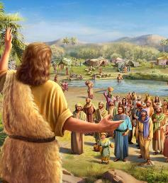
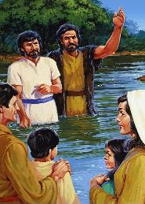
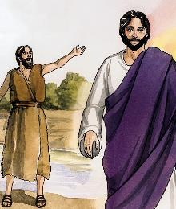
KO E TEUTEU
"Pea ko ʻene pōpoakí ʻeni: "Ka hili ʻeku haʻu ʻa e tokotaha ʻoku mālohi ange ʻiate aú, ko e ngaahi meʻa haʻi ʻo hono senitolo ʻoku ʻikai te u taau ke tulolo hifo ʻo haʻi" (Maʻake 1:7)
ʻOku kamata ʻaki ʻe Maʻake hono fakafeʻiloaki kitautolu ki he ʻOtua ʻo teuteuʻi ʻa e fononga ʻa hono ʻAlo (Mk. 1:1-2; Malakai 3:1). Ko ha fononga ʻoku kamata ʻi he ngaahi fakamaauʻanga fakalangi, pea te ne ʻave ʻa Sisu Kalaisi ki he kolosi, ke toe tali ʻi he Langi (Maʻake 16:19).
Ke teuteu ʻi he founga ko ʻeni, ʻoku fili ʻe he ʻOtua ʻa Sione Papitaiso, ko e "leʻo ʻoku tangi ʻi he toafa" (Mk. 1:3; Is. 40:3).
Kimuʻa pea kamata ʻe Sisu ʻene fononga ke foaki ʻene moʻui maʻatautolu, naʻe teuteuʻi ʻe Sione ʻa e loto ʻo e kakai ʻaki hono fakahinohinoʻi kinautolu ke nau fakatomala mo fakaafeʻi kinautolu ke nau papitaiso (Maʻake 1:4-6).
Naʻá Ne teuteuʻi kinautolu ke nau tali ʻa e ʻAlo ʻo e ʻOtuá: ʻo mālohi ange ʻia Sione tonu; moʻui taau ange; pea te ne fai papitaiso ʻaki ʻa e papitaiso ʻoku ola lelei angé (Maʻake 1:7-8).

Slide 9
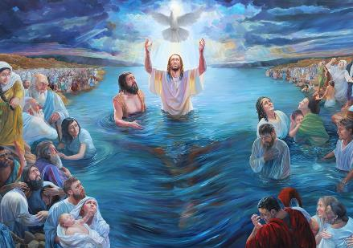
KO E PAPITAISÓ
"ʻI he taimi ko iá naʻe haʻu ʻa Sīsū mei Nāsaleti ʻi Kāleli pea naʻe papitaiso ia ʻe Sione ʻi Soatani" (Maʻake 1:9)
ʻOku kamata ʻe Sisu ʻene fononga ʻi ha founga fakaofo: ʻOku foaki ia ʻe he ʻOtua ko e Tamai ko hono ʻAlo, pea ʻoku fakaha ʻe he Laumalie Maʻoniʻoni ʻa ʻene ʻi ai ʻi hono fotunga fakaesino (Maʻake 1:10-11). Talu mei he kamataʻangá mo hono fokotuʻu ʻa Sīsū ko ha tokotaha fakalangi, ko e ʻAlo ʻo e ʻOtuá. Ka ʻoku toe ʻoatu foki ia ko ha tokotaha ʻo e tangata:
ʻOku papitaiso ia ʻe Sione, kae ʻikai ʻi he hala kehe
(Maʻake 1:9)
ʻOku tataki ia ʻe he Laumālié
(Maʻake 1:12)
ʻOku fie maʻu ke ne nofo toko taha pē mo e ʻOtuá
(Maʻake 1:13)
ʻOku ʻahiʻahiʻi ia ʻe he tēvoló
(Maʻake 1:13)
Fehangahangai mo e ngaahi fakatuʻutāmaki fakatuʻasinó
(Maʻake 1:13)
Tauhi kiate ia ʻa e kau ʻāngeló (Maʻake 1:13)
Ko e founga eni ʻ oku ʻ omai ai ʻ a Sīsū kiate kitautolú: ko e tangata fakaʻotua mo kakato. Ko Ia ʻa e Fakamoʻuí mo e Tokoua, ʻEiki mo e Faʻifaʻitakiʻanga. Ko e fakahā kakato ia ʻo e ʻofa ʻa e ʻOtuá ki he faʻahinga ʻo e tangatá.

Slide 10
«Ko e nāunau naʻe nofoʻia ʻe Kalaisí ko ha fakapapau ia ʻo e ʻofa ʻa e ʻOtuá kiate kitautolú. ʻOkú ne talamai ʻa e mālohi ʻo e lotú—ʻa e founga ʻe lava ke aʻu ai ʻa e leʻo ʻo e tangatá ki he telinga ʻo e ʻOtuá pea mo ʻetau ngaahi kolé ke tali ʻi he ngaahi fakamaauʻanga ʻo e langí.... ʻE to kiate kitautolu ʻa e maama naʻe to mei he ʻulu ʻo hotau Fakamoʻui ʻi heʻetau lotu ke maʻu ha tokoni ke tekeʻi ʻa e ʻahiʻahi. ʻOku pehē ʻe he leʻo naʻe folofola kia Sīsuú ki he laumālie tui kotoa pē, "Ko ʻeku tama ʻofeina ʻeni, ʻa ia ʻoku ou fiemālie lahi aí."»
EGW (ʻI he Ngaahi Feituʻu Fakalangí - Kuo Fili Au ʻe he ʻOtuá, Sānuali 20)

Slide 11
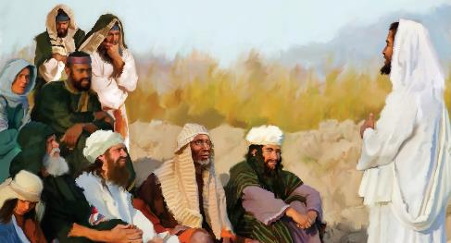
KO E POPOAKI
70 weeks = 490 years
7 weeks
62 weeks
½ week
½ week
49 years
434 years
7 years
"Hili hono tuku ʻo Sione ki he fale fakapōpulá, naʻe hāʻele ʻa Sīsū ki Kāleli, ʻo fakahā ʻa e ongoongo lelei ʻo e ʻOtuá" (Maʻake 1:14)
Naʻe fakamatalaʻi ʻe he ʻuluaki pōpoaki ʻa Sīsuú ha tafaʻaki ʻe tolu (Maʻake 1:15)
"Kuo ofi mai ʻa e puleʻanga ʻo e ʻOtuá"
"fakatomala pea tui ki he ongoongoleleí"
"Kuo hokosia ʻa e taimí"
Ko ha fakamatala ki he kikite uike ʻe 70 (Teniela 9:24).
Mei he tuʻutuʻuni ʻ a Artaxerxes, taʻu 457 BC, ʻ o aʻu ki hono pani ʻ o e Mīsaiá, ʻ e ʻ osi atu ʻ a e uike ʻ e 69 (v.25).Naʻe fakahoko ʻeni ʻi he papitaiso ʻo Sisuu, tuʻuaki 27. Hili ha haafe uike mei ai, naʻe pekia ʻa Sisu (v. 27).
Naʻe ʻi ai ha talaʻofa kuo kamata ke fakahoko ʻa e fuakava ʻo e fakamoʻuí.
Ko ha ui ke kau mālohi ʻi he fuakavá, ʻaki hono tali e fakamolemolé ʻo fakafou ʻi he tui kia Sīsuú.
ʻOku kau foki ʻi heʻetau pōpoaki lolotongá ʻa e ngaahi tafaʻaki ko ʻení ʻe tolu: Kuo ʻosi fakahoko ʻa e taimí; ʻOku hāʻele mai ʻa Sīsū; pea kuo pau ke tau fakatomala mo tui kae lava ke tau ō mo Ia.

Slide 12
"Ko e kavenga ʻeni ʻo e malanga ʻa Kalaisí, "Kuo fakahoko ʻa e taimí, pea ʻoku ofi ʻa e puleʻanga ʻo e ʻOtuá; mou fakatomala, pea tui ki he ongoongoleleí." Ko ia ai, ko e pōpoaki ʻo e ongoongoleleí, ʻo hangē ko ia naʻe fai tonu pē ʻe he Fakamoʻuí, naʻe makatuʻunga ia ʻi he ngaahi kikité. Ko e "taimi" naʻá Ne fakahā kuo fakahokó ko e vahaʻataimi ia naʻe fakahā ʻe he ʻāngelo ko Kepalelí kia Taniela...
Hangē ko hono fanongonongo ʻe he pōpoaki ʻo e ʻuluaki hāʻele mai ʻa Kalaisí ʻa e puleʻanga ʻo ʻEne ʻaloʻofá, ʻoku pehē pē hono fakahā ʻe he pōpoaki ʻo ʻEne hāʻele ʻangaua maí ʻa e puleʻanga ʻo Hono nāunaú. Pea ko e pōpoaki hono uá, hangē ko e ʻuluakí, ʻoku fakatefito ia ʻi he ngaahi kikité."
EGW (Ko e Fakaʻamu ʻo e Taʻu Motuʻá, pg. 233, 234)

