Slide 1
KO HA ʻAHO ʻI HE NGĀUE FAKAFAIFEKAU ʻA SĪSUÚ
Lesoni 2 ki he ʻaho 13 ʻo Siulai 2024

Slide 2
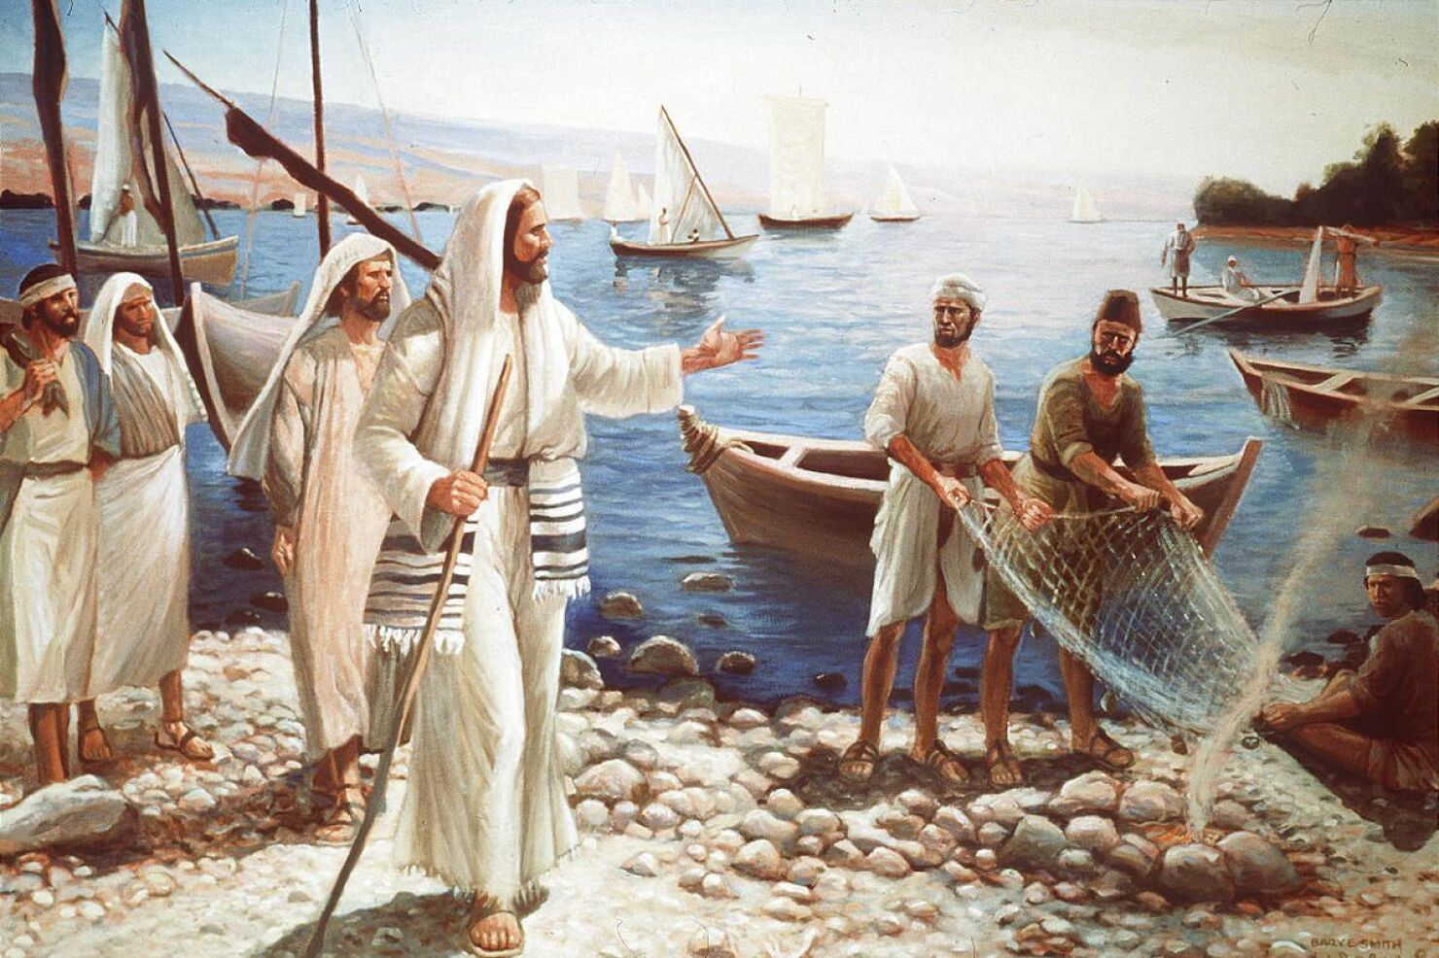
“Pea pehē ʻe Sisu kiate kinaua, “Mo muimui mai ʻiate au, pea te u ngaohi ʻakimoua ke mo toutai tangata.”
(Ma’ake 1:17)

Slide 3
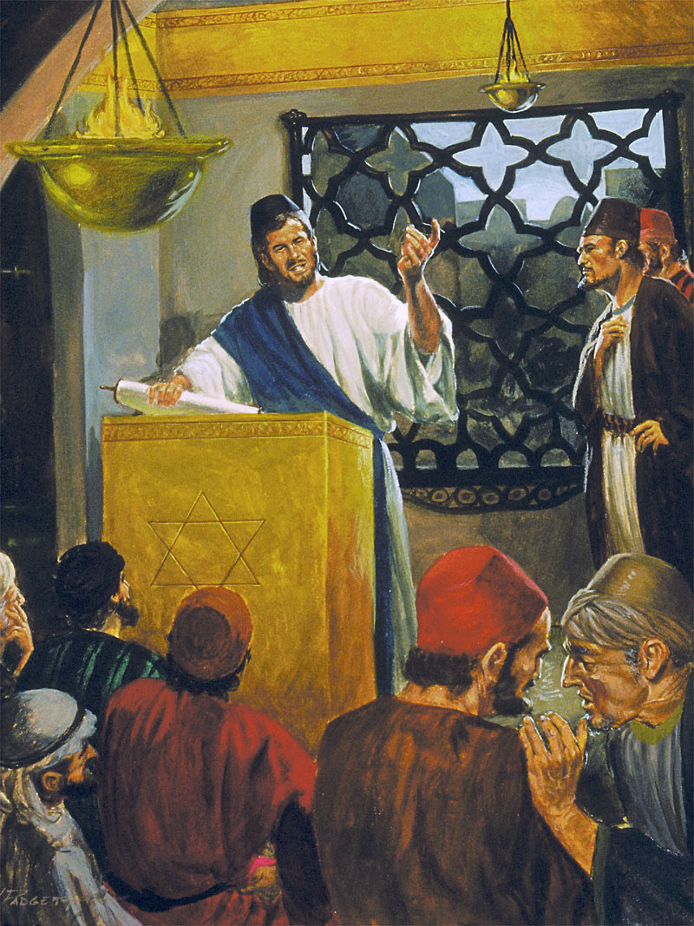
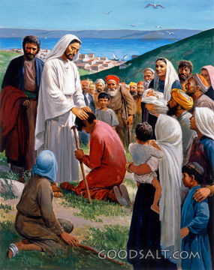
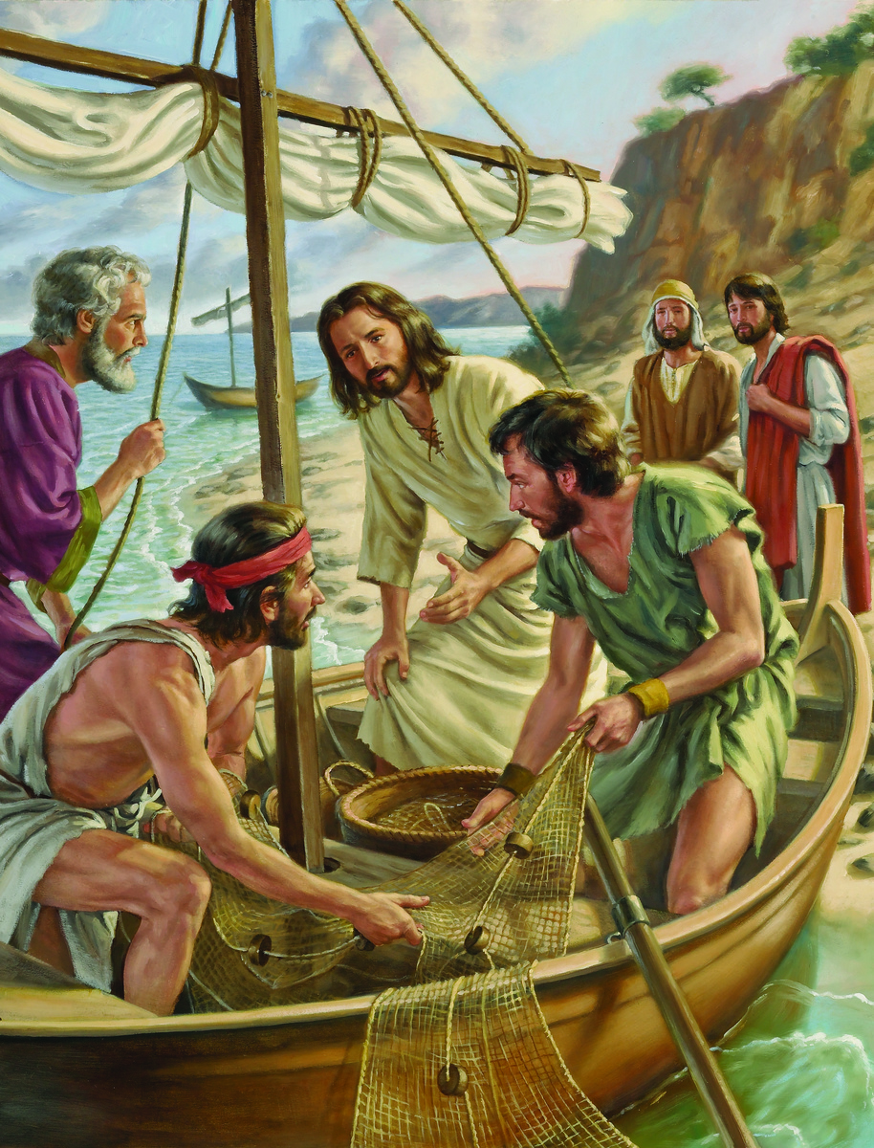
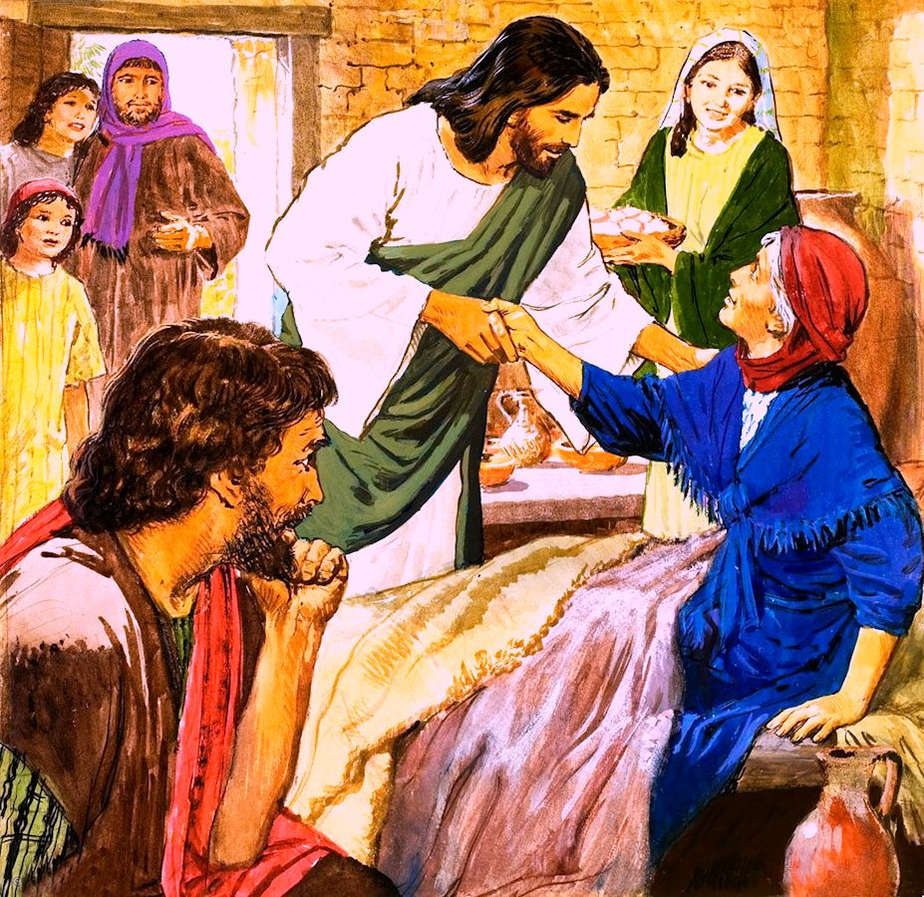
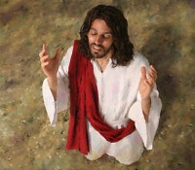
ʻE fēfē nai ha ʻaho ʻi he moʻui ʻa Sīsuú? Fefe kapau te tau o mo ia ʻi ha uike kakato?
ʻOku tokoni ʻa Maʻake ke tau moʻui ʻaki e meʻa ko ʻeni ne hoko ʻi he konga fakaʻosi ʻo ʻene vahe ʻuluaki (Maʻake 1:16-45).
Te tau ʻalu fakataha mo Sīsū ʻaki hano ui ha kau toutai ke nau muimui taimi kakato ʻiate ia; fiefia ʻi ha ʻaho Sapate femoʻuekina; pea ko hono fakaʻosí, te tau sio pe ko e hā ʻenau ngaahi anga fakafonua fakaʻahó.
Ngaahi ʻekitivitī makehé:
Ui ha kau ākonga. Maʻake 1:16-20.
Ngaahi ʻEkitivitī he Sāpaté:
Malanga ʻi he falelotu lahí. Maʻake 1:21-28.
Fakamoʻui. Maʻake 1:29-34.
Ngaahi ʻekitivitī fakaʻahó:
Lotu mo malanga. Maʻake 1:35-39.
Fakamoʻui mo fakaʻapaʻapaʻi ʻa e fono. Maʻake 1:40-45.

Slide 4
NGAAHI ʻEKITIVITĪ MAKEHÉ

Slide 5
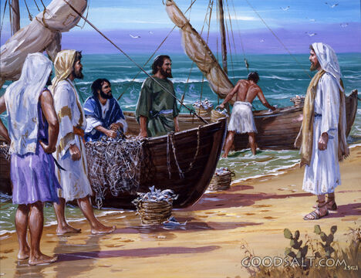
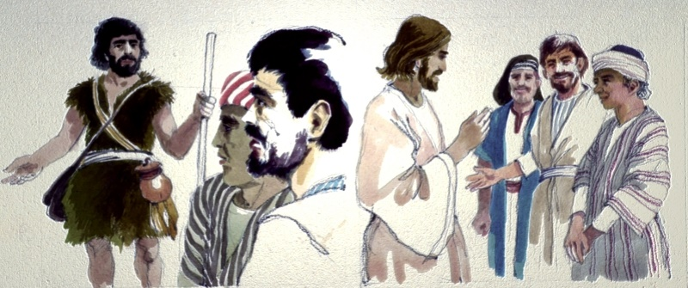
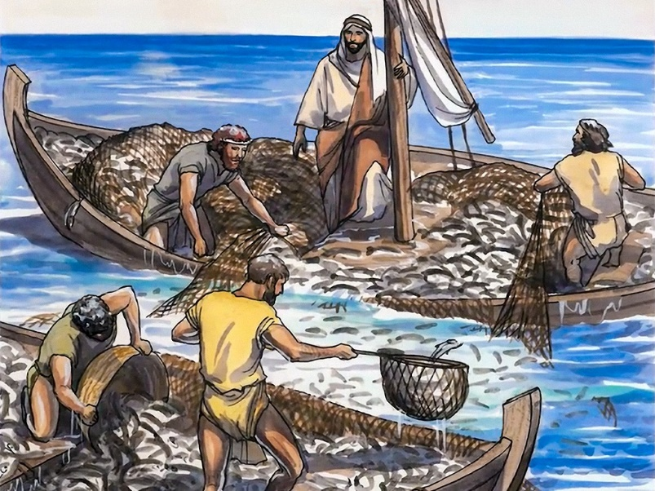
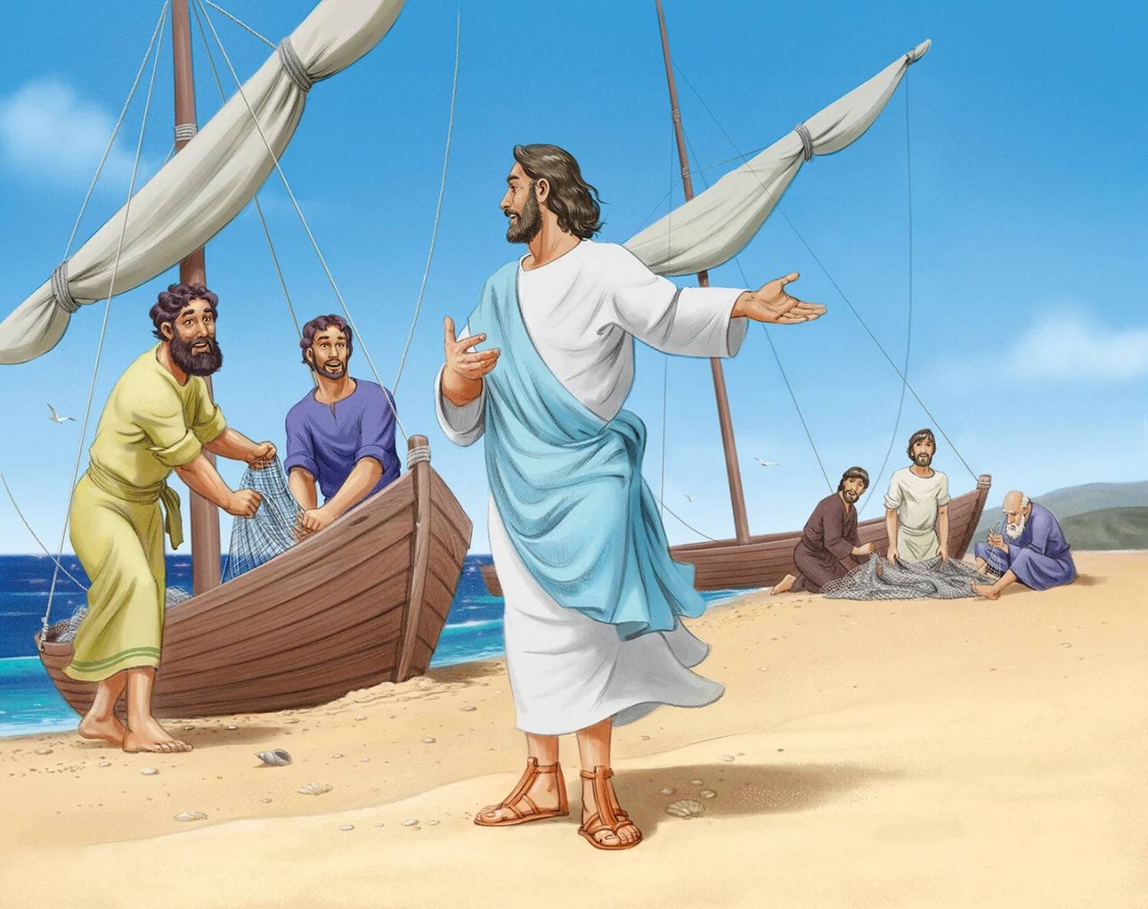
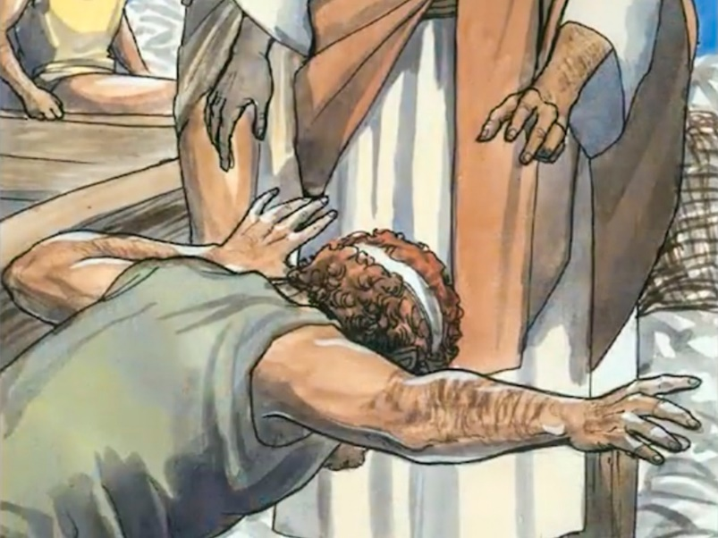
UI ʻO E KAU ĀKONGÁ
Naʻe folofola ʻa Sīsū, "Muimui ʻiate au, pea te u fekau koe ke ke toutai maʻá e kakaí." (Maʻake 1:17)
ʻOku fakafotunga ʻa Maʻake ʻe heʻene nounou. Kapau naʻe ʻikai ke tau talanoa ki he ngaahi ongoongolelei kehé, ʻe lava ke tau aʻusia ha ngaahi aofangatuku hala fekauʻaki mo e uiuiʻi ko ʻení.
Naʻe ʻikai ko e fuofua taimi ʻeni ke fetaulaki ai e kau tangatá ni mo Sīsuú. ʻI heʻenau hoko ko e kau muimui ʻo Sione Papitaisó, naʻa nau fanongo ki heʻene ngaahi lea fekauʻaki mo Sīsuú, pea naʻa nau muimui ʻiate ia. Ko e ʻuluaki ke fai ia ko ʻAnitelu mo Sione, hoko ai mo hona ongo tokoua takitaha (Jn. 1:35-42).
‘Oku malanga ʻa Sīsū mei he vaka ʻo Pitá, pea ʻoku hoko leva ha meʻa fakaemana. Naʻe meimei mahae ʻa e kupenga ʻo e ongo tautehina ʻe toko faa ʻi he lahi ʻo e ika (Luke 5:1-7). Lolotonga hono monomono ʻe Sēmisi mo Sione ʻa e kupengá, ʻoku tō ʻa Pita ʻi he vaʻe ʻo Sīsuú (Luke 5:8-11).
Naʻe tuku ʻe Sekope mo Sione ʻena tamai ke ne tokangaʻi e pisinisi fakafamili, pea naʻe tuku ʻe Pita mo ʻAnitelu ʻena maʻuʻanga moʻui ke hoko ko e kau ikuna ʻo e Laumalie. ʻI heʻenau talangofua ki he ui ʻa Sīsuú, naʻe liliu ai ʻenau moʻuí, pea mo e moʻui ʻa e māmaní kotoa.

Slide 6
NGAAHI ʻEKITIVITI ʻI HE SAPATE

Slide 7
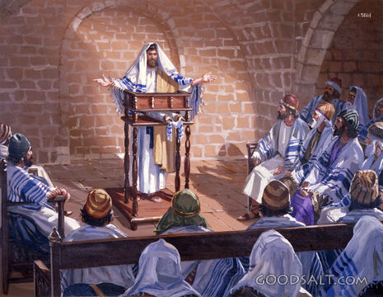
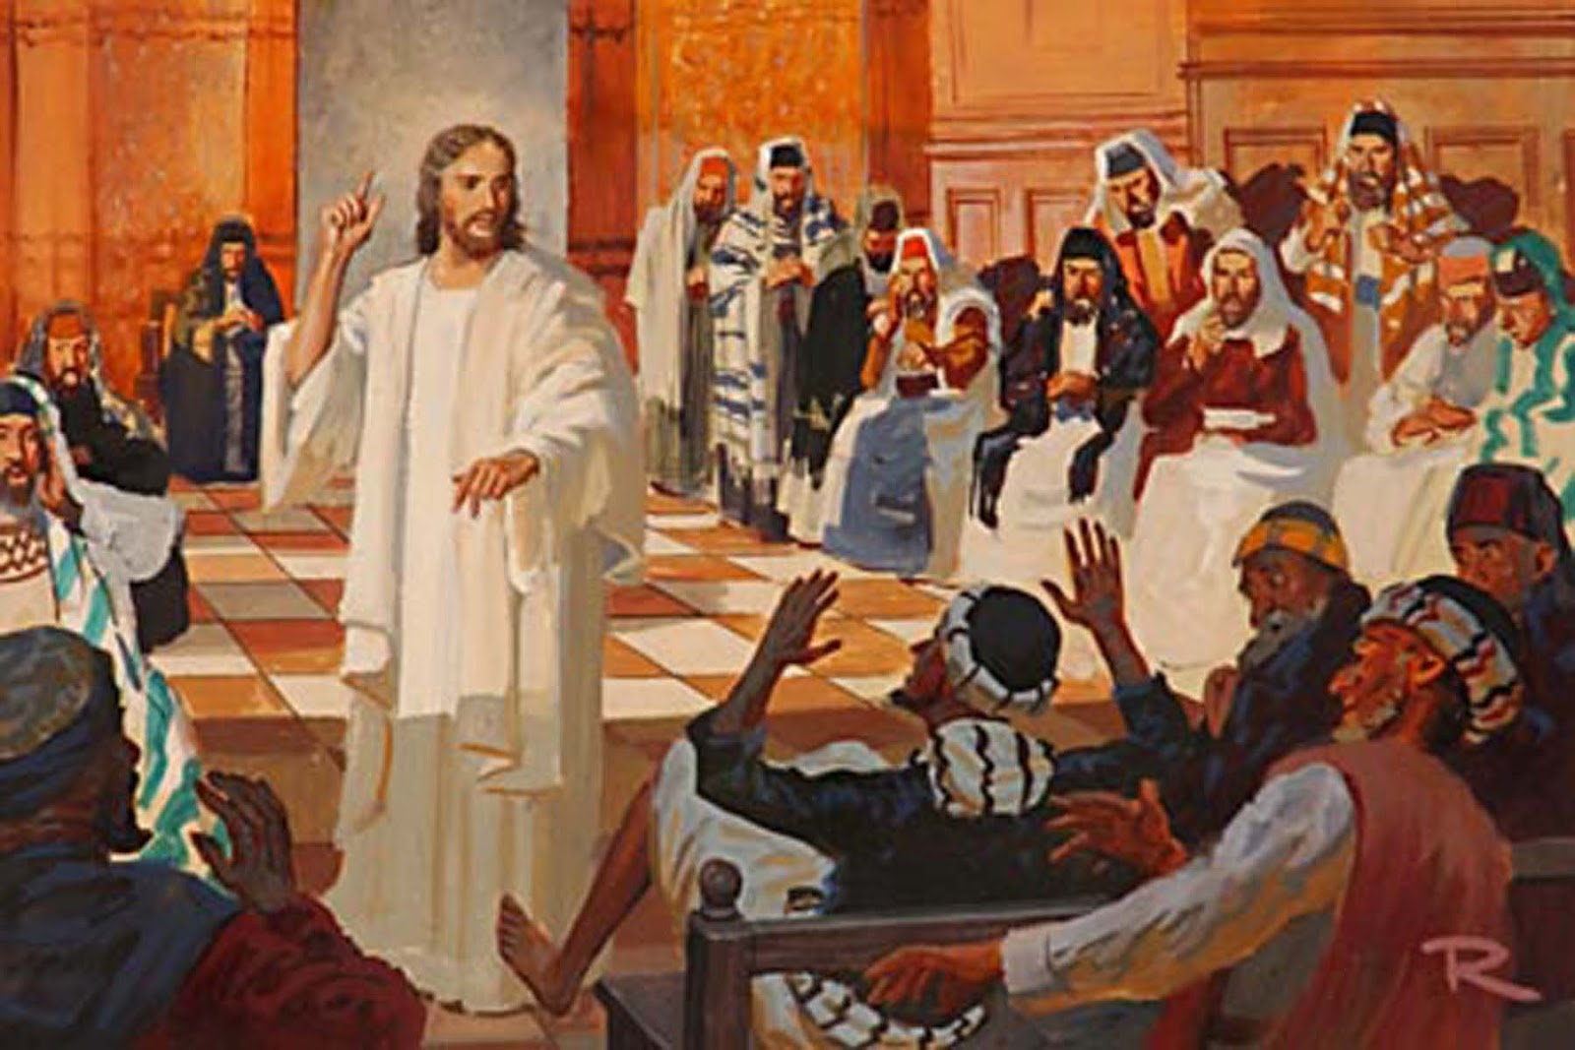
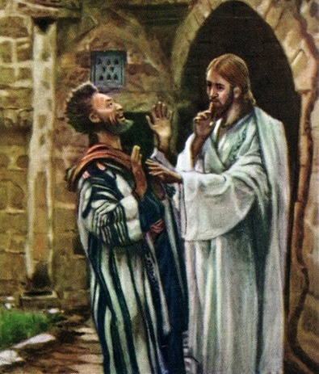
MALANGA ʻ I HE SINAKOKÉ
"Naʻa nau ʻalu ki Kāpaneume, pea ʻi he hoko ʻa e Sāpaté, naʻe hāʻele ʻa Sīsū ki he fale lotú, ʻo kamata ke akonaki" (Maʻake 1:21).
ʻOku fakamahinoʻi ʻe he ngaahi kosipeli ko e ʻalu ki he fale lotu ʻi he ʻaho Sapate ko ha ʻulungaanga ia ʻo Sisu, kae ʻikai ko ha meʻa naʻe hoko (Luke 4:16).
Naʻe anga - fēfē ʻ a e tali ʻ a e kakaí ki he malanga ʻ a Sīsuú? (Maʻake 1:22).
Ka naʻe ʻikai ke fiefia ʻa e taha kotoa. Naʻe fakakaukau ʻa e fili ke ne fakahohaʻasi ʻa e ngaue, ʻo ʻamanaki ke taʻeʻaonga ai ʻa e ivi takiekina ʻo Sisuu (Maʻake 1:23-26). Naʻe hanga ʻe ha tokoni vave ʻo ʻai ke toe lahi ange hono takiekina ʻo e kakai ʻe Ia (Maʻake 1:27-28).
ʻOku ʻi ai ha moʻoniʻi meʻa ʻe tolu ʻoku makehe mei he talanoa ko ʻeni:
Naʻe ʻi ai ha tevolo ʻi he Siasi. ʻOku ʻi ai ha "ngaahi tea" ʻi he Siasi, pea he ʻikai ke tau lava ʻo fakafaikehekeheʻi kinautolu (Moʻunga 13:24-30).
Naʻe ʻ iloʻi ʻ e he tēmenioó ko hai ʻ a Sīsū, pea kumi ki ha founga ke fakafepakiʻi ai ʻ a Hono tākiekiná.
Naʻe tuʻutuʻuni ʻe Sīsū ke ne fakalongolongo. Naʻe ʻ ikai ko e taimi ia ke talaki fakahāhā ai ko e Mīsaiá ia.

Slide 8
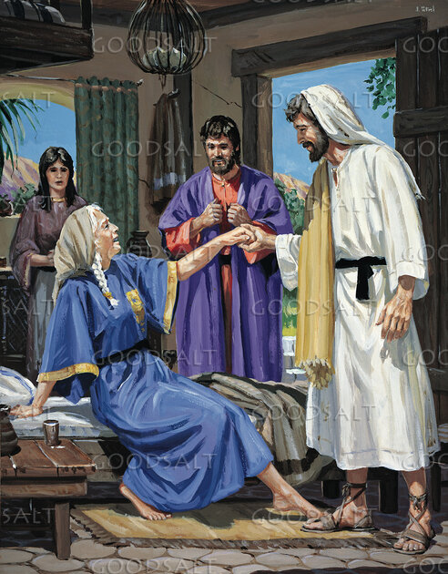
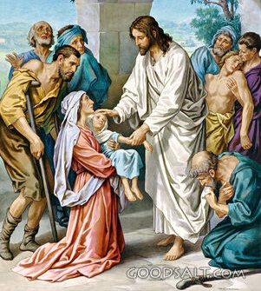
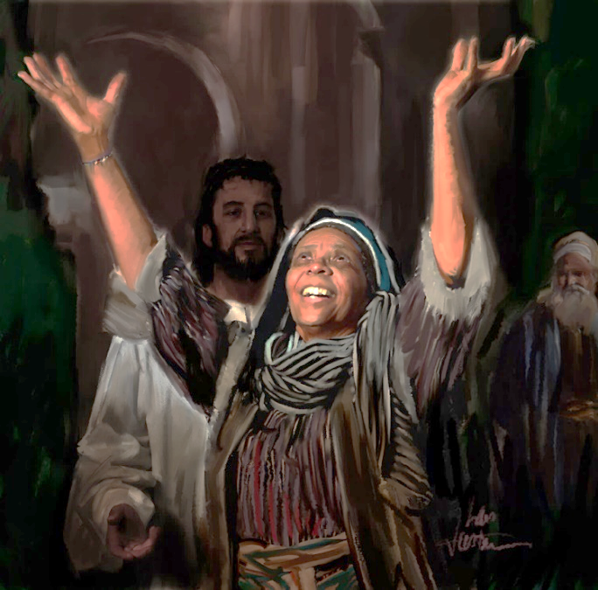
FAKAMOʻUI
“ʻI he efiafi ko ia hili e to ʻa e laʻaa, naʻe ʻomi ʻe he kakai kia Sisu ʻa e kau mahaki mo e kau tevolo kotoa pe" (Maʻake 1:32)
ʻI he fakaʻosinga ʻo e ouau ʻi he fale lotu, naʻe malolo ʻa Sisu mo ʻene kau akonga ʻe toko faa ki he fale ʻo Pita ke maʻu ha meʻatokoni ʻi he tauʻataina fakafoʻituitui (Maʻake 1:29).
Lolotonga ʻenau teuteuʻi e tēpilé, naʻa nau fakamatala kia Sīsū ʻo kau ki he faʻē ʻi he fono ʻa Pitá, ʻa ia ne ʻohofi ʻe he mofí (Maʻake 1:30). ʻI hono fakamoʻui ʻo e fefine ni, naʻa ne fakatapui ia ke tokoni ki he kau fakaafe (Maʻake 1:31). Ko e ngaahi ʻ aonga ʻ oku ʻ omai ʻ e Sīsū kiate kitautolú ʻ okú ne fakatupunga ʻ iate kitautolu ʻ a e holi ke vahevahe atu ia ki he niʻihi kehé.
Ko e mana naʻe maʻu ʻe he tēmenioó ko e talanoa ʻi ha ngaahi ʻapi lahi ʻi Kāpaneume. Ko ia, ʻi he fakaʻosinga ʻo e ngaahi houa toputapu ʻo e Sāpaté, ʻi he tō ʻa e laʻaá, naʻa nau ʻomi ha kakai mahaki tokolahi kia Sīsū ke fakamoʻui (Maʻake 1:32-34).
Ko ha meʻa fakafiefia moʻoni ia! Ko e tangi moʻoni ē ʻ o e fakahīkihiki naʻe fai ʻ i he fale ʻ o Saimoné! Pea naʻe ʻikai ngata pē ʻi hono fai ʻo e fakahīkihiki naʻe fakamoʻuí, ka naʻe fiefia ʻa Sīsū tonu ʻi hono fakamoʻui kinautolú.

Slide 9
NGAAHI ʻEKITIVITI FAKAʻAHO

Slide 10
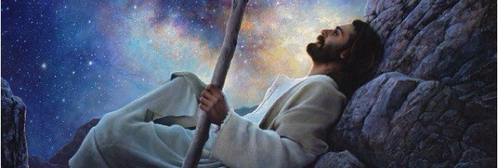
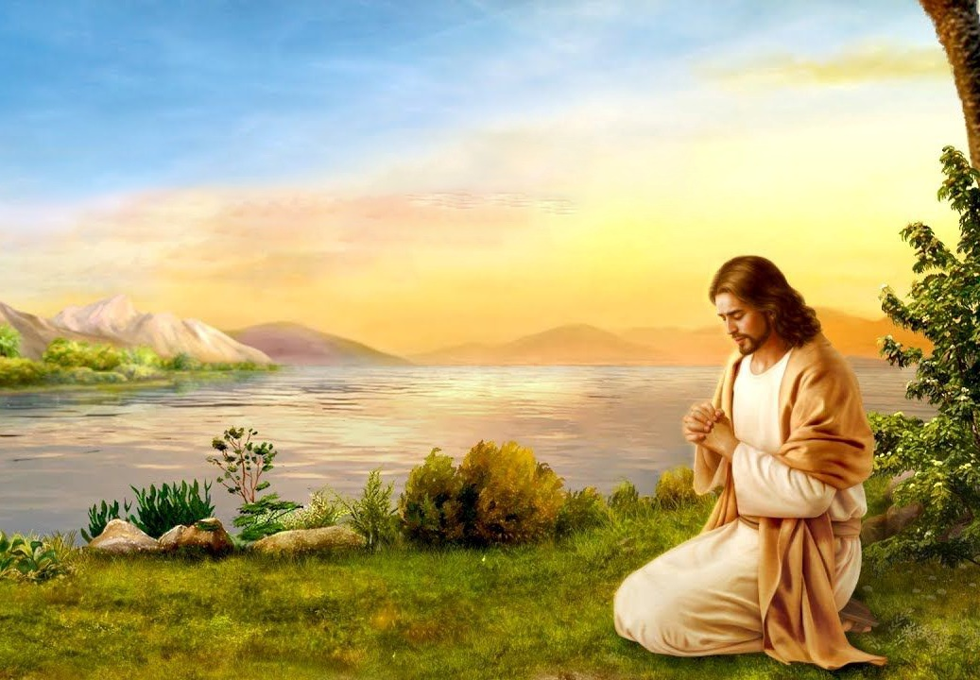
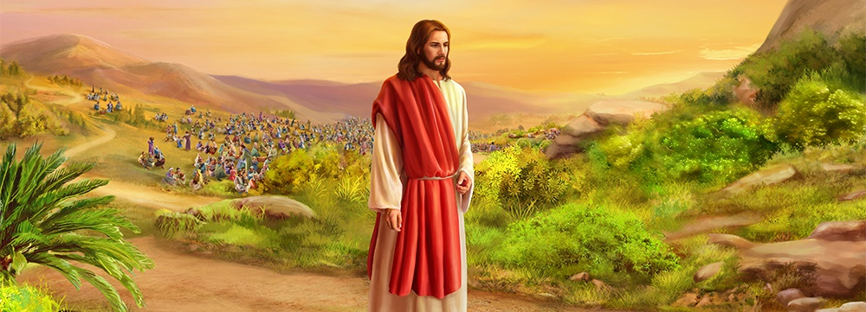
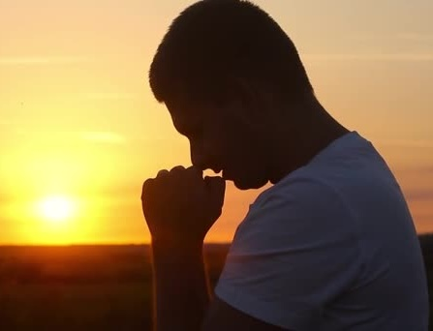
LOTU MO MALANGA
"ʻI he hengihengi ʻo e pongipongí, lolotonga ʻene kei fakapoʻulí, naʻe tuʻu hake ʻa Sīsū, pea mavahe mei he falé ʻo ʻalu ki he potu naʻe tuʻu ai, ʻa ia naʻá ne lotu aí" (Maʻake 1:35)
ʻI he ʻaho Sāpaté, naʻe tatali ʻa e kau ākongá ke malanga ʻa Sīsū ʻi he koló. Ka naʻe kehe ʻa e palani ia ʻa Sīsuú. Naʻe pau ke ne maʻu ʻ aonga ki he tokolahi kehe ʻ a ʻ ene ngaahi leá mo e tōʻongá (Maʻake 1:36-39).
Ka naʻe ʻ ikai ke ngāue ʻ a Sīsū ʻ i heʻene tamuʻomuʻa pē ʻ aʻaná. Hange ko e angamaheni, naʻa ne ʻuluaki ʻalu ke talanoa mo ʻene Tamai koeʻuhi ke ne lava ʻo talaange ʻa e meʻa naʻe pau ke ne fai ʻi he ʻaho ko ia (Mk. 1:35; Sione 8:28 ).
Naʻe faʻa fekumi ʻa Sisu ʻi he ʻaho kotoa pe ki he ʻOtua ʻi he lotu, pea ʻoku ne fakaafeʻi kitautolu ke tau faʻifaʻitaki kiate ia (Maʻake 6:46; Luke 3:21; 5:16; 9:18; 11:1; 18:1). ʻI ha ngaahi tūkunga makehe, naʻe aʻu ʻo ne fakatapui e pō kakato ki he lotú (Luke . 6:12-13; Matiu 14:21-23).

Slide 11
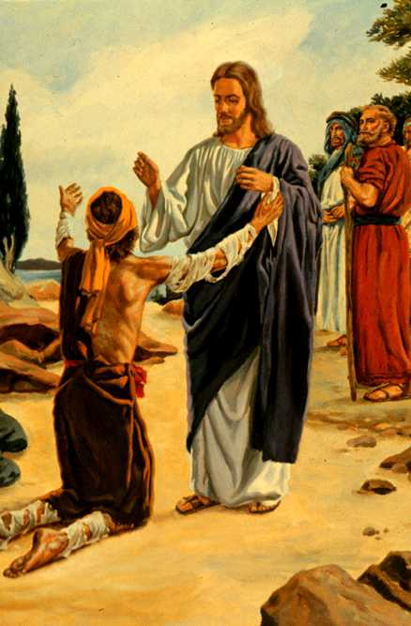
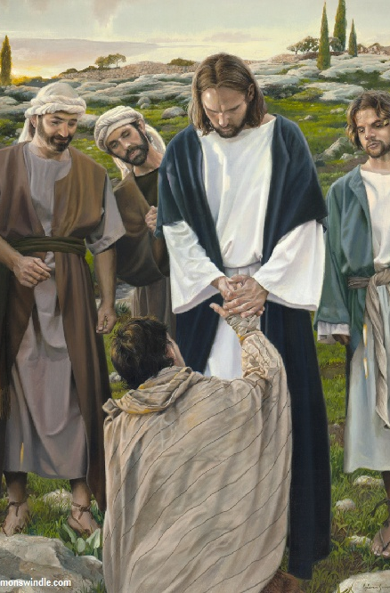
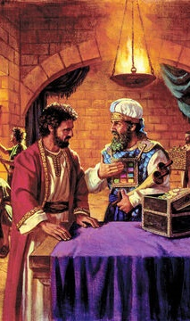
FAKAMOʻUI MO FAKAʻAPAʻAPAʻI ʻA E FONO
"Tokanga ke ʻoua naʻa ke tala ʻeni ki ha taha. Ka ke ʻalu, fakaha koe ki he taulaʻeiki pea ʻoatu ʻa e ngaahi feilaulau naʻe fekau ʻe Mosese ke fakamaʻa koe, ko ha fakamoʻoni kiate kinautolu." (Maʻake 1:44)
Naʻe tuʻulutui ʻa e tangata kilia, ʻa ia naʻe mamaʻo mei he fetuʻutaki kotoa ʻa e tangata koeʻuhi ko ʻene puke, ʻi he ʻao ʻo Sisu ʻo kole ha fakamoʻui (Lev. 13:45; Maʻake 1:40).
ʻI he ʻao ʻo e fuʻu kakaí, ʻoku fai ai ʻe Sīsū ha meʻa ʻ oku fepaki mo e laó: ʻokú ne ala ki he kiliá pea hoko ai ʻo taʻemaʻa. Ka naʻe ʻikai ke ne maʻu ʻa e taʻemaʻa ʻa e tangata kilia, ka naʻe maʻu ʻe he tangata kilia ʻa e fakamoʻui ʻo Sisuu.
ʻI heʻetau haʻu kia Sīsū mo ʻetau ngaahi angahalá mo e ʻulí, he ʻikai ke Ne mavahe meiate kitautolu. Te Ne fakamolemoleʻi mo fakamoʻui kitautolu, ʻo ngaohi kitautolu ke tau maʻa hangē ko Iá.
Hili hono fakamoʻui ia, naʻa ne ʻoange ha ʻota ʻe ua mo ha taumuʻa ʻe ua
(Mk. 1:44)
Fakahā koe ki he kau taulaʻeikí
Naʻá ne fakahaaʻi ʻene fakaʻapaʻapa ki he laó
Naʻá ne ʻ oange ki he kau taulaʻeikí ʻ a e faingamālie ke tali ia ko e Mīsaiá.
Ke fakalongolongo
Naʻá Ne taʻofi ʻa e kau taulaʻeikí mei haʻanau fakaʻauha ʻa e kiliá
Naʻa ne fakaʻehiʻehi mei hono feinga fafangu e ʻamanaki faka-Misaia ʻi he kakai

Slide 12
"Naʻe ʻikai faingofua e moʻui ʻa e Fakamoʻuí ʻi he māmaní. Ka naʻe ʻikai ke Ne teitei helaʻia ʻi he ngāue ke fakahaofi e kakai naʻe molé. Naʻá Ne moʻui taʻesiokita mei Hono ʻaloʻí ʻo aʻu ki Heʻene pekiá. Naʻe ʻikai ke ne feinga ke tauʻataina mei he ngaue malohi mo e ngaahi fononga fakaongosia. Naʻá Ne pehē ko e Foha ʻo e tangatá "naʻe ʻikai ke haʻu ia ke tauhi, ka ke tauhi mo foaki ʻene moʻuí ke huhuʻi ʻa e kakai tokolahi." Matiu 20:28. Ko e taumuʻa maʻongoʻonga taha ʻeni ʻe taha ʻo ʻEne moʻuí. Naʻe ʻikai ke fuʻu mahuʻinga ʻa e meʻa kotoa pe. Naʻe hangē ʻEne ngāué ko ha meʻakai mo ha inu kiate Ia, ke fai e finangalo ʻo e ʻOtuá mo fakaʻosi ʻEne ngāué. Naʻe ʻikai ha fakakaukau kiate kita ʻi Heʻene ngāué."
EGW (Ngaahi Sitepu kia Kalaisí, pg. 77)

