Slide 1
NGAAHI TALANOA FAKATĀTĀ
Lesoni 4 ki he ʻaho 27 ʻo Siulai 2024

Slide 2
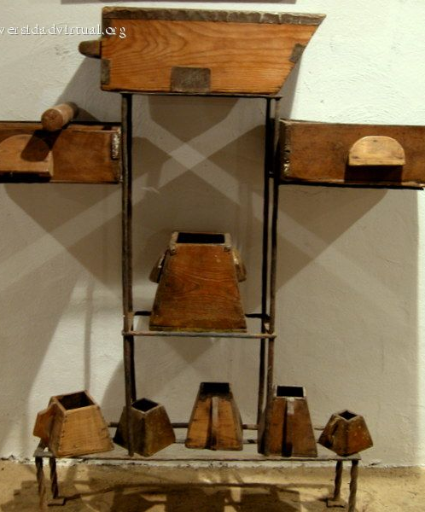
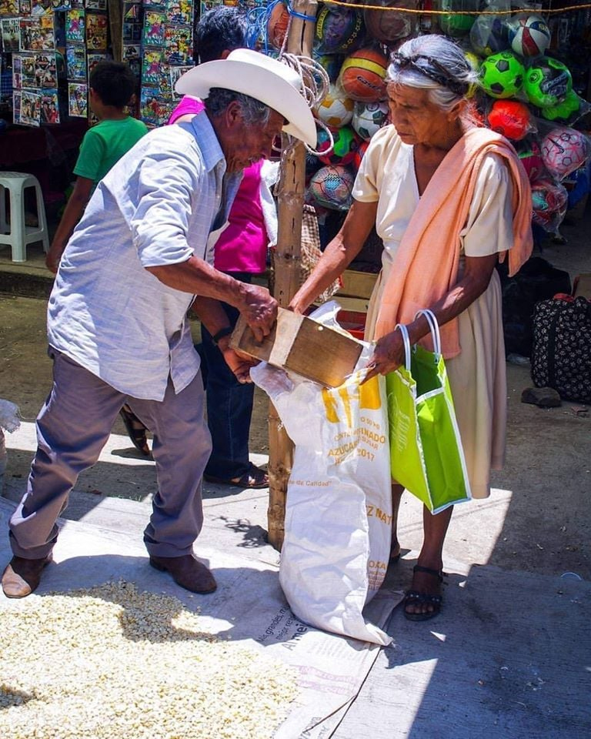
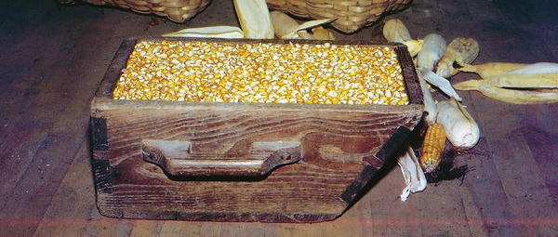
“Pea pehē ʻe ia kiate kinautolu, “Tokanga ki he meʻa ʻoku mou fanongo ki ai: he ko e meʻa fuofua te mou fua ʻaki, ʻe toe fua ʻaki kiate kimoutolu: pea ʻe foaki fakalahi kiate kimoutolu ʻoku tokangaHe ko ia ʻoku ne maʻu, ʻe toe foaki kiate ia: pea ko ia ʻoku ʻikai ke maʻu, ʻe toʻo meiate ia ʻaia ʻoku ne maʻu.””
(Ma’ake 4:24, 25)

Slide 3
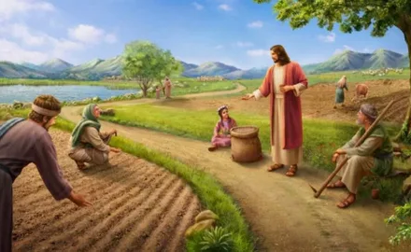
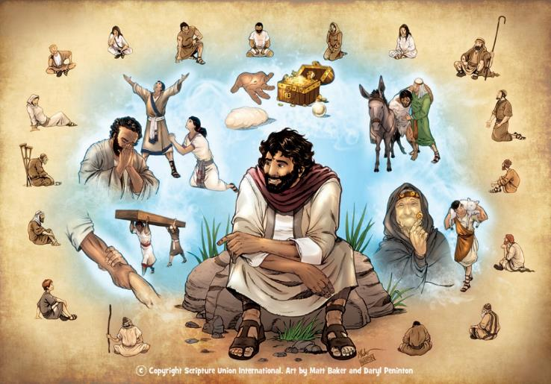
Ko e talanoa fakatātaá ko hano fakamatalaʻi ia ʻo ha meʻa naʻe hoko (makatuʻunga pe ʻikai ʻi ha ngaahi meʻa moʻoni ne hoko) ʻa ia ʻoku fakaʻaiʻai mei ai ha moʻoni mahuʻinga pe akonaki fakaeangamaʻa ʻi hono fakafehoanaki pe faitatau.
Ko e fokotuʻutuʻu ʻeni naʻe fakaʻaongaʻi ʻe Sīsū ʻi heʻene ngaahi akonakí (Maʻake 4:34). Naʻe faʻa toʻo ʻEne ngaahi talanoa fakatātaá mei he moʻui fakaʻahó, pea ko ia ai, naʻe faingofua ke manatuʻi mo fakahoko.
ʻI he foki mai ʻa ʻene kau fanongó ki ʻapí, naʻa nau vahevahe ʻa e meʻa naʻa nau akó mo honau fāmilí mo e ngaahi kaumeʻá.
Ko e ʻuhinga ʻo e ngaahi talanoa fakatātaá. Maʻake 4:10-12.
Ko e talanoa fakatātā ʻo e tangata tūtuuʻí:
Naʻe ʻalu atu ʻa e tangata tutuuʻi ke tutuuʻi ... Maʻake 4:1-9.
Ko hono fakamatalaʻi ʻo e talanoa fakatataa. Maʻake 4:13-20.
Ngaahi talanoa fakatātā kehé:
Ko e mama mo e meʻafua. Maʻake 4:21-25.
Tupulaki mo e musita. Maʻake 4:26-32.

Slide 4
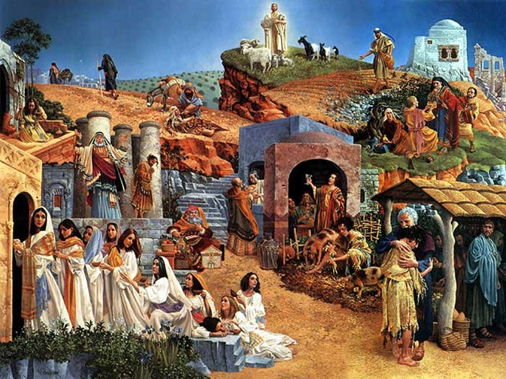
KO E ʻUHINGA ʻO E NGAAHI TALANOA FAKATĀTAÁ
"mahalo pē ʻoku nau mamata ka ʻoku ʻikai pē te nau ʻilo, pea fanongo maʻu ai pē kae ʻikai pē ke mahino; ka ʻikai pea ʻe lava ke nau tafoki ʻo fakamolemoleʻi!" (Maʻake 4:12)
Naʻe vilo takai ʻa e malanga ʻa Sisu ʻi he Puleʻanga ʻo e Langi (Maʻake 1:14-15). Naʻe fai ha konga lahi ʻo ʻene ngaahi talanoa fakatataa ke fakamatalaʻi ʻa e natula ʻo e Puleʻanga (Maʻake 4:30).
Ko e meʻa mālié, he ko e ʻuhinga naʻe foaki ai ʻe Sīsū tonu ʻa e ngaahi talanoa fakatātaá ʻoku fakaofo moʻoni: telia naʻa mahino kiate kinautolu, pe ului, pe fakamolemoleʻi! (Maʻake 4:12).
Naʻe ʻikai ko ha meʻa foʻou ʻeni. ʻI hono fekauʻi ia ʻe he ʻOtuá ke malangá, naʻá Ne folofola kia ʻĪsaia: "Fanongo lelei, pea ʻoua naʻa mahino kiate koe; vakai ki he moʻoni, ka ʻoku ʻikai mahino kiate koe. […] telia naʻa ne mamata ʻaki hono fofonga, pe fanongo ʻaki hono telinga, pe mahino ʻaki hono loto, pe ului, pea ke ʻi ai ha fakamoʻui kiate ia" (Isaia 6:9-10).
Ko ia ʻoku fiekaia ki he Folofola ʻa e ʻOtuá te ne fanongo ki he moʻoní pea fiefia. Ka ko kinautolu ʻoku ʻikai ke nau fie fanongo, tatau ai pe pe ko e ha hono faingofua ʻo e foʻi moʻoni ko ʻeni, te nau fakafisi ke mahino, ke liliu, pea mo aʻusia ʻa e fakamoʻui.

Slide 5
KO E TALANOA FAKATĀTĀ ʻO E TANGATA TUTUUʻÍ

Slide 6
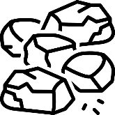
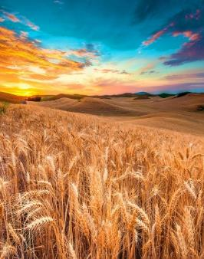
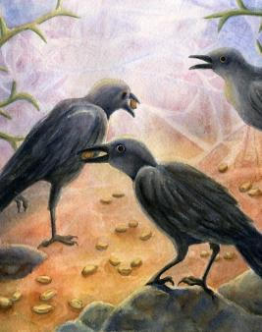
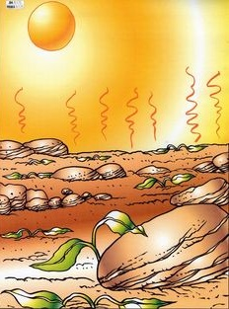
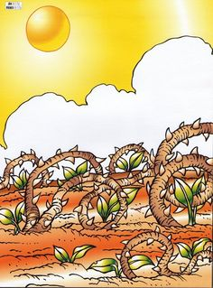
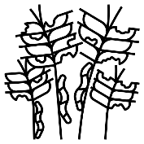
NAʻE HAʻU ʻA E TANGATA TUTUUʻI KE TUTUUʻI
"Naʻá Ne akoʻi kiate kinautolu ha ngaahi meʻa lahi ʻi he ngaahi talanoa fakatātaá, pea ʻi heʻene akonakí naʻá ne pehē: "Fakafanongo! Naʻe ʻalu atu ha tangata faama ke tutuuʻi hono hako" (Maʻake 4:2-3)
ʻI he hala
ʻI ha ngaahi ʻaho siʻi, ʻoku mate ʻa e tengaʻi ʻakau (Maʻake 4:4)
vahaʻa ʻo e ngaahi maka
ʻI ha ngaahi uike siʻi, ʻoku mate ʻa e tengaʻi ʻakau (Maʻake 4:5-6)
ʻi he ngaahi ʻakau talatalá
ʻI ha ngaahi mahina siʻi, ʻoku mate ʻa e tengaʻi ʻakau (Maʻake 4:7)
ʻi he fonua leleí
ʻI he fakaʻosinga ʻo e faʻahitaʻu, ʻoku fua ʻa e tengaʻi ʻakau (Maʻake 4:8)
ʻOku ʻikai ke kehekehe ʻa e tangata tutuuʻi mo e tengaʻi ʻakau. Neongo ia, ʻoku kehekehe ʻaupito hono ola ki he ʻuha takitaha ʻe faa. ʻOku fakafalala pē ia ki he founga hono maʻu ʻo e tengaʻi ʻakaú.

Slide 7
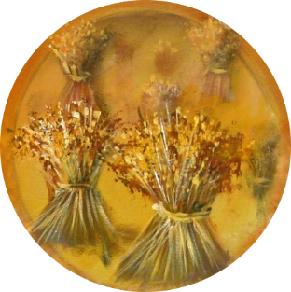
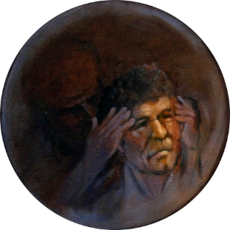
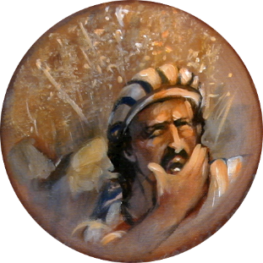
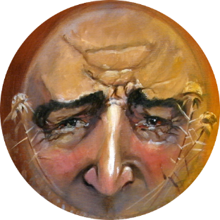
KO HONO FAKAMATALAʻI ʻO E TALANOA FAKATĀTAÁ
"ʻOku tutuuʻi ʻe he tangata ngoue ʻa e folofola" (Maʻake 4:14)
Ko e tengaʻi ʻakau ko e Folofola ia ʻa e ʻOtua, pea ko e tangata tutuuʻi ko ha taha pe ʻoku ne ʻave ia.
ʻI he hala
ʻOku ʻikai haʻanau tokanga, pea taki halaʻi kinautolu ʻe Sētane (Maʻake 4:15)
ʻI he vahaʻa ʻo e ngaahi maka
ʻOku nau maʻu ʻa e folofolá, ka ʻoku ʻikai ke nau kātakiʻi ʻa e ngaahi ʻahiʻahí (Maʻake 4:16-17)
ʻI he ngaahi ʻakau talatalá
ʻOku nau maʻu ʻa e folofola, ka ʻoku nau ongoʻi fiemalie (Maʻake 4:18-19)
ʻI he fonua leleí
ʻOku nau tekeʻi ʻa e ngaahi siví pea ʻikai ke nau fakaleleiʻi. ʻOku nau fua (Maʻake 4:20)
Ko e ha e faʻahinga kelekele ʻoku ou ʻi ai? Ko e hā e meʻa ʻoku totonu ke u fai ke u fua lahí?

Slide 8
NGAAHI TALANOA FAKATĀTĀ KEHÉ

Slide 9
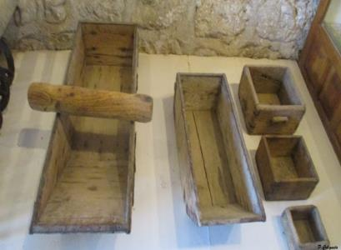
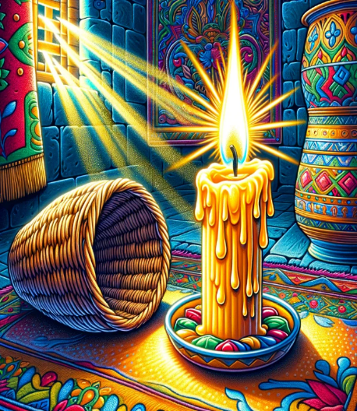
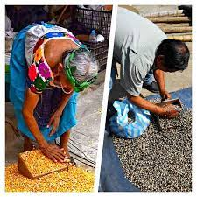
KO E MAMA MO E MEʻAFUA
"Naʻa ne pehe ange kiate kinautolu, "ʻOku mou ʻomi ha maama ke faʻo ʻi ha lalo poulu pe ko ha mohenga? Ka, ʻoku ʻikai ke ke fokotuʻu ia ʻi hono tuʻunga? (Maʻake 4:21)
Naʻá ne hoko atu, "Fakakaukau fakalelei ki he meʻa ʻokú ke fanongo ki aí. "Ko e meʻafua te mou fakaʻaongaʻí, ʻe fua ʻaki ia kiate kimoutolu—pea toe lahi ange" (Maʻake 4:24).
Fakakaukauloto ki he fepotalanoaʻaki: "ʻoku ke ʻomi ...?" "ʻIkai!"; "ʻoku ʻikai ke ke fokotuʻu ia ...?" "ʻIo!"
ʻI he ngaahi hala ʻo e kolo, naʻe fakatau atu ʻe he kau fefakatauʻaki ʻenau koloa ʻo fakaʻaongaʻi ha ngaahi meʻafua angamaheni pe siʻisiʻi ange ke fakafuofuaʻi ʻaki e lahi ʻo e koloa naʻe fie maʻu ʻe he tokotaha fakatau.
Naʻe ʻiloʻi ʻe Sīsū ʻa e founga ke maʻu ai ʻa e tokanga ʻa ʻene kau fanongó. Kuo nau mateuteu ʻeni ke maʻu ʻa e lēsoni fakalaumālié.
Naʻe fakahā māmālie pē ʻe Sīsū ʻa e moʻoni ʻo e ongoongoleleí koeʻuhí ke ʻiloʻi ia ʻe he kakai kotoa pē (Maʻake 4:22).
Kapau naʻe lelei ʻa e ngaahi koloa fakataua, te ne tanaki atu ha kiʻi koloa lahi ange ki he meʻafua ke fakafiemalieʻi ʻaki ʻene kasitoma.
ʻI he pō ko iá, ʻi heʻenau tutu ʻenau ngaahi maama ʻi ʻapí, naʻe manatuʻi ʻe "kinautolu ʻoku maʻu ʻa e telinga ke fanongó" (Maʻake 4:23) ʻa e lēsoní.
Kapau ʻoku tali ʻe ha taha ʻa e moʻoni, te nau maʻu ha meʻa lahi ange. Ka ʻo kapau te ke fakasītuʻaʻi ia, naʻa mo e moʻoni kuó ke maʻú ʻe mole ia (Maʻake 4:25).

Slide 10
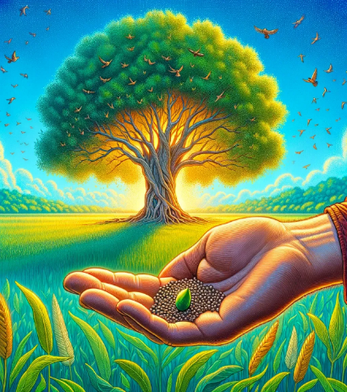
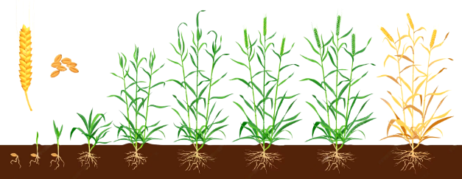
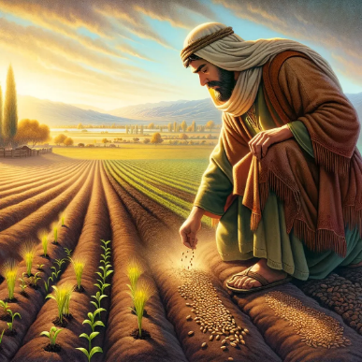
TUPU MO E TENGA'I MŪSITA
"Naʻá ne toe pehē foki, "Ko e anga ʻeni ʻo e puleʻanga ʻo e ʻOtuá. Ko e tangata ʻokú ne fakamoveteveteʻi ʻa e tengá ki he kelekelé" (Maʻake 4:26)
"ʻOku hangē ia ko e tengaʻi mūsitá, ʻa ia ko e siʻisiʻi taha ia ʻi he ngaahi tengaʻi ʻakau kotoa pē ʻi he māmaní" (Maʻake 4:31)
ʻOku manatuʻi ʻe Sisu ʻa e siakale ʻo e tupu ʻa e keleni (Maʻake 4:28):
ʻOku tatau ʻa e Puleʻanga ʻo e Langi mo ha kiʻi tengaʻi musita (Maʻake 4:30-31).
Mohuku
Talatala
Uite
Hili ha ʻaho ʻe 50 ʻo e tutuuʻi, ʻoku aʻu ʻa e musita ki he senitimita ʻe 30-40 hono maʻolunga, pea kuo ʻosi lava ke ne ngaohi ha fuaʻiʻakau harvestable. ʻE lava ke tupu hake ia ʻo mita ʻe 7 hono maʻolunga (23 FT.).
Ko ha founga ia ʻoku fakafalala ki he ʻOtuá, kae ʻikai ko e tangatá (Maʻake 4:27).
Ko e tenga ʻeni ʻo e ongoongoleleí naʻe tō ʻi he kelekele lelei ʻo e tokotaha ʻoku tuí.
Ko e siʻisiʻi foki ʻa e kamataʻanga: ko e kakai "taʻe-ako" ʻe toko 120 naʻe fufuuʻi ʻi ha loki ʻi Selusalema.
ʻOku tau tupulaki lahi ange ʻi he moʻoní ʻi he ngāue ʻa e Laumālie Māʻoniʻoní... kae ʻoua ke haʻele mai ʻa Sisuu (Maʻake 4:29; Matiu 13:39).
Ka kuo aʻu hono tupuʻangá ki he māmaní kotoa, ʻ o hoko ko e lotu fakataha mo e tokolahi taha ʻ o e kau tuí.

Slide 11
“ʻI he ngaahi talanoa fakatātaá mo e fakafehoanakí, naʻá Ne ʻilo ai e founga lelei taha ke fakahoko ʻaki e moʻoni fakalangí. ʻI he lea mahinongofuá, fakaʻaongaʻi e ngaahi fakatātā mo e ngaahi fakatātā mei he māmani fakanatulá, naʻá Ne fakaava e moʻoni fakalaumālié ki Heʻene kau fanongó, mo fakahaaʻi e ngaahi tefitoʻi moʻoni mahuʻinga ne mei mavahe mei honau ʻatamaí, pea ʻikai ke nau faʻa fakatokangaʻi, kapau naʻe ʻikai ke Ne fakafehokotaki ʻEne ngaahi leá mo ha ngaahi meʻa fakafiefia ʻo e moʻuí, meʻa ne nau aʻusiá, pe natulá. ʻI he founga ko ʻení, naʻá Ne fakatupu ʻenau fie ʻiló, pea ʻi Heʻene fakapapauʻi kakato ʻenau tokangá, naʻá Ne fakamahino kiate kinautolu ʻa e fakamoʻoni ʻo e moʻoní. ʻI he foungá ni, naʻá Ne lava ai ke ʻai ha ongo feʻunga ki he lotó koeʻuhí ke lava ʻe Heʻene kau fanongó ʻo sio ki he meʻa naʻá Ne fakafehokotaki ʻaki ʻEne lēsoní, pea manatuʻi e ngaahi folofola ʻa e Faiako fakalangí.
EGW (Ngaahi Tefitoʻi Meʻa Mahuʻinga ʻo e Ako Faka - Kalisitiané, 236)

