Slide 1
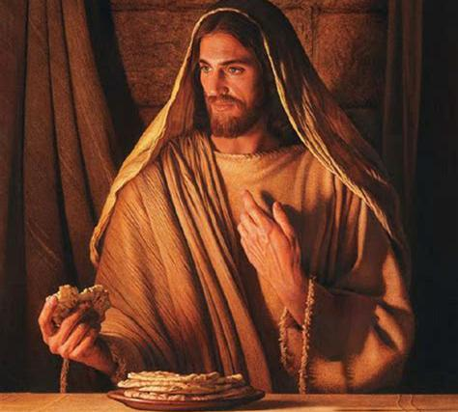
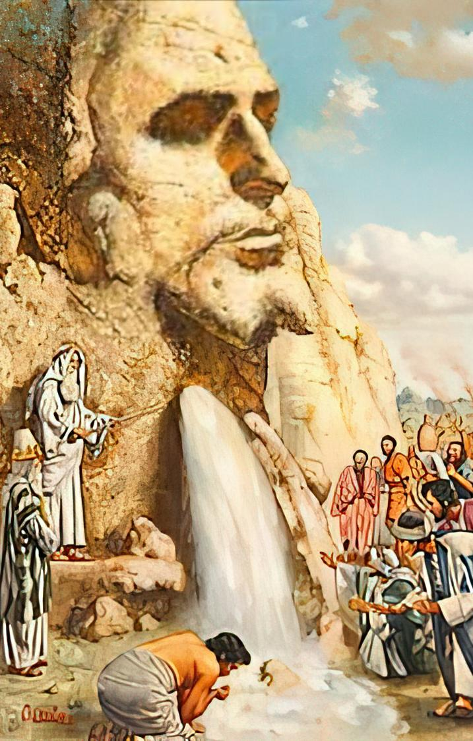
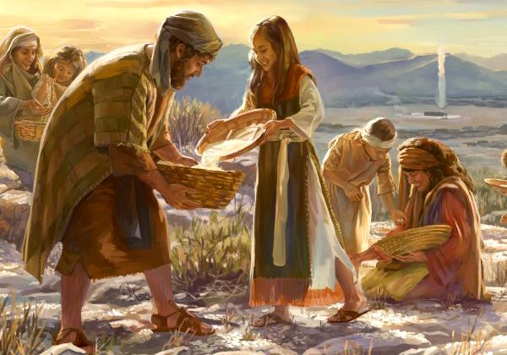
KO E MĀ
MO E VAI ʻO E MOʻUI
Lesoni 7 ki he ʻaho 16 ʻo ʻAokosi 2025

Slide 2
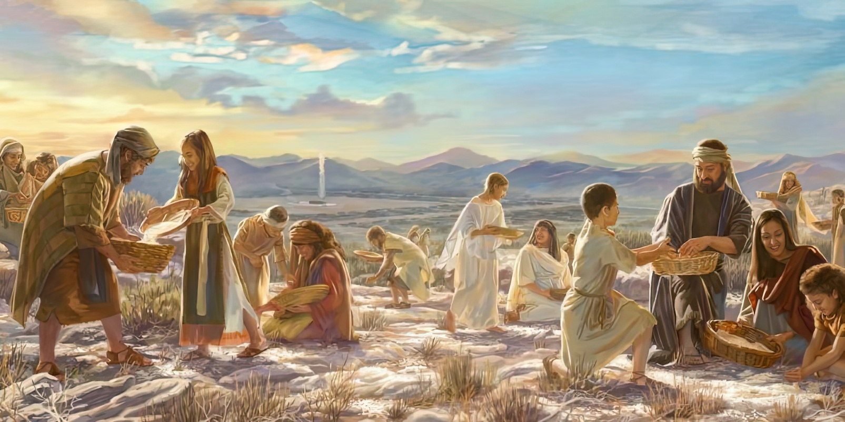

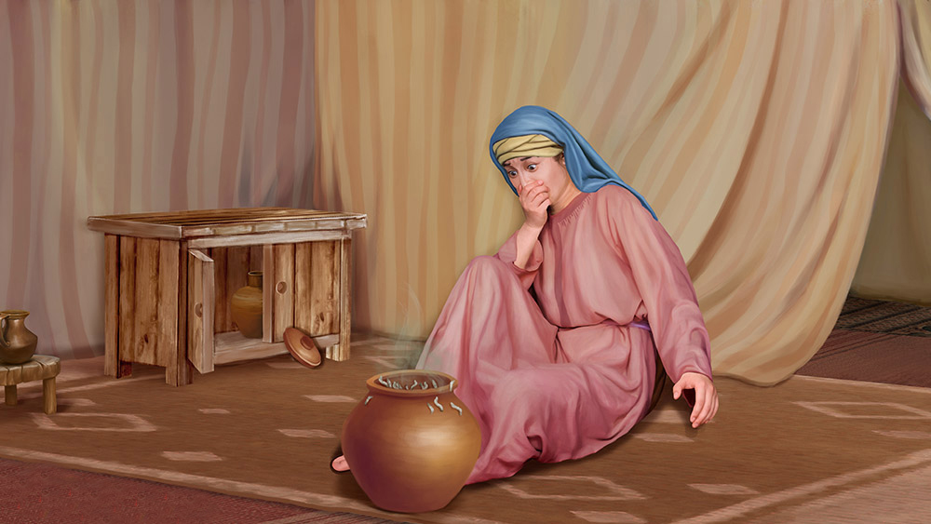
“Pea naʻe folofola ʻa Sihova kia Mōsese, “ʻE tuku ʻafē hoʻomou taʻefietauhi ʻeku ngaahi fekau mo ʻeku ngaahi fono? Vakai, ko e meʻa ʻi he foaki ʻe Sihova ʻae Sāpate kiate kimoutolu, ko ia ʻoku ne foaki ai kiate kimoutolu ʻi hono ono ʻoe ʻaho, ʻae mā ki he ʻaho ʻe ua: mou nofomaʻu taki taha ʻae tangata ʻi hono potu, ʻoua naʻa ʻalu ha tangata ʻe tokotaha mei hono potu ʻi hono fitu ʻoe ʻaho.”Ko ia naʻe mālōlō ai ʻae kakai ʻi hono fitu ʻoe ʻaho.”
‘Ekisotosi 16:28–30

Slide 3

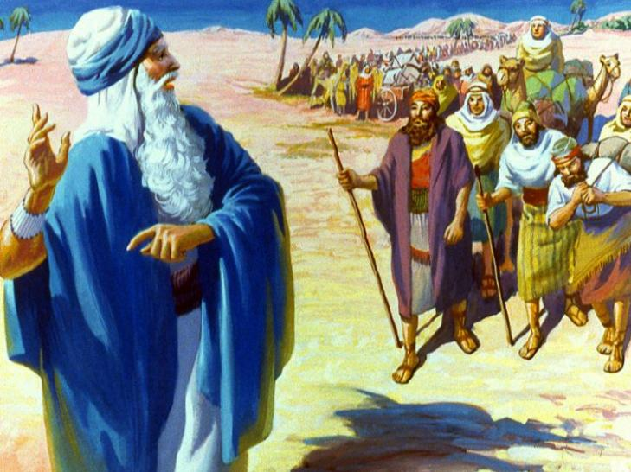
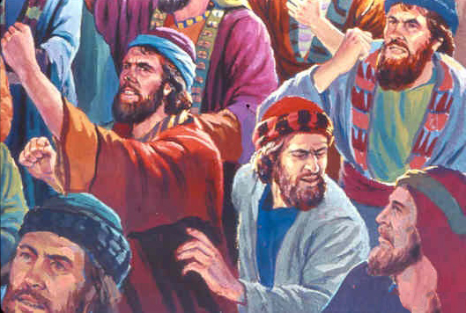
Naʻe faifai pea nau kolosi ʻi he kauʻafonua ʻo ʻIsipite. Naʻe faifai pea nau aʻu ki he hala ki Kenani, ʻa ia naʻe tafe ʻa e fonua ʻi he huʻakau mo e hone.
ʻI ha ʻaho ʻe tolu, naʻe hange naʻe haohaoa ʻa e meʻa kotoa pe. Ka naʻe ʻosi ʻa e ngaahi naunau naʻa nau maʻu. ʻE lava fefe ke nau fafanga ha kakai ʻe toko ua miliona ʻi he toafa?
ʻI he ʻuluaki fakaʻilonga ʻo e faingataʻa, naʻe kamata ke launga ʻa e kakai. Naʻa nau mei saiʻia ange ke nau mate ʻi ʻIsipite! ʻ Oku hā mahino, naʻe fiemaʻu ke tupulaki mo fakaivimālohiʻi ʻ enau tuí. Ko ia naʻe foaki ʻe he ʻOtua kiate kinautolu ʻa e vai mo e maa; maluʻi kinautolu mei honau ngaahi fili; pea tokoniʻi kinautolu ke nau fokotuʻutuʻu.
Vai maʻa (ʻEkesotosi 15:22-27)
Ko e ma mei he langi (ʻEkesotosi 16:1-36)
Ko e Maka ʻo Holepi (ʻEkesotosi 17:1-7)
Ko e nima naʻe hiki hake (ʻEkesotosi 17:8-16)
Faleʻi lelei (ʻEkesotosi 18:1-27)
Ko e mā mo e vai ʻo e moʻui: Sisu

Slide 4

"Ko e ngaahi meʻa kehekehe naʻe aʻusia ʻe he kau Hepeluú ko ha akoʻanga ia ʻo e teuteu ki honau ʻapi naʻe talaʻofa ʻaki ʻi Kenani. ʻOku finangalo ʻa e ʻOtua ke vakaiʻi ʻe Hono kakai ʻi he ngaahi ʻaho ni ʻi he loto fakatokilalo mo e laumalie akoʻingofua ʻa e ngaahi faingataʻa naʻe foua ʻe ʻIsileli ʻo e kuonga muʻa, koeʻuhi ke lava ʻo fakahinohinoʻi kinautolu ʻi heʻenau teuteu ki he Kenani fakalangi."
EGW (Kau Pēteliake mo e Kau Palōfitá, p. 293)

Slide 5


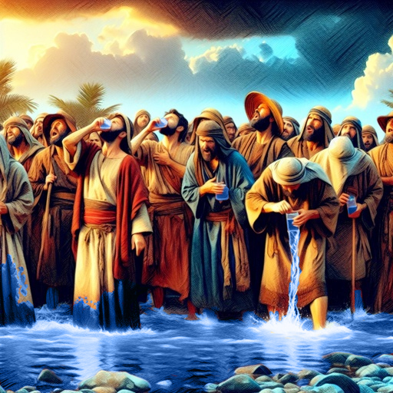
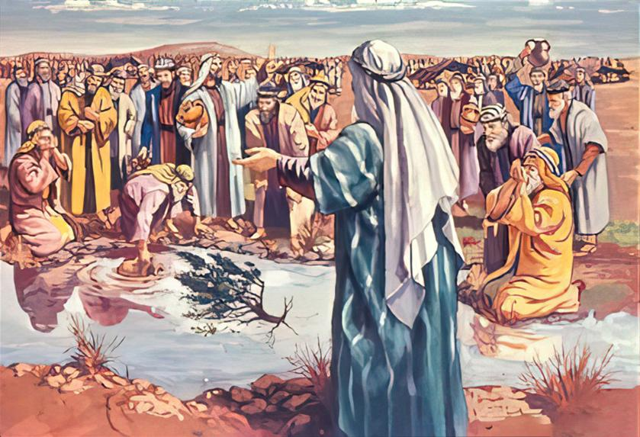
VAI MAʻA
“Pea ʻi heʻenau hoko ki Mala, naʻe ʻikai te nau faʻa inu ʻae vai ʻo Mala, he naʻe kona: (ko ia naʻe ui ai hono hingoa ko Mala).” (ʻEkesotosi 15:23)
Kapau ʻoku ʻiate kitautolu ʻa e ʻOtua, ʻe lava fefe ke hoko ha meʻa kovi kiate kitautolu? Naʻe hange ko e fakakaukau ʻeni ʻa e kakai ʻo ʻIsileli hili ʻenau kolosi ʻi he Tahi Kulokula.
ʻI heʻenau ʻiloʻi ʻoku ʻikai malu ʻa e vai ke inu, naʻa nau launga, "Ko e ha te mau inu?" (ʻEkesotosi 15:24). Naʻe mei lava pe ke fakamaʻa ʻe he ʻOtua ʻa e vai kimuʻa pea nau aʻu atu, ka naʻa Ne tatali ki he taimi totonu.
Naʻa Ne kole foki kia Mosese ke tokoni ʻi hono fakahoko ʻo e mana, ʻo kole ange ke ne li ha fuʻu ʻakau ke fakamaʻa ʻa e vai (ʻEkesotosi 15:25).
ʻOku fie maʻu ʻe he ʻOtua ke tau ʻafioʻi ʻa Hono ʻao, ke tatali ki Heʻene ngaahi fekau, pea ke ngaue fakataha mo Ia.
Kapau naʻe fakahoko ʻe ʻIsileli ʻa e ngaahi fie maʻu ʻa e ʻOtua, ʻo talangofua ki he ngaahi fono naʻe ʻoange ʻe he ʻOtua kiate kinautolu, te nau lava ʻo fakapapauʻi ʻe maluʻi kinautolu mei he kovi (ʻEkesotosi 15:26).

Slide 6


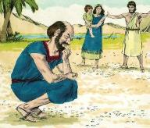
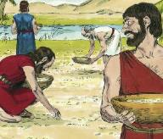
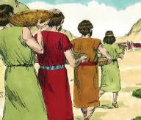
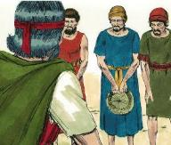
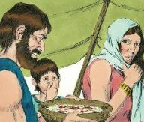
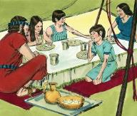
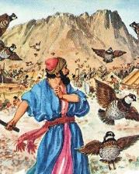
KO E MA MEI HE LANGI
“Pea ʻi he mamata ki ai ʻae fānau ʻa ʻIsileli, naʻa nau fepehēʻaki, “Ko e hā ia?”He naʻe ʻikai te nau ʻilo pe ko e hā.Pea pehē ʻe Mōsese kiate kinautolu,“Ko e mā eni kuo foaki mai ʻe Sihova ke mou kai.”
(Ekisotosi 16:15)
Naʻe fakatupu ʻe he holi ke kai kakanoʻi manu ʻa ʻIsileli ke launga kia Mosese mo ʻElone (ʻEkesotosi 16:2-3). Ka ko ʻenau launga naʻe fepaki moʻoni ia ki he ʻOtua tonu (ʻEkesotosi 16:8). Ko e ha ʻenau palopalema?
Naʻe fakaofo moʻoni ʻa e ma ko ʻeni mei he langi:
Naʻe ngalo ʻiate kinautolu ʻa e kuohili
Naʻa nau tokanga taha ki he ngaahi faingataʻa ʻo e lolotonga
Naʻe mole meiate kinautolu ʻa e kahaʻu naʻe talaʻofa mai
ʻI he hopo hake ʻa e laʻaa naʻe vaia ia (ʻEkisoto 16:21)
Naʻe to ʻa e lahi tatau ʻi he ʻaho ʻe nima (ʻEkesotosi 16:16)
ʻI he ʻaho hono ono naʻe liunga ua hono lahi (ʻEkesotosi 16:22)
Hili hono ʻ oange kiate kinautolu ʻ a e kueili ke nau kai, naʻe tokonaki ange ʻ e he ʻ Otuá kiate kinautolu ʻ a e mā feʻunga ke fafangaʻi kinautolu ʻ i he ʻ aho kotoa pē... ʻi he taʻu ʻe 40! (ʻEkesot 16:35)
ʻI he ʻaho hono 7 naʻe ʻikai hoko ha meʻa (ʻEkesotosi 16:26)
Mei he ʻaho ʻe taha ki he ʻaho hono hoko naʻe fonu ia ʻi he fanga kiʻi ʻuanga (ʻEkesotosi 16:20)
Mei he ’aho 6 ki he ’aho 7 naʻe ʻikai ke maumauʻi ia (ʻEkisoto 16:23-24)

Slide 7


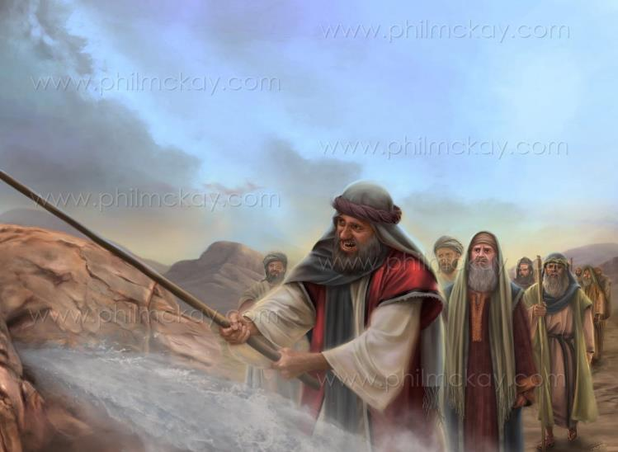
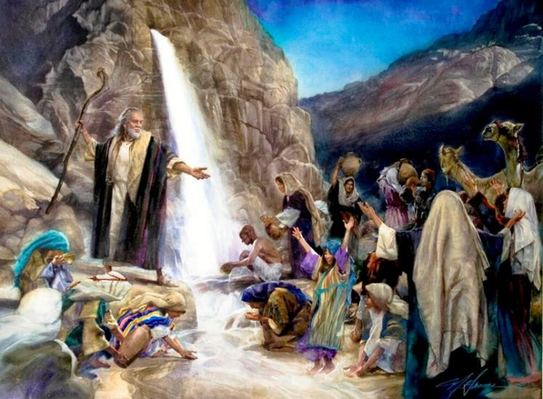
KO E MAKA ʻO HOLEPI
“Vakai, te u tuʻu ʻi ho ʻao ʻi ai ʻi he maka ʻi Holepi; pea te ke tā ʻae maka pea ʻe tupu mei ai ʻae vai, koeʻuhi ke inu ai ʻae kakai.” Pea naʻe fai ia ʻe Mōsese ʻi he ʻao ʻoe kau mātuʻa ʻo ʻIsileli. ” (Ekisotosi 17:6)
"ʻOku ʻiate kitautolu ʻa e ʻEIKI pe ʻikai?" (ʻEkesotosi 17:7). ʻIkai naʻe ʻomi ʻe he ʻOtua ha ma mei he langi ʻi he ʻaho kotoa pe? ʻIkai ke nau lava ʻo sio ki ai ʻi he ʻao?
ʻOku fakaofo ʻa e taʻetui naʻe fakahaaʻi ʻe ʻIsileli. Ka ʻoku fakatokanga mai ʻa Paula ke ʻoua naʻa tau to ki he sipinga tatau ʻo e taʻetui (Hepelu 3:12).
Neongo ʻ enau taʻetuí, naʻe māfahi tonu ʻ e Sīsū ʻ a e foʻi maká pea hokohoko atu hono tokonaki kiate kinautolu ʻ a e vaí ʻ i he kotoa ʻ o ʻ enau fonongá. Ko Ia "ʻa e maka fakalaumalie naʻe muimui ʻiate kinautolu" (1 Kolinito 10:4).
Kiate kinautolu, pea kiate kitautolu, ko Kalaisi ʻa e Tupuʻanga ʻo e moʻui mo e Tokotaha ʻOku Foaki ʻo e moʻui taʻengata.

Slide 8

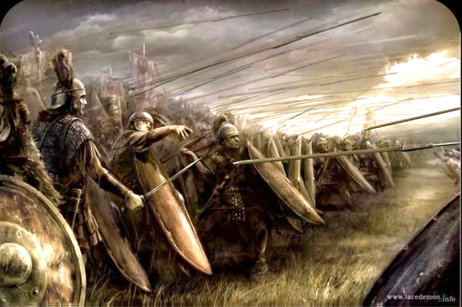
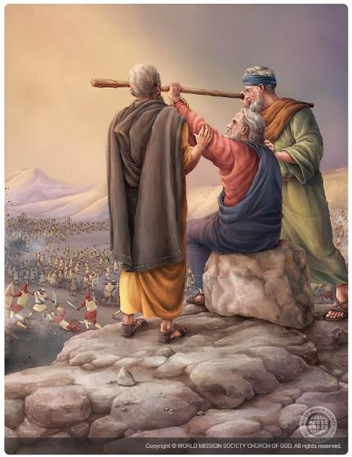
KO E HIKI HAKE ʻO E NIMA
“Pea naʻe haʻu ʻa ʻAmaleki, ʻo tauʻi ʻa ʻIsileli ʻi Lefitimi.” (Ekisotosi 17:8)
ʻI heʻenau laka atu ʻi he toafa, naʻe ʻohofi ʻe he kau ʻAmalekai ʻa ʻIsileli, pea kole ʻe Mosese kia Sosiua ke maluʻi kinautolu lolotonga ʻene kaka hake mo ʻElone, mo Hua ki he moʻunga mo e "tokotoko ʻo e ʻOtua" (ʻEkesotosi 17:8-10).
Ha naʻe ʻohofi ai ʻe he kau ʻAmaleki?
Naʻa nau fanongo ki he meʻa naʻe fai ʻe he ʻOtua ʻi ʻIsipite. Ka, ʻ i he ʻ ikai hangē ko e kau Kēnani kehé, naʻe ʻ ikai te nau ilifia. Naʻa nau manukiʻi ʻa e ʻOtua mo fakafepakiʻi Ia ʻaki ʻenau ʻohofi Hono kakai, ke fakamoʻoniʻi pe naʻa nau malohi ange ʻiate Ia (ʻEkesotos 17:16).
Naʻe ikuna ʻa ʻIsileli ʻi he taimi naʻe hiki hake ai ʻe Mosese ʻa e tokotoko ʻa e ʻOtua. Ka ʻi he fakaʻau ke ongosia hono nima, naʻe ikunaʻi ʻa ʻIsileli (ʻEkesotosi 17:11).
Kuo taimi ke vahevahe ʻe he kau taki kehe ʻa e kavenga ʻo e ngaue. Naʻe poupouʻi ʻe ʻElone mo Hua ʻa Mosese mo tokoniʻi ia ke ola lelei e ngaue ʻa e ʻOtua, ʻo ikunaʻi ai ʻa e fili (ʻEkesotoso 17:12).

Slide 9


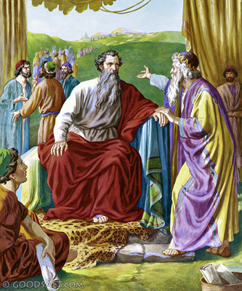
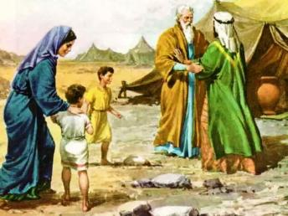
FALEʻI LELEI
"Ka ke fili ha kau tangata lavameʻa mei he kakai kotoa pe—ʻa e kau tangata manavahe ki he ʻOtua, kau tangata falalaʻanga ʻoku fehiʻa ʻi he koloa taʻefaitotonu—pea fokotuʻu kinautolu ko ha kau ʻofisa ki he lauiafe, laungeau, nimangofulu mo e hongofulu." (ʻEkesotosi 18:21)
ʻI heʻenau mamata ki he fakaʻilonga naʻe fakaha ʻe he ʻOtua kia Mosese, naʻe ʻalu ʻa Setelo, mo Sipolo mo hono ngaahi foha, ke ʻaʻahi kiate ia ʻi Holepi (ʻEkesotosi 3:12; 18:1-5).
Neongo naʻe ʻikai ko ha ʻIsileli ʻa Setelo, ka naʻa ne lotu ki he ʻOtua. Ko ia ai, hili ʻene maʻu ʻa e fakamatala ʻa Mosese ki he meʻa naʻe hoko ʻi ʻIsipite, naʻa ne fakafetaʻi ki he ʻOtua mo fai ha ngaahi feilaulau kiate ia (ʻEkesotosi 18:8-12).
ʻI he ʻaho hono hoko, hili ʻene mamata ki hono fakamauʻi ʻe Mosese ʻa e kakai kotoa, naʻa ne fai ange ha faleʻi fakapotopoto: vahevahe ʻa e ngaahi fatongia(ʻEkesotosi 18:17-23).
Naʻe fakahaaʻi anga - fakatōkilalo ʻ e Mōsese ʻ a e ngaahi folofola ʻ a e ʻ Otuá ʻ i he faleʻi ko ení. Ko ia ai, naʻa ne tokanga ki he faleʻi ʻa ʻene tamai ʻi he fono pea fili ha kakai te nau lava ʻo fua ʻa e ngaahi fatongia.
Ko hono ngaahi ʻulungaanga (ʻEkesotosi 18:21):
Fakaʻapaʻapaʻi ʻa e ʻOtua
Falalaʻanga
Fehiʻa ki he totongi fufu

Slide 10


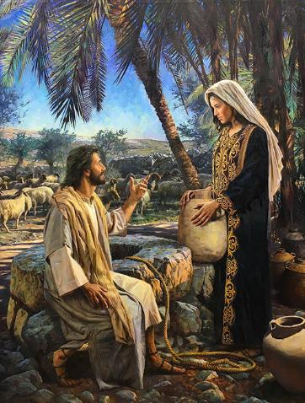
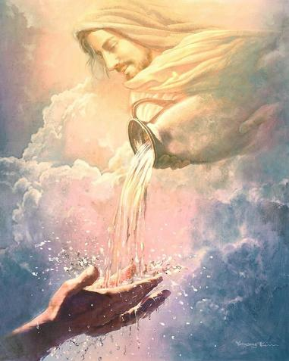
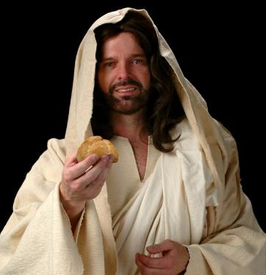
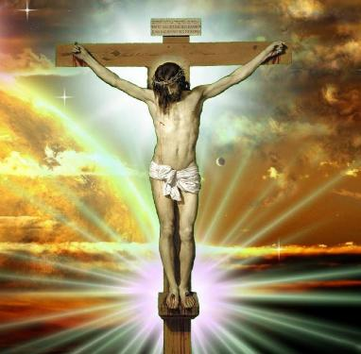
KO E MA MO E VAI ʻO E MOʻUI: SISU
“Ko au ko e mā moʻui kuo ʻalu hifo mei he langi: kapau ʻe kai ʻe ha tangata ʻae mā ni, ʻe moʻui taʻengata ia: pea ko e mā ʻoku ou foaki ko hoku sino, ʻaia te u foaki ke moʻui ai ʻa māmani.”” (Sione 6:51)
ʻOku talamai ʻe Paula naʻe hiki ʻa e ngaahi talanoa ʻo e ʻEkesotosi ke akoʻi kitautolu, ʻa ia, ʻoku ʻi ai hono kaunga fakalaumalie ki heʻetau moʻui (1 Kolinito 10:1-11).
ʻOku fakatokanga mai ʻa e ngaahi talanoa ko ʻeni fekauʻaki mo e manumanu; tauhi tamapua; feʻauaki; ʻahiʻahiʻi ʻa e ʻOtua; mo e ngutu lau.
ʻ Ikai ko ia pē, naʻe ngāueʻaki tautefito ʻ e Sīsū kiate ia ʻ a e ngaahi talanoa fekauʻaki mo e vai mei he maká mo e mā mei hēvaní.
Ko ia ia ‘oku ne tokonaki ‘a e vai ‘o e mo’ui, ‘o ne fakataipe ‘a e Laumalie Ma’oni’oni (Sn. 4:14; 7:37-39). Ko Ia pē ‘e lava ke ne fakafiemālie‘i ‘etau fieinua ‘i lotó ki he melinó, fiefiá, mo e nekeneka.
Naʻe pehē ʻe Sīsū ko Ia ʻa e mā moʻoni naʻe ʻalu hifo mei he langí. Ko e mā ko iá ko Hono kakano pē ʻoʻoná (Sione 6:51). Ko Hono sinó ia, kuo fesiʻi ʻi he kolosí ke ʻomi ʻa e fakamoʻuí kiate kinautolu kotoa pē te nau “kai” iá﻿—ʻa ia ko hono tali Ia ko e Fakamoʻuí pea maʻu ha fetuʻutaki fakaʻaho mo Ia. Ko Kalaisi pē te ne lava ʻo fakafiemālieʻi ʻetau fieinua mo e fiekaia fakalaumālié.

Slide 11
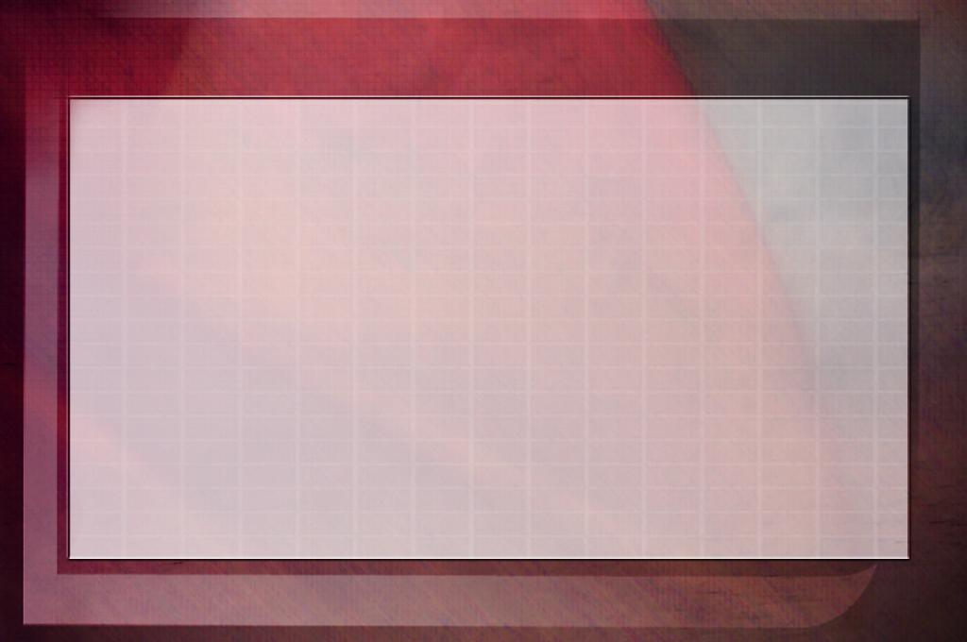
“ʻOku ʻafioʻi ʻe he Huhuʻi ʻo e māmaní ʻa e ngaahi fie maʻu ʻa e laumālie kotoa pē. ʻI he taimi ʻoku tau fakamālohiʻi ai mo vaivaí, ʻokú ne ʻafioʻi ia, pea ko ia ʻokú ne ʻomi ʻa e fakaivifoʻou fakalaumālié. Kole kiate ia; kelesi.
‘E fa‘a ‘osi ‘a e ngaahi vaitupu ‘o e māmaní, ‘o mōmoa ‘a hono ngaahi vaitupú; ka ʻoku ʻi ai ʻia Kalaisi ha matavai moʻui ʻe lava ke tau maʻu maʻu pē mei ai. Ko e hā hono lahi ʻo ʻetau toʻo mo foaki ki he niʻihi kehé, ʻe kei ʻi ai pē ha lahi. ‘Oku ‘ikai ha fakatu‘utāmaki ‘o e ‘osi ‘a e tokonakí; ha ko Kalaisi ko e matavai ta‘efa‘a‘au ‘o e mo‘oní”
EGW (Ko e Ngaahi Fakaʻilonga ʻo e Kuongá, ʻaho 22 ʻo ʻEpeleli, 1897
)

