Slide 1

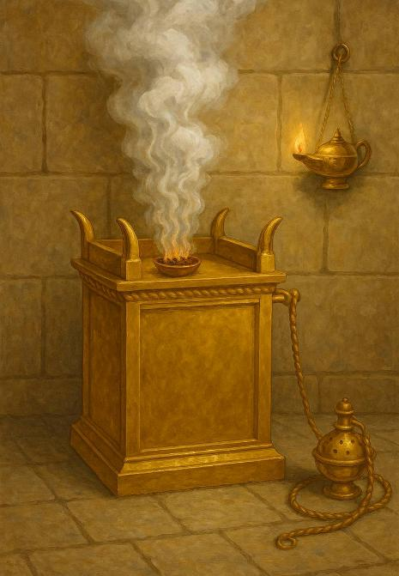
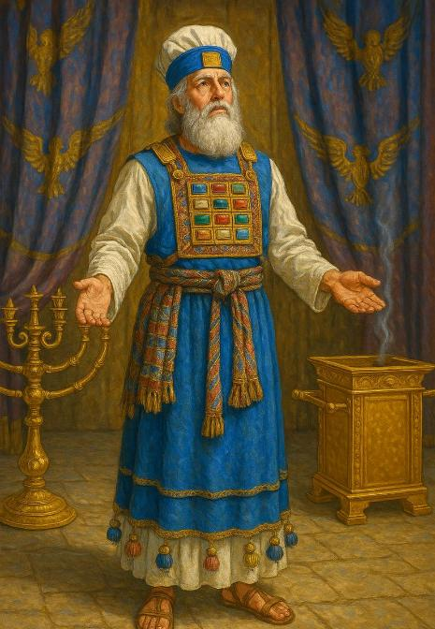
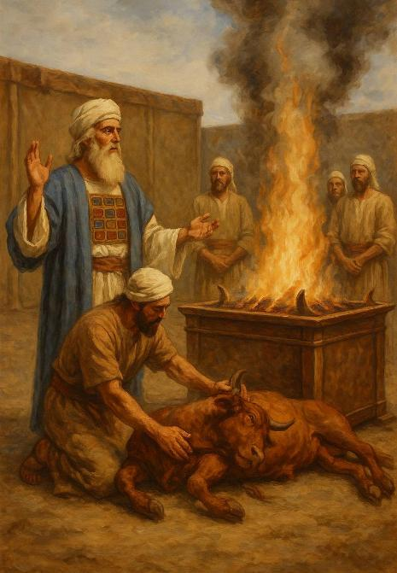
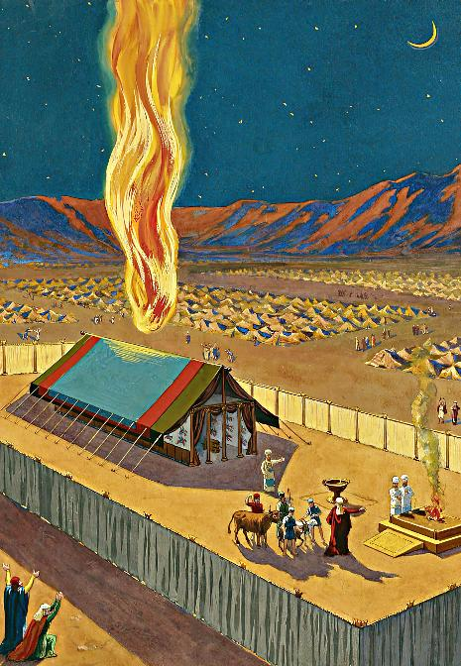
FALE FEHIKITAKI
Lesoni 13 ki he ʻaho 27 ʻo Sepitema, 2025

Slide 2
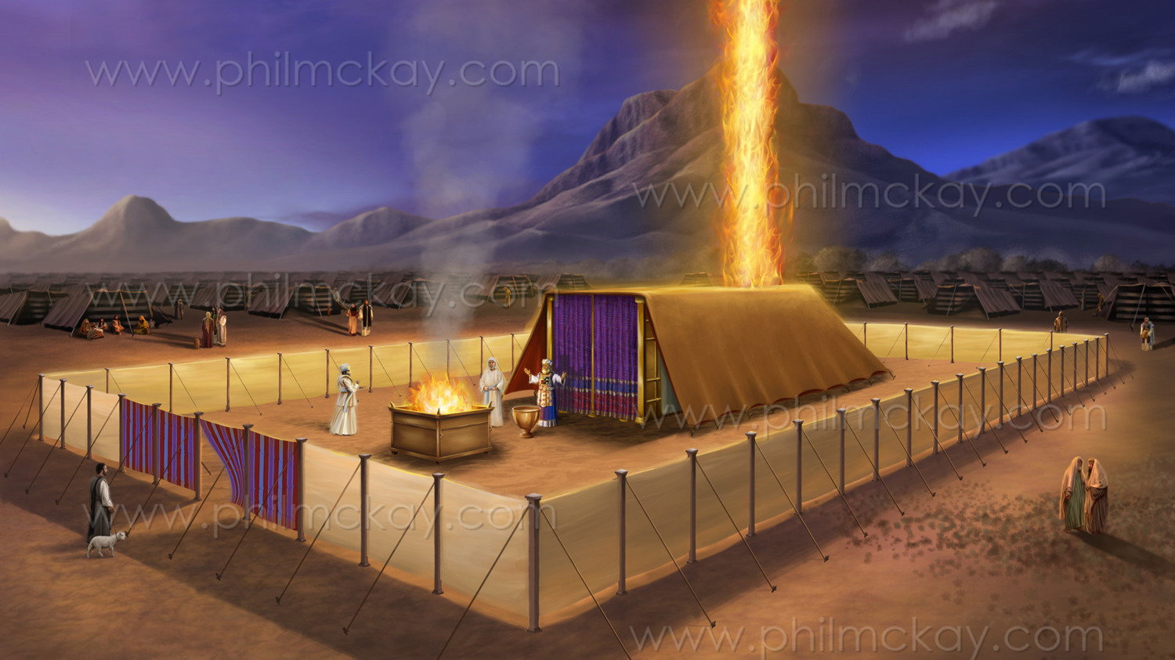
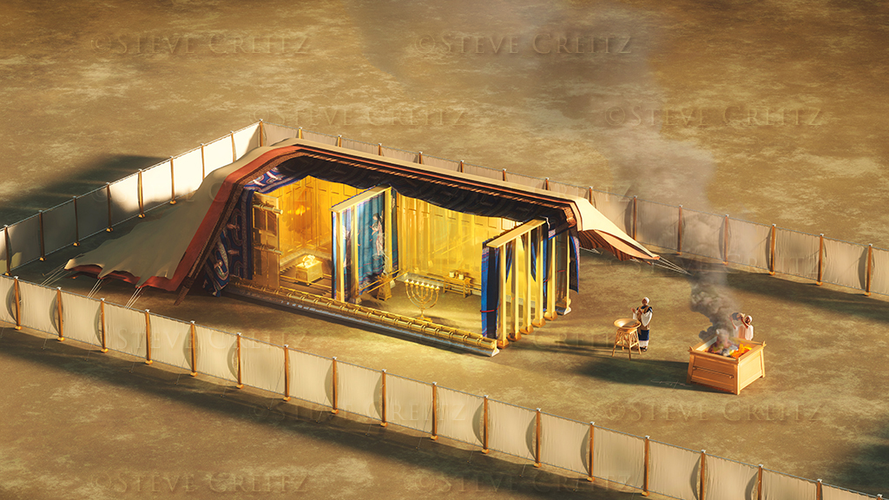
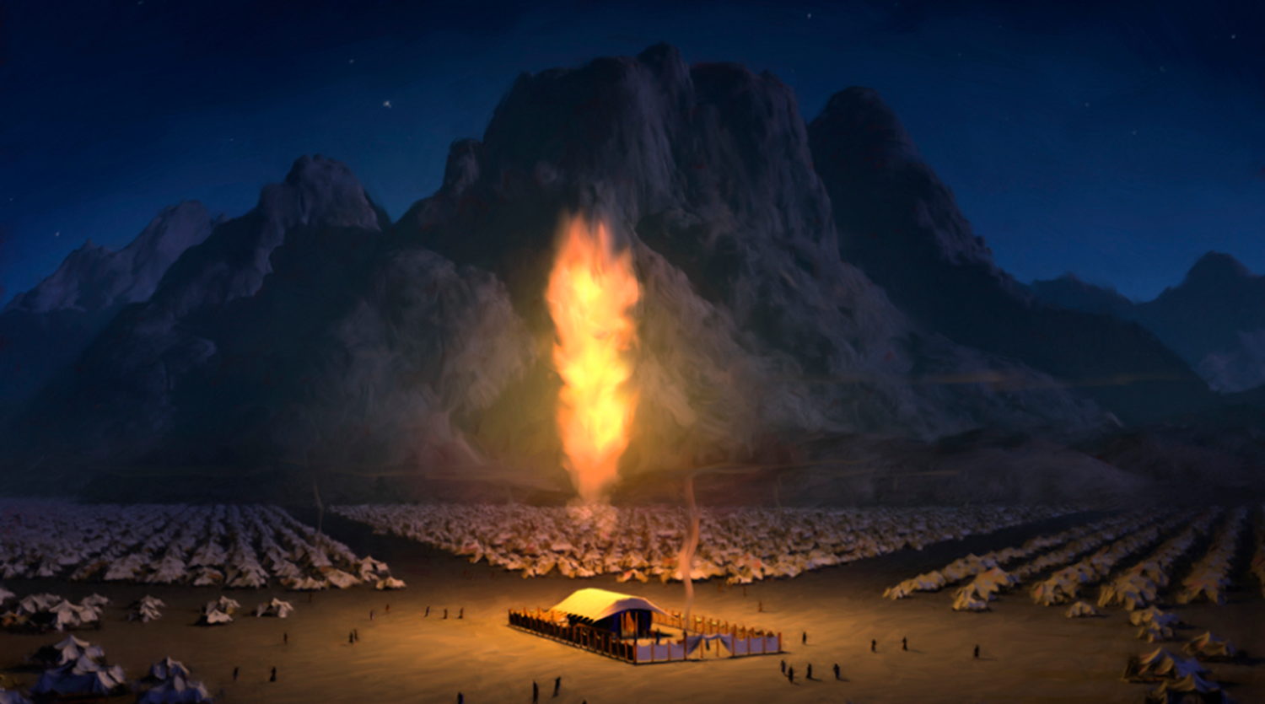
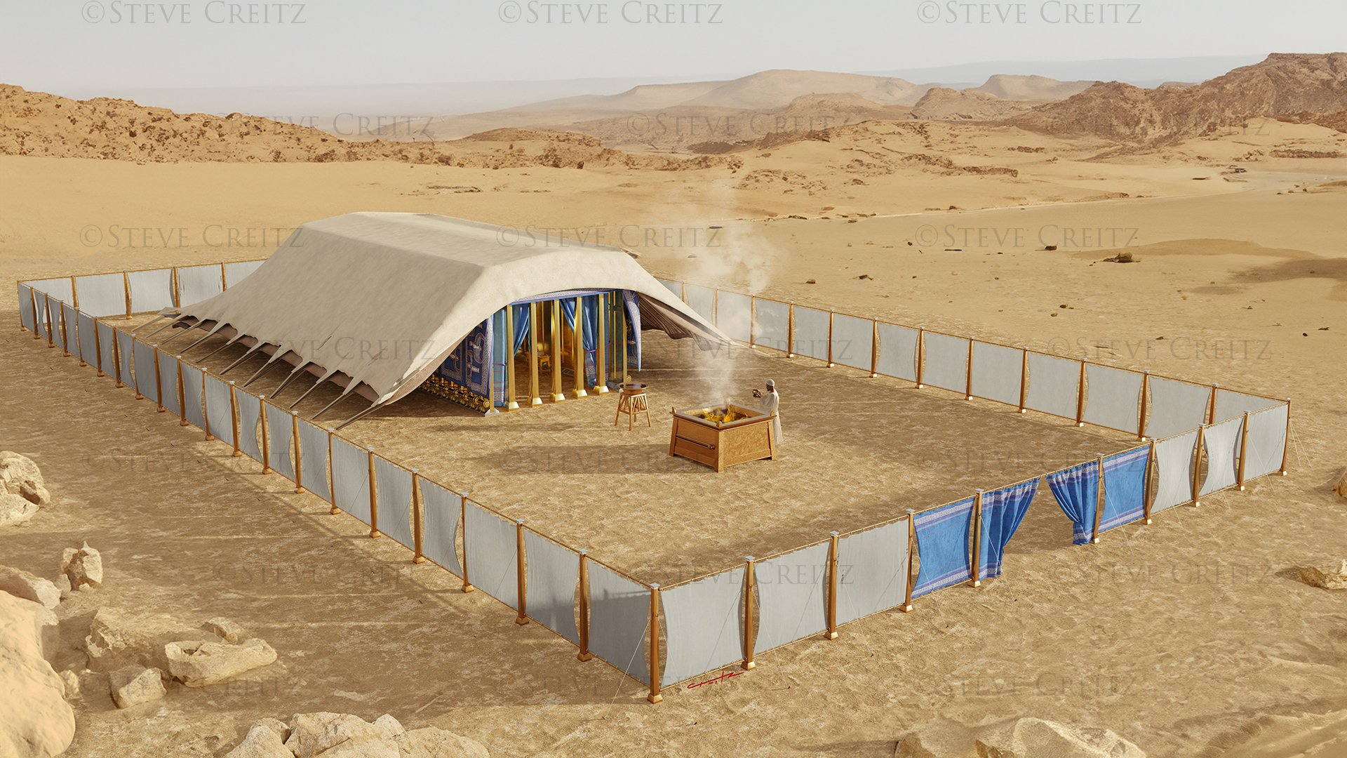
“Pea hili ia naʻe ʻufiʻufi leva ʻe he ʻao ʻae fale fehikitaki ʻoe kakai, pea naʻe fakafonu ʻe he nāunau ʻo Sihova ʻae fale fehikitaki.… He naʻe fakamalumalu ʻae fale fehikitaki ʻe he ʻao ʻo Sihova ʻi he ʻaho, pea naʻe ʻi ai ʻae afi ʻi he poʻuli, ʻi he ʻao ʻoe fale kotoa pē ʻo ʻIsileli, ʻi honau ngaahi fononga kotoa pē.”
‘Ekisotosi 40:34,38

Slide 3

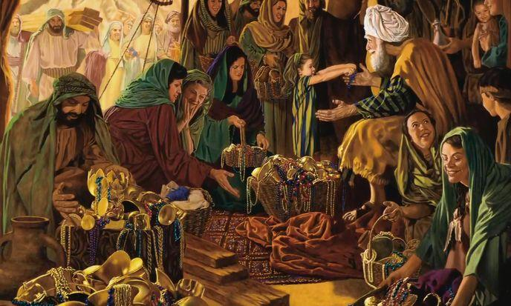

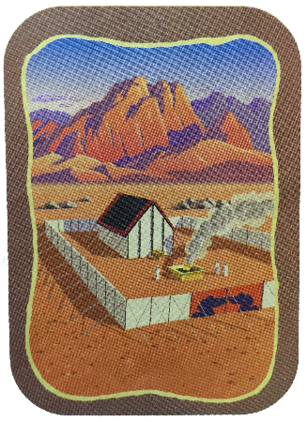
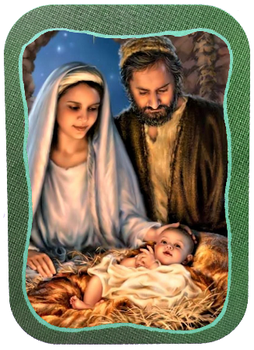
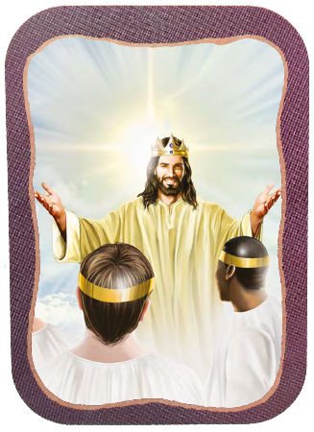







Ko e ngaahi vahe faka’osi ‘o e ‘Ekisoto ‘oku fakataumu’a ia ki he fakamatala fakaikiiki ‘o hono langa mo fakatapui ‘o e Fale fehikitaki
Ko ha ngaahi momeniti makehe ʻeni, ʻa ia naʻe kau fiefia ai ʻa e kakaí, ʻo nau tokoni﻿—ʻo fakatatau mo ʻenau lavá﻿—ki he ngāue maʻongoʻonga ko ʻeni maʻá e ʻOtuá.
Ko e tefito’i ‘uhinga ‘oku ‘omai ‘e he ‘Otua ki hono langa ‘o e Temipale to’oto’o ko ‘eni, ko ‘ene finangalo ke nofo ‘i hono kakai (Ek. 25:8). Na’e fakahoko ‘a e holi ko ‘eni ‘i he tokotaha ko Sisu, pea ‘e fakahoko kakato ia ‘i he taimi te tau ‘i ai kotoa ai mo Ia ‘i he Mamani Fo’ou.
Ko e teuteu:
  Ko e Sapate (‘Eki 35:1-3)
  Ko e Feilaulau Tauʻatāina (ʻEki 35:4-36:7)
Ko e Fale fehikitaki:
  Ko e Langa (Ekisoto 36:8-39:43)
  Ko e Fakatapui (Ekisoto 40:1-38)
Ko e ngaahi fale fehikitaki kehe:
  Ko Sisu mo Selusalema Fo'ou .

Slide 4
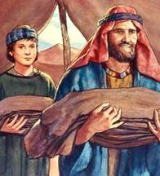
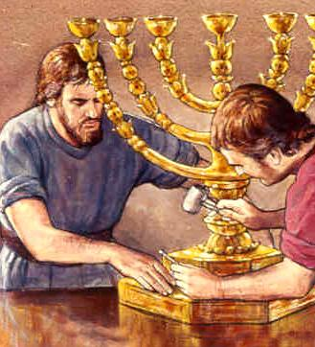
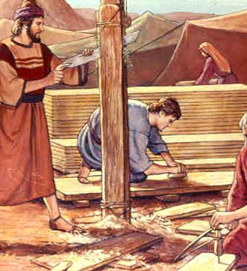
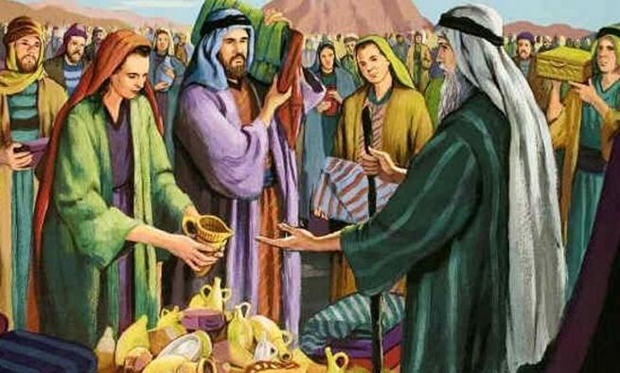
KO E TEUTEU

Slide 5

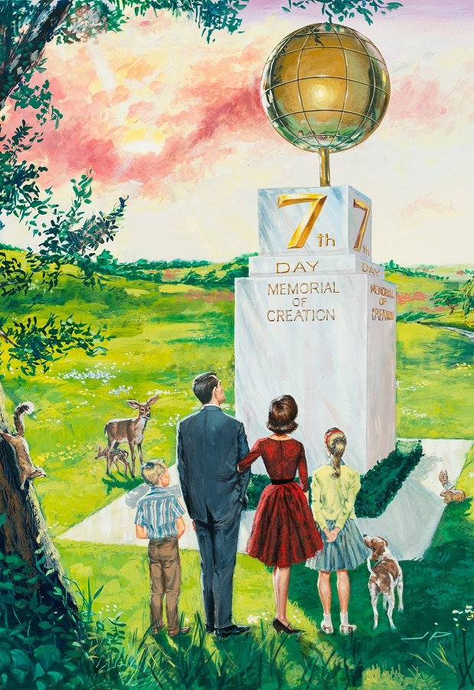
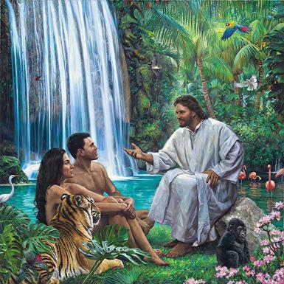
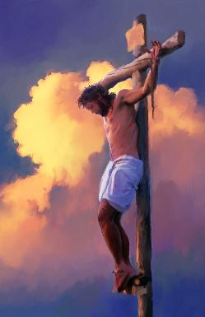
KO E SĀPATE
“ʻE fai ʻae ngāue ʻi he ʻaho ʻe ono, ka ʻi hono fitu ʻoe ʻaho ʻe ʻai kiate kimoutolu ʻae ʻaho tapu, ko e Sāpate ʻoe mālōlō kia Sihova: ko ia fulipē ʻoku fai ha ngāue ʻi ai ʻe tāmateʻi ia.” (Ekisotosi 35:2)
Hili ‘ene sio ki he langilangi ‘o e ‘Otua, na’e fakahoko ‘e Mosese ki he kakai “‘a e me’a kuo fekau ‘e Sihova” (Eki. 35:1, 4). Naʻe kau ʻi he ngaahi fakahinohino ko ʻení ʻa ʻenau fetuʻutaki mo e ʻOtuá ʻi he taimí (ʻa e Sāpaté) pea ʻi he ʻataá (fale fehikitaki).
Na’e vahe’i ‘e he ‘Otua ‘a e Sāpate ko ha taimi makehe ke tau fiefia ai ‘i he’ene feohi ‘i he Fakatupu tonu (Sen. 2:1-3; ‘Eki. 20:11), pea na’a ne fakamanatu ‘a e me’a ni ki ‘Isileli ‘i ha taimi nounou kimu’a pea toki talaki ‘a e Fekau ‘e Hongofulu (‘Eki. 16:22-29).
‘Oku fakamanatu mai ‘e he Sāpate, ko e ‘Otua ko hotau Fakatupu mo Huhu’i (Teut. 5:15), pea ‘oku ne ‘ave kitautolu ki he taimi ‘i he kaha’u ‘a ia te tau lava ai ‘o fiefia ‘i hono feohi ‘o ta’engata (Isaia. 66:22-23).

Slide 6
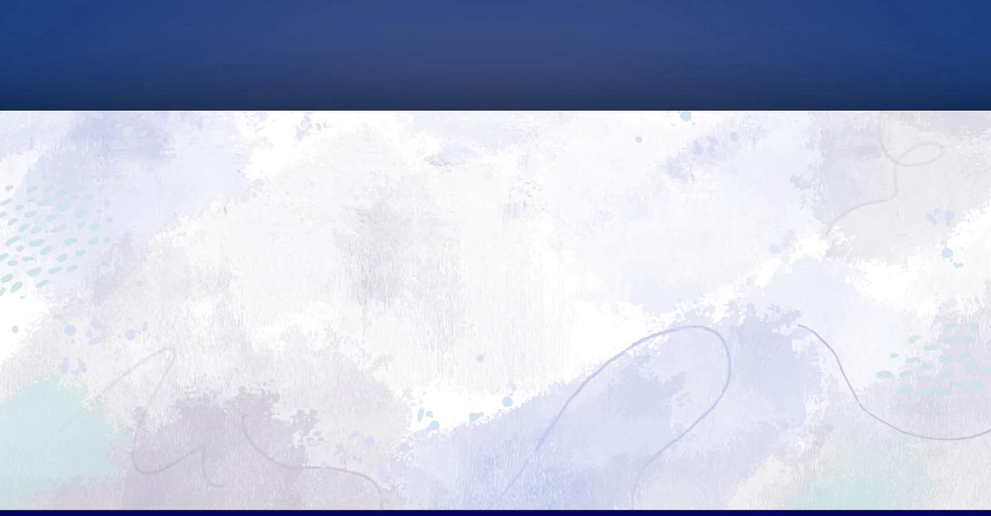
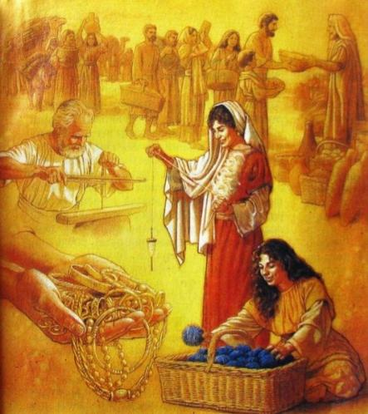
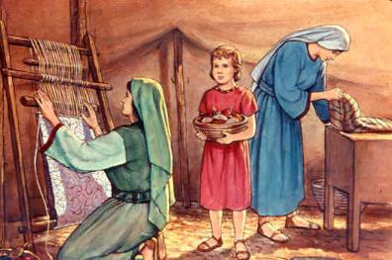
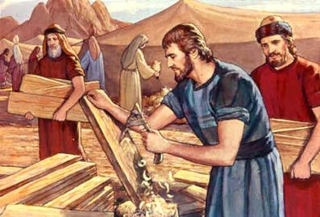
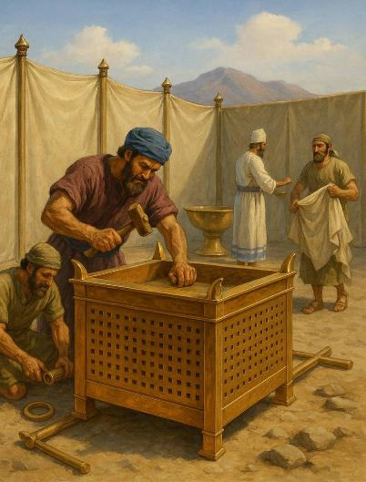
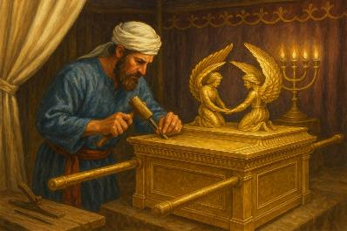
KO E FOAKI LOTO TA'ETOTONGI .
“Mei he meʻa ʻokú ke maʻú, toʻo ha feilaulau maʻa Sihova. Ko e tokotaha kotoa pē ʻoku loto fiemālié ke ne ʻomi kia Sihova ha feilaulau koula, siliva mo e palasa [ ...] Ko kinautolu kotoa pē ʻoku taukei ʻiate kimoutolú ke nau haʻu ʻo ngaohi ʻa e meʻa kotoa pē kuo fekau ʻe Sihová” ( ʻEkesōtosi 35:5,10 )
Naʻe ʻi ai ha founga ʻe ua ke tokoni ai ki he ngāue ʻo e Falefehikitaki: ko hono foaki ʻo e ngaahi nāunaú mo hono fakahoko ʻo e ngāué.
Na’e laka hake ‘i he toni ‘e taha ‘a e koula, toni ‘e 3.75 nai ‘o e siliva, mo e toni ‘e 2.5 nai ‘o e palasa na’e ngaue’aki, pea pehe ki he ‘akau mo e ngaahi tupenu kehekehe (Ek. 38:21-31).
Na‘e ha‘u kotoa ‘eni mei fē? Ko e konga lahi na’e ma’u mei he me’a na’e to’o ‘e ‘Isileli mei he kakai ‘Isipite ‘i he’enau mavahe (Ek. 11:2).
ʻIkai ngata ai, naʻe fie maʻu ʻa e ngaue ʻa e kau filo, kau tuitui mo e kau tuitui, kau tufunga, kau ta tongitongi siueli, mo e ala meʻa pehee.
Naʻe loto fiemalie ʻa e tokotaha kotoa pe ke tokoni ko ia naʻe kole ai ʻe Pesalieli, ʻAholiapi, mo e kau ngaue kehe kia Mosese ke taʻofi ʻa e kakai mei hono ʻomi ʻo e ngaahi feilaulau (ʻEkisotosi 36:3-7).
Ke fakahoko ʻa e ngaue ni, naʻe fakakoloaʻi ʻe he Laumalie Maʻoniʻoni ʻa e kau ngaue kotoa pe naʻe kau ki ai ʻaki ha ngaahi meʻafoaki (ʻEkesotoso 35:30–36:2). Ko e meʻa tatau pe, ʻoku hokohoko atu ʻEne foaki ʻa e ngaahi meʻafoaki ʻoku fie maʻu kiate kinautolu kotoa pe ʻoku kau fakataha ʻi he ngaue ʻa e ʻOtua.

Slide 7

"Kuo tuku ʻe he ʻOtuá ʻa e houʻeiki tangata mo fafine ke nau maʻu ha ngaahi meʻaʻofa mahuʻinga. Kuo Ne foaki ha ngaahi meʻafoaki kehekehe ki he niʻihi kehekehe. ʻOku ʻikai ke maʻu ʻe he taha kotoa ʻa e malohi tatau ʻo e ʻulungaanga pe loloto tatau ʻo e ʻilo. Ka kuo pau ke fakaʻaongaʻi ʻe he tokotaha kotoa pe ʻene ngaahi meʻafoaki ʻi he ngaue ʻa e ʻEiki, neongo pe ko e ha hono siʻisiʻi ʻo e meʻafoaki ko ʻeni. ʻOku fakapotopoto ʻa e fefakatauʻaki ʻa e tauhi faivelenga ʻi he ngaahi koloa kuo fakafalala kiate ia."
EGW (Ko e Sio ki ʻOlunga , Tisema 31 .)

Slide 8
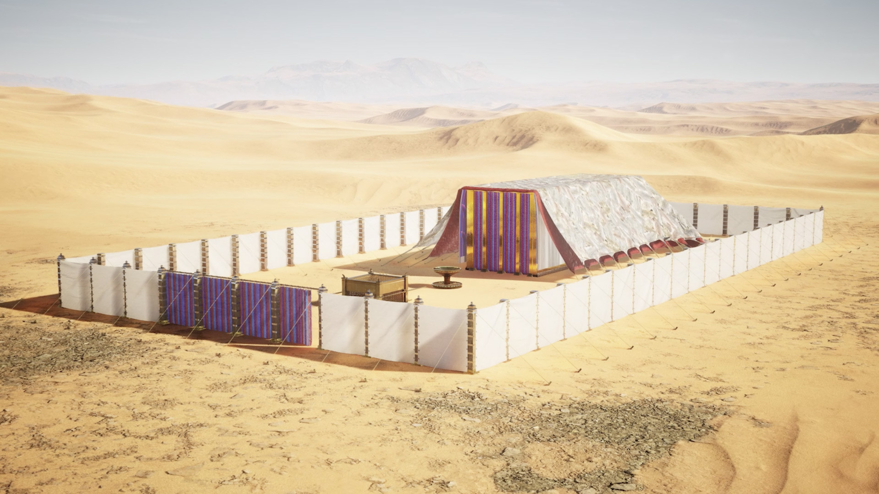
KO E FALE FEHIKITAKI

Slide 9

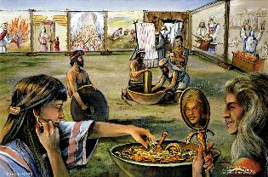
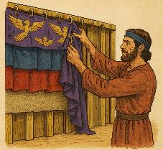
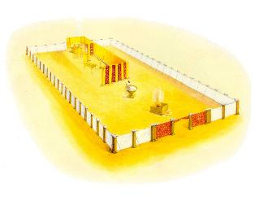
KO E LANGA
“Pea naʻe vakai ʻe Mōsese ki he ngaahi ngāue kotoa pē, pea vakai, kuo nau fai ia ʻo hangē ko e fekau ʻa Sihova, .. pea naʻe tāpuaki ʻakinautolu ʻe Mōsese.” (Ekisotosi 39:43)
Ko e ha e ngaahi meʻa naʻe fie maʻu ke fakahoko ai ʻe he falefehikitaki ʻo e Fakataha ʻa hono ngaahi fatongia?
Ko e Fale fehikitaki (Potu Maʻoniʻoni mo Toputapu Taha)
Ko e ʻaʻake koula
Ko e tēpile mā
Ko e tuʻunga māmá .
Ko e ‘ōlita ‘inisēnisí .
Ko e feilaulau‘anga ‘o e feilaulau tutu .
Ko e pesoni Palasa
Ko e lotoʻa ʻi tuʻa
Ko e ʻēfoti .
Ko e kato fatafata .
Ko e toenga ʻo e ngaahi kofú

Slide 10

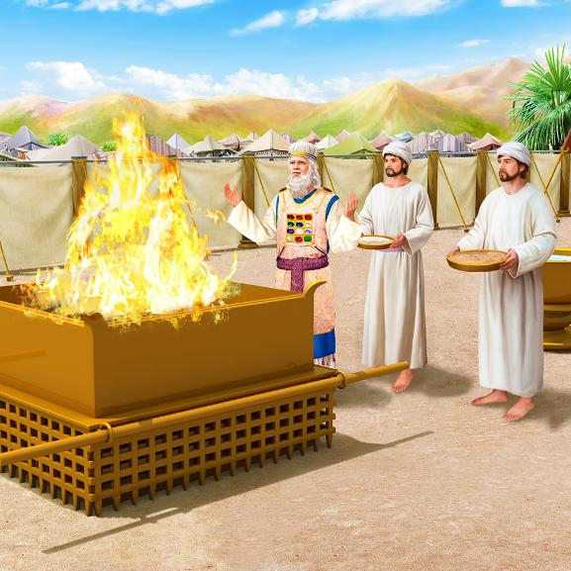
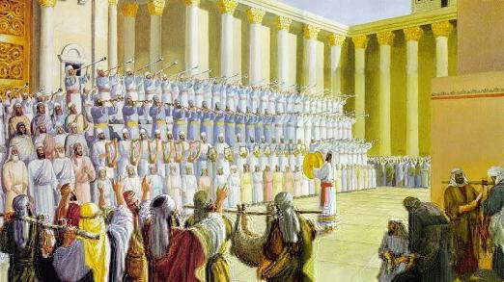
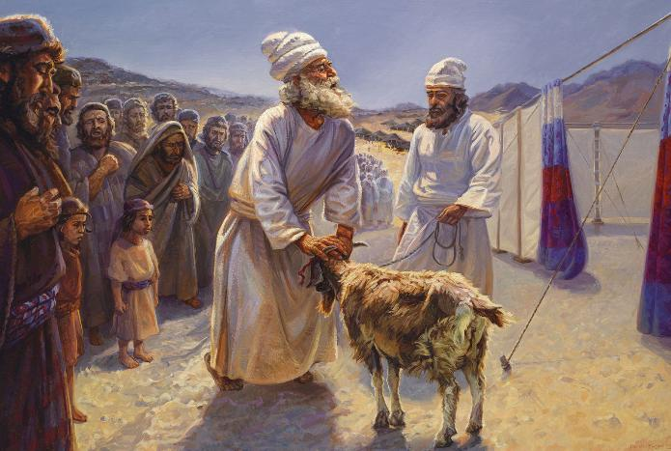
KO E LANGA .
ʻI hono langa pē ʻo e Fale Tapú (ko e Tāpanekalé mo e lotoʻaá) naʻe ʻi ai ha ongo ngāue kehekehe ʻe ua: ko e ngāue fakaʻahó mo e ngāue fakataʻú. Ko ‘enau ngaahi ouau kehekehé, ‘i hono fakataha‘í, ‘oku ako‘i mai ai kiate kitautolu:
ʻOku fehiʻa ʻa e ʻOtua ʻi he angahala
ʻOku fakahaofi ʻe he ʻOtua ʻa e tokotaha faiangahala
ʻE fakaʻauha ʻe he ʻOtua ʻa e kau faiangahala
ʻOku fakapapauʻi mai ʻ e he ʻ Otuá kiate kitautolu ha kahaʻu lāngilangiʻia
Naʻe fakahaaʻi ʻe he ʻOtua ʻi he ngaue fakaʻaho ʻa e founga ʻoku Ne fakamolemoleʻi ai ʻa e angahala, ʻi he ʻaloʻofa: ʻi he mate ʻa e monumanu taʻehalaia, "ko e Lami ʻa e ʻOtua ʻoku ne toʻo ʻa e angahala ʻa mamani". (Sione 1:29).
ʻI he ouau fakataʻu (ʻAho ʻo e Fakalelei), naʻe fakahaaʻi ai ʻe he ʻOtua ʻa e founga te Ne toʻo atu ai ʻa e angahala mei he ʻunivesi, ʻo fakahaaʻi ʻa e founga fakaʻosi ki he palopalema ʻo e kovi (Saame 73:17).
Naʻe toe hoko foki ʻa e Potu Tapu ko e feituʻu ke hu ai ki he ʻOtua, fakahikihikiʻi ia mo fakahaaʻi ʻa e houngaʻia kiate ia.

Slide 11
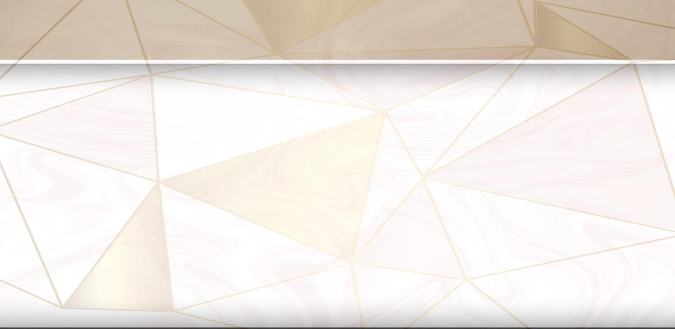
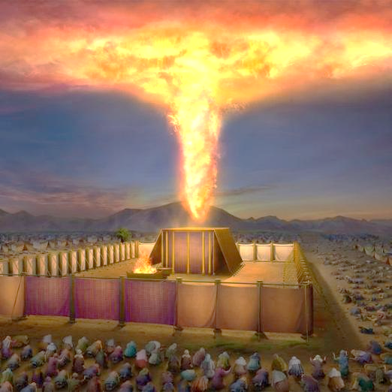
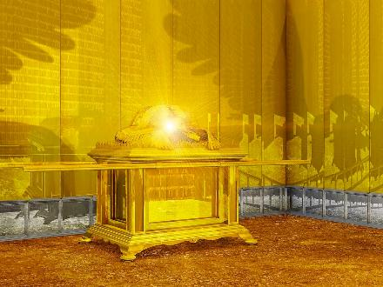
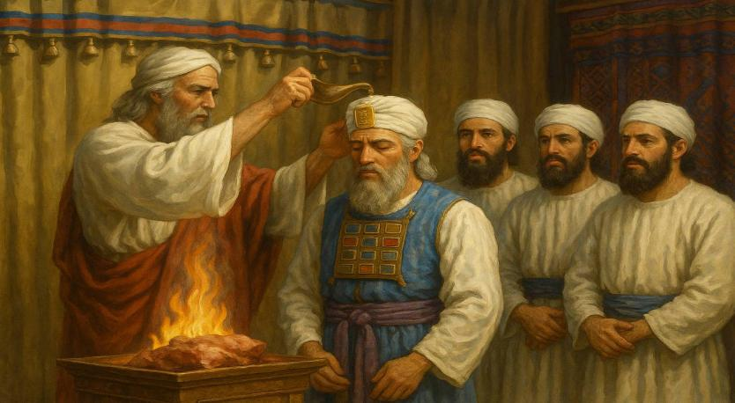
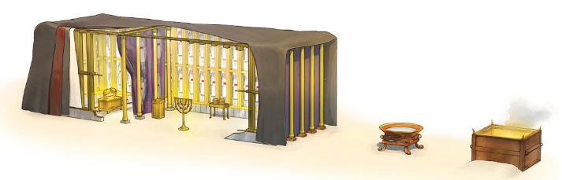
KO E FAKATĀPUI
“Pea hili ia naʻe ʻufiʻufi leva ʻe he ʻao ʻae fale fehikitaki ʻoe kakai, pea naʻe fakafonu ʻe he nāunau ʻo Sihova ʻae fale fehikitaki.” (Ekisotosi 40:34)
ʻOku fakaʻosi ʻa e tohi ʻEkesotosi ʻaki hono fakatapui ʻo e Potu Tapu mo hono kau taulaʻeiki. ʻOku ʻikai ha veiveiua ko e tokotaha tefito ʻi he vahe ko ʻeni ko e ʻOtua, ʻa ia ʻoku ne fakafonu ʻa e meʻa kotoa pe ʻaki hono ʻafioʻanga naunauʻia (ʻEkesotosi 40:34). Naʻe hokohoko atu ʻa e ʻAfio ko ʻeni ʻi he Tapanekale ʻi he ʻao pea ʻi he Shekinah (ko e fakahaaʻi ʻo e naunau fakalangi ʻi he vahaʻa ʻo e kau selupimi ʻo e puha tapu).
Hili ha ngaahi mahina ʻo e ngaue, naʻe langa ʻa e potu toputapu ʻi he ʻuluaki ʻaho ʻo e ʻuluaki mahina ʻo e taʻu hono ua hili ʻenau mavahe mei ʻIsipite (ʻEkesotosi 40:2, 17). Naʻe fokotuʻutuʻu maau ʻa e meʻa kotoa pe (ʻaʻake, veili, tepile, maama fakaʻofoʻofa, ʻolita koula, ʻolita palasa, ʻolita), pea fakatapui (ʻEkesotosi 40:9).
Fakaʻosi, naʻe tui ʻe ʻElone mo hono ngaahi foha honau ngaahi kofu taulaʻeiki, pea pani ki heʻenau ngaue fakafaifekau (ʻEkesotosi 40:12-15).

Slide 12

EGW (Kau Pēteliake mo e Kau Palōfitá, p. 349)
"ʻOku ʻikai ha lea te ne lava ʻo fakamatalaʻi ʻa e naunau ʻo e meʻa naʻe hoko ʻi loto ʻi he potu toputapu—ʻa e ngaahi holisi koula ʻoku fakaulo mai ʻa e maama mei he tuʻuʻanga teʻelango koula, ʻa e lanu ngingila ʻo e puipui tuitui fakaʻofoʻofa mo ʻenau kau ʻangelo ngingila, ʻa e tepile, mo e ʻolita ʻo e ʻinisēnisi, ʻoku fetapaki ʻaki ʻa e koula; ʻi he tafaʻaki ʻe taha ʻo e veili hono ua ʻoku ʻi ai ʻa e ʻaʻake toputapu, mo hono kau selupimi, pea ʻi ʻolunga ai ʻa e Sikaina maʻoniʻoni, ʻa ia ʻoku ha mai ʻa e ʻao ʻo Sihova; ka ko ha ʻata siʻisiʻi pe pe ʻo e ngaahi naunau ʻo e temipale ʻo e ʻOtua ʻi he langi, ʻa ia ko e uho maʻongoʻonga ʻo e ngaue ki he huhuʻi ʻo e tangata."

Slide 13
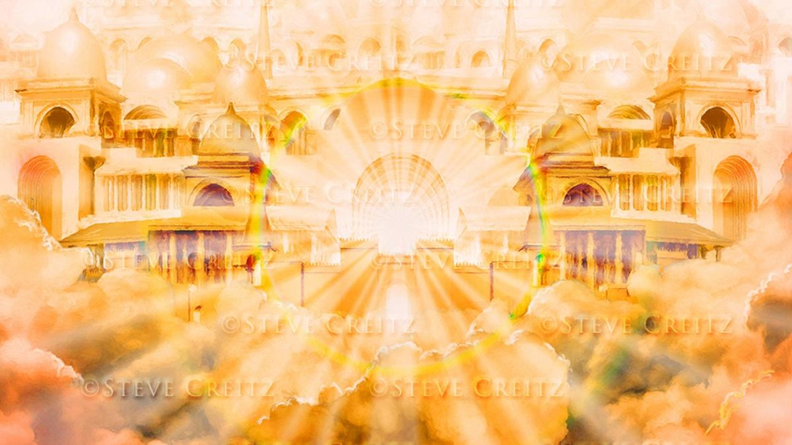
FALE FEHIKITAKI MAKEHE

Slide 14
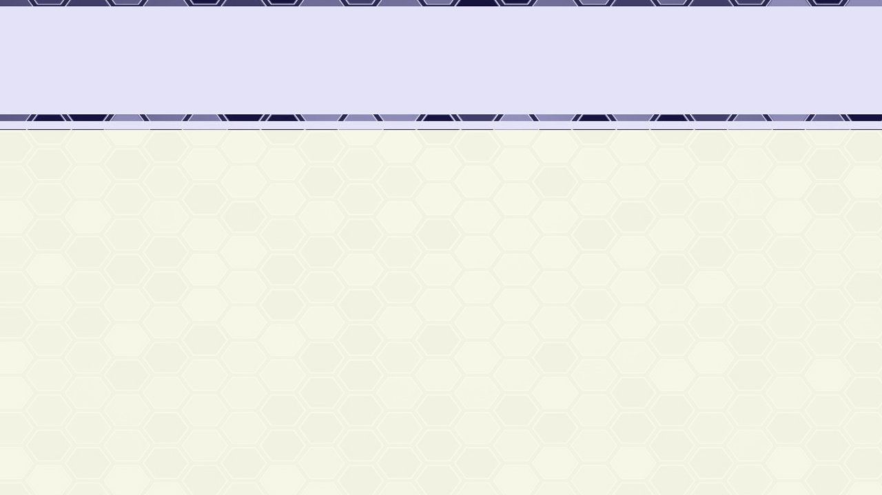
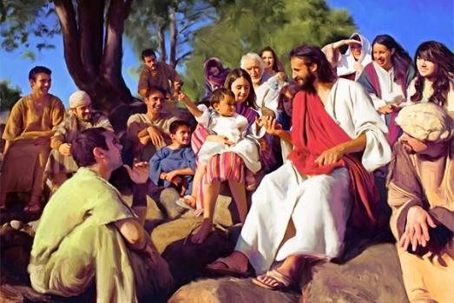
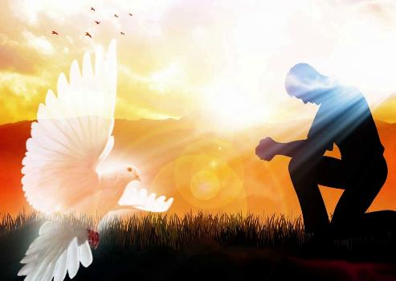
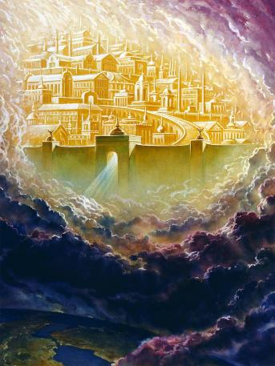
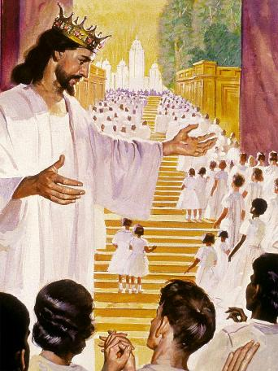
SISU MO SELUSALEMA FO'OU .
“Pea naʻe hoko ʻae Folofola ko e kakano, pea nofo ia ʻiate kitautolu, ” (Sione 1:14)
“Pea ne u fanongo ki he leʻo lahi mei he langi, ʻoku pehē, “Vakai, ko e fale fehikitaki ʻoe ʻOtua ʻoku ʻi he kakai, pea ʻe nofo ia mo kinautolu; pea te nau hoko ko hono kakai, pea ʻe ʻiate kinautolu ʻae ʻOtua, ko honau ʻOtua.”
(Fakahā 21:3)
ʻOku pehe ʻe he Sione 1:14 naʻe hoko ʻa Sisu ko e kakano pea naʻa ne "hoko ko ha tapanekale) ʻiate kitautolu. Naʻe fakahoko ʻe Sisu, ko e ʻOtua taʻengata, ʻa ʻene holi ke nofo fakatuʻasino ʻi hotau lotolotonga. Naʻa ne hoko ko ʻImanuela, ko e ʻOtua ʻoku ʻiate kitautolu (Matiu 1:23).
ʻOku kei ʻafio pe ʻa e ʻOtua mo kitautolu he ʻaho ni ʻo fakafou ʻi he Laumalie Maʻoniʻoni (Matiu 18:20; 1Ko. 3:16).
Ka ʻe vave ni pe ʻa e hokosia ʻa e ʻaho te tau lava ai ʻo tuʻu mata ki he mata mo hotau ʻOtua, pea nofo mo Ia, ʻi he Fale fehikitaki fakaʻeiʻeiki naʻa Ne teuteu maʻatautolu: ʻa e Selusalema Foʻou (Fakaha 21:3).
ʻE hoko ʻeni ʻi he taimi ʻe kakato ai ʻa e Palani ʻo e Fakamoʻui, pea ʻe fakaʻauha fakaʻaufuli ʻa e kovi.

Slide 15

EGW (Ko e Holi ʻo e Ngaahi Kuongá, p. 23)
"Naʻe fekau ʻe he ʻOtua kia Mosese maʻa ʻIsileli, "Tuku ke nau ngaohi hoku potu tapu; koeʻuhi ke u nofo ʻiate kinautolu" (ʻEkesotosi 25:8), pea naʻa Ne ʻafio ʻi he potu tapu, ʻi he lotolotonga ʻo Hono kakai. Naʻa nau maʻu ʻa e fakaʻilonga ʻo ʻEne ʻi ai ʻi he kotoa ʻo ʻenau he holo ʻi he toafa. Ko ia naʻe fokotuʻu ai ʻe Kalaisi Hono tapanekale ʻi he lotolotonga ʻo hotau ʻapitanga ʻo e tangata. Naʻa Ne fokotuʻu Hono fale fehikitaki ʻi he tafaʻaki ʻo e ngaahi fale fehikitaki ʻo e tangata, koeʻuhi ke Ne ʻafio ʻi hotau lotolotonga, pea ʻai ke tau maheni mo Hono natula fakalangi mo ʻEne moʻui."

