Slide 1
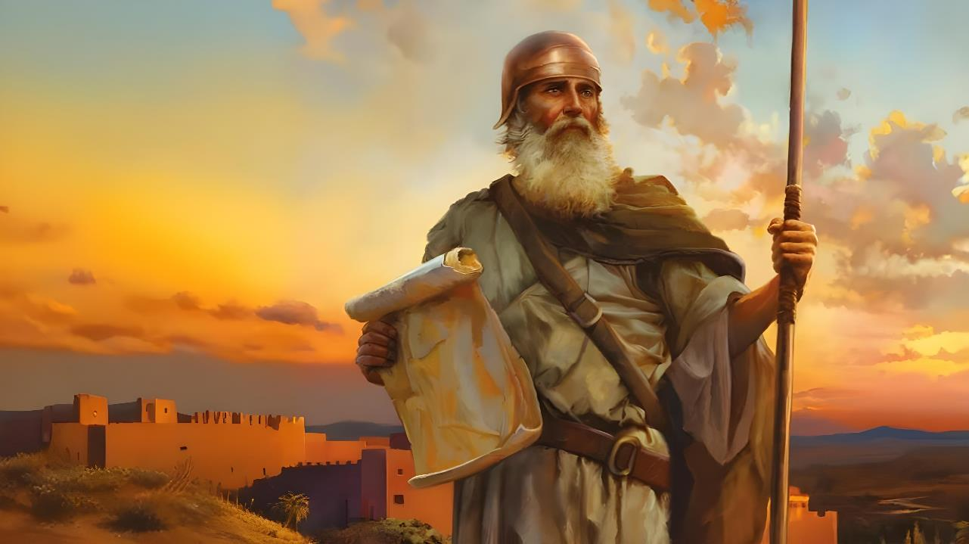

FOUNGA KI HE LAVAME’A
Lesoni 1 ki he ʻaho 4 ʻo ʻOkatopa 2025

Slide 2
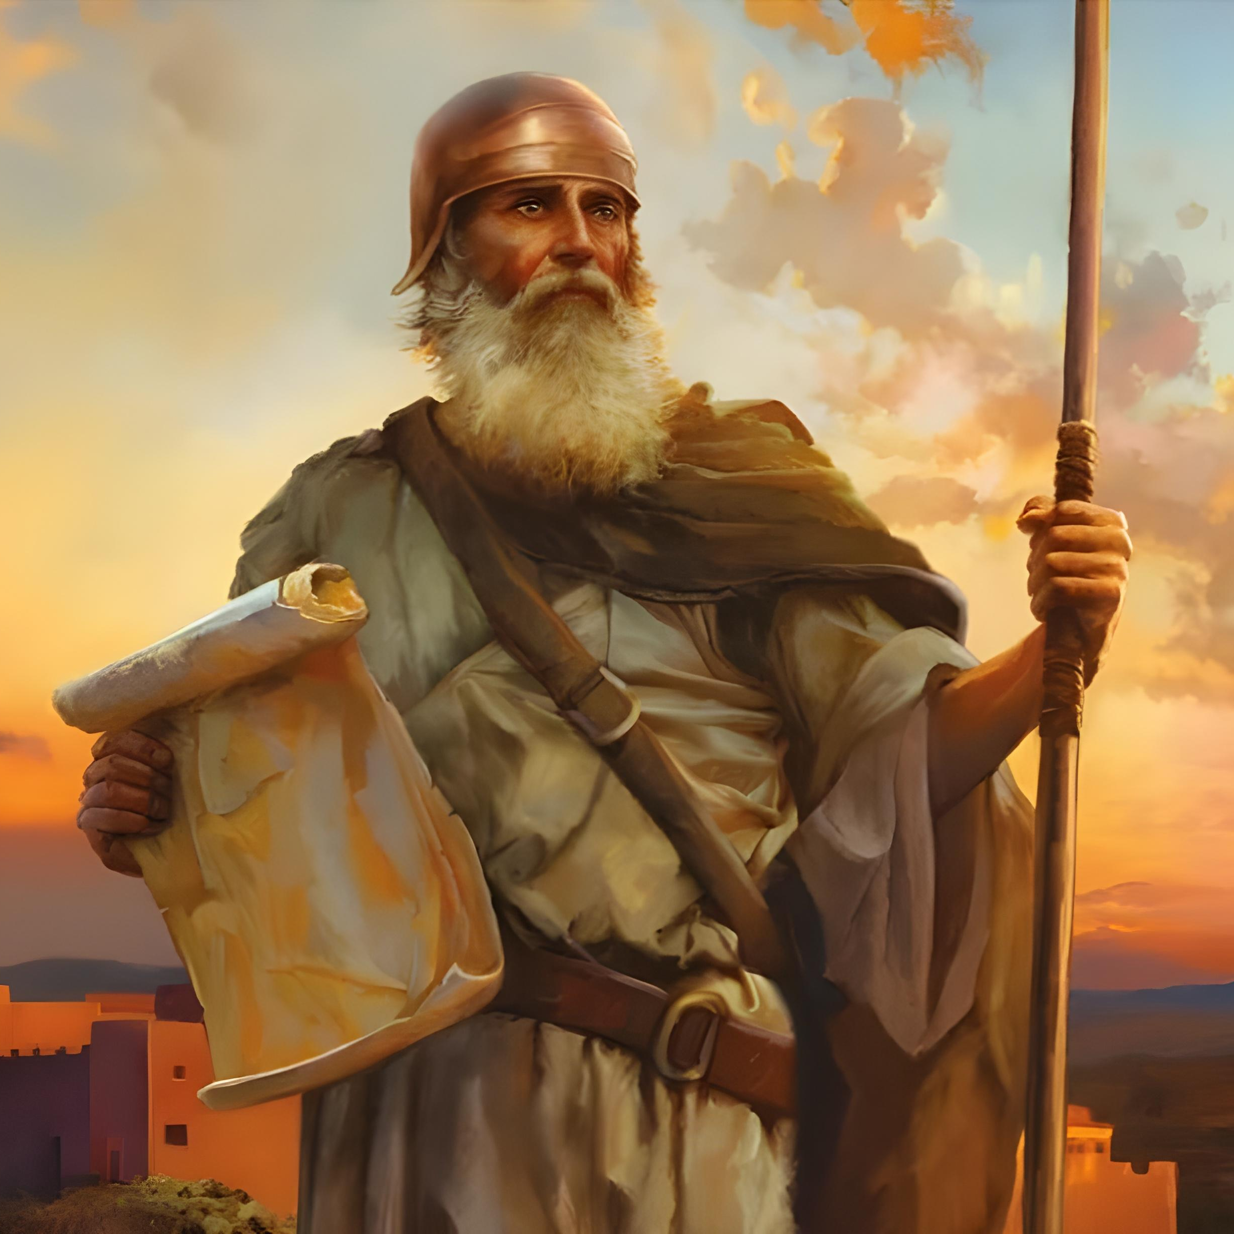
“Kae kehe ke mālohi pe ʻa koe mo ke lototoʻa ʻaupito, koeʻuhi ke ke tokanga ʻo fai ʻo fakatatau ki he fono kotoa pē, ʻaia naʻe fekau kiate koe ʻe heʻeku tamaioʻeiki ko Mōsese: ʻoua naʻa ke tafoki mei ai ki he nima toʻomataʻu pē ki he toʻohema, koeʻuhi ke ke monūʻia koe ʻi he potu kotoa pē ʻoku ke ʻalu ki ai.” Sōsiua 1:7

Slide 3

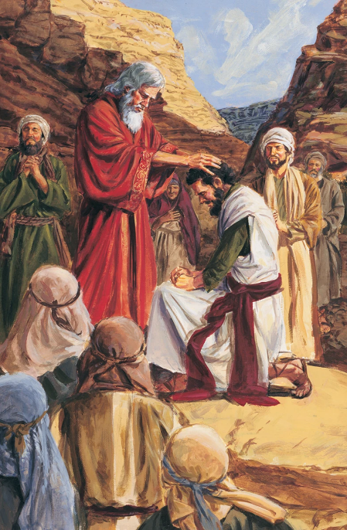
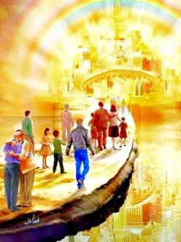


Hili ʻ a e taʻu ʻ e 40 ʻ o e hē he toafa, kuo tuʻu hake ai ha toʻutangata foʻou, pea kuo hokosia ʻ a e taimi ke ikunaʻi ai ʻ a e Fonua ʻ o e Talaʻofá. Kuo pekia ʻa Mosese, pea kuo fili ʻe he ʻOtua ha taki foʻou ki he ngaue ni: ko Sosiua.
Kimuʻa pea kamata ʻa e ikuna, ʻoku fakatou ui ʻa e taki foʻou mo e toʻu tangata foʻou ke nau falala kakato ki he ʻOtua.
ʻI he tuʻu ʻa e toʻu tangata lolotonga (kitautolu) ʻi he kauʻafonua ʻo Kenani fakalangi, ʻoku kei ongo malohi pe ʻa e ui fakalangi: "Ke ke malohi pe mo loto-toʻa ʻaupito" (Sōsiua 1:7).
Talateu (Sosiua 1:1-3):
Mosese mo Sosiua
Faʻunga ʻo e tohi
Ko e Misiona ʻo Sosiua (Sosiua 1:4-9):
Maʻu ʻa e ngaahi talaʻofa
Malohi mo e lototoʻa
Ko e lavameʻa ʻo e ngaue fakafaifekau

Slide 4
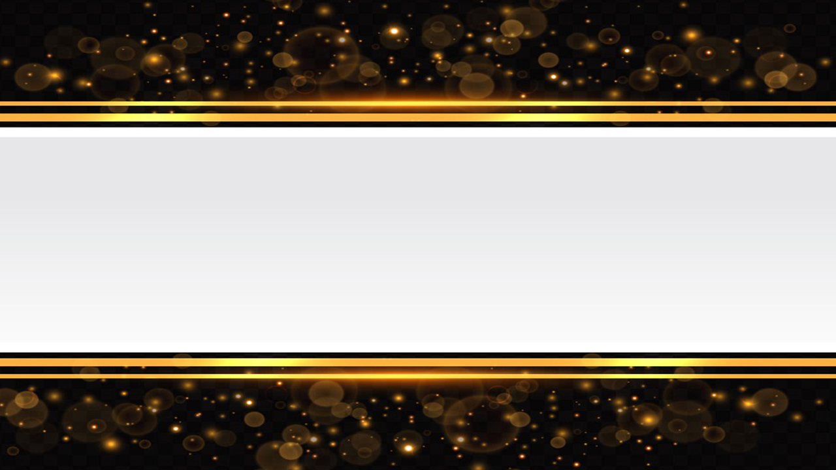
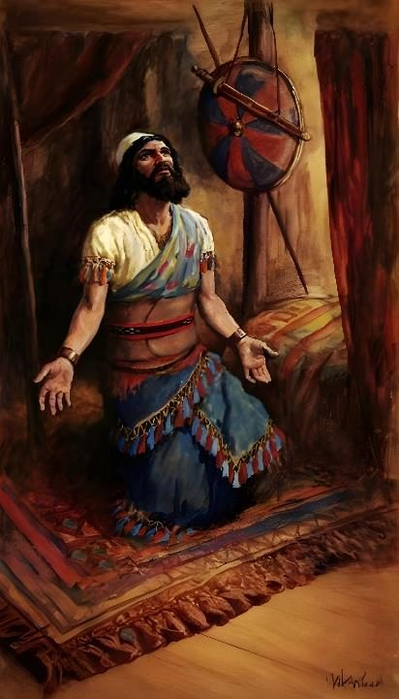
TALATEU
(SŌSIUA 1:1-3)

Slide 5







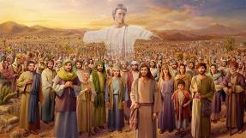
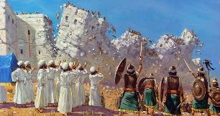








MOSESE MO SIOSIUA
Naʻe ha ʻa e ʻOtua kiate kinautolu
(ʻEkesotosi 3:2-4;Sosiua 5:13-14)
Naʻe kole ange ke nau toʻo honau suu
(ʻEkesotosi 3:5 ; Sosiua 5:15)
Naʻe talaʻofa ʻa e ʻOtua kiate kinautolu te Ne ʻiate kinautolu (ʻEkesotosi 3:12; Sosiua 1:5)
Naʻa nau katoangaʻi ʻa e Lakaatu
(ʻEkesotosi 12:21-23; Sosua 5:10)
Naʻa nau fou atu ʻi he vai ʻi he kelekele momoa
(ʻEkesotosi 14:21-22; Sosiua 3:14-17)
Naʻe haʻu fakataha mo e taha ʻa e mana, pea ngata ʻa e taha
(ʻEkisoto 16:4-5, 31; Sosiua 5:11-12)
Naʻa nau fekauʻi atu ha kau mataki ke nau mamataʻi ʻa e fonua
(Nomipa 13:1-3; Sosiua 2:1)
“Pea hili ʻae pekia ʻa Mōsese ko e tamaioʻeiki ʻa Sihova, naʻe hoko ʻo pehē, naʻe folofola ʻa Sihova kia Siosiua ko e foha ʻo Nuni, ko e tauhi ʻo Mōsese, ʻo pehē, ” (Sōsiua 1:1)
ʻI he vahe ʻuluaki ʻo e tohi ʻa Sosiua, ʻoku lave tuʻo hongofulu ma taha ai ʻa Mosese, pea ʻoku toutou ʻasi hono hingoa ʻi he kotoa ʻo e tohi.
ʻOku lahi ʻa e ngaahi meʻa ʻoku faitatau ai ʻa e ongo taki ni
Neongo ʻoku lekooti ʻi he vahe ʻuluaki ʻo e tohi ʻa Sosiua ʻa e liliu ʻi he vahaʻa ʻo e ongo taki maʻongoʻonga ʻo ʻIsileli, ka ʻoku ʻikai ha taha ia ʻo e tokotaha ʻoku fai ki ai ʻa e talanoa. Ko e tokotaha mahuʻinga tahá ko e ʻ Otuá tonu, ʻ a ia ko ʻ Ene ngaahi folofolá ʻ okú ne fakaava ʻ a e tohí, pea ko ʻ Ene tuʻunga takimuʻá ʻ a e kaveinga tefito. ʻOku ʻikai ha veiveiua pe ko hai ʻa e taki moʻoni ʻo ʻIsileli.

Slide 6
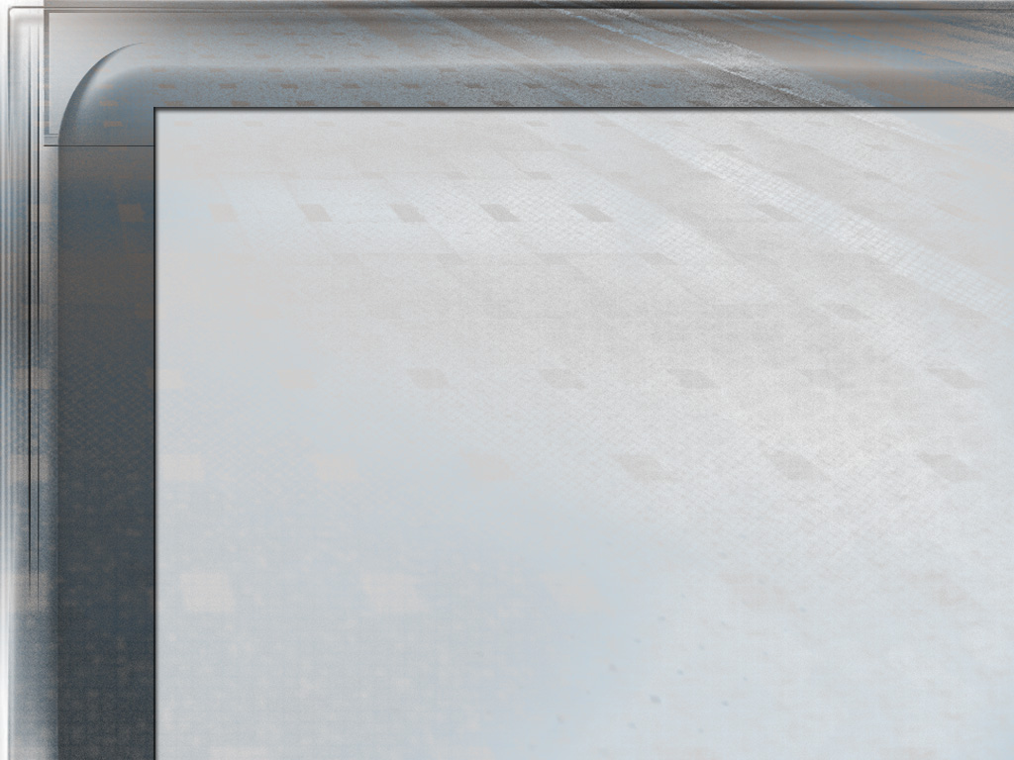
EGW (Kau Peteliake mo e Kau Palofita, p. 481)
"Naʻe hoko ʻeni ʻa Siosiua ko e taki ʻiloa ʻo ʻIsileli. Naʻe ʻiloa ia ko ha tangata tau, pea naʻe matuʻaki mahuʻinga ʻene ngaahi meʻafoaki mo e ngaahi ʻulungaanga lelei ʻi he tuʻunga ko ʻeni ʻo e hisitolia ʻo hono kakai. Naʻa ne loto-toʻa, loto fakapapau, mo vilitaki, vave, taʻe-faʻa-ʻauha, taʻetokanga ki he ngaahi meʻa siokita ʻi heʻene tokangaʻi ʻa kinautolu kuo tuku ke ne tokangaʻi, pea ko e mahuʻinga taha, naʻe ueʻi fakalaumalie ia ʻe ha tui moʻui ki he ʻOtua—ko e ʻulungaanga ia ʻo e tangata naʻe fili fakalangi ke tataki ʻa e kau tau ʻa ʻIsileli ʻi heʻenau hu ki he Fonua ʻo e Talaʻofa. Lolotonga ʻene fononga ʻi he feituʻu maomaonganoa naʻa ne hoko ko e palemia kia Mosese, pea ʻi heʻene anganofo fakalongolongo mo taʻemalualoi, ʻi heʻene tuʻu maʻu ʻi he taimi naʻe veiveiua ai ʻa e niʻihi kehe, ʻa ʻene tuʻu maʻu ke tauhi maʻu ʻa e moʻoni ʻi he lotolotonga ʻo e fakatuʻutamaki, naʻa ne fakamoʻoniʻi ai ʻene taau ke fetongi ʻa Mosese, kimuʻa pea toki ui ia ki he lakanga ko ia ʻe he leʻo ʻo e ʻOtua."

Slide 7

FOKOTUʻUTUʻU ʻO E TOHI
"Kuo mate ʻa ʻeku tamaioʻeiki ko Mosese. Ko ia ko ia, ko koe mo e kakai ni kotoa pe, teuteu ke aʻa atu ʻi he Vaitafe Soatani ki he fonua ʻoku ou ʻamanaki ke foaki kiate kinautolu, ki he kakai ʻIsileli" (Sosiua 1:2)
ʻ Oku fakahaaʻi ʻ e he Tohi ʻ a Siosiuá ʻ a hono fakahoko ʻ o e ngaahi talaʻofa naʻe fai ʻ e he ʻ Otuá ki ʻ Isileli ʻ i he taimi naʻá ne ʻ omai ai kinautolu mei ʻ Isipité, ʻ a ia ko hono ʻ oange kiate kinautolu ʻ a Kenani. ʻOku fakatou vahevahe ʻa e talamuʻaki (vahe 1) mo e tohi ki ha konga lalahi ʻe fa:
KOLOSI ki Kenani
Sōsiua 1:1-9
Sōsiua 1:1-5:12
ʻAve ʻa Kenani
Sōsiua 1:10-11
Sōsiua 5:13-12:24
VAHEVAHE ʻa e kelekele
Sōsiua 1:12-15
Sōsiua 13:1-21:45
NGĀUE TOKONI fakafou ʻ i he talangofua ki he Laó
Sōsiua1:16-18
Sōsiua 22:1-24:33

Slide 8
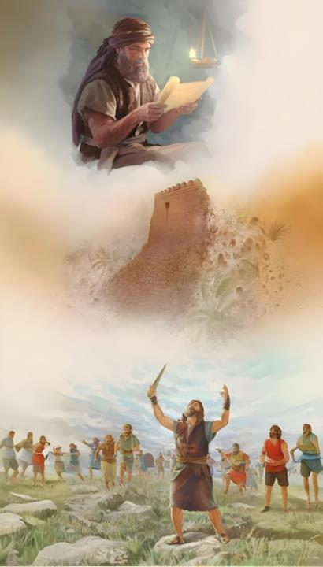
KO E MISIONA ʻA SŌSIUA
(SŌSIUA 1:4-9)

Slide 9

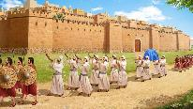
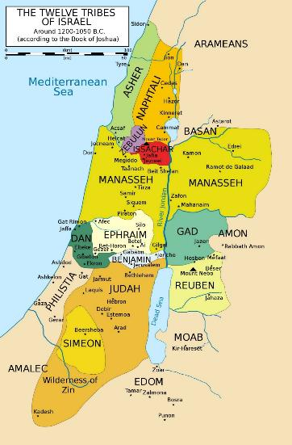
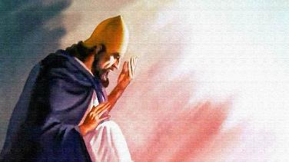
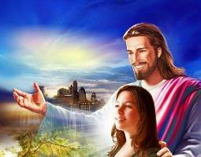
MAʻU ʻA E NGAAHI TALAʻOFA
"Te u foaki kiate koe ʻa e potu kotoa pe ʻoku ke tuʻu ai, ʻo hange ko ʻeku talaʻofa kia Mosese" (Sosiua 1:3)
ʻI he Sosiua 1:3, ʻoku folofola ʻa e ʻOtua ʻi he taimi lolotonga. ʻOku ne lea fekauʻaki mo Kenani ʻo hange kuo ʻosi foaki ia ki ʻIsileli. ʻ Oku ʻ uhinga ení naʻe ʻ oange ʻ e he ʻ Otuá kiate kinautolu ʻ a e fakapapau kakato ki he lavameʻa ʻ o e ikuna.
ʻIUFALETESI
ʻOku ne fakamanatu leva kiate kinautolu ʻa e ngaahi fakangatangata ʻe aʻu ki ai ʻa e ikuna (Sosiua 1:4): ko e konga ʻi he vahaʻa ʻo e Vaitafe Soatani (hahake) mo e Tahi Meteleniane (hihifo), mei he toafa (tonga) ki he Vaitafe ʻIufaletesi (tokelau).
Naʻa ne tafoki leva kia Sosiua ʻo fakapapauʻi ange kapau ʻoku ne malohi mo loto-toʻa, he ʻikai lava ʻe ha taha ʻo fakafepakiʻi ia (Sosiua 1:5-6).
METELENIANE
SOATANI
Ka naʻe ʻikai makatuʻunga ʻa e ikuna ʻi he ngaahi feinga ʻa Siosiua, ka ʻi he ʻao ʻo e ʻOtua. Naʻa Ne fakapapauʻi ange kiate ia, ʻo hange ko ʻEne fakapapauʻi mai kiate kitautolu takitaha: "Te u ʻiate koe" (Sosiua 1:5; Matiu 28:20).
TOAFA

Slide 10

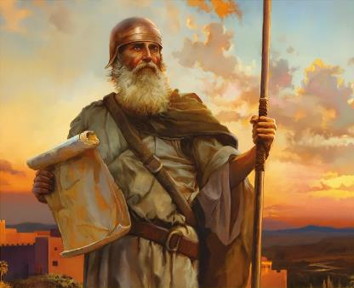
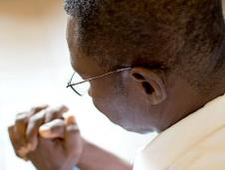
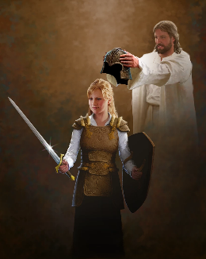
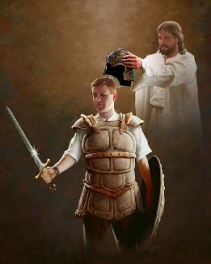
MALOHI MO E LOTOTOʻA
“ʻIkai ko au kuo u fekauʻi koe? Ke ke mālohi koe pea ke lototoʻa; ʻoua naʻa ke manavahē, pea ʻoua naʻa ke puputuʻu: he ko Sihova ko ho ʻOtua ʻoku ʻiate koe ia ʻi he potu kotoa pē ʻoku ke ʻalu ki ai.” (Sosiua 1:9)
Kimuʻa pea kole kia Sosiua ha ivi mo ha loto-toʻa ʻi he tau (Sosiua 1:9), naʻe kole ʻe he ʻOtua kiate ia ha malohi mo ha loto-toʻa ke talangofua ki he Fono (Sosiua 1:7).
Ko e meʻa foki ʻeni ʻoku hoko he ʻaho ni. ʻOku kole mai ʻa e ʻOtua ke tau feinga ke tauhi ʻEne fono (Fakaha 14:12). ʻOku fie maʻu ki he meʻa ni ha loto-toʻa lahi ʻi heʻetau tafaʻaki.
ʻI Heʻene tafaʻaki, ʻoku Ne talaʻofa mai "te ke ʻiate kimoutolu ʻi ha feituʻu pe te mou ʻalu ki ai" (Sosiua 1:9), ʻo tokoniʻi kitautolu ke tau fai ʻa e tau ʻoku tau kau ki ai. ʻOku ʻikai ko ha tau fakatuʻasino, ka "mo e kau pule, mo e kau mafai, mo e ngaahi malohi ʻo e fakapoʻuli ʻo e kuonga ni, mo e laumalie kovi ʻi he ngaahi potu maʻolunga" (ʻEfeso 6:12). Ke fai ʻeni, kuo Ne ʻomi kiate kitautolu ʻa e ngaahi meʻatau ʻoku fie maʻu (ʻEfeso 6:13-17).
Ko e ki ki he lavameʻa ko e falala kakato ki he ʻOtua. Pea ke fai ia, ʻoku fie maʻu ke tau fetuʻutaki mo Ia ʻi he ʻaho kotoa pe (ʻEfeso 6:18).

Slide 11


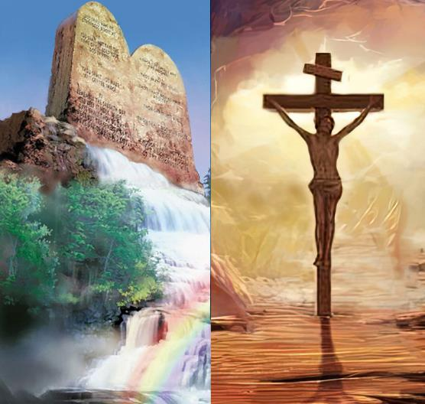
KO E LAVAMEʻA ʻO E MISIONA
“Ko e tohi ni ʻoe fono ke ʻoua naʻa mahuʻi ia mei ho ngutu: ka ke fakalaulauloto ki ai ʻi he ʻaho mo e pō, koeʻuhi ke ke tokanga ʻo fai ʻo fakatatau ki he meʻa kotoa pē kuo tohi ʻi ai: he ko ia te ke ngaohi ke monūʻia ai ho hala, pea ke toki fai fakapotopoto ai.” (Sosiua 1:8)
ʻOku ʻikai fenapasi ʻa e lavameʻa mei he vakai fakalangi mo e lavameʻa mei he vakai ʻa e tangata.
ʻE lava ke aʻusia ʻa e lavameʻa fakataimi ʻi he mamani ko ʻeni ʻi hono maumauʻi ʻo e ngaahi fono fakalangi mo fakaetangata, ka he ʻikai lava ʻa e lavameʻa moʻoni mo taʻengata (Sosiua 1:8).
Te tau lavameʻa kapau te tau muimui ʻ i he ngaahi tefitoʻi moʻoni mo e ngaahi meʻa mahuʻinga ʻ oku fakahaaʻi ʻ i he Lao ʻ a e ʻ Otuá. Ka ʻoku ʻikai ko e fakamoʻui ʻeni ʻi he ngaue?
ʻIkai ʻaupito. ʻOku ʻikai ke fengaueʻaki ʻa e tui mo e Lao, ka ʻoku na fepoupouʻaki (Loma 3:31).ʻI he taimi ʻoku tau talanoa ai ki he Lao, ʻoku tau lea ki he founga ʻoku totonu ke tau moʻui ai, kae ʻikai ko e founga ʻoku fakamoʻui ai kitautolu. ʻOku fakahaaʻi hotau va fetuʻutaki mo e ʻOtua ʻi heʻetau talangofua ki Hono finangalo.

Slide 12

EGW (Kau Palōfita mo e Ngaahi Tuʻí, p. 576)
"ʻOku maʻu maʻu pe ʻe he Kalisitiane ha tokoni malohi ʻi he ʻEiki. Mahalo he ʻikai ke tau ʻiloʻi ʻa e founga ʻo e tokoni ʻa e ʻEiki; ka ʻoku tau ʻiloʻi ʻeni: He ʻikai ke Ne teitei liʻaki ʻa kinautolu ʻoku falala kiate Ia. ʻE lava nai ke ʻiloʻi ʻe he kau Kalisitiane ʻa e tuʻo lahi hono tuʻutuʻuni ʻe he ʻEiki honau hala, ke ʻoua naʻa fakahoko ʻa e ngaahi taumuʻa ʻa e fili fekauʻaki mo kinautolu, he ʻikai ke nau humu ʻi he launga. ʻE tuʻu maʻu ʻenau tui ki he ʻOtua, pea he ʻikai ha ʻahiʻahi te ne maʻu ha malohi ke ueʻi kinautolu. Te nau fakamoʻoniʻi Ia ko honau poto mo e lavameʻa, pea te Ne fakahoko ʻa e meʻa ʻoku Ne finangalo ke fakahoko ʻiate kinautolu."

