Slide 1
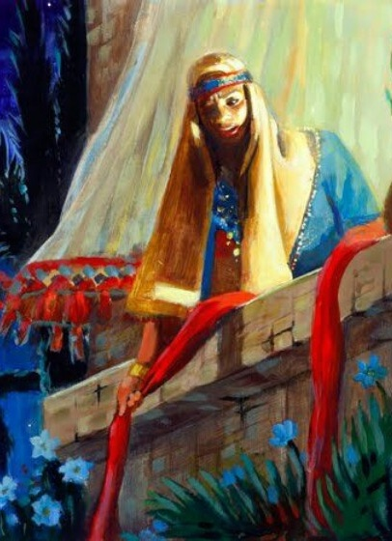
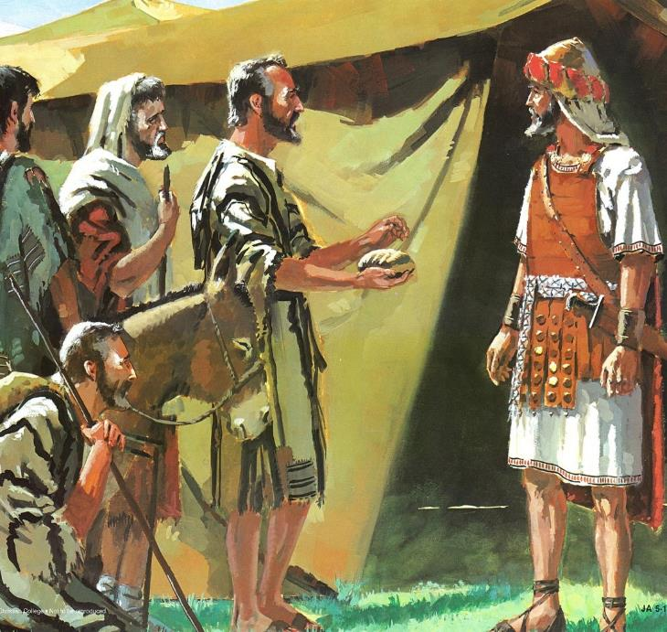
OFONGI ‘E HE KELESI
Lesoni 2 ki he ʻaho 11 ʻo ʻOkatopa 2025

Slide 2

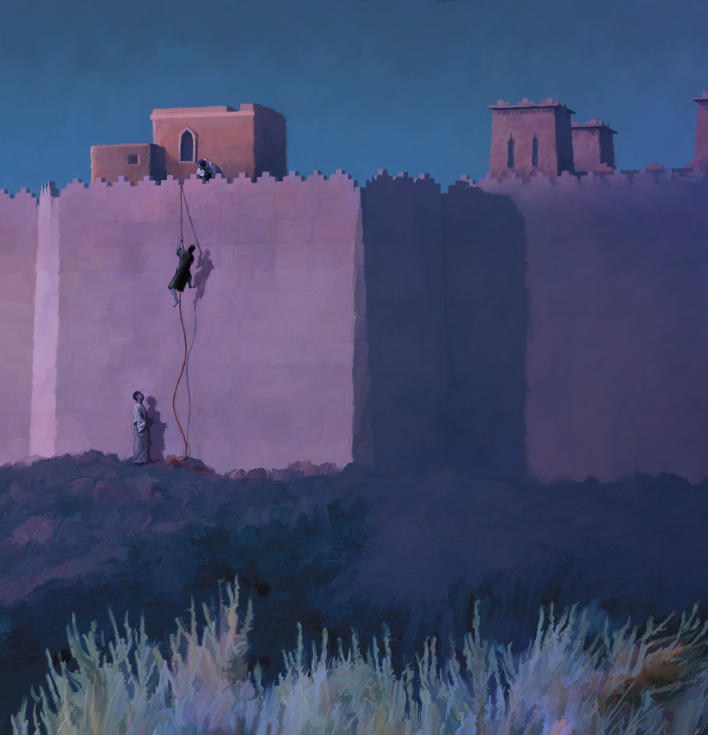
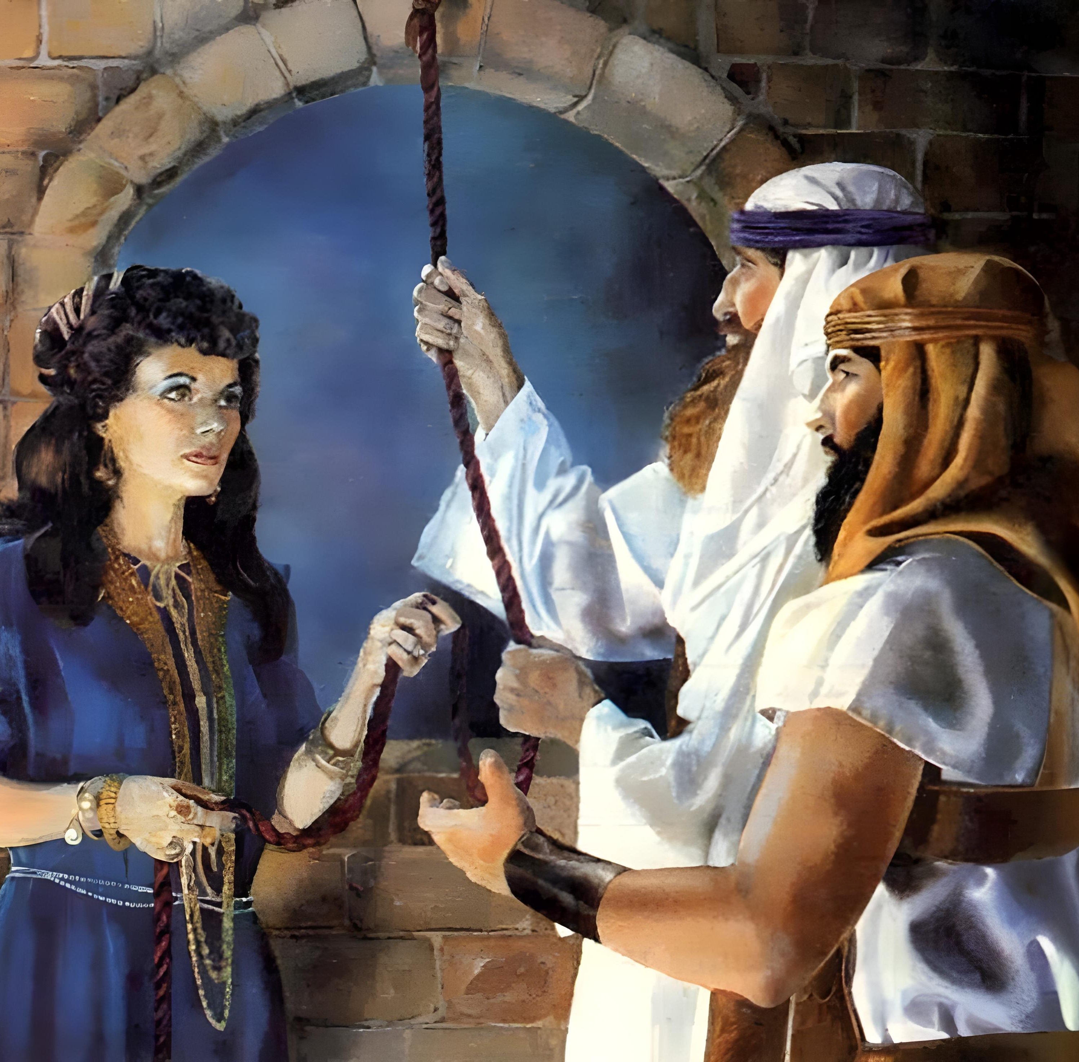
“Ko e tui naʻe ʻikai ʻauha ai ʻa Lehapi, ko e fefine feʻauaki, fakataha mo kinautolu naʻe ʻikai tui, ko ʻene tali lelei pe ʻae kau mataki.”
(Hepelū 11:31)

Slide 3

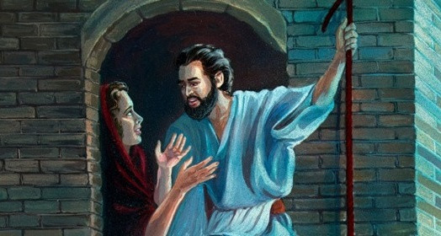
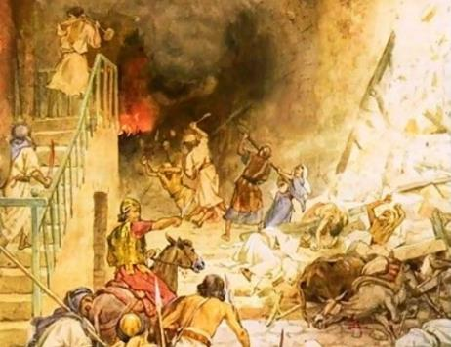



Naʻe fakalaka atu ʻa e kau Kenani ʻi he ngaahi fakangatangata ʻo e ʻaloʻofa. ʻI he ʻuhinga ko ia, ko e fekau ki ʻIsileli: hu ki loto, tamateʻi kotoa kinautolu, pea puke ʻenau koloa.
Kae kehe, naʻe kei ʻ i ai pē ʻ a e kakai ʻ i Kēnani naʻe teʻeki ai ke nau kolosi ʻ i he ngaahi ngataʻanga ko iá. Naʻe fakahaofi kinautolu mei he fakaʻauha ʻa kinautolu kotoa pe naʻa nau loto fiemalie ke tali ʻa e ʻaloʻofa naʻe finangalo ʻa e ʻOtua ke foaki kiate kinautolu.
ʻAloʻofa ki he kakai ʻo ʻIsileli (Sōsiua 2:1, 22-24):
Faingamalie hono ua
ʻAloʻofa kia Lēhapi (Sosiua 2:2-21):
  Ko e tui ʻo ha tengaʻi musita
  Ko e fuakava naʻe fakaaʻu kia Lēhapi
ʻAloʻofa ki he kau Kipione (Sōsiua 9):
  Kau ʻamipasitoa kākā
  Tapuaki mo e fakamalaʻia

Slide 4
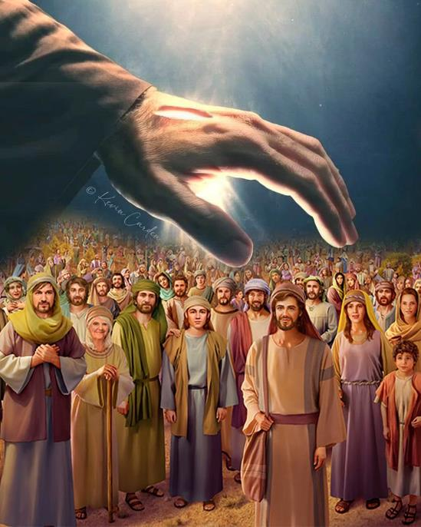
ʻALOʻOFA MAʻA E KAKAI ʻO ʻISILELI
(SŌSIUA 2:1, 22-24)

Slide 5


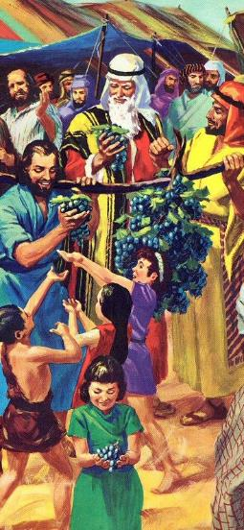
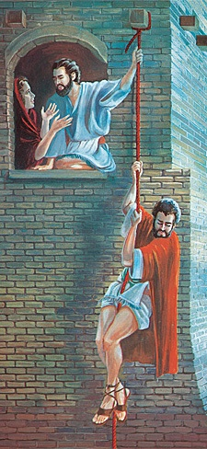
FAINGAMĀLIE HONO UA
“Pea naʻe fekau ʻe Siosiua, ko e foha ʻo Nuni, ʻae ongo tangata mei Sitimi, kena fakaʻasiʻasi fakafufū pē, ʻo ne pehē, Mo ō ʻo vakai ʻae fonua, ʻio, ʻa Seliko.” (Sosiua 2:1)
‘I he taimi na‘e fekau atu ai ‘e Mōsese ha kau sipai ke nau sivisivi‘i ‘a Kēnaní, na‘e fakafisi ‘a e kakaí ke nau hū ki ai. ‘I he ta‘u ‘e fāngofulu ki mui aí, na‘e fekau‘i atu ai ha kau asiasi fo‘ou, pea na‘e kehekehe ‘a e olá.
‘Oku fekau‘i atu ha kau faka’asi’asi
Fakahāhā (faka’asi’asi ʻe toko 12)
Fakapulipuli (faka’asi’asi 2)
Fakahoko 'o e kau faka’asi’asi
'aho 'e 40 'o e sivi
'Aho 'e 3 'i he fūfū .
Lipooti ʻa e kau faka’asi’asi
ʻOku nau fakalotosiʻi ʻa e kakaí .
‘Oku nau fakalototo‘a‘i ‘a Sosiua .
Neongo kuo tōnounou lahi ‘a e to’utangata fo’ou ‘i he fehangahangai mo e ‘ahi’ahi ‘a Pelami, ka na’e ‘oange ‘e he ‘Otua ha faingamalie hono ua kiate kinautolu (Nōmipa. 25:1-3, 31:16; Sosiua. 2:1).
Ko e taimi ko ení na‘e ‘ikai ha ngaahi fu‘u kālepi, ‘ikai ha ngaahi fua ‘o e fonuá. Ko e talanoa pe ‘o e tui (‘a Lehapi), ‘a ia na’a ne fakalotolahi’i ‘a ‘Isileli ke nau ma’u ‘a e Fonua ‘o e Tala’ofa.

Slide 6
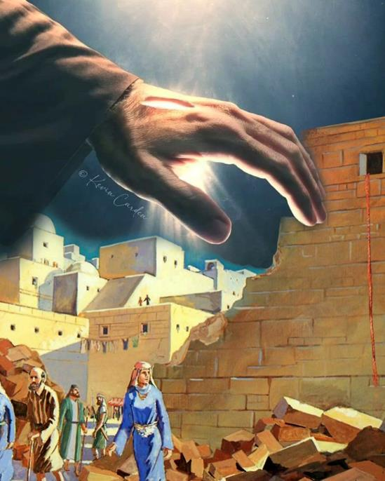
KELESI MO LĒHAPI .
( SŌSIUA 2:​2-21 )

Slide 7

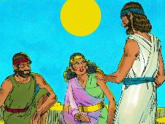
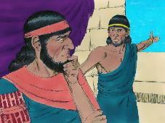
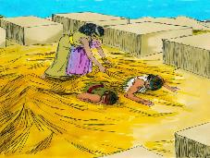
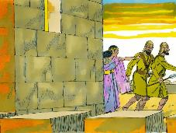
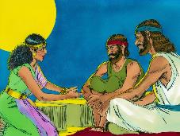
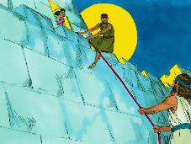
KO E TUI ‘A HA TENGA‘I MUSITA .
“Ko e tui naʻe ʻikai ʻauha ai ʻa Lehapi, ko e fefine feʻauaki, fakataha mo kinautolu naʻe ʻikai tui, ko ʻene tali lelei pe ʻae kau mataki.” (Hepelū 11:31)
Ko e hā na‘e makatu‘unga ai ‘a e tui ‘a Lēhapí (Siosiua. 2:9-11)?
Fakatokanga‘i ‘oku lea ‘a Lēhapi ki he ngaahi me‘a na‘e hoko ‘a ia na‘e ‘ilo ki ai ‘a e tokotaha kotoa pē, hangē ko e kolosi ‘i he Tahi Kulokulá. Ka lolotonga ‘a e manavahē ‘a e ni’ihi ki he ‘Otua ‘o e kau Hepelū, na’a ne fili ke hūfanga ki hono lalo kapakau (Sosiua. 2:12-13).
Ko e hā, kapau na‘á ne tui ki he ‘Otuá, na‘á ne ngāue‘aki ai ha loi ke tokoni‘i ‘aki ‘a e kau asiasí .?
Naʻe ʻikai ke fakahuʻunga ʻe heʻene tui foʻoú ha mahino kakato ki he finangalo ʻo e ʻOtuá. Na‘á ne ngāue ‘i he lelei taha na‘á ne lavá ke tokoni‘i ‘a e kau asiasí pea fakahaofi ‘ene mo‘uí mo hono fāmilí. ʻE hoko mai ʻamui ange ʻa e ʻiló.
‘Oku fakaongoongolelei‘i ia ‘e he Tohitapú ‘i he fili na‘á ne faí; koe‘uhi ko ‘ene mahino‘i ‘a e founga ngāue ‘a e ‘Otuá; pea mo e founga naʻá ne poupouʻi ai ʻene ngaahi leá ʻaki ha ngaahi ngāue pau ( Sēmisi 2:25 ).
Ko Lēhapi ko ha sīpinga ia ‘o e me‘a na‘e mei hoko ki ha taha pē ‘o e kau nofo ‘i Selikō na‘á ne tukulolo ki he ‘Otuá.

Slide 8
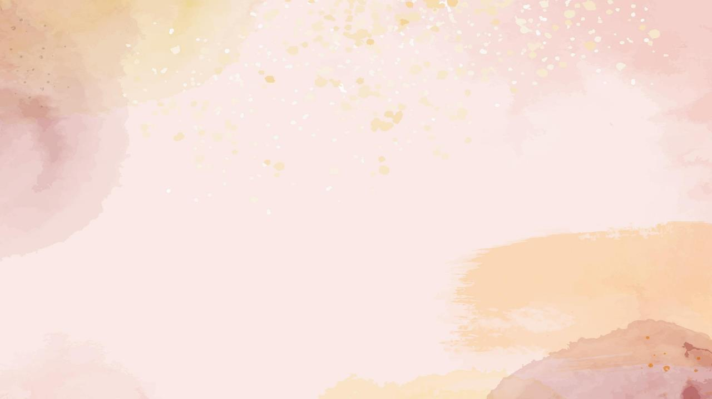
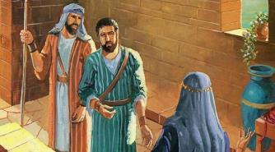
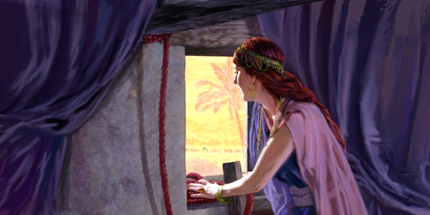
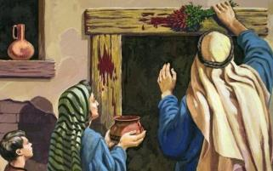
KO E FUAKAVA NA'E FAKALAHI KIA LĒHAPI
“Pea ʻe pehē, ʻilonga ʻaia ʻe hū kituʻa ʻi he matapā ʻo ho fale ki he hala, ʻe ʻi hono ʻulu pē ʻa hono toto, pea ʻe taʻehala ʻakimaua: pea ʻilonga ʻaia ʻe ʻiate koe ʻi he fale, ʻe ʻi homa ʻulu hono toto, ʻo kapau ʻe ala ʻe ha nima kiate ia.” (Sosiua 2:19 )
ʻIsileli ʻi he Laka Atú .
Na‘e pau ke nau pani ‘a hono ‘ulu‘i ‘aá ‘aki ‘a e toto .
( ‘Eki. 12:7 )
Kapau na‘a nau mavahe mei ‘api, na‘a nau mate (‘Eki. 12:13 )
Ko Lehapi ‘i Sēliko .
Naʻe pau ke ne ʻai ha afo kulokula ki hono matapā sioʻatá
( Sios. 2:18 )
Kapau na‘á ne mavahe mei he falé, na‘á ne mate .(Sios. 2:19)
Naʻe ʻikai lava ke fakakikihiʻi ʻa e fakakaukau fakalūkufua ʻa Lēhapí: Kuó u ngāue angaʻofa [hesed] ʻo fakahaofi koe; ko eni ke ke fai angalelei ‘o fakahaofi au mo hoku kāinga (Sosiua. 2:12-13).
Neongo na’e ‘ikai ke ne ‘ilo ki ai, ka na’e kole ‘e Lehapi kia ‘Isileli ke nau fai kiate ia ‘o hange ko e ngaue ‘a e ‘Otua tonu ki ‘Isileli, ‘a ia ko e anga’ofa [hesed] (Tet. 7:12).
Na‘e kole ‘e he kau asiasí kia Lēhapi ke ne fakahoko ‘a e ngaahi tu‘unga tatau pē na‘a nau fakakakató ke nau hao ai mei he mate ‘i ‘Isipité. ‘I he founga ko ení, na‘e fakakau ai ia ‘i he fuakava ‘a e ‘Otuá mo ‘Isilelí.

Slide 9
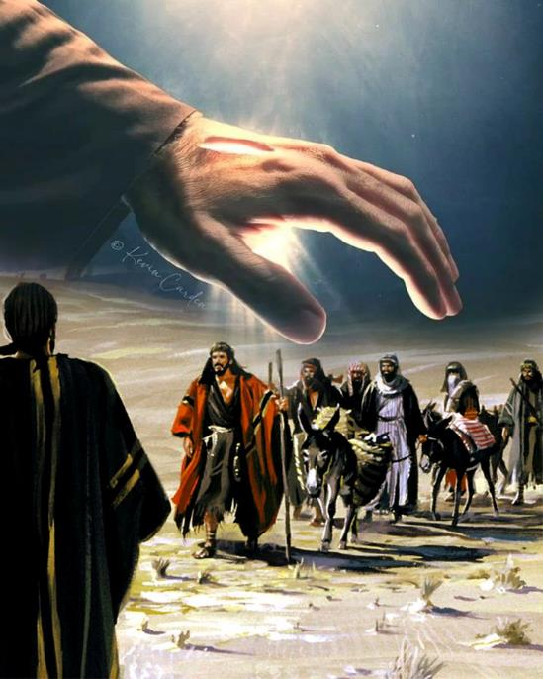
KELESI MO E KAU KIPIONE .
(SIOSUA 9)

Slide 10


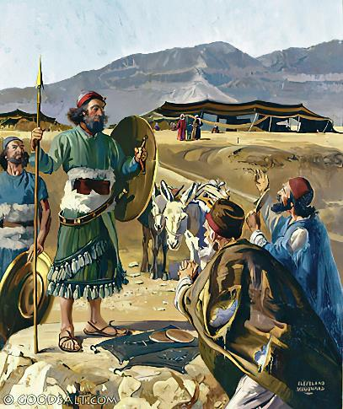
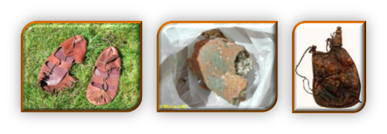
KAU 'AMIPASITOA KĀKĀ
“Pea naʻa nau ʻalu kia Siosiua ʻi he ʻapitanga ʻi Kilikali, ʻonau pehē kiate ia, pea ki he kau tangata ʻo ʻIsileli, “Kuo mau haʻu mei he fonua mamaʻo: pea ko eni te tau alea mo kimoutolu.”” (Sosiua 9:6)
Fakatokanga‘i ‘a e ngaahi me‘a ‘oku faitatau mo faikehekehe ai ‘a Lēhapi mo e kau Kipioné:
Ngaahi ʻElemēniti ʻo e Tuí | Lēhapi | Ko e kau Kipione .
Makatu'unga | Fanongo (2:10) | Fanongo(9:3)
Founga | Loi (2:4-5) | Loi(9:4)
Taumu’a | Ke fakahaofi (2:13) | Ke fakahaofi (9:24)
Ngaahi Ola Vave | Fakahaofi (6:23) | Fakahaofi (9:26)
Ngaahi Ola taimi lōloa | tangataʻi fonua kakato (6:25) | Ko e Sevāniti (9:27)
Na‘e loi fakafokifā ‘a Lēhapi ke fakatau‘atāina‘i ‘a e kau asiasí. Kae kehe, na‘e loi ‘osi fakakaukau‘i ‘a e kau Kipioné, ‘o fakataumu‘a ke kākaa‘i, ‘o ngāue‘aki ‘a e kākaá (vakai, Sēnesi 3:1 ). ‘Ikai ngata ai, ka na’e tō ‘a e kau taki ‘o ‘Isileli ‘i he ‘ikai ke nau fehu’i ki he ‘Otua (Siosiua. 9:14).
Na’e tuku kinautolu ‘e he me’a ni ke nau ‘i ha tu’unga faingata’a: faka’auha ‘a e kau Kipione, pe faka’apa’apa’i ‘a e fuakava (Siosiua. 9:18).

Slide 11

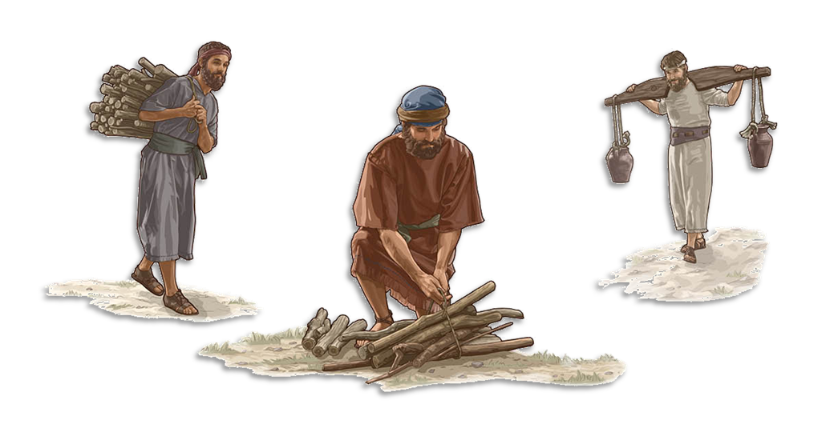
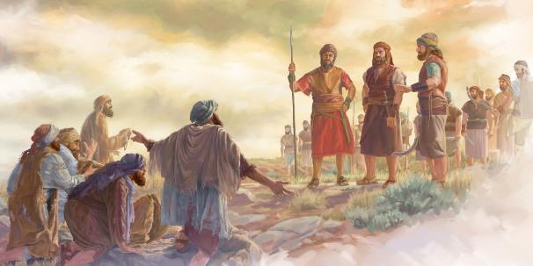
KO E TAPUAKI MO E MALA'IA .
“Pea ko eni, ʻoku malaʻia ʻakimoutolu, pea ʻe ʻikai fakatauʻatāina hamou tokotaha mei he pōpula, ka ko e kau tā fefie mo e kau ʻutu vai ʻakimoutolu ki he fale ʻo hoku ʻOtua.”” (Sosiua 9:23)
Ko hono fakahaofi ‘o e mo’ui ‘a e kakai Kipione, na’a ne mei talangata’a ai ki ha tu’utu’uni fakahangatonu mei he ‘Otua (Teut. 7:1-2). Ko hono maumauʻi ʻo ha fuakava ʻo hangē ko ia naʻe fuakava kiate kinautolú, naʻe lau foki ia ko e angahala (Sios. 9:19; Same 15:4). Na‘e anga-fēfē hono fakalelei‘i ‘a e palopalemá?
Na’e fakahaofi ‘enau mo’ui, ka na’e tuku kinautolu ki he mala’ia (Sios. 9:20-23). Ko e malaʻiá ke nau hoko ko e kau tamaioʻeiki mei he toʻutangata ki he toʻutangata. Na’e ‘ai kinautolu ‘e he me’a ni ke nau feohi vāofi mo e kakai ‘a e ‘Otua, ‘a ia na’e ‘ikai ‘aupito ke nau mavahe mei ai (Neh. 7:6, 25).
ʻ Ikai ngata aí, ko hono fetuku ʻ a e vaí mo e tā fefie ki he temipale ʻ o e ʻ Otuá naʻá ne tauhi kinautolu ke nau ofi maʻu pē ki he ʻ Otuá. Tuʻunga ʻi he ʻaloʻofa ʻa e ʻOtua, naʻe hoko ʻa e meʻa ko ia naʻe hoko ko ha fakamalaʻia ʻo hoko ko ha tapuaki. "ʻOku ʻikai te u manako ʻi he mate ʻa e angahala, ka ke nau tafoki mei honau ngaahi hala kae moʻui" (ʻIsi. 33:11).

Slide 12

“Na’e pau ke nofo’i ‘e he fanau ‘a ‘Isileli ‘a e vahefonua kotoa pe na’e vahe’i ‘e he ‘Otua kiate kinautolu. Ko e ngaahi pule’anga ko ia na’a nau fakafisinga’i ‘a e lotu mo e tauhi ‘o e ‘Otua mo’oni na’e pau ke kapusi kinautolu. Ka ko e taumu’a ‘a e ‘Otua ke tohoaki’i mai ‘a e kakai ‘i he fakahaa’i ‘o Hono ‘ulungaanga ‘o fakafou ‘ia ‘Isileli. ko e fefine Mōapé, ‘a ia na‘a nau tafoki mei he tauhi ‘aitolí ki he lotu ki he ‘Otua mo‘oní, na‘e pau ke nau fā‘ūtaha mo ‘Ene kakai kuo filí.”
EGW (Ko e Ngaahi Lesoni Fakataumuʻa ʻa Kalaisi, p. 290))

