Slide 1
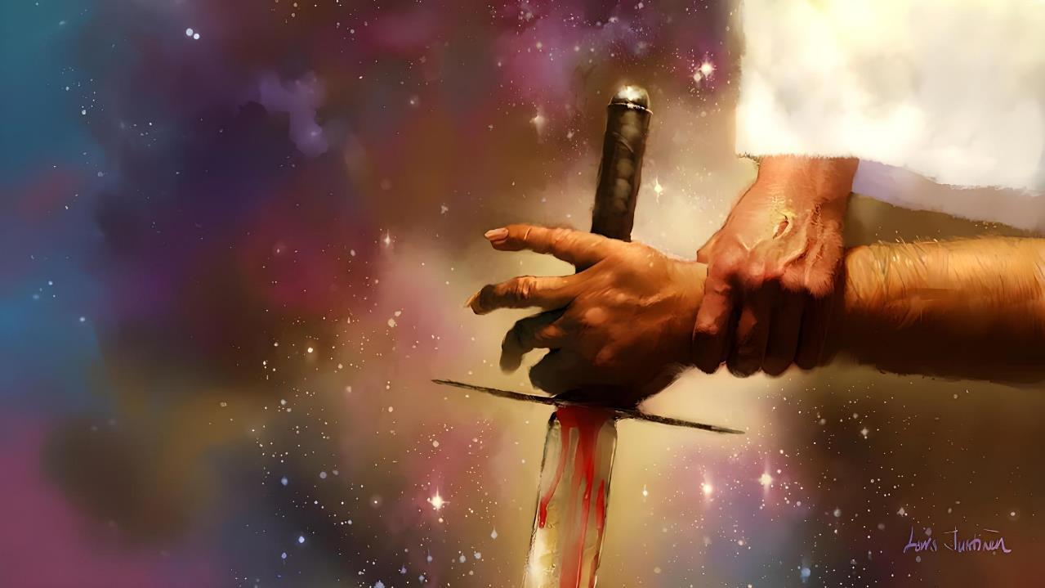
KO E FEPAKI 'I MUI 'I HE NGAAHI FEPAKI KOTOA
Lesoni 4 ki he ʻaho 25 ʻo ʻOkatopa 2025

Slide 2
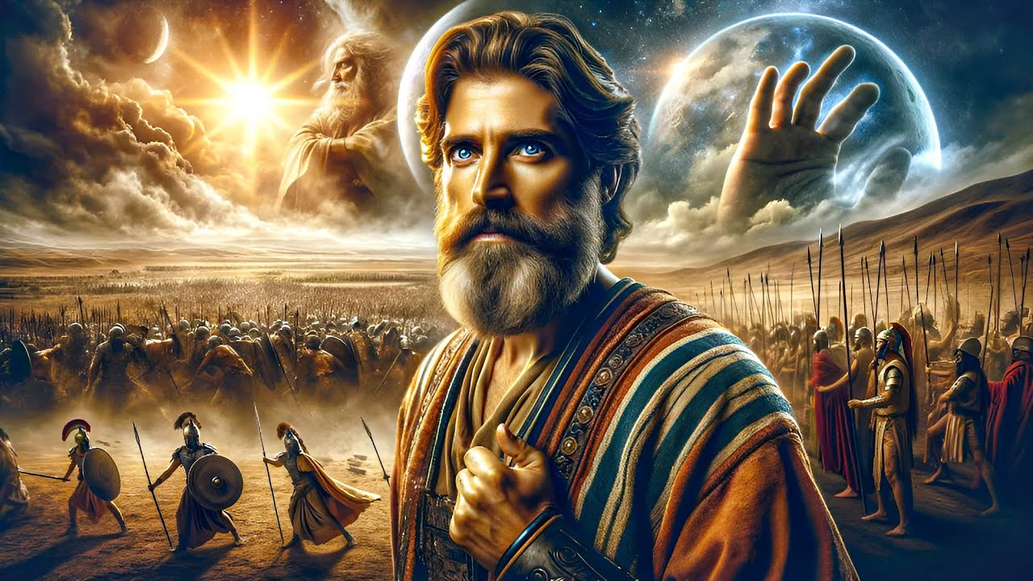
“Pea naʻe ʻikai ha ʻaho ʻo hangē ko ia ʻi muʻa pe kimui ʻo ia, koeʻuhi ke tokanga ʻa Sihova ki he leʻo ʻoe tangata: he naʻe tau ʻa Sihova koeʻuhi ko ʻIsileli.”
Sōsiua 10:14

Slide 3

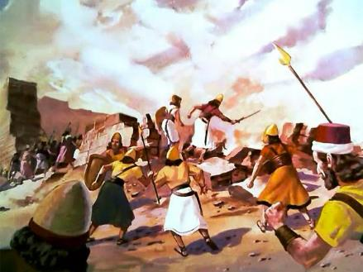
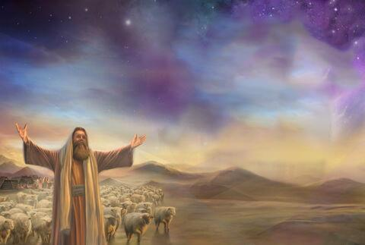
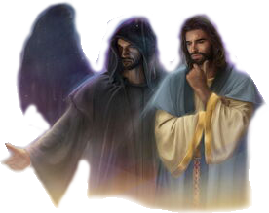
Ko hono ikunaʻi ʻo Kenani ko ha tau fakaʻauha ia naʻe tuʻutuʻuni ʻe he ʻOtua. Ka ʻo kapau ko e ʻOtua ko e ʻofa, ko e ha naʻa ne tuʻutuʻuni ai ha fakapo fakatokolahi pehe?
Ke maʻu ha vakai ki he ngaahi ʻuhinga ʻo e ngaahi meʻa ko ʻeni naʻe hoko, ʻoku fie maʻu ke tau vakai ki ai.
Kuo pau ke tau fakalahi ʻetau vakai ʻo fakalaka atu ʻi he meʻa ʻoku ha mai, kae ʻoua kuo tau lava ʻo fakatokangaʻi ʻa e fepakipaki ʻoku tupu mei he ngaahi fepakipaki kotoa pe (kau ai hono ikunaʻi ʻo Kenani): ko e fepaki lahi ʻi he vahaʻa ʻo Kalaisi mo Setane, ʻi he vahaʻa ʻo e lelei mo e kovi.
Ko e ngaahi faʻahi ʻoku fepaki:
Ko e kau tau ʻa e Pilinisi ʻo e ʻOtua.
Ko e pilinisi ʻo e kau tau ʻa e kovi.
Ko e tangata tau malohi taha.
Ko e ngaahi founga ʻo e fepakipaki:
ʻOku tau ʻa e ʻOtua maʻatautolu.
ʻOku tau tau maʻa e ʻOtua.

Slide 4
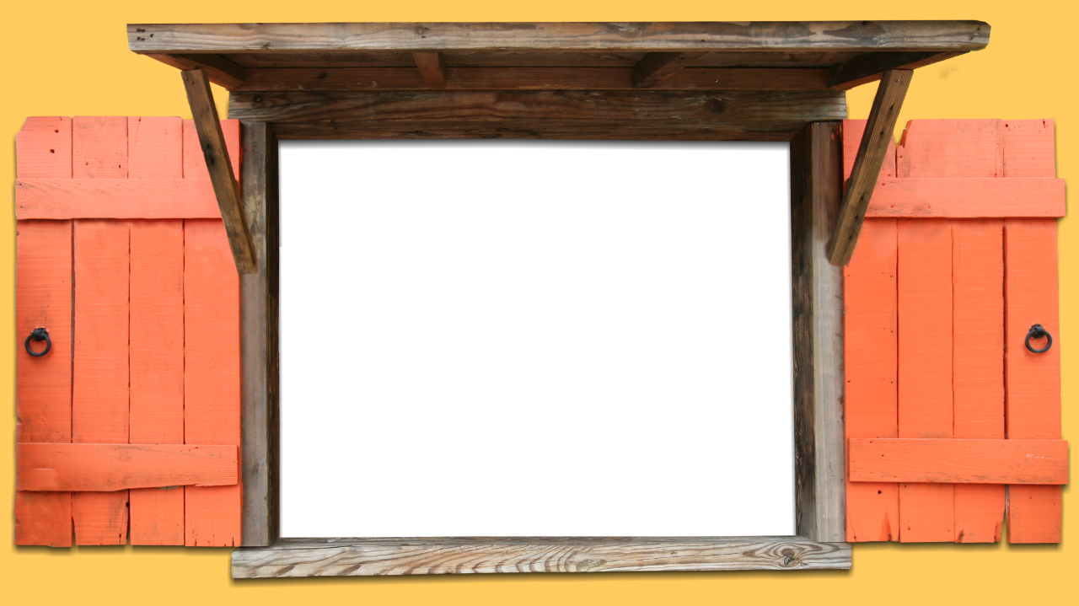
KO E NGAAHI FAʻAHI ʻOKU FEPAKI

Slide 5


KO E PILINISI ʻO E KAU TAU ʻA E ʻOTUA
Naʻa ne tali mai, "ʻIkai, ka kuo u haʻu ʻeni ko e pule ʻo e kau tau ʻa e ʻEiki." Pea naʻe to hifo ʻa Siosiua foʻohifo ki he kelekele ʻi he loto ʻapasia, ʻo ne fehuʻi kiate ia, "Ko e ha ʻa e popoaki ʻa hoku ʻEiki ki heʻene tamaioʻeiki?" (Sosiua 5:14)
ʻI he lotu ʻa Sosiua ofi ki Sieliko ʻo fekumi ki ha fakahinohino fakalangi ke maʻu ʻa e kolo, naʻe tuʻu ʻi muʻa ʻiate ia ha tangata tau kuo unuhi ʻene heletaa (Sosiua 5:13).
ʻ I hono fakafehuʻi ʻ e Siosiuá, naʻe fakaʻikaiʻi ʻ e he tangatá ni ʻ a ʻ ene kau ki ha faʻahinga kongakau fakaemāmaní. Ko e Pule ia ʻo e kau tau ʻa e ʻOtua (Sosiua5:14).
ʻI heʻene fie maʻu ʻa e lotu, naʻa ne fakahaaʻi ai ko e ʻOtua tonu ia, ʻi he tokotaha ʻo Sisuʻa ia naʻe ʻiloa ko Maikeli ʻi he tohi ʻa Taniela (Sosiua 5:15; Taniela 12:1).
Naʻe tali ʻa e lotu. ʻ I he fiemālie ʻ a Siosiuá, ko e ʻ Otuá tonu naʻá ne puleʻi ʻ a e ngāué. ʻI heʻene hoko ko e ʻeikitau ʻo ʻIsileli, naʻe pau ke muimui pe ʻa Sosiua ki he ngaahi tuʻutuʻuni ʻa e ʻeikitau pule moʻoni: ʻa e ʻOtua.

Slide 6

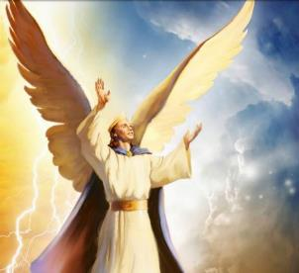
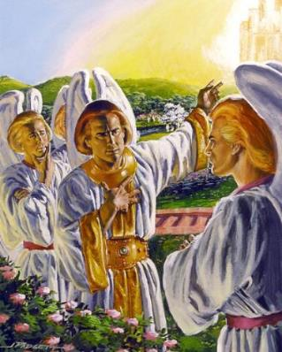
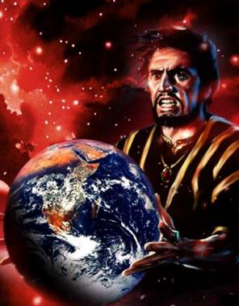
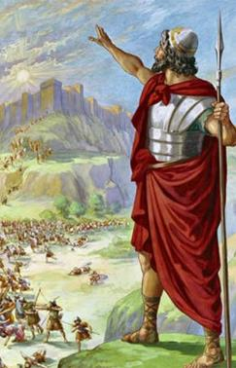
KO E PILINISI ʻO E KAU TAU ʻO E KOVI
“ʻE Lusifā, ko e foha ʻoe pongipongi! Hono ʻikai tō hifo koe mei he langi! Hono ʻikai tuʻusi ki lalo koe ki he kelekele, ʻa koe ne ke fakavaivaiʻi ʻae ngaahi puleʻanga!”(‘Isaia 14:12)
Te tau lava ʻo pehe naʻa ne faʻu ʻa e tau. Naʻe faʻeleʻi ia ko ha pilinisi; ko ha selupi ʻo e tuʻunga maʻolunga taha; ʻi he tafaʻaki ʻo e ʻOtua; lue ʻi he malala vela; mahuʻinga; haohaoa... (ʻIsikeli28:12-15).
ʻI hono fakakoloaʻi ʻaki ʻa e tauʻataina ke fili – hange ko e kakai poto kotoa pe naʻe fakatupu ʻe he ʻOtua – naʻe fili ʻa Lusifa ke angatuʻu mo faʻao ʻa e taloni ʻo e ʻOtua (ʻIsaia 14:12-14).
Neongo naʻe ʻikai lavameʻa ʻene angatuʻu, kuo lomekina ʻa e ʻunivēsí ʻe he tau talu mei ai. ʻ I hono puleʻi ʻ e Sētane mo ʻ ene kau ʻ āngeló ʻ a e māmaní, ʻ oku ʻi ai ʻ a e taumuʻa pē ʻ e taha: ke taʻofi ʻ a e ngaahi palani ʻ a e ʻ Otuá ke fakahaofi ʻ a e matakali ʻ o e tangatá.
Ko hono ikunaʻi ʻo Kenani ko ha tau mahuʻinga ia ʻi he tau ko ʻeni.

Slide 7

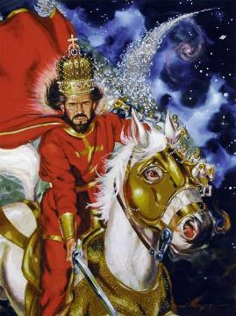
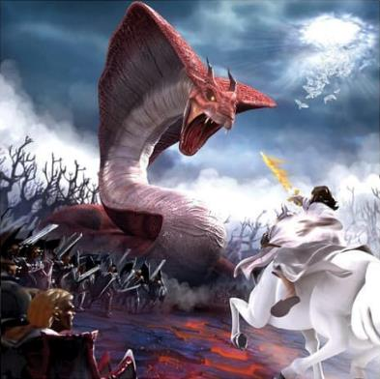
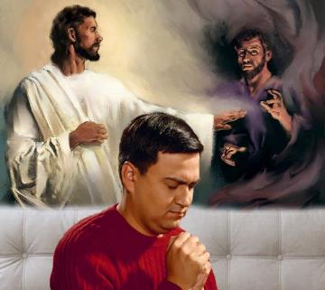
KO E TANGATA TAU MALOHI TAHA
"Ko e tangata tau ʻa e ʻEIKI; ko e ʻEIKI ʻa hono huafa" (ʻEkesotosi 15:3)
ʻOku fakahaaʻi tonu ʻa e ʻOtua ko ha "tangata tau," ko e tangata tau malohi taha ia ʻi he tau. (ʻEkesotosI 15:3; Saame 24:8).
Ka ʻoku ʻikai ke tau ʻa e ʻOtua mo e faʻahinga ʻo e tangata, ka mo e ngaahi malohi fakalaumalie ʻoku nau pikitai ki ai. Ko ia ai, ʻoku fakahaaʻi ʻa e ngaahi mahaki fakaʻauha ko ha tau mo e ngaahi ʻotua ʻo ʻIsipite, ʻa ia ko e kau tevolo (ʻEkesotosi 12:12; Teu. 32:17)
ʻOku finangalo ʻa e ʻOtua ke fakaʻauha ʻa e kovi mei he mamani. Ko ia ai, naʻa Ne kapusi mei Kenani ʻa kinautolu naʻa nau fili ke kau mo Setane, pea foaki ʻa e fonua ki he kakai naʻa nau kau mo Ia.
ʻI he ʻaho ni ʻoku kei hokohoko atu pe ʻa e tau, ka ʻoku ʻikai ko e feituʻu. Ko e tau maʻa e famili takitaha, maʻa e tokotaha fakafoʻituitui. ʻOku ʻikai ke ʻi ai ha tuʻunga ʻoku ʻikai kau ki ha tafaʻaki. ʻOku tau ʻi he ʻOtua pe ko e fili.

Slide 8
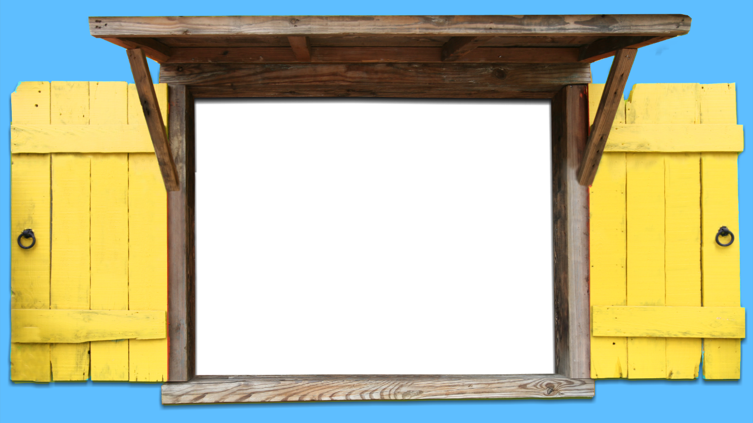
KO E NGAAHI FOUNGA ʻO E FEPAKIPAKI

Slide 9

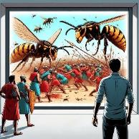
'OTUA 'OKU TAU MA'A KITAUTOLU
“E tau ʻa Sihova maʻamoutolu, pea te mou fakalongo pe.”(Ekisotosi 14:14)
Na‘á ne fakangoto ‘a e kau tau ‘Isipité ‘i he Tahi Kulokulá ( ‘Eki. 14:24-28 )
Naʻá ne ngāueʻaki ʻ a e ʻ uha maka ki he kau Kēnani (Siosua 10:11)
Naʻa Ne fakaʻauha ʻa kinautolu naʻa nau fehiʻa kia ʻIlaisiaa (2 Ngaahi Tuʻi 1:9-10)
Naʻa Ne fekauʻi atu ha fanga pea ke tauʻi ʻa kinautolu naʻa nau manukiʻi ʻa ʻIlaisa (2 Ngaahi Tuʻi 2:23-24)
Naʻa ne maʻu ʻa e melino ʻaki hono fakakuihi ʻa e kau tau Silia (2 Ngaahi Tuʻi 6:14-23)
Naʻa ne ʻai ʻa e kau ʻAmoni mo e kau Moape ke tau (2Kol. 20:15-17, 22-24)
Naʻa ne tamateʻi ʻa e kau ʻAsilia ʻe toko 185,000 ʻi he po pe ʻe taha (2 Ngaahi Tuʻi 19:35)
Naʻa Ne ʻoatu ha mahaki fakatupu mate kia Helota (Ngāue 12:21-23)
Ko e fuofua fokotu’utu’u ‘a e ‘Otua ke ikuna’i ‘a Kenani ‘aki ‘a e ngaahi founga fakanatula, ‘o ‘ikai fiema’u ke fai ha tau ‘a ‘Isileli (Ekisotosi 23:28). Kapau na'e 'ikai ko e ta'etui 'a e kakai na'e mei hoko 'a e me'a ni.
‘Oku lēkooti ‘e he Tohi Tapú ‘a e ngaahi fakatātā ‘e ni‘ihi ‘o e me‘a ‘e lava ke fai ‘e he ‘Otuá ke fakahaofi ‘a hono kakaí, ‘o ‘ikai fiema‘u ke nau to‘o ha me‘atau ki honau ngaahi filí:

Slide 10

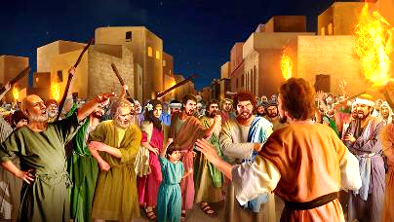
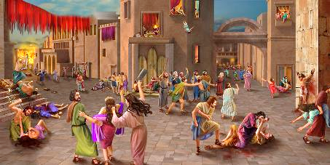

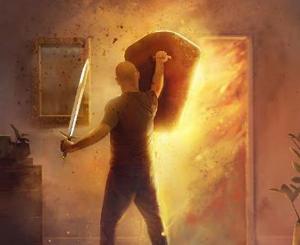
ʻOKU TAU TAU MAʻA E ʻOTUA
“Pea naʻa nau fakaʻauha ʻaia kotoa pē naʻe ʻi he kolo, ʻae tangata mo e fefine, ʻae talavou mo e mātuʻa, mo e fanga pulu, mo e ʻasi, mo e sipi, ʻaki ʻae mata ʻoe heletā. ” (Sosiua 6:21)
Hange ko e kau Kēnani ʻi muʻa, pe ko Sotoma mo Komola, naʻe fakalaka atu ʻa e kau Kēnani ʻi he ngaahi fakangatangata ʻo e ʻaloʻofá, pea naʻa nau kau fakataha mo Setane (Senesi 6:5; 18:20-21; 15:16).
Naʻe fakataumuʻa kotoa kinautolu ki he mate ʻanga ua, ʻa e mate taʻengata. He ʻikai liliu honau ikuʻanga aofangatuku ʻi hono fakaloloa ʻenau moʻui heni. Pea naʻe fakaʻata ʻe he ʻOtua ʻa ʻIsileli, ʻi he taimi ko ʻeni (ko hono kapa ʻo Kenani), ke nau kau longomoʻui ʻi he tamate.
Ko e ha ʻoku ʻikai ke Ne fai tonu ai ia, ʻo hange ko ia naʻa Ne palani? Koeʻuhi ko ʻenau taʻetui. Naʻe fuofua ʻahiʻahiʻi ʻe ʻIsileli ʻa e tau hili ʻenau pehe, "ʻOku ʻiate kitautolu ʻa e ʻEiki pe ʻikai?" (ʻEkesotosi 17:7-9).
ʻI heʻetau kau longomoʻui ʻi he tau (fakatuʻasino kiate kinautolu, fakalaumalie kiate kitautolu), ʻoku tau fakatupulaki ai ha falala taʻefakangatangata ki he tokoni ʻa e ʻOtua.

Slide 11

"Kuo pau ke fai ʻa e ngaahi tau ʻi he ʻaho kotoa pe. ʻOku hoko ha fuʻu tau lahi ki he laumalie kotoa pe, ʻi he vahaʻa ʻo e pilinisi ʻo e fakapoʻuli mo e Pilinisi ʻo e moʻui.... ʻI hoʻomou hoko ko e kau fakafofonga ʻo e ʻOtua, kuo pau ke mou tukulolo kiate Ia, koeʻuhi ke Ne lava ʻo palani mo tataki mo fai ʻa e tau maʻau, ʻi hoʻomou fengaueʻaki. ʻOku taki ʻa e Pilinisi ʻo e moʻui ʻi Heʻene ngaue. Kuo pau ke Ne ʻiate koe ʻi hoʻo fefaʻuhi fakaʻaho mo koe, koeʻuhi ke ke tuʻu maʻu ʻi he tefitoʻi moʻoni; koeʻuhi ko e holi, ʻi he taimi ʻoku tau ai ke mapuleʻi, ʻe lava ke fakavaivaiʻi ia ʻe he ʻaloʻofa ʻa Kalaisi; ʻoku ke ikuna lahi ange ʻiate Ia naʻa Ne ʻofa kiate kitautolu."
EGW (Fepakipaki mo e Loto-toʻa, ʻEpeleli 21)

