Slide 1
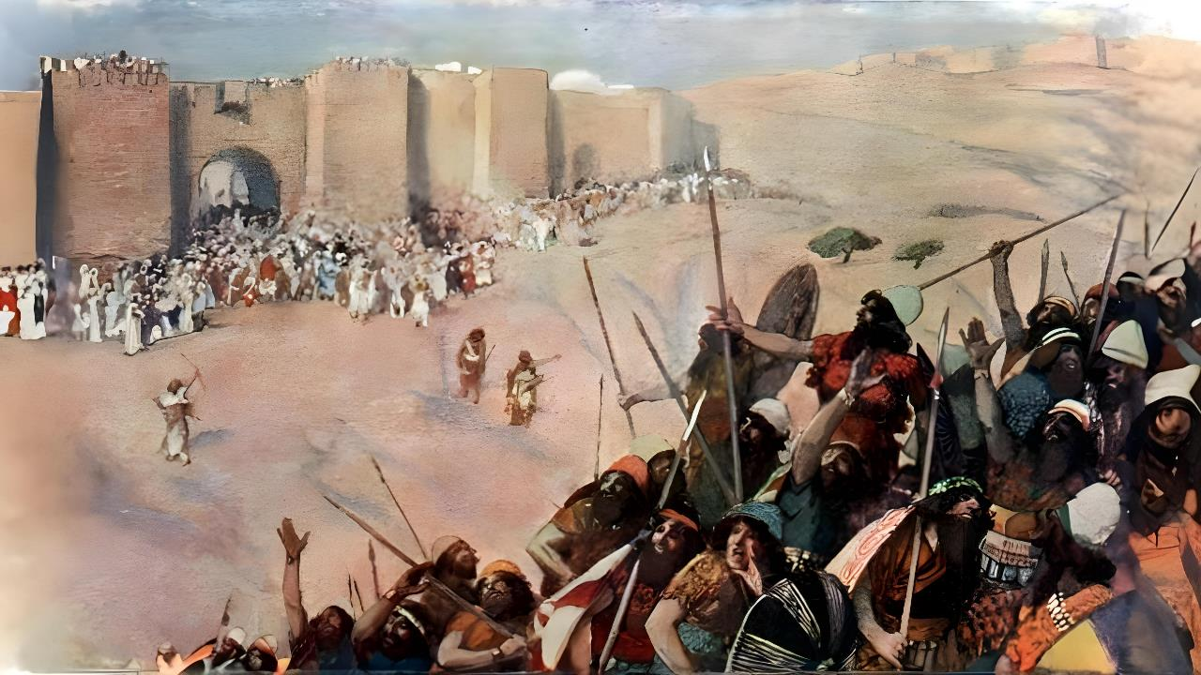
ʻOKU TAU ʻA SIHOVA
MAʻAU
Lesoni 5 ki he ʻaho 1 ʻo Nōvema 2025

Slide 2

“Pea ko e ngaahi tuʻi ni mo honau fonua naʻe maʻu ʻe Siosiua ʻi he kuonga pe taha, he ko Sihova ko e ʻOtua ʻo ʻIsileli naʻa ne tau maʻa ʻIsileli.”
Sōsiua 10:42

Slide 3

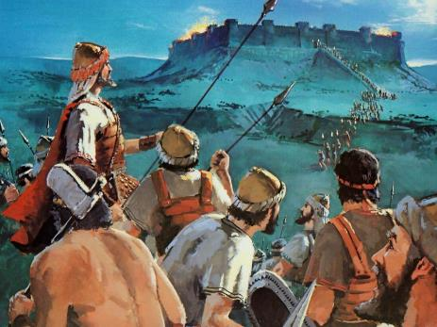
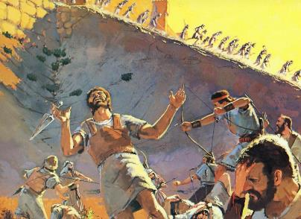
Ko hono mahino’i ‘o e tau na’e taki ai ‘a ‘Isileli ke nau ma’u ‘a e fonua ko Kenani, ‘oku ‘ikai ko ha me’a faingofua.
Hangē pē ko e ‘ikai ‘aupito fakataumu‘a ‘e he ‘Otuá ke ‘i ai ‘a e angahalá, na‘e ‘ikai foki ke ne fakataumu‘a ke ‘i ai ‘a e taú.
Ko ia ko e hā na‘e mate ai ‘a e kakai tokolahi? 'E lava nai ke lau 'a e tau ko ia ko e "tapu"?
Ke mahino kiate kitautolu ‘a e palopalemá ni, kuo pau ke tau fakatotolo‘i loloto ‘a e fakakaukau fakatohitapu ‘o e taú pea mo e ngaahi tu‘unga-lea fakae‘ulungaanga ‘oku ‘i he tu‘unga fakatu‘utāmaki ‘i he momeniti mahu‘inga ko ia ‘i he hisitōliá.
Ko ha meʻa ʻo e angahala
Ko ha meʻa ʻo e fakamaau totonú
Ko e fakakaukau fakatohitapu ki he tau
Faka'auha 'e he'enau fili 'anautolu
Fekumi ki he melinó

Slide 4

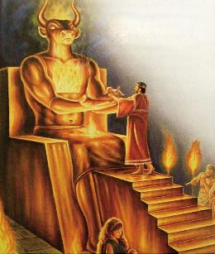
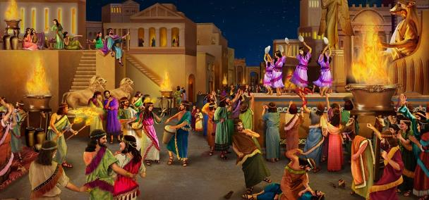
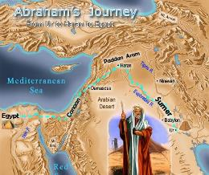
KO HA MEʻA ʻO E ANGAHALA
“Pea ʻi hono fā ʻoe toʻutangata te nau toe haʻu ki heni; he ʻoku teʻeki ai fonu ʻae angahala ʻae kakai ʻAmoli.”” (Senesi 15:16)
Kuo fakahaaʻi ʻ e he keli fakatotoló ko e lotu ʻ a Kēnaní ko e meʻa tofu pē ia ʻ oku leaʻaki ʻ e he Tohi Tapú: ko e ngāue fakafaimana, vavalo, fetuʻutaki mo e kau maté, fakahaʻele faʻahikehé... mo e feilaulau ʻo e fanau! (Teu. 18:9-12).
Kuo pau ke tanaki atu ki heni ʻa e ouau ʻo e "paʻumutu toputapu" – ʻa ia naʻe siʻisiʻi ʻene fekauʻaki mo e toputapu – ʻa ia naʻe fakahoko ʻe he kau taulaʻeiki mo e kau taulaʻeiki fefine fakatouʻosi.
Neongo naʻe ʻosi angamaheni ʻaki ʻa e ngaahi toʻonga ko ʻeni ʻi he taimi ʻo ʻEpalahame, naʻe ʻoange ʻe he ʻOtua kiate kinautolu ha taʻu ʻe 400 tupu ke fakatonutonu ʻenau toʻonga.
Fakaʻosí, ko e ngaahi ouau taʻefeʻunga ko ení, ʻ a ia naʻá ne holoki ʻ a e tuʻunga fakaeʻulungaanga ʻ o e kakaí pea pouaki ai ʻ a e faʻahinga kovi kotoa pē, naʻe pau ke fakangata ia. ʻE taʻofi ʻe hono fakaʻauha ʻo e kau Kenani—ʻi ha vahaʻataimi—ʻa e holoki fakaeangamaʻa ʻo e faʻahinga ʻo e tangata.

Slide 5

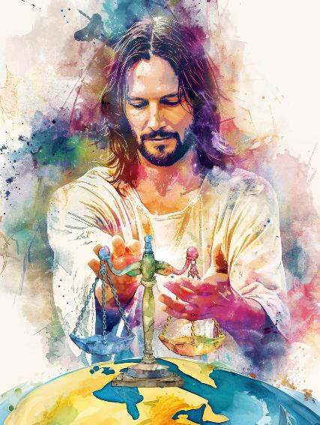
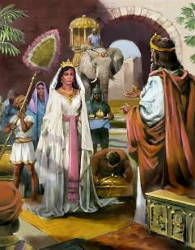
KO HA MEʻA ʻO E FAKAMAAU TOTONU
"ʻOku fakamaau ʻe he ʻOtua ʻae māʻoniʻoni,pea ʻoku houhau ʻae ʻOtua ki he angakovi ʻi he ʻaho kotoa pē.Kapau ʻe ʻikai te ne tafoki, te ne fakamata ʻa ʻene heletā;kuo ne teteke ʻene kaufana, ʻo teuteu ia." (Saame 7:11-12)
Ko e ʻofa mo e fakamaau totonu ʻa e fakavaʻe ʻo e ʻulungaanga ʻo e ʻOtua. ʻOku hoko ʻeni ko ha fakamaau totonu mo taʻefilifilimanako, ʻa ia ʻoku ne fakatoloi ʻa e tautea koeʻuhi ke ului ʻa e tokotaha faiangahala, ka he ʻikai ke ne katakiʻi ʻa e kovi ʻo taʻengata.
Ko e tau ke ikunaʻi ʻ a Kēnaní naʻe ʻ ikai fai ia ʻ i he ngaahi ʻ uhinga fakaʻemipaeá, ka ʻ i he tuʻutuʻuni fakaʻotua ke fakahoko ʻ a e tautea naʻe tuha mo hono kakai fulikivanú.
Ko e finangalo ʻo e ʻOtua ke fokotuʻu ha puleʻanga totonu ʻi he vahefonua ko ia, ʻa ia ʻe hoko ko ha faʻifaʻitakiʻanga ki he ngaahi puleʻanga kotoa pe, ʻo fakaʻaiʻai kinautolu ke hiki hake ʻenau ngaahi fakakaukau fakaeangamaʻa, pea aʻusia ai ha tuʻunga ʻo e melino mo e fakamaau totonu ʻi mamani (Teut 4:5-6).
ʻI heʻene hoko ko ha tangata tau mo ha fakamaau, ʻoku tukupa ʻa e ʻOtua ke fakahoko, tuʻu maʻu mo tauhi ʻa e pule ʻa e lao, ʻa ia ko ha fakafotunga ia ʻo hono ʻulungaanga.

Slide 6

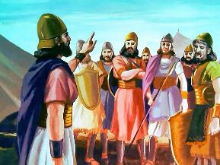
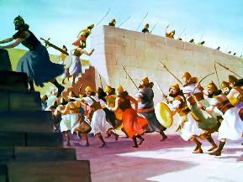
KO E FAKAKAUKAU FAKATOHITAPU ʻO E TAU
" Ko ia ke ke ʻilo he ʻaho ni, ko Sihova ko ho ʻOtua ko ia ia ʻoku ʻalu muʻomuʻa ʻiate koe; hangē ko e afi fakaʻauha te ne fakaʻauha ʻakinautolu, pea ʻe tulaki hifo ʻe ia ʻakinautolu ʻi ho ʻao: ko ia te ke kapusi ai ʻakinautolu kituʻa, ʻo fakaʻauha vave ʻakinautolu, ʻo hangē ko e folofola ʻa Sihova kiate koe.." (Teutalonome 9:3)
ʻI he tuʻunga Fakatohitapu, naʻe pau ke fakangatangata pe ʻa e ngaahi tau ki ha ngaahi tukunga pau pea naʻe fakaʻuhingaʻi tonu ia ʻe he ʻOtua. Ko e ngaahi lao ʻeni naʻa ne puleʻi ʻa e ngaahi tau kuo fakamafaiʻi ʻe he ʻOtua:
Naʻe ʻikai ngofua ke ʻi ai ha kau tau fakapalofesinale
Naʻe ʻikai totongi ʻa e kau sotia pea ʻi he taimi ʻe niʻihi naʻe ʻikai ke nau lava ʻo maʻu ʻa e koloa
Naʻe toki fakangofua pe ʻa e tau ki hono ikunaʻi pe maluʻi ʻo e Fonua ʻo e Talaʻofa ʻi he momeniti fakahisitolia ko ia
Naʻe tataki kinautolu ʻe he kau palofita naʻe ueʻi fakalaumalie ʻe he ʻOtua (hange ko Mosese pe Sosiua)
Naʻe fie maʻu ʻa e teuteu fakalaumalie kimuʻa ʻi he tau
Ko ha ʻ Isileli pē naʻe ʻ ikai te ne talangofua ki he ngaahi tuʻutuʻuni ʻ o e taú naʻe ngaohi ia ko ha fili
ʻ I he ngaahi taimi lahi, naʻe kau fakahangatonu mai ai ʻ a e ʻ Otuá ʻ i he taú

Slide 7

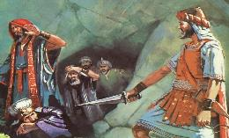
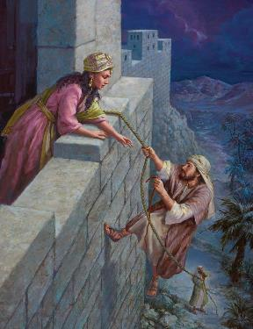
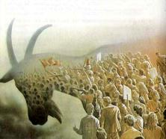
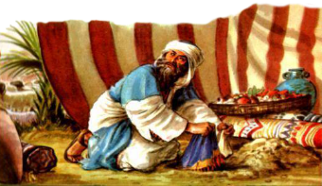
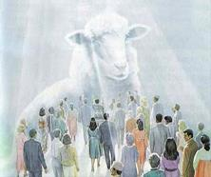
FAKAʻAUHA ʻE HEʻENAU FILI PE ʻANAUTOLU
“Naʻe pehē ʻae taaʻi ʻe Siosiua ʻae fonua kotoa pē ʻoe ngaahi moʻunga, pea mo e potu tonga, pea mo e tafangafanga, mo e ngaahi matavai, pea mo honau ngaahi tuʻi kotoa pē: naʻe ʻikai tuku ʻe ia ha niʻihi ke toe, ka naʻe fakaʻauha ʻakinautolu kotoa pē naʻe mānava, ʻo hangē ko e fekau ʻa Sihova ko e ʻOtua ʻo ʻIsileli.(Sōsiua 10:40)
Ko e feituʻu kotoa ʻ o Kenání naʻe fakahaaʻi ko e fakalielia, ʻ a ia ko e fakatapui ki he fakaʻauhá. Ko e meʻa moʻui kotoa pe naʻe pau ke mate (Teu. 20:16-18; Sosiua 10:40).
ʻE lava ke moʻui ʻa kinautolu naʻe fakataumuʻa ki he fakaʻauha naʻa nau talangofua ki he ʻOtua (Lehapi)
Ko e kau ‘Isileli na’a nau talangata’a ki he ‘Otua, na’e pau ke tamate’i kinautolu (‘Akani).
Neongo ia, naʻe ʻi ai ha ngaahi fakaʻata makehe:
ʻ I he ʻ ao ʻ o e ʻ Otuá, ko e kau Kēnani mo e kau ʻ Isilelí naʻe vakai tatau ki ai: taʻefilifilimānako. Ko e faikehekehe ko e fili ʻa e niʻihi ke vilitaki ʻi heʻenau angatuʻu ki he ʻOtua, lolotonga ia naʻe fili ha niʻihi ke talangofua kiate Ia.
ʻI he taimi ni, ʻoku kei ʻatautolu pe ʻa e fili. ʻI he haʻele mai ʻa Sisuu, ʻe fakamoʻui pe fakaʻauha kitautolu ʻe heʻetau fili.

Slide 8

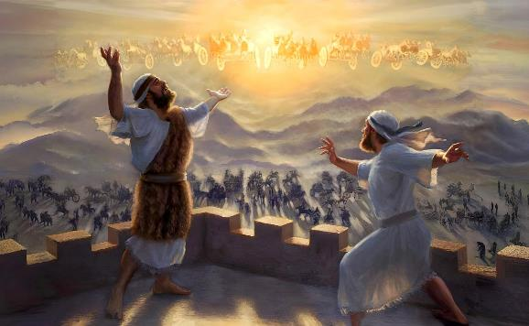
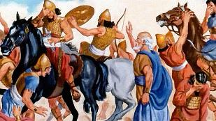
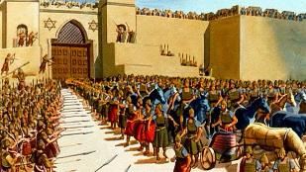
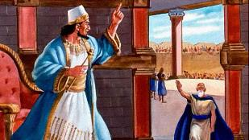
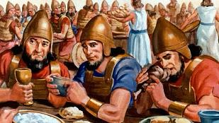
FEKUMI KI HE MELINO
“pea te u ngaohi ho kau fakamaau ko e melino,
pea mo ho kau pule ko e māʻoniʻoni.” (Isaia 60:17b)
ʻOku ui ʻa Sīsū ko e “Pilinisi ʻo e Melinó” ( ʻĪsaia 9:6 ). Na’a ne ha’u ke ‘omi ‘a e melino, pea te ne pule ‘i he melino (Sione 14:27; ‘Isaia 60:17).
Kae ‘oua kuo hoko ‘a hono pule‘anga ‘o e melinó ko ha me‘a mo‘oni, ‘oku tau kei ‘i ha vahefonua ‘oku tau, ‘o fakauku ‘i he fepaki fakamamani ‘i he vaha‘a ‘o e leleí mo e koví.
Ko e taimi naʻe ʻākoloʻi ai ʻe he kau tau Sīliá ʻa Totani ke puke ʻa e palōfita ko ʻIlaisá, naʻe ʻikai ke ne kole ki he ʻOtuá ke ʻai ʻe he kau tau fakalangi ʻoku nau ʻātakaiʻi iá ke nau fakaʻauha ʻa e kau Sīliá. Ka, na’a ne kole ke ne taki ‘a e kau tau Sīlia kuo fakakuihi ki Samēlia koe’uhi, ‘i he’ene a’u ki ai, te ne lava ‘o ‘omi ‘a e melino ‘i he vaha’a ‘o e ongo pule’anga ‘oku na fetau’aki (2 Tu’i 6:12-23).
Ko e sīpinga ʻeni naʻe akoʻi mai ʻe Sīsū kiate kitautolú: ke tau fekumi maʻu pē ki he melinó ʻi he fepakipakí. Ke ikuna’i ‘a e kovi ‘aki ‘a e lelei (Loma. 12:20-21).

Slide 9

“Ko hono fakaʻauha fakaʻaufuli ʻ o e kakai ʻ o Sielikoó ko hano fakahoko pē ia ʻ o e ngaahi fekau naʻe fai ki muʻa fakafou ʻ ia Mōsese ʻ o fekauʻaki mo e kau nofo ʻ i Kenani [...] Ki he tokolahi, ʻoku hange ʻoku fepaki ʻa e ngaahi fekau ko ʻeni mo e laumalie ʻo e ʻofa mo e ʻaloʻofa ʻoku tuʻutuʻuni ʻi he ngaahi konga kehe ʻo e Tohi Tapu, ka ko hono moʻoni ko e ngaahi tuʻutuʻuni ia ʻo e poto mo e lelei taʻefakangatangata. Naʻe ʻamanaki ke fokotuʻu ʻe he ʻOtua ʻa ʻIsileli ʻi Kenani, ke fakatupulaki ʻiate kinautolu ha puleʻanga mo ha puleʻanga ʻoku totonu ke hoko ko hano fakahaaʻi ʻo Hono puleʻanga ʻi he mamani. Naʻe ʻikai ngata pe ʻi heʻenau hoko ko e kau maʻu tofiʻa ʻo e lotu moʻoni, ka ke fakamafola ʻene ngaahi tefitoʻi moʻoni ʻi he funga ʻo e mamani. Naʻe liʻaki ʻe he kau Kenani kinautolu ki he anga fakahiteni fulikivanu mo maʻulalo taha, pea naʻe fie maʻu ke fakaʻataʻata ʻa e fonua mei he meʻa te ne taʻofi hono fakahoko ʻo e ngaahi taumuʻa angaʻofa ʻa e ʻOtua..”
EGW (Kau Pēteliake mo e Kau Palōfitá, p. 492)

