Slide 1
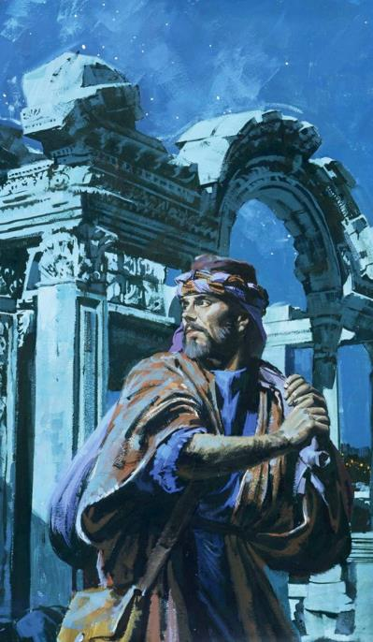
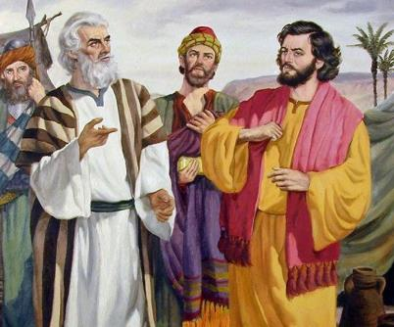
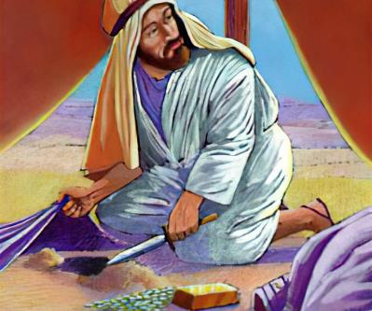
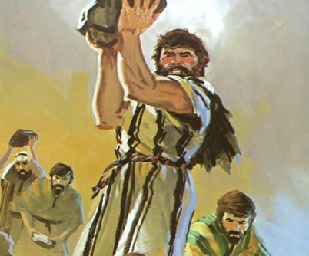
Lesoni 6 ki he ʻaho 8 ʻo Nōvema, 2025
KO E FILI
‘I
LOTO

Slide 2
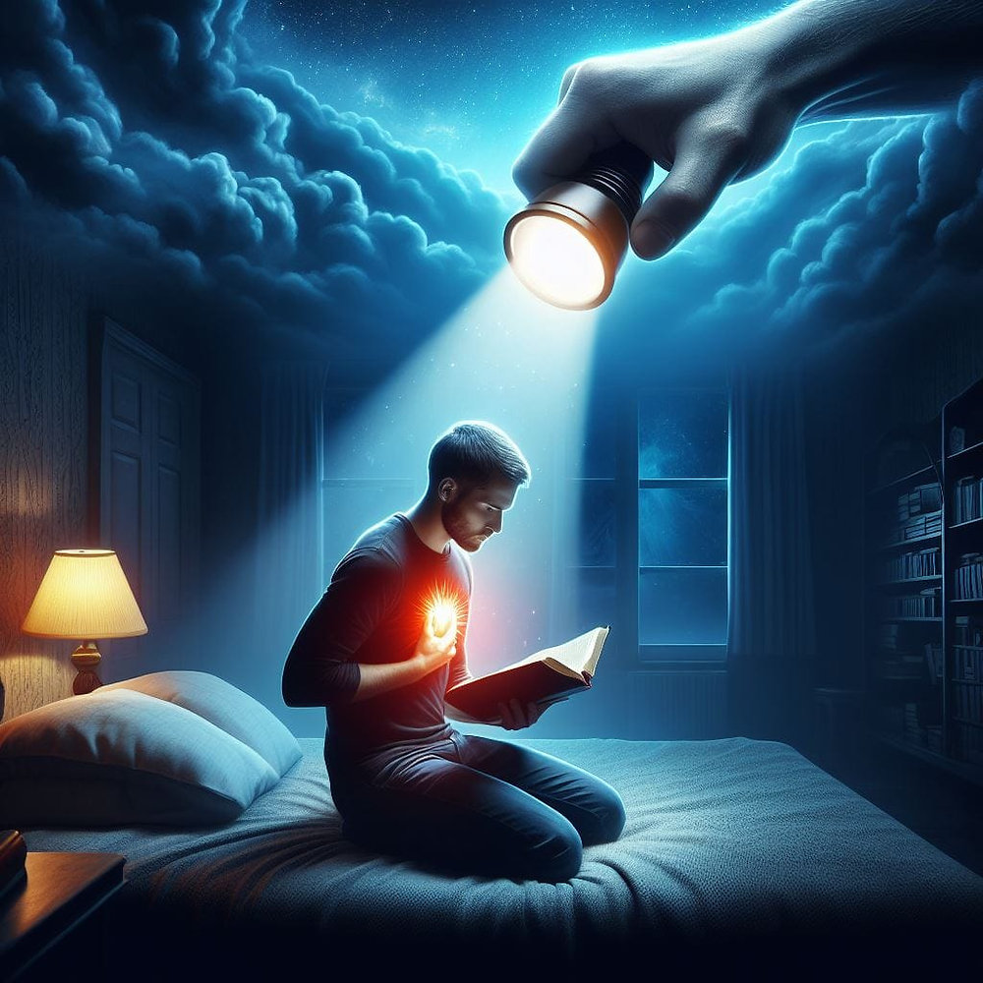

“Ko au Sihova ʻoku ou vakili ʻae loto,ʻoku ou hakule ʻae ngaahi mahalo,
ke foaki ki he tangata taki taha ʻo fakatatau mo ʻene ngaahi ʻulungāanga, pea tatau mo e fua ʻo ʻene faianga.”
Selemaia 17:10

Slide 3


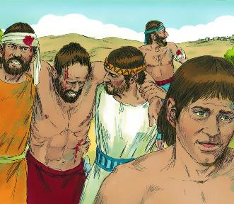
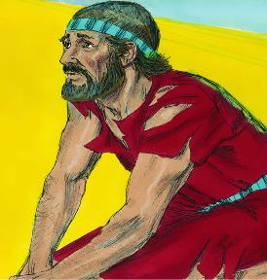





Hili ha founga fakakautau ta‘efakakaukau‘i, na‘e holo ai ‘a e ngaahi ‘ā ‘o Selikoó. Na‘e hū ‘a ‘Isileli ki he koló ‘o holoki ia ki he kelekelé. Ko e Ikuna! A ia? ‘a e ‘Otuá, koe‘uhi na‘e si‘i ‘a e kaunga ‘a ‘Isileli ki ai.
Hili ha founga fakakautau na‘e fakakaukau‘i lelei, ‘oku ikuna ‘a ‘Ai. Foʻi! ‘E fai ‘e hai? ʻE he kakai ʻo ʻIsilelí, he naʻe ʻikai ke nau falala ki he ʻOtuá.
‘I he’enau fakafehu’ia faka’osi ‘a e ‘Otua, na’e ongo ‘a e tali: Kuo faiangahala ‘a ‘Isileli pea ‘oku ‘ikai ke nau toe lava ‘o ikuna’i ‘a hono ngaahi fili. ‘E lava fēfē ke ne toe ma‘u ‘a e hōifua faka‘Otuá?
Ko e tupu’anga ‘o e ikuna (Siosiua 7:1-5, 10-13)
Fakahoha‘asi mo mamahi (Siosiua 7:6-9)
Ko hono ‘ilo‘i ‘o e tokotaha maumau-fonó (Siosiua 7:14-19)
Ko e angahala ‘a ‘Ākaní (Siosiua 7:20-26)
Toe Ikuna (Siosiua 8:1-29)

Slide 4

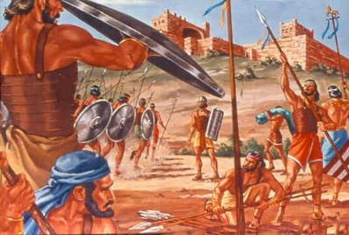
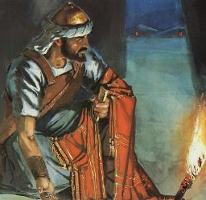
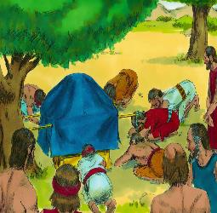
KO E TUPUʻANGA ʻO E FOʻI
“Kuo fai angahala ʻa ʻIsileli, pea kuo nau fai talangataʻa ki heʻeku fuakava ʻaia naʻaku fekau kiate kinautolu: he kuo nau toʻo ʻae meʻa malaʻia, pea kuo nau kaihaʻa, mo fai fakakākā foki, pea kuo nau ʻai ia ki he ngaahi meʻa ʻanautolu.” (Siosiua 7:11)
Hili ʻ a e līpooti lelei mei he kau asiasi naʻe fekauʻi atu ki Selikoó, naʻe kumi faleʻi ʻ a Siosiua ki he ʻ Otuá pea maʻu meiate Ia ʻ a e founga ki hono maʻu ʻ a e koló.
Kapau naʻe fai ʻe Siosiua ʻa e meʻa tatau, hili hono maʻu ʻa e lipooti mei he kau asiasi naʻe ʻave kia ʻAi, naʻe mei fakaʻehiʻehi mei he mate ʻa e kakai ʻe toko 36. (Sosiua 7:1-5).
Ka ko e ha ʻa e ʻuhinga moʻoni ʻo e foʻi, pe ko e ha ʻa e ʻuhinga naʻe tala ai ʻe he ʻOtua kia Sosiua ke ʻoua naʻa ʻohofi ʻa ʻAi (Sosiua 7:11)?
Naʻe ʻafioʻi ʻe he ʻOtua "kuo angahala ʻa ʻIsileli." ʻ Oku ʻ ikai ha feituʻu ʻ i he Tohi Tapú ʻ oku fakamatalaʻi ai ʻ a e angahalá ʻ aki ʻ a e ngaahi meʻa kehekehe pehē: "kuo nau maumauʻi... kuo nau toʻo... kuo nau kaihaʻasi... kuo nau loi... kuo nau tuku ia mo ʻenau koloa pe ʻanautolu."
Fakatokangaʻi ange ʻa e tokolahi. Naʻe fai ʻa e angahala ʻe ha tangata ʻe taha, ka naʻe tukuakiʻi ʻe he ʻOtua ʻa e kakai kotoa. Kuo nau maumauʻi ʻa e fuakava; naʻe pau ke taʻaki fuʻu ʻa e angahala kae lava ke toe fakafoki mai.

Slide 5

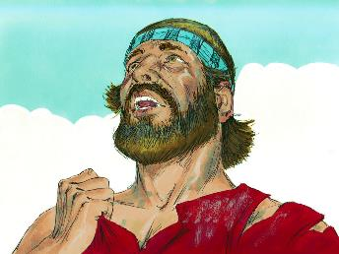
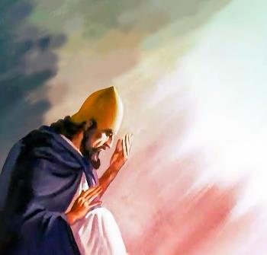
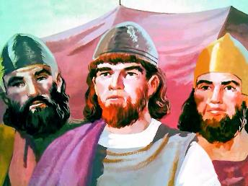
LOTO-FOʻI MO FAINGATAʻAʻIA
“Pea naʻe pehē ʻe Siosiua, “ʻOiauē, ʻE Sihova ko e ʻOtua, ko e hā nai kuo ke ʻomi ai ʻae kakai ni, ki he kauvai ni ʻo Soatani, ke fakatukutukuʻi ʻakimautolu ki he nima ʻoe kakai ʻAmoli, ke fakaʻauha ʻakimautolu? ʻAmusiaange ne mau fiemālie, pea nofomaʻu ʻi he kauvai ʻe taha ʻo Soatani!” (Siosiua 7:7)
Naʻe loto-mamahi ʻa Siosiua mo e kaumatuʻa ʻi he ʻulungia ʻi ʻAi, pea naʻa nau ha mahino ʻa e ngaahi fakaʻilonga ʻo e mamahi (Siosiua 7:6).
Naʻe tali leva ʻe Siosiua ʻaki ha ʻita tatau mo e toutou tali ʻa ʻIsileli lolotonga e taʻu ʻe 40 ʻo ʻenau hee: "Ko e ha naʻa ke ʻomi ai kimautolu ki he kolosi...? Pehe ange mai naʻa mau fiemalie pe ke nofo ai...!" (Siosiua 7:7).
Kae kehe, ko e laumālie ʻ o Siosiuá naʻe ʻ ikai ke tatau ia mo e laumālie ʻ o e kau ʻ Isileli ʻ i he toafá. Naʻe ʻikai fakatupu ʻene launga ʻe he loto mamahi, ka ko e manavasiʻi naʻa taʻefakaʻapaʻapaʻi ʻa e huafa ʻo e ʻOtua ʻi he lotolotonga ʻo e kau Senitaile (Siosiua 7:8-9).
Naʻa ne ʻiloʻi lelei ʻe fakaʻuhingaʻi ʻe he kau taʻetui ʻa e ʻulungaanga ʻo e ʻOtua ʻo makatuʻunga ʻi he anga ʻo e ngaue ʻa Hono kakai. ʻI he ʻaho ni ʻoku tau kei hoko pe ko e fakamoʻoni ʻa e ʻOtua ʻi he mamani. Ko ha fatongia maʻongoʻonga moʻoni ia!

Slide 6
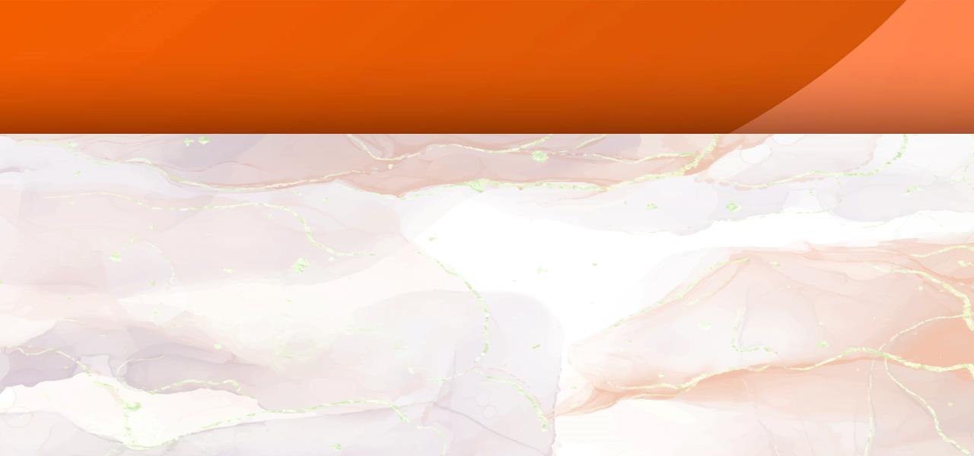
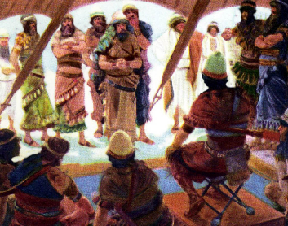
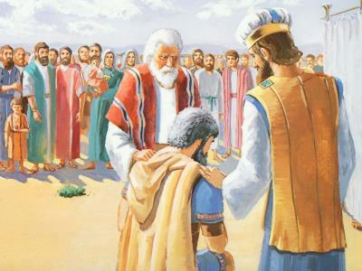
KO HONO ʻILOʻI ʻO E TOKOTAHA MAUMAUFONO
“Ko ia, ʻe ʻomi ʻakimoutolu ʻi he pongipongi ʻo fakatatau ki homou ngaahi faʻahinga: pea ʻe pehē, ko e faʻahinga ko ia ʻe fili ʻe Sihova ʻe haʻu ia ʻo fakatatau ki honau ngaahi nofoʻanga: pea ko e nofoʻanga ko ia ʻe fili ʻe Sihova tenau haʻu ʻo fakatatau mo honau ngaahi fale: pea ko e fale ko ia ʻe fili ʻe Sihova tenau haʻu tautau tokotaha pe ʻae tangata.” (Siosiua 7:14)
Ke toʻo atu ʻa e angahala fakakulupu (ʻa e halaia ʻa e kakai kotoa), naʻe pau ke toʻo atu ʻa e tokotaha faiangahala (Siosiua 7:15). Toʻo? He ʻikai nai fakamolemoleʻi ia kapau naʻa ne fakatomala? Ko e moʻoni te ne fai ia! Ka naʻe ʻ ikai ha fakaʻilonga ʻ o e fakatomala loto - moʻoni ʻ a ʻ Ākani (pea naʻá ne maʻu ʻ a e ngaahi faingamālie lahi ke fai pehē).
Naʻe fanongonongo ʻa e founga fakatotolo pea toloi ki he ʻaho hono hoko (Siosiua 7:14-15)
Naʻe puke ʻa e faʻahinga ʻo Siuta (Siosiua 7:16)
Naʻe ʻave ʻa e famili ʻo Sela (Siosiua 7:17a)
Naʻe ʻave ʻa e taki ko Sāpití ( Siosiua 7:17e)
Naʻe ʻave ʻa ʻĀkani ( Siosiua 7:18)
Ne fakalongo pē ʻa ʻĀkani
Ne fakalongo pē ʻa ʻĀkani
Ne fakalongo pē ʻa ʻĀkani
Ne fakalongo pē ʻa ʻĀkani
Ne fakalongo pē ʻa ʻĀkani
‘I he’ene fakahaa’i ‘a e angalelei mo e ‘ofa faka’otua, na’e kole ai ‘e Siosiua kia ‘Akani ke vete ‘ene angahala (Sosiua 7:19).
Na‘e mole ‘a e keisi ‘a ‘Ākaní. Na’a ne vete, ka na’e ‘ikai te ne kole fakamolemole (Sosiua. 7:20). Ka naʻe tangilaulau ʻa e ʻOtuá ʻi hono loto fefeká, ʻo fakahaaʻi ʻi he ui kotoa pē ki he fakatomalá.

Slide 7
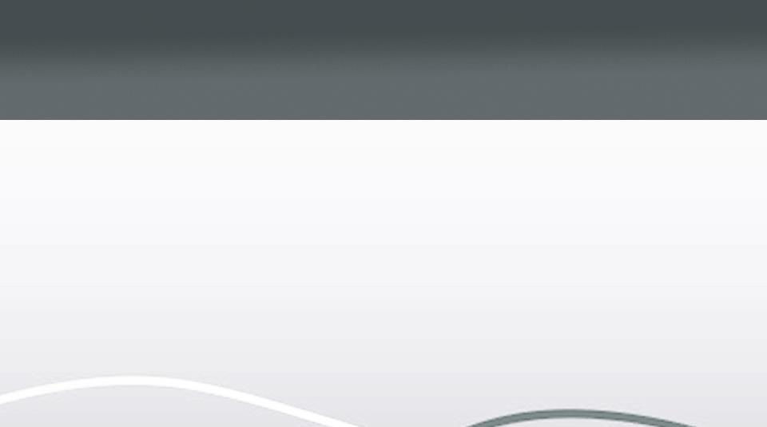
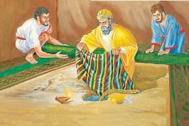

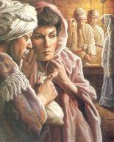
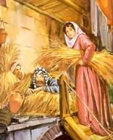
KO E ANGAHALA 'A 'ĀKANI
“ʻI heʻeku mamata ʻi he meʻa naʻe vete ki he kofu fakaPapilone matamatalelei, mo e sikeli siliva ʻe uangeau mo e konga koula, ko e sikeli ʻe nimangofulu hono mamafa, ne u manumanu ki ai, peau ʻave ia: pea vakai, kuo fufū ia ʻi he kelekele ʻi hoku loto fale fehikitaki, pea ʻoku ʻi lalo ʻae siliva.”” (Siosiua 7:21)
Naʻe kole ʻe Siosiua kia ʻAkani ke ne ʻoatu ʻa e langilangi ki he ʻOtua mo vete ʻene angahala (Sosiua 7:19). Ko hono faingamalie fakaʻosi ia. Kapau naʻa ne kole fakamolemole ʻi heʻene vete hia... Ka naʻe ʻikai, pea naʻe ʻikai ha fakamolemole kiate ia (Nomipa 15:30-31).
Lēhapi
Naʻá ne fufū ʻa e kau asiasí ʻi he ʻaá
Na‘á ne ngāue anga-lelei ki ‘Isileli
ʻĀkani
Naʻá ne fufū ʻa e koloa veté ʻi he kelekelé
Naʻá ne ʻomi ha faingataʻa ki ʻIsileli
Naʻá ne saiʻia ʻi he ikuná koeʻuhí ko ʻene tuí
Naʻá ne fakatupu ʻa e ikuna ʻaki ʻene ngaahi ngāué
Naʻá Ne fai ha fuakava mo ʻIsileli
Naʻá ne maumauʻi ʻa e fuakava ʻo ʻIsilelí
Naʻá ne fakatauʻatāinaʻi ʻene moʻuí mo hono fāmilí
Naʻá ne pekia mo hono fāmilí
Hangē ko ʻIví, naʻe “sio,” “holi,” mo “toʻo” ʻa ʻĀkani, pea naʻe uesia ai ʻe heʻene angahalá ʻa e tokolahi (Sen. 3:6). Hange ko ‘Ananaia mo Safaila, na’e to’o ‘e ‘Akani ‘a e ni’ihi ‘o e ngaahi me’a mala’ia ‘o fakatapui ki he ‘Otua ‘o ne totongi (Ngaue 5:1-2).
Ko e ngaahi tu‘utu‘uni na‘e fai ‘e ‘Ākani ‘i Sielikoó na‘e fehangahangai ia mo e ngaahi tu‘utu‘uni ‘a Lēhapí:

Slide 8

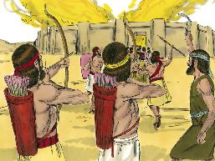
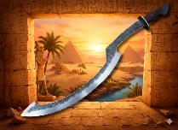
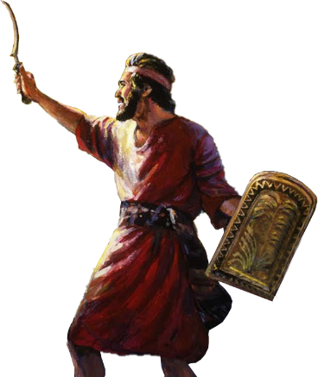
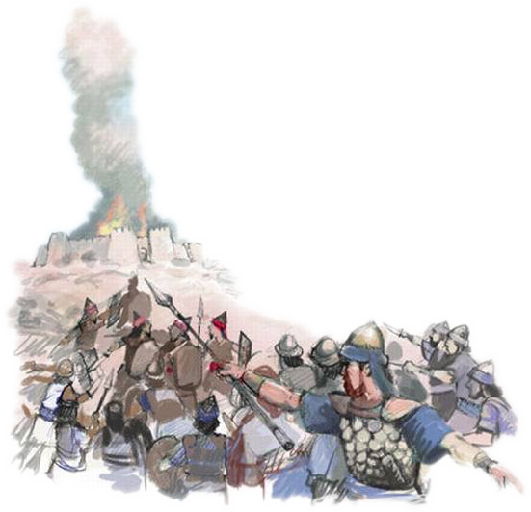
TOE IKUNA
“Pea naʻe folofola ʻa Sihova kia Siosiua, “ʻOua naʻa ke manavahē, pea ʻoua naʻa ke ilifia: ʻave ʻae kautau kotoa pē, pea tuʻu hake, ʻo ʻalu hake ki ʻAi: vakai, kuo u tuku ki ho nima ʻae tuʻi ʻo ʻAi, mo hono kakai, mo ʻene kolo, mo hono fonua:” (Siosiua 8:1)
Hange ko ia ʻi Sieliko, naʻe ʻoange ʻe he ʻOtua kia Sosiua ʻa e founga ke ikunaʻi ai ʻa ʻAi (Siosiua 8:1-2).
ʻI he lolotonga ʻo e poʻuli, naʻe fokotuʻutuʻu ha ʻohofi ʻi mui ʻi he kolo. ʻ I he mafoa ʻ a e ata, naʻe fakaofiofi atu ʻ a e kau taú kia ʻ Ai ʻ o fakangalingali ʻ oku nau toe hola ʻ i honau ʻ ao.
ʻI hono hiki hake ʻe Mosese ʻene tokotoko kae ʻoua kuo ne ikunaʻi ʻa e kau ʻAmalekai, ʻi he fekau ʻa e ʻOtua, naʻe hiki hake ʻe Siosiua ʻene "meʻatau" (mahalo ko ha heleta hele tuʻusi naʻe fakaʻaongaʻi ʻe he kau ʻIsipite), pea tauhi ia ke hiki hake kae ʻoua kuo ne ikuna kakato (Siosiua 8:18-22, 26).
Naʻe toe foaki ʻe he ʻOtua ʻa e ikuna ki hono kakai. Naʻe fakaava ʻe he Teleʻa ʻAkoni, ʻa ia naʻe tamateʻi ai ʻa ʻAkani mo hono famili, ʻa e matapa ki he ikuna, ko ha "matapa ʻo e ʻamanaki lelei" (Hosea 2:15).
Ko e taimi ʻoku tau tali ai ʻa e fakamolemole fakalangí ʻi he tuí, ʻoku tanu ʻe he ʻOtuá ʻetau angahalá ʻi ʻAkola, pea fakaava ʻa e matapā ki he ʻamanaki leleí.

Slide 9

“Ko e tākiekina lahi taha ke manavahē ki ai ‘a e siasí ‘oku ‘ikai ko e kau fakafepaki fakahāhā, kau ta‘etui, mo e kau lea fakaanga, ka ko e kau palōfesa ta‘efa‘alaua ‘o Kalaisí. Ko kinautolu eni 'oku nau ta'ofi 'a e tapuaki 'a e 'Otua 'o 'Isileli pea 'omi 'a e vaivai ki he siasi, ko e manuki 'oku 'ikai faingofua hono holoki...
‘Oku ‘ikai ke faka‘ali‘ali pē ‘a e lotu faka-Kalisitiané ‘i he Sāpaté pea faka‘ali‘ali ‘i he feitu‘u toputapú; ʻoku ʻuhinga ia ki he ʻaho kotoa pē ʻo e uiké pea mo e feituʻu kotoa pē. Kuo pau ke ʻiloʻi mo talangofua ki hono ngaahi fakamatalá ʻi he fale ngāué, ʻi ʻapí, pea ʻi he ngaahi fefakatauʻaki fakapisinisí mo e kāingá pea mo e māmaní...”
EGW (Fepakipaki mo e Loto-toʻá, ʻEpeleli 23)

