Slide 1
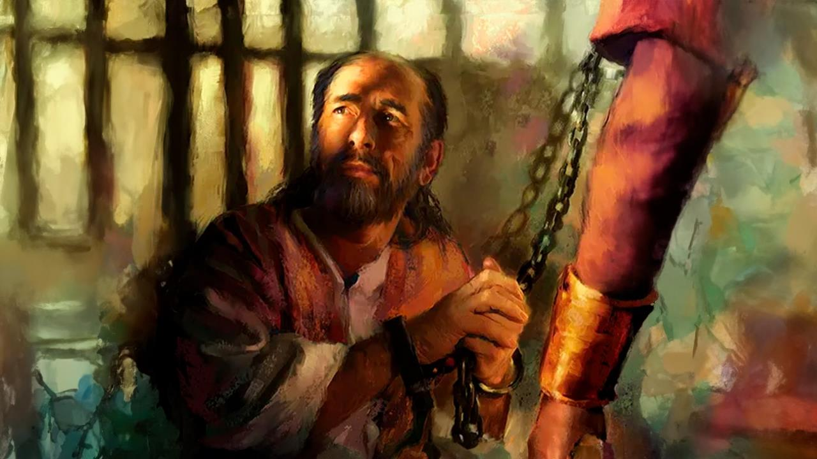
FAKATANGAʻI KAE ʻIKAI LIʻAKI
Lesoni 1 ki he ʻaho 3 ʻo Sanuali 2026

Slide 2

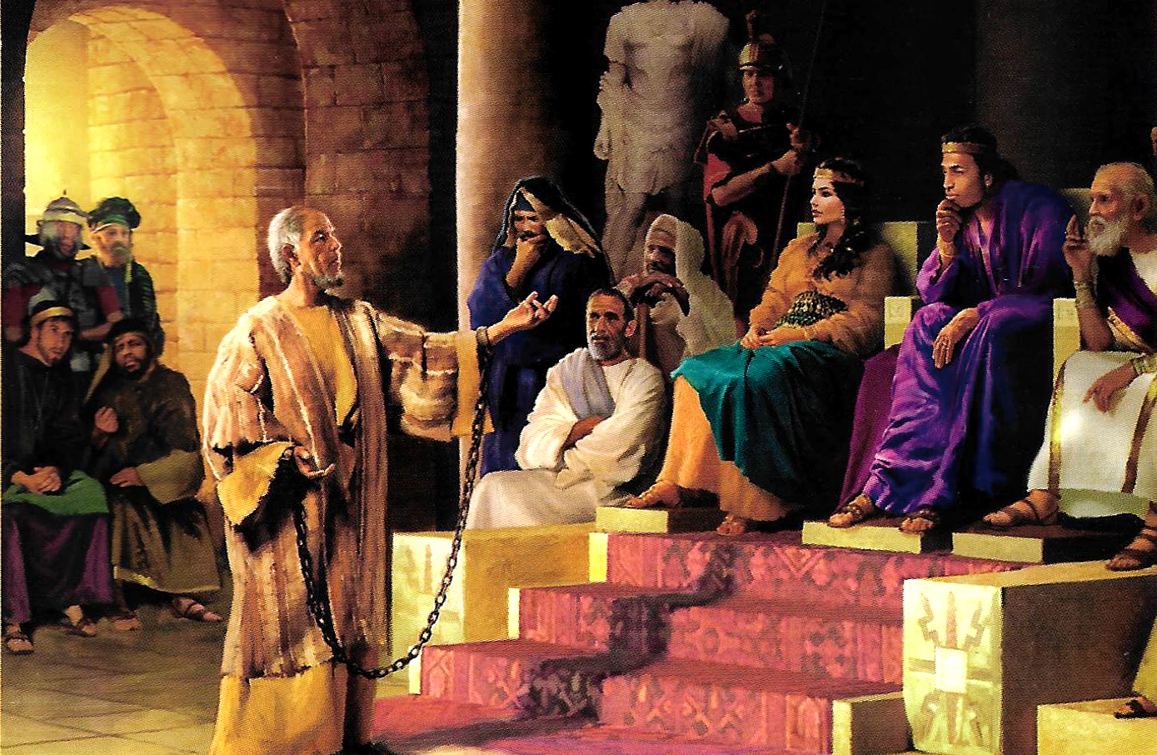
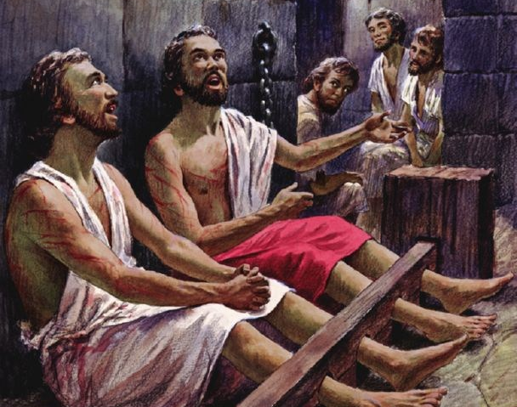
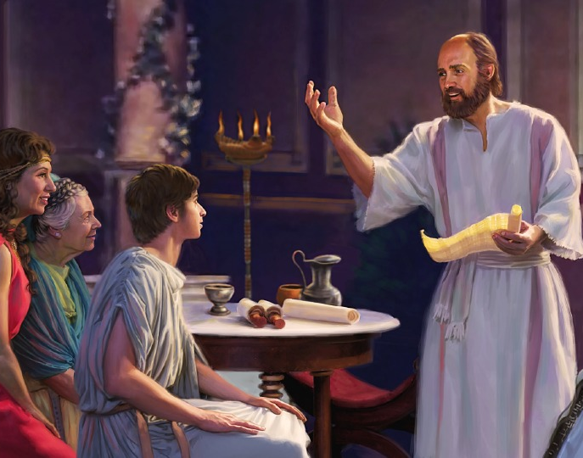
“Fiefia maʻuaipē ʻi he ʻEiki: ʻoku ou toe pehē, Fiefia.”
Filipai 4:4

Slide 3

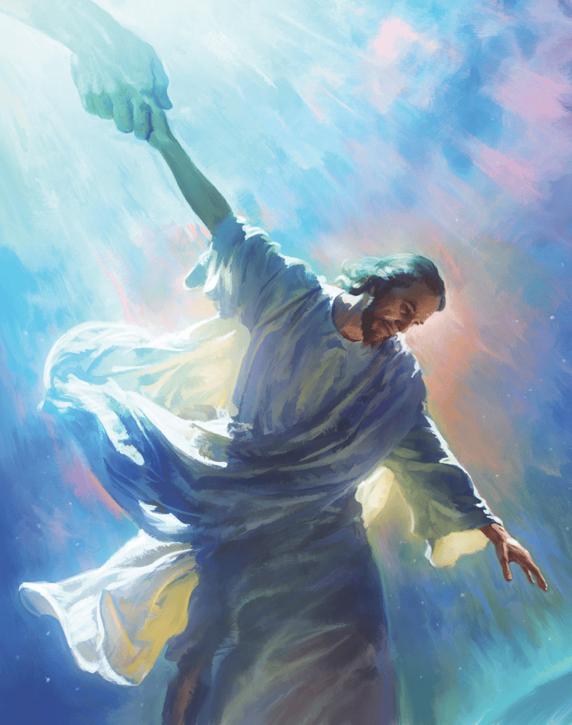


ʻI he kotoa ʻo ʻene ngaue fakafaifekau, naʻe fokotuʻu ai ʻe Paula ke ʻoatu kiate kinautolu kotoa pe ʻe fanongo kiate ia, ʻa e tokotaha pe ʻe taha te ne lava ʻo fakatahaʻi ʻa Langi mo Mamani: ko Sisu Kalaisi, ko e Fakamoʻui.
ʻI heʻene fai ʻene ngaahi tohi ki he kau Filipai mo e kau Kolose, naʻa ne fai ʻa e meʻa kotoa pe naʻa ne lava ke ʻomi ʻa e siasi ke ofi ange ki he Langi, pea toe ofi ange ʻa e kau Kalisitiane.
ʻI heʻene fai ia, naʻa ne fakahaaʻi mai ai ʻa e founga ʻe lava ke fakataha ai ʻa e siasi ʻo e ʻOtua he ʻaho ni mo Langi ke fakahoko ʻi mamani ʻa e fekau naʻe fakafalala mai ʻe Sisu kiate kitautolu.
Ko e tokotaha naʻa ne faʻu ʻa e ngaahi tohi:
Naʻe tuku popula ʻa Paula
ʻAmipasitoa ʻi he ngaahi seini
Ko kinautolu naʻa nau maʻu ʻa e meʻa ni:
Hisitolia ʻo Filipai
Hisitolia ʻo Kolose
Ko e ngaahi siasi ʻo Filipai mo Kolose

Slide 4
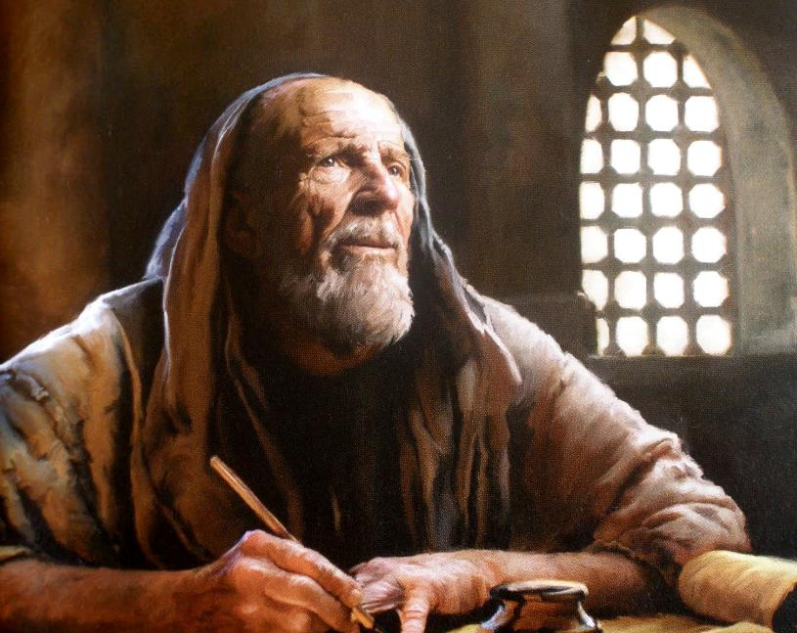

KO E TOKOTAHA NAʻA NE FAʻU ʻA E NGAAHI TOHI

Slide 5

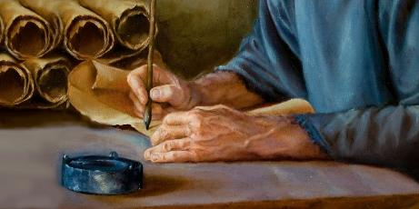
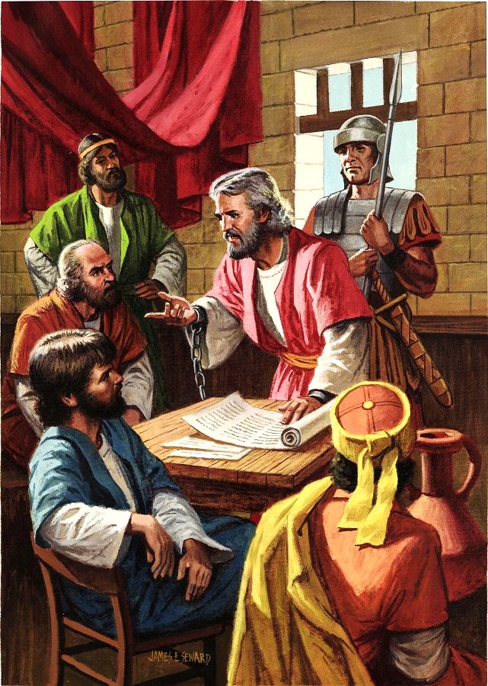
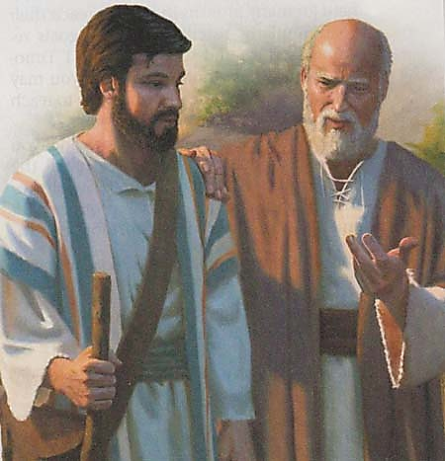
TUKU POPULA ʻA PAULA
“Ko au Paula, ko e pōpula ʻa Kalaisi Sisu, mo Timote, ko e kāinga, kia Filimone, ko hotau ʻofeina, mo e kaunga ngaue,” (Filimone 1:1)
Lolotonga ʻene fuofua nofo popula ʻi Loma – ʻi he vahaʻa ʻo e 60 mo e 62 AD – naʻe fai ʻe Paula ha tohi ʻe nima: ki he kakai ʻEfeso, ki Filipai, ki he kau Kolose, kia Filimone, pea ki he siasi ʻo Laotisiaa (ʻa ia ʻoku teʻeki ai ke aʻu mai kiate kitautolu)
Koeʻuhi naʻe ʻikai ha ngaKoeʻuhi naʻe ʻikai ke ʻi ai ha ngaahi tukuakiʻi mamafa kiate ia, naʻe fakangofua ia ke nofo ʻi ha fale totongi, ʻo tokangaʻi maʻu pe ʻe ha sotia Loma (Ngaue 28:16). Naʻe hanga ʻe he meʻa ni ʻo ʻai ke ne lava ʻo hokohoko atu hono malangaʻi ʻo e ongoongolelei, ʻo aʻu ki he Kaʻate Paletoria (Filipai 1:13)
‘I hono sivisivi’i ‘o e ngaahi ‘ipiseli, ‘oku tau lava ‘o sio ai, na’e tokolahi ‘a e kau ngāue fakataha ‘a Paula (Kol. 4:7-14; Filim. 23-24). Na’a ne fetu’utaki foki mo e fale ‘o Sisa (Filip. 4:22)
Na’e ‘amanaki ‘a Paula ke vave hono tukuange (Filim. 22), ko e ‘amanaki ia na’e ‘ikai ke ne toe ma’u lolotonga ‘ene nofo pōpula hono ua (2 Tim. 4:6).

Slide 6

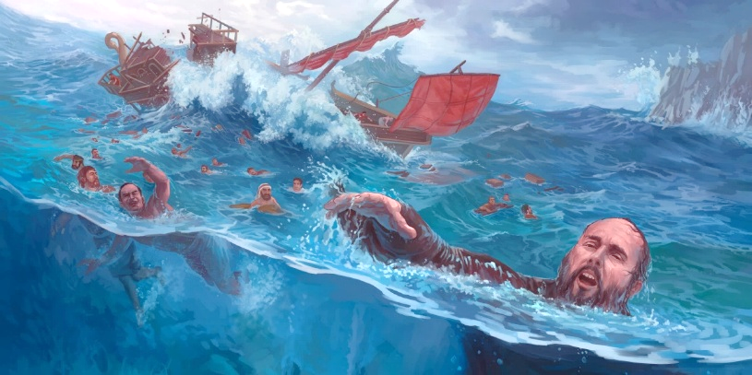
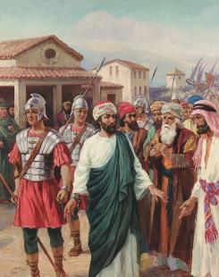
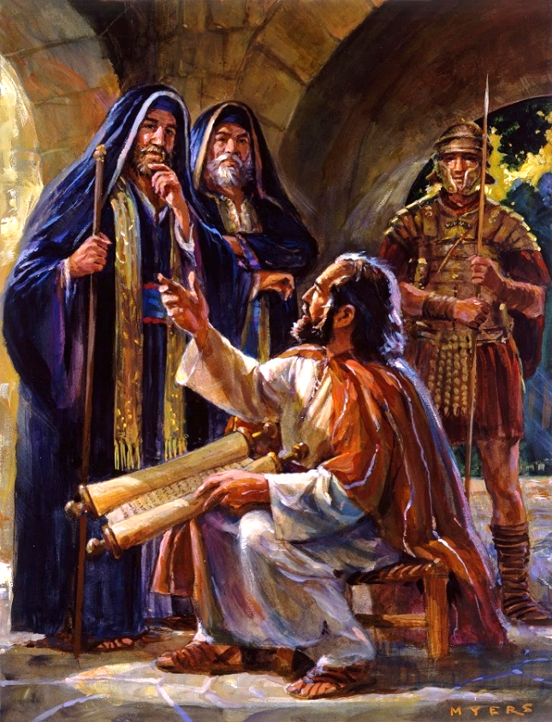
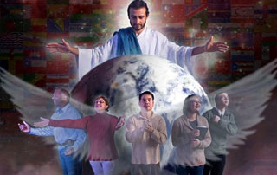
'AMIPASITOA 'I HE NGAAHI SEINI
“ʻAia kuo haʻisia ai au ko hono faifekau: koeʻuhi ke u lea mālohi ai au, ʻo taau mo e lea ʻoku totonu” (Efeso 6:20)
Talu mei he momeniti naʻa ne fili ai ke hoko ko ha fakafofonga ʻo Kalaisi, naʻe ʻikai faingofua ʻa e moʻui ʻa Paula (2 Kolinito 6:4-5)
ʻOku lekooti ʻe he Tohi Tapu ʻa hono tuku popula tuʻo tolu pe ʻo Paula kimuʻa pea toki ʻave ia ki Loma: ʻi Filipai (Ngaue 16:22-24); ʻi Selusalema (Ngaue 23:10); pea ʻi Sesalia (Ngaue 23:33-35). Ka ko e moʻoni naʻe toe ʻi ai mo ha niʻihi kehe (2 Kolinito 11:23)
ʻI he ngaahi faingataʻa kotoa ko ʻeni, naʻe ʻikai teitei fakakaukau ʻa Paula ʻoku ʻikai ke ne lava ʻo fai ha meʻa (2 Kolinito 4:7-9). ʻI he ʻikai ke ne lava ʻo malanga tauʻataina, naʻa ne hoko ai ko ha "fakafofonga kuo haʻisini" (ʻEfeso 6:20)
ʻOku akoʻi kitautolu ʻe he toʻonga fakakaukau ʻa Paula ko e taimi ʻoku tau faingataʻaʻia ai ʻi hono malangaʻi ʻo e ongoongolelei, kuo pau ke tau falala kakato ki he ʻOtua; manatuʻi maʻu pe ʻEne Folofola (2 Timote 2:15); pea pikitai ki he Laumalie Maʻoniʻoni, ko e Fakafiemalie ʻoku ne ʻomi kiate kitautolu ʻa e malohi mo e loto-toʻa (Sakalaia 4:6)

Slide 7
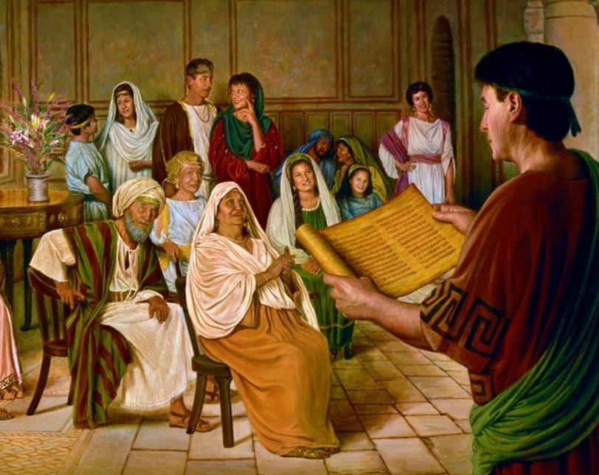

KO E NIʻIHI ʻOKU NAU MAʻU

Slide 8

“Naʻe ongoʻi ʻ e he ʻ apositolo ko Paulá ha fatongia lahi ki he faʻahinga naʻe ului ʻ i he malumalu ʻ o ʻ ene ngaahi ngāué. Kae mahulu hake ʻi he ngaahi meʻa kotoa pe, naʻa ne fakaʻamu ke nau faivelenga, "koeʻuhi ke u fiefia ʻi he ʻaho ʻo Kalaisi," naʻa ne pehe, "kuo ʻikai te u lele taʻeʻaonga, pe ngaue taʻeʻaonga." Filipai 2:16. Naʻa ne tetetete koeʻuhi ko e ola ʻo ʻene ngaue fakafaifekau. Naʻa ne ongoʻi naʻa mo hono fakamoʻui ʻe ala tuʻu fakatuʻutamaki kapau he ʻikai ke ne fakahoko hono fatongia pea ʻikai fengaueʻaki ʻa e siasi mo ia ʻi he ngaue ʻo hono fakahaofi ʻo e ngaahi laumalie.”
EGW (Ko e Ngaahi Ngāue ʻa e Kau ʻApositoló, p. 206)

Slide 9

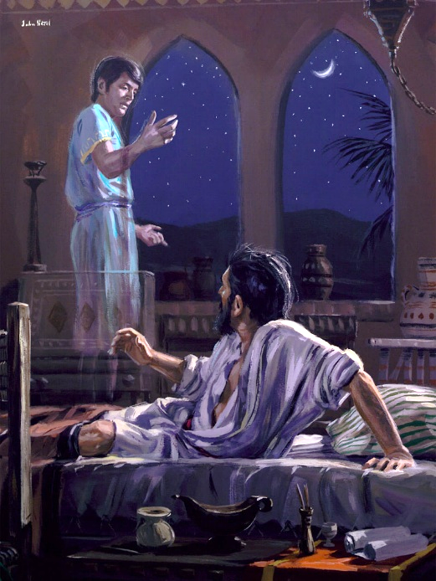
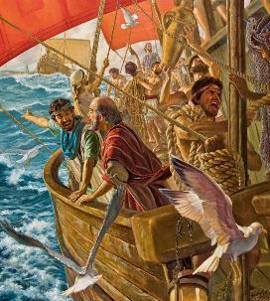
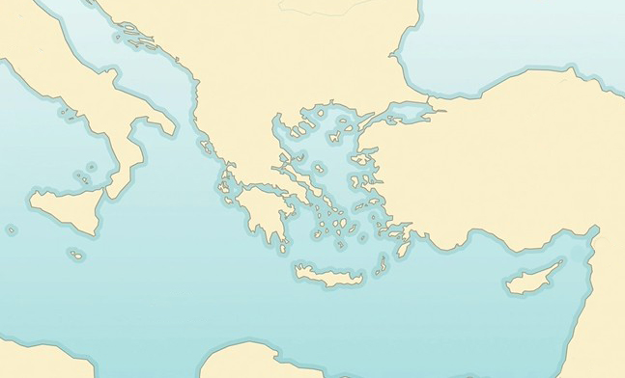

HISITOLIA 'O FILIPAI
“Pea naʻe hā mai ha meʻa kia Paula ʻi he poʻuli; naʻe tuʻu mai ʻae tangata Masitōnia, ʻo kole kiate ia, ʻo pehē, “Haʻu ki Masitōnia, ʻo tokoni mai kiate kimautolu.”” (Ngaue 16:9)
Vahefonua Masitōnia
Filipai
Neapoli
Pitinia
Samotesia
X
Lolotonga ‘ene fononga fakamisinale hono uá, na‘e liliu ‘a e ngaahi palani ‘a Paulá. Na’e tataki ‘e he Laumalie Ma’oni’oni ‘ene laka (Ngaue 16:6-12):
Taloasi
Misia
Kalētia
Filisia
Na‘e ‘alu ‘a Paula ki Filisia (6a)
Na‘e ‘ikai te ne lava ‘o malanga ‘i ai pe ‘i Kalētia (6e)
Na‘á ne a‘u ki Misia (7a)
Naʻá ne feinga ke ʻalu ki Pitinia, ka naʻe ʻikai ke ne lava (7e)
Naʻa ne ʻalu ki Taloasi, ʻo ne maʻu ai ha visone (8-10)
Na‘á ne folau ki Samōtesia (11a)
Mei ai ki Neapoli (11e)
Fakahiku ai, ne hoko atu a ia ki Filipai (12)
Ngaue 16:6-12
Ko Filipai ‘a e feitu’u na’e fili ‘e he Laumalie Ma’oni’oni ke kamata ai hono malanga’i ‘o e Kosipeli ‘i ‘Iulope. ‘I he tu‘unga ko ha kolo Loma kakató, na‘e faka‘atā ai ‘a e kau Filipaí mei he totongi tukuhaú pea na‘a nau ma‘u ‘a e tangata‘ifonua Lomá mei hono fanau‘í.

Slide 10
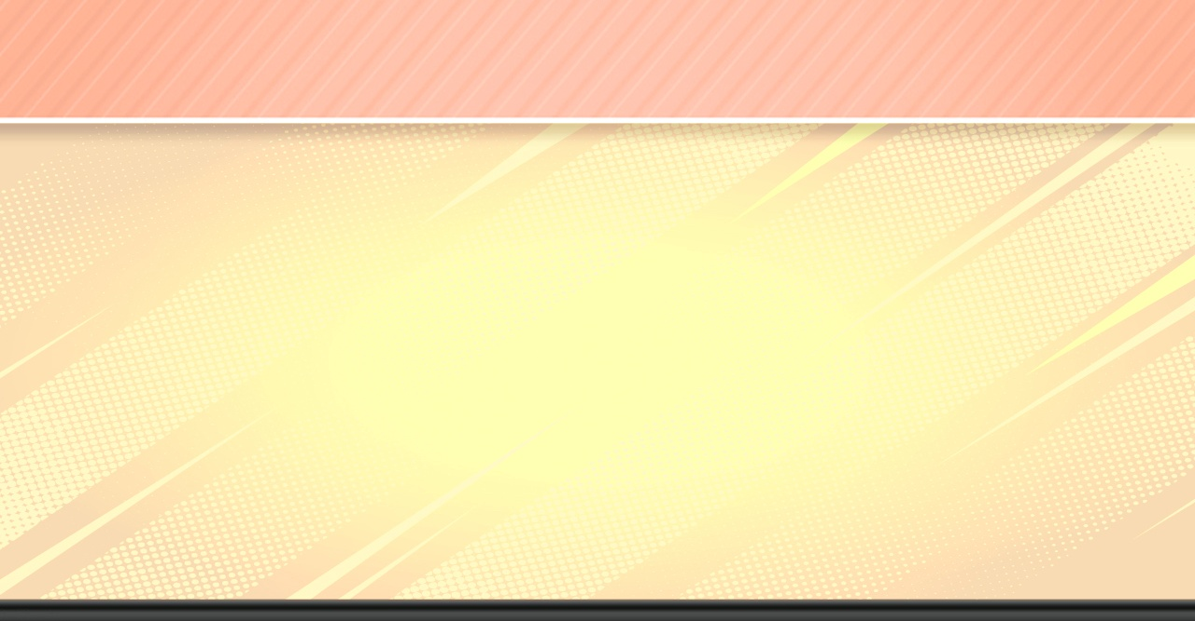
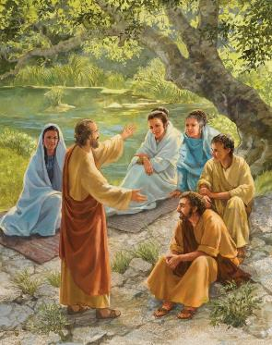
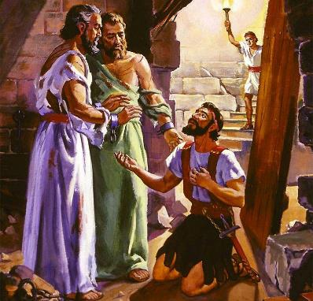
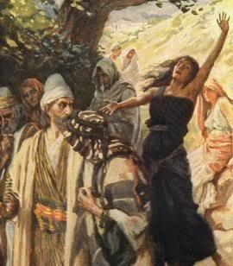
HISITOLIA 'O FILIPAI
“Pea naʻe hā mai ha meʻa kia Paula ʻi he poʻuli; naʻe tuʻu mai ʻae tangata Masitōnia, ʻo kole kiate ia, ʻo pehē, “Haʻu ki Masitōnia, ʻo tokoni mai kiate kimautolu.” (Ngāue 16:9)
Ko e tō‘onga ‘a Paula ‘i he‘ene a‘u ki ha kolo fo‘oú ko e ‘a‘ahi ki he sinakoké. Kae ʼi Filipe neʼe mole he sinakoka! ‘I he ‘aho Sapate na’a nau ma’u ai ha feitu’u ke fai ai ‘a e lotu pea na’a nau malanga ai ki he kau fefine na’e fakatahataha mai (Ngaue 16:13)
Naʻe ʻasi mai mei he fakataha ko ʻení ʻa e fuofua ului ʻIulopé: ko Litia. Na‘e papitaiso ia, fakataha mo hono fāmilí kotoa ( Ngāue 16:14-15 ) .
Ka naʻe ʻikai nofo noa pe ʻa e fili. Naʻa ne fakaʻaiʻai ha tangata kikite ke ne puputuʻu ʻa e ʻatamai ʻo e kakai ʻaki ʻene fakangalingali ʻoku ne poupouʻi ʻa Paula (Ngaue 16:16-17). ʻI he taimi naʻe tukuange ai ʻa e taʻahine, naʻe kamata ʻa e faingataʻaʻia ʻa Paula mo Sailosi (Ngaue 16:18-24)
Ko hono ola: ko e ului ʻa e tauhi fale fakapopula mo hono famili (Ngaue 16:25-33). ʻOku ʻikai ha veiveiua naʻe hu mai ʻa e Ongoongolelei ki ʻIulope ʻi he malohi mo e tataki ʻa e Laumalie Maʻoniʻoni

Slide 11

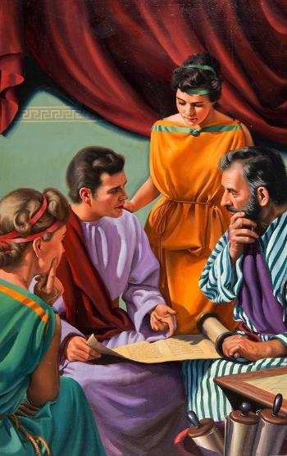
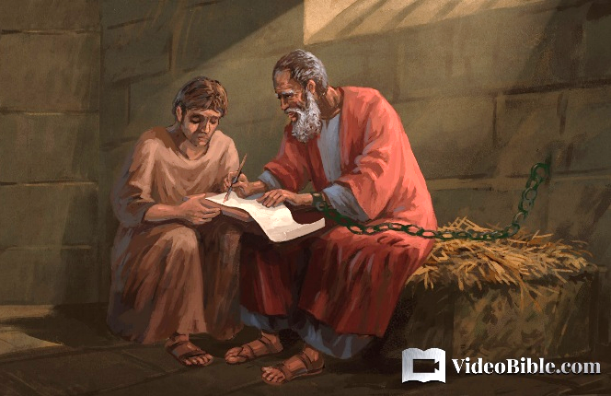
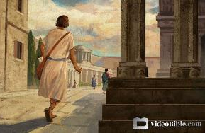
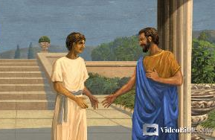
HISITOLIA ʻO KOLOSE
“‌ʻO hangē ko ia foki kuo mou ʻilo meia Epafasi, ko homa kaungā tamaioʻeiki ʻofeina, ʻaia ko e faifekau angatonu ʻa Kalaisi kiate kimoutolu; ” (Kolose 1:7)
Naʻe hoko ʻa ʻEpafasa ko e takaua ʻo Paula lolotonga hono nofo popula ʻi Loma (Fili. 23). Naʻa ne tupu ʻi Kolose (Kolose 4:12), pea ko ia naʻa ne fakafeʻiloaki ʻa e ongoongolelei ki he kolo ko ia (Kolose 1:7)
Ko Kolose ko ha kolo ia ʻi he vahefonua ko Filisia, ofi ki Leotisia mo Heiapolisi, ʻa ia naʻe malanga ai foki ʻa ʻEpafasa (Kolose 4:13). Naʻe tokolahi ʻa e kakai Siu. Ko e taha ʻo e kau Siu tuʻukimuʻa taha naʻe nofo ai ko Filimone, ko ha kaunga ngaue ʻo Paula, ʻa ia naʻe fakataha ai ha siasi ʻi hono fale (Filim. 1-2)
Ko e taha ʻo e kau tamaioʻeiki ʻa Filimone, ʻa ʻOnesimasi, naʻa ne hola ki Loma, ʻa ia naʻa ne tali ai ʻa Sisu ʻia Paula (Filimone 10-11). ʻI heʻene fakafoki ʻa ʻOnesaimi ki heʻene ʻeiki, naʻe fakahaaʻi ai ʻe Paula ʻa e founga ʻoku totonu ke ʻi ai ʻa e va fetuʻutaki ʻi he vahaʻa ʻo e kau pule mo e kau popula, pe kau maʻolunga mo e kau maʻulalo (Filimone 12-17)

Slide 12

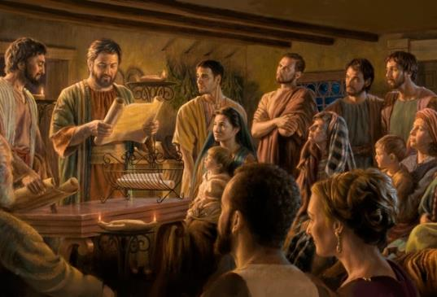
KO E NGAAHI SIASI ʻO FILIPAI MO KOLOSE
"Ko Paula mo Timote, ko e ongo tamaioʻeiki ʻa Sisu Kalaisi, ki he kāinga māʻoniʻoni kotoa pē ʻia Kalaisi Sisu, ʻoku ʻi Filipai, mo e kau tauhi mo e kau akonaki: " (Filipai 1:1)
ʻOku fakahaaʻi mai ʻe he talateu ki he ngaahi tohi ki he kau Filipai mo e kau Kolose, ʻa ia ʻoku faitatau ʻaupito, ʻa e tafaʻaki mahuʻinga ʻe ua (Filipai 1:1; Kolose 1:1-2)
ʻ I he vakai mai ʻ a e ʻ Otuá, ʻ oku māʻoniʻoni mo faitōnunga ʻ a e kau mēmipa ʻ o e siasí, neongo ʻ enau ngaahi fehālaakí
ʻOku ʻi ai ha kautaha ʻi he siasi, ʻa ia ʻoku maʻu ai ʻe ha niʻihi ʻo hono kaingalotu ha mafai mo ha fatongia lahi ange ʻi ha niʻihi kehe:
Ko Paula ko ha ʻaposetolo, ko ha taki tuʻunga maʻolunga
Ko Timote ʻa hono kaunga-ngaue (faifekau)
Ko e kau pisope ko ha kau taki fakalotofonua (kaumatuʻa)
ʻOku puleʻi ʻe he kau tikoni ʻa e siasi
ʻOku fakamalo ʻa Paula mei he fale fakapopula ki he kau Filipai ʻi he tokoni naʻa nau fekauʻi atu kiate ia (Fili. 4:18)
ʻOku ne fekauʻi atu ʻa hono kaunga-ngaue ke fakafiemalieʻi kinautolu ki he kau Kolose (Kolose 4:7-9)

Slide 13
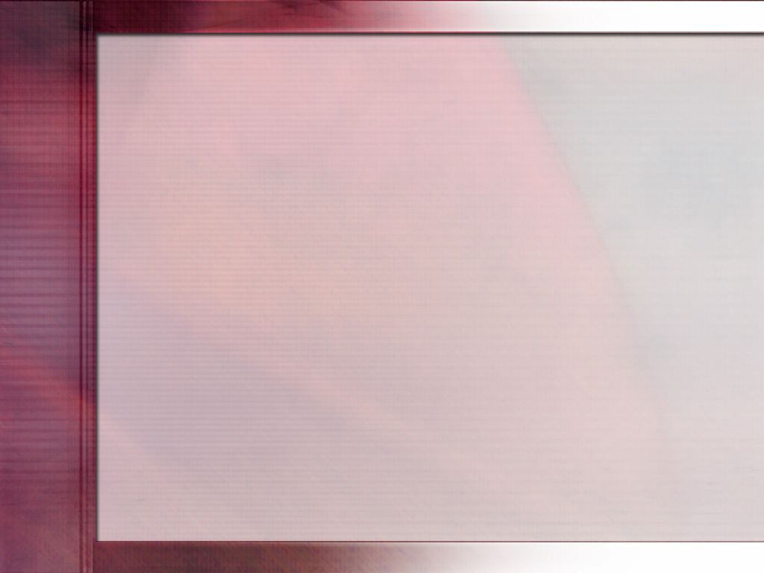
“Tau lāulea angé ki he meʻa naʻe hokosia ʻ e Paulá ʻ i ha kiʻi taimi siʻi. ʻI he taimi ko ia naʻe hange naʻe fie maʻu lahi taha ai ʻa e ngaue ʻa e ʻaposetolo ke fakamalohia ʻa e siasi naʻe ʻahiʻahiʻi mo fakatangaʻi, naʻe toʻo ʻene tauʻataina, pea naʻe haʻi ia ʻi ha ngaahi seini. Ka ko e taimi ʻeni ke ngaue ai ʻa e ʻEiki, pea naʻe mahuʻinga ʻa e ngaahi ikuna naʻe maʻu.
ʻ I he taimi naʻe hā mai ai naʻe malava ke fai ʻ e Paula ʻ a e siʻisiʻi tahá, ko ia leva naʻe maʻu ai ʻ e he moʻoní ha hūʻanga ki he palasi fakatuʻí. Naʻe ʻ ikai ko e ngaahi malanga tuʻukimuʻa ʻ a Paula ʻ i he ʻ ao ʻ o e kau tangata maʻongoʻonga ko ení, ka ko hono ngaahi haʻi naʻá ne tohoakiʻi ʻ enau tokangá. Naʻa ne ikunaʻi ʻa Kalaisi ʻi heʻene nofo popula. Naʻe hanga ʻe he faʻa kataki mo e angavaivai naʻa ne tukuloloa ki heʻene nofo popula fuoloa mo taʻetotonu ʻo ʻai ʻa e kau tangata ni ke nau fakafuofuaʻi ʻa e ʻulungaanga.”
EGW (Ko Hono Fakafotunga ʻo Kalaisi, Tisema 10)

