Slide 1
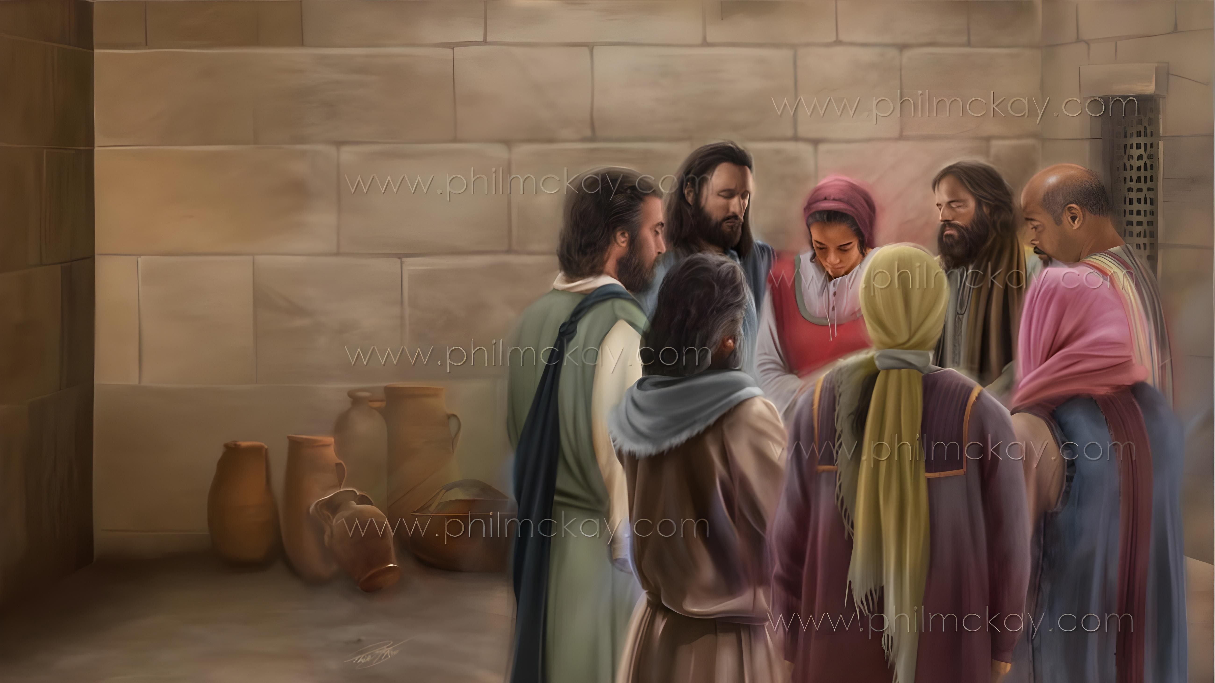
NGAAHI ʻUHINGA KI HE FAKAFETAʻI MO E LOTU
Lesoni 2 ki he ʻaho 10 ʻo Sanuali 2026

Slide 2
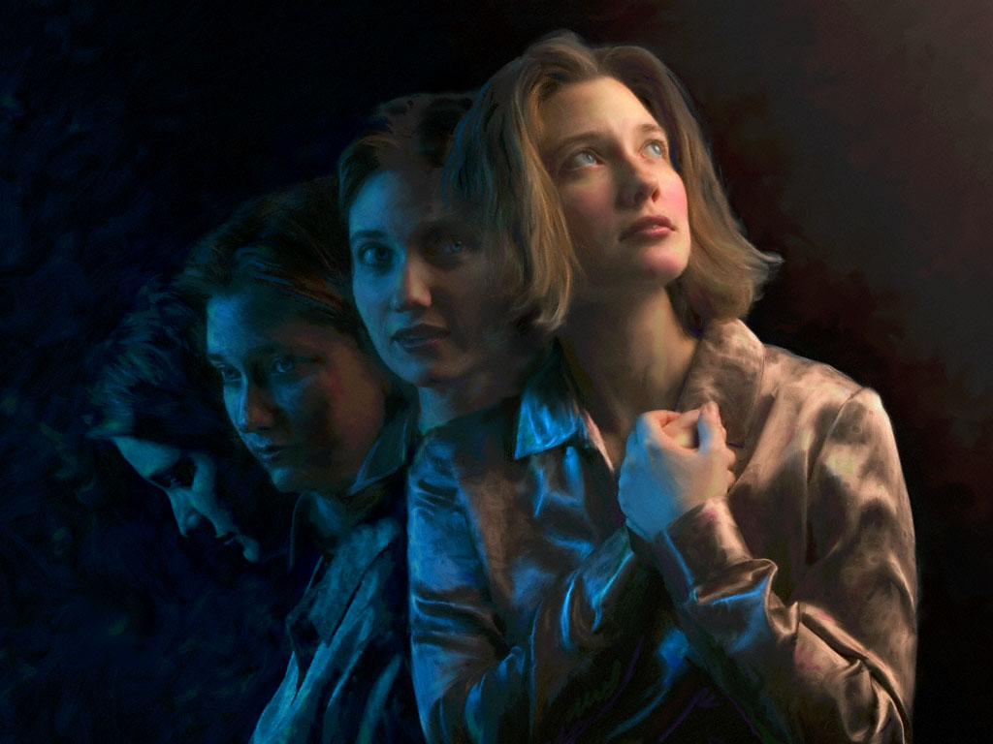

“‌ʻOku ou ʻilo pau ʻae meʻa ko eni, koeʻuhi ko ia kuo ne kamata ʻae ngāue lelei ʻiate kimoutolu, te ne fakahaohaoa ia ʻo aʻu ki he ʻaho ʻo Sisu Kalaisi:”
Filipai 1:6

Slide 3

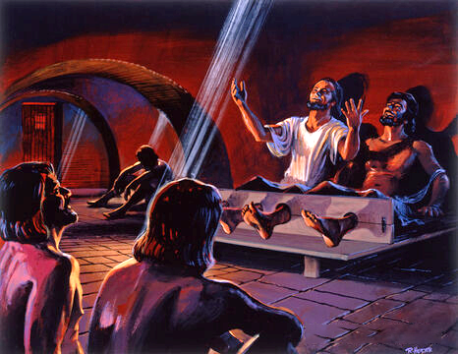
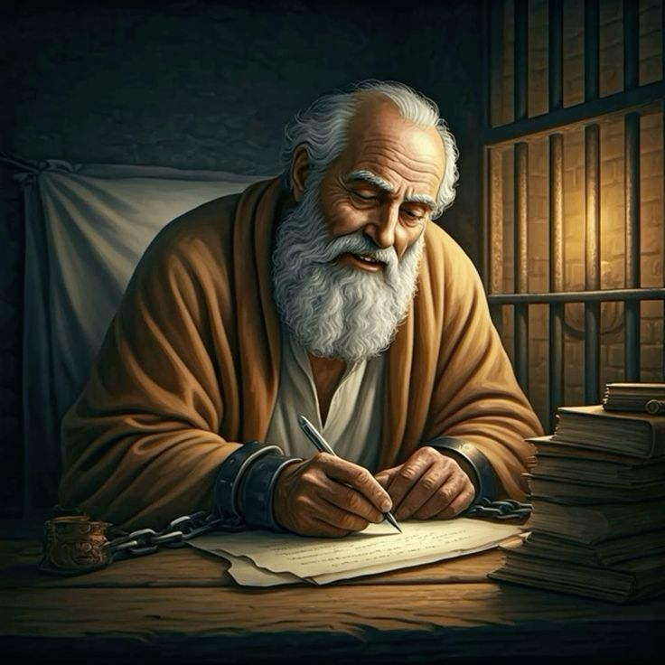







Naʻe ʻ ikai ko ha taimi faingofua eni kia Paula. Naʻe mei faingofua ke tukulolo ki he siva ʻa e ʻamanaki ʻi he mole ʻene tauʻataina.
Kae kehe, hangē pē ko ʻ ene hivaʻi ʻ a e ngaahi himi ʻ i hono pilīsone fakamamahi ʻ i Filipaí, naʻe maʻu ʻ e Paula ʻ a e ngaahi ʻ uhinga ki he houngaʻiá ke fakahaaʻi ki hono fanga tokoua mo e fanga tuofāfine ʻ i Filipai mo Kolosé.
Naʻe ʻikai taʻofi ia ʻe heʻene nofo popula mei heʻene hokohoko atu ʻene fetuʻutaki mo ʻene Tamai, pea taukapo maʻa e niʻihi kehe ʻi he lotu.
Ko e ngaahi ʻuhinga ke fai ai ʻa e fakafetaʻi mo e lotu ʻi he tohi ki he kakai Filipai:
  Ngaahi ʻuhinga ke fakafetaʻi ai (Filipai 1:3-8)
  Kole ki he lotu (Filipai 1:9-11)
Fakafetaʻi mo lotu ʻi he ngaahi taimi faingataʻa (Filipai 1:12-18)
Ko e ngaahi ʻuhinga ke fakafetaʻi mo lotu ai ʻi he tohi ki he kakai Kolose:
  Ngaahi ʻuhinga ke fakafetaʻi ai (Kolose 1:3-8)
  Kole ki he lotu (Kolose 1:9-12)

Slide 4
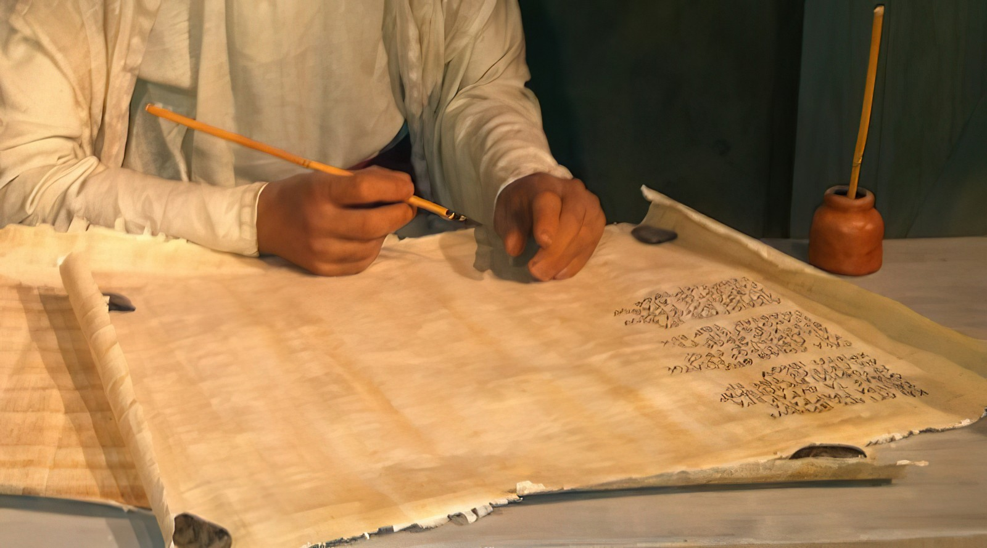
Ngaahi ʻUhinga ke Fai ai ʻa e Fakafetaʻi mo e Lotu ʻi he Tohi ki he Kau Filipai

Slide 5

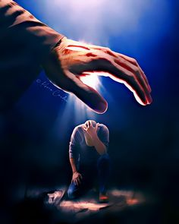
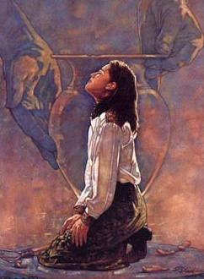
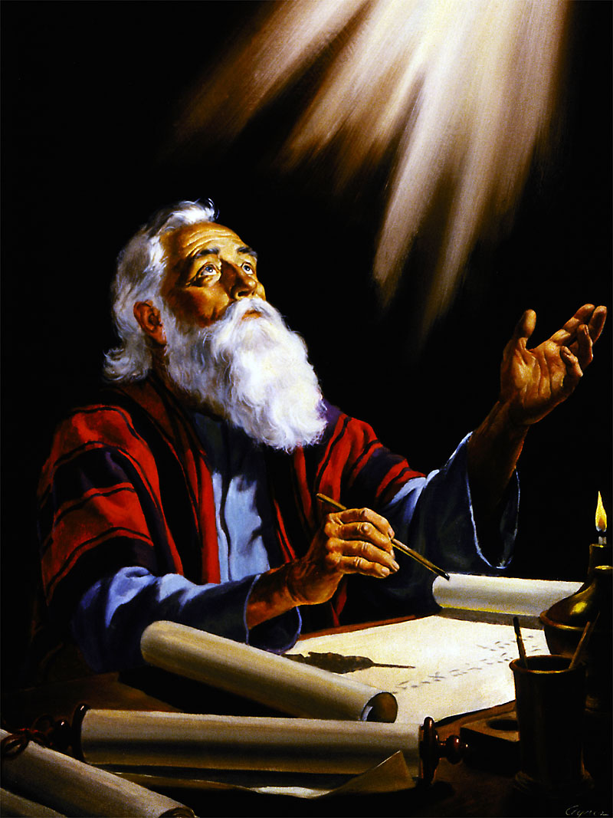
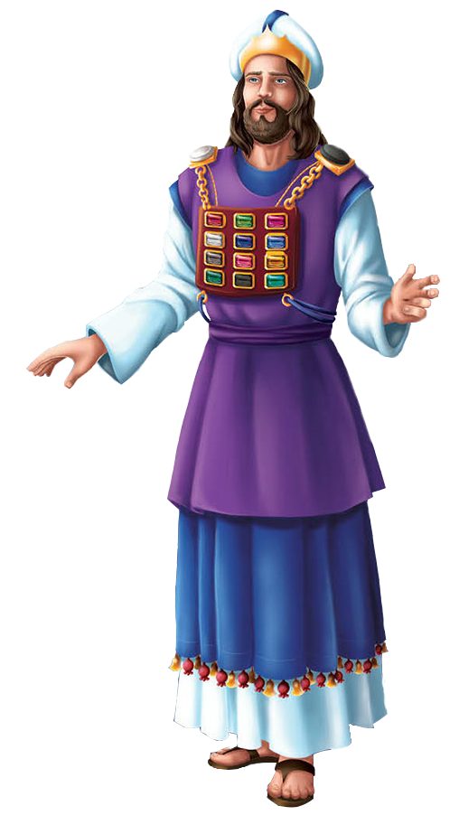
NGAAHI ʻUHINGA KE HOUNGAʻIA AI
“‌ʻOku ou ʻilo pau ʻae meʻa ko eni, koeʻuhi ko ia kuo ne kamata ʻae ngāue lelei ʻiate kimoutolu, te ne fakahaohaoa ia ʻo aʻu ki he ʻaho ʻo Sisu Kalaisi:” (Filipai 1:6)
ʻOku kamata ʻe Paula ʻene tohi ʻaki ʻene fakafetaʻi ki he ʻOtua koeʻuhi ko e kakai tui ʻi Filipai (Filipai 1:3), ʻa ia naʻa ne ʻofa lahi ai (Filipai 1:8)
Hangē pē ko hono tui ‘e he taula’eiki lahi ‘i hono sifa fatafatá, ‘i he tafa’aki ‘o hono lotó, ‘a e ngaahi hingoa ‘o e ngaahi matakali ‘o ‘Isileli ‘oku tongitongi ‘i he ngaahi makakoloa ‘i he’ene tu’u ‘i he ‘ao ‘o e ‘Otuá, na’e pehē pē mo e ‘ave ‘e Paula “‘i hono lotó” ‘a e mēmipa takitaha ‘o e siasí ‘i he’ene tu’u ‘i he ‘ao ‘o e ‘Otuá ‘o lotu ke hufekina kinautolu (Filipai 1:7).
Na’e kau ‘i he’ene hounga’ia ‘a e mo’oni’i me’a ko ia na’e nofo ma’u ‘a e kakai Filipai ‘i he kosipeli, pea ‘oku fakahaohaoa’i kinautolu ‘e he ‘Otua ‘i he ‘aho kotoa pe (Filipai 1:5-6).
Ko e ‘uhinga hono tolu ‘o e hounga’ia, ko e ‘inasi ‘a e kakai Filipai mo ia “ ‘i hoku ngaahi ha’i, pea ‘i he’eku taukapo’i mo fakapapau’i ‘a e Kosipeli” (Filipai 1:7).

Slide 6


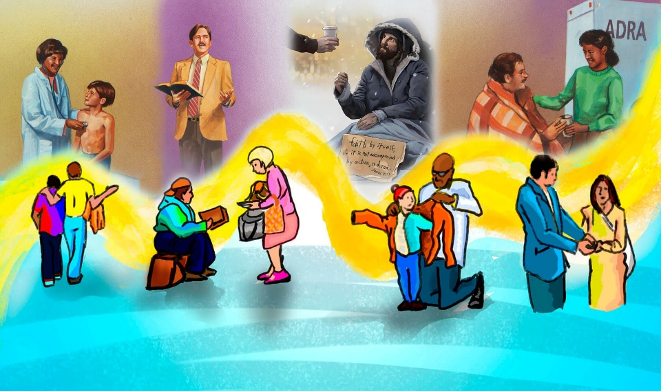
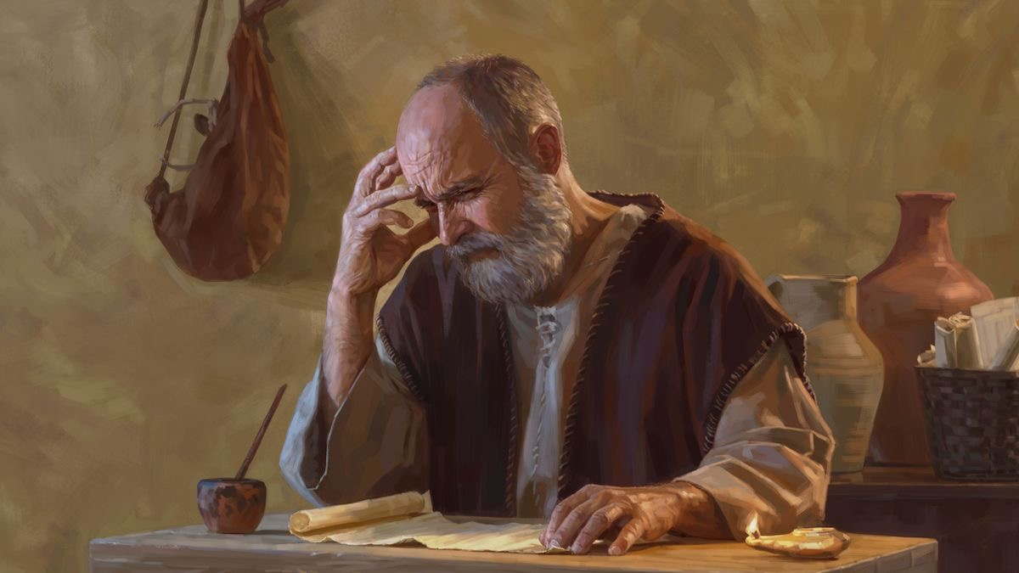
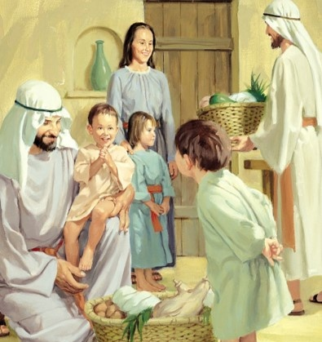
NGAAHI KOLE LOTU
“Pea ko ʻeku lotu eni, ke tupulekina hoʻomou ʻofa ʻo lahi, pea lahi hake ʻi he ʻilo mo e angafakapotopoto kotoa pē; Koeʻuhi ke mou ʻahiʻahiʻi ʻae ngaahi meʻa ʻoku fai kehekehe; ka mou angatotonu mo taʻehalaia ʻo aʻu ki he ʻaho ʻo Kalaisi; Ke fakafonu ʻaki ʻakimoutolu ʻae ngaahi fua ʻoe māʻoniʻoni, ʻaia ʻoku ia Sisu Kalaisi, ke ongoongolelei ai mo fakafetaʻi ai ki he ʻOtua. ” (Filipai 1:9-11)
Te tau lava ‘o lau ‘a e fakalotolahi ‘a Paula ki he lotu ko e “‘uhinga seini” (Filipai 1:9-11 ):
Fakatauange ke lahi 'a e 'ofa 'iate kimoutolu
Te ne ngaohi koe ke ke poto ange
Te ke ʻiloʻi ʻa e lelei taha
Te ke maʻa mo angatonu
Te ke fua ʻo fakafou ʻia Sisu Kalaisi
‘E iku eni ki he lāngilangi mo e fakamālō ki he ‘Otuá .
ʻE lava fēfē ʻetau ʻofá ʻo “fakaʻau ke lahi ange”? Ko e hā ‘oku mātu‘aki mahu‘inga ai ‘a e me‘a ko iá ki he mo‘ui faka-Kalisitiané?

Slide 7
KOE FAKAFETA'I MOE LOTU HE TAIMI FAINGATA'A

Slide 8

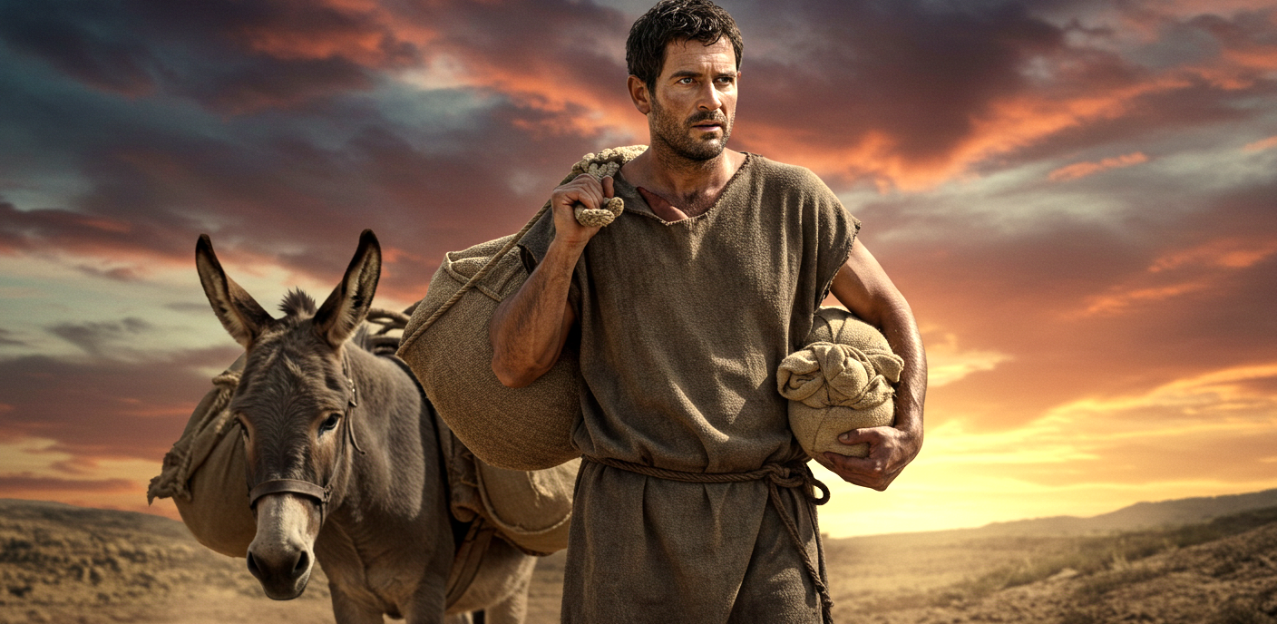
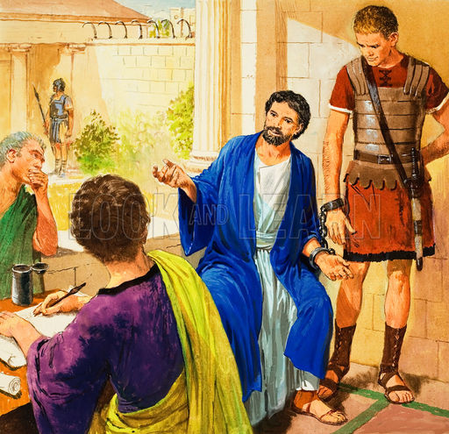
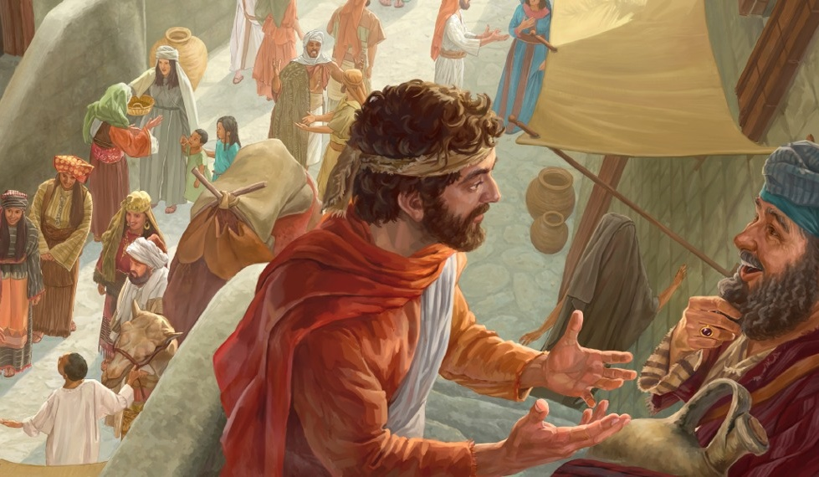
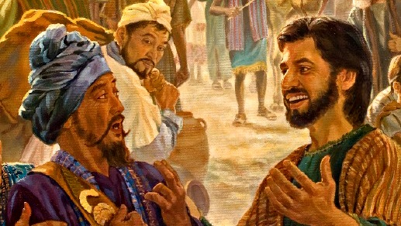
KO HA FAINGAMALIE KE TAUKAVEʻI ʻA E ONGOONGOLELEI
“Pea ko hoku loto ke mou ʻilo, ʻe kāinga, ko e ngaahi meʻa naʻe tō kiate au kuo iku ia ʻi he fakatupulekina pe ʻoe ongoongolelei;” (Filipai 1:12)
ʻI he taimi naʻe ʻilo ai ʻe he kau Filipai naʻe tuku popula ʻa Paula ʻi Loma, naʻa nau fuʻu mamahi lahi, pea naʻa nau fekau atu ʻa ʻEpafalotaito ke tokoni ki he ʻaposetolo (Filipai 4:18).
ʻ I he ʻ ikai loto - mamahi, naʻe fakamālō ʻ a Paula ki he ʻ Otuá ʻ i hono tuku pilīsone iá. Ko e ha ʻoku fai ai ʻa e fakafetaʻi? Koeʻuhi he naʻa ne lava ʻi he founga ko ʻeni ʻo malanga ki ai, ka ne ʻikai, naʻe ʻikai ke ne mei lava ʻo aʻu ki ai (Filipai 1:13)
ʻIkai ngata ai, ʻi heʻenau mamata ki he toʻonga fakakaukau ʻa e ʻaposetolo, naʻe fakalotolahiʻi ai ʻa e kau tangata faivelenga kehe, pea kamata ke malanga ʻaki ʻa e ongoongolelei neongo ʻa e ngaahi faingataʻa naʻe kau ki ai (Filipai 1:14)
Ko e niʻihi kehe, ʻi heʻenau fakakaukau ʻe ʻomi ʻe he lea tauʻataina fekauʻaki mo e ongoongolelei ha ngaahi faingataʻa kia Paula, naʻa nau tokoni foki –taʻeʻamanekina– ke fakamafola ia (Filipai 1:15-18)

Slide 9
Ngaahi ʻUhinga ke Fai ai ʻa e Fakafetaʻi mo e Lotu ʻi he Tohi ki he Kakai Kolose

Slide 10


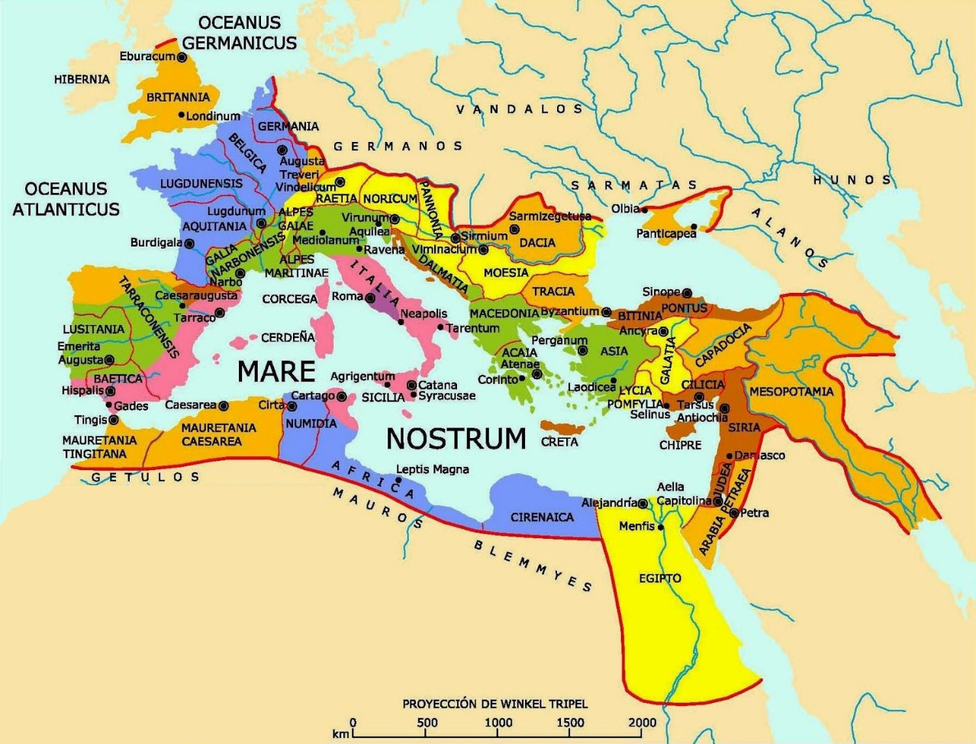
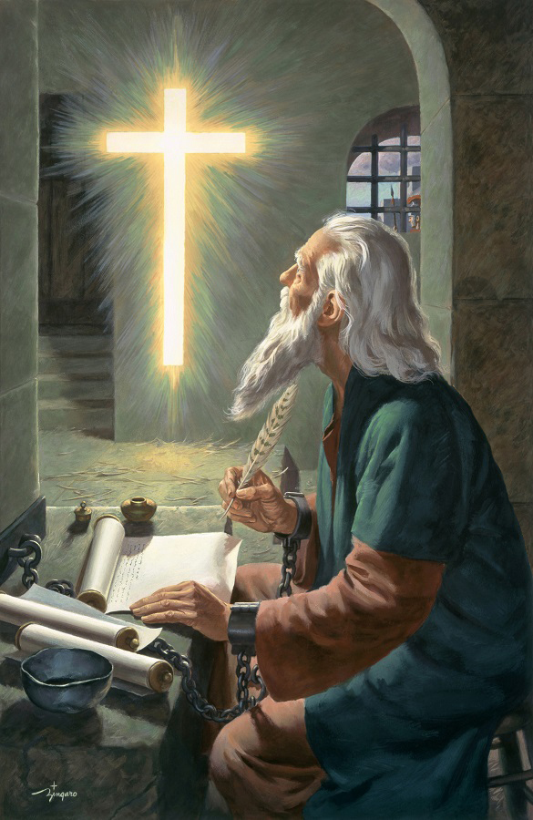

NGAAHI 'UHINGA KE FAKAFETA’I AI
“ʻOku ma fakafetaʻi ki he ʻOtua ko e Tamai ʻa hotau ʻEiki ko Sisu Kalaisi, ʻo hūfia maʻu pe ʻakimoutolu,” (Kolose 1:3)
‘I he’ene toe lea’aki ‘e Paula ‘a e ngaahi lea ‘o 1 Kolinito 13:13, ‘oku ne fakafeta’i ki he ‘Otua he ‘oku ma’u ‘e he kakai Kolose ‘a e ngaahi ‘ulungaanga faka-Kalisitiane ‘e tolu ko eni: ko e tui, ‘amanaki lelei, mo e ‘ofa (Kolose 1:4-5)
Ko e ngaahi ‘ulungaanga lelei ko ‘eni ‘oku tupu “ia Kalaisi Sisu”, ‘oku ne uesia ‘etau feohi mo e “kau ma’oni’oni kotoa pe”, pea kuo tuku mai ia kiate kitautolu ‘o fakafou ‘i he “lea mo’oni ‘o e ongoongolelei” .
‘Oku fakamamafa’i ‘e Paula, ko e ongoongolelei ni, kuo ‘ikai ke malanga’aki pe ki he kakai Kolose, ka “ki mamani kotoa pe” (Kolose 1:6)… pea ‘i he ta’u pe ‘e 30!
Ko e ivi ‘o e ‘Otua, ‘a ia ‘oku fakahoko mai ‘i he kosipeli ‘i he ngāue ‘a e Laumālie Mā’oni’oni, ‘oku ne ngaohi ‘a e Tohitapu ko e “folofola ‘o e mo’ui” (Filipai 2:16). Ko hono ‘uhinga, ‘i he’etau tali ‘a e ongoongolelei, ‘oku tau ma’u ai ‘a e mo’ui ta’engata mo ha tofi’a “kuo tanaki ma’amoutolu ‘i he langi” (Kolose 1:5).

Slide 11


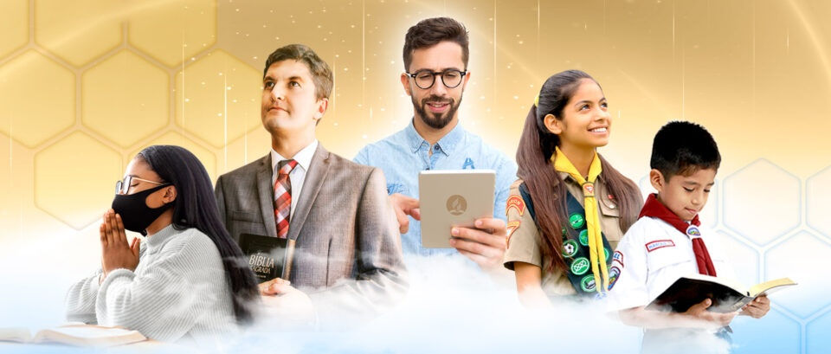
NGAAHI KOLE LOTU
“Pea ko e meʻa ko ia foki, talu ʻae ʻaho naʻa ma fanongo ki ai, ʻoku ʻikai tuku ʻema hūfia ʻakimoutolu, pea mo e holi ke fakafonu ʻakimoutolu ʻaki ʻae ʻilo ki hono finangalo ʻi he poto kotoa pē mo e ʻilo fakalaumālie;” (Kolose 1:9)
‘Oku kau ‘i he kole lotu ‘a Paula ‘a e ngaahi me’a lelei lahi ma’ae kakai Kolose (Kolose 1:9-11):
ʻOfa ke nau maʻu ʻa e ʻilo ki he ʻOtua, ʻa ia te ne ʻoange kiate kinautolu ʻa e poto mo e mahino fakalaumalie
Mo‘ui ‘o hangē ko e fānau ‘a e ‘Otuá, ‘o fakahōifua kiate ia ‘i he me‘a kotoa pē
Fakatauange ke nau fua pea tupulaki 'i he 'ilo .
Fakatauange ke fakamalohi'i kinautolu 'aki 'a e ivi 'o e 'Otua ke nau lava 'o kataki
Ko e lotu ko eni, ‘oku fai ia ‘i he “fakafeta’i fiefia ki he Tamai” (Kolose 1:12)
‘Oku ‘i ai ‘a e ngaahi founga ‘e fā ‘oku ngāue ai ‘a e ‘Otuá ke hoko ‘a e lotu ‘a Paulá ko ha me‘a mo‘oni ‘iate kitautolu:
Ko e Tohi Tapú
(Sāme 119:105)
Ko e laumalie ʻo e kikite (Fakaha 19:10), naʻe fakahaaʻi ʻia ʻEleni G.White
Ko e tataki ʻa e ʻOtua (Kolose 4:3)
Ko e Laumalie Maʻoniʻoni
(ʻIsaia 30:21)

Slide 12
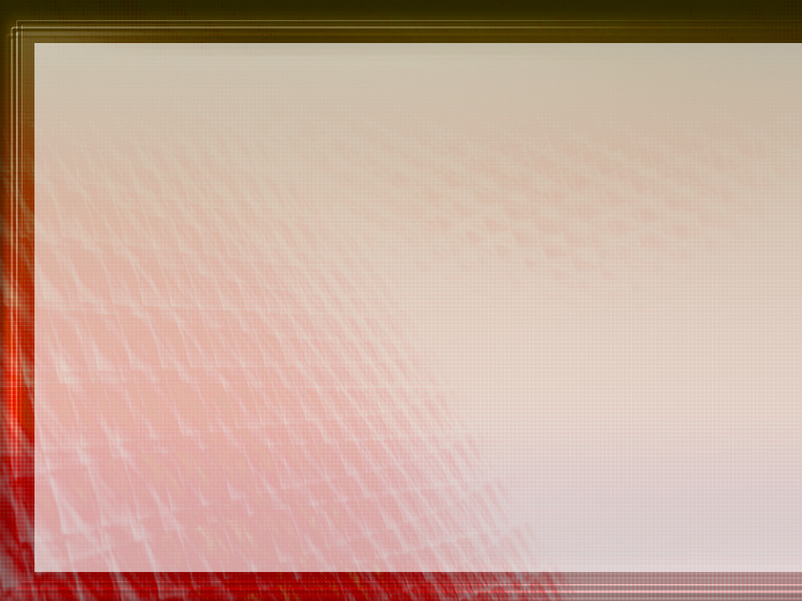
"Kuo pau ke haʻi ʻetau moʻuí mo e moʻui ʻa Kalaisí; ʻoku fie maʻu ke tau maʻu maʻu pe meiate Ia, ʻo maʻu meiate Ia, ʻa e Ma moʻui naʻe ʻalu hifo mei he langi, ʻo maʻu mei ha matavai mapunopuna ʻoku foʻou maʻu pe, ʻo ʻomi maʻu pe hono ngaahi koloa mahutafea. Kapau te tau fakamuʻomuʻa maʻu ai pe ʻa e ʻEiki, ʻo tuku hotau loto ke ʻalu atu ʻi he fakafetaʻi mo e fakafetaʻi kiate Ia, te tau maʻu maʻu pe ha foʻou ʻi heʻetau moʻui fakalotu. Ko ʻ etau ngaahi lotú ʻ e tuʻunga ia ʻ i ha fetalanoaʻaki mo e ʻ Otuá ʻ o hangē ko haʻatau talanoa mo ha kaumeʻa. Te Ne folofola fakatautaha mai ʻEne ngaahi meʻa lilo kiate kitautolu. ʻE faʻa hoko mai kiate kitautolu ha ongoʻi fiefia mo fakafiefia ʻo e ʻi ai ʻa Sisuu. ʻOku faʻa vela hotau loto ʻi hotau loto ʻi Heʻene ʻunuʻunu mai ke fetuʻutaki mo kitautolu ʻo hange ko ia naʻa Ne fai kia ʻInoke. ʻI he taimi ko ia ʻoku hoko ai ʻeni ko e meʻa ʻoku aʻusia ʻe he Kalisitiane, ʻoku ha ʻi heʻene moʻui ʻa e faingofua, loto fakatokilalo, angamalu, mo e loto fakatokilalo, ʻa ia ʻoku ne fakahaaʻi kiate kinautolu kotoa pe ʻoku feohi mo ia naʻa ne ʻi ai mo Sisu mo ako ʻiate Ia."
EGW (Ko e Ngaahi Lesoni Fakataumuʻa ʻa Kalaisi, p. 129)

