Slide 1
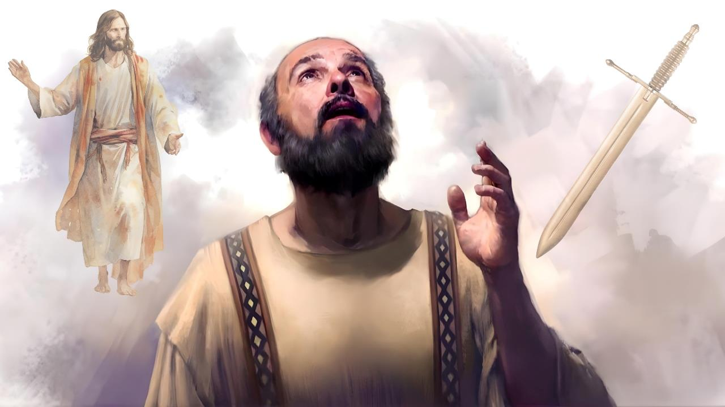
MOʻUI mo e MATE
Lesoni 3 ki he ʻaho 17 ʻo Sanuali 2026

Slide 2

“He ko e moʻui kiate au ko Kalaisi ia, ka ʻe ʻaonga lahi ʻae mate.”
Filipai 1:21

Slide 3


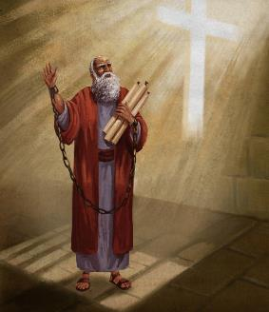


Naʻe tatali ʻa Paula ke fakamauʻi ia ʻe he anga fakamamahi ko Nelo. Ko hono kahaʻú naʻe fakatuʻunga lahi ange ia ʻ i he loto ʻ o Sisa kae ʻ ikai ko e fakamaau totonú.
Ka naʻá ne ʻ iloʻi ko hono ikuʻangá naʻe ʻ ikai ʻ i he nima moʻoni ia ʻ o Nelo, ka ʻ i he toʻukupu ʻ o e ʻ Otuá. Ko ia ai, naʻa ne fakapapauʻi ʻe fakatauʻatainaʻi ia ʻi he ngaahi lotu naʻe fai maʻana ʻi he ngaahi siasi.
Neongo ia, kapau naʻe ʻaonga ʻene pekia ki he ongoongolelei (ʻo hange ko hono tuku popula ia), naʻa ne loto fiemalie ke foaki ʻene moʻui maʻa Kalaisi.
Ke moʻui maʻa Kalaisi pe mate maʻa Kalaisi?
Naʻe hakeakiʻi ʻa Kalaisi ʻia Paula (Filipai 1:10-20, 25-26)
Ke moʻui pe mate maʻa Kalaisi (Filipai 1:21-22)
Ko e fakamavahe’i ʻa Paula (Filipai 1:23-24)
ʻOku ʻuhinga ki he ha ke moʻui maʻa Kalaisi?
ʻUlungaanga ʻi ha founga ʻoku taau mo e ongoongoleleí (Filipai 1:27a)
Ke tau uouangataha ma'ae ongoongolelei (Filipai 1:27b-30)

Slide 4

KE MO'UI MA'A KALAISI PE KE MATE MA'A KALAISI?

Slide 5



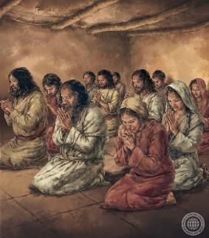
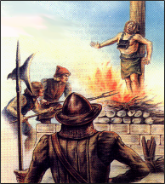
NAʻE HAKEAKIʻI ʻA KALAISI ʻIA PAULA
“‌ʻO fakatatau ki heʻeku holi lahi mo e ʻamanaki lelei, ke ʻoua naʻa ai ha meʻa te u mā ai, ka ʻi he fai mālohi lahi, ke hangē ko ia ʻi muʻa, ke pehē eni foki, ʻae fakaongolelei ʻa Kalaisi ʻi hoku sino, ʻi he moʻui, pe ʻi he mate.” (Filipai 1:20)
Naʻe fiefia ʻa Paula ʻi he ngaahi mamahi naʻa ne katakiʻi, ʻa ia naʻe lahi (Kolose. 1:24a; 2 Kolinito 11:23-27) Ko e moʻoni, naʻe ʻikai ke ne fiefia ʻi he faingataʻaʻia, ka ʻi he ngaahi ʻuhinga naʻa ne katakiʻi ai ʻa e ngaahi faingataʻa, ko e taha ʻo e ngaahi ʻuhinga ko ia ko e lelei naʻa ne ʻomi ki he siasi ʻo Kalaisi (Kolose. 1:24b; 2 Kolinito 11:28).
ʻI heʻene faʻifaʻitaki kia Sisu ʻi heʻene mamahi—pea naʻa mo ʻEne pekia naʻe hakeakiʻi ai ʻa Kalaisi ʻia Paula (Filipai. 1:20).
ʻI heʻene tohi ki he kakai Filipai, naʻe fakamahinoʻi ai ʻe Paula, ʻi he momeniti ko ʻeni, naʻe ʻikai ke ne ʻamanaki ke hakeakiʻi ʻa Sisu ʻaki ʻene pekia, ka naʻa ne ʻamanaki ʻi he ngaahi lotu ʻa e siasi mo e ngaue ʻa e Laumalie Maʻoniʻoni, ke fakatauʻatainaʻi ia pea hokohoko atu ʻene tauhi kia Kalaisi ʻaki ʻene moʻui. (Filipai 1:19, 25-26).
Koeʻuhi ko e kovi ʻoku mafola ʻi hotau mamani, ʻoku faʻa kau ai ʻa e mamahi ʻo hange ko e mamahi ʻa Kalaisi ʻi he moʻui ʻa Kalaisi, pea ʻi he ngaahi meʻa ʻe niʻihi, ko e mate ʻo hange ko e pekia ʻa Kalaisi (2 Timote 3:12).

Slide 6



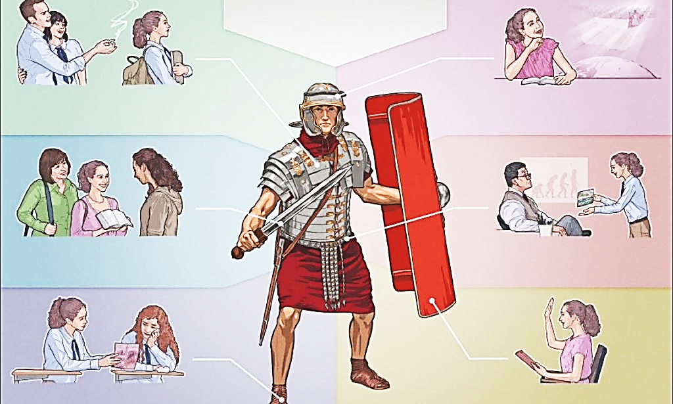

KE MOʻUI PE MATE MAʻA KALAISI
"He kiate au, ko e moʻui ko Kalaisi ia, pea ko e mate ko e tupu." (Filipai 1:21)
Ko e aka ʻo e faingataʻaʻia kotoa pe ʻoku ʻi he tau ʻo e mamani ʻoku fai he ʻaho ni ʻi he vahaʻa ʻo e lelei mo e kovi, ʻi he vahaʻa ʻo Kalaisi mo Setane.
Ko ha tau fakalaumalie ʻeni, ʻa ia kuo pau ke fai ʻaki ha ngaahi meʻatau fakalaumalie. ʻOku fakaʻaongaʻi ʻe he kau muimui ʻo e fili ʻa e ngaahi meʻatau ʻoku taʻefakalao ki he kau Kalisitiane (loi, fakaanga, malohi fakatoʻu, etc.).
Ka ʻoku tau fakaʻaongaʻi ʻa e ngaahi meʻatau hange ko e moʻoni mo e fakamaau totonu (2 Kolinito 6:4-7). Ko e ngaahi meʻatau malohi "ke holoki ʻa e ngaahi kolotau" (2 Kolinito 10:3-5).
Ka ko e ha ʻoku hoko ʻi he taimi ʻoku mate ai ʻa e kau maʻoniʻoni ʻi he tau? Fakatatau kia Paula, ʻoku maʻu ʻe he meʻa ni ha tupu maʻatautolu (Filipai. 1:21).
Kiate kitautolu ʻoku faivelenga kia Kalaisi, ʻoku hanga ʻe he mate ʻo ʻai kitautolu ke ʻoua naʻa tau lava ʻo aʻu ki ai ʻa e fili, pea ʻoku ne fakaʻataʻata kitautolu mei he faingataʻa kotoa pe (Palovepi 14:32; ʻIsaia 57:1).

Slide 7



KO E FAKAMAVAHE’I ‘A PAULA
“He ʻoku ʻefihia au ʻi he meʻa ʻe ua, ʻoku ou holi ke ʻalu, ke u ʻia Kalaisi; ʻaia ʻoku lelei lahi ʻaupito: Ka ko e nofo ʻi he sino ʻoku ʻaonga lahi ia kiate kimoutolu..” ( Filipai 1:23-24 )
Neongo na’e ‘ikai ke ne lava ‘o fai ‘a e tu’utu’uni, ka ‘oku haea ‘a Paula ‘i he vaha’a ‘o e ongo me’a ‘e ua (Filipai 1:23-24):
Ke mavahe
Ke kau mo Kalaisi .
Ke nofo
Ke 'aonga ki he siasi
‘I he’etau to’o ‘a e text ko eni, ‘oku tau lava ‘o faka’uhinga’i ‘oku ako’i ‘e Paula, ko ‘etau mate pe ‘oku tau ‘alu hake ki Hevani ke tau ‘ia Sisu, ‘o fepaki mo e ngaahi konga tohitapu kehe (Lea fktata 9:5; Saame 6:5).
‘I he tohi tatau ki he kakai Filipai ‘oku ne talamai, ke ne kakato mo Kalaisi, kuo pau ke ne tatali ki he momeniti ‘o e toetu’u (Fil. 3:8-11).
‘I he taimi ‘e taha, ‘oku fakahoa ‘e Paula ‘a e sino ki ha tēniti ‘oku maumau (mate) koe’uhi ke kofu’aki ‘a e mo’ui ta’efa’amate (2 Kol. 5:1-4). Kaekehe, ‘oku ne fakamahino mai, ‘oku hoko ‘a e teunga ko eni ‘i he Hā’ele ‘Angaua Mai, ‘o ‘ikai ‘i he momeniti ‘o e mate (1 Kol. 15:42, 51-54)

Slide 8

KO E HA 'A E 'UHINGA 'O E MO'UI MA'A KALAISI?

Slide 9


ʻULUNGAANGA ʻI HA FOUNGA ʻOKU TAAU MO E ONGOONGOLELEI
“ke taau hoʻomou ʻulungāanga mo e ongoongolelei ʻa Kalaisi: ” (Filipai 1:27a)
Ko e kupuʻi lea ko e "ho ʻulungaanga" ko e liliu ia ʻo e foʻi lea faka-Kalisi ko e politeuomai, ʻa ia ko hono ʻuhinga "ke moʻui ko ha tangataʻi fonua." ʻOku naʻinaʻi ʻa Paula ki he kakai Filipai (mo kitautolu kotoa) ke tau ʻulungaanga ʻi ha founga ʻoku taau mo e kakai ʻo e Langi (Filipai 3:20).
Angamaluu
Fiekaia mo fieinua ki he fakamaau totonu
Loto maʻa
Kau Faʻa Fakalelei
Loto fiemalie ke fulihi atu ʻa e kouʻahe ʻe taha
ʻOfa ki hotau ngaahi fili
Tapuakiʻi ʻa kinautolu ʻoku kapeʻi kitautolu
Fai lelei kia nautolu ʻoku fehiʻa kiate kitautolu
Ke ʻofa mo angaʻofa
Ke ʻaloʻofa mo loto fakatokilalo
Masiva ʻi he laumalie
ʻAloʻofa
Ala meʻa pehe.
Naʻe akoʻi kitautolu ʻe Sisu ʻi he Malanga ʻi he Moʻunga ki he founga ʻoku totonu ke moʻui ʻaki ʻe he kakai ʻo e Langi.
ʻE lava ke fakanounouʻi ia ʻo peheni: "ka ke fai ʻa e fakamaau totonu, mo ʻofa ki he ʻaloʻofa, pea ke ʻaʻeva ʻi he loto fakatokilalo mo ho ʻOtua" (Maika 6:8).
ʻOku fakaʻaongaʻi ʻe Paula ʻa e faleʻi ko ʻeni ko ha talateu ki ha kaveinga naʻe hohaʻa kiate ia: ko e uouangataha ʻi he siasi.
Naʻa ne ʻiloʻi ʻoku faʻa tupu ʻa e moveuveu mei he hikisia mo e ʻulungaanga taʻefeʻunga. Ko ia ai, ʻ okú ne naʻinaʻi mai ke tau tōʻonga ʻ i ha founga fakangeingeia.

Slide 10



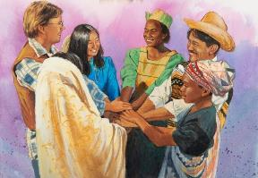
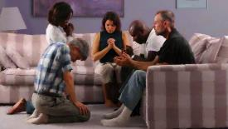
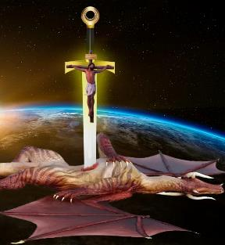

KE TAU UOUANGATAHA MAʻA E ONGOONGOLELEI
“…koeʻuhi ka ai haʻaku ʻalu atu ʻo vakai kiate kimoutolu, pe teu mamaʻo, te u fanongo pe ki hoʻomou ngāue, ʻoku mou tuʻumaʻu ʻi he loto pe taha, ʻo uouangataha pe, ʻo feinga fakataha ʻi he tui ki he ongoongolelei;” (Filipai 1:27b)
ʻOku ʻikai fakapapauʻi ʻe he angatonu mo e angatonu ha moʻui taʻe ʻi ai ha fepakipaki (Filipai 1:30). ʻI he tafaʻaki ʻe taha, naʻe faingataʻaʻia ʻa Siope, ʻa ia naʻe fakaha ʻe he ʻOtua "ʻoku taʻehalaia mo angatonu, ko e tangata ʻoku manavahe ki he ʻOtua mo fakaʻehiʻehi mei he kovi" (Siope 1:8), ʻi ha fepaki fakalilifu, ko e ngaue ʻa e fili.
ʻOku mahuʻinga ʻa e uouangataha ʻi he tau ʻoku tau kau ki ai. ʻOku naʻinaʻi mai ʻa Paula ke tau tau fakataha ke taukapoʻi ʻa e ongoongolelei (Filipai 1:27b)
Kuo pau ke fakatahaʻi ʻa e uouangataha ko ʻeni ʻo e taumuʻa mo e lotu mo e ako ʻo e Folofola (ʻEfeso 6:18; Fili. 2:16).
ʻI he taimi ʻoku tau fepaki ai mo e kovi, kuo pau ke ʻoua naʻa tau ilifia ʻiate kinautolu ʻoku fakafepakiʻi kitautolu (Fili. 1:28). Tau manatuʻi muʻa ko Setane ko ha fili kuo ikunaʻi, he kuo ʻosi ikunaʻi ʻe Kalaisi ʻa e tau ʻi he kolosi (Luke 10:18; Kolose 2:15)

Slide 11
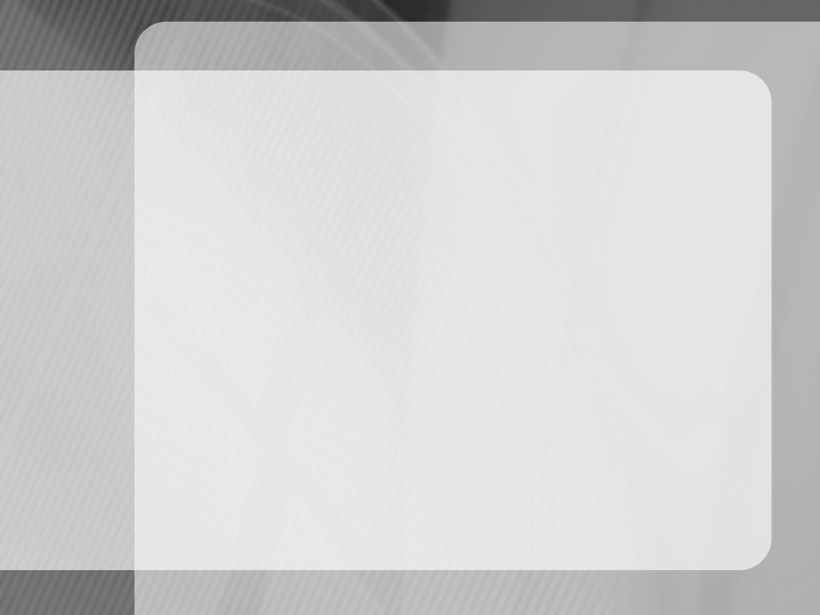
"Ko e taʻu nai ʻeni kuo ta ʻi he ngoue ʻa e ʻEiki? Pea ko e ha ha ʻaonga kuo tau ʻomi ki he ʻEiki? ʻOku anga fefe haʻatau fetaulaki mo e fofonga sivisivi ʻo e ʻOtua? ʻOku tupulaki nai ʻetau ʻapasia, ʻofa, loto fakatokilalo, mo e falala ki he ʻOtua? ʻOku tau mataʻikoloa ʻaki nai ʻa e houngaʻia ʻi he kotoa ʻo ʻEne ngaahi ʻaloʻofa? ʻOku tau feinga nai ke faitapuekina ʻa kinautolu ʻoku tau feohi? ʻOku tau fakahaaʻi nai ʻa e laumalie ʻo Sisuu ʻi hotau ngaahi famili? ʻOku tau akoʻi nai ʻEne Folofola ki heʻetau fanau, pea fakaha kiate kinautolu ʻa e ngaahi ngaue fakaofo ʻa e ʻOtua? Kuo pau ke fakafofongaʻi ʻe he Kalisitiane ʻa Sisu ʻaki ʻene fakatou lelei mo fai lelei. Pea ʻe ʻi ai leva ha meʻa namu lelei fekauʻaki mo e moʻui, ko ha ʻulungaanga fakaʻofoʻofa, ʻa ia te ne fakahaaʻi ʻa e foʻi moʻoni ko e fanau ia ʻa e ʻOtua, ko ha ʻea-hoko ki he langi."
EGW (Te Mou Maʻu ʻa e Malohi, 10 ʻo Tisema)

