Slide 1
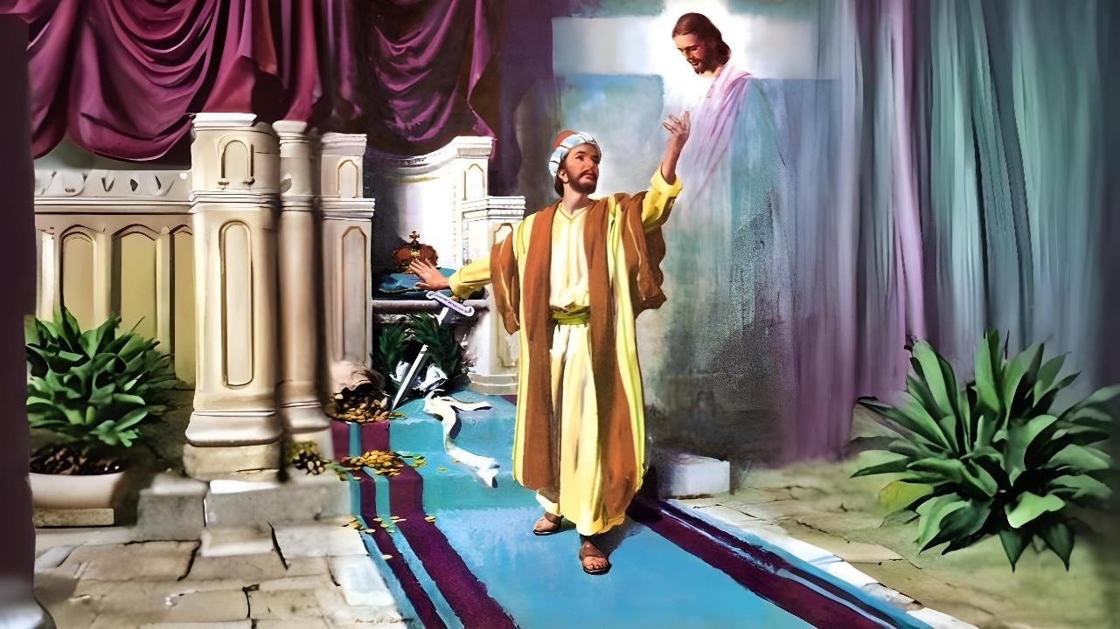
Lesoni 6 ki he ʻaho 7 ʻo Fepueli, 2026
FALALA PE KIA KALAISI

Slide 2


“Koeʻuhi ke u ʻiloʻi ia, mo e mālohi ʻo ʻene toetuʻu, peau kau ʻi heʻene ngaahi mamahi, ʻi he fakatatau au ki heʻene pekia; Kapau teu faʻa lavaʻi ʻi he meʻa kotoa pē ʻae toetuʻu mei he mate. ”
Filipai 3:10, 11

Slide 3
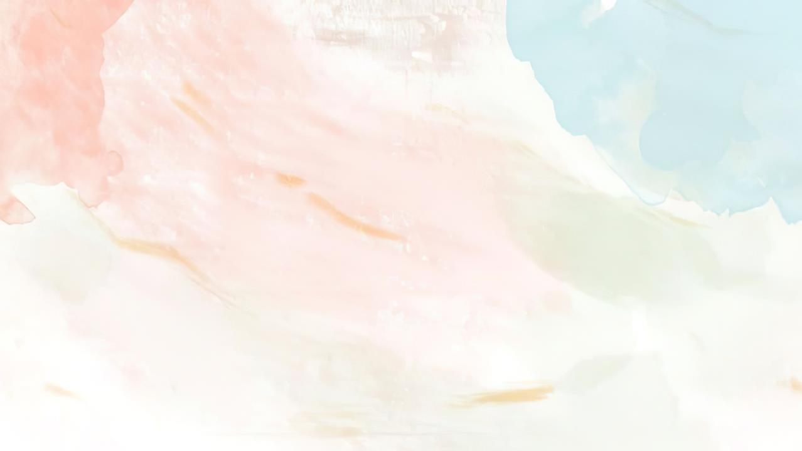









Naʻe ʻilo ʻe he kau Filipai ʻa e hala ki he fakamoʻui, ʻo hange ko ia naʻe fakaha mahino ʻe Paula mo Sailosi ki he taha ʻo e kau fuofua ului ʻi he kolo ko ia: ko e tauhi fale fakapopula (Ngaue 16:30-31).
Ko ʻeni kuo fokotuʻu maʻu ʻa e siasi, naʻa nau ʻi ha tuʻunga fakatuʻutamaki ke takihalaʻi kinautolu mei he hala ʻo e fakamoʻui.
ʻ I he ʻ uhinga ko ení, ʻ oku fakamanatu ai ʻ e Paula kiate kinautolu ʻ a e ngaahi pou tefito ʻ o e fakamoʻuí ʻ i he tuí.
Ngaahi tokoni ke fakaʻehiʻehi mei he mole ho fakamoʻui:
Ko e meʻa ke fakaʻehiʻehi mei ai (Filipai 3:1-3)
Ko e meʻa ʻoku toe (Filipai 3:4-6)
Ko e meʻa mahuʻinga (Filipai 3:7-8)
Ngaahi tokoni ki he nofo maʻu ʻi he fakamoʻui:
Ko e tui kia Kalaisi (Filipai 3:9)
Ko e ʻilo ʻo Kalaisi (Filipai 3:10-16)

Slide 4

NGAAHI TOKONI KE FAKAʻEHIʻEHI MEI HE MOLE HO FAKAMOʻUI

Slide 5

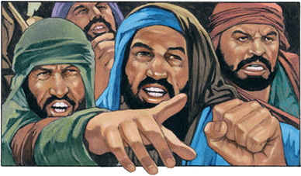

MEʻA KE FAKAʻEHIʻEHI MEI AI
“Vakai telia ʻae fanga kulī, vakai telia ʻae kau ngāue kovi, vakai telia ʻae kau tuʻusi.” (Filipai 3:2)
Kimu’a pea tau talanoa ki he ngaahi fakatu’utamaki ‘oku ne fakamanamana’i ‘a e tui, ‘oku ‘omai ‘e Paula ha ngaahi fale’i: “Mou fiefia ‘i he ‘Eiki” (Fil. 3:1a). ‘Oku ne tānaki mai ki he me’a ni ha me’a mahu’inga: ‘oku lelei ke toutou lea’aki ‘a e mo’oni ‘oku tau ma’u, neongo ‘oku tau ‘osi ‘ilo’i lelei ia (Filipai 3:1e)
Ko hono maʻu ʻo e ʻaloʻofa ʻa e ʻOtuá (Saame 31:7)
Ko hono tuku ‘etau falalá kiate ia (Saame 5:11)
Ko hono maʻu ʻo e ngaahi tāpuaki ʻo e fakamoʻuí (Saame 9:14)
Tauhi ‘a e Lao ‘a e ‘Otuá ( Sāme 119:14; ‘Aisea 58:​13, 14 )
Tui ki Heʻene Folofola (Saame 119:162)
Ko hono ʻohake ʻo e fanau anga faka-ʻOtua (Lea Fakatata 23:24,25)
Te tau fiefia fēfē ʻi he ʻEikí?
Naʻe fakamahinoʻi ʻe Paula ʻa e fakatuʻutamaki lahi taha naʻe tuʻu fakatuʻutamaki ki he siasi ʻi he taimi ko ia: ko e kau akonaki loi naʻa nau akoʻi ʻa e talangofua pau ki he fono ʻo e ouau (Fili. 3:2). ʻOku ne lave ki he ngaahi meʻa ni ʻi ha founga kehekehe ʻe tolu: ko e fanga kulii (Saame 22:16;
2 Pita 2:21-22); kau faikovi; mo e kau tuʻusi ʻo e kakano (ʻi he kamu)

Slide 6

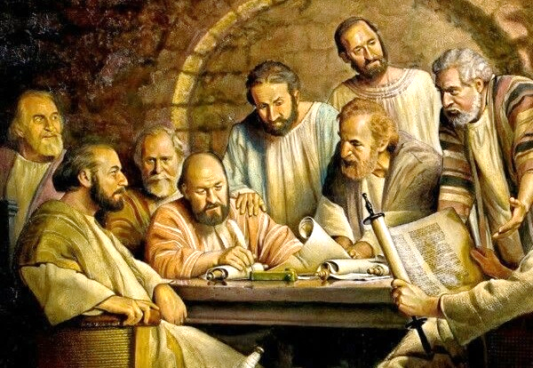
KO E MEʻA ʻOKU TOE
“Naʻe kamu au ʻi hono valu ʻoe ʻaho, mei he hako ʻo ʻIsileli, mei he faʻahinga ʻo Penisimani, ko e Hepelū ʻoe kau Hepelū; pea ʻi he meʻa ʻae fono ko e Fālesi;” (Filipai 3:5)
ʻI he Fakataha Alelea ʻo Selusalema, naʻe tuʻutuʻuni ai ke ʻoua naʻa fakahohaʻasi ʻa e kau Senitaile ʻi he ngaahi meʻa fekauʻaki mo e lao ouau faka-Siu (Ngaue 15:19-21). Neongo ia, naʻe haʻu ha kau faiako ʻe niʻihi ki Filipai ʻo akoʻi ʻa e fie maʻu ke kamu (Filipai 3:2-3).
ʻI heʻene foki ki he kuohili, ʻoku fakamanatu ange ʻe Paula kiate kinautolu ʻa ʻene haohaoa ʻi he taimi naʻa ne hange ai ko e kau faiako ko ia (Filipai 3:4-6):
Kamu ʻi hono ʻaho valu; foha ʻo ha ongomātuʻa mateaki
Hepelu ʻo e kau Hepeluu; Penisimani ʻo e ʻinasi maʻa
ʻ I he fekauʻaki mo e laó, ko e Fālesi fefeka tahá
ʻ I he fekauʻaki mo e faivelengá, ko ha tokotaha fakatanga ia ʻ o e siasí
Ko e tokotaha maluʻi taʻetukuakiʻi ʻo e Lao
Ka naʻá ne pōlepole fekauʻaki mo e ngaahi meʻá ni kotoa ki muʻa ke ne ʻ iloʻi ʻ a Sīsuú. Naʻa ne ʻiloʻi ʻeni naʻe ʻikai mahino kiate ia ʻa e Fono (Matiu 5:21-22). Naʻa ne ʻiloʻi ko Kalaisi pe ʻoku ne fakamoʻui (Filipai 3:7).

Slide 7

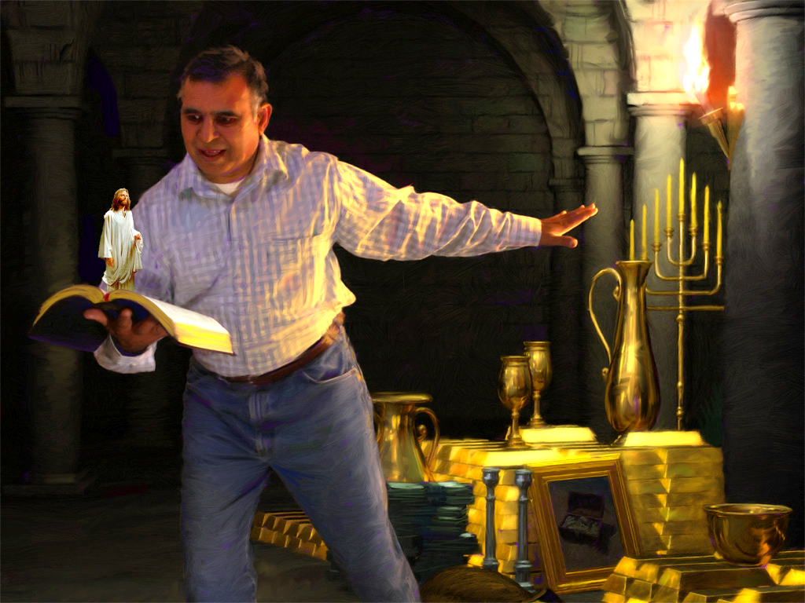
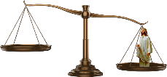


KO E MEʻA MAHUʻINGA
“Ka ko e ngaahi meʻa ko ia naʻe ʻaonga kiate au, naʻaku lau ia ko e meʻa ke siʻaki koeʻuhi ko Kalaisi.”
(Filipai 3:7)
‘Oku fuatautau ‘e Paula ‘ene mo‘ui ki mu‘á mo ‘ene mo‘ui lolotongá. ‘I he tafa‘aki ‘e taha, ‘okú ne tuku ai ‘ene ‘iló kotoa; ko hono kaha‘u nāunau‘iá ko ha tokotaha ako fetu‘u ‘a Kāmelieli; ‘ene ngaahi me‘a‘ofa faka-Fālesi fakaofo. Maʻu kotoa.
Ko ʻeni, tuku ʻi he tafaʻaki ʻe taha ʻo e meʻafuá ʻene moʻuí talu mei heʻene fetaulaki mo Kalaisí. ‘Oku hoko ‘a e ma’u kotoa pe ko e veve, he ‘oku ‘ikai ha me’a ‘e fakatatau ki he ‘ofa ‘a Kalaisi (Filipai 3:7-8).
Ko e hā ha meʻa ʻe toe mahuʻinga ange ʻi he moʻui taʻengata ʻi he langí pea ʻi he māmani foʻoú? Ka, ‘oku fakakuihi ‘e he ngaahi me‘a mahu‘inga fakamāmaní ‘a e tokolahi mei he mo‘oni‘i me‘a ko ení. ʻOku ʻi ai ha feʻauʻauhi fakanatula ʻi he vahaʻa ʻo e ngaahi meʻa ʻoku lau ʻoku mahuʻinga hení mo e meʻa ʻoku fakamahuʻingaʻi moʻoni ʻe Hēvaní: ʻulungaanga faka-Kalaisí mo e fakamoʻui ʻo e laumālié.

Slide 8

NGAAHI TOKONI KI HE NOFO MAʻU ʻI HE FAKAMOʻUI

Slide 9



KO E TUI KIA KALAISI
“Pea ke ʻilo au ʻiate ia, ʻo ʻikai ʻi heʻeku fakatonuhia ʻaʻaku, ʻaia ʻoku mei he fono ka ko ia ʻoku ʻi he tui kia Kalaisi, ko e fakatonuhia ʻaia ʻoku mei he ʻOtua ʻi he tui:” (Filipai 3:9)
Naʻe falala ʻa Paula ki heʻene maʻoniʻoni, pea naʻa ne ʻalu ki Tamasikusi ke fakafoki ʻa e kau lotu hee ʻo e "Hala" ki he hala ʻo e fakamoʻui (Ngaue 9:1-2). Ka naʻa ne hu ki Tamasikusi kuo ikunaʻi ia ʻe ha maʻoniʻoni ʻe taha, ʻa e maʻoniʻoni ʻa e ʻOtua: "ʻa ia ʻoku tupu ʻi he tui kia Kalaisi" (Filipai 3:9)
Talu mei he momeniti ko ia, mo e ʻikai ke ne toe falala ki heʻene anga maʻoniʻoni. He ʻoku taʻeʻaonga ke falala ki heʻetau ngaahi ngaue ke maʻu ʻa e fakamoʻui (Kaletia 2:16)
Naʻa ne fakaʻamu ke "ʻiloʻi ia ʻia [Kalaisi]" (Fili. 3:9). Ko e ha ʻoku ʻuhinga ki ai ʻeni?
Fakatatau ki he 1 Kolinito 1:30, ʻoku falute ʻe he "ʻia Kalaisi" ʻa e meʻa kotoa pe ʻoku kau ʻi he Palani ʻo e Fakamoʻui, mei he kamataʻanga ʻo ʻetau poto fakalaumalie (poto), ʻo fakafou ʻi he fakatonuhiaʻi ʻi he tui (maʻoniʻoni) mo e teuteu ki he langi (fakamaʻoniʻoniʻi), ʻo aʻu ki he fakalangilangiʻi ʻi he Haʻele ʻAngaua Mai (huhuʻi).

Slide 10
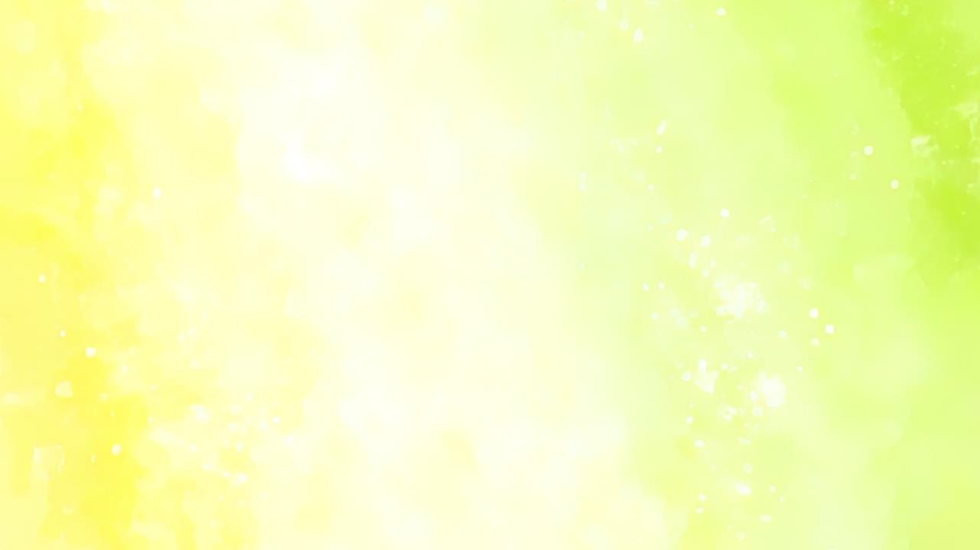

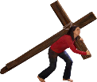




KO E ʻILO ʻO KALAISI
“Koeʻuhi ke u ʻiloʻi ia, mo e mālohi ʻo ʻene toetuʻu, peau kau ʻi heʻene ngaahi mamahi, ʻi he fakatatau au ki heʻene pekia; ” (Filipai 3:10)
ʻE lava fefe ke tau ʻiloʻi ʻa Kalaisi (Fili. 3:10-16)?
ʻI he taimi ʻoku tau ako ai ʻEne Folofola
ʻI he taimi ʻoku tataki ai kitautolu ʻe he Laumalie Maʻoniʻoni
ʻI he taimi ʻoku tau kau ai ʻi Heʻene ngaahi mamahi
ʻI he taimi ʻoku tau hoko atu ai ki he taumuʻa
ʻOku hange ʻa e moʻui faka-Kalisitiane ko ha lova. Kuo pau ke tau fakakaukau lelei ki heʻetau taumuʻa. ʻOku ʻikai ke tau moʻui ke nofo heni ʻo fiefia pe ʻi he moʻui ni. ʻOku tau ʻamanaki ke aʻu ki he toetuʻu ʻo e mate (Filipai 3:11)
Kae ʻoua kuo hokosia ʻa e momeniti ko ia, ʻoku tau feinga ke "puke maʻu ʻa ia naʻe puke ai au ʻe Kalaisi Sisu" (Filipai 3:12 ) Naʻe maʻu au ʻe Sisu ke foaki kiate au ha kolo; ko ha pale; ko ha moʻui taʻengata ke nofo mo Ia (Hepelu 11:10; Filipai 3:14; 1Tesalonika 4:17)

Slide 11

“Ko e taumuʻa lahi naʻá ne ueʻi ʻ a Paula ke ne vilitaki atu ki muʻa ʻ i he fehangahangai mo e faingataʻá mo e faingataʻá ʻ oku totonu ke ne taki atu ʻ a e tokotaha ngāue Kalisitiane kotoa pē ke ne fakatapui kakato ia tonu ki he ngāue ʻ a e ʻ Otuá. ʻE fakahoko ʻa e ngaahi meʻa fakaʻofoʻofa ʻo e mamani ke tohoakiʻi ʻene tokanga mei he Fakamoʻui, ka kuo pau ke ne vilitaki atu ki he taumuʻa, ʻo fakahaaʻi ki he mamani, ki he kau ʻangelo, pea ki he tangata ʻoku feʻunga ʻa e ʻamanaki lelei ke mamata ki he fofonga ʻo e ʻOtua ʻa e ngaue mo e feilaulau kotoa pe ʻoku fie maʻu ke aʻusia ʻa e ʻamanaki lelei ko ʻeni.Ko e ākonga māʻulalo taha ʻ a Kalaisí te ne hoko nai ko ha tokotaha nofo ʻ i hēvani, ko ha ʻ ea ʻ o e ʻ Otuá ki ha tofiʻa taʻefaʻauha.”
EGW (Fepakipaki mo e Lototoʻa, Tisema 13)

