Slide 1
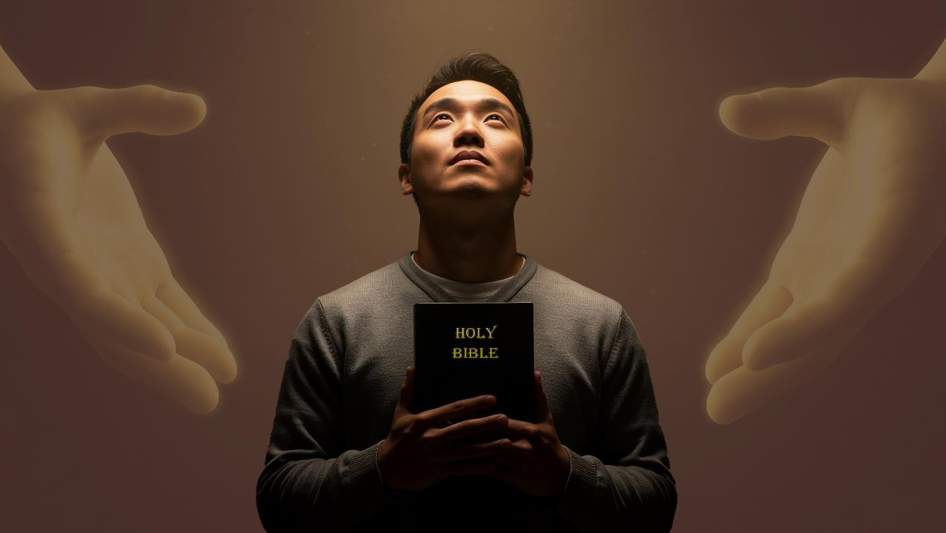
FAKALELEI MO E ʻAMANAKI LELEI
Lesoni 9 ki he ʻaho 28 ʻo Fepueli 2026

Slide 2


2 Kolinitō 5:21
“He naʻa ne ngaohi ia, ʻaia naʻe ʻikai haʻane angahala, koe feilaulau ʻi he angahala koeʻuhi ko kitautolu; kae hoko ai ʻakitautolu ko e māʻoniʻoni ʻae ʻOtua ʻiate ia.”

Slide 3

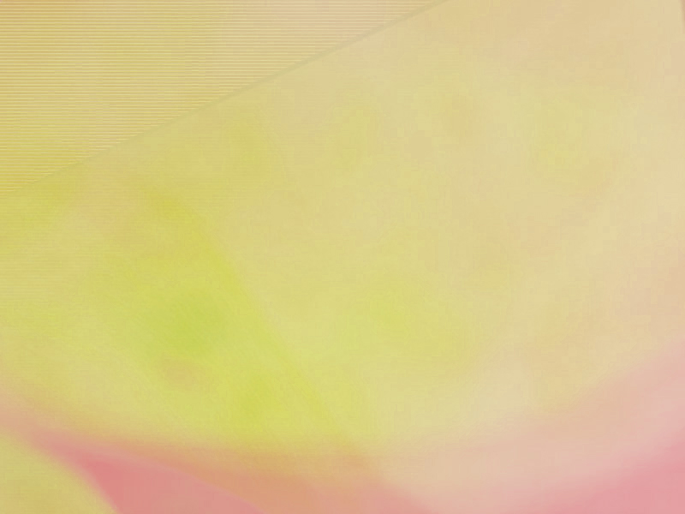
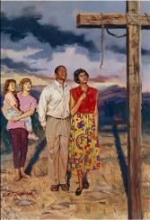
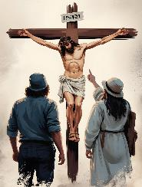
Hili ʻene pehe naʻe fakaleleiʻi ʻe he kolosi ʻo Kalaisi ʻa Langi mo Mamani (Kolose 1:20), naʻe hoko atu ʻa Paula ʻo fakamatalaʻi ʻa e ngaahi ola ʻaonga ʻo e fakalelei ko ʻeni kiate kitautolu.
Kuo liliu fefe kitautolu ʻe he meʻa ni? Naʻe anga - fēfē ʻ a e tomuʻa ʻ afio ʻ a e ʻ Otuá ki he kotoa ʻ o e meʻá ni? Ko e ha te tau lava ʻo fai ke tokoniʻi e niʻihi kehe ke nau kau ʻi he fakalelei mo maʻu ha ʻamanaki lelei?
KO E FAKALELEI MO E ʻAMANAKI LELEI ʻI HE ONGOONGOLELEI
Ko e ngaahi ola ʻo e fakalelei
Mei he kau faikovi ki he kau maʻoniʻoni (Kolose 1:21-22)
Tuʻu maʻu mo tuʻu maʻu
(Kolose 1:23)
ʻAmanaki lelei
ʻOmi ʻa e ʻamanaki lelei
(Kolo.1:24-25)
Ko e meʻa lilo ʻa e ʻOtua
(Kolo. 1:26-27)
Ko e malohi ʻo e ongoongolelei
Ko Hono Fanongonongo ʻo e Ongoongolelei (Kolo. 1:28-29)

Slide 4

KO E NGAAHI OLA ʻO E FAKALELEI

Slide 5

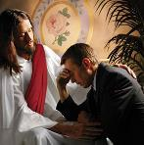
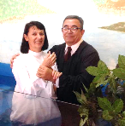
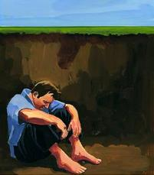
MEI HE KAU FAIKOVI KI HE KAU MAʻONIʻONI
“Pea ko kimoutolu, naʻe ʻāuhē ko e ngaahi fili ʻi muʻa ʻi loto ʻi he ngaahi ngāue kovi, ka ko eni kuo ne fakalelei. ‌ʻI he sino ʻo hono kakano, ʻi he mate, koeʻuhi ke ne ʻatu ʻakimoutolu ʻoku mou māʻoniʻoni mo taʻemele mo taʻevalokiʻia ʻi hono ʻao:.” (Kolose 1:21-22)
ʻOku faingofua pe ʻa e palopalema. Naʻa tau moʻui ʻo fai kovi, pea ko ia ai, naʻe tauteaʻi ai kitautolu ki he mate taʻengata (Loma 6:23; Fakaha 21:8).
Naʻa Ne pekia ʻi he kolosi ke totongi ʻetau angahala (Loma 5:8)
ʻOku fakatauʻatainaʻi kitautolu mei heʻetau angahala ʻi he tui, fakatomala, mo e papitaiso, pea ʻoku tau taʻe-ha-mele mo taʻehalaia ʻi he ʻao ʻo e ʻOtua [fakatonuhiaʻi] (Loma 5:10; Kolo. 1:22)
Tuʻunga ʻi he ngaue ʻa e Laumalie Maʻoniʻoni ʻoku liliu mamalie ai ʻetau moʻui pea tau hoko ʻo maʻoniʻoni ʻi he ʻao ʻo e ʻOtua [fakamaʻoniʻoniʻi] (Loma 8:1; 2 Kolinito 5:17)
Naʻe ʻikai ke tau lava ʻiate kitautolu pe ʻo liliu ʻa e tuʻunga ko ʻeni, pe totongi hotau fakamoʻui (Saame 49:7-8).
Ka naʻe ʻi ai ha palani maʻongoʻonga ʻa e ʻOtua kuo teuteuʻi maʻatautolu:

Slide 6
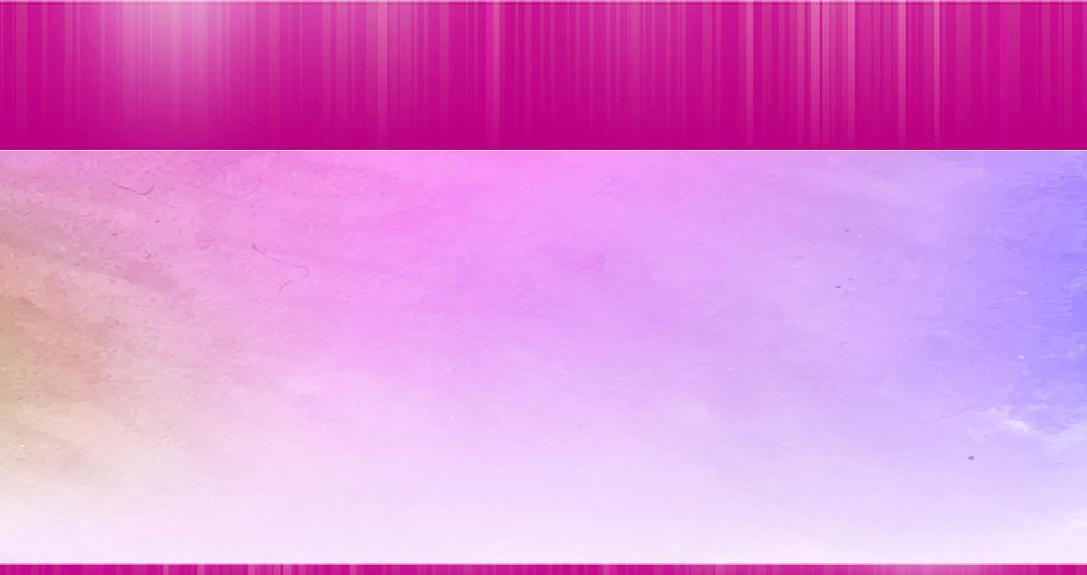
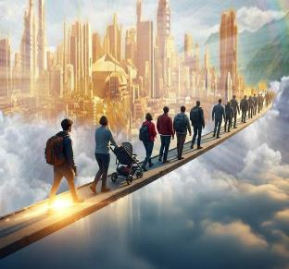
MAKATU'UNGA MO TU'UMA'U
“kapau ʻoku mou nofo maʻu ʻi he tuí, ʻo makatuʻunga mo tuʻu maʻu, pea ʻoku ʻikai ueʻi mei he ʻamanaki lelei ʻo e ongoongoleleí ʻa ia naʻa mou fanongo ki aí” (Kolose 1:23a)
Kuo ‘osi fakatonuhia’i kitautolu, ‘oku lolotonga fakamā’oni’oni’i kitautolu, ka ‘oku te’eki ke ‘osi ‘a e fononga. ʻOku tau ʻi he tuʻunga fakatuʻutāmaki ʻo e hē pea ʻikai ke tau aʻusia ʻa e taumuʻá. Ko e ‘uhinga ia ‘oku fale’i ai kitautolu ‘e Paula ‘i he me’a ‘e tolu (Kol. 1:23a):
Hokohoko atu ʻi he tuí .
Kātaki, ‘o hangē ko Pita ‘i he taimi, hili hono tukuange mei he pilīsoné, na‘á ne tukituki ‘i he matapaá kae ‘oua kuo fakaava kiate ia
( Ngāue 12:​11-​16 )
Fakava'e
Kuo pau ke mālohi ‘etau tuí, ‘o fakatu‘unga ‘i he ngaahi mo‘oni kuo tau ako ‘i he Tohi Tapú
Tuʻu maʻu
Kuo pau ke tau taʻeueʻia, ʻo ʻikai tuku ʻetau falala ki he "ʻamanaki lelei ʻo e ongoongolelei"

Slide 7

ʻAMANAKI LELEI

Slide 8
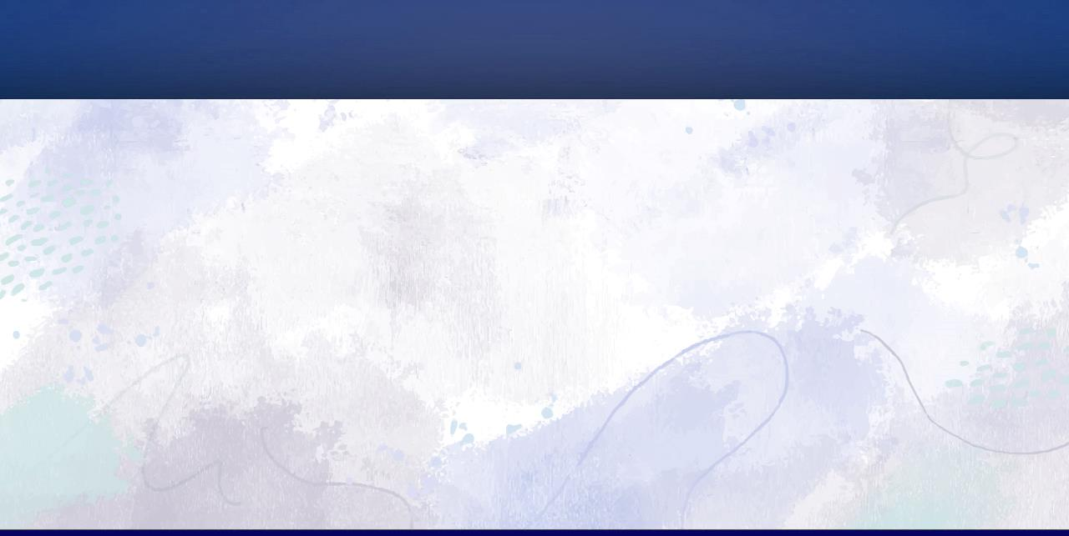
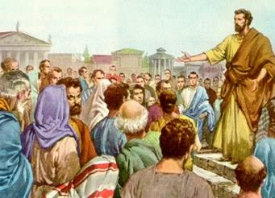
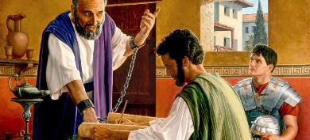
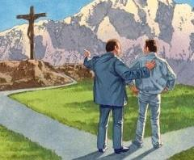
ʻOMI ʻA E ʻAMANAKI LELEI
“ʻAia kuo fakanofo au ko e faifekau ʻo ia, ʻo taau mo e tuʻutuʻuni ʻae ʻOtua naʻe foaki kiate au koeʻuhi ko kimoutolu, ke malanga lahi ʻaki ʻae folofola ʻae ʻOtua;” (Kolose 1:25)
Hangē ko ia naʻa tau vakai ki aí, ko e palani ʻa e ʻOtuá ki hotau fakamoʻuí ʻoku makatuʻunga ia ʻi he pekia ʻa Sīsuú pea ʻoku kau ai hotau fakatonuhia mo fakamāʻoniʻoniʻí. Ka naʻe ʻi ai ha meʻa mahuʻinga naʻe ʻikai ke ʻi ai: ʻi ha faʻahinga founga, ʻoku fie maʻu ke tau ʻiloʻi ʻa e palani ko ʻení kae lava ke tau tali ia. ʻOku tau fie maʻu ha taha ke ne fakahā mai ia kiate kitautolu.
Ko e feitu’u ‘eni ‘oku hū mai ai ‘a e “pule ‘a e ‘Otua” [ko e founga ‘a e ‘Otua ki hono fakahokohoko ‘o e ngaahi tūkunga, fakakaukau, kakai, etc.], ‘a ia na’e faifekau ai ‘a Paula (Kol. 1:25).
Na’e fiefia ‘a Paula ‘i he’ene hoko ko e konga ‘o e palani ko eni, neongo na’e kau ai ‘a e ngaahi mamahi, (Kol. 1:24). Mei hono puke ia ʻi Lomá ʻo aʻu ki heʻene pekiá, naʻá ne tohi ʻo ʻikai siʻi hifo ʻi he ʻipiseli ʻe fitu mei he ʻipiseli ʻe hongofulu mā fā ʻoku tauhi ʻi he Fuakava Foʻoú.
Naʻe hoko ʻa Paula ko ha konga mahuʻinga ʻo e palani ʻa e ʻOtuá, pea naʻá ne fiefia ai. Te tau lava foki ʻo hoko ko ha konga ʻo e palani ko ʻení ʻaki hono tataki e niʻihi kehé ki he ʻilo ʻo Kalaisí. Ko ‘etau fiefiá ia!

Slide 9
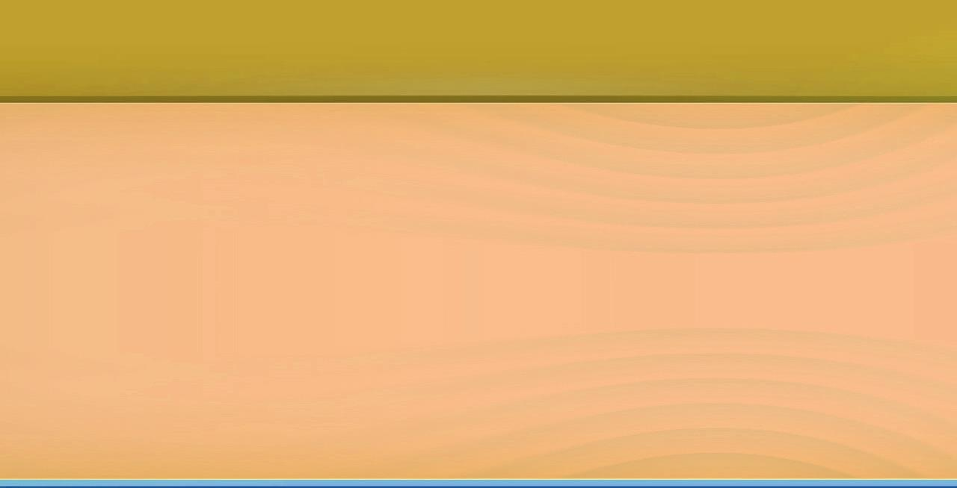
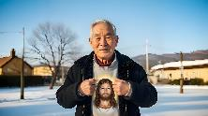
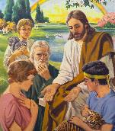

KO E MISITELI 'O E 'OTUA .
“ko e misiteli naʻe fufū talu mei he ngaahi kuonga mo e ngaahi toʻutangata, ka kuo fakahā ʻeni ki heʻene kakai māʻoniʻoní” ( Kolose 1:26 ).
‘Oku lea ‘a Paula ki ha misiteli kuo fakahā ki he siasi hili ‘a e toetu’u ‘a Kalaisi (Kol. 1:26). ʻI heʻene aʻu ki he taimi ko iá, naʻe ʻi ai pē ha ngaahi kiʻi sioʻata ʻo ia. Ka ko e hā ‘a e misiteli ko ení? “Ko Kalaisi ʻiate kimoutolu, ko e ʻamanaki lelei ʻo e nāunau” (Kol. 1:27)
Naʻe faʻufaʻu ia kimuʻa pea toki fakatupu ʻa māmaní (1 Pita 1:20)
Naʻe fakahoko fakakonga ia ki he kau ʻāngeló (1 Pita 1:12)
Naʻe ʻomi ha ʻuluaki vakai kia ʻAtama mo ʻIvi (Senesi 3:15)
Naʻe fakaha ia ki he kau palofita (1 Pita 1:10-11)
Naʻe ʻuluaki fakaha ia ʻe Sisu ki he kau Siu (Matiu 15:24)
Pea naʻe fakaha kakato ia ki he kakai kotoa pe (Kolo. 1:27)
ʻOku kei ʻi ai pe ʻa e ngaahi sitepu ke fakaha ʻi he misiteli ko ʻeni. ʻOku tau moʻui he taimi ni ʻi he ʻamanaki lelei ke naunauʻia kitautolu. Ko ha liliu moʻoni ia! Ko ha misiteli moʻoni ia! ʻOku fakatonuhiaʻi, fakamaʻoniʻoniʻi, mo naunauʻia ʻa e kakai angahalaʻia ʻaki ʻa e taʻataʻa huhuʻi ʻo Sisuu. ʻE hokohoko atu ʻa e hoko ʻa e misiteli ko ʻeni ko ha kaveinga ke ako ki ai ʻi he kotoa ʻo ʻitaniti.

Slide 10

KO E MALOHI ʻO E ONGOONGOLELEI

Slide 11
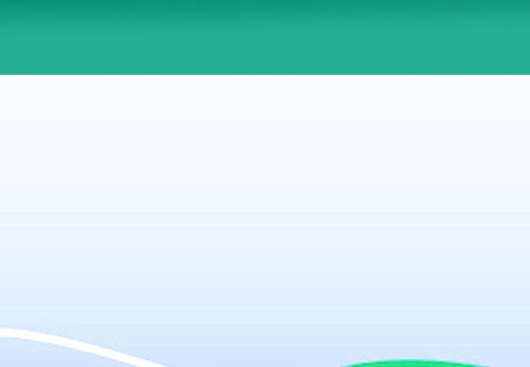
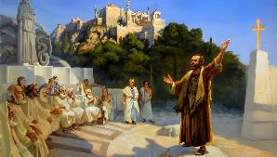
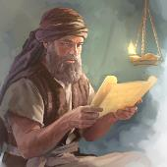
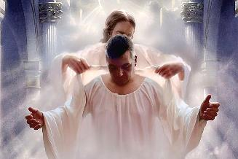
KO HONO FANONGONONGO ʻO E ONGOONGOLELEI
"ʻOku mau malanga ʻaki ia, ʻo fakatokanga ki he tangata kotoa pe, mo akonakiʻi ʻa e tangata kotoa pe ʻi he poto kotoa pe, koeʻuhi ke mau fakaha ʻa e tangata kotoa pe ʻoku haohaoa ʻia Kalaisi Sisuu." (Kolose 1:28)
Naʻe malanga fefe ʻaki ʻe Paula ʻa e ongoongolelei? Ko e uho ʻo ʻene malanga ko hono tutuki ʻo Kalaisi (1 Kolinito 1:23). ʻI he tali pe ʻe he kakai ʻa Sisu, naʻa ne naʻinaʻi mo akoʻi kinautolu kae ʻoua kuo nau haohaoa (Kolose 1:28-29). Naʻe anga fefe ʻene fai ʻeni?
Naʻa Ne fakamatalaʻi kiate kinautolu ʻa e tokateline mo e founga ngaue faka-Kalisitiane (2 Tesalonaika 2:15)
Naʻa Ne fakatokanga kiate kinautolu fekauʻaki mo e ngaahi nunuʻa ʻo hono fakafisingaʻi ʻo e ongoongolelei (Hepelu 10:25-29)
Naʻa Ne fakatokanga kiate kinautolu fekauʻaki mo e fakatuʻutamaki ʻo e kau akonaki loi (Ngaue 20:29-30)
Kiʻi tatali siʻi... ʻai ke nau haohaoa? Pea ʻikai ko ha niʻihi tokosiʻi pe... "tangata kotoa pe"! (Kol. 1:28b).
Ko e foʻi lea faka-Kalisi naʻe liliu ko e "matuʻotuʻa" (teleios) ʻoku ʻuhinga ia ki he haohaoa pea ʻikai hano mele. Fakafou ʻ i he founga ʻ o e tupu faka - Kalisitiané, ʻ oku tau hoko ai ʻ o lāuʻilo vēkeveke ki he loloto ʻ o e lao ʻ a e ʻ Otuá pea mo hono ngaahi fiemaʻú. Ko ia ai, ko ʻ etau taumuʻá ke hoko ʻ o haohaoa ʻ ia Kalaisi Sīsū.

Slide 12

"ʻI heʻetau vakai atu ki he Huhuʻi naʻe tutuki, ʻoku mahino kakato ange ai kiate kitautolu ʻa e maʻongoʻonga mo e ʻuhinga ʻo e feilaulau naʻe fai ʻe he Mafimafi ʻo e langi. ʻOku fakalangilangiʻi ʻi hotau ʻao ʻa e palani ʻo e fakamoʻui, pea ʻoku hanga ʻe he fakakaukau ki Kalevale ʻo fakaake ʻa e ngaahi ongo moʻui mo toputapu ʻi hotau loto. ʻE ʻi hotau loto mo hotau loungutu ʻa e fakafetaʻi ki he ʻOtua mo e Lami; he he ʻikai lava ke tupulaki ʻa e hikisia mo e lotu kiate kita ʻi he laumalie ʻoku ne manatuʻi foʻou ʻa e ngaahi meʻa naʻe hoko ʻi Kalevale."
EGW (Ko e Holi ʻo e Ngaahi Kuongá, p. 661)

