Slide 1
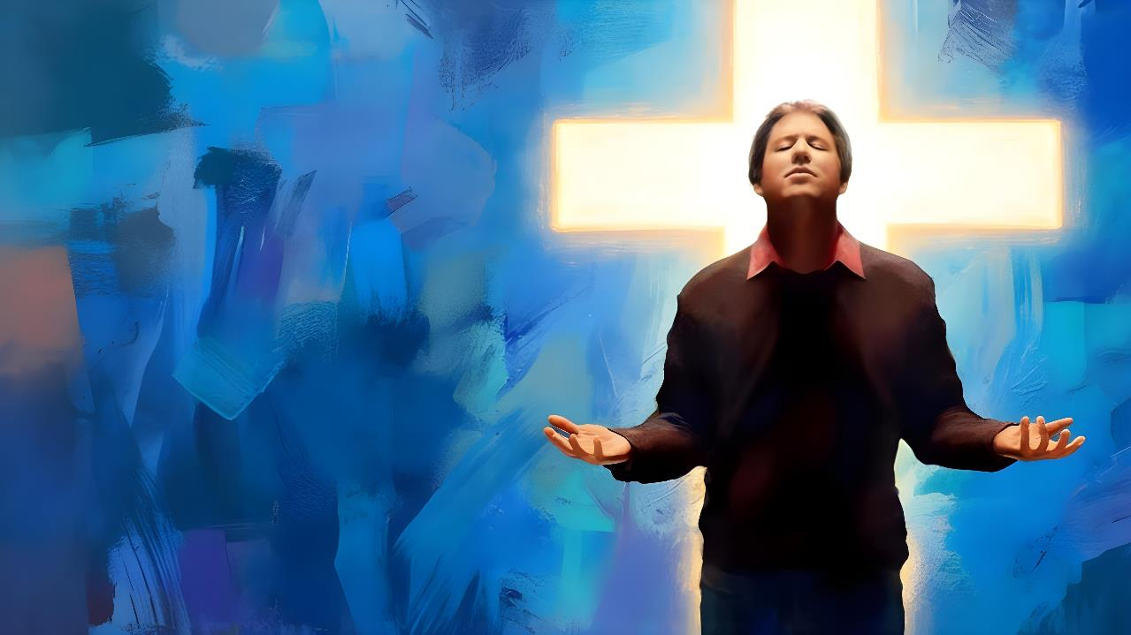
KAKATO
‘IA
KALAISI
Lesoni 10 ki he ʻaho 7 ʻo Māʻasi, 2026

Slide 2
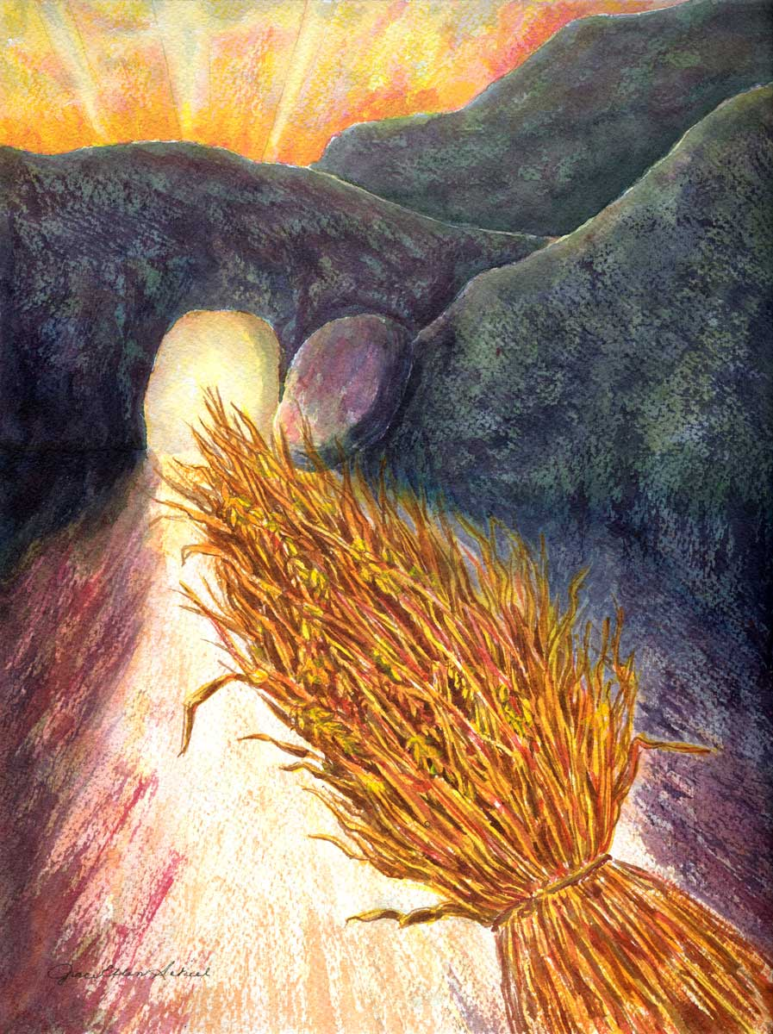
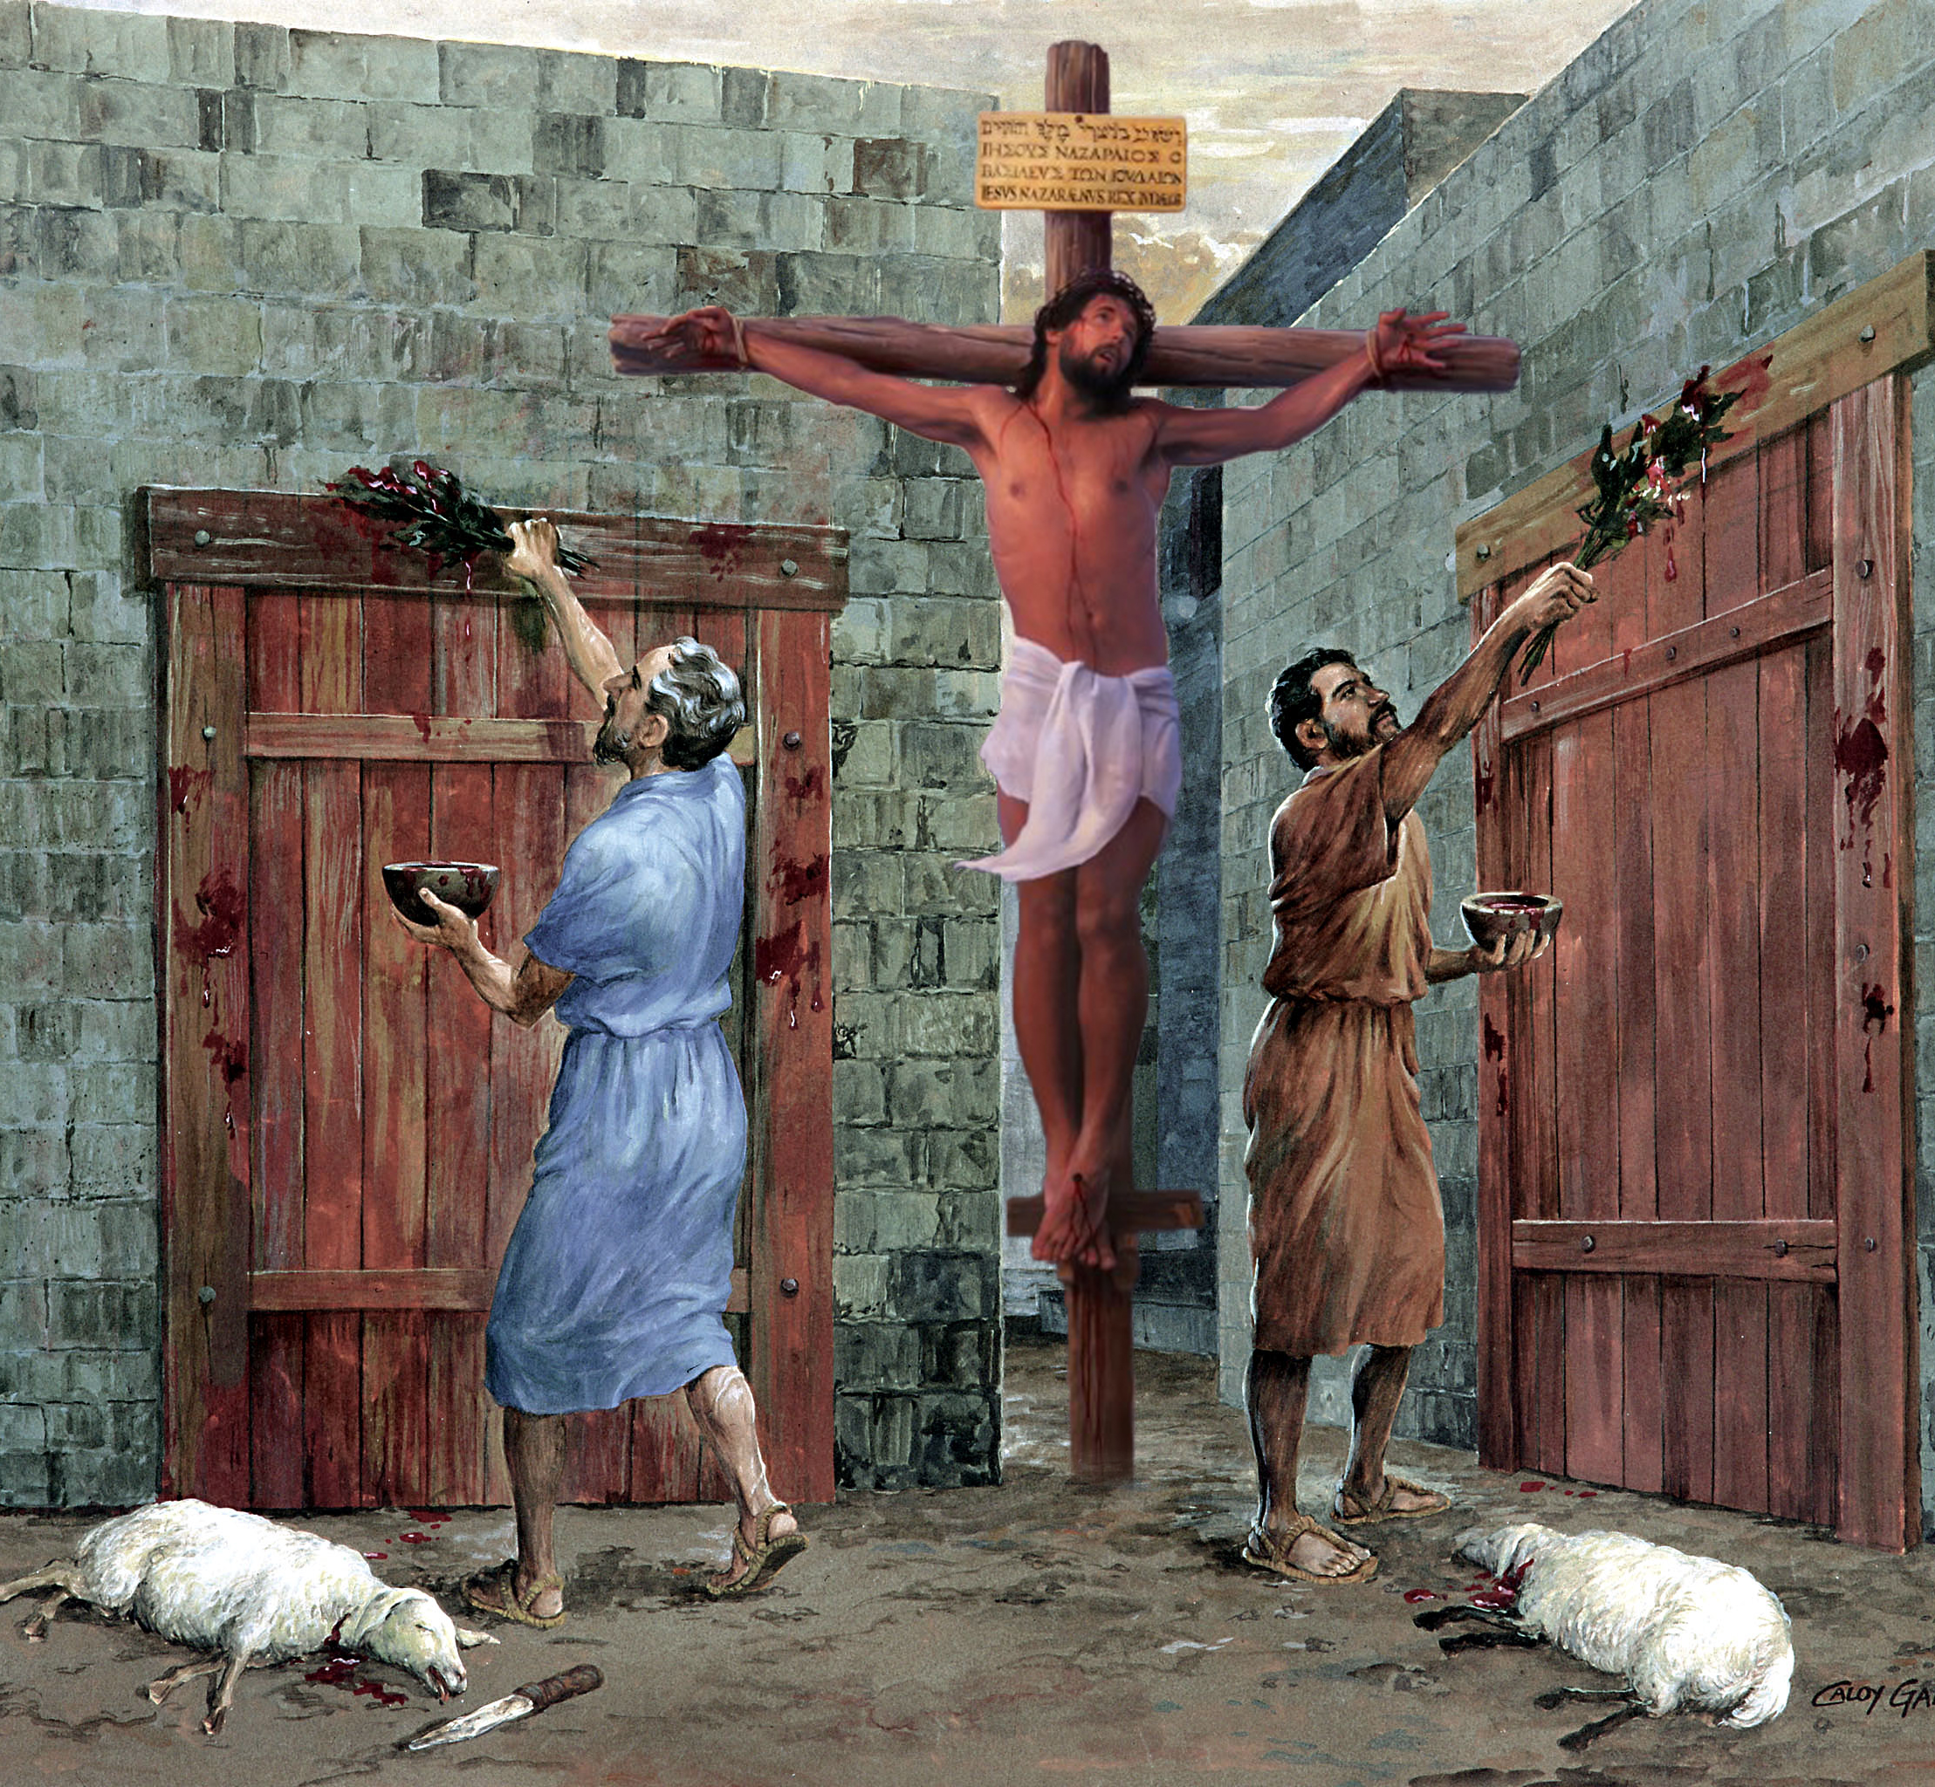
“Ko ia ke ʻoua naʻa ai ha taha ʻe fakaanga kiate kimoutolu ʻi ha meʻakai, pe ha meʻainu, pe ki ha ʻaho kātoanga, pe ʻi ha tuʻu efiafi, pe ʻi he ngaahi Sāpate:ʻAia ko e ngaahi ʻata ʻoe meʻa ʻoku haʻu; ka ko hono sino ʻoku ʻia Kalaisi.” Kolose 2:16, 17

Slide 3





Ko e tui kia Sīsuú ‘oku ‘omai ai kiate kitautolu ‘a e ngaahi ‘aonga lahi. Tānaki atu ki hono fakamolemoleʻi ʻo ʻetau ngaahi angahalá, ʻoku tau maʻu ha fakafiemālie, poto, mo ha ngaahi meʻa lahi ange.
‘Oku fakaafe’i kitautolu ‘e Paula ke tau aka ‘i he tui ko ia koe’uhi ke tau hoko ko e ngaahi ‘akau ‘oku nau fua lelei ma’ae Pule’anga ‘o e ‘Otua.
‘Oku ne toe fakatokanga mai foki kiate kitautolu ‘a e founga ‘oku totonu ke tau aka ai: ‘o ‘ikai makatu’unga ‘i he ngaahi filosofia mo e ngaahi teolosia ‘a e tangata, ka ‘i he Folofola mo’ui ‘a e ‘Otua pe.
Ko e ngaahi lelei ʻo e tuí:
Ko e fakafiemālie, fakahīkihiki, mo e maau (Kolose 2:1-5)
Aka 'ia Kalaisi (Kolose 2:6-8)
Ko e tohi nima ‘o e ngaahi ouau na’e fa’o ki hono kolosi (Kolose 2:9-15)
Ngaahi palopalema ʻokú ne luluʻi ʻa e tuí:
‘Aho mālōlō, māhina fo‘ou, ‘aho Sāpate (Kolose 2:16-19)
Ko e ngaahi fekau ‘a e tangata (Kolose 2:20-23)

Slide 4


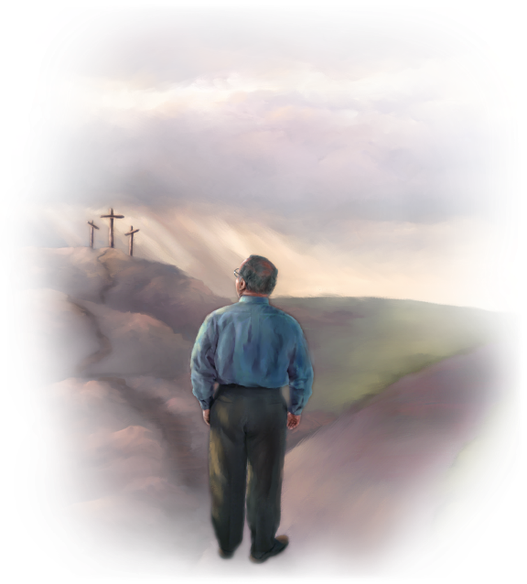
KO E ‘AONGA ‘O E TUI

Slide 5

‘Oku ma‘u ‘a e potó ‘i fē? Ko fē ‘oku nofo ai ‘a e ‘atamaí?
( Siope 28:12 ) .
ʻOku fufū ʻia Kalaisi ʻa e ngaahi koloa kotoa pē ʻo e potó mo e ʻiló .
( Kolose 2:3 )

Slide 6

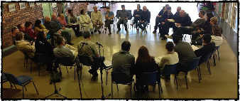
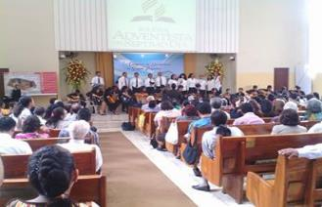
FAKAFIEMALIE, FAKAHIKIHIKIʻI MO E MAAU
"He neongo ʻoku ou mamaʻo ʻi he kakano, ka ʻoku ou ʻiate kimoutolu ʻi he laumalie, ʻo fiefia ke mamata ki hoʻomou maau mo e tuʻu maʻu ʻi hoʻomou tui kia Kalaisi." (Kolose 2:5)
Neongo naʻe ʻikai ke ne ʻiloʻi fakatautaha ʻa e siasi ʻi Kolose, ka naʻe ʻiloʻi ʻe Paula naʻe fakamanamanaʻi ia ʻe he ngaahi akonaki hala (Kolose 2:1, 4)
ʻI he ʻuhinga ko ʻeni, ʻoku ne tohi kiate kinautolu mo ha taumuʻa mahino ʻe tolu ʻe tokoni kiate kinautolu ke nau matuʻuaki ʻa e fakatuʻutamaki ko ʻeni (Kolose 2:2 NIV):
ʻ E fakalototoʻaʻi nai kinautolu ʻ i he lotó
pea uouangataha ʻi he ʻofa
koeʻuhi ke nau maʻu ʻa e ngaahi koloa kakato ʻo e ʻilo kakato
Koeʻuhi ke nau ʻilo ʻa e meʻa lilo ʻo e ʻOtua, ʻa ia ko Kalaisi
Kimuʻa pea ʻiloʻi ʻa e ngaahi tokateline hala, ʻoku ʻi ai ha fakahikihikiʻi ʻe ua ki he kakai Kolose: ʻoku nau maau lelei; pea ʻoku nau tuʻu maʻu ʻi he tui (Kolose 2:5).
Ko e "fokotuʻutuʻu" ʻoku ʻuhinga ki ai ʻa Paula ʻoku ʻuhinga ia ki he maau ʻi he lotu pea ʻi he ngaahi ngaue kehekehe ʻa e siasi. Kuo pau ke ʻi ai ha tuʻunga fakatakimuʻa mo vahevahe ʻo e ngaahi fatongia; kuo pau ke fakahoko ʻa e ngaahi ʻekitivitii ʻi he anga fakaʻapaʻapa totonu; mo e ala meʻa pehee. ʻE iku ʻeni ki hano malanga lelei ange ʻo e ongoongolelei mo maluʻi kinautolu mei ha ngaahi fehalaaki pau.

Slide 7
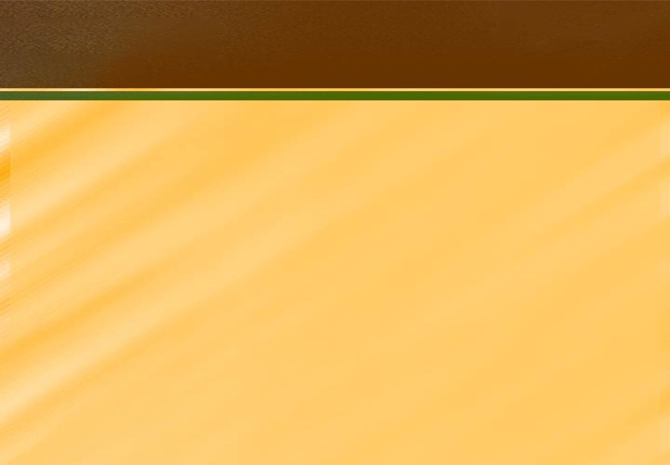


FAKATEFITO ʻIA KALAISI
"Kuo ke aka mo langa hake ʻiate Ia, pea fokotuʻu maʻu ʻi he tui, ʻo hange ko ia kuo akoʻi kiate kimoutolu, pea fonu ʻi ai ʻa e fakafetaʻi." (Kolose 2:7)
ʻOku tau maʻu ʻa e fakamoʻui ʻi heʻetau tali ha Tokotaha, kae ʻikai ʻi hono tali ʻo e ngaahi tokateline (Kolose 2:6). Neongo ia, ʻoku mahuʻinga ʻeni. ʻOku naʻinaʻi mai ʻa Paula ke tau ʻaʻeva ʻia Kalaisi "ʻo hange ko hono akonekina ʻa kimoutolu" (Kolose 2:7b).
ʻI heʻetau ʻaʻeva mo Sisuu, ʻoku tau tuʻu maʻu ʻiate Ia. Ko kitautolu, ʻi he lea fakatataa, "ko e to ʻa e ʻEiki, koeʻuhi ke fakalangilangiʻi ia" (ʻIsaia 61:3) . Ko e "ʻakau" kitautolu ʻoku pikitai kia Sisu mo ʻEne ngaahi akonaki (Saame 1:3).
ʻOku ʻi ai ha faʻahinga tokateline ʻe ua
Fakatatau kia Kalaisi mo ʻene akonaki ʻoku lekooti ʻi he Tohi Tapu
ʻOku fakamalohia kitautolu ʻi he tui pea fonu ʻi he fakafetaʻi (Kolose 2:7)
Fakatatau ki he ngaahi fakakaukau fakapoto mo e ngaahi meʻa olopoto taʻeʻaonga, fakatatau ki he ngaahi tukufakaholo ʻa e tangata
ʻOku kakaaʻi, fakamauʻi, pea ʻikai ke tau maʻu hotau pale
(Kolo. 2:8, 16, 18)

Slide 8

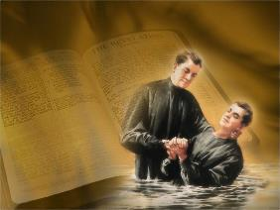

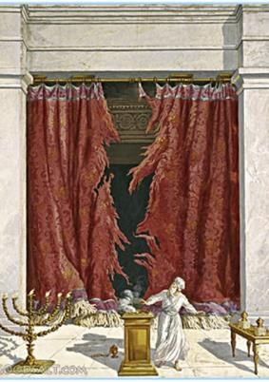
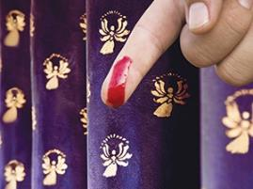
KO E TOHINIMA ʻO E NGAAHI OUAU NAʻE TUTUKI KI HONO KOLOSI
"Naʻa ne tamateʻi ʻa e tohi ʻo e ngaahi ouau naʻe angatuʻu kiate kitautolu, ʻa ia naʻe taʻe-fiemalie kiate kitautolu, pea toʻo ia mei he hala, ʻo tutuki ki hono kolosi" (Kolose 2:14)
Naʻe fakapapauʻi ʻe ʻEpalahame ʻene fuakava mo e ʻOtua ʻo fakafou ʻi he kamu (Senesi 17:11). ʻOku tau fakamoʻoniʻi ʻetau fuakava mo Sisu ʻo fakafou ʻi he papitaiso, ʻa ia ko e "kamu ʻo Kalaisi" (Kolose 2:11–12). ʻOku ʻuhinga ʻeni ʻoku ʻikai kei fie maʻu ke kamu fakaesino. Hili hono fakamahinoʻi ʻa e meʻa ni, ʻoku lea ʻa Paula ki he ngaue ʻa Sisu ʻi he kolosi. Ko e hā naʻe lavaʻi ʻ e Sīsuú?
Naʻa Ne foaki mai ʻa e moʻui kiate kitautolu, ʻo fakamolemoleʻi ʻetau ngaahi angahala (Kolose 2:13)
Naʻa ne kaniseli ʻa e tukuakiʻi ʻo homau moʻua fakalao, ʻa ia naʻe tuʻu kiate kimautolu (Kolose 2:14)
Naʻa ne ikunaʻi ʻa e ngaahi malohi mo e ngaahi mafai ʻo e kovi (Kolose 2:15)
ʻOku fakamahinoʻi ʻe he ʻEfeso 2:14-15 ko e "ngaahi ouau" pe "ngaahi fie maʻu" naʻe fakafepakiʻi kitautolu ko e fono ʻo e ouau, ʻa ia naʻe hoko ko ha ʻa fakamavahevaheʻi ʻi he vahaʻa ʻo e kau Siu mo e kau Senitaile.
ʻI he ʻuhinga ko ʻeni, ʻoku ʻikai fie maʻu ke tau toe hohaʻa fekauʻaki mo hono tauhi ʻo e ngaahi fono ʻo e Fuakava Motuʻa, ʻa ia naʻe fakahoko mo ikuʻanga ʻia Kalaisi.

Slide 9

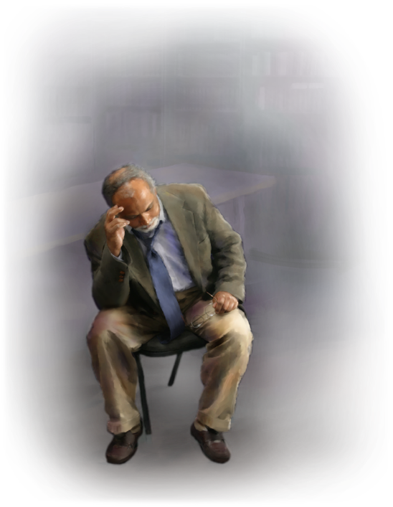
NGAAHI PALOPALEMA ʻOKU NE LULUʻI ʻA E TUI

Slide 10


'AHO MALOLO, MAHINA FO'OU, 'AHO SAPATE
“Ko ia ke ʻoua naʻa fakamāuʻi kimoutolu ʻe ha taha ʻi he meʻakai, pe ʻi he inu, pe ʻi he ngaahi ʻaho mālōlō, pe ʻi he māhina foʻou, pe ʻi he ngaahi ʻaho Sāpate” ( Kolose 2:16 ).
Fakataha mo e kamú, na‘e ‘i ai ‘a e ngaahi poini kehe na‘á ne fakafaikehekehe‘i ‘a e kau Siú mei he kau Senitailé: ko e ngaahi ouau fakalotú mo e ngaahi kātoangá.
Na‘e ‘osi fakahaa‘i mahino ‘e Paula ‘a e ngafa ‘o e kamú. Ko eni, ‘i he lea “tuku,” ‘oku fakahaa’i ai ‘e Paula ‘a e ngaahi ‘uhinga ‘o hono fakata’e’aonga’i ‘o e “tohi nima” (ko e ngaahi lao faka-ouau): na’e ‘ikai ke kei fakangatangata ki he fakamo’ui ke tauhi ‘a e ngaahi ouau mo e ngaahi katoanga, ‘a ia na’e fakahoko ‘e Sisu ‘aki ‘ene pekia ‘i he kolosi (Mt. 27:51; Kol. 2:16).
‘Oku hā mai ‘oku lave ‘a Paula ki he Hosea 2:11 ke fakanounou’i ‘a e founga ouau kotoa ‘o e Fale Tapu ‘i ha sētesi pē ‘e taha. ‘Oku ‘uhinga ‘eni, ko e ngaahi Sāpate ‘oku lave ki ai heni, ko e ngaahi Sāpate ouau ‘e fitu (‘oku tauhi tatau ai pē pe ko e hā ‘a e ‘aho ‘o e uike na‘a nau tō ai), kae ‘ikai ko e Sāpate fakauike (‘oku kau ‘i he lao fakae‘ulungaanga, ‘oku fakamāmani lahi pea ‘oku ‘aonga ki he kakai kotoa pē, Siu mo e Senitaile).

Slide 11
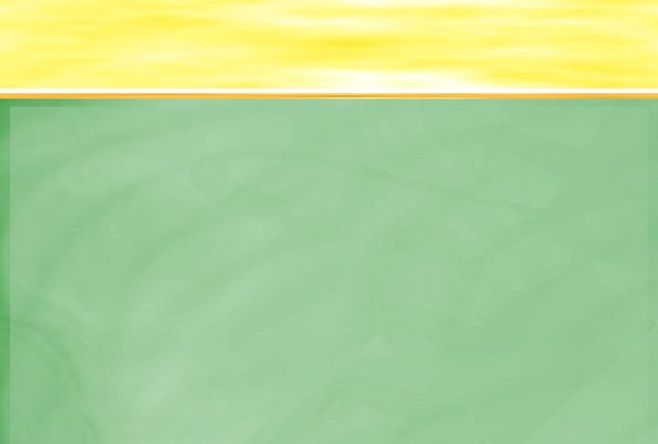

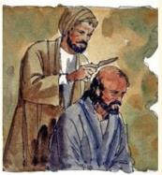

NGAAHI FEKAU ʻA E TANGATA
"Ko e ngaahi tuʻutuʻuni ko ʻeni, ʻa ia ʻoku fekauʻaki mo e ngaahi meʻa kotoa pe kuo pau ke ʻauha ʻi hono fakaʻaongaʻi" (Kolose 2:22)
Ko e kau akonaki loi, ʻa ia naʻe toutou lave ki ai ʻa Paula ʻi heʻene tohi, ko e kau Siu naʻa nau akoʻi ʻa e fie maʻu ke muimui ki he fono ʻa e kau Siu ke maʻu ʻa e fakamoʻui (Ngaue 15:1, 5). Naʻe kau foki ʻi he ngaahi lao ko ʻeni ʻa e ngaahi lao lahi naʻe faʻu ʻe he kau lapai.
Tau muimui angé ʻ i he fakaʻuhinga ʻ a Paulá. Kuo tau mate ʻi he papitaiso ki he "ngaahi tefitoʻi meʻa ʻo e mamani" pea moʻui maʻa Kalaisi. Hange ko ʻeni, kapau ʻe hokohoko atu ʻetau hohaʻa ki he ngaahi meʻa taʻemaʻa ʻo e ouau, ʻoku tau kei moʻui pe ʻi mamani, pea ʻoku tau hohaʻa ki he ngaahi meʻa ʻoku mole ʻi hono fakaʻaongaʻi (Kolose 2:20-22).
Neongo ia, ʻoku fakamahinoʻi ʻe Paula, ki he kau Siu ʻoku anga ki he ngaahi ouau ko ʻeni, ʻoku ʻi ai honau mahuʻinga fakaeangamaʻa kiate kinautolu, neongo ʻoku ʻikai ʻaonga ia ki hono liliu ʻo e loto (Kolo. 2:23).
Ko hono fakanounou, kuo pau ke tataki kitautolu ʻe he ngaahi akonaki ʻoku ʻi he Folofola –naʻe ueʻi fakalangi –, kae ʻikai ko e ngaahi fakakaukau pe fakaʻuhinga ʻa e tangata.

Slide 12
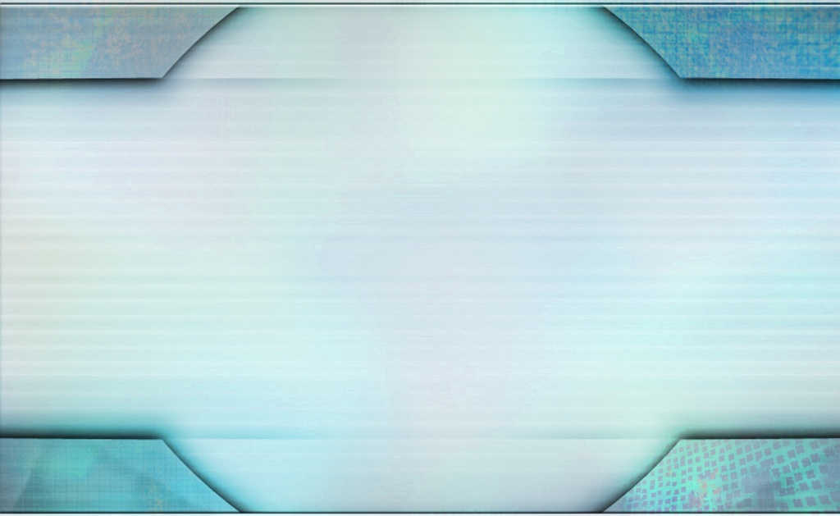
"ʻOku fakatatau ʻa e Kalisitiane ki he sita ʻo Lepanoni. Kuo u lau ʻoku lahi ange ʻa e meʻa ʻoku fai ʻe he fuʻu ʻakau ni ʻi hono tuku hifo pe ha fanga kiʻi aka nounou ki he kelekele ʻoku fua. ʻOku ne ʻoatu ha aka malohi ki he kelekele, pea toe mamaʻo ange ʻi he fekumi ki ha meʻa ʻoku toe malohi ange. Pea ʻi he malohi ʻo e matangi, ʻoku tuʻu maʻu ia, ʻo pukepuke ʻe heʻene ngaahi uaea ʻi lalo.
Ko ia ʻoku tuʻu loloto ʻa e Kalisitiane kia Kalaisi. ʻOku ne tui ki hono Huhuʻi. ʻOku ne ʻafioʻi ʻa e tokotaha ʻoku ne tui ki ai. ʻOku ne tui kakato ko Sisu ko e ʻAlo ia ʻo e ʻOtua mo e Fakamoʻui ʻo e kau angahala. ... .... ʻOku ongo moʻoni ʻa e ngaahi aka ʻo e tui. Ko e kau Kalisitiane moʻoni, hange ko e sita ʻo Lepanoni, ʻoku ʻikai ke nau tupu ʻi he kelekele molu ka ʻoku nau tuʻu ʻi he ʻOtua, ʻo maʻu ʻi he ngaahi ava ʻo e ngaahi maka ʻo e moʻunga."
EGW (Ko Hotau Uiuiʻi Maʻolunga, 21 Novema)

