Slide 1
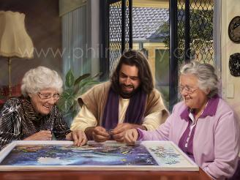
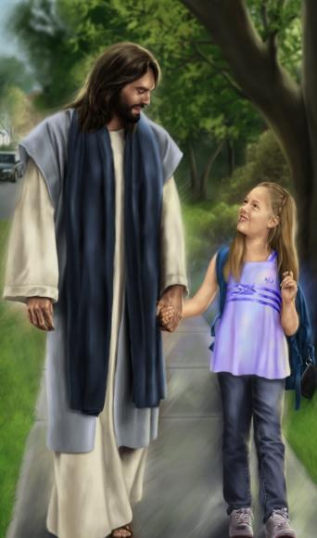
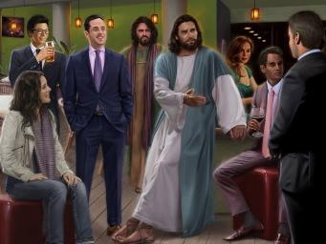
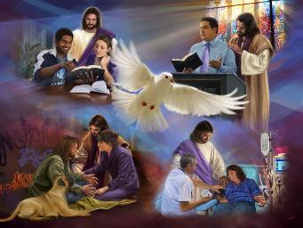
NOFO MO KALAISI
Lesoni 11 ki he ʻaho 14 ʻo Maʻasi 2026

Slide 2
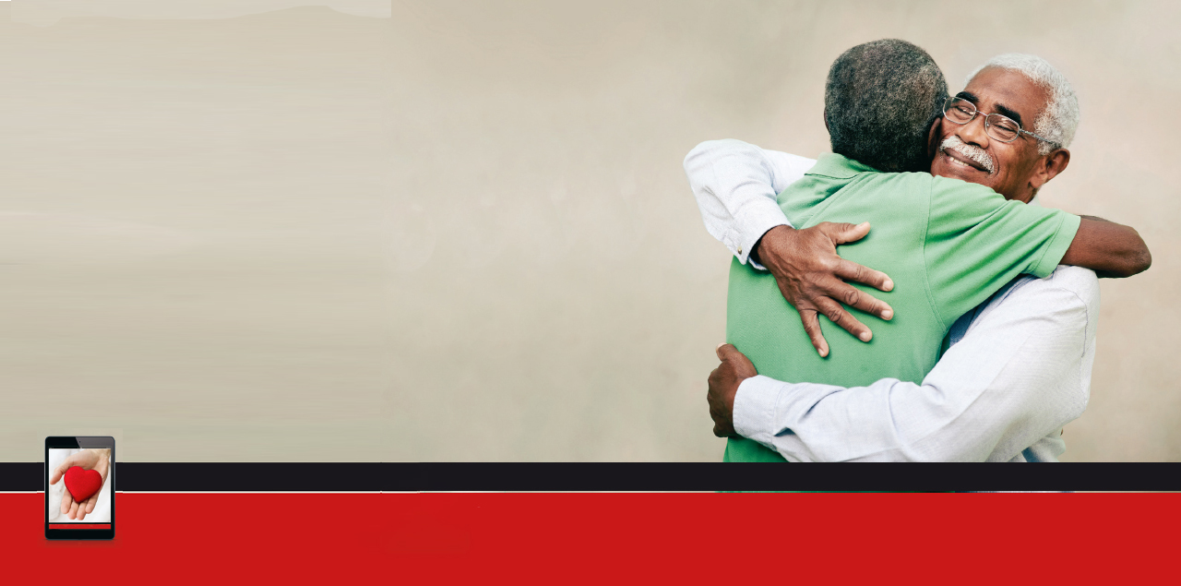
“Pea ke ʻufiʻufi ʻaki ʻae ngaahi meʻa ni kotoa pē ʻae ʻofa, ʻaia ko e noʻo ʻoe haohaoa.”
Kolose 3:14

Slide 3

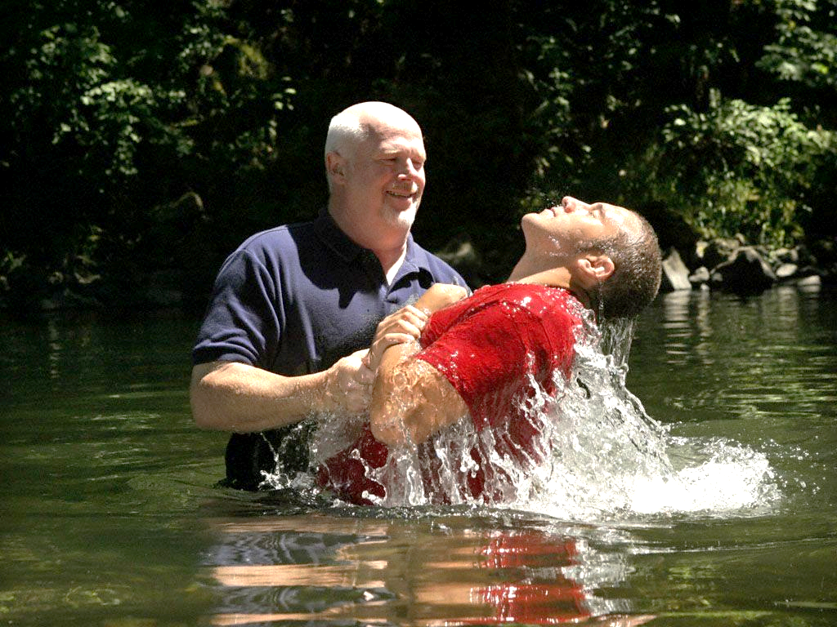
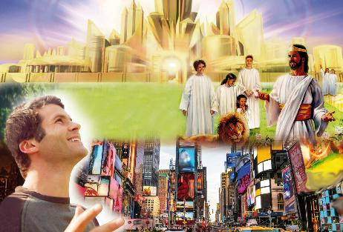





ʻI he taimi ʻoku tanu ai kitautolu ʻi he vai ʻo e papitaiso, ʻoku tau mate ai ki heʻetau moʻui angahala motuʻa. ʻI heʻetau mavahe mei he vai, ʻoku tau tuʻu hake ko ha kakai foʻou.
Naʻa mau liʻaki ʻemau founga moʻui mo e fakakaukau motuʻa. Talu mei ai, naʻe kehe ʻemau moʻui pea kehe ʻemau fakakaukau. Naʻe ʻikai ke tau toe maʻu ha fakakaukau fakamamani ka tau maʻu ha fakakaukau fakalangi.
ʻOku ʻi ai pe ʻa e ʻuhinga, ʻoku kei feinga pe ʻetau ngaahi founga motuʻa ke toe ʻasi hake. Ko e ʻ uhinga ia ʻ oku naʻinaʻi ai ʻ a e ʻ apositolo ko Paulá ke hanga ʻ etau sio ki hēvani pea situʻa mei he ngaahi meʻa fakaemāmaní.
Fakakaukau fakaemamani pe fakalangi?
Ko ʻetau tokanga ki ai (Kolose 3:1-4)
Mate ki he ngaahi meʻa fakamamani (Kolose 3:5-6)
Ke fakakofuʻi ʻa e meʻa fakasilesitiale (Kolose 3:7-11)
Ngaahi ʻulungaanga ʻo e moʻui foʻou ʻia Kalaisi:
Ko e haʻi ʻo e haohaoa (Kolose 3:12-14)
Ko e Meʻakai fakalangi (Kolose 3:15-17)

Slide 4

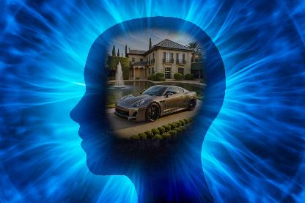
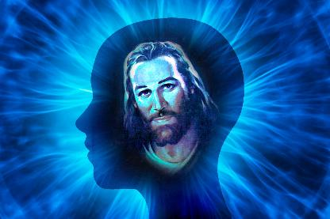
KO E FAKAKAUKAU FAKAEMAMANI PE FAKALANGI?

Slide 5

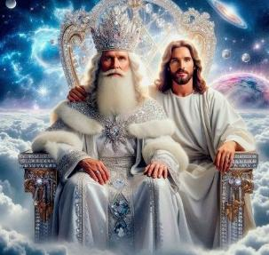
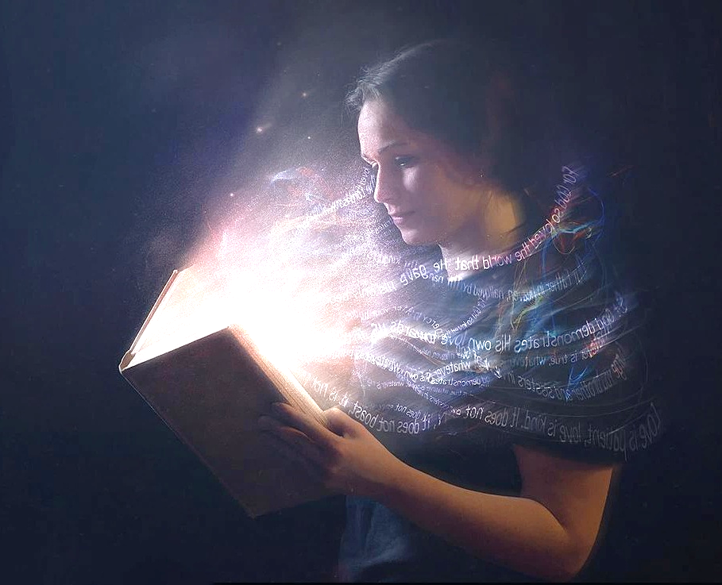
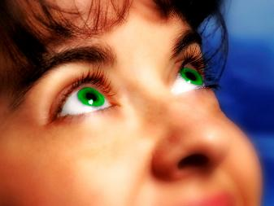
KO ʻETAU TOKANGA
"Tuku homou fakakaukau ki he ngaahi meʻa ʻi ʻolunga, kae ʻikai ki he ngaahi meʻa fakamamani." (Kolose 3:2)
Kamata mei he fakaʻuhinga kuo fokotuʻu hake kitautolu mo Kalaisi ʻi he papitaiso (Kolose 2:12), ʻoku naʻinaʻi mai ʻa Paula ke tau muimui ʻia Sisu ki he feituʻu naʻa ne ʻalu ki ai hili ʻene toetuʻu: ko e taloni ʻo e ʻOtua (Kolose 3:1).
Ko e moʻoni, te tau toki lava pe ʻo fai fakatuʻasino ʻeni ʻi he taimi ʻe ʻave ai kitautolu ʻe Sisu ki ai ʻi Heʻene Haʻele ʻAngaua Mai (Kolose 3:4). ʻI he taimi tatau, kuo pau ke tukutaha ʻetau tokanga—ʻa ʻetau taumuʻa—ʻi he ngaahi meʻa fakalangi (Kolose 3:2).
Kuo tau "mate," pea ko ʻetau moʻui "ʻoku fufuuʻi ia mo Kalaisi ʻi he ʻOtua" (Kolose 3:3). Ko e moʻui ʻoku lau ki ai heni ko e moʻui ia ʻoku tau maʻu ʻi he taimi ʻoku tau tali ai ʻa Kalaisi.
Ka ko e moʻui ko ia, kae lava ke kei moʻui, ʻoku fie maʻu ke fafangaʻi fakaʻaho ia (2 Kolinito 4:16). Kuo pau ke tau fekumi ʻi he ʻaho kotoa pe ki he "ngaahi meʻa ʻi ʻolunga," "tukutaha hotau mata kia Sisu" (Hepelu 12:2).

Slide 6
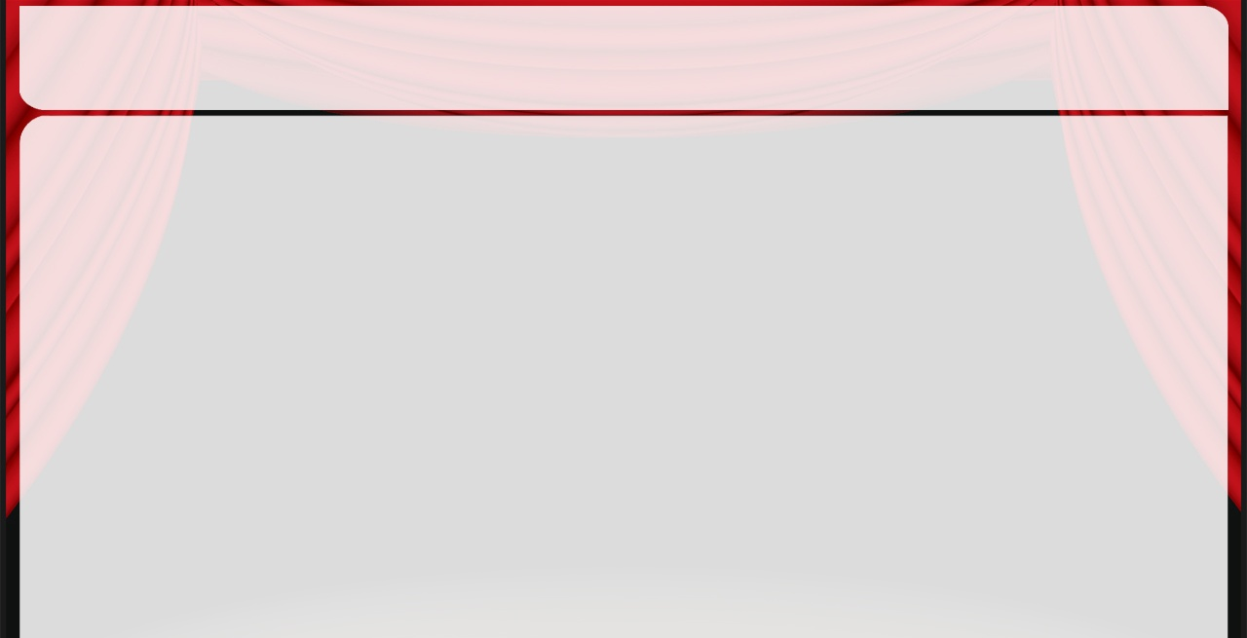
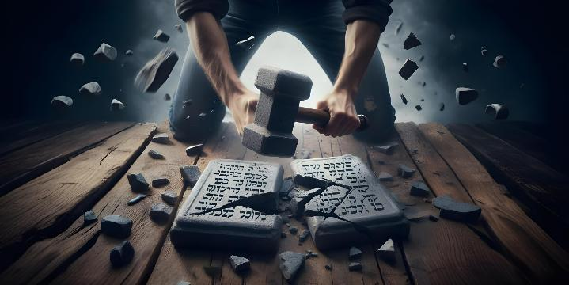


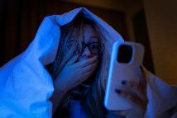
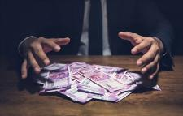
MATE KI HE NGAAHI MEʻA FAKAMAMANI
"Ko ia ke tamateʻi ʻa e meʻa kotoa pe ʻoku ʻi homou natula fakamamani: ʻa e feʻauʻauaki, mo e taʻemaʻa, mo e holi kovi, mo e manumanu, ʻa ia ko e tauhi tamapua." (Kolose 3:5)
Koeʻuhi kuo tau toetuʻu fakataha mo Kalaisi pea moʻui ʻo fakakaukau ki he meʻa fakalangi, kuo pau ke tau tamateʻi ʻa e meʻa ʻoku ne taʻofi kitautolu mei hono fakahoko ʻetau taumuʻa: ʻa e meʻa fakamamani.
Koeʻuhi ke ʻoua naʻa hala ha taha, ʻoku fakamahinoʻi ʻe Paula ʻa e ngaahi tefitoʻi pou ʻo e fakakaukau fakamamani (ʻa ia te ne fakatupulaki kimui ʻi ha ngaahi meʻa pau ange): "ʻa e angaʻuli, mo e taʻemaʻa, mo e holi kovi, mo e manumanu, ʻa ia ko e tauhi tamapua" (Kolose 3:5).
Kuo te’eki ke fu’u liliu ‘a e natula ‘o e tangata talu mei he kuonga ‘o Paula, he ‘oku kei ‘atakai’i kitautolu ‘e he ngaahi holi tatau ‘oku ne maumau’i fakatou’osi ‘a e mata’itohi mo e laumalie ‘o e Fekau ‘e Hongofulu.
Pea ko e hā kuo pau ai ke tau “fakapoongi”—li‘aki, to‘o—‘a e ngaahi me‘a ko ení mei he‘etau ngaahi fakakaukaú mo ‘etau ngaahi ngāué? He ‘oku nau ‘omi ‘a e “houhau ‘o e ‘Otua” pea ko ia ai ‘oku ‘ikai ke nau hoa mo hotau natula fakalangi (Kolose 3:6). Tamate'i 'a e kau mamani kimu'a pea toki tamate'i koe 'e he kau mamani!

Slide 7




KE FAKAKOFUʻI KOE ʻAKI ʻA E MEʻA FAKASILESITIALE
"pea kuo mou ʻai ʻa e tokotaha foʻou, ʻa ia ʻoku fakafoʻou ʻi he ʻilo ʻi he tatau ʻo hono tupuʻanga" (Kolose 3:10)
ʻOku tanaki atu ʻe Paula ki he ngaahi pou ʻe nima ʻo e fakakaukau fakamamani ha ngaahi ngaue fakaemamani ʻe nima ke fakaʻehiʻehi mei ai: "ʻita, houhau, taufehiʻa, lauʻikovi, mo e lea ʻuli mei homou loungutu" (Kolose 3:8), pea fakaʻosi ʻaki ʻa e konga hono ono—ko e kovi taha ia—: "ʻOua naʻa mou feloi" (Kolose. 3:9 ).
ʻOku pehe ʻe Paula kuo tau ʻosi fai ia "koeʻuhi kuo mou toʻo homou ʻulungaanga motuʻa mo hono ngaahi ngaue" (Kolose 3:9 ). Kuo tau toʻo hotau "kofu ʻuli" ʻi he taimi naʻa tau tuku ai ʻa Sisu ke toʻo ʻetau ngaahi angahala(Sakalaia 3:4 ).
ʻOku fie maʻu ke tau tui ʻa e "ngaahi kofu lelei." ʻI heʻetau kofu ʻaki ʻa e ngaahi kofu foʻou ko ʻeni, ʻoku fakafoʻou maʻu ai pe kitautolu, ʻo tupulaki ʻi he maʻoniʻoni ʻi he ʻaho ki he ʻaho (Kolose 3:10).
ʻI hono fakafoʻou kitautolu ʻe he ngaue ʻa e Laumalie Maʻoniʻoni mo hono ako ʻo e Folofola, ʻoku mole atu leva ʻa e ngaahi ʻa vahevahe ʻoku ne fakamavahevaheʻi kitautolu (Kolose 3:11).

Slide 8
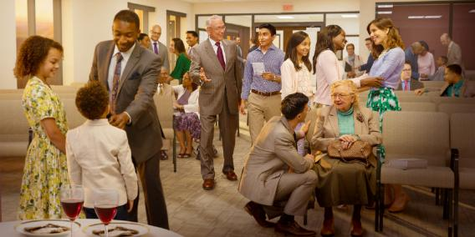

NGAAHI ʻULUNGAANGA ʻO E MOʻUI FOʻOU ʻIA KALAISI

Slide 9
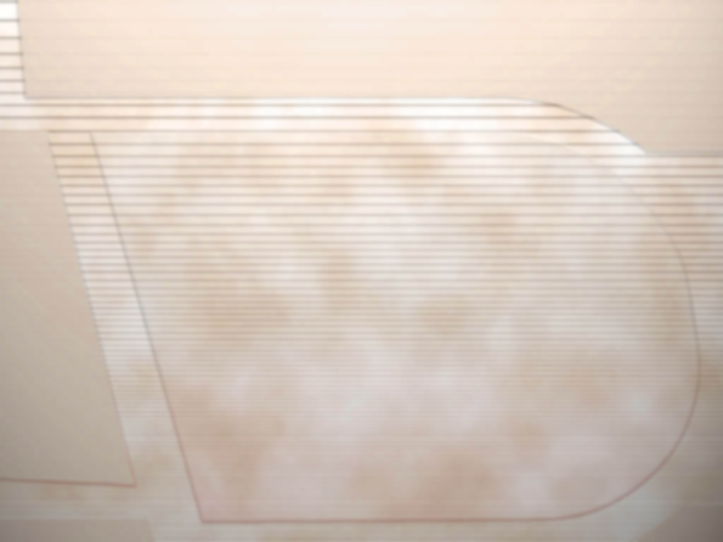
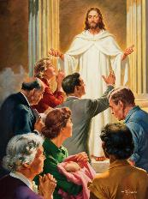

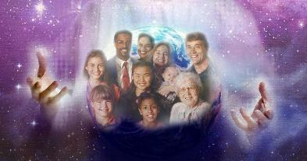
KO E HAʻI ʻO E HAOHAOA
"Pea lahi hake ʻi he ngaahi meʻa ni kotoa pe ʻai ʻa e ʻofa, ʻa ia ko e haʻi ʻo e haohaoa" (Kolose 3:14)
Ko e "kakai fili kitautolu ʻa e ʻOtua, maʻoniʻoni mo ʻofeina lahi" (Kolose 3:12). ʻOku talamai ʻe Pita ʻoku ʻomi ʻe he meʻa ni kiate kitautolu ha ngaahi lelei lahi mo ha fatongia lahi (1 Pita 2:9). Ka ʻoku anga fefe ʻa e ʻulungaanga ʻo ha taha ʻo e kakai fili ʻa e ʻOtua (Kolose 3:12-13)?
1
2
3
4
ʻI he ʻaloʻofa ongongofua
ʻI he angaʻofa
ʻI he loto fakatokilalo
ʻI he angavaivai
ʻI he kataki fuoloa
Fekātaki’aki
Fakamolemoleʻi koe
5
6
7
Pea ko e ngaahi meʻa ni kotoa ʻi he tuʻunga ʻo e haʻi ʻo e haohaoa: ʻa e ʻofa (Kolo. 3:14). Pea ko hotau ngaahi lelei mo e ngaahi fatongia ʻeni:
ʻAONGA
FATONGIA
ʻI heʻetau toʻonga peheni, ʻoku tau hoko ai ko ha tapuaki ki he niʻihi kehe pea mo kitautolu fakatouʻosi.
ʻOfa ke fakalāngilangiʻi ʻ e hotau ʻ ulungāngá ʻ a e ʻ Otuá, pea ʻ ofa ke ne fakalototoʻaʻi ʻ a e niʻihi kehé ke nau tui mo muimui kia Sīsū

Slide 10

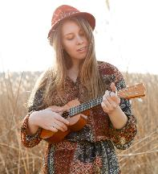
KO E MEʻAKAI FAKALANGI
"Tuku ke nofoʻia lahi ʻa e popoaki ʻa Kalaisi ʻiate kimoutolu ʻi hoʻomou feakoʻiʻaki mo fevalokiʻaki ʻiate kimoutolu ʻi he poto kotoa pe ʻi he ngaahi saame, ngaahi himi, mo e ngaahi hiva mei he Laumalie, ʻo hiva ki he ʻOtua mo e fakafetaʻi ʻi homou loto." (Kolose 3:16)
ʻOku fakahaaʻi mai ʻe he Kolose 3:15-17 ʻa e founga ke fafangaʻi ai hotau natula fakalangi (pea ʻoku mahino he ʻikai ke tau lava ʻo fafanga toko taha ia, ka ʻoku tau fie maʻu ʻa e feohi ʻa e siasi ki he meʻa ni):
Ko hono tuku ke puleʻi kitautolu ʻe he melino ʻa e ʻOtua
Nofo lototaha ko ha sino pe ʻe taha
Houngaʻia
Ako lahi ʻ a e Tohi Tapú
Feakoʻiʻaki ʻa e meʻa kuo tau ako
Hivaʻi ʻo e ngaahi same, ngaahi himi, mo e ngaahi hiva fakalaumalie
Fai ʻa e meʻa kotoa pe ʻi he huafa ʻo Sisuu
"Ko e hiva ko ha meʻatau ia ʻe lava ke tau fakaʻaongaʻi maʻu pe ke fakafepakiʻi ʻaki ʻa e loto-foʻi. ʻI heʻetau fakaava ʻa e loto ki he huelo ʻo e laʻaa ʻi he ʻao ʻo e Fakamoʻui, te tau maʻu ʻa e moʻui lelei mo ʻEne tapuaki" (ʻEleni G. Uaite, “Ko e Potungāue Fakamoʻuí,” p. 254)

Slide 11
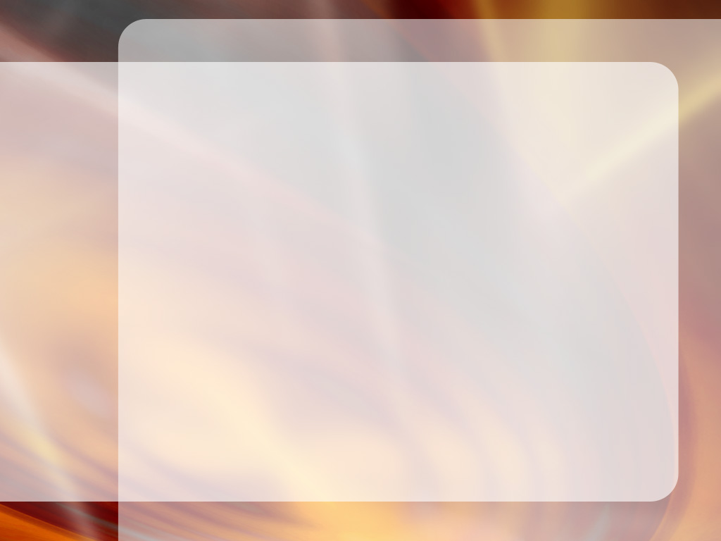
“Fakatupulaki ha loto angaʻofa, angaʻofa, kaungāongoʻi, pea ʻoua naʻá ke teitei ui ʻa e ngaahi ʻulungāanga ko ʻení ko e vaivai, he ko e ngaahi ʻulungāanga ia ʻo Kalaisí. Tokanga ki hoʻo tākiekiná. Tuku ke fuʻu maʻa mo namu kakala ʻa e ʻulungāangá ʻo ʻikai te ke teitei mā ke toe fakatupu ia ʻi he niʻihi kehé.
Hangē ko hono fa‘u ‘e he ngaahi mata‘itofe vaí ‘a e vaitafé, ‘oku pehē pē ‘a e fa‘u ‘e he fanga ki‘i me‘a īkí ‘a e mo‘uí. Ko e moʻuí ko ha vaitafe, melino, nonga, mo fakafiefia, pe ko ha vaitafe faingataʻaʻia, ʻokú ne lī maʻu pē ʻa e pelepelá mo e ʻulí. ‘I he mo’ui ko ‘eni te ke lava ‘o fokotu’u koe ‘i he malumalu ‘o e akonaki ‘a e Laumalie Ma’oni’oni. Ko ia te ke tupulaki lahi ange ai ʻo hangē ko Kalaisí ʻi he fakamāʻoniʻoniʻi ʻo e Laumālié.
EGW (Ke u ʻiloʻi Ia , Siulai 22 .)

