Slide 1
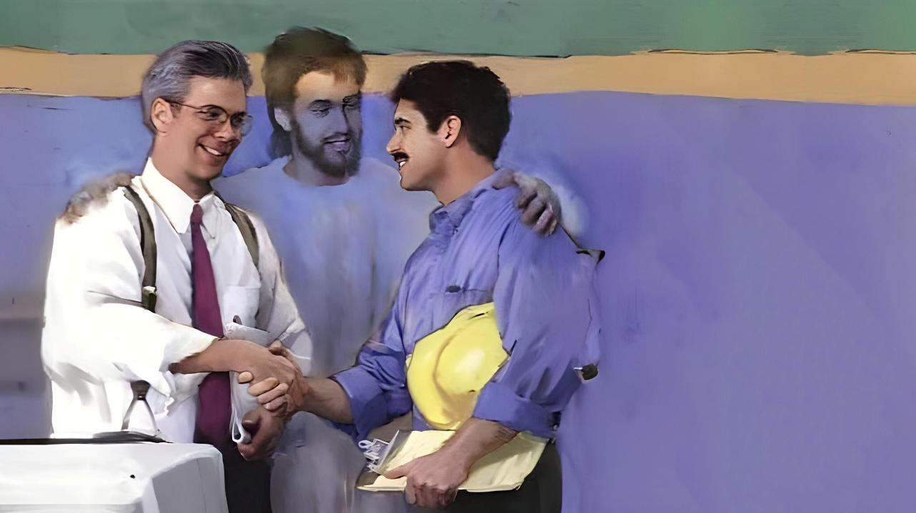
Lesoni 12 ki he ʻaho 21 ʻo Maʻasi 2026
NOFO FAKATAHA MO E NI’IHI KEHE

Slide 2
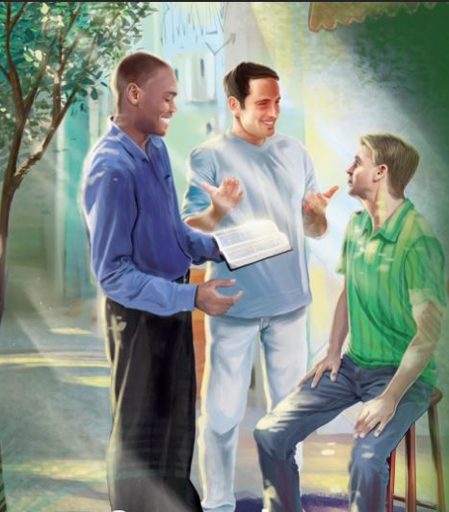
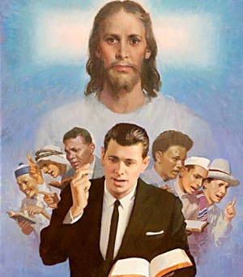
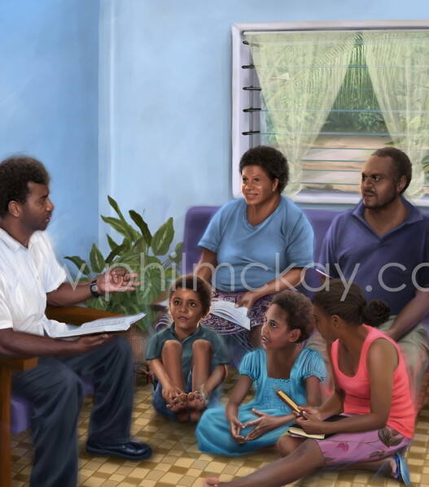
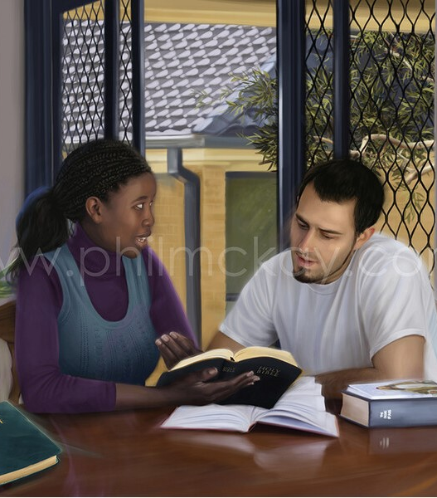
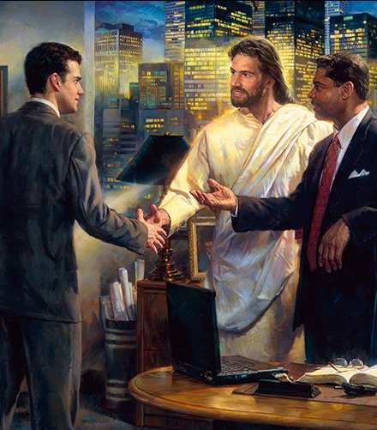
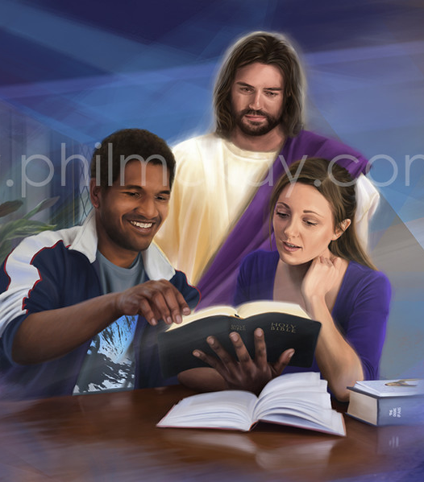
“Ke lelei maʻuaipē hoʻomou lea, ʻo fakalelei ʻaki ʻae māsima, koeʻuhi ke mou ʻilo ke tali totonu ʻae tangata kotoa pē.” Kolose 4:6

Slide 3

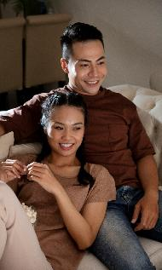
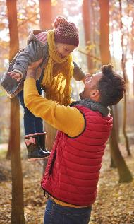
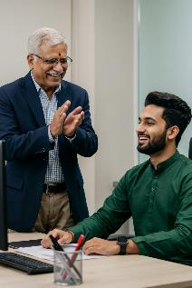
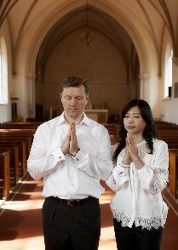
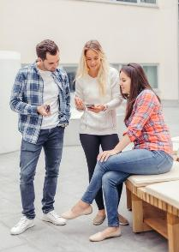
ʻI he konga ʻaonga ange ʻo e tohí, ʻoku lave ai ʻa Paula ki he kaveinga ʻo e ngaahi fetuʻutaki fakaetangatá ʻi he ngaahi siakale kehekehe ʻo e tākiekiná.
ʻOku fakatupu ʻe he ngaahi vā fetuʻutakí ʻa e fepakipaki mo e fakakikihi. Ko ia ai, ‘oku fiema‘u ke ‘i ai ha feongoongoi, ko ha aleapau fakalūkufua fekau‘aki mo e ngaahi tu‘unga mahu‘ingá, ngaahi taumu‘á, mo e ngaahi taumu‘á.
ʻOku ʻomi ʻe Paula kiate kitautolu ha ngaahi tefitoʻi moʻoni ʻaonga ki hono fakaleleiʻi ʻo e ngaahi vā fetuʻutaki ʻi he vahaʻa ʻo e ngaahi hoá, ʻi he vahaʻa ʻo e mātuʻá mo e fānaú, ʻi he vahaʻa ʻo e kau ʻeikí mo e kau pōpulá, ʻi he vahaʻa ʻo e ngaahi tokoua mo e tuofāfine ʻo e siasí, pea ʻi he vahaʻa ʻo e kau tuí mo e kau taʻetuí.
Ko e ngaahi fetu’utaki ‘i he vaha’a ‘o e ngaahi hoa mali (Kol. 3:18-19)
Ko e ngaahi feohi ‘i he vaha‘a ‘o e mātu‘á mo e fānaú (Kol. 3:20-21)
Ko e ngaahi vaha‘angatae ‘i he vaha‘a ‘o e kau pulé mo e kau ngāué
(Kol. 3:22-25; 4:1)
Ngaahi Feohi ‘i he Siasi (Kol. 4:2-4)
Ko e ngaahi feohi mo e kau ta’etui (Kol. 4:5-6)

Slide 4




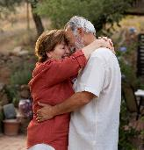
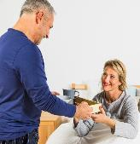
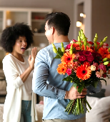
KO E NGAAHI FETU'UTAKI 'I HE VAHE 'O E NGAAHI HOA
“ʻAe ngaahi uaifi, mou fakavaivaiʻi kimoutolu ki homou ngaahi husepaniti, ʻo hangē ko ia ʻoku taau mo e ʻEiki: ʻae ngaahi husepāniti, mou ʻofa ki homou ngaahi uaifi, pea ʻoua naʻa mou anga fefeka kiate kinautolu.” (Kolose 3:18-19)
Na’e tohi ‘i he taimi tatau, ‘oku ‘i he ‘ipiseli ‘a Kolose mo ‘Efesō ‘a e ngaahi fale’i tatau (pea fakakakato) fekau’aki mo e ngaahi hoa mali (Kol. 3:18-19; ‘Efes. 5:21-33).
‘Oku mo‘ulaloa ‘a e ngaahi uaifí ki honau ngaahi husepānití (Kol. 3:18; ‘Efe. 5:22-24)
Ko e fakavaivai ko ʻeni ʻoku fai ia ʻi he fetukuloloʻaki (ʻEfeso 5:21), pea kuo pau ke "hange ko ia ʻoku taau mo e ʻEiki."
‘Oku totonu ke ‘ofa ‘a e ngaahi husepānití ki honau ngaahi uaifí ( Kol. 3:19 ; ‘Ef. 5:28 )
ʻOfa kiate kinautolu ʻaki ʻa e ʻofa tatau naʻe ʻofa ai ʻa Kalaisi kiate kitautolu (ʻEfeso 5:25)
ʻOku nau fatongia ʻaki ʻenau lelei pe ʻanautolu
(ʻEfeso 5:29)
ʻOua naʻa ke "fefeka" (ʻoua naʻa ke fakaʻitaʻi kinautolu, ʻoua naʻa ke ʻulungaanga fefeka pe fakamalohi, ʻoua ʻe anga fakamalohi)
ʻOku totonu ke fakatou ngaue fakataha ʻa e ongo meʻa mali, fealeaʻaki, pea fai ha ngaahi tuʻutuʻuni ʻi he loto-taha, pea hoko ʻa e husepaniti ko e taki lelei taha ʻo e famili. ʻOku totonu ke na takitaha fekumi maʻu pe ki he lelei ʻa e tokotaha kehe.

Slide 5
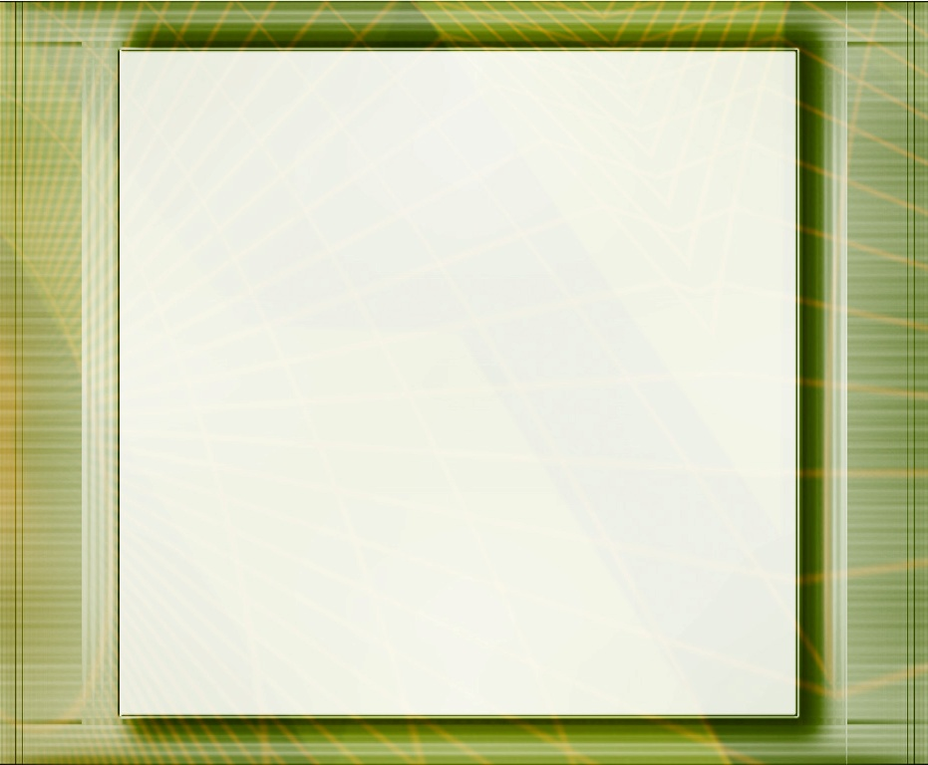
"Tuku ke takitaha ʻofa kae ʻikai fie maʻu ia. Tanumaki ʻa e meʻa ʻoku fakaʻeiʻeiki taha ʻiate kimoutolu, pea vave ke mou fakatokangaʻi ʻa e ngaahi ʻulungaanga lelei ʻiate kimoutolu. Ko e ʻiloʻi ʻo e fakahoungaʻi ko ha fakaʻaiʻai mo e fiemalie fakaʻofoʻofa. ʻOku poupouʻi ʻe he manavaʻofa mo e fakaʻapaʻapa ʻa e feinga ke maʻu ʻa e lelei taha, pea ʻoku tupulaki ʻa e ʻofa ʻi heʻene fakaʻaiʻai ki ha ngaahi taumuʻa fakaʻeiʻeiki ange. […]
ʻOku totonu ke fakaʻapaʻapaʻi ʻe he uaifi ʻa hono husepaniti. ʻOku fie maʻu ke ʻofa mo fakamahuʻingaʻi ʻe he husepaniti ʻa hono uaifi; pea hange ko hono fakatahaʻi kinaua ʻe heʻena fuakava mali ke na taha, ʻoku totonu ke hanga ʻe heʻenau tui kia Kalaisi ʻo ngaohi kinaua ke nau taha ʻiate Ia. Ko e ha ha meʻa ʻe fakahoifua ange ki he ʻOtua ka ko e mamata kiate kinautolu ʻoku nau fakahoko ʻa e fetuʻutaki ʻo e nofo-mali ʻoku nau feinga fakataha ke ako kia Sisu pea ke fakaʻau ke fakafonu lahi ange kinautolu ʻe Hono Laumalie?
EGW (Ko e ʻApi Faka-Kalisitiané, peesi 107, 114)

Slide 6

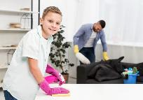


KO E FEOHI 'A E MATU'A MO E FANAU
“ʻAe fānau, fai talangofua ki hoʻomou mātuʻa ʻi he meʻa kotoa pē: he ʻoku lelei lahi ia ki he ʻEiki.‌ʻAe ngaahi tamai, ʻoua naʻa mou fakafiufiu ki hoʻomou fānau, telia naʻa nau fiu ai.. (Kolose 3:20-21)
'I he sosaieti 'o e 'aho ni, 'oku totonu ke faka'aonga'i 'a e fo'i lea "matu'a" ki he ngaahi mali kuo fokotu'u mo e ngaahi famili matu'a 'e taha. Fakatatau kia Paula, ko e feohi mo’ui lelei ‘oku ‘ikai ko e fatongia pe ia ‘o e matu’a, ka ko e fanau foki.
Ngaahi fatongia ʻo e ngaahi foha mo e ngaahi ʻofefine
( Kolose 3:20; Efeso 6:1-3 )
ʻOku ʻikai ko ha fili pe ʻa e talangofua ʻa e fanau
ʻOku makatuʻunga ʻa e talangofua ko ʻeni ʻi he fekau hono nima
ʻIkai ngata ai, ʻoku haʻu ʻa e talangofua mo hono pale pe ʻoʻona
Ngaahi Fatongia Fakamatuʻa
(Kolose 3:21; ʻEfeso 6:4)
Akoʻi kinautolu ʻo ʻikai fakaʻitaʻi pe fakaʻitaʻi kinautolu, koeʻuhi ke ʻoua naʻa fakalotosiʻiʻi kinautolu
‘Oua ‘e faka‘ita‘i kinautolu ‘aki ha ngāue ta‘ekātaki pe fakapikopiko .
Akoʻi kinautolu ʻi he ngaahi founga ʻa e ʻOtua
(Teu. 6:6-7; Lea Fakatata 22:6)
ʻOku mahuʻinga ʻa e lotu fakafamili pongipongi mo e/pe efiafi ki heʻetau fanau ke nau ako fekauʻaki mo e ʻOtua mo fai ʻa e ngaahi fili ki he moʻui taʻengata. Pea ʻoua naʻa ngalo ko ʻetau faʻifaʻitakiʻanga ko e faiako maʻongoʻonga taha ia ki heʻetau fanau.

Slide 7
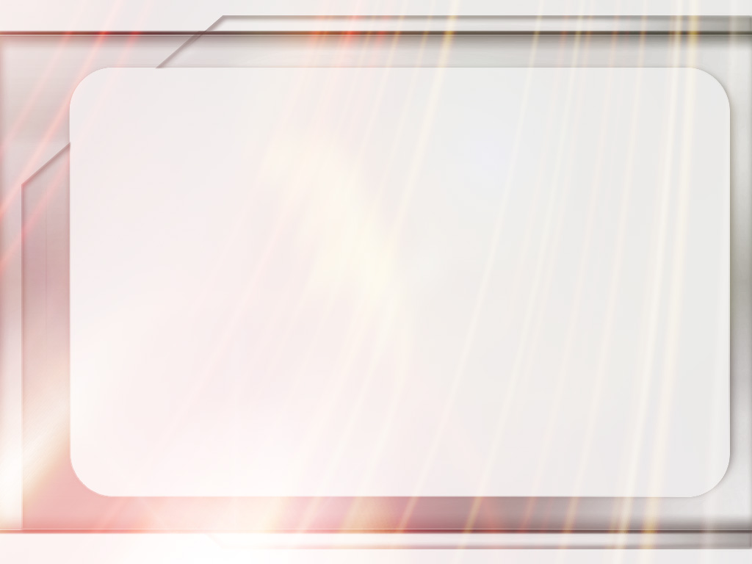
“Ngaahi mātu‘a, ‘ai ho‘omou fānaú ke nau sio ‘oku mou ‘ofa ‘iate kinautolu pea te mou fai ‘a e me‘a kotoa ‘i homou mālohí ke ‘ai kinautolu ke nau fiefia. Kapau te ke fai pehē, ‘e lahi ange ‘aupito ‘a e mamafa ‘o ho‘o ngaahi fakangatangata ‘oku fiema‘ú ‘i honau ‘atamai kei talavoú. Puleʻi hoʻo fānaú ʻi he angaʻofa mo e manavaʻofa, ʻo manatuʻi “ʻoku mamata maʻu ai pē ʻenau kau ʻāngeló ki he fofonga ʻo ʻEku Tamai ʻoku ʻi he langí.” Kapau ʻokú ke fakaʻamu ke fai ʻe he kau ʻāngeló maʻa hoʻo fānaú ʻa e ngāue kuo ʻoange ʻe he ʻOtuá kiate kinautolú, fengāueʻaki mo kinautolu ʻaki hoʻo fai hoʻo tafaʻakí ..”
EGW (Ko e ʻApi Faka-Kalisitiané, p. 193)

Slide 8



KO E NGAAHI FETU'UTAKI 'I HE VAHE 'O E KAU PULE MO E KAU NGAUE
“ʻAe kau tamaioʻeiki, fai talangofua ʻi he meʻa kotoa pē ki homou ʻeiki fakakakano; ʻoua naʻa ʻi he ngāue fakamamata pe, ʻo hangē ko e kau fakamālie ki he tangata; ka ʻi he loto totonu, ʻo manavahē ki he ʻOtua:” (Kolose 3:22)
Ko e fekau’aki ‘o e nofo popula na’e ‘i ai ‘i he kuonga ‘o Paula, ‘oku si’isi’i ‘ene kaunga ki he ngaahi fa’ahinga nofo popula, ‘a ia, ko e me’apango, ‘oku kei ‘i ai pe he ‘aho ni. Ko ia ai, kuo pau ke mahino kiate kitautolu 'a e fale'i ko 'eni 'i loto 'i he tu'unga 'o ha fetu'utaki 'a e pule/ma'ulalo .
Ko e tōʻonga ʻa e kau ngāue ʻi laló
(Kolose 3:22-25; ʻEfeso 6:5-8)
Fai maʻu pē ho lelei tahá, neongo kapau ʻoku ʻikai ke sio mai ha taha .
Feinga ke lelei taha ‘i ho‘o ngāué, ‘o hangē ‘okú ke fai ia ma‘á e ‘Otuá .
Tali e valoki 'i he taimi 'oku fakatonuhia'i ai
ʻOku ʻaonga ʻa e ngaue lelei
ʻOku ʻikai fakaʻata kitautolu ʻe he pule kovi mei he angavaivai (1P 2:18)
Ko e 'ulungaanga 'o e kau pule
( Kolose 4:1; ‘Efeso 6:9 ) (Kolose 4:1)
Ke taki ʻi he fakamaau totonu mo e maʻoniʻoni
ʻOua naʻa fakaʻaongaʻi ʻa e ngaahi fakamanamana pe ngaahi fie maʻu taʻeʻaonga
Ko e pule kotoa pe 'oku 'i ai 'ene Pule 'oku 'iate ia, 'a ia te ne taliui ki ai
Ko kitautolu kotoa pe, kau pule pe kau ngaue ma’ulalo, ko e kau tamaio’eiki (popula) ‘a Kalaisi, he ‘oku tau tauhi kiate Ia.

Slide 9

“Na’e ‘ikai ko e ngāue ‘a e ‘aposetoló ke ne holoki ta’efakakaukau’i pe fakafokifā ‘a e tu’utu’uni kuo fokotu’u ‘o e sōsaietí. Ko hono feingaʻi ʻení ʻe hoko ia ko hono taʻofi ʻo e lavameʻa ʻo e ongoongoleleí. Ka na‘á ne ako‘i ‘a e ngaahi tefito‘i mo‘oni na‘e taa‘i ‘a e makatu‘unga tonu ‘o e pōpulá pea kapau ‘e fakahoko, ‘e pau ke ne fakavaivai‘i ‘a e fokotu‘utu‘ú kotoa. [...]
‘Oku hanga ‘e he lotu faka-Kalisitiane ‘o ngaohi ha ha’i fefeka ‘o e fakatahataha ‘i he vaha’a ‘o e ‘eiki mo e tamaio’eiki, tu’i mo e mo’ulaloa, faifekau ‘o e ongoongolelei mo e tokotaha angahala kuo ma’ulalo ‘a ia kuo ne ma’u ‘ia Kalaisi ‘a e fakama’a mei he angahala. Kuo fufulu kinautolu ʻi he taʻataʻa tatau, kuo fakamoʻui ʻe he Laumālie tatau; pea kuo ngaohi kinaua ke taha ʻia Kalaisi Sīsū ..
EGW (Ko e Ngaahi Ngāue ʻa e Kau ʻAposetoló, p. 460)

Slide 10


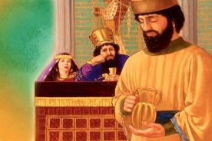
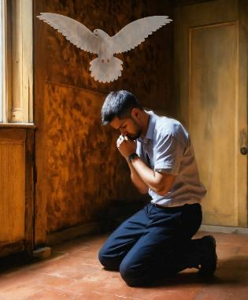
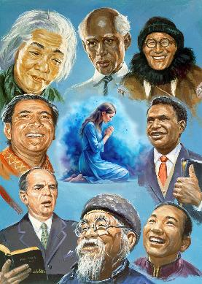
KO E NGAAHI FEOHI 'I HE SIASI .
“Fai maʻu pe ʻae lotu, pea leʻo ʻi ai mo fakafetaʻi;” (Kolose 4:2)
‘Oku uki kitautolu ke tau “felotua’aki” he “Ko e lotu ‘a e tokotaha ma’oni’oni ‘oku malohi mo ola lelei”
(Semisi 5:16 )
‘I he tafa’aki ‘o e lotu pongipongi mo e efiafi, ‘oku fokotu’u mai ‘e Paula ke tau lotu ‘i ha fa’ahinga taimi pe (Kol. 4:2; ‘Efe. 6:18; 1 Tes. 5:17). Hangē pē ko e lotu fakalongolongo ‘a Nehemaia ‘i he ‘ao ‘o e tu’í (Neh. 2:4), ‘oku tau ma’u ‘a e monū’ia ke tau lotu ‘i ha fa’ahinga feitu’u pē pe tu’unga pē.
‘Ikai ngata ai, ‘oku tau ma’u ‘a e fakapapau ‘e liliu ‘e he Laumalie Ma’oni’oni ‘etau lotu ke ola lelei (Lom. 8:26).
‘Oku fai ‘e Paula ha kole makehe ke tau lotua ‘a kinautolu ‘oku nau talaki ‘a e ongoongolelei (Kol. 4:3-4; ‘Efe. 6:19). 'Oku 'ikai mahu'inga pe 'oku si'isi'i pe lahi 'a e taukei 'a e tangata malanga 'i he ngaue faka'evangelioo; ʻoku ʻikai feʻunga ha taha ki he ngāue ni. Ko Paula tonu na’e ‘ikai ngata pe ‘i he’ene lotu, ka na’a ne kole foki ki he fanga tokoua ke nau lotu ma’ana koe’uhi ke hoko ‘ene ngaahi lea ko e ngaahi lea totonu.

Slide 11

“ʻI he feinga kotoa pē ʻi he feituʻu kotoa pē ʻoku fakafeʻiloaki ai ʻa e moʻoní ʻoku fie maʻu ai ha ngaahi ʻatamai kehekehe, ngaahi meʻafoaki kehekehe, ngaahi palani kehekehe mo e ngaahi founga ngāue ʻoku fakatahatahaʻi. ʻOku totonu ke ʻai ʻe he tokotaha kotoa pē ko ha poini ke aleaʻi fakataha, ke lotu fakataha. ʻOku pehē ʻe Kalaisi ʻo pehē, “Kapau ʻe lototaha ha toko ua ʻiate kimoutolu ʻi he māmaní ʻo kau ki ha meʻa pē ʻe fai ʻe heʻena Fak ʻo hangē ko kinauá.”
( Mātiu 18:19 )”
EGW (Ngaahi Pōpoaki Filifili, vol. 3, p. 24)

Slide 12

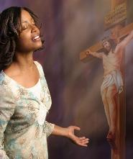
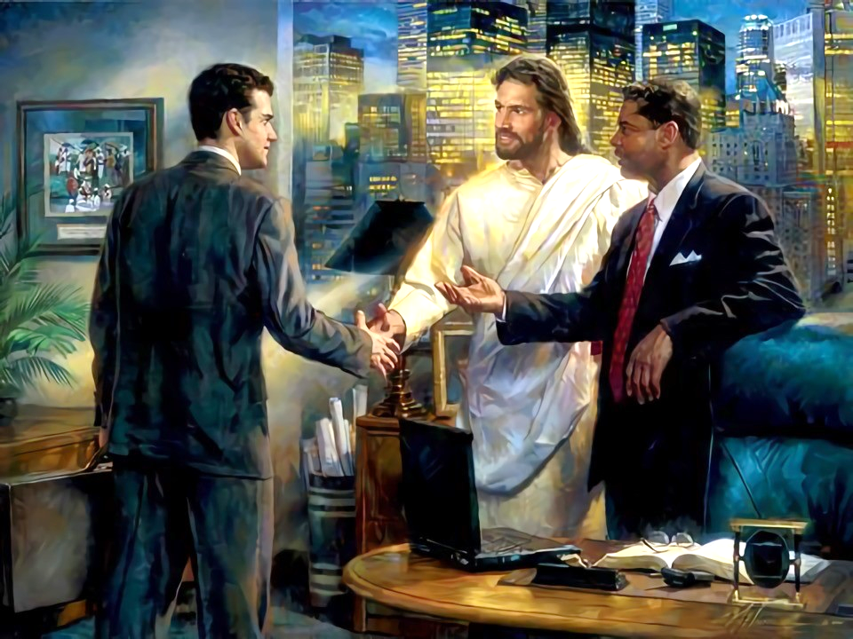
KO E NGAAHI FETU‘UTAKI MO E KAU TA‘ETUI
“Mou ʻaʻeva ʻi he angafakapotopoto kiate kinautolu ʻoku ʻi tuaʻā, ʻo huhuʻi ʻae kuonga..” (Kolose 4:5)
‘Oku tau ma‘u ‘a e ngaahi ‘aonga lahi: kuo tau ako ‘a e me‘a na‘e fai ‘e Sīsū ma‘atautolú; kuo tau tali ia; pea ʻoku tau maʻu ʻa e fakapapau ʻo e fakamoʻuí.
ʻOku tau ʻiloʻi ʻeni koeʻuhí he naʻe talamai ʻe ha taha. Pehē foki, kuo pau ke tau vahevahe ia mo e niʻihi kehé. ‘Oku pehē ‘e Paula ‘oku totonu ke tau fetu’utaki fēfē mo e “kau tu’a,” ‘a kinautolu ‘oku te’eki ke nau ‘ilo ‘a Sīsū (Kol. 4:5-6)?
Mo e poto
ʻOku tau fie maʻu ʻa e “poto ʻoku haʻu mei he langí” ( Sēmisi 3:17 ) ʻi heʻetau fetuʻutaki mo kinautolu ʻoku teʻeki ke nau ʻiloʻi ʻa Sīsuú .
‘Aki ‘a e ngaahi lea anga-‘ofa
‘Oku totonu ke anga-faka‘apa‘apa ma‘u pē ‘etau ngaahi leá koe‘uhi ke nau fanongo fiefia mai kiate kitautolu.
‘Aki ‘a e ngaahi lea “kuo fakaifo ‘aki ‘a e māsima .”
‘Oku totonu ke fe‘ungamālie ‘a e fetalanoa‘akí pea fe‘ungamālie mo e tokotahá pea mo e ‘ātakai ‘oku nau ‘i aí.
Tali takitaha 'o fakatatau ki he'ene fe'unga
Koe'uhi 'oku kehekehe 'a e tokotaha takitaha, 'e tataki kitautolu 'e he Laumalie Ma'oni'oni ki he me'a ke tau tali 'i he momeniti takitaha .

Slide 13

“ʻOku hanga ʻe he fakaʻapaʻapa moʻoni fakataha mo e moʻoni mo e fakamaau totonu ʻo ʻai ʻa e moʻui ke ʻoua naʻa ngata pe ʻi heʻene ʻaonga ka ʻoku fakaʻofoʻofa mo namu Ko e ngaahi lea ʻ ofá, ngaahi fotunga fakafiemālie, mo ha fotunga fiefia ʻ oku takatakaiʻi ai ʻ a e Kalisitiané ʻ aki ha fakaʻofoʻofa ʻ a ia ʻ okú ne ʻ ai hono tākiekiná ke meimei taʻemalava ke talitekeʻi. ʻI heʻene fakangaloʻi kita, ʻi he mama, melino, mo e fiefia ʻoku ne foaki maʻu pe ki he niʻihi kehe, ʻoku ne maʻu ai ʻa e fiefia moʻoni.
Tuku muʻa ke tau fakangaloʻi kitautolu, tokanga maʻu pe ke fakafiefiaʻi e niʻihi kehe, ke fakamaʻamaʻa ʻenau ngaahi kavenga ʻaki ʻa e ngaahi ngaue ʻo e angaʻofa ongongofua mo e ngaahi ngaue ʻo e ʻofa taʻesiokita..”
EGW (ʻI he Ngaahi Potu Fakalangi, ʻaho 22 ʻo Sune)

