Slide 1
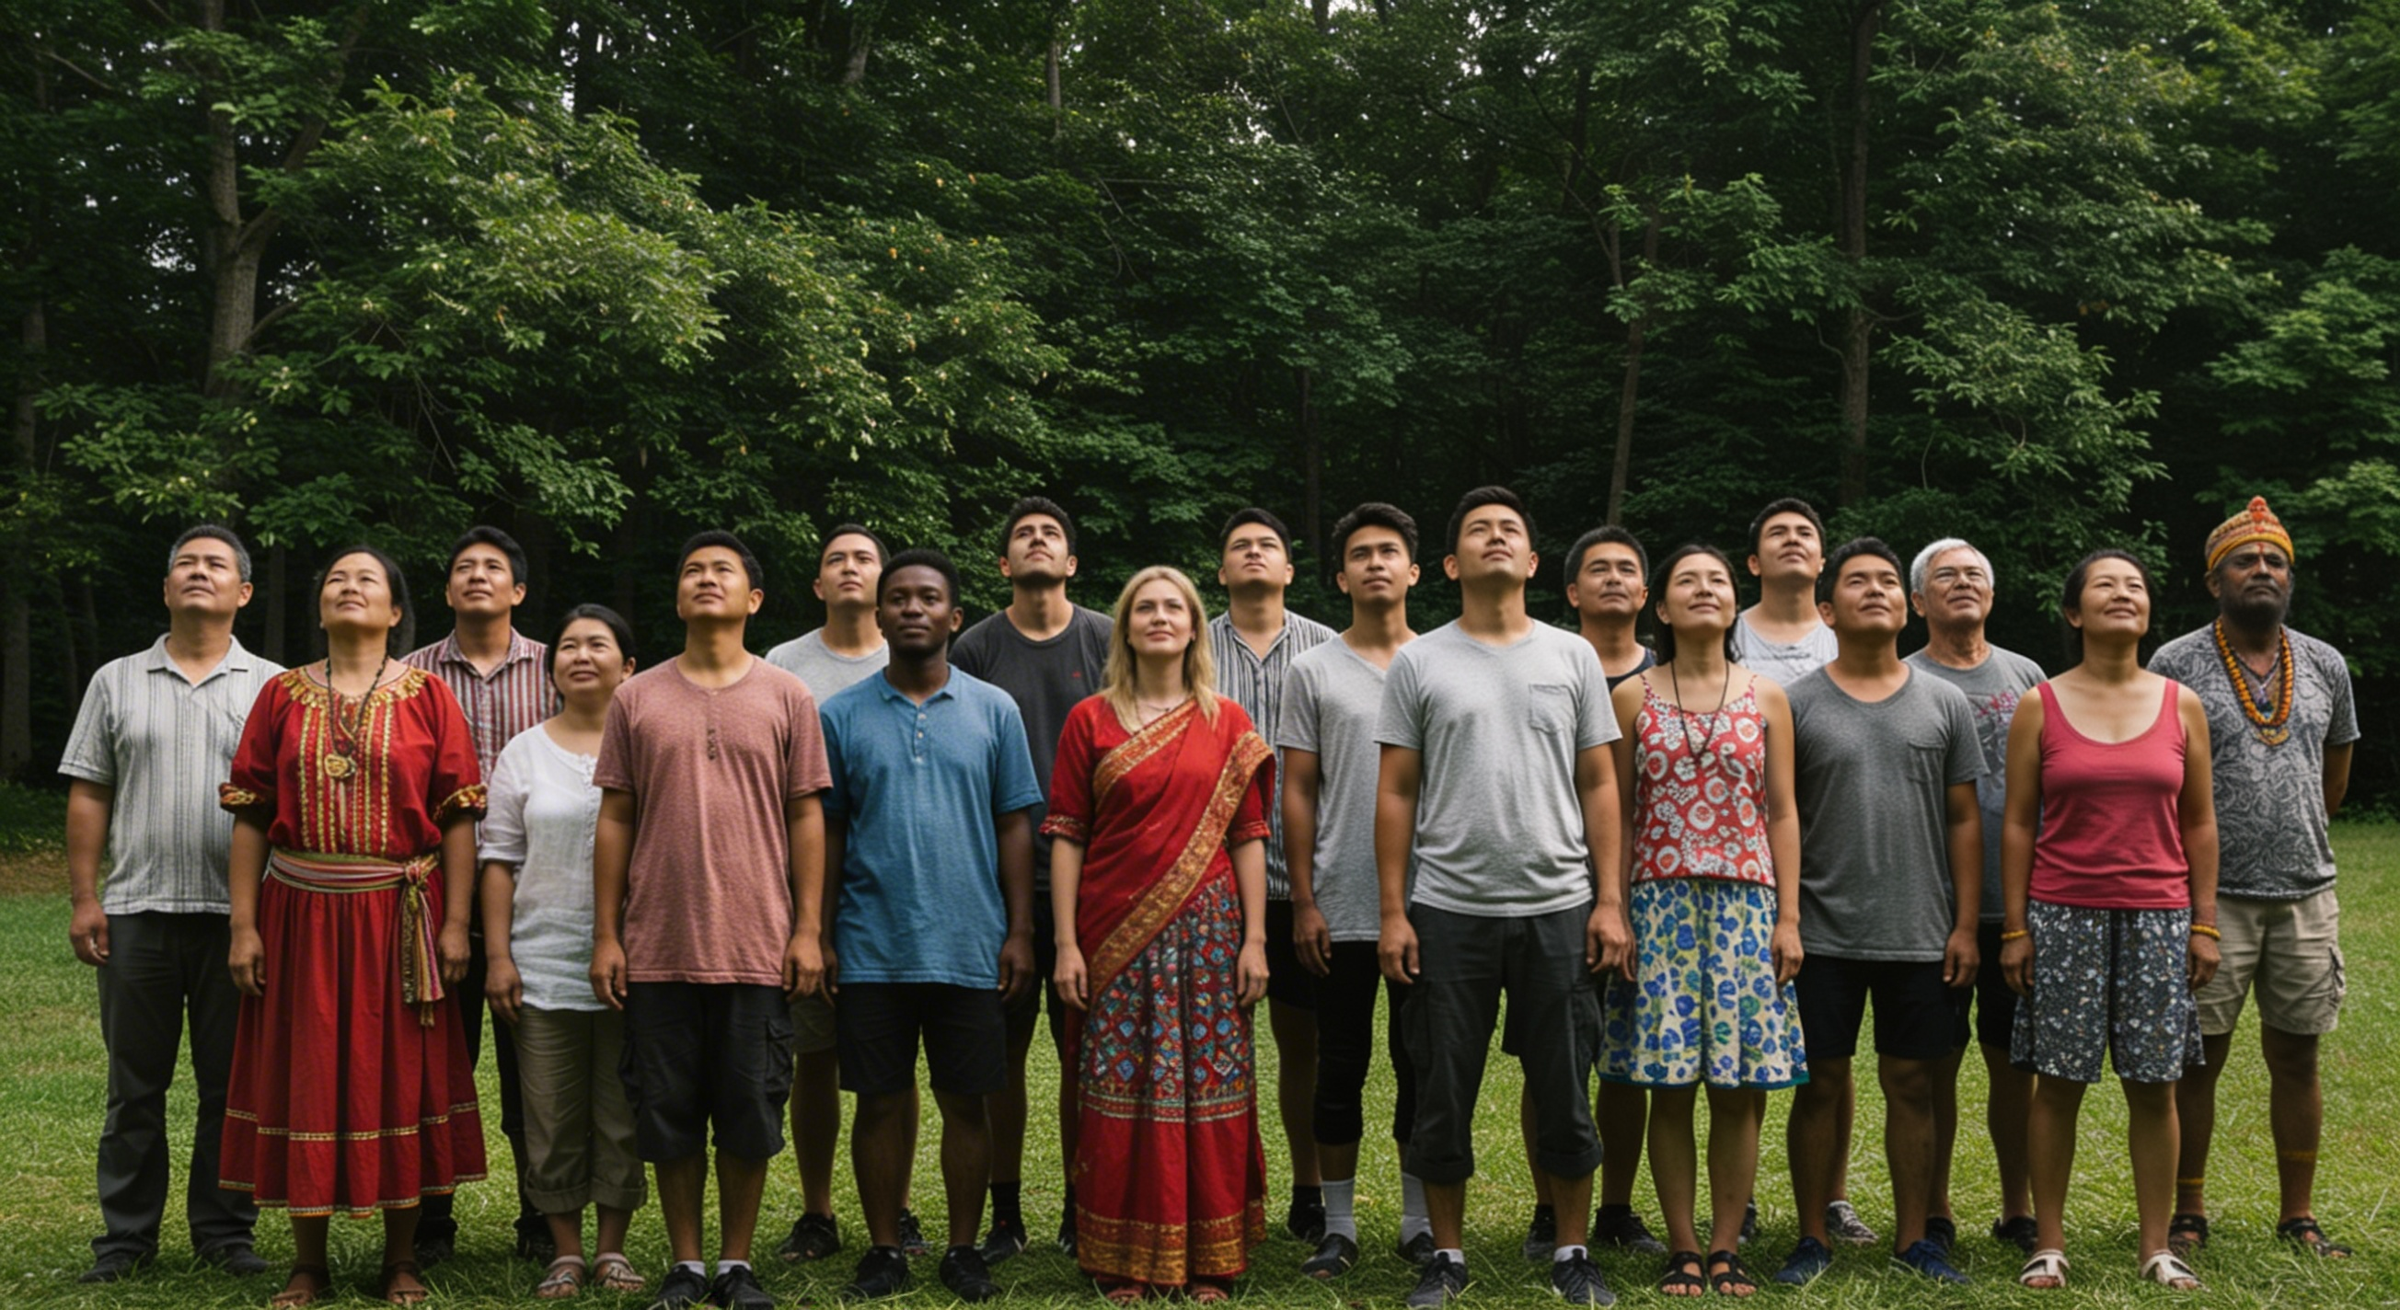
TUʻU ʻI HE FINANGALO KOTOA PE ʻO E ʻOTUA
Lesoni 13 ki he ʻaho 28 ʻo Maʻasi 2026

Slide 2
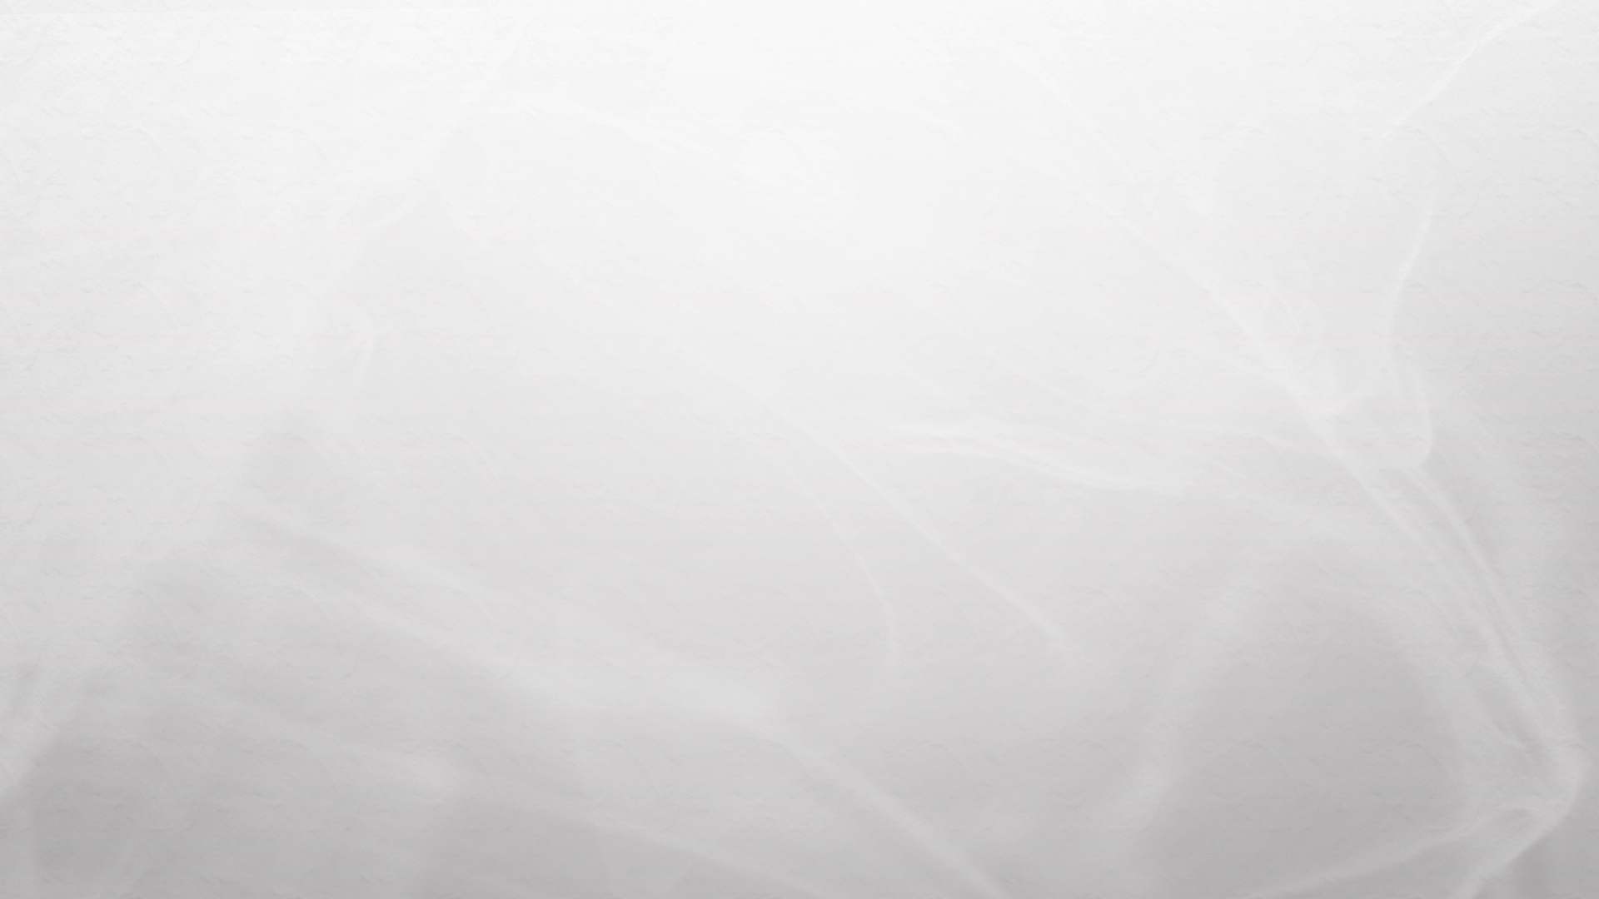
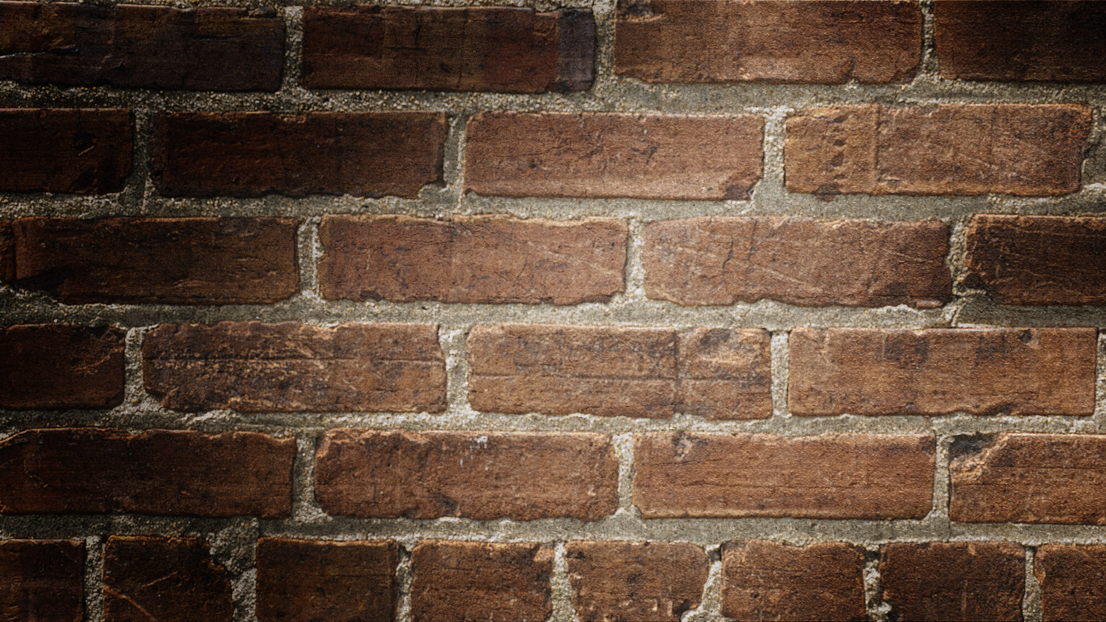
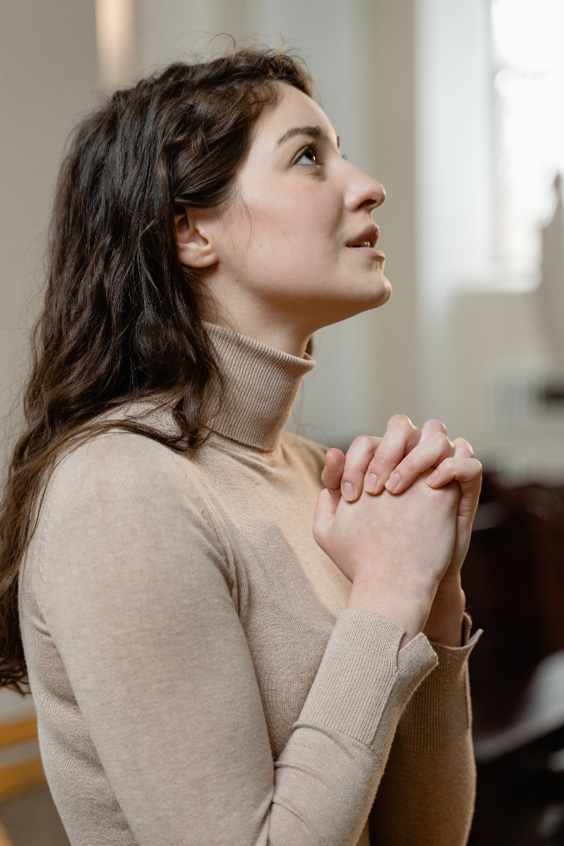
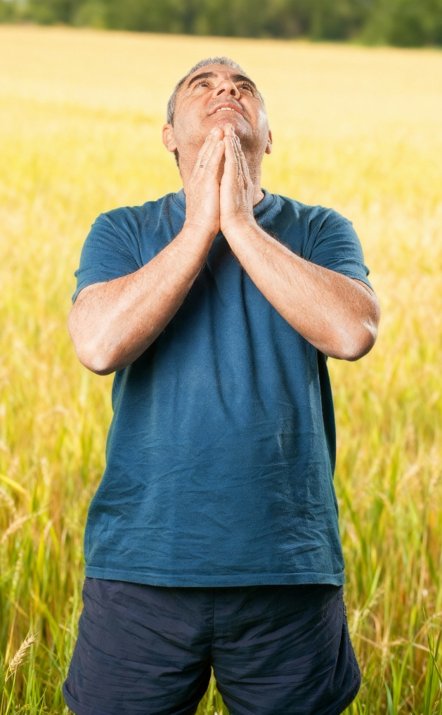
“Fakafetaʻi ʻi he meʻa kotoa pē: he ko e finangalo ia ʻoe ʻOtua ʻia Kalaisi Sisu kiate kimoutolu.”
1 Tesalonaika 5:18

Slide 3
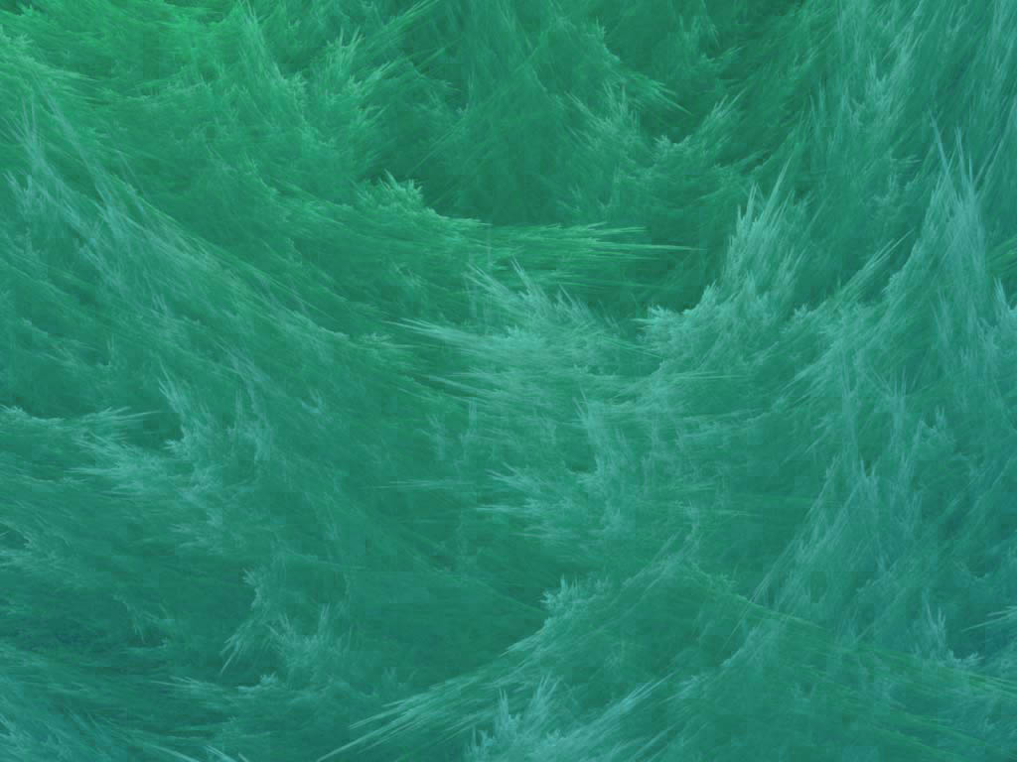
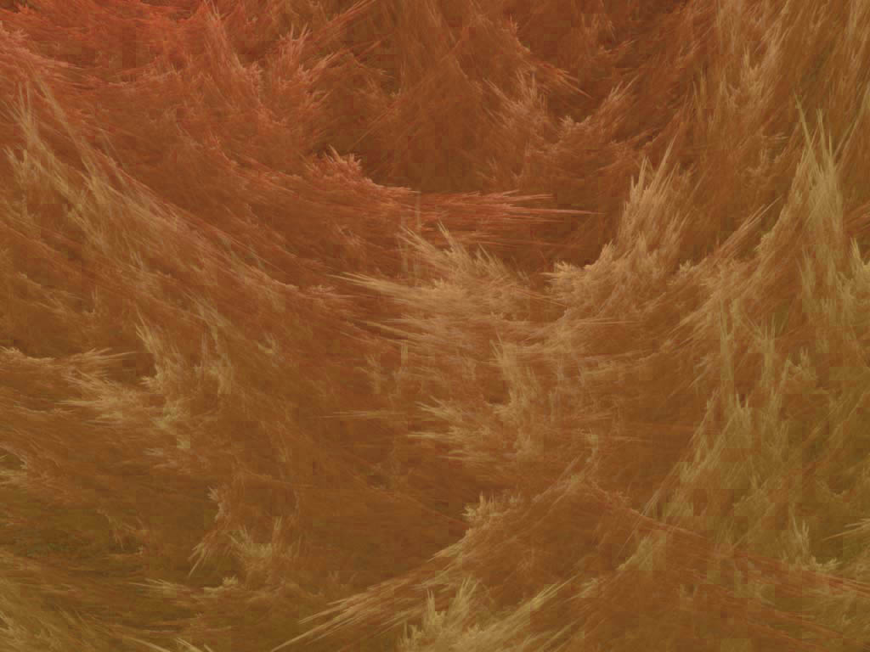
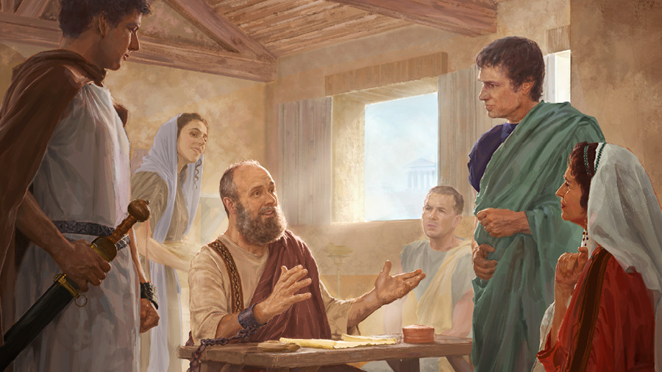
Naʻe ngāue ʻ a Paula mo e ngaahi kaungāngāue kehekehe, pea naʻá ne fakatokangaʻi ʻ a e ngāue ʻ a e faʻahinga naʻa nau līʻoa ʻ aufuatō kinautolu ki hono tauhi mo fakaivimālohiʻi ʻ a e ngaahi siasí.
Ko e kau fakafofonga
Tikiko mo ʻOnesimosi (Kolose 4:7-9)
Ko kinautolu ʻo e kamu
ʻAlisitako, Maʻake mo Sisu (Kolose 4:10-11)
Ko e faiako
ʻEpafasi (Kolose 4:12-13)
Ko e ʻofeina mo e anga fakamamani
Luke mo Timasi (Kolose 4:14)
Kau taki ʻo e Siasi
Nimifa mo Akipa (Kolose 4:16-18)
ʻ I he ngataʻanga ʻ o e tohi ki he kau Kolosé, ʻ oku ʻ oatu ai ʻ e Paula ʻ a e talamonū mei hono kaungāngāué, pea fakafeʻiloaki ki he fanga tokoua faitōnunga ʻ o Kolosé.
ʻOku ne toe fakahu mai foki ʻa e holi fakamatoato ʻa ʻEpafalesi: "koeʻuhi ke mou tuʻu maʻu ʻi he finangalo kotoa pe ʻo e ʻOtua, ʻo matuʻotuʻa mo fakapapau kakato" (Kolose 4:12).

Slide 4

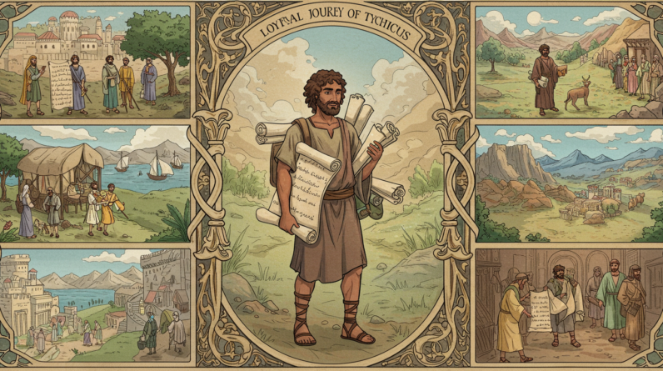
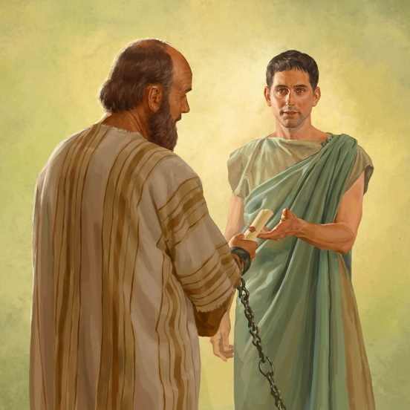


KO E KAU FAKAFOFONGA
“E fakahā atu ʻeku meʻa kotoa pē kiate kimoutolu ʻe Tikiko, ʻaia ko e tokoua ʻofeina, mo e faifekau angatonu mo e kaungā tamaioʻeiki ʻi he ʻEiki:[…] Pea mo Onesimosi, ko e tokoua angatonu mo ʻofeina, ʻaia ko homou tokotaha. Te na fakaʻilo kiate kimoutolu ʻae meʻa kotoa pē ʻi heni. ” (Kolose 4:7, 9)
Makehe mei hono fakamafola ʻo e ongoongolelei ʻi he ngaahi kolo mahuʻinga taha ʻo e Puleʻanga, naʻe fai ʻe Paula ha ngaahi tohi ke fetuʻutaki ai mo e ngaahi siasi, pe ke fakalotolahiʻi ʻa kinautolu naʻe ʻikai ke ne ʻiloʻi fakatautaha.
Naʻe ʻoatu ʻa e ngaahi tohi ko ʻeni ʻo fakafou ʻi he ngaahi tokoua ʻofeina mo faivelenga (Kolose 4:7-9).
TIKIKO
ONESIMOSI
ʻI he fononga fakafaifekau hono tolu ʻa Paula, naʻa ne ʻalu mo ia ke ʻave ha feilaulau ki Selusalema (Ngaue 20:4). Naʻa ne tokoni kia Paula ʻi Loma pea ʻave ʻa e ngaahi tohi ki he kakai ʻEfeso mo e kau Kolose (ʻEfeso 6:21; Kolose 4:7). ʻI he taimi naʻe tukuange ai ʻa Paula, naʻa ne mei lava pe ʻo fetongi ʻa Taitusi ʻi Keleti (Taitusi 3:12). Lolotonga e nofo popula fakaʻosi ʻa Paula, naʻe fekauʻi ia ko e faifekau ki he siasi ʻi ʻEfeso (2 Timote 4:12).
Ko ha tamaioʻeiki naʻe hola mei hono ʻ eikí, ʻ a Fimone. Naʻa ne ului lolotonga hono fuofua tuku popula ʻa Paula ʻi Loma. Naʻe fakafoki ia ʻe Paula ki heʻene ʻeiki mo ha tohi ongo moʻoni, ʻo fakaʻaiʻai kia Filimone ke ne tauhi ia ʻaki ʻa e ʻofa faka-Kalisitiane (Filimone. 1:10). Naʻa ne ʻave fakataha mo Taikikasi ʻa e tohi ki he kakai Kolose (Kolose 4:9).

Slide 5
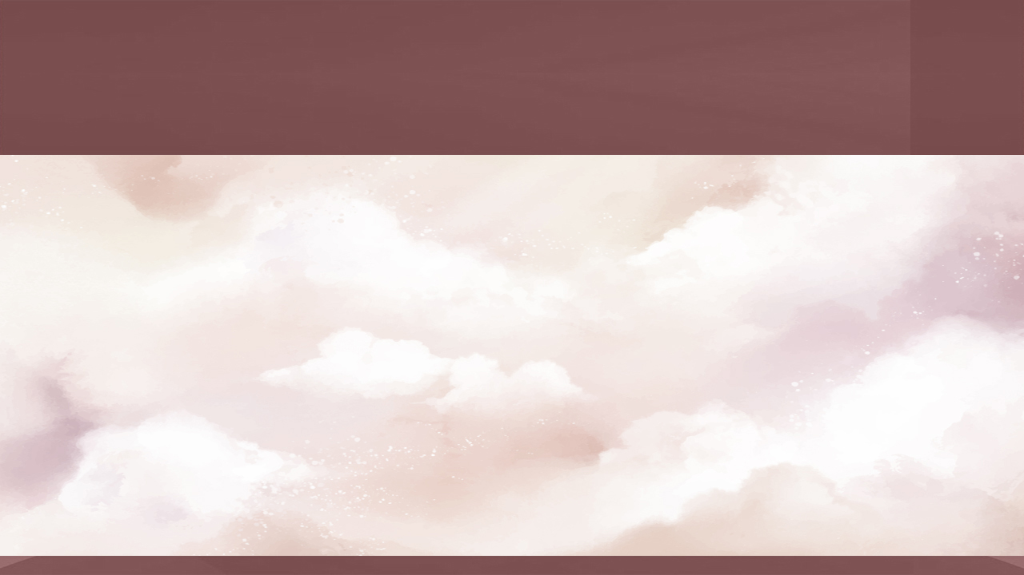
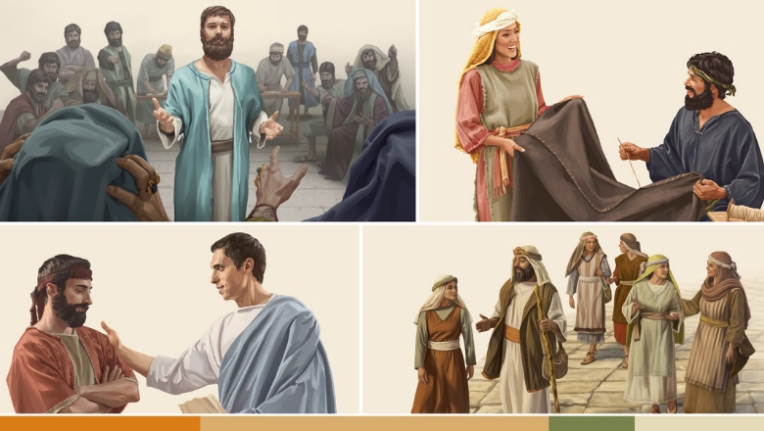
KO KINAUTOLU ʻO E KAMU
“…Ko kinautolu ni pe ko hoku kaunga ngāue ki he puleʻanga ʻoe ʻOtua, pea naʻa nau fakafiemālie kiate au.” (Kolose 4:11)
Naʻe feinga ʻa Paula ke holoki ʻa e ngaahi ʻa naʻa ne fakamavahevaheʻi ʻa e Siasi. Naʻa ne ʻatakaiʻi ia ʻe ha kau ngaue mei he ngaahi feituʻu kehekehe pea mei he ngaahi puipuituʻa kehekehe. Naʻe ngaue fakataha ʻa e kau Siu mo e kau Senitaile, kau ʻEsia mo e kau ʻIulope ʻi he uouongataha.
Ko ʻene visone ke aʻusia ha siasi uouangataha ʻoku ngaue ki ha taumuʻa tatau: ko hono malangaʻi ʻo e ongoongolelei.
‘ALISITAKO
Naʻa ne tupu ʻi Tesalonaika (Ngaue 27:2). Naʻa Ne aʻusia ʻa e faingataʻa lolotonga ʻa e moveuveu ʻi ʻEfeso (Ngaue 19:29). Naʻa Ne ʻalu fakataha mo Paula ke ʻave ʻa e feilaulau ʻi Selusalema (Ngaue 20:4). Naʻe tuku popula ia mo Paula ʻi Loma pea ne talamonu ki he kau Kolose mo Filimone.
MA’AKE
Naʻe liʻaki ʻe he ʻilamutu ʻo e ʻuluaki hoa ʻo Paula ko Panepasa ʻa e misiona ʻi Pamifilia, pea naʻe fakafisi ʻa Paula ke ʻave ia ʻi ha fononga hono ua (Ngaue 15:37-38). Naʻa ne ʻalu mo ʻene faʻetangata ʻo hoko ko ha ʻevangelio mahuʻinga kia Paula (Ngaue 15:39; 2 Timote 4:11). Naʻe ngaohi ia ʻe Pita ʻo hange ha foha (1 Pita 5:13). Ko ia naʻa ne faʻu ʻa e Kosipeli ʻa Maʻake.
Ko e meʻa pe ʻoku tau ʻilo fekauʻaki mo ia ko e Siu ia, pea naʻe ʻiloa ia ʻaki ʻa e hingoa fakatenetene ko ʻSusitoʻ
(Kolose 4:11)
SISU

Slide 6

KO E FAIAKO
“Ko Epafasi, ko homou tokotaha, ko e tamaioʻeiki ʻa Kalaisi, ʻoku ʻofa atu ia kiate kimoutolu: ʻoku fai feinga maʻuaipē ia koeʻuhi ko kimoutolu ʻi he ngaahi lotu, koeʻuhi ke mou tuʻu haohaoa mo kakato ʻi he finangalo kotoa pē ʻoe ʻOtua.” (Kolose 4:12)
Naʻe tokoni ʻa ʻEpafasa ki hono fakamafola ʻo e ongoongolelei ʻi Kolose, Hierapolis, mo Laotisia, ko e ngaahi siasi naʻa ne ʻofa lahi ai (Kolose 4:13). Fakataha mo e fakafeʻiloaki ʻa ʻEpafalesi, ʻoku fakakau ai ʻe Paula ʻene ngaahi fakaʻamu ki he kakai Kolose (Kolose 4:12):
Naʻa ne fakahinohinoʻi ʻa e siasi ʻi Kolose, ʻo ʻai ke ʻiloa lahi ʻa e ongoongolelei kiate kinautolu (Kolose 1:7). ʻOku foaki ange ʻe Paula kiate ia ʻa e hingoa ʻe tolu: ʻkaunga tamaioʻeiki ʻofeinaʻ; ʻtamaioʻeiki ʻa Kalaisiʻ; mo e ʻkaunga populaʻ (Kol. 1:7; 4:12; Filimone 1:23)
EPAFASI
Tuʻu maʻu
Kuo pau ke nau taʻeueʻia, tautautefito ʻi he fehangahangai mo e ngaahi faʻufaʻu ʻa e fili (ʻEfeso 6:11)
ʻOfa ke ke haohaoa
ʻOku maʻu ʻa e haohaoa ko ʻeni ʻi he ʻofa taʻesiokita (Matiu 5:44, 48), neongo ʻoku tupulaki maʻu pe ai ha taha
(Filipai 3:12)
Fakatauange ke mou kakato
Ke fakafonu kitautolu ʻaki ʻa e meʻa kotoa pe ʻoku tau lava ʻo maʻu mei he ʻOtua

Slide 7

KO E ʻOFEINA MO E ANGA FAKAMAMANI
“Ko Luke, ko e faitoʻo ʻofeina, mo Timasi, ʻoku na ʻofa atu kiate kimoutolu.” (Kolose 4:14)
LUKE
Naʻa ne faʻu ʻa e Kosipeli ʻa Luke mo e Ngaue ʻa e Kau ʻAposetolo, pea ʻoku lau ia ko e tokotaha faʻu piokalafi ʻo Paula (Luke 1:1-4; Ngaue 1:1). Ko ha toketa ia ʻi heʻene ngaue, pea ʻoku ui ia ko e "ʻofaʻanga" ʻe Paula. Naʻa ne nofo mo Paula ʻo aʻu ki heʻene mate (2 Timote 4:11).
DEMAS
Ko e kaunga-ngaue ia ʻo Paula lolotonga ʻene fuofua nofo popula ʻi Loma (Filimone 1:24). Neongo ia, ʻi he lolotonga ʻo ʻene nofo popula fakaʻosi, naʻa ne liʻaki ʻa Paula, ʻo "ʻofa ki mamani" (2 Timote 4:10).
Kapau naʻe lave pe kiate ia ʻi he Kolose 4:14, naʻe mei hoko pe ʻa Temasi ko ha takaua faivelenga ʻo Paula.
Naʻe fakaʻau ke mahino ʻa e faikehekehe ʻi he vahaʻa ʻo Luke mo Temasi ʻi he ʻalu ʻa e taimi. Naʻe ʻofeina ʻa Luke ʻi heʻene ngaue, ka naʻe ʻofa ʻa Temasi ʻi mamani mo
tuʻu maʻu ʻa Luke ʻi heʻene ʻamanaki lelei ki he Haʻele ʻAngaua Mai mo e Mamani Foʻou. Naʻe ʻofa lahi ange ʻa Teimasi ki he naunau ʻo e mamani ʻi he naunau ka hoko mai.
Naʻe ʻikai ke ne toe ʻofa kia Sisuu ka naʻa ne foaki hono loto ki he mamani (1 Sione 2:15).

Slide 8

KAU TAKI ʻO E SIASI
“Tala atu ʻeku ʻofa ki he kāinga ʻoku ʻi Leotisia, mo Nimifa, mo e siasi ʻi hono fale.”
(Kolose 4:15)
Ko e meʻa pe ʻoku tau ʻilo fekauʻaki mo Nimifa naʻa ne tataki ha siasi ʻi he kolo ko Leotisia. ʻOku ʻikai ke tau ʻiloʻi pe ko ha tangata pe fefine ia, he ʻoku pehe ʻe he ngaahi tohi ʻe niʻihi ko hono fale,niʻihi ko honau fale, pea ko e niʻihi ko e tokolahi ko hono fale.
Ko e foha ‘o Filimone, ko e tangata’i fonua ‘o Kolose, na’e ‘i ai ‘a e taimi na’e kaungame’a ai ‘a Paula (Filim. 1:1-2). ‘Oku kole ange ‘e Paula ke ne hoko atu ‘ene ngaue ‘i he ngaue fakafaifekau (ko e tīkoni, faifekau, pe motu’a ‘o e siasi ‘i Kolose).
NIMIFA
AKIPA
ʻOku kole ʻe Paula ki he kakai Kolose ke lau ʻene tohi ki he kakai ʻo Leotisia, pea ke nau lau ʻa e tohi naʻa ne fai ki he kakai Leotisia (Kolose 4:16).
Ko ia ai, ʻoku ne lave ki he ongo taki lalahi ʻo e ongo siasi ko ʻeni: ko Nimifa [ʻo Leotisia] mo ʻAkipa [ʻo Kolose] (Kolose 4:15, 17).
ʻOku ʻikai ke tau ʻilo ʻa e popoaki ʻa Paula ki he kakai Leotisia, neongo ʻoku tau ʻilo ʻa e popoaki naʻe tohi ʻe he ʻaposetolo ko Sione kiate kinautolu ʻi he taʻu ʻe 30 mei ai (Fakaha 3:14-22).

Slide 9
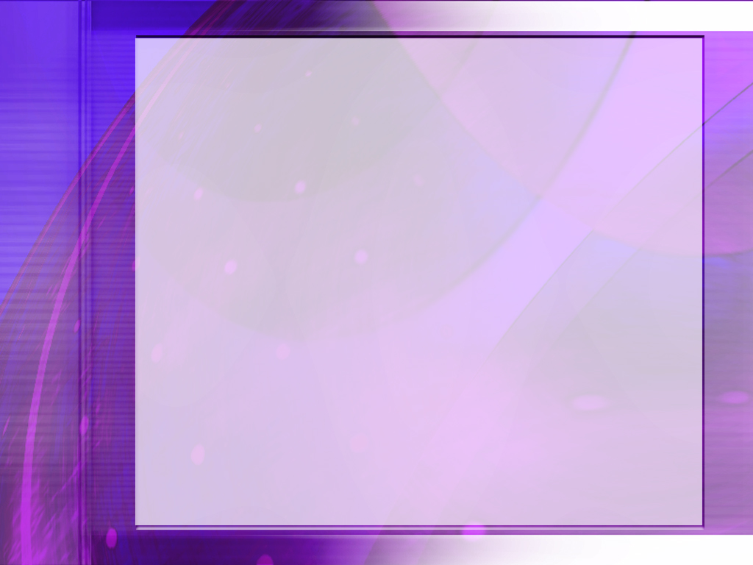
“Service for God demands the whole being—heart, mind, soul, and strength. Without reservation we are to give ourselves to God, that we may bear the image of the heavenly instead of the image of the earthly. There must be a quickening of the sensibilities, that the mind may be fully awake to the work to be done for all classes, high and low, rich and poor, learned and ignorant. We are to reveal the tenderness shown by the great Shepherd as He gathers the lambs in His arms and carefully guards His flock from harm, leading it in safe paths. Christ’s followers are to show His tenderness and sympathy, and they must also show His intensity of desire to impart the truths that mean eternal life to the receiver.”
EGW (Christ Triumphant, February 9)

