Slide 1
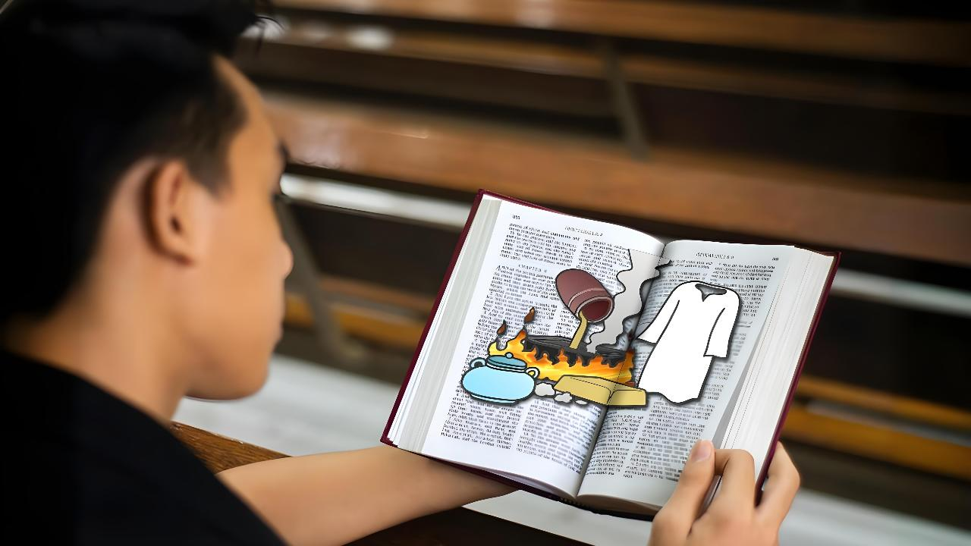
VAKAI’I ‘A E ME’A MO'ONI
Lesoni 1 ki he ʻaho 4 ʻo ʻEpeleli, 2026

Slide 2
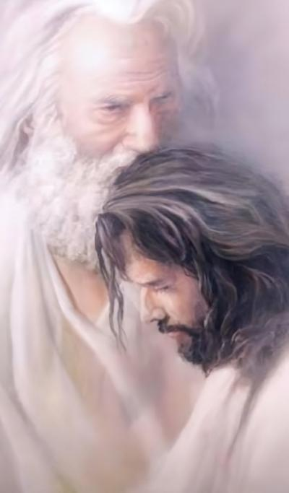
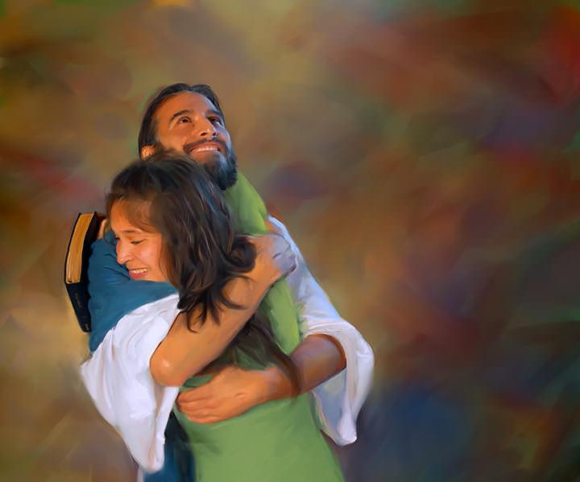
“Hangē ko e ʻofa ʻae Tamai kiate au, kuo pehē ʻeku ʻofa kiate kimoutolu: mou nofomaʻu ʻi heʻeku ʻofa.”
(Sione 15:9)

Slide 3

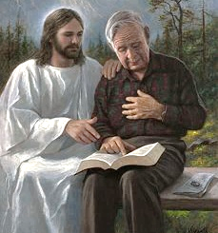
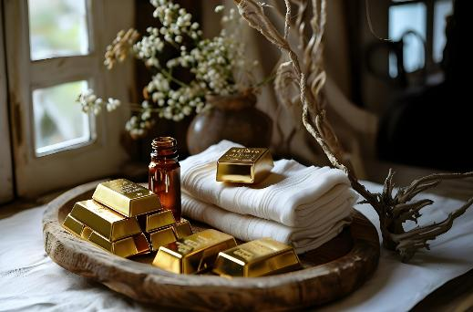


Kuo tau taki taha fakatupulekina ha vaha‘angatae kehekehe mo e ‘Otuá. Ka ʻoku tau lototaha kotoa ki ha meʻa ʻe taha: ʻe lava (pea ʻoku totonu ke) tupulaki ʻa e fetuʻutaki ko ʻení.
Ko e ʻuluaki sitepu kuo pau ke tau fai kae lava ke tau tupulakí ko ʻetau ʻiloʻi hotau tūkunga lolotongá.
Kuo ‘omi ‘e he ‘Otua ha fekau fakalukufua fekau’aki mo e tu’unga fakalaumalie ‘o e siasi ‘i he tu’unga faka’osi ko ‘eni ‘o e mo’ui. Ko eni ‘oku ‘atautolu ke tau sivisivi’i kitautolu ke tau ‘ilo pe ko e fē ‘a e konga ‘o e fekau ko ia ‘oku kaunga kiate kitautolu, pea mo e founga ke fakamālohia mo fakaloloto ai hotau vaha’angatae mo e ‘Otua.
Ko e fekau ‘a e ‘Otua (Fakahā 3:14-22):
Ko e sivi (vahe 14-17)
Fakaleleiʻanga (v. 18)
Ola (vahe 19-20)
Ko e Fakafiemalie (vahe 21-22)
Sivi moʻoni (Sione 15:1-11):
Ko e vaʻa mo e vaine .
Ko e Huhu’a’i ‘akau.

Slide 4

KO E FEKAU 'A E 'OTUA .
( Fakahā 3:​14-​22 )

Slide 5


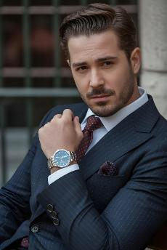

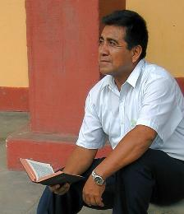
FAKAMAHUʻINGA
“Koeʻuhi ʻoku ke pehē, ‘ʻOku ou koloaʻia, pea kuo u fakamaʻumeʻaʻi au,’ pea ʻoku ʻikai te u masiva ʻi ha meʻa; ka ʻoku ʻikai te ke ʻilo ʻoku ke kovi lahi, pea malaʻia, pea masiva, pea kui, pea telefua.” (Fakaha 3:17)
Ko e fekau ki he ngaahi siasi ‘e fitu, ‘oku ne ‘omai ‘a e tu’unga ‘o e siasi ‘o mamani mei he kuonga ‘o e kau ‘aposetolo ‘o a’u mai ki he ‘aho ni (Fakh. 2-3). ‘I he’ene ‘omai ‘a e fekau ki hotau kuonga (Leotisia), ‘oku ‘omai ai ‘e Sisu ia tonu ko e “’Emeni [ko e Mo’oni], ko e fakamo’oni faitotonu mo mo’oni” (Fakh. 3:14).
Ko ‘etau sio kiate kitautolu ‘oku tau sio ki hotau Mo’oni : “Kuo u koloa’ia, pea kuo u koloa’ia, pea ‘oku ‘ikai ha me’a ‘oku ou masiva ai” (Fakh. 3:17a).
Ka ‘oku sio ‘a Sisu ki he mo’oni , ko ‘etau mo’oni: “Ko koe ‘oku ke faka’ofa, faka’ofa, masiva, kui mo telefua” (Fakh. 3:17b) .
Ko ʻeni kuo taimi ke tau sivisiviʻi kitautolu. ʻOku ou ʻiloʻi nai ʻa e meʻa ʻoku ou maʻu moʻoní, mo e meʻa ʻoku ou kei fie maʻú? Ko e hā hono lahi ʻo ʻeku tupulaki ʻi hoku vā mo Sīsuú? ʻOku ou liliu nai ki he lelei angé?

Slide 6

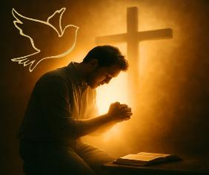
FOUNGA
“‌ʻOku ou akonakiʻi koe ke ke fakatau ʻiate au ʻae koula kuo ʻahiʻahi ʻi he afi, koeʻuhi ke ke koloaʻia ai; pea mo e kofu hinehina, koeʻuhi ke ke kofuʻaki, ke ʻoua naʻa hā mai ʻae mā ʻo hoʻo telefua pea ke tuluʻi ho mata ʻaki ʻae meʻa tuluʻi mata koeʻuhi ke ke ʻā ai.”
(Fakaha 3:18)
Koe‘uhi ko e ongo‘i fiemālie ‘i hotau tu‘ungá ‘okú ne fakatupu ‘a e ta‘efiemālie (mafana), ‘oku fale‘i mai ai ‘e Sīsū ke tau fai ‘a e me‘a ‘e tolu:
Fakatau 'a e koula kuo fakalelei'i
Kuo pau ke ‘oua te tau fiemālie pē ki ha ngaahi mo‘oni vaeua pe ko ha ako fakalūkufua ‘o e Tohi Tapú. Kuo pau ke tau liʻaki ʻa e ngaahi tokāteline fakaetangatá (ngingila) pea loloto ange ʻetau ako ʻa e Tohitapú ke toʻo ʻa e taʻehaohaoa kotoa pē (Veve) mei heʻetau mahino ki aí.
Fakatau ha ngaahi kofu hinehina
Ko hono tali ‘a e ma’oni’oni ‘a Sisu ko e founga pe ia ‘e taha ke a’usia ai ‘a e fakamo’ui. Ko e feinga ke ‘oatu kitautolu ki he ‘Otua ‘aki ‘etau ngaahi ngaue totonu ‘atautolu, ko ‘etau fakahaa’i telefua kitautolu ‘i Hono ‘ao.
Fakatau ʻa e ngaahi tuluta ʻo e mata
Maʻu ʻa e Laumalie Maʻoniʻoni. Ko Ia pe te Ne lava ʻo ʻomi kiate kitautolu ʻa e faʻa ʻiloʻilo fakalaumalie mo fakalotoʻi kitautolu ki hotau tuʻunga totonu (Sione 16:8)

Slide 7

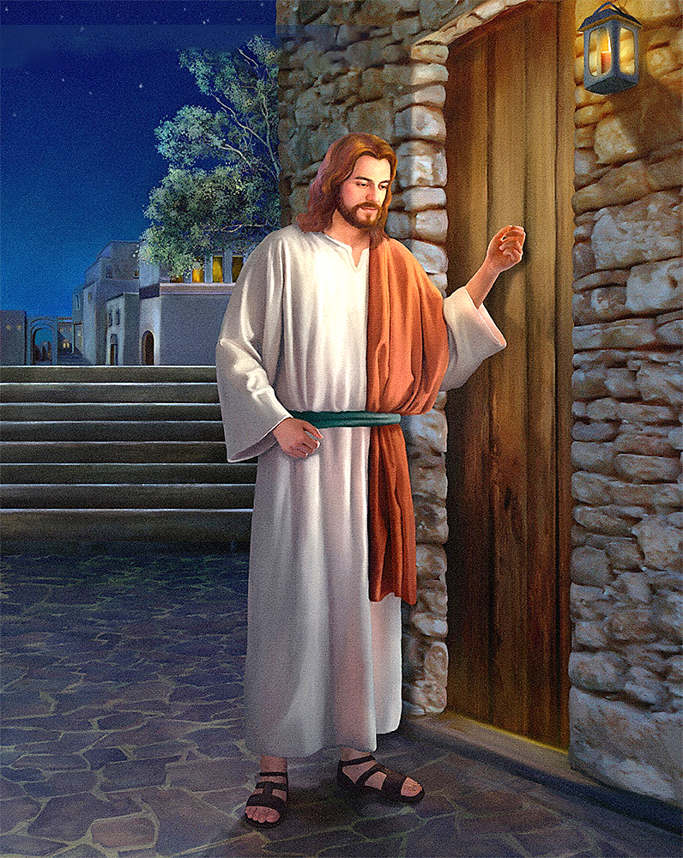
OLA
“Vakai, ʻoku ou tuʻu ʻi he matapā, mo tukituki: kapau ʻe fanongo ʻe ha taha ki hoku leʻo, mo toʻo ʻae matapā, teu hū atu kiate ia, pea te ma keinanga fakataha mo au. .” (Fakaha 3:20)
ʻOku ʻi ai ha palopalema. ʻ Oku ou ongoʻi lelei fakalaumālie, ka ʻ oku fiemaʻu ʻ e Sīsū ke u fakalakalaka. Neongo ia, kapau ʻoku ʻikai ke u ʻiloʻi ʻeku fie maʻu ke liliu, he ʻikai ke u teitei liliu. He ʻikai ke u teitei fie fakatau ʻa e meʻa ʻoku ou ʻosi fakakaukau ʻoku ou maʻu.
Ke fakaleleiʻi ʻeni, ʻoku ʻi ai ʻa e ngaahi founga pe ʻa Sisu: "Ko kinautolu kotoa pe ʻoku ou ʻofa ai, ʻoku ou valokiʻi mo tauteaʻi"; pea ne toe pehe: "Fakatomala" (Fakaha 3:19).
ʻOku ʻikai ke kovi ʻa e valoki mo e tautea ʻa Sisuu. ʻOku saiʻia ange ʻi he hala ʻo e fetalanoaʻaki. ʻOku ne fie tangutu fakalongolongo mo kimautolu ʻo talanoa... "Vakai, ʻoku ou tuʻu ʻi he matapaa ʻo tukituki. Kapau ʻe fanongo ha taha ki hoku leʻo, pea toʻo ʻa e matapaa, te u hu atu kiate ia, ʻo maʻu meʻatokoni mo ia, pea ko ia mo au" (Fakaha 3:20).
ʻOku tukituki ʻa Sisu ʻi he matapa ʻo hoku loto pea tatali ʻi he faʻa kataki. ʻOku ʻikai ke Ne fakahohaʻasi ʻeku moʻui ke fakamalohiʻi au ke u fetuʻutaki mo Ia. Ko e fili ke fakaava ʻoku ʻaʻaku ia.

Slide 8


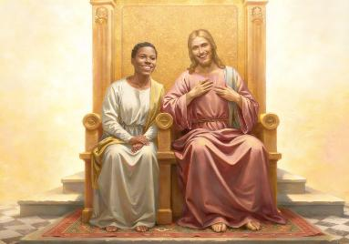
FAKATOLIʻA
“Ko ia ia ʻe ikuna, te u foaki ki ai ke nofo mo au ʻi hoku nofoʻa fakaʻeiʻeiki, ʻo hangē foki ko ʻeku ikuna, peau nofo mo ʻeku Tamai ʻi hono nofoʻa fakaʻeiʻeiki.” (Fakaha 3:21)
ʻOku ʻafioʻi ʻe Sisu ʻoku ʻikai faingofua ʻa e hala. ʻOku Ne ʻafioʻi ʻetau feinga ke fakatau mai ʻa e koula, pulupulu, mo e faitoʻo ki he mata. ʻOku Ne ʻafioʻi ʻetau ngaahi faingataʻaʻia ke ikunaʻi ʻa e mafana, fakaava ʻa e matapaa, pea fetuʻutaki mo Ia. Ko e ʻuhinga ia ʻoku Ne folofola mai ai kiate kitautolu: Te mou lava ʻo ikuna, ʻo hange pe ko ʻeku ikuna (Fakaha 3:21).
ʻOku Ne toe ʻafioʻi foki he ʻikai ke tau teitei fakahoko ʻa e ʻuluaki sitepu. Kuo tamuʻomuʻa maʻu pe ʻa e ʻOtua.
Naʻa ne fakakaukau ke fakatupu kitautolu
(Senesi 2:7)
ʻOku Ne kumi kitautolu ʻi heʻetau faiangahala (Senesi 3:8-9)
Naʻa Ne foaki ʻEne moʻui ke fakamoʻui kitautolu (Sione 3:16)
ʻOku Ne finangalo ke foaki mai ha pale: ke nofo fakataha mo Ia, pea fiefia ʻi he taʻengata ʻi Heʻene feohi (Fakaha 3:21)
Ko e ki ki he ʻulungaanga fakalangi ko ʻeni (ʻa ia ʻoku ʻikai totonu ke tau maʻu) ko e ʻofa: "Kuo u ʻofa kiate kimoutolu ʻaki ʻa e ʻofa taʻengata" (Selemaia 31:3). ʻOku Ne fie maʻu ke ʻi ai haʻane va fetuʻutaki mo kitautolu. ʻOku ou fie maʻu nai ha va fetuʻutaki mo Ia? Te u fakaava nai hoku loto kiate Ia pea ʻofa kiate Ia ʻo hange ko ʻEne ʻofa ʻiate au?

Slide 9

VAKAIʻI ʻO E MOʻONI
(Sione 15:1-11)

Slide 10

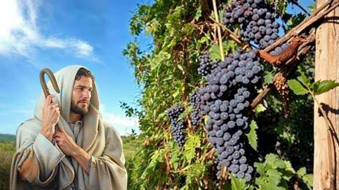
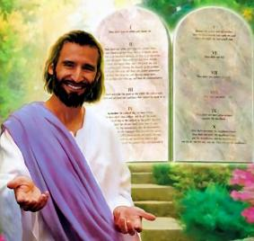

KO E VAʻA MO E VAINE
“Ko au ko e vaine, ko e ngaahi vaʻa ʻakimoutolu: ko ia ʻoku nofo ʻiate au, mo au ʻiate ia, ko ia ia ʻe fua lahi: ka māvae mo au, ʻe ʻikai te mou faʻa fai ha meʻa.” (Sione15:5)
ʻI ha taimi nounou kimuʻa pea ne pekia, naʻe fakaha ʻe Sisu ko ia "ʻa e vaine," pea ko ʻEne kau akonga ʻa e "ngaahi vaʻa." Ko e ha ʻene ʻuhinga ki he meʻa ni?
ʻE lava ke moʻui ha vaʻa ʻi ha vahaʻataimi ʻo ʻikai pipiki ki he vaine, ka ʻe faifai pe pea mae ia. Koeʻuhi ke ʻoua naʻa mole meiate kitautolu ʻa e moʻui taʻengata, ʻoku fai mai ai ʻe Sisu ha kole kiate kitautolu: "Nofo ʻiate au"(Sione 15:4). ʻI he veesi ʻe 11 ʻa ia ʻoku fai ai ʻe Sisu ʻa e talanoa fakatata ko ʻeni ʻo e vaine mo e ngaahi vaʻa, naʻa Ne fakaʻaongaʻi tuʻo 10 ʻa e foʻi veape ko e "nofo." Kuo pau pe ko ha meʻa mahuʻinga moʻoni ia.
Ko e nofo maʻu ʻ ia Sīsuú ko ha faitoʻo ia ki he māmafana ʻ a Leotisiá. ʻIkai ngata ai, ko ha tupuʻanga ia ʻo e fiefia (Sione 5:11). Ka ʻe lava fefe ke tau nofo maʻu ʻia Sisu?
ʻI heʻene fai ʻa ia ʻoku lelei kiate Ia, ʻa ia ko hono tauhi ʻEne ngaahi fekau (Sione 15:10). Ko ha tali ʻofa ʻeni ki he ʻofa kuo fakaha mai ʻe he ʻOtua kiate kitautolu (1 Sione 4:19).

Slide 11


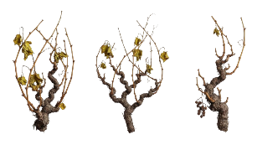

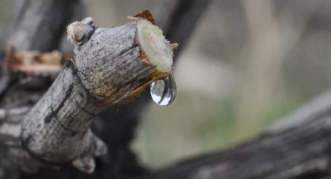
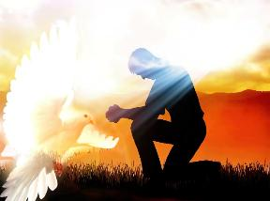
KO E HUHU’A’I ‘AKAU
“Nofo ʻiate au, mo au ʻiate kimoutolu. Hangē ʻoku ʻikai faʻa fua ʻae vaʻa ʻiate ia pē, ʻo kapau ʻe ʻikai nofo ʻi he vaine; pea ʻe pehē foki ʻakimoutolu, ʻo kapau ʻe ʻikai te mou nofo ʻiate au.” (Sione 15:4)
ʻI he faʻahitaʻu momoko, ʻoku pipiki ʻa e ngaahi vaʻa ki he vaine, ka ʻoku ʻikai ke nau fua. Ko e ha hono ʻuhinga? Koeʻuhi he ʻoku ʻikai ke nau maʻu ʻa e huhuʻa.
‘I he a‘u mai ‘a e fa‘ahita‘u failaú ‘oku toki ma‘u ai ‘e he ngaahi me‘á ni ‘a e huhu‘a mei he vainé, pea ‘oku ‘asi mai leva ‘a e ngaahi va‘á (ngaahi uoua). Ko e fo‘i lea faka-Kalisi na‘e ngāue‘aki ‘e Sioné ‘oku lava ke toe ‘uhinga ia ki he ngaahi va‘a kuo motuhi pea toe hunuki ki he fu‘u kālepí.
Pe ko e ngaahi vaʻa ngingila pe ko e ngaahi vaʻa kuo motuʻa, ʻoku mahino ʻa e meʻa ʻe taha: ʻoku tau fie maʻu ʻa e huhuʻa ʻo e vainé. Ko e hā ‘e lava ke tau fakahoa ki ai ‘a e huhu‘á ni?
‘I he lea tatau (Sione 14-17), ‘oku ‘omai ai ‘e Sisu ‘a e fakamatala: Ko e Laumalie Ma’oni’oni ‘oku ne ngaue ‘iate kitautolu ke ne ‘omai ‘a e mo’ui, ‘o kapau ‘oku tau loto ki ai.
Ko Ia hotau Fakafiemalie (Sione 14:16-17)
‘Oku ne fakahā ‘a Sīsū kiate kitautolu (Sione 15:26)
‘Oku ne fakahalaia’i kitautolu ki he angahala (Sione 16:8)
ʻOkú ne tataki kitautolu ki he moʻoni kotoa pē (Sione 16:13)

Slide 12

“Ko e koula ʻoku fokotuʻu atu heni ʻo hangē kuo ʻahiʻahiʻi ʻi he afí ko e tuí mo e ʻofá. ʻOkú ne ʻai ke koloaʻia ʻa e lotó; he kuo fakamaʻa ia kae ʻoua kuo maʻa, pea ko e lahi ange hono ʻahiʻahí ko e ngingila ange ia ʻa hono ngingilá. Ko e kofu hinehina ko e kofu maʻa ʻo e ʻulungāangá, ko e māʻoniʻoni ʻa Kalaisi ʻoku ʻoange ki he angahalá. fakatau pē meia Kalaisi ki ha moʻui ʻo e talangofua loto fiemālié ko e poto mo e ʻaloʻofa ko ia ʻokú ne fakaʻatā kitautolu ke tau ʻiloʻi ʻa e angahalá ʻi ha faʻahinga fakapulipuli pē kuo ʻoange ʻe he ʻOtuá ki Hono siasí ʻa ia ʻokú Ne fie maʻu ke nau pani ʻaki ʻa e potó ka naʻe ʻikai ke nau lava ʻo tamateʻi ʻa e maama ʻo e siasí; telia na’a valoki’i kinautolu ‘e he faito’o mata faka’otua ‘a e mahino ki he mahino ko Kalaisi ‘a e tauhi ‘o e ngaahi kelesi kotoa pe ‘oku ne pehe: “Fakatau meiate au”. (Fakaha 3:18).”
EGW (Ngaahi Fakamoʻoni maʻá e Siasí, vol. 4, p. 88)

