Slide 1

KE ʻILOʻI ʻA E ʻOTUA
Lesoni 2 ki he ʻaho 11 ʻo ʻEpeleli 2026

Slide 2
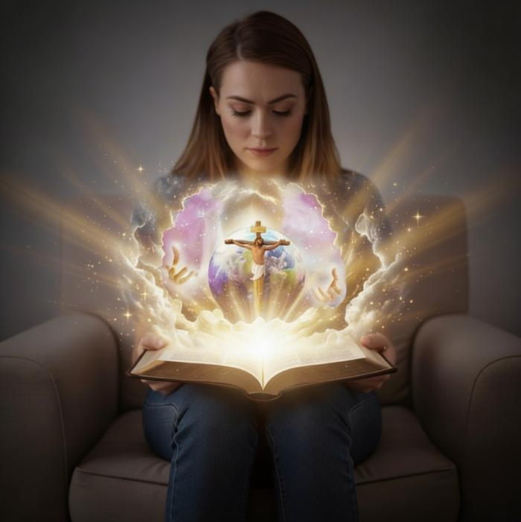
“Pea ko eni ʻae moʻui taʻengata, ko ʻenau ʻilo koe ko e ʻOtua moʻoni pe taha, mo Sisu Kalaisi, ʻaia naʻa ke fekau.”
(Sione 17:3)

Slide 3
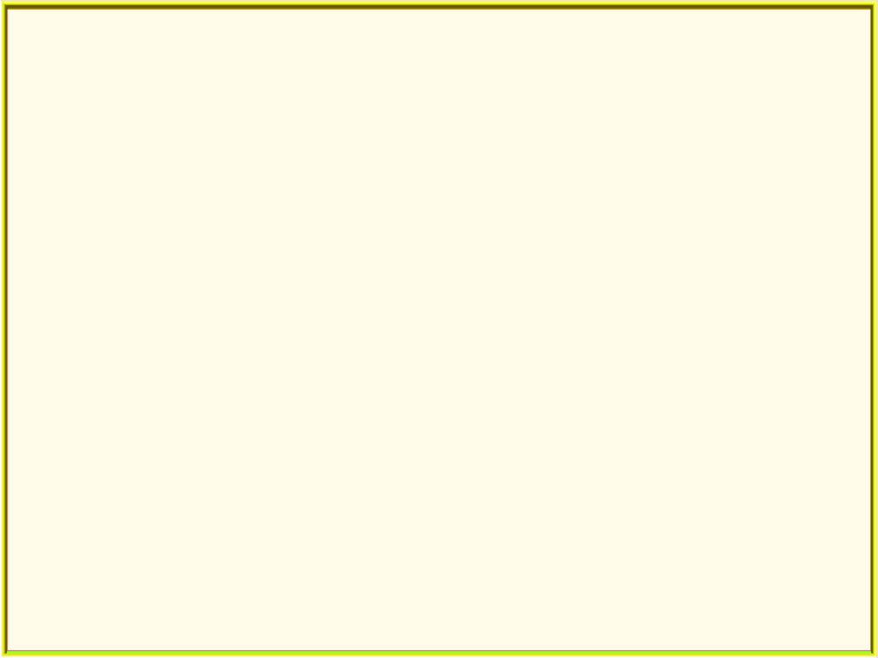
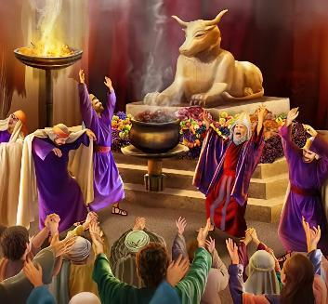
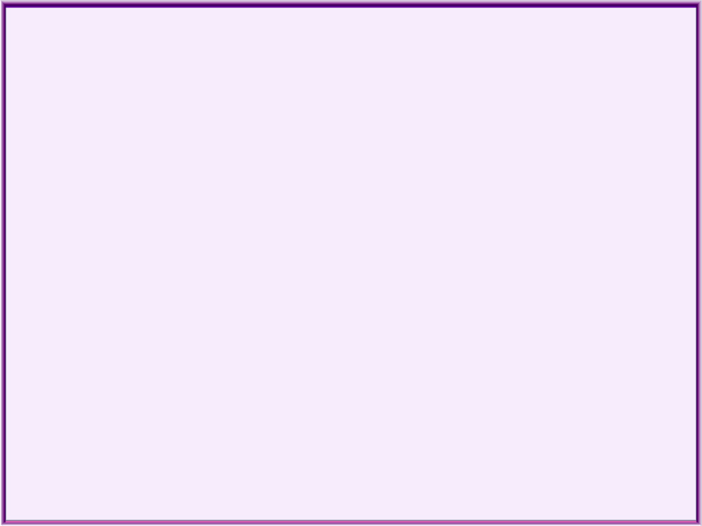
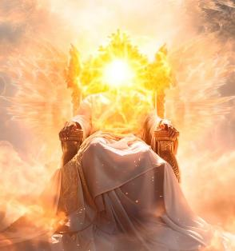
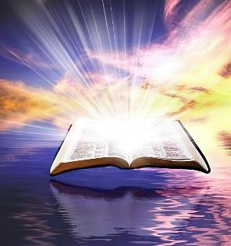
Kuo fakameleʻi ʻetau mahino ki he ʻOtua ʻe he angahala. Kuo tau feinga ke fakafofongaʻi Ia ʻi ha ngaahi tamapua ʻoku hange ha fanga monumanu pe kakai. Kuo fakaʻaliʻali ia ko ha tokotaha taʻeʻaonga pe pule fakaaoao. Ko hono aofangatuku, kuo fakatupu ʻe he faʻahinga ʻo e tangata ha ʻimisi ʻo e ʻOtua ʻi hono tatau pe ʻoʻona.
Ka ʻoku fefe moʻoni ʻa e ʻOtua? ʻOku Ne fuʻu maʻongoʻonga nai ʻo ʻikai ke tau lava ʻo mahino kiate Ia? Ko e moʻoni, tatau ai pē pe ko e hā ʻ a e lahi ʻ o ʻ etau feingá, heʻikai lava ke mahinoʻi ʻ e hotau ʻ atamaí ʻ a e ʻ Otuá. ʻOku tau fie maʻu tokoni.
Ka kuo aʻu mai ʻa e tokoni. ʻOku ke fie ʻilo pe ʻoku fefe Ia? ʻOku tau maʻu ʻi he Tohi Tapu ʻa e fakaha moʻoni ʻo e natula ʻo e ʻOtua.
Ko e ngaahi ʻulungaanga ʻo e ʻOtua.
Ko e ʻulungaanga ʻo e ʻOtua:
ʻOku maʻoniʻoni ʻa e ʻOtua
Ko e ʻOtua ko e ʻofa
Ko Hono ʻIloʻi ʻo e ʻOtua:
Naʻe fakaha ʻe he ʻOtua ʻi he Fakatupu
Naʻe fakaha ʻe he ʻOtua ʻia Sisu (ʻImanuela)

Slide 4


KO E NGAAHI ʻULUNGĀANGA ʻO E ʻOTUA

Slide 5
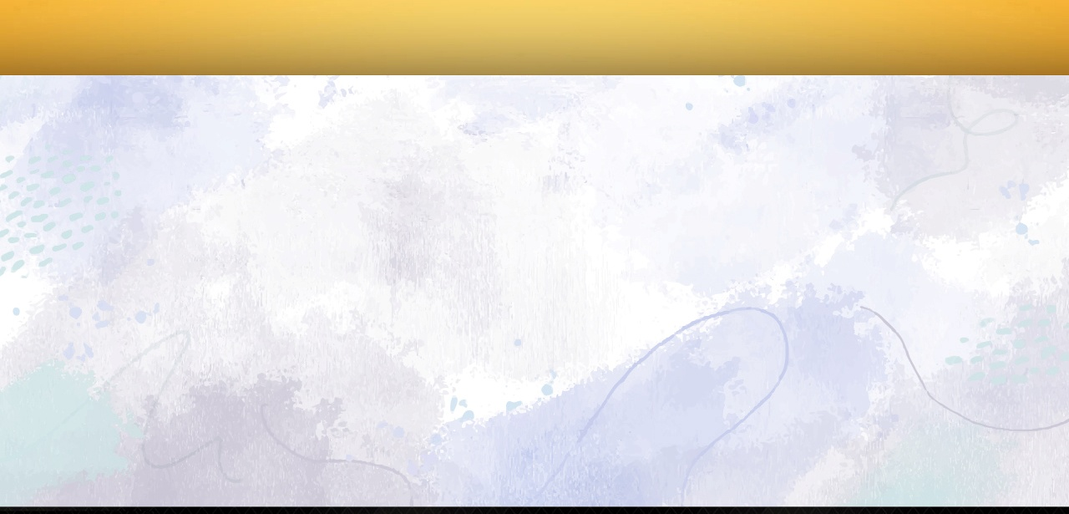

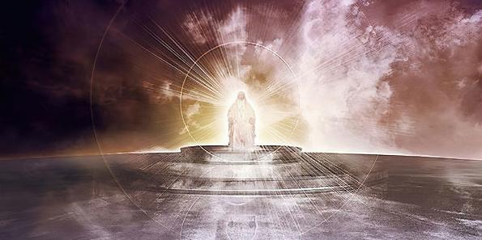
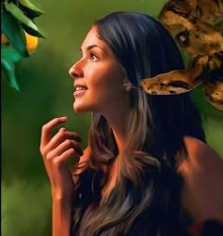
“ʻE Sihova ko e ʻOtua ʻoe ngaahi kautau, ko hai ʻoku tatau mo koe ko Sihova māfimafi?
Pea ko hoʻo moʻoni ʻoku kāpui koe.” (Saame 89:8)
KO E NGAAHI ʻULUNGAANGA ʻO E ʻOTUA
ʻOku ʻomi ʻe he Tohi Tapu ʻa e ʻimisi faitotonu, mahino, mo pau taha ʻo e ʻOtua. Ko e taha ʻo e ngaahi founga ʻoku ne fakaʻata kitautolu ke tau ʻiloʻi Ia ʻoku fakafou ia ʻi Hono ngaahi ʻulungaanga.
KO HA NIʻIHI ʻO E NGAAHI ʻULUNGAANGA ʻO E ʻOTUA
Maʻoniʻoni (Saame 11:7)
ʻAloʻofa (Teutalonome 4:31)
Faʻa kataki mo fakafiemalie (Loma 15:5)
Ko e tokotaha foaki ʻo e ʻaloʻofa (Loma 3:24)
Fakamolemoleʻi ha Taha (Saame 86:5)
Tuʻi (Saame 47:8)
Taʻengata (Senesi 21:33)
ʻOtua Mafimafi (Senesi 17:1)
Tokaimaʻananga (1 Sione 3:20)
ʻOku Ne ʻAfioʻi ʻa e kahaʻu (ʻIsaia 46:10)
ʻI heʻene tafaʻaki, kuo feinga ʻa Setane mei he kamataʻanga ke mioʻi ʻa e ʻulungaanga ʻo e ʻOtua, ʻo fakahaaʻi ia ko ha ʻOtua siokita, ʻa ia ʻoku fekumi pe ki heʻene lelei pe ʻaʻana (Senesi 3:4-5).

Slide 6
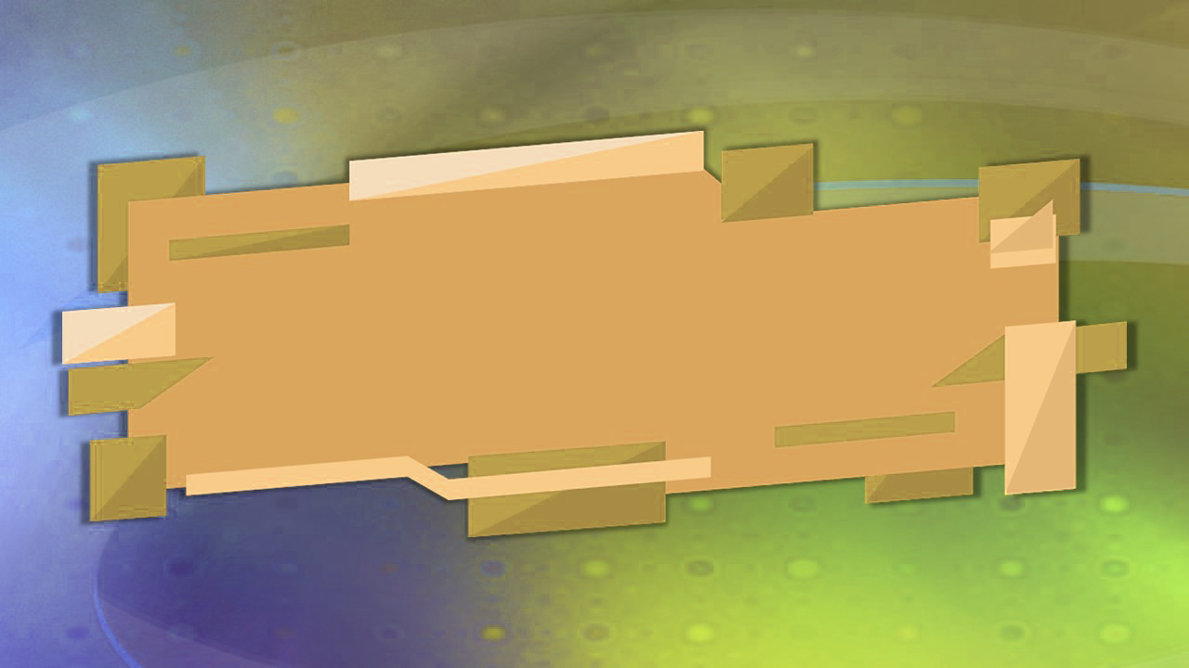
KO E ʻULUNGAANGA ʻO E ʻOTUA

Slide 7

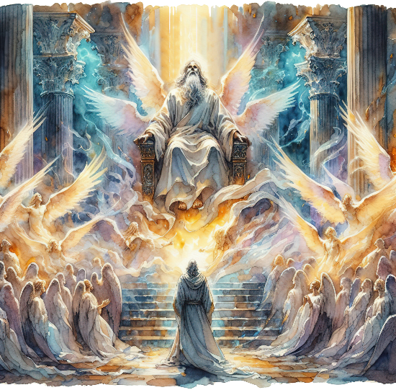
“Pea naʻa na lea fetāliaki, ʻo pehē,
“ʻOku māʻoniʻoni, ʻoku māʻoniʻoni, ʻoku māʻoniʻoni, ʻa Sihova ʻoe ngaahi kautau:
ʻoku fonu ʻa māmani kotoa pē ʻi hono nāunau.”.” (‘Isaia 6:3)
ʻOKU MAʻONIʻONI ʻA E ʻOTUA
ʻOku fakahikihikiʻi Ia ʻe he kau ʻangelo ʻoku tuʻu ʻi he tafaʻaki ʻo e ʻOtua ko e "Maʻoniʻoni, maʻoniʻoni, maʻoniʻoni" (ʻIsaia 6:3; Fakaha 4:8). ʻOku fehokotaki ʻaupito ʻa e ʻulungaanga ko ʻeni mo Hono ʻulungaanga ʻo fakaʻaongaʻi ia ʻe ʻIsaia ko e huafa totonu ʻo e ʻOtua: "ʻoku folofola ʻa e Tokotaha Maʻoniʻoni". (ʻIsaia 40:25; 57:15).
ʻOku ʻuhinga ki he ha ke hoko ʻo maʻoniʻoni? ʻOku ʻuhinga ia ke fakatapui, vaheʻi, maʻa. ʻOku tau maʻoniʻoni ʻi he taimi ʻoku tau tafoki ai mei he kovi pea fai ʻa e ngaue kuo fakafalala mai ʻe he ʻOtua kiate kitautolu. (Nomipa 15:40; Lev. 11:44; 1 Pita 2:9).
Ka ʻ oku anga - fēfē ʻ a e kaunga ʻ a e meʻá ni ki he ʻ Otuá? ʻOku Ne mavahe kakato mei he kovi pea ʻoku ʻikai haʻane fekauʻaki mo e angahala.
ʻOku ʻuhinga ʻeni, koeʻuhi ʻoku Maʻoniʻoni Ia, ʻoku maʻoniʻoni, haohaoa, pea tauʻataina mei he siokita ʻEne ʻofa. Koeʻuhi ʻoku Maʻoniʻoni Ia, ʻoku maʻoniʻoni, haohaoa, pea tauʻataina mei he siokita ʻa Hono mafimafi. ʻOku fonu kotoa Hono ngaahi ʻulungaanga ʻi he maʻoniʻoni mo e haohaoa.

Slide 8


KO E ʻOTUA KO E ʻOFA
“Pea kuo tau ʻiloʻi mo tui ki he ʻofa kuo ʻi he ʻOtua kiate kitautolu. Ko e ʻOtua ko e ʻofa; pea ko ia ʻoku nofo ʻi he ʻofa, ʻoku nofo ia ʻi he ʻOtua, mo e ʻOtua ʻiate ia.” (1 Sione 4:16)
ʻOku ʻikai ngata pe ʻi he ʻofa pe foaki ʻe he ʻOtua ʻa e ʻofa (neongo ʻoku Ne fai fakatouʻosi), ka "ko e ʻOtua ko e ʻofa" (1 Sione 4:8, 16). Hange ko e maʻoniʻoni, ko e ʻofa ko ha konga mahuʻinga ia ʻo e natula faka-ʻOtua.
Naʻa ne fakatupu ʻa e tangata ʻi he ʻofa ko e tangata mo e fefine, pea "fekauʻi" kinaua ke nau feʻofaʻaki (Senesi 2:24)
ʻI he taimi naʻe faiangahala ai ʻa ʻAtama mo ʻIvi ʻi he ʻofa, naʻa Ne fekumi kiate kinaua pea ʻoange ha ʻamanaki lelei kiate kinaua (Senesi 3:9, 15)
Tuʻunga ʻi Heʻene ʻofa, naʻa Ne fai ai ha fuakava mo ʻEpalahame pea talaʻofa mai ha ngaahi tapuaki maʻa e faʻahinga kotoa ʻo e tangata (Senesi 26:4)
ʻI he ʻofa, naʻa ne foaki ai hono ʻAlo –Sisu Kalaisi– ke pekia maʻa ʻetau ngaahi angahala (Sione 3:16)
Te u lava fefe ʻo tali ʻEne ʻofa?
"ʻOku tau ʻofa kiate ia, koeʻuhi ko ia naʻa ne fuofua ʻofa kiate kitautolu"
(1 Sione 4:19)
Notes:
SmartArt with large images (the four “for love”)

Slide 9

KO HONO ʻILOʻI ʻO E ʻOTUA

Slide 10



FAKAHA ʻA E ʻOTUA ʻI HE FAKATUPU
“ʻOku fakahā ʻe he ngaahi langi ʻae nāunau ʻoe ʻOtua;
pea ʻoku fakahā ʻe he ʻatā ʻae ngāue ʻa hono nima.”
(Saame 19:1)
ʻOku kamata ʻaki ʻe he Tohi Tapu ʻa e lave ki he ʻOtua ko e אֱלֹהִ֑ים (elohim). Neongo ko e liliu totonu ʻo e hingoa ko ʻeni ko e "ngaahi ʻotua," ka ʻoku fakaʻaongaʻi ia ko ha foʻi lea pe ʻe taha. Ko ha meʻa hange ko e "ʻI he kamataʻanga, naʻe fakatupu ʻe he ngaahi ʻOtua ʻa e langi mo e mamani"
(Senesi 1:1).
ʻOku ne ʻomi kiate kitautolu ʻa e Tupuʻanga, ʻa ia ʻoku malohi ke ʻomi ʻa e meʻa kotoa pe ʻoku ʻi ai ʻi he Folofola [Sisu Kalaisi], pea ʻi he tokoni ʻa e Laumalie.
ʻI he Senesi vahe 2, ʻoku tanaki atu ai ha huafa fakatautaha ki he ʻOtua: יְהוָ֥ה (Yahweh). ʻOku ʻikai ke Ne folofola pe he taimi ni, "Tuku ke hoko ia." ʻOku Ne toʻo ʻa e tangata ʻo oʻi ia ʻaki Hono toʻukupu. ʻOku fakahaaʻi ʻe he ʻOtua mafimafi Ia ko ha ʻOtua fakatautaha mo faingofua ke talanoa ki ai.
ʻOku ne ueʻi kitautolu, ʻoku ne folofola mai, ʻoku ne akoʻi kitautolu, ʻoku ne vahe mai ʻetau ngaue... ʻOku Ne ʻofa ʻiate kitautolu.

Slide 11

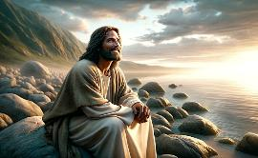
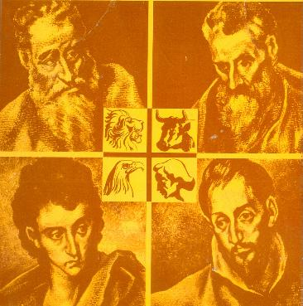
FAKAHA ʻA E ʻOTUA ʻIA SISU (ʻIMANUELA)
“‌ʻOku ʻikai ha tokotaha kuo ne mamata ki he ʻOtua ʻi ha kuonga; ko e ʻAlo pē taha naʻe fakatupu, ʻaia ʻoku ʻi he fatafata ʻoe Tamai, kuo ne fakahā ia.” (Sione 1:18)
Kapau ʻ oku tau loto ke ʻ iloʻi pe ʻ oku fēfē ʻ a e ʻ Otuá, tau hoko muʻa ʻ o ʻ iloʻi ʻ a Sīsū. Ko e ʻOtua ia kuo hoko ko ha sino (Sione 1:14), ʻa ia naʻa ne fakaha ia ʻaki ʻene maʻu ʻa e natula fakaetangata koeʻuhi ke tau lava ʻo mamata mo fanongo ki ai (Sione 1:18; 14:9; 1 Sione 5:20)
Naʻe fanongonongo ia ʻi ha hingoa fakapalofita naʻa ne fakahaaʻi ʻa e taumuʻa ʻo ʻene moʻui: ʻImanuela, ʻoku ʻiate kitautolu ʻa e ʻOtua (ʻIsaia 7:14; Matiu 1:23). ʻOku fakahaaʻi mai ia ʻe he kau ʻevangelio ʻe toko fa kiate kitautolu ʻi he ngaahi tafaʻaki kehekehe.
Matiu
Mei ha Siu ki he kau Siu
Ma’ake
Mei ha Siu ki he Kau Senitaile
Luke
Mei ha Senitaile ki he Kau Senitaile
Sione
Mei ha Siu ki he kau Siu mo e kau Senitaile
Ko Ia ʻa e Misaia ʻoku ne fakahoko ʻa e meʻa naʻa ne talaʻofa
Tokanga maʻu pe ke tokoniʻi e niʻihi kehe
ʻOfa mo manavaʻofa
Ko e tokotaha foaki ʻo e moʻui fakatuʻasino mo fakalaumalie

Slide 12

“ʻOku ʻi ai ha lauiafe ʻoku nau maʻu ha fakakaukau hala ki he ʻOtua mo Hono ngaahi ʻulungaanga... Ko e ʻOtua ko ha ʻOtua ʻo e moʻoni. Ko e fakamaau totonu mo e ʻaloʻofa ko e ongo ʻulungaanga ia ʻo Hono taloni. Ko ha ʻOtua ia ʻo e ʻofa, ʻo e manavaʻofa mo e manavaʻofa ongongofua. Ko ia ʻoku fakafofongaʻi ai Ia ʻi Hono ʻAlo, ko hotau Fakamoʻui. Ko ha ʻOtua Ia ʻo e faʻa kataki mo e kataki fuoloa. Kapau ko e tokotaha ia ʻoku tau ʻofa ki ai pea ʻoku tau feinga ke mahino ki hono ʻulungaanga, ʻoku tau lotu ki he ʻOtua moʻoni.”
EGW (ʻOku Tokanga Mai ʻa e ʻOtua Kiate Kitautolu, 8 ʻAokosi)

