Slide 1
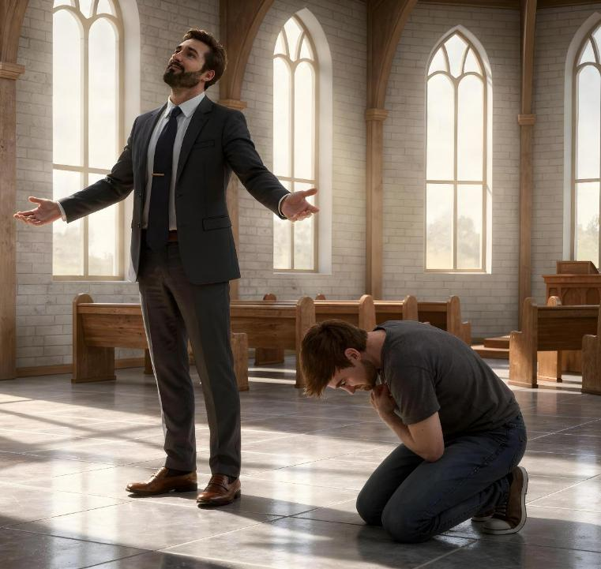
HĪKISIA MO E LOTO FAKATŌKILALO
Lesoni 3 ki he ʻaho 18 ʻo ʻEpeleli 2026

Slide 2

“He ko ia ia ʻoku hiki hake ia, ʻe fakavaivai ia; pea ko ia ʻoku fakavaivai ia, ʻe hakeakiʻi ia.”
(Luke 14:11)

Slide 3

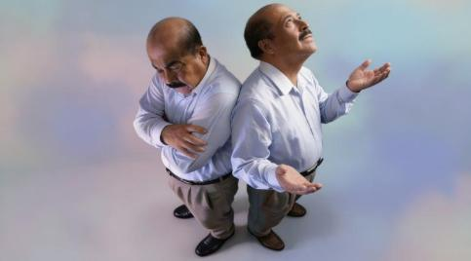
Ko e ha ʻoku mahuʻinga fekauʻaki mo au? Ko ha fehuʻi faingataʻa ia ke tali.
Kapau te u lea ʻaki ha meʻa lahi (tuʻunga laukau), ʻoku ou fakahaaʻi ko e meʻa kotoa pe ʻoku ou ʻi ai mo kuo u lavaʻi ʻiate au pe.
Fefe kapau te u lea lahi koeʻuhi he ʻoku lau au ʻe he ʻOtua ko Hono foha?
Kapau ʻoku ʻikai ke u lea ʻaki ha meʻa (tuʻunga fakatokilalo), ʻoku ou fakahaaʻi ko e meʻa kotoa pe ʻoku ou ʻi ai mo ʻoku ou maʻu ʻoku haʻu ia mei he ʻOtua.
Fefe kapau ʻoku ʻikai ke u lea ʻaki ha meʻa koeʻuhi ko e ʻikai ke u ongoʻi mahuʻingaʻia ʻiate au?
Ngaahi sipinga ʻo e hikisia
Lusefa
Ko e kau akonga ʻa Sisu
Ngaahi sipinga ʻo e loto fakatokilalo
Ko e tokotaha tānaki tukuhau
Mosese
Ko Sisu, ko e faʻifaʻitakiʻanga haohaoa

Slide 4

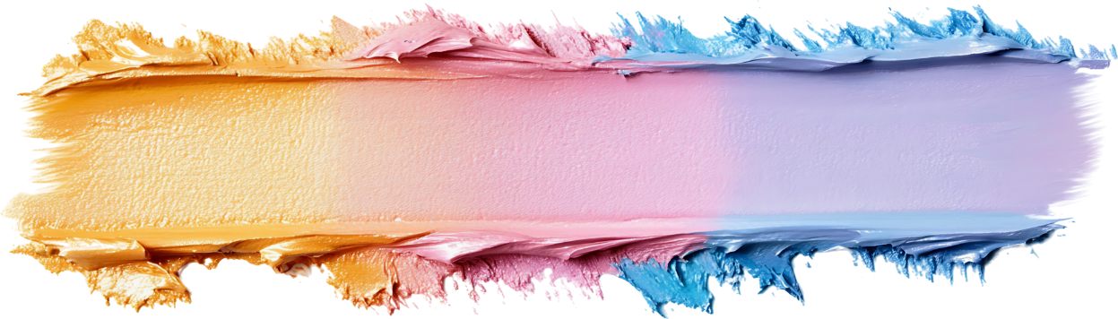
NGAAHI SIPINGA ʻO E HIKISIA

Slide 5




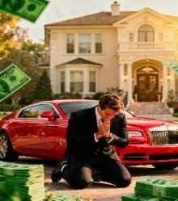
LUSEFA
“He ko e meʻa kotoa pē ʻoku ʻi he māmani, ko e holi ʻoe kakano, pea mo e holi ʻoe mata, mo e laukau ʻoe moʻui, ʻoku ʻikai ʻoe Tamai, ka ʻoku ʻoe māmani ia.” (1 Sione 2:16)
Kapau ʻoku tau talanoa ki he hikisia, kuo pau ke tau lea ʻo kau ki he tokotaha naʻe fuofua haʻu ʻi ai ʻa e ongo ko ʻeni: Lusifaa. Naʻa ne fili ke ʻoua naʻa fiemalie ʻi hono tuʻunga, ka naʻa ne fie maʻu ke ʻalu hake ki ha tuʻunga maʻolunga ange. Naʻe aʻu ki ha taimi, naʻa ne holi ke hakeakiʻi ia ʻo ne fakaʻamu ke nofo ʻi he taloni ʻo e ʻOtua (ʻIsaia 14:12-14).
Kuo tau "maʻu tukufakaholo" ʻa e holi ke fai ha meʻa pe ʻoku tau fakahoifua ki ai, ke maʻu ha meʻa pe ʻoku tau fie maʻu, pea ke maʻu ha ngaahi tuʻunga ʻe lava ke tau ongoongoa pe koloaʻia. Ko e meʻa ia ʻoku foaki mai ʻe he mamani kiate kitautolu! (1 Sione 2:16).
Ka ʻoku ʻikai ko e fakaʻamu kotoa pe ko e hikisia. Ko e fiemālie ʻ oku maʻu mei he lavameʻa ʻ a ha kiʻi tamá, pe taumuʻa fakafoʻituituí, ʻ oku ʻ ikai ko ha hīkisia taʻelelei ia.
Ko e meʻa mahuʻinga ke manatuʻi ʻoku ʻikai fakapapauʻi hotau mahuʻinga ʻi heʻetau koloa, potoʻi ngaue, mo e ngaahi lavameʻa. ʻOku kau ʻi he hikisia ʻa e ʻikai ke ʻoange ki he ʻOtua ʻa e langilangi ʻi he meʻa ʻoku Ne fai ʻi heʻetau moʻui.

Slide 6



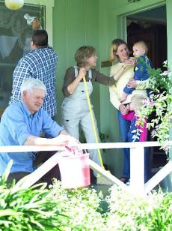

KO E KAU AKONGA ʻA SISUU
“Pea naʻe ai ʻae kikihi foki ʻiate kinautolu, pe ko hai ʻiate kinautolu ʻe lahi. ” (Luke 22:24)
Naʻa nau nofo mo Sisu ʻo laka hake ʻi he taʻu ʻe tolu. Naʻa Ne toki fufulu pe honau vaʻe mo fakaha kiate kinautolu ʻa Hono taʻataʻa naʻe lilingi maʻa e taha kotoa. Ka ʻi heʻena maʻu meʻatokoni efiafi, naʻe ʻikai ha kaunga ʻo ʻena talanoa ki he ngaahi meʻa ni kotoa: ko hai ʻiate kinautolu naʻe lahi taha? (Luke 22:24).
Naʻe hanga ʻe heʻenau laukau ʻo ʻai ke nau tui naʻe totonu ke nau maʻu ʻa e tuʻunga maʻolunga. Naʻe ʻ ikai te nau lava ʻ o mahinoʻi ʻ a e mafatukituki ʻ o ʻ enau ngaahi ongoʻí. Naʻa nau tekeʻi ʻa e ʻOtua mei honau loto koeʻuhi ko ʻenau hikisia.
Naʻe lea hangatonu ʻa Sisu ki he meʻa naʻe hoko: "ʻOku ou ʻiate kimoutolu ʻo hange ko e Tokotaha ʻoku tauhi" (Luke 22:27). ʻI hono fakalea ʻe taha: kapau ʻoku ke fie maʻu ke ke maʻongoʻonga ʻo hange ko ho ʻEiki, tokoni ki he niʻihi kehe.
ʻOku talamai ʻe heʻetau hikisia ʻoku taau ke tokoniʻi kitautolu ʻe he niʻihi kehe (ʻoku tau lelei ange ʻiate kinautolu). ʻOku tau fie maʻu ʻa e ʻaloʻofa ʻa e ʻOtua ke tau hoko ai ko ha kau tamaioʻeiki loto fakatokilalo.

Slide 7

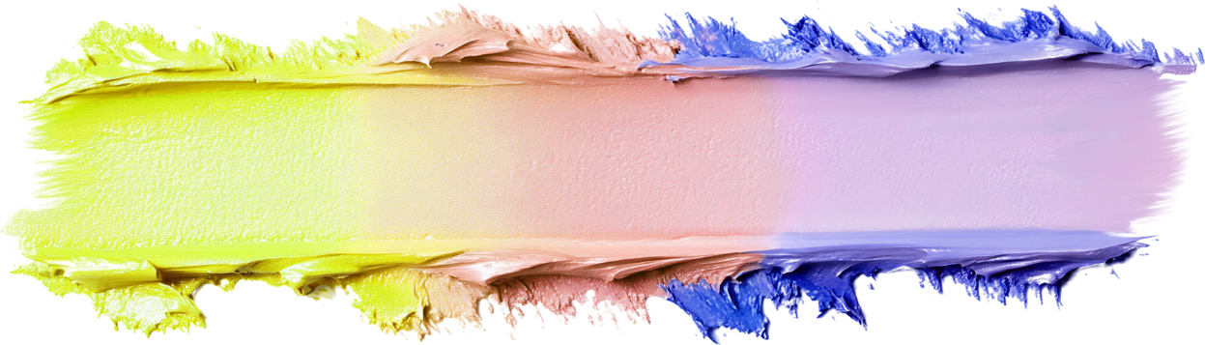
NGAAHI SIPINGA ʻO E LOTO FAKATOKILALO

Slide 8





KO E TANAKI TUKUHAU
“Ka naʻe tuʻu mamaʻo atu ʻae tānaki tukuhau, pea ʻikai faʻa hanga hake hono mata ki he langi, ka naʻe si fatafata ia, mo pehē, ‘ʻE ʻOtua, ke ke ʻaloʻofa mai kiate au ko e angahala!’ ” (Luke 18:13)
Naʻe fakaha ʻe ha Falesi ki he ʻOtua ʻa e ngaahi ngaue lelei naʻa ne fai pea mo e ngaahi lelei naʻa ne maʻu ʻi he ʻao ʻo Hevani. Ka naʻe pehe ʻe Sisu naʻa ne "lotu kiate ia," kae ʻikai ki he ʻOtua (Luke 18:11-12). Ko ha sipinga haohaoa ia ʻo e hikisia.
Naʻe kole tokoni ʻa e tangata tanaki tukuhau ki he ʻOtua, he ko ha tokotaha faiangahala ia (Luke 18:13). ʻI heʻene fakaha ia ʻi he loto fakatokilalo ʻi he ʻao ʻo e ʻOtua, naʻa ne "ʻalu hifo ai ki hono fale kuo tonuhia ia," koeʻuhi "he ko ia kotoa pe ʻoku ne hakeakiʻi ia ʻe fakavaivaiʻi ia, pea ko ia ʻoku ne fakavaivaiʻi ia ʻe hakeakiʻi ia" (Luke 18:14).
ʻOku kamata ʻa e loto fakatokilalo moʻoni ʻi he taimi ʻoku tau fakahaaʻi ai ʻetau angahala pea kole e tokoni ʻa Kalaisi. Pea ...
He ʻikai ke tau lau ʻa e niʻihi kehe ʻoku nau maʻulalo ange (Fili. 2:3)
He ʻikai ke tau feinga ke tali ʻe he kakai (Luke 14:7-11)
Te tau tuku ke ʻomi ʻe he niʻihi kehe ʻa e fakalangilangi ko ia kiate kitautolu (Palovepi 27:2)
Te tau ma'u 'a e kelesi 'a e 'Otua (Semisi 4:6)
Te tau foaki ʻa e ʻaloʻofa ko ia ki he niʻihi kehe (1 Pita 4:10)

Slide 9

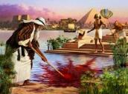






“Ko e tui ʻa Mōsese naʻa ne liʻaki ai, ʻi heʻene lahi, hono ui ia ko e tama ʻae ʻofefine ʻo Felo; ‌ʻO ne fili muʻa ke ne kātaki ʻae mamahi fakataha mo e kakai ʻae ʻOtua, ʻi heʻene maʻu ʻae fiefia ʻoe angahala ʻo fuoloa siʻi;.” (Hepelū 11:24-25)
MOSESE
Naʻe akoʻi ʻa Mosese ke hoko ko e Felo hono hoko ʻo ʻIsipite. Ko ha tokotaha fokotuʻutuʻu lelei ia pea naʻa ne maʻu ha poto fakaʻatamai lahi (Ngaue 7:22). ʻI hono taʻu 40, naʻa ne fakakaukau ke tuku kotoa ʻeni ki he tafaʻaki kae kau fakataha mo hono kakai (Hepelu 11:24-25).
Ko ia ʻa e tokotaha fakatauʻataina! ʻE fakatauʻatainaʻi ʻe hono toʻukupu mafimafi ʻa hono ngaahi tokoua! Ko ha fehalaaki lahi. Naʻe ʻ ikai lava ke ngāueʻaki ia ʻ e he ʻ Otuá lolotonga ʻ ene tukulotoa ʻ a e hīkisia peheé.
Naʻe hoko ia ko ha tangata loto fakatokilalo ʻi ha taʻu ʻe 40 ʻi heʻene feohi mo e ʻOtua ʻi he toafa (Nomipa 12:3). Ko ʻeni ʻe lava ke fakaʻaongaʻi ia ʻe he ʻOtua ke ʻomi ʻa e ngaahi mahaki fakaʻauha; kolosi ʻi tahi; maʻu ʻa e Fekau ʻe Hongofulu; lea hangatonu ki he ʻOtua; taaʻi ʻa e maka... Naʻe aʻu ʻo ne lava ʻo tali ʻi he loto fakatokilalo ʻa e tautea ki heʻene toʻonga hikisia, ʻo ne fakahikihikiʻi ʻa e meʻa naʻa ne fai (Nomipa 20:10-12).
ʻOku fakahaaʻi mai ʻe he sipinga ʻa Mosese ʻoku ʻikai ke tupu fakafokifa pe ʻiate kitautolu ʻa e loto fakatokilalo, ka kuo pau ke tau kole ki he ʻOtua ke ne fakafonu kitautolu ʻaki ia ʻi he ʻaho kotoa pe.

Slide 10




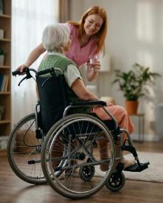
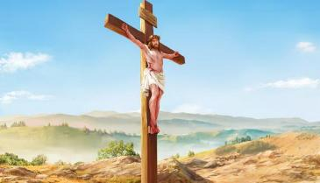
KO SISU, KO E FAʻIFAʻITAKIʻANGA HAOHAOA
“Pea kuo ʻilo ia ʻi he tatau ʻoe tangata, naʻa ne fakamoʻulaloaʻi ia, pea talangofua ki he mate, ʻio, ʻae mate ʻi he ʻakau.!” (Filipai 2:8)
Kuo teʻeki ai ke maʻu ʻe ha taha ʻi he mamani ko ʻeni pe ʻe teitei maʻu ʻa e maʻongoʻonga naʻe maʻu ʻe Sisu kimuʻa pea ne hoko mai ki he sino. Ka naʻa ne liʻaki ʻa e meʻa kotoa pe koeʻuhi ko ʻene ʻofa kiate kitautolu. ʻI heʻetau fehangahangai mo e fakama pehee, ko e meʻa kotoa pe ʻoku tau maʻu, ʻa e meʻa kotoa pe ʻoku tau ʻi ai, pe ko e meʻa kotoa pe ʻe lava ke tau hoko ʻo ʻikai ke tau lava ʻo fakahoa atu.
Naʻe liʻaki ʻe Sisu ʻa Langi ke pekia maʻa e faʻahinga ʻo e tangata ʻi he ʻamanaki ʻe mahino kiate kitautolu ʻene ngaue ʻo e ʻaloʻofa pea tali ʻene fakaafe ke tau fetuʻutaki mo ia (Filipai 2:5-8). ʻOku ʻikai ha veiveiua, ko e faʻifaʻitakiʻanga haohaoa ia ʻo e loto fakatokilalo.
"Tuku ke ʻiate kimoutolu ʻa e fakakaukau ko ʻeni, ʻa ia naʻe ʻia Kalaisi Sisu foki" (Filipai 2:5).
ʻI Heʻene muimui ki Heʻene sipinga, "ʻOua naʻa fai ha meʻa ʻi he siokita pe fielahi, ka ʻi he loto-fakatōkilalo, tuku ke taki taha ʻofa ki he niʻihi kehe ʻiate ia. Tuku ke ʻoua naʻa ngata pe ʻi hoʻomou tokanga ki heʻene ngaahi lelei ʻaʻana, ka ki he lelei foki ʻa e niʻihi kehe" (Filipai 2:3-4).

Slide 11

Ko e Saame ʻa Tevita.
1 Te u fakamālō kiate koe ʻaki hoku loto kotoa pē:
ʻi he ʻao ʻoe ngaahi ʻotua te u hiva fakamālō kiate koe.
2 Te u lotu ʻo hanga atu ki ho faletapu māʻoniʻoni,
mo fakamālō ki ho huafa koeʻuhi ko hoʻo ʻaloʻofa mo hoʻo moʻoni:
he kuo ke hiki ke māʻolunga hake hoʻo folofola ʻi ho huafa kotoa pē.
3 ‌ʻI he ʻaho ne u tangi ai naʻa ke talia au,
mo fakamālohi ʻaki au ʻae mālohi ʻi hoku laumālie.
4 ‌ʻE Sihova, ʻe fakamālō kiate koe ʻae ngaahi tuʻi kotoa pē ʻo māmani,
ʻoka nau ka fanongo ki he ngaahi folofola ʻo ho fofonga.
5 ‌ʻIo, tenau hiva ʻi he ngaahi hala ʻo Sihova:
he ʻoku lahi ʻae nāunau ʻo Sihova.
6 Ko e moʻoni ʻoku māʻolunga ʻa Sihova, ka ʻoku ʻofa ia ki he angavaivai:
ka ʻoku ʻilo ʻe ia ʻae laukau ki he mamaʻo.
7 Neongo ʻeku ʻeveʻeva ʻi he lotolotonga ʻoe mamahi, te ke fakaakeake au:
te ke mafao atu ho nima ke taʻofi ki he ʻita ʻa hoku ngaahi fili,
pea ko ho nima toʻomataʻu te ne fakamoʻui au.
8 ‌ʻE fakahaohaoa ʻe Sihova ʻaia ʻoku kau kiate au:
ko hoʻo ʻaloʻofa, ʻE Sihova ʻoku tolonga ʻo taʻengata:
ʻoua naʻa ke liʻaki ʻae ngaahi ngāue ʻa ho nima ʻoʻou.
Saame 138

Slide 12
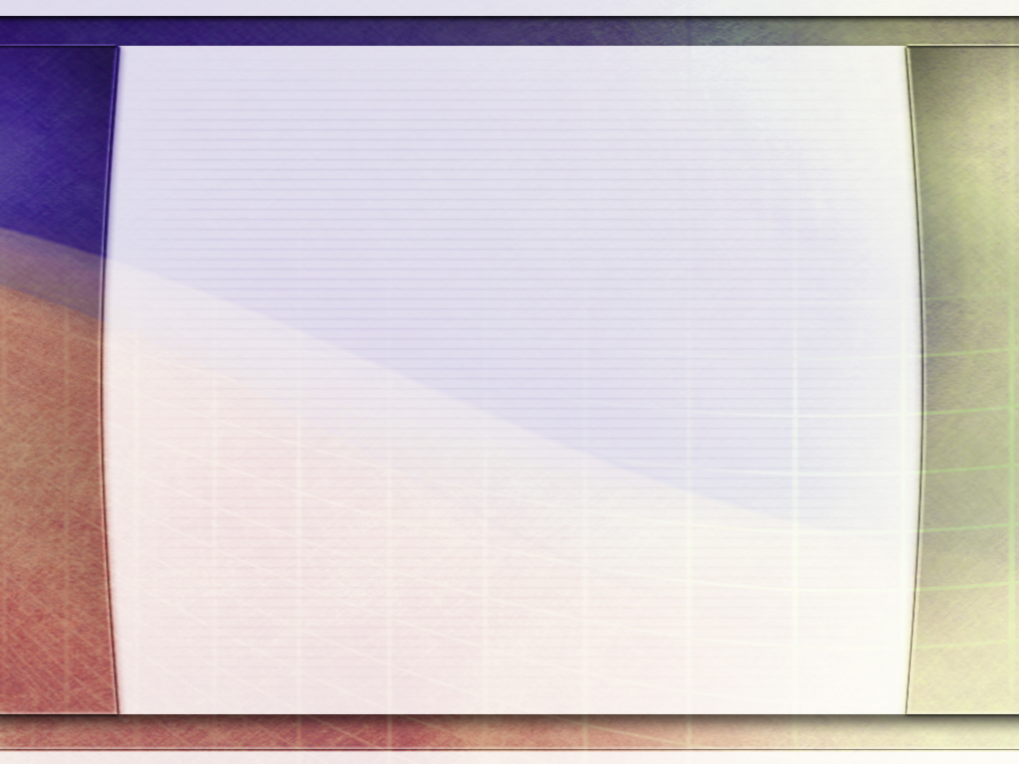
“ʻOku ʻi ai ha vaivai lahi ʻi he ʻofa pe kiate kita, hakeakiʻi kita, mo e hikisia; ka ʻoku ʻi ai ha malohi lahi ʻi he loto fakatokilalo. ʻOku ʻikai pukepuke hotau ngeia moʻoni ʻi he taimi ʻoku tau fakakaukau lahi taha ai kiate kitautolu, ka ʻi he taimi ʻoku ʻi heʻetau fakakaukau kotoa pe ʻa e ʻOtua pea ulo hotau loto ʻi he ʻofa ki hotau Huhuʻi mo e ʻofa ki hotau kainga. ʻE ʻomi ʻe he angavaivai mo e loto fakatokilalo ʻa e fiefia, ka ʻe ʻomi ʻe he fielahi ʻa e taʻefiemalie, loto mamahi, mo e taʻefiemalie maʻu pe. Ko e ako ko ia ke fakasiʻisiʻi ange ʻetau fakakaukau kiate kitautolu kae lahi ange ki hono ʻai e niʻihi kehe ke fiefia te ne ʻomi kiate kitautolu ʻa e malohi fakalangi.”
EGW (Ngaahi Fakamoʻoni Maʻa e Siasi, vol. 3, p. 476)

