Slide 1

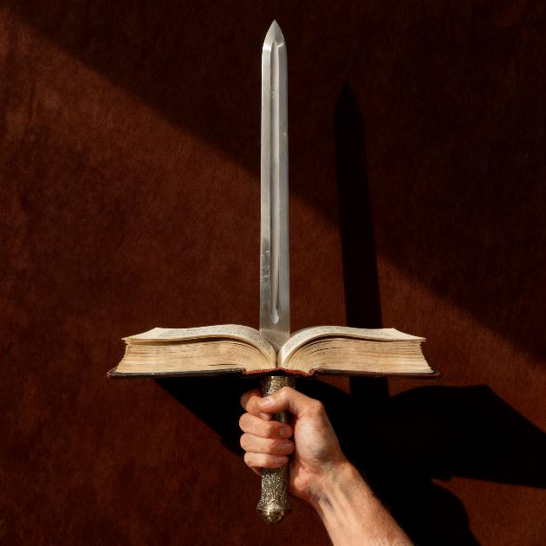

KO E TAUMU’A ʻO E TOHI TAPÚ
Lesoni 4 ki he ʻaho 25 ʻo ʻEpeleli 2026

Slide 2

“He ko e folofola ʻae ʻOtua ʻoku moʻui, mo mālohi, pea māsila lahi ʻi ha heletā ʻoku fakatoumata, ʻoku ʻasi ki hono vaheʻi ʻoe loto mo e laumālie, mo e ngaahi hokotanga hui mo e uho, pea ʻoku ne fakahā ʻae ngaahi mahalo mo e filioʻi ʻoe loto. ” (Hepelū 4:12)
Notes:
Buscar en biblia-espada

Slide 3


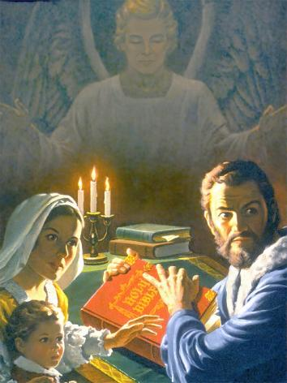
Ko e Tohi Tapu ʻa e tohi fakatau lelei taha ʻi he mamani, ʻo tuʻo nima hono fakatau atu ʻi he tohi fika ua. Ka naʻe ʻikai ke hoko maʻu pe ʻeni.
Naʻe ʻ i ai ha taimi ʻ a ia ko hono maʻu ha Tohi Tapu, lau ia, pe naʻa mo e talanoa fekauʻaki mo iá naʻe lava ke hoko ia ko ha makatuʻunga ki he pilīsone, fakamamahiʻi, pea naʻa mo e maté.
Ka ne taʻeʻoua ʻ a e maluʻi makehe ʻ a e ʻ Otuá, naʻe mei pulia fuoloa atu ʻ a e Tohi Tapú. Ko e ha hono ʻuhinga? Ko e ha ʻa e meʻa makehe fekauʻaki mo e tohi ni ʻoku ne ʻai ke fakatou ʻofeina mo fehiʻanekinaʻi?
Ko e fili ʻo e Tohi Tapu
Ngaahi founga totonu mo hala ki hono lau ʻo e Tohi Tapu
Ko e ha ʻa e Tohi Tapu?
Ngaahi ola lelei ʻ o hono lau ʻ o e Tohi Tapú
Ngaahi Kaumeʻa ʻo e Tohi Tapu

Slide 4


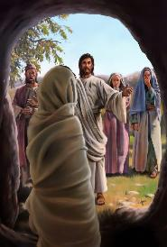
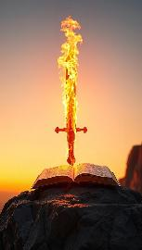

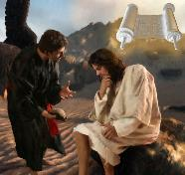
KO E FILI ʻ O E TOHI TAPÚ
“Pea ʻai mo e tatā ʻoe fakamoʻui, mo e heletā ʻoe Laumālie, ʻaia ko e folofola ʻae ʻOtua:” (Efesō 6:17)
Fakakaukau ki he meʻa ʻoku malava ke fai ʻe he folofola ʻa e ʻOtua: fakatupu mo foaki ʻa e moʻui (Saame 33:6), pe fokotuʻu ʻa e mate (Sione 5:28-29).
Ko e ha ʻe lava ke fai ʻe he Tohi Tapu, ʻa e folofola ʻa e ʻOtua kuo tohi? ʻOku ne maʻu ʻa e malohi ke maluʻi kitautolu (ʻEfeso 6:17b) mo liliu kitautolu (Hepelu 4:12). Naʻe fakaʻaongaʻi ʻe Sisu ʻa e Tohi Tapu ke maluʻi ia mei he ʻahiʻahi (Matiu 4:4, 7, 10).
ʻOku ʻiloʻi ʻe Setane ʻoku ʻikai hano malohi ke fakafepakiʻi ʻa e malohi ʻo e Tohi Tapu. Ko ia ai, kuo ne feinga ke fakaʻauha fakatuʻasino ia. Naʻe ʻ ikai lava, ʻ i he kamata ke tufaki ʻ e he ngaahi sōsaieti Tohi Tapú ʻ a e ngaahi tatau ʻ e laui afe. Naʻa ne feinga leva ke fakaongoongokoviʻi ia ʻaki ha fakaanga maʻolunga ange. ʻ Okú ne feinga he taimí ni ke taʻofi kitautolu mei hono lau iá ʻ aki hono fakamoleki hotau taimí ʻ i he ngaahi meʻa kehé.
Te u tuku nai ke ne hao mei ai? ʻ Ikai lava ke u maʻu ha taimi ʻ i heʻeku taimi - tēpile ke lau ai ʻ a e Tohi Tapú? ʻOku liliu kitautolu ʻe heʻetau lau ia pea ʻai ke tau malohi ʻi heʻetau fakafepakiʻi hotau fili kovi taha: ʻa e tevolo.

Slide 5

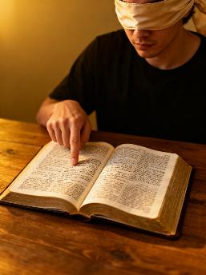



NGAAHI FOUNGA TOTONU MO HALA KI HONO LAU ʻO E TOHI TAPU
“Ke ke feinga ke fakahā koe ʻoku ke lelei ki he ʻOtua, ko e tangata ngaue ʻoku ʻikai ke mā, kae vahevahe totonu atu ʻae folofola ʻoe moʻoni.” (2 Timote 2:15)
Ngaahi foomu hala
Kumi ha meʻa ʻoku fenapasi mo ʻetau fakakaukau
Fili tavale pe ʻa e ngaahi tohi, taʻe ʻi ai ha taumuʻa
Ngaahi foomu totonu
Feinga ke ʻilo ʻa e finangalo ʻo e ʻOtua
Fakahoko ha ako ʻoku fokotuʻutuʻu
Fili ʻa e ngaahi konga ʻoku tau saiʻia aí, pea fakafisingaʻi ʻa e ngaahi konga ʻoku ʻikai ke tau saiʻia aí.
‘Oua ‘e fakafisinga‘i ha konga tohi, ka ke ‘analaiso kotoa kinautolu.
‘Oku totonu ke fakakaukau fakapotopoto ‘etau ako Tohitapu, ka kuo pau ke mo’ulaloa ‘etau fakakaukau ki he ivi ‘o e Laumalie Ma’oni’oni kae lava ke tau ‘ilo’i totonu ‘a e fekau fakatohitapu.
Ko e hā hono ʻuhingá? He ‘oku fakangatangata ‘etau ‘uhingá pea ‘oku ‘ikai ke falala‘anga ma‘u pē. Ko e 'uhinga ia, 'i he taimi 'oku tau ako ai 'a e Tohitapu, kuo pau ke tau kumi ki he poto 'o hono Fa'u.

Slide 6


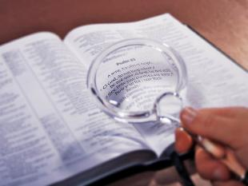
KO E HA 'A E TOHITAPU?
ʻI hotau sōsaietí, pea naʻa mo e ngaahi siakale faka-Kalisitiané, ʻoku ʻi ai ha tui ʻoku fakafekauʻaki ʻa e moʻoní, ʻoku ʻikai ha moʻoni ʻe tuʻu maʻu mo ʻikai liliu ʻi he ʻalu ʻa e taimí.
“Ko e kakato ‘o Ho‘o folofolá ko e mo‘oni, .
Pea ko Ho‘o ngaahi fakamaau mā‘oni‘oni kotoa pē ‘oku tolonga ‘o ta‘engata.”
( Saame 119:160 )
Kae kehe, ko e Tohitapú ‘i he tu‘unga ko e folofola ‘a e ‘Otuá ‘okú ne taukave‘i ‘okú ne ma‘u ‘a e mo‘oni faka‘aufuli ( Sāme 119:160; Sione 17:17; Sēmisi 1:18 ). ‘Oku ne pehe ‘oku ma’a pea ko e pale malu’i ia mei he sofisiti ‘a e tangata (Palovepi 30:5). Kapau te tau tānaki ki ai ha taha ‘o ‘etau ngaahi “mo’oni” ‘atautolu, ‘e ala lau kitautolu ko e kau loi ‘i he ‘ao ‘o e ‘Otua (Palovepi 30:6)
Ko ha fa’ahinga taukave pe, ha fa’ahinga mo’oni, kuo pau ke sivi’i ia ‘e he Tohitapu. Ka ‘i ai ha fepakipaki ‘i he vaha‘a ‘o e me‘a ‘oku tau lau ‘oku mo‘oní mo e me‘a ‘oku fakahā ‘e he Tohitapú, ‘oku ‘i ai ‘a e me‘a ‘e ua ‘e lava ke hoko: pe ‘oku tau hala, pe ‘oku tau faka‘uhinga hala ‘a e Tohitapú.

Slide 7


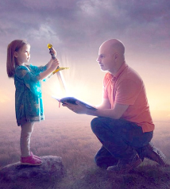


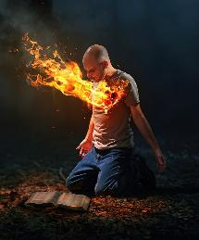
KO E NGAAHI OLA LELEI ‘O E LAU ‘A E TOHI TAPÚ .
“Kuo u fufū hoʻo folofola ʻi hoku loto,
koeʻuhi ke ʻoua naʻaku angahala kiate koe.” (Saame 119:11)
Ko ha me‘a ‘oku ‘ikai lava ke faka‘ikai‘i na‘a mo e ngaahi fili vela taha ‘o e Tohi Tapú ko hono mālohi ke liliu ‘a e kakaí. ‘Oku fakahoa ia ‘e Paula ki ha heletā ‘okú ne ma‘u ‘a e mālohi lahi.
ʻOkú ne ʻai ke tau vakai kiate kitautolu ʻo hangē ko ia ʻoku tau ʻi ai moʻoní .
( Hep. 4:12 )
ʻOkú ne taʻofi kitautolu mei he angahalá .
( Sāme 119:11 )
Ko e meʻakai ia ki hotau laumālié
(Sel. 15:16)
ʻOkú ne ʻai ke tau tupulaki fakalaumālie
(1 Pita 2:2)
ʻOkú Ne ʻomi kiate kitautolu ʻa e moʻuí .
( Sione 6:63 )
ʻOku ʻikai ha toe tohi te ne lava ʻo uesia kitautolu ʻo hange ko e Tohi Tapu. ʻI he taimi ʻoku tau loto fiemalie ai ke fakaʻaongaʻi hono ngaahi akonaki ʻi heʻetau moʻui, ʻoku tau liliu leva ʻo lelei ange.
ʻI he taimi ʻoku tau lau ai ia ʻi he loto tauʻataina mo kole ki he ʻOtua ʻa e maama ʻo e Laumalie Maʻoniʻoni, ʻoku liliu leva ʻetau moʻui.

Slide 8

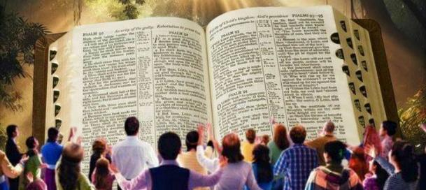
“Ko e meʻa ko ia ʻoku mau fakafetaʻi taʻetuku ai foki ki he ʻOtua, koeʻuhi, ʻi hoʻomou maʻu ʻae folofola ʻae ʻOtua ʻaia ne mou fanongo ai ʻiate kimautolu, naʻe ʻikai te mou maʻu ia ʻo hangē ko e lea ʻae tangata, kae hangē ko ia ʻoku moʻoni, ko e folofola ʻae ʻOtua, ʻaia ʻoku ngaue ʻaonga foki kiate kimoutolu ʻoku tui.” (1 Tesalonaika 2:13)
NGAAHI KAUMEʻA ʻ O E TOHI TAPÚ
ʻI he taimi ʻoku tau tali ai ʻa e Tohi Tapu ʻi he founga ko ʻeni...
ʻ Okú ne fakahaaʻi mai kiate kitautolu ʻ a e tuʻunga ʻ o hotau vahaʻangatae mo e ʻ Otuá
ʻOku ne talamai ʻa e founga ke fakamalohia ai ʻa e va fetuʻutaki ko ia
ʻOku tau aʻusia ha liliu mamalie
ʻ Oku tau ʻ unuʻunu ofi kia Sīsū
ʻOku ne ngaohi kitautolu ke tau poto ki he fakamoʻui
ʻOku tau tupulaki ʻi he ʻilo ki he moʻoni
ʻOku tupulaki mo fakamalohia ʻetau tui
ʻOku tau maʻu ʻa e ʻamanaki lelei
ʻOku tau ʻiloʻi ʻoku fakatatali mai kiate kitautolu ha moʻui lelei ange, taʻengata, mo fakaʻofoʻofa
ʻOku fakaofiofi ki ai ʻa e ngaahi kaungameʻa ʻo e Tohi Tapu mo ʻenau ʻiloʻi ko e Folofola Moʻui ia ʻa e ʻOtua (1Tesalonaika 2:13). Ka ʻe anga fefe haʻaku aʻusia ʻa e tui ko ia?
ʻOku talamai ʻe Paula, ʻoku tau fie maʻu ʻa e faʻa ʻiloʻilo fakalaumalie, ʻa ia ko e malava ke mahino ʻa e ngaahi meʻa fakalaumalie (1 Kolinito 2:14). Ko ia ai, ko hono ʻiloʻi ʻo e popoaki fakalangi ʻi he Tohi Tapu ko e ngaue ia ʻa e Laumalie Maʻoniʻoni ʻoku ngaue ʻiate kitautolu.

Slide 9

“ʻOku fakamatalaʻi ʻe he Tohi Tapu ʻa e moʻoni ʻi ha founga faingofua mo feʻunga haohaoa ki he ngaahi fie maʻu mo e fakaʻanaua ʻa e loto ʻo e tangata, ʻa ia kuo ne fakatumutumu mo fakaʻofoʻofaʻia ʻa e ʻatamai lelei taha, lolotonga ia ʻoku ne ʻai ke ʻiloʻi ʻe he loto fakatokilalo mo taʻepoto taha ʻa e hala ʻo e fakamoʻui. Ka ʻoku maʻu ʻe he ngaahi moʻoni faingofua ko ʻeni ʻa e ngaahi kaveinga ʻoku fuʻu maʻolunga, mamaʻo, taʻefakangatangata ʻi he malohi ʻo e faʻahinga ʻo e tangata, pea te tau toki lava pe ʻo tali kinautolu koeʻuhi he kuo fakaha kinautolu ʻe he ʻOtua. […] Ko e lahi ange ʻene fekumi ʻi he Tohi Tapu, ko e loloto ange ia ʻene tui ko e folofola ia ʻa e ʻOtua moʻui, pea ʻoku punou ʻa e ʻuhinga ʻa e tangata ʻi he ʻao ʻo e fakaʻeiʻeiki ʻo e fakaha fakalangi."
EGW (Ngaahi Sitepu kia Kalaisi, p. 107)

