Slide 1
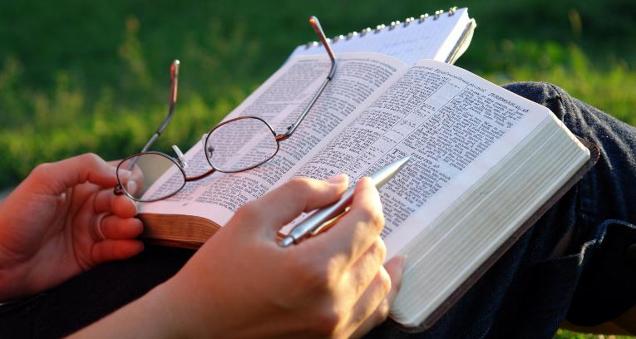
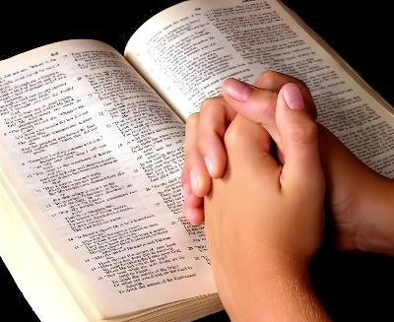
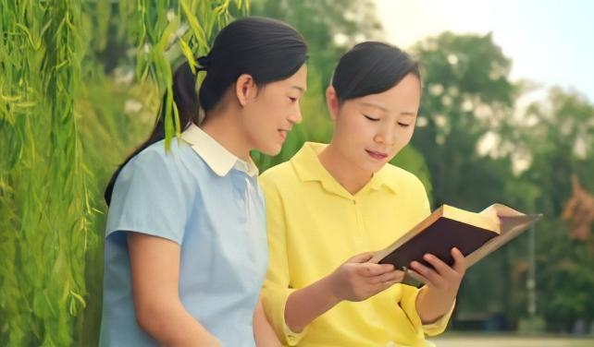
FOUNGA KE AKO AI ʻ A E TOHI TAPÚ
Lesoni 5 ki he ʻaho 2 ʻo Me 2026

Slide 2

“ʻE pehē ʻeku folofola ʻaia ʻoku ʻalu atu ʻi hoku fofonga:ʻe ʻikai foki taʻefua kiate au,
ka e lavaʻi ia ʻaia ʻoku ou faʻiteliha ki ai,
pea ʻe monūʻia ia ʻi he meʻa ʻoku ou fekau ia ki ai.” (Isaia 55:11)

Slide 3

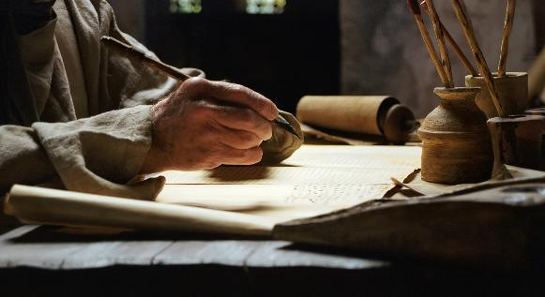

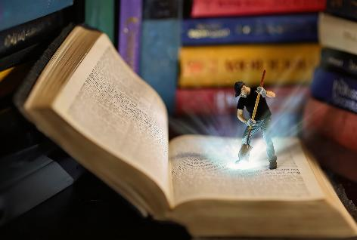
"Naʻe lea ʻa e kau tangata maʻoniʻoni ʻa e ʻOtua ʻi hono ueʻi ʻa kinautolu ʻe he Laumalie Maʻoniʻoni" (2 Pita 1:21), pea hiki ʻenau popoaki ʻi he ngaahi peesi ʻo e Tohi Tapu.
ʻOku tau maʻu ai ʻa e ngaahi siueli ʻoku ne ʻomi ʻa e moʻui, ʻamanaki lelei, fakalotolahi, fakafiemalie, ... ʻOku ʻi ai ha niʻihi ʻoku ʻasi mai ʻi he ʻuluaki sio ki ai, pea ko e niʻihi kuo pau ke fekumi fakalelei ange.
ʻ E lava fēfē ke tau toʻo ʻ a e ngaahi makakoloa ko eni kuo teuteu ʻ e he ʻ Otuá maʻatautolu ʻ i he Tohi Tapú, pea ko e hā ʻ a e ngaahi ʻ aonga ʻ oku tau maʻu mei hono ako iá?
Founga ke ako ai ʻa e Tohi Tapu:
Taimi
Ko e feituʻu
Ko e founga
Ngaahi ʻ aonga ʻ o hono ako ʻ a e Tohi Tapú:
Ko e lelei ʻo hono vahevahe ia
Ko e lelei ʻo hono kai ia

Slide 4

FOUNGA KE AKO AI ʻ A E TOHI TAPÚ

Slide 5
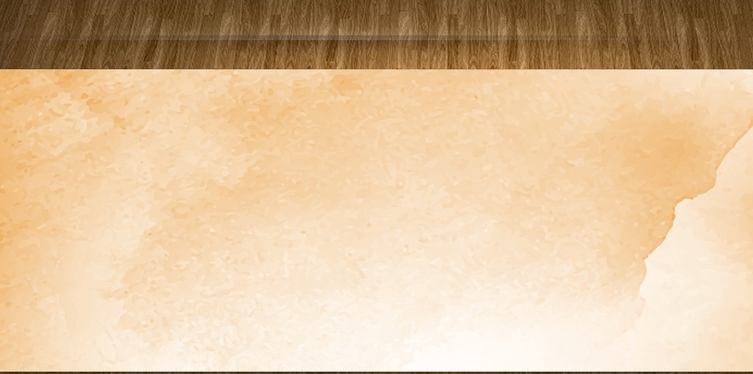
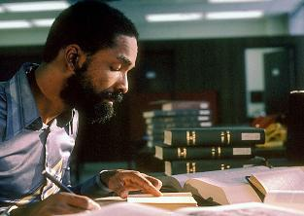
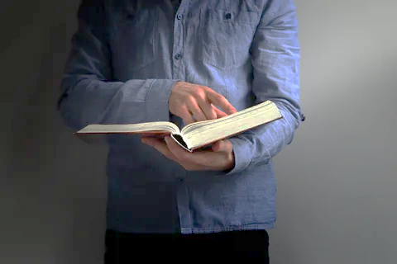

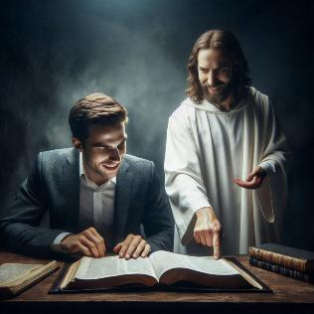
TAIMI
"Te ke kumi mo ʻilo au ʻi hoʻo kumi kiate au ʻaki ho loto kotoa." (Selemaia 29:13)
Ko e hā ʻ a e taimi lelei taha ke ako ai ʻ a e Tohi Tapú?
Kuo pau ke tau vakaiʻi ʻetau tali ʻo fakakaukauʻi ʻa e meʻa ʻe ua: ko e taimi mo e tuʻunga lelei.
ʻ Oku hā mahino te tau maʻu ʻ aonga lahi ange mei hono vaheʻi ha houa ʻ e taha ʻ i heʻetau taimi - tēpile ki he ako Tohi Tapú ʻ i hono fakatapui pē ʻ a e miniti ʻ e nima.
Kae kehe, ko e taimi ʻ oku tau līʻoa ki he akó ʻ oku ʻ ikai lava ke fakangatangata pē ia ki he lautohi fakangalingali. Ko e feituʻu ʻeni ʻoku kau ai ʻetau fakaʻaiʻai. Ko e ha ʻoku ou lau ai ʻa e Tohi Tapu? ʻOku ou fekumi pe ki he ʻilo, pe ʻoku ou maʻu ha holi lahi ke ʻilo lahi ange fekauʻaki mo e ʻOtua?
Te tau maʻu ʻa e lelei taha mei heʻetau ako Tohi Tapu ʻi he taimi ʻe hoko ai ko ha taimi ke nofo ai mo e ʻOtua (Selema. 29:13), pea fiefia ʻiate Ia (Saame 37:4); ʻi he taimi ʻoku tau kumi ai ʻi hono ngaahi pesi ʻa e popoaki makehe ʻa e ʻOtua maʻatautolu.

Slide 6
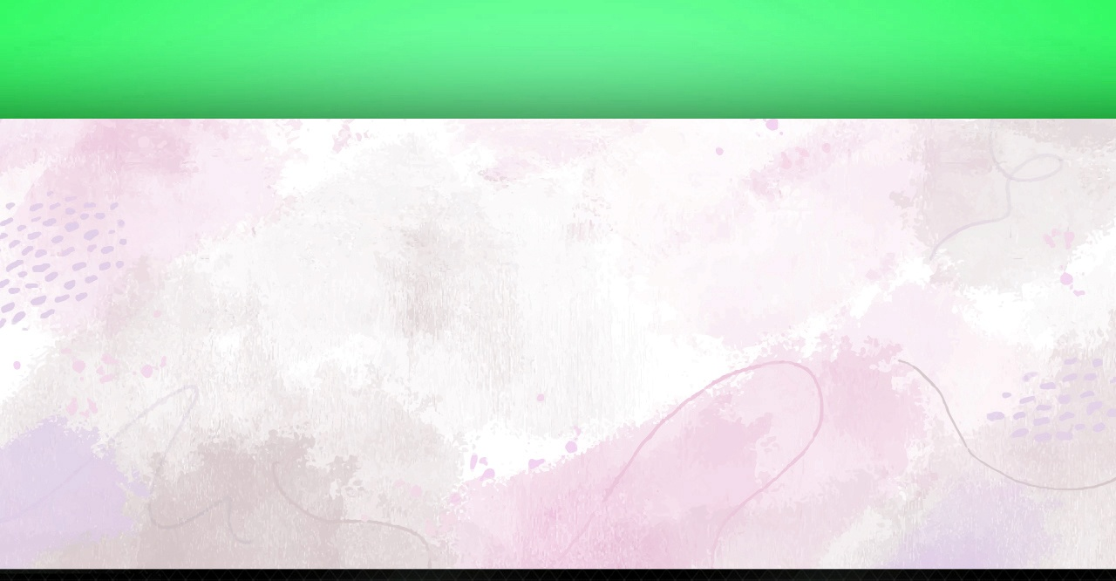
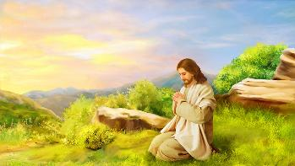


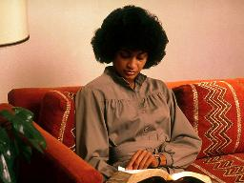
KO E FEITUʻU
“Pea pongipongi ai, naʻa ne tuʻu hake ʻoku teʻeki ʻaho, pea ʻalu ia kituaʻā ʻo mole atu ki he potu lala, pea lotu ai. ” (Ma’ake 1:35)
ʻI he taimi naʻe fie maʻu ai ʻe Sisu ha momeniti makehe ʻo e fetuʻutaki mo e ʻOtua, naʻa ne ʻa hengihengia hake ʻo kumi ha feituʻu longonoa (Maʻake 1:35). ʻ E lava ke ngāueʻaki eni fakatouʻosi ki he lotú mo e ako Tohi Tapú.
ʻOku faingataʻa ke tokanga taha ki he ako ʻi ha feituʻu longoaʻa pe femoʻuekina. ʻOku faingofua ange ke fai ia ʻi ha feituʻu fiemalie, longonoa mo maomaonganoa.
Ko e houa ʻuluaki pe fakaʻosi ʻo e ʻaho, ʻi he taimi ʻoku longonoa ange ai, ʻe lava ke hoko ia ko ha ngaahi taimi ʻe faingofua ange ai ke tukutaha ʻetau fakakaukau ki he ʻOtua.
Ko ʻetau maʻu pe ʻa e taimi mo e feituʻu totonu, tau ʻai ʻeni ke hoko ko ha ʻekitiviti angamaheni. Mahalo pē ʻ e ʻ i ai ha tuʻunga makehe te ne fakatupunga kitautolu ke tau liʻaki ʻ a e taimi ko iá, kae ʻ oua naʻa tau tuku ha fuʻu taimi lahi taʻe ʻ i ai ʻ etau ako Tohi Tapu fakaʻahó.

Slide 7


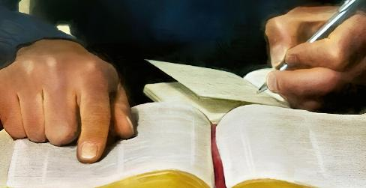
KO E FOUNGA (1)
"ʻOku pehe ʻeku lea ʻoku ʻalu mei hoku ngutu: ʻE ʻikai foki taʻeʻaonga ia kiate au..." (ʻIsaia 55:11)
Ko ha ako fakaʻauliliki ʻ o e Tohi Tapú ʻ oku ʻ i ai ʻ a e konga ʻ e fā
Lotu
Laukonga mo e mahino [founga fokotuʻu]
Lotu
Vahevahe
Fakaafeʻi ʻa e Laumalie Maʻoniʻoni ke hoko ko ho fakahinohino ʻi hoʻo ako
Fili ha veesi pe potufolofola mei he Tohi Tapu
Te Ne ueʻi ho loto mo e ʻatamai koeʻuhi ke mahino kiate koe ʻa e meʻa ʻoku ke lau
Hiki ia ke tokoniʻi koe Tohitongi ia ki ho ʻatamai
Laineʻi ʻa e ngaahi tefitoʻi fakakaukau
Hiki ʻa e ngaahi fakakaukau ʻoku ne ueʻi fakalaumalie ʻa e ngaahi fakakaukau mahuʻinga ko ia
Kole ki he ʻOtua ke tokoni atu ke ke fakaʻaongaʻi ʻa e ngaahi fakakaukau kuo ke ako
Fakakaukau pe ko hai te ke lava ʻo vahevahe ki ai ʻa e meʻa kuo ke ako

Slide 8

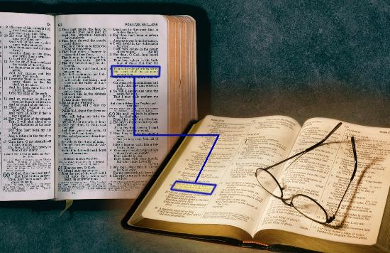
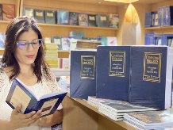
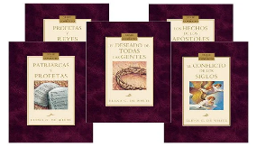
KO E FOUNGA (2)
"ʻOku pehe ʻeku lea ʻoku ʻalu mei hoku ngutu: ʻE ʻikai foki taʻeʻaonga ia kiate au..." (ʻIsaia 55:11)
Ko e ngaahi founga ako Tohi Tapu kehe
Fakafehoanaki ʻa e veesi ki he veesi (ʻIsaia 28:10)
Ako ʻa e ngaahi vahe pe ngaahi tohi kakato
Ko hono ako ʻo ha tefito pe foʻi lea ʻi he tokoni ʻa ha potufolofola
Vakai ki he ngaahi fakamatala fakatohitapu pe tikisinale
Lau fakataha mo e ngaahi konga mei he hokohoko ʻo e “Fepakipaki ʻo e Ngaahi Kuongá” ʻa Ellen G White .

Slide 9

NGAAHI ‘AONGA ‘O HONO AKO ‘A E TOHI TAPÚ

Slide 10
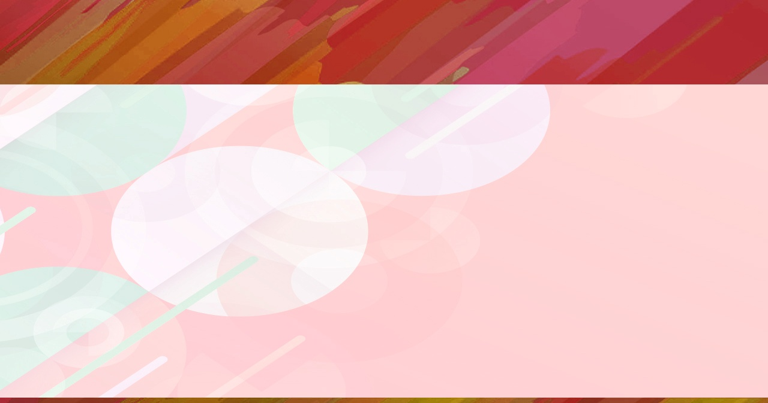


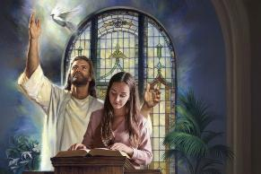
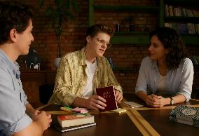

KO E 'AONGA 'O E VAHEVAHE IA
“Kuo foaki kiate au ʻe he ʻEiki ko Sihova ʻae ʻelelo ʻoe poto, koeʻuhi ke u ʻilo ke lea ʻaki ha lea ʻi he kuonga totonu kiate ia ʻoku vaivai:ʻoku ne ʻa ʻi he pongipongi kotoa pē, ke ne fafangu hoku telinga ke ongoʻi ʻo hangē ko e poto.” (Isaia 50:4)
'Oku kole atu ke mou teuteu ha malanga ki he lotu 'o e Tokonaki. ʻOkú ke fakatapui ha taimi makehe ke ako ʻi he faʻa lotu ha kaveinga kuo ueʻi koe ʻe he Laumālie Māʻoniʻoní ke ke fili. ‘I he Tokonakí, ‘okú ke malanga ‘aki ‘a e mālohi. Ko hai 'oku tu'u ke ma'u 'aonga lahi taha mei he malanga ko 'eni?
Ko e ako Tohitapu ‘oku tau vahevahe mo e kakai kehe pe ‘i ha malanga pe ‘i ha tu’unga fakafo’ituitui ‘oku ‘i ai ‘a e ‘aonga ‘e ua.
‘Uluakí, ‘oku tau ma‘u ‘aonga mei he me‘a kuo tau akó. Uá, ko e kakai ‘oku tau vahevahe mo kinautolu ‘a e ‘ilo ko ení ‘oku nau ma‘u ‘aonga pea ‘oku fakalototo‘a‘i kinautolu ke nau fakatotolo loloto ange ki he ‘ilo ko iá.
ʻ I he ongo tuʻungá fakatouʻosi, ʻ oku fakaivimālohiʻi mo fakaloloto ai ʻ a e vahaʻangatae mo e ʻ Otuá. Ko e malohi ia ʻo e Folofola ʻa e ʻOtua, ʻa ia "ʻe ʻikai foki taʻeʻaonga mai kiate au" (ʻIsaia 55:11).

Slide 11

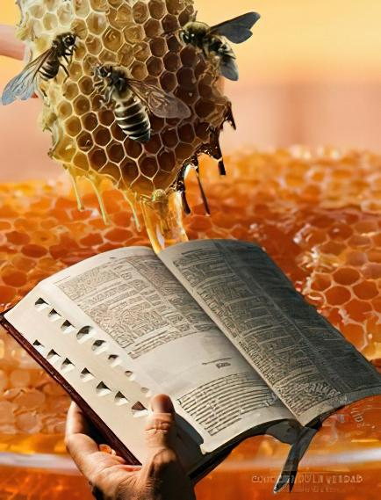

KO E LELEI ʻO E KAI IA
"Hono ʻikai melie hoʻo ngaahi lea kiate au, ʻoku melie ange ʻi he hone ki hoku ngutu!" (Sāme 119:103)
Kuo pau ke tau kai ʻa e Folofola ʻa e ʻOtua (Selema. 15:16)!
Neongo ʻoku melie ange ia ʻi he hone, ka ʻoku ʻikai totonu ke tau kai moʻoni ia (Saame 119:103). Ko hono lau ʻo e Tohi Tapu ko ha meʻakai ia ki he laumalie, ko ha fakaivifoʻou moʻoni ʻoku ne fakamoʻui hotau laumalie mo liliu hotau ʻulungaanga.
Pea ko e meʻa ʻe taha, ʻoku taʻetotongi ʻa e meʻakai ko ʻeni (ʻIsaia 55:1)!
ʻOku fie maʻu pe ke tau ʻunuʻunu ofi mo fakafanongo ki he meʻa ʻoku talamai ʻe he ʻOtua ʻi he Tohi Tapu (ʻIsaia 55:3). Ko e lahi ange ʻa e taimi ʻoku tau fakamoleki ʻi hono fekumi ki hono ngaahi pesi, ko e lahi ange ia ʻo e meʻakai te tau maʻu, pea ko e lahi ange ia ʻo e ngaahi tapuaki te tau maʻu.
"Neongo pe ko e ha ʻa e fakalakalaka fakaʻatamai ʻa e tangata, ʻoua naʻa ne fakakaukau ʻi ha kiʻi momeniti ʻoku ʻikai fie maʻu ke fekumi fakaʻauliliki mo hokohoko ʻi he Folofola ki ha maama lahi ange. ʻI heʻetau hoko ko ha kakai, ʻoku ui fakafoʻituitui kitautolu ke tau hoko ko ha kau ako ʻo e kikite." Ellen G. White, Ngaahi Faleʻi ki he Kau Faʻu Tohí mo e Kau ʻĒtitá, p. 41

Slide 12

"He ʻikai lava ʻe hono lau pe ʻo e Folofola ʻo aʻusia ʻa e ola naʻe fokotuʻutuʻu ʻe he Langi; kuo pau ke ako mo mataʻikoloa ʻaki ia ʻi he loto. ʻOku ʻikai maʻu ʻa e ʻilo ki he ʻOtua taʻe kau ai ha feinga fakaʻatamai. ʻOku totonu ke tau ako faivelenga ʻa e Tohi Tapu, ʻo kole ki he ʻOtua ʻa e tokoni ʻa e Laumalie Maʻoniʻoni, koeʻuhi ke mahino kiate kitautolu ʻEne Folofola. ʻOku totonu ke tau toʻo ha veesi ʻe taha, pea tukutaha ʻetau fakakaukau ki he ngaue ke fakapapauʻi ʻa e fakakaukau kuo tuku mai ʻe he ʻOtua ʻi he veesi ko ia maʻatautolu. […]Ko e Folofola ʻa e ʻOtua ko e ma ia ʻo e moʻui. Ko kinautolu ʻoku nau kai mo fakamoluluʻi ʻa e Folofola ni, ʻo ʻai ia ko ha konga ʻo e ngaue mo e ʻulungaanga kotoa pe, ʻoku nau tupulaki ʻo malohi ʻi he malohi ʻo e ʻOtua. ʻOku ne ʻomi ʻa e ivi taʻe-faʻa-mate ki he laumalie, ʻo fakahaohaoaʻi ʻa e meʻa ʻoku tau aʻusia mo ʻomi ʻa e fiefia ʻe tuʻuloa ʻo taʻengata.
EGW (Hiki Hake Ia, ʻEpeleli 7)

