Slide 1
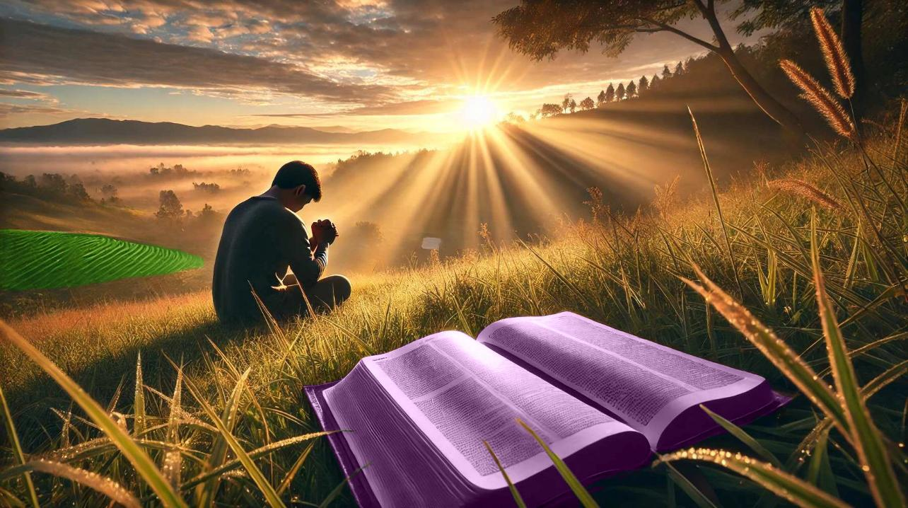
KO E MA'U 'A E TUI
Lesoni 8 ki he ʻaho 23 ʻo Mē, 2026

Slide 2

“Ko eni, ko e tui ko e tuʻunga ia ʻoe ngaahi meʻa ʻoku ʻamanaki lelei ki ai, ko e fakamoʻoni ʻoe ngaahi meʻa taʻehāmai. ”
(Hepelū 11:1)

Slide 3
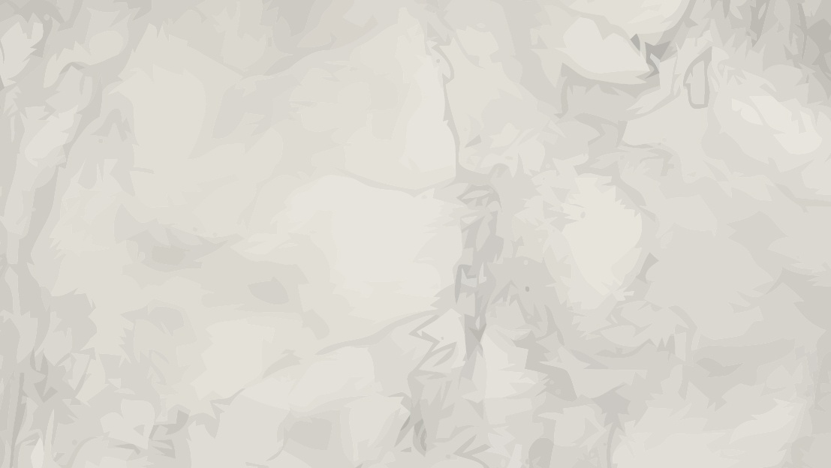





Ko e ‘ilo ki he ‘Otua, ako Tohitapu, mo e lotu, kuo pau ke ‘i ai ha ‘elemeniti ‘e taha ‘oku nau tatau ai kae lava ke nau hoko ko e ngaahi ‘elemeniti liliu ‘i he’etau mo’ui: ko e tui.
Ka ‘ikai ha tui, ‘oku hoko ‘a e ngaahi ‘elemēniti ko ení ko ha ‘ilo pē, pe ngaahi ouau ‘oku ‘ikai hano ‘uhinga.
Ka ʻi he tuí, ko ha ngaahi ʻelemēniti mālohi ia te ne ʻave kitautolu ki he ngaahi tumutumu māʻolunga taha ʻo ʻetau aʻusia fakalaumālié: “ʻoku malava ʻa e meʻa kotoa pē kiate ia ʻoku tuí” ( Maʻake 9:23 ).
Fa'ahinga kehekehe 'o e tui :
  Ko e tui mo e ngaahi faka'ilonga
  Ko e meʻafua ʻo e tuí
  Ko e tuí mo e ngaahi ongó
Ko e hā ʻa e tuí?
  Ko hono fakaʻuhingaʻi mo e fakalakalaka ʻo e tuí
  Ko e tui 'a Sisu

Slide 4

NGAAHI FA'AHINGA KEHEKEHE 'O E TUI

Slide 5
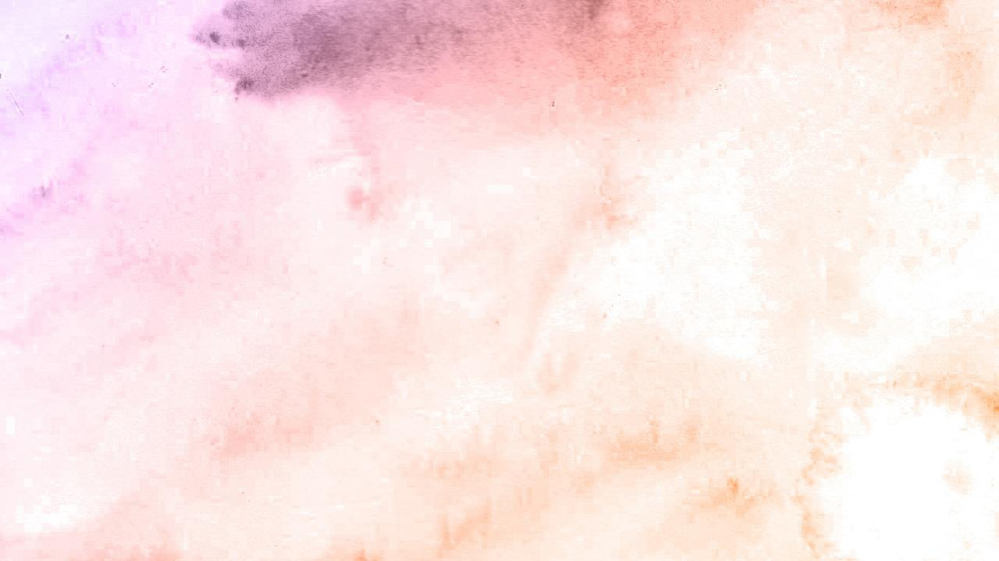




TUI MO E NGAAHI FAKA'ILONGA
“Pea tala ʻe Sisu, kiate ia, “Kapau ʻoku ʻikai te mou mamata ki he ngaahi fakaʻilonga, mo e meʻa fakaofo, ʻe ʻikai te mou tui.” (Sione 4:48)
Ko ha faka‘ilonga ko ha faka‘ilonga makehe pe fakahāhā ia ‘oku fai ke fakapapau‘i‘aki ha pōpoaki fakamānava‘i pe ke poupou‘i ‘aki ‘a e mafai faka‘otuá. Neongo ‘oku mahino fakalūkufua ha faka‘ilonga ko ha me‘a fakaofo—hangē ko e mali ‘i Kená (Sione 2:11)—ka ko e mo‘oni‘i me‘a ko ia na‘e ‘apitanga ‘a ‘Isileli ‘i he ‘ao ‘o Mo‘unga Sainaí ke lotu ki he ‘Otuá (‘Ekisoto 3:12) na‘e ‘omai foki ia ko ha faka‘ilonga.
Naʻe kole ʻe he kau Fālesí kia Sīsū ke fakahā ange ha fakaʻilonga ʻo ha faʻahinga faʻahinga pē ʻe lava ke ne fakamoʻoniʻi ko Ia ʻa e Mīsaiá, koeʻuhí ke nau tui kiate Ia (Maʻake 8:11).
Naʻe ʻita ʻa Sīsū ʻi heʻenau kole ha fakaʻilonga ke fakatonuhiaʻi ʻaki ʻenau taʻetuí (Maʻake 8:12). Ka ʻikai fie tui ha taha, he ʻikai ha fakaʻilonga ia te ne lava ʻo fakalotoʻi kinautolu.
Kuo ‘omi ‘e he ‘Otua ‘a e fakamo’oni fe’unga ‘i he’ene Folofola pea ‘i natula koe’uhi ke tui ‘a ia ‘oku fie tui. Kae kehe, ‘oku ‘i ai ma‘u pē ‘a e feitu‘u ki he veiveiuá. Ko e ʻuhinga ia naʻe foaki ai ʻe Sīsū ha tāpuaki makehe kiate kinautolu “naʻe ʻikai mamata kae tui” ( Sione 20:29 ).

Slide 6



KO E FUA 'O E TUI
“Pea pehē ʻe he ʻEiki, “Ka ne mou maʻu ʻae tui ke tatau mo e foʻi tengaʻi musita, te mou lea ki he ʻakau ko e sukamino ni, ‘Ke mataʻaki fuʻu hake koe, pea tō koe ʻi he tahi;’ pea ʻe talangofua ia kiate kimoutolu.” (Luke 17:6)
ʻOku ʻi ai ha ngaahi meʻafua kehekehe ʻo e tuí:
Ko e tui 'a e kau 'apositolo .
Ko e tui ʻa Pita
Ko e Tui ʻa e Tamai
The faith of the Canaanite woman
Ko e Tui ʻa e ʻEikitau
Ko e tui ʻa Sitiveni
"Ko e ha ʻoku ʻikai ke ke tui ai?" (Maʻake 4:40)
"ʻA koe ʻoku siʻisiʻi ʻa e tui!"
(Matiu 14:31)
"Haʻu ʻo tokoniʻi ʻeku kiʻi tui“
(Maʻake 9:24)
"ʻOku lahi hoʻomou tui"
(Matiu 15:28)
"Kuo teʻeki ai te u ʻilo ha tui lahi pehe ʻi ʻIsileli”
(Luke 7:9)
"ko e tangata ʻoku fonu ʻi he tui“
(Ngaue6:5)
ʻOku mahino ʻe lava ke tupulaki ʻa e tui ʻi hono taʻaki fuʻu ʻo e ngaahi aka ʻo e taʻetui. Kuo pau ke fetongi mamalie ʻe he loto fakapapau ʻa e veiveiua. ʻOku totonu ke peheni ʻetau kole: "Fakalahi ʻemau tui" (Luke 17:5).
‘I he ngāue ‘a e Laumālie Mā’oni’oni, mo e ako ‘o e Tohitapu, pea mo ‘etau a’usia mo e ‘Otua, te tau lava ai ‘o fakatokanga’i ‘oku “tupu ho’omou tui” (2Tes. 1:3).

Slide 7





TUI MO E ONGO
“He ʻoku mou moʻui ʻi he ʻofa pe ʻi he tui; pea ʻoku ʻikai meiate kimoutolu ia: ka ko e foaki ʻae ʻOtua: (Efeso 2:8)
Ko e tuí ko ha ongo pe ko ha ngāue fakakaukau?
ʻOku mahuʻinga ʻa e tali ki he fehuʻi ko ʻení. 'Oku 'ikai tatau ia mo e pehe "'Oku ou ONGO'I kuo fakahaofi" mo e pehe "'Oku ou 'ILO'I kuo fakahaofi au."
Ka tau kamata mei he kamataʻangá. Ko e hā ʻa e tupuʻanga ʻo e tuí? Ko e tui ‘oku mei he ‘Otua pea ‘oku ne foaki mai ia kiate kitautolu ko e me’a’ofa (Lom. 12:3; ‘Efe. 2:8).
ʻI he taimi ʻoku tau tali lelei ai e meʻaʻofa ko iá﻿—ʻi he taimi ʻoku tau kamata ngāue ʻaki ai e tuí﻿—ʻoku fakatupu ʻe he tui ko iá ʻiate kitautolu ha ngaahi ongo hangē ko e fiefiá; nonga; ko ha ongoʻi nonga fakalaumālie; ...
Ka ko e tuí ʻiate ia pē ʻoku ʻikai ko ha ongo ia; ko e “pau” mo e “fakapapau” (Hep. 11:1). ʻOku ʻikai ko ha meʻa ia ʻoku makatuʻunga ʻi heʻetau ongoʻí. Ko e taimi ʻoku ou ongoʻi vaivai aí, pe ongoʻi ʻoku mamaʻo hoku fakamoʻuí, ko e taimi ia kuo pau ke u ngāueʻi ai ʻa e tui lahi tahá.

Slide 8

KO E HĀ ʻA E TUI?

Slide 9




KO E FAKA'UHINGA MO E FAKALAKALAKA 'O E TUI
"ʻOku fakahaaʻi ʻe he tuí ʻa e moʻoni ʻo e meʻa ʻoku tau ʻamanaki ki aí; ko e fakamoʻoni ia ʻo e ngaahi meʻa ʻoku ʻikai ke tau lava ʻo mamata ki ai." (Hepelu 11:1)
Ngaue ʻaki ʻa e tui, neongo pe ko e ha hono siʻisiʻi (Matiu 17:20)
Ako ʻa e Tohi Tapu (Loma 10:17)
Kole ki he ʻOtua ke fakalahi ia (Luke 17:5)
ʻOua naʻa ke tukulolo ki he veiveiua (Maʻake 9:23-24)
ʻOua naʻa fakavaʻe ʻeku tui ʻi he tui ʻa e niʻihi kehe (Matiu 25:8)
Tali ki he Laumalie Maʻoniʻoni (Kal. 5:22)
Ke angamaheni ʻaki ʻeku tui (2 Kolinito 5:7)
ʻOku ʻomi ʻe he Hepelu 11:1, 3, mo e 6 ha fakaʻuhinga lahi ʻo e tui. ʻOku kaunga lahi ʻa e tui ki heʻetau fakakaukau ki he ʻOtua. ʻOku ne tataki kitautolu ke tau tui kiate Ia ko e Tupuʻanga mo e Fakapale.
ʻI he toenga ʻo e vahe, ʻoku fakamatalaʻi ai ʻe Paula ʻa e tui ʻa e kau tangata mo e kau fafine tokolahi ʻoku nau hoko ko ha faʻifaʻitakiʻanga mo ha fakalotolahi kiate kitautolu ke ʻoua naʻa tau loto foʻi lolotonga ʻetau tatali ki he pale.
Hange ko ia kuo tau mamata ki ai, ʻoku ʻikai ke tau maʻu kotoa ʻa e tuʻunga tatau ʻo e tui. Te u lava fefe ʻo fakatupulaki ha faʻahinga tui pe ʻoku ou maʻu, ʻo tatau ai pe pe ʻoku siʻisiʻi pe lahi?

Slide 10




KO E TUI ʻA SISUU
“Ko eni ʻae faʻa kātaki ʻae kakai māʻoniʻoni: ko ʻeni ʻakinautolu ʻoku fai ʻae ngaahi fekau ʻae ʻOtua, mo e tui kia Sisu. ” (Fakaha 14:12)
Ko kitautolu, ko e kau faivelenga ʻoku nofo ofi ki he toe haʻele mai ʻa Sisuu, ʻoku fakafaikehekeheʻi kitautolu ʻe he meʻa ʻe ua kuo pau ke tau "tauhi" (ʻa ia ko e talangofua pe fakatolonga): ko e ngaahi fekau mo e tui kia Sisuu (Fakaha 14:12).
ʻOku fehokotaki ʻa e Fono (ʻa e ngaahi fekau) mo e Ongoongolelei (tui). He ʻikai te ke lava ʻo talangofua taʻe maʻu ʻa e tui, pe tui taʻe talangofua. Ka ʻoku ʻuhinga ki he ha ʻa e "tui kia Sisuu"?
Talangofua kia Sisu mo ʻEne Folofola
Ko ha aʻusia fakaʻaho mo Sisuu
ʻAi ʻa Sisu ke hoko ko e uho ʻo ʻetau moʻui
Ke moʻui ʻo fakatatau mo ʻetau tui
Ke makatuʻunga ʻetau tui ʻia Sisu
Ko hono fakafotunga atu ʻo Sisu ʻi heʻetau moʻui
Tali ʻa e meʻafoaki ʻo ʻEne ʻaloʻofa
ʻOku fakatonuhiaʻi kitautolu ʻi heʻetau tui kia Sisuu.(Loma 5:1), fakamaʻoniʻoniʻi (Ngaue 26:18), pea hoko ko e fanau ʻa e ʻOtua (Sione 1:12).

Slide 11

“Hili ia pea falala ki he ʻEiki ko Sisuu ke Ne tataki koe ʻi he sitepu ki he sitepu ki he hala totonu. Te ke lava ʻo maʻu ha loto fakapapau mo ha malohi ʻi he foʻi laka kotoa pe ʻoku ke laka ki muʻa, he ʻe lava ke ke fakapapauʻi ʻoku ʻi Hono toʻukupu ho toʻukupu. Te ke lava ʻo "lele kae ʻoua ʻe ongosia"; te ke lava ʻo "ʻaʻeva kae ʻikai pongia," he te ke lava ʻo ʻiloʻi ʻi he tui ʻoku ke maʻu ho nima ʻi he toʻukupu ʻo Kalaisi. He ʻikai te ke vaivai ʻi he loto-foʻi, he ʻi hoʻo hoko atu ke ʻiloʻi ʻa e ʻEiki, ʻo falala kiate Ia, te ke maʻu ai ʻa e ʻilo pau ko e Tokotaha ʻoku ʻikai teitei liʻaki ʻa kinautolu ʻoku falala kakato kiate Ia, ko ho Tokoni maʻu pe ia”
EGW (ʻOku Tokanga ʻEtau Tamai, ʻOkatopa 27)

