Slide 1





Lesoni 11 ki he ʻaho 13 ʻo Sune 2026
NGAAHI FAKAHOLOMUI

Slide 2

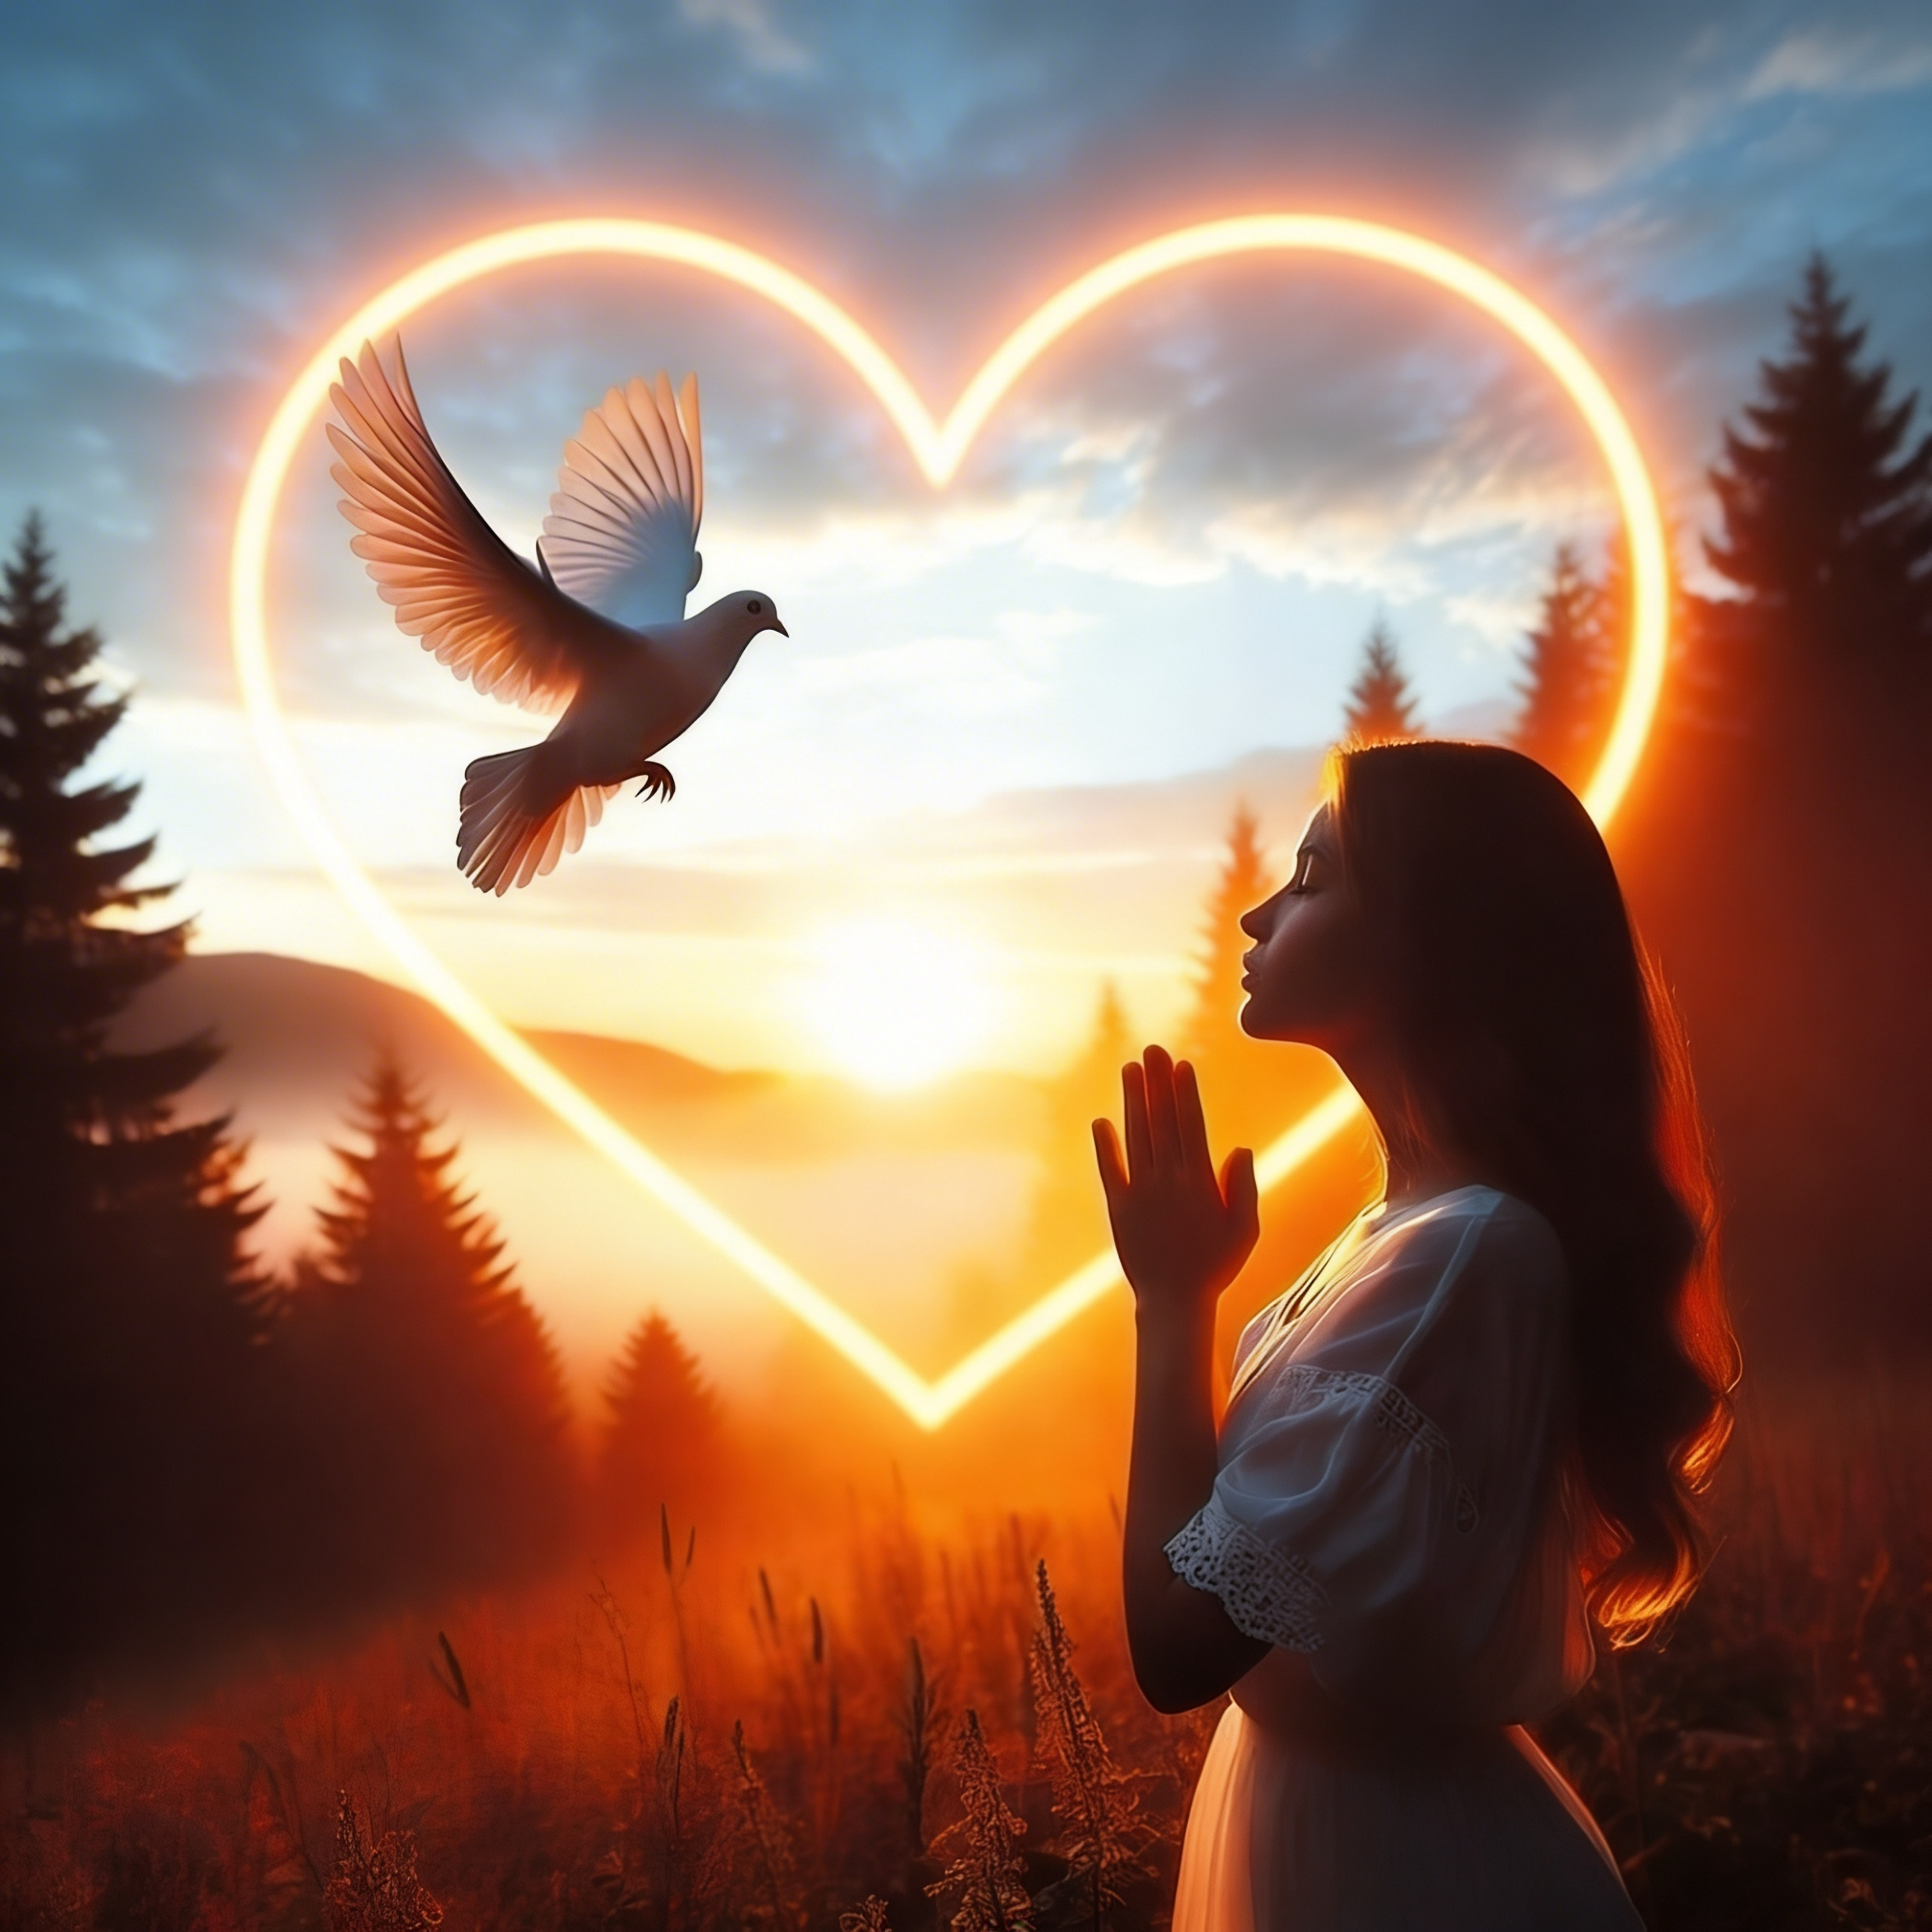
“Pea ʻoku ʻikai ke ngata ai, ka ʻoku tau vikiviki ʻi he ngaahi mamahi foki: ʻi heʻetau ʻilo ʻoku tupu mei he mamahi ʻae faʻa kātaki; Pea mei he faʻa kātaki, ʻae ʻilo; pea mei he ʻilo, ʻae ʻamanaki lelei:Pea ʻoku ʻikai fakamā ʻe he ʻamanaki lelei; he koeʻuhi kuo lilingi ʻae ʻofa ʻae ʻOtua ki hotau loto ʻi he Laumālie Māʻoniʻoni, ʻaia kuo foaki kiate kitautolu.”
(Loma 5:3–5)

Slide 3
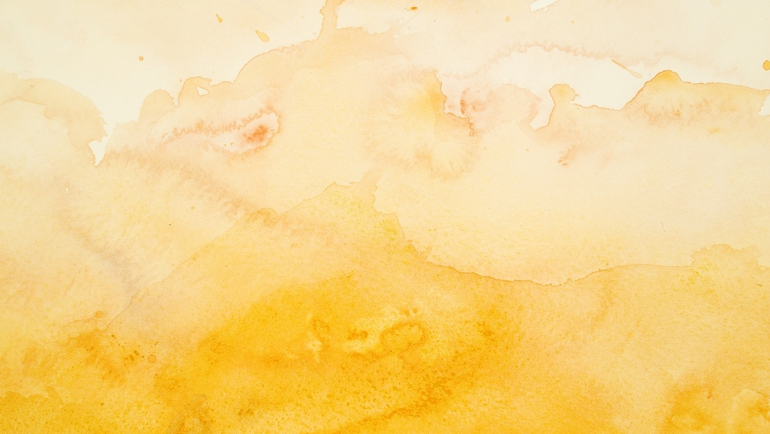

ʻOku tau moʻui ʻi ha mamani ʻoku fonu ʻi he angahala mo e faingataʻaʻia. ʻOku tau fehangahangai kotoa pe mo e ngaahi faingataʻa ʻi ha taimi ʻe lava ke ne ʻai ke tau fehuʻia ʻa e ʻofa ʻa e ʻOtua.
ʻOku anga fefe ʻetau tali ki he ngaahi faingataʻa ko ʻeni?
Te tau ako ʻ a e anga ʻ o e tali ʻ a e faʻahinga ʻ e niʻihi ʻ i he Tohi Tapú ki he ngaahi tuʻunga faingataʻa kehekehe, pea mo e founga ʻ e lava ke tokoniʻi ai kitautolu ʻ e heʻenau faʻifaʻitakiʻangá ke tau fehangahangai ai mo e ngaahi meʻa fakatuʻutāmaki meimei tatau.
Ko e ngaahi matangi ʻo e moʻui
Ngaahi mahaki
Ngaahi fakatamaki
Ngaahi meʻa fakamamahi
Vakai kia Sisu .

Slide 4




KO E NGAAHI MATANGI ʻO E MOʻUI
“Pea naʻe tupu ʻae fuʻu matangi lahi, pea feʻohofi ʻae ngaahi peau ki he vaka, pea ngoto ai. ” (Ma’ake 4:37)
Naʻe ʻikai ko ha meʻa foʻou kia Pita, ʻAnitelu, Semisi mo Sione, ko e kau toutai taukei ʻa e kolosi ʻi he Tahi Kaleli ʻi he tuʻuapoo, naʻa mo e lotolotonga ʻo ha matangi.
Neongo ia, naʻe lomekina kinautolu ʻe he matangi. Naʻe puhiʻi hake ʻe he havili ʻa e ngaahi peau, ʻo tafea ʻa e vaka pea tuʻu fakatuʻutamaki ki heʻenau moʻui. Pea nau toki fakatokangaʻi... ʻOku ʻi fe ʻa Sisu? ʻOku ne mohe? Ko e ha ʻoku ʻikai ke ne tokoniʻi ai kitautolu? ʻOku ʻikai ke ne tokanga ki he meʻa ʻoku hoko kiate kitautolu? (Maʻake 4:35-38)
ʻOku tau foua ʻi heʻetau moʻui ʻa e ngaahi matangi. ʻOku tau kole tokoni kia Sisu, ka ʻoku hange ʻoku Ne mohe. ʻOku ʻikai ke tau ongoʻi ʻEne ʻi ai. Ka ʻoku Ne ʻi ai.
Tatali ki ha momeniti ke valokiʻi ai ʻetau matangi: "Melino, ke ke longo pe" (Maʻake 4:39). ʻOku Ne tokanga mai kiate kitautolu (1 Pita 5:7). Te Ne lava ʻo fakanonga hotau ngaahi matangi. ʻOua naʻa ngalo ke fakahikihikiʻi Ia ʻi he taimi ʻoku Ne fai ai ia (Maʻake 4:40-41)

Slide 5





NGAAHI MAHAKI
“He kuo pehē ʻe ia, “Kapau teu ala pe ki hono kofu, te u moʻui ai.””
(Ma’ake 5:28)
Naʻe faingataʻaʻia ʻa e fefine ʻi he toto ʻi ha taʻu ʻe hongofulu ma ua ʻo ʻikai maʻu ha toketa te ne lava ʻo fakamoʻui ia (Maʻake 5:25-26). ʻI he ʻaho ni, ʻoku ʻi ai ha ngaahi fonua ʻoku ʻikai ke ʻi ai ha maluʻi fakafaitoʻo taʻetotongi, pea ʻoku kei moʻoni pe ʻa e talanoa ko ʻeni.
ʻI ha faʻahinga tuʻunga pe, te tau lava kotoa ʻo fehangahangai mo e ngaahi tuʻunga ʻoku tuku popula mo fakafulufuluʻi ai kitautolu ʻe he mahamahaki, ʻo ʻikai maʻu ha fakafiemalie.
Naʻe sio ʻa e fefine kia Sisu ʻa e fakaleleiʻanga, pea naʻe fakahaofi ia ʻe heʻene tui (Maʻake 5:27-29).
Kuo pau ke tau falala ʻe lava ke fakaʻaongaʻi ʻe Sisu ha kau toketa taukei ke fakamoʻui kitautolu, pe fakahoko ha mana fakahangatonu ʻiate kitautolu.
ʻI ha faʻahinga meʻa pe, ʻoku fakaafeʻi kitautolu ʻe Sisu ke tuku kiate Ia ʻetau ngaahi kavenga mo e hohaʻa kotoa pe
(Matiu 11:28-30)

Slide 6





NGAAHI FAKATAMAKI
“Pea ka ʻosi hoku kili pea maumau hoku sino,
ka te u mamata ʻi hoku kakano ki he ʻOtua:.” (Siope 19:26)
Naʻe liliu lahi ʻe he tau, fetaʻaki, mo e ngaahi fakatamaki fakanatula ʻa e moʻui ʻa Siope (Siope 1:13-19). ʻOku tau fehangahangai kotoa pe mo e ngaahi fakatamaki, ʻo tatau ai pe pe ʻoku fakanatula pe fakatupunga ʻe he kovi ʻoku mafola ʻi he mamani ko ʻeni.
ʻ E anga - fēfē ʻ etau fakafeangaí? Naʻe anga - fēfē ʻ a e fakafeangai ʻ a Siopé?
Naʻe ʻikai ke ne tukuakiʻi ʻa e ʻOtua pe fakafisingaʻi Ia
Naʻa ne pikitai kiate Ia ʻaki hono ivi kotoa
Naʻa ne falala ʻo aʻu ki he ngaahi momeniti faingataʻa taha
Naʻa ne fokotuʻu ʻene tokanga ki ha kahaʻu naunauʻia (Siope 19:25-27)
Kapau he ʻikai ke tau loto foʻi, te tau ʻiloʻi ʻoku ʻi ai maʻu pe ʻa e ʻOtua ʻi hotau ngaahi faingataʻa taha. ʻOku Ne ʻofa mo fakamalohia kitautolu ke tau maʻu ha malohi mei he vaivai, loto-toʻa mei he loto foʻi, mo e ʻamanaki lelei mei he fakatamaki
(Sioeli 3:10; Loma 5:3-5).
Kapau ʻoku ke foua ha ngaahi taimi faingataʻa, fakakaukau ki he moʻoniʻi meʻa ko ia ko e ʻofa mo e tokanga ʻa e ʻOtua kiate koe ko e meʻa malu mo tuʻumaʻu taha ia ʻi hoʻo moʻui.

Slide 7






NGAAHI MEʻA FAKAMAMAHI
“Ka naʻa mau falala ko ia ia te ne huhuʻi ʻa ʻIsileli:…” (Luke 24:21a)
Ko e fakakaukau: Ko Sisu ʻa e Misaia te Ne huhuʻi ʻa ʻIsileli. Ko hono moʻoni: Kuo Ne pekia (Luke 24:18-21).
Naʻe fuʻu lahi fau ʻenau loto mamahi ʻo ʻikai ke nau lava ai ʻo tali ʻo aʻu ki he fakamoʻoni mahino taha ʻo e toetuʻu ʻa Sisuu
(Luke 24:22-24).
ʻ I he kātakí, naʻe tokoniʻi kinautolu ʻ e Sīsū ke nau toe maʻu ʻ enau ʻ amanakí. Fakaʻosi, "naʻe fakaava honau mata" (Luke 24:31 NIV) , pea naʻa nau lele ke fakalotolahiʻi ʻa kinautolu naʻe kei loto-mamahi (Luke 24:32–35; 2 Kolinito 1:4). Ko e ha te tau lava ʻo ako mei he meʻa ne nau aʻusia?
Kuo pau ke ʻoua naʻa tau tuku ʻa e veiveiua ke aka ʻi hotau ʻatamai
ʻOku ʻaʻeva ʻa Sisu ʻi hotau tafaʻaki ʻo aʻu pe ki heʻetau loto mamahi
Te Ne toʻo atu ʻetau puputuʻu, kapau te tau fakaʻata ia ke
ʻOku ʻafioʻi lelei ange ʻe Sisu ʻiate kitautolu ʻa e tuʻunga ʻoku tau moʻoni ai
Notes:
Jesus died and was resurrected

Slide 8


MAMATA KIA SISU
“He ʻoku ou pehē, ʻoku ʻikai ngali ke fakatatau ʻae ngaahi mamahi ʻoe moʻui ni ki he nāunau ʻaia ʻe fakahā kiate kitautolu.” (Loma 8:18)
ʻI he taimi naʻe fuʻu siva ai ʻa e ʻamanaki ʻa ʻEleni G. Uaiti, naʻa ne maʻu ha meʻa-ha-mai ʻo ne mamata ai kia Sisuu.
Naʻe mahino kiate ia naʻe mahino kiate Ia ʻa e meʻa kotoa pe naʻa ne foua. ʻI ha taimi ʻe taha, naʻe hilifaki ʻe Sisu Hono toʻukupu ki hono ʻulu, pea ne pehe ange kiate ia, "ʻOua naʻa ke manavahe."
Naʻa ne mamata ki ha ngaahi meʻa naunauʻia, pea naʻe hange kiate ia kuo ne maʻu ʻa e malu mo e nonga ʻo e langi.
Naʻe ʻoange ʻe he misi ko ʻeni kiate ia ha ʻamanaki lelei mo ha tui, pea mo e fakapapau te ne lava ʻo falala ki he ʻOtua.

Slide 9


“Pea ʻoku tau ʻilo ʻoku fengāueʻaki fakataha ʻae ngaahi meʻa kotoa pē ke lelei ai ʻakinautolu ʻoku ʻofa ki he ʻOtua, ʻakinautolu kuo ui ʻo tatau mo ʻene tuʻutuʻuni”
(Loma 8:28)
“ʻOua naʻa tokanga mamahi ki ha meʻa ʻe taha; kae fakahā atu hoʻomou holi ʻi he meʻa kotoa pē, ki he ʻOtua, ʻi he lotu mo e lotu tāumaʻu mo e fakafetaʻi. Pea ko e melino ʻoe ʻOtua, ʻaia ʻoku lahi hake ʻaupito ʻi he faʻa ʻiloa, te ne maluʻi homou laumālie mo homou loto ʻia Kalaisi Sisu. ” (Filipai 4:6-7)
“‌ʻE hoku kāinga, ʻoka mou ka tō ki he ngaahi ʻahiʻahi kehekehe, ui ia kotoa pē ko e meʻa fakafiefia; ʻO ʻilo, ko e ʻahiʻahiʻi ʻo hoʻomou tui, ʻoku ne fakatupu ʻae kātaki.Kae tuku ʻae kātaki ke ngāue ki he haohaoa, koeʻuhi ke mou haohaoa mo māʻopoʻopo, ʻo taʻemasiva ʻi ha meʻa. […] ʻOku monūʻia ʻae tangata ʻoku ne kātaki ʻae ʻahiʻahi: he ʻoka ʻilo ia ʻoku lelei, ʻe maʻu ʻe ia ʻae pale ʻoe moʻui, ʻaia kuo talaʻofa ki ai ʻae ʻEiki kiate kinautolu ʻoku ʻofa kiate ia.” (Semisi 1:2-4, 12)
“Pea pehē mai ʻe ia kiate au, “Ko ʻeku tokoni ʻe lahi maʻau: he kuo fakakakato ʻeku mālohi ʻi hoʻo vaivai.” Ko ia teu fiefia lahi mo polepole ai muʻa ʻi heʻeku ngaahi vaivai, koeʻuhi ke nofoʻia au ʻe he mālohi ʻo Kalaisi.” (2 Kolinitō 12:9)

Slide 10

“ʻOku hoko mai ʻa e ngaahi taimi ʻo e loto-mamahi mo e loto-foʻi ʻi he meʻa kotoa pe—ʻa e ngaahi ʻaho ʻoku hoko ai ʻa e mamahi ko e konga mahuʻinga, pea ʻoku faingataʻa ke tui ʻoku kei hoko pe ʻa e ʻOtua ko e tokotaha angaʻofa ki Heʻene fanau naʻe fanauʻi ʻi he mamani; ngaahi ʻaho ʻoku fakahohaʻasi ai ʻe he faingataʻa ʻa e laumalie, kae ʻoua kuo hange ʻoku lelei ange ʻa e mate ʻi he moʻui. Ko e taimi ia ʻoku mole ai ʻa e pikitai ʻa e tokolahi ki he ʻOtua pea ʻomi kinautolu ki he popula ʻo e veiveiua, ʻa e popula ʻo e taʻetui. Kapau te tau lava ʻi he ngaahi taimi pehee ʻo ʻiloʻi ʻi he ʻilo fakalaumalie ʻa e ʻuhinga ʻo e tokoni ʻa e ʻOtua, ʻoku totonu ke tau mamata ki he feinga ʻa e kau ʻangelo ke fakahaofi kitautolu meiate kitautolu, ʻo feinga ke fokotuʻu hotau vaʻe ʻi ha fakavaʻe ʻoku tuʻu maʻu ange ʻi he ngaahi moʻunga taʻengata, pea ʻe tupu hake ʻa e tui foʻou, ʻa e moʻui foʻou.”
EGW (Kau Palōfita mo e Ngaahi Tuʻí, p. 163)

