Slide 1

VAHEVAHE ATU IA
Lesoni 12 ki he ʻaho 20 ʻo Sune 2026

Slide 2

“‘Kuo foaki kiate au ʻe he ʻEiki ko Sihova ʻae ʻelelo ʻoe poto,
koeʻuhi ke u ʻilo ke lea ʻaki ha lea ʻi he kuonga totonu kiate ia ʻoku vaivai:
ʻoku ne ʻa ʻi he pongipongi kotoa pē,
ke ne fafangu hoku telinga ke ongoʻi ʻo hangē ko e poto.”
(‘Isaia 50:4)

Slide 3
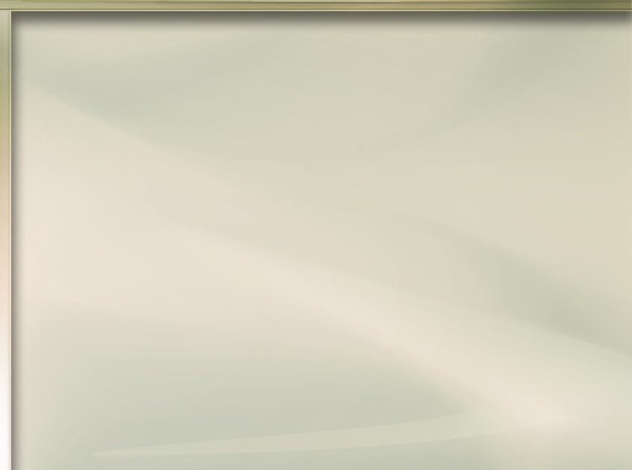






ʻOku ʻikai ke ʻiloʻi moʻoni ʻe ha lauiafe ʻa Sisu. ʻOku tau ui kinautolu ko e "sipi hee," ka ʻoku ʻikai ke nau ʻiloʻi kuo nau hee. Pea ʻe anga fefe haʻanau ʻiloʻi ʻoku nau fie maʻu ʻa Sisu kapau ʻoku ʻikai fakamatalaʻi ia ʻe ha taha kiate kinautolu?
ʻOku tokanga ʻa e ʻOtua ki he tokotaha kotoa pe ʻi he palanite ko ʻeni pea "ʻoku Ne finangalo ke fakamoʻui ʻa e kakai kotoa pe pea nau aʻusia ʻa e ʻilo ʻo e moʻoni" (1 Timote 2:4). ʻOku kau heni fakatouʻosi ʻa kinautolu ʻoku ʻikai ke nau ʻiloʻi ia pea mo kinautolu kuo nau tafoki mei heʻene ngaahi founga.
Kuo anga - fēfē ʻ a e fili ʻ a e ʻ Otuá ke aʻu ki he kakai kotoa ko iá? Fakafou ʻiate kitautolu. Ko hotau "tufakanga maʻongoʻonga" ʻeni.
Ko e ha ʻoku totonu ke tau vahevahe?
  Ko e Komisoni Lahi
ʻE lava fefe ke tau vahevahe?
  Faʻifaʻitaki kia Sīsū
  Ko hono tanumaki ʻo e anga fakakaumeʻa
ʻEanga fefe hono fakafoki mai ʻo kinautolu naʻe mavahe?
  ʻOku fekumi ʻa e ʻOtua ki Heʻene fanau
  ʻOku mau kumi ʻa e tokotaha naʻe mavahe

Slide 4

KO E HA ʻOKU TOTONU KE TAU VAHEVAHE?

Slide 5

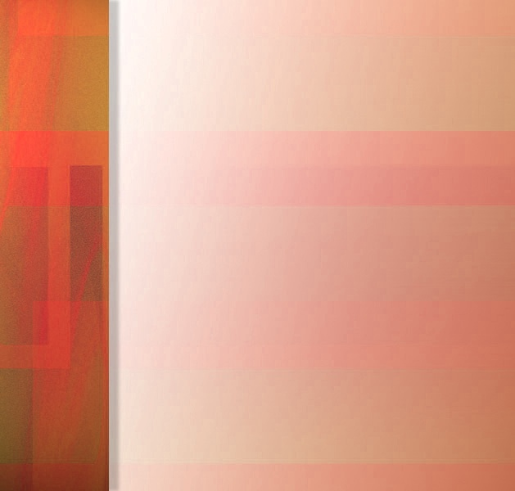





KO E TUFAKANGA LAHI
“Ko ia ke ʻalu ʻakimoutolu, ʻo fakalotuʻi ʻae ngaahi puleʻanga kotoa pē, ʻo papitaiso ʻakinautolu ʻi he huafa ʻoe Tamai, mo e ʻAlo, mo e Laumālie Māʻoniʻoni: ”
(Matiu 28:19)
"ʻAlu... [ki he] ngaahi puleʻanga kotoa pe" ko e fekau ia naʻe fai ʻe Sisu ki he kakai naʻa nau fakataha ke mamata kiate ia hili ʻene toetuʻu (Matiu 28:18-19a)
Ko e ha naʻe totonu ke nau fai? Naʻe pau ke nau ʻalu ʻo ngaohi akonga. ʻA ia, ke fetuʻutaki ki he kakai, papitaiso kinautolu, pea akoʻi kinautolu ke nau hoko ko e kau akonga ʻa Sisu (Matiu 28:19-20).
Ko e kau ākonga ko iá, ʻ i he tafaʻaki ʻ e tahá, naʻa nau akoʻi ai ʻ a e kau ākonga kehé... pea pehe ai pe ʻi he taʻu ʻe ua afe... ʻo aʻu ki hotau kuonga. Ko kitautolu ʻeni ʻoku tau maʻu ʻa e fekau ʻa Sisuu.
Hange ko Pita mo Sione, "ʻoku ʻikai te mau faʻa taʻofi ʻa e lea ki he meʻa kuo mau mamata mo fanongo ki ai" (Ngaue 4:20). Te tau lava ʻo lea mei he tuʻunga malanga, tangi ʻi he hala, vahevahe ʻetau fakamoʻoni ʻi he mitia fakasosiale, pe vahevahe pe ia mo ha taha. ʻOku tau kau kotoa ki ai.

Slide 6

ʻE LAVA FEFE KE TAU VAHEVAHE?

Slide 7





KO E FAʻIFAʻITAKI KIA SĪSŪ
"He ʻoku ueʻi kimautolu ʻe he ʻofa ʻa Kalaisi, koeʻuhi he ʻoku mau tui naʻe pekia ʻa e toko taha maʻa e kakai kotoa pe" (2 Kolinito 5:14a)
Ko e ha naʻa ne fakaʻaiʻai ʻa Sisu ke fekumi ki he "sipi hee" (Matiu 15:24)?
ʻOku ʻikai ha veiveiua, ko ʻEne ʻofa ia kiate kitautolu (Matiu 9:36; ʻEfeso 5:2). Kuo Ne tuku foki ʻEne ʻofa ʻiate kitautolu, koeʻuhi ke tau lava ʻo vahevahe ia mo kinautolu ʻoku teʻeki ai ke nau ʻiloʻi ʻa Sisu. ʻI he taimi ʻe niʻihi, ʻoku feinga ʻa e kakai ke fakamalohiʻi ʻa e niʻihi kehe ke nau tali ʻa Sisu koeʻuhi ko ʻenau lelei pe ʻanautolu. Ka ʻoku ʻikai ko e founga ia naʻe fili ʻe he ʻOtua.
Naʻe ʻikai fakamālohiʻi ʻ e he ʻOtuá ʻa ʻĀtama mo ʻIvi ke ʻoua te na faiangahala. Naʻe ʻikai te ne fakamālohiʻi ʻa e kau muʻomuʻa ʻi he vaʻá ke nau hū ki he ʻ aʻaké Naʻe ʻikai te ne fakamālohiʻi ʻ a e kau Ninive ke nau tali ia. Naʻa Ne folofola kiate kinautolu ʻi he ʻofa mo fakatokanga kiate kinautolu fekauʻaki mo e ngaahi nunuʻa ʻo e muimui ʻi honau ngaahi hala.
ʻI heʻetau faʻifaʻitaki kia Sisuu, ʻoku tau fakahaaʻi ai ʻEne ʻofa ki he niʻihi kehe, pea fakaafeʻi kinautolu ke nau muimui ʻiate Ia.

Slide 8
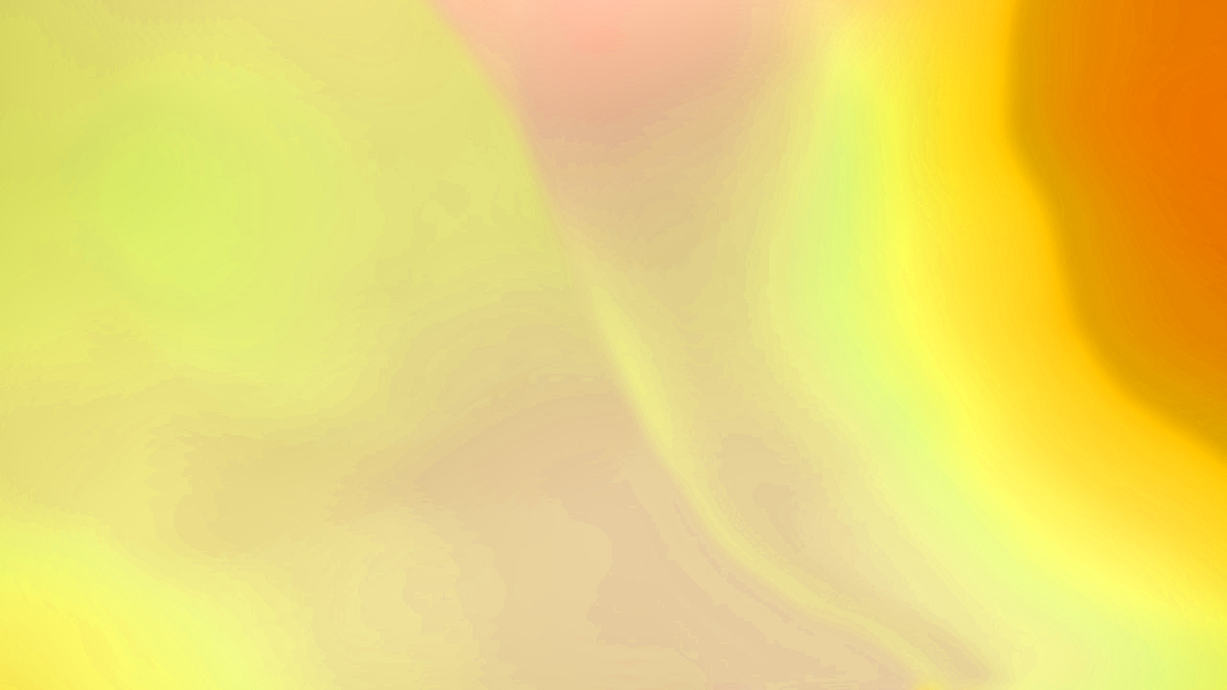


FAKATUPULEKINA ʻ A E ANGA - FAKAKAUMEʻÁ
ʻAi ke ke maheni mo ha taha pea fokotuʻu ha feohi fakakaumeʻa ʻi ha vahaʻa taimi
Lotu ke ngaue ʻa e Laumalie Maʻoniʻoni ʻi he loto ʻo e tokotaha.Lotua ʻa e ngaahi faingamalie totonu ke fengaueʻaki ai mo kinautolu
Kumi ha ngaahi founga fakanatula ke talanoa ai ki he ngaahi meʻa kuo ke aʻusia ʻi he tui pe fai ha lotu maʻanautolu
Kumi ha ngaahi founga ke fakafehokotaki ai ho kaungameʻa foʻou mo e niʻihi kehe mei homou siasi
Lotua ha ngaahi fie maʻu pau pe ngaahi fehuʻi ʻe ala maʻu ʻe ho kaungameʻa foʻou
Kumi ki ha faingamālie ke fakahaaʻi ai kiate kinautolu ʻa e founga ʻoku ʻomai ai ʻe he Tohi Tapú ʻa e fakafiemālie, faleʻi, mo e tataki ʻi heʻetau moʻuí
ʻE ʻi ai ʻa e taimi te ke loto ai ke ʻeke ange pe ʻoku saiʻia ho kaumeʻá ke ako Tohi Tapu mo koe ʻAmui, ʻe loto nai ho kaumeʻá ke papitaiso
“…Kae fakaʻapaʻapa ki he ʻEiki ko e ʻOtua ʻi homou loto: pea mou nofo teu pe ke talia ʻi he angavaivai mo e manavahē ʻae tangata kotoa pē ʻe ʻekea ʻakimoutolu ki hono ʻuhinga ʻoe ʻamanaki lelei ʻoku ʻiate kimoutolu:.” (1 Pita 3:15)
Ko e kau malanga kotoa kitautolu ʻa Sisu pea ʻoku fekauʻi kitautolu ke tau teuteuʻi kitautolu ki he meʻa ni (1 Pita 3:15). Ka ʻ oku ʻ ikai ke tau ʻ iloʻi kotoa ʻ a e founga ke malanga aí. Neongo ia, ʻoku tau maʻu ʻa e talaʻofa ʻe foaki mai ʻe he ʻOtua tonu pe ʻa e ngaahi lea ʻoku fie maʻu (ʻIsaia 50:4).
Ko ha fanga kiʻi tokoni faingofua ʻeni ke ke manatuʻi ʻi hoʻo fakakaukau ki he founga ke toe tokanga ange ai ki hono vahevahe ʻo Sisu mo e niʻihi kehe:

Slide 9

ʻE ANGA FEFE HONO FAKAFOKI MAI ʻO KINAUTOLU NAʻE MAVAHE?

Slide 10
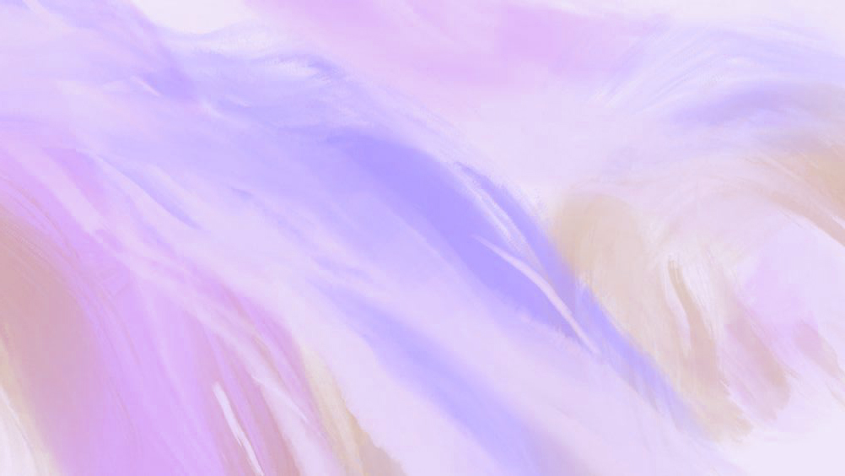




ʻOKU FEKUMI ʻA E ʻOTUA KI HEʻENE FANAU
“‌ʻIkai ko hoku foha ʻofeina ʻa ʻIfalemi? ʻIkai ko e tamasiʻi fakaʻofoʻofa ia? He kuo talu ʻeku lea kiate ia, ʻoku ou kei manatu lahi kiate ia: ko ia ʻoku mamahi hoku fatu koeʻuhi ko ia; ko e moʻoni te u ʻofa kiate ia, ʻoku pehē mai ʻa Sihova. .” (Selemaia 31:20)
ʻI ha taimi ʻe taha, naʻe mavaeua ʻa e kakai ʻa e ʻOtua: naʻe liʻaki ʻe ʻIfalemi (ko e puleʻanga fakatokelau) ʻa e ʻOtua; Naʻe kei faivelenga pe ʻa Siuta (ko e puleʻanga fakatonga).
Neongo hono liʻaki, ka naʻe kei lau pe ʻe he ʻOtua ʻa ʻIfalemi ko hono foha ʻofaʻanga (Selema. 31:20). Naʻe aʻu ʻo ne fakatataaʻi ʻene kui fefine ko Lesieli ʻoku ne tangi koeʻuhi ko hono ngaahi foha, ʻa ia kuo nau mate ʻi heʻenau ngaahi angahala (Selema. 31:15).
Ko kinautolu naʻa nau tauhi ki he ʻOtua pea liʻaki Ia, ʻoku hokohoko atu ʻa e ui ʻa e ʻOtua kiate kinautolu ʻi he ʻofa. Ko ʻEne fanau kinautolu, pea ʻoku Ne ʻofa ʻiate kinautolu mo toutou poupouʻi kinautolu ke nau foki ange kiate Ia.
Mahalo kuo liʻaki ia ʻe ha niʻihi ʻo ʻetau fanau, ʻa ia naʻa nau ʻiloʻi kimuʻa ʻa e tui. ʻI he ʻ ikai ke tau situʻa meiate kinautolu, kuo pau ke tau hokohoko atu ke ʻofa kiate kinautolu pea lea anga - ʻ ofa kiate kinautolu. ʻOku fakamanatu mai ʻe he ʻOtua ko e taumuʻa kinautolu ʻo ʻEne manavaʻofa ongongofua taha, pea ʻoku Ne finangalo fakamatoato ke nau foki ange kiate Ia.

Slide 11



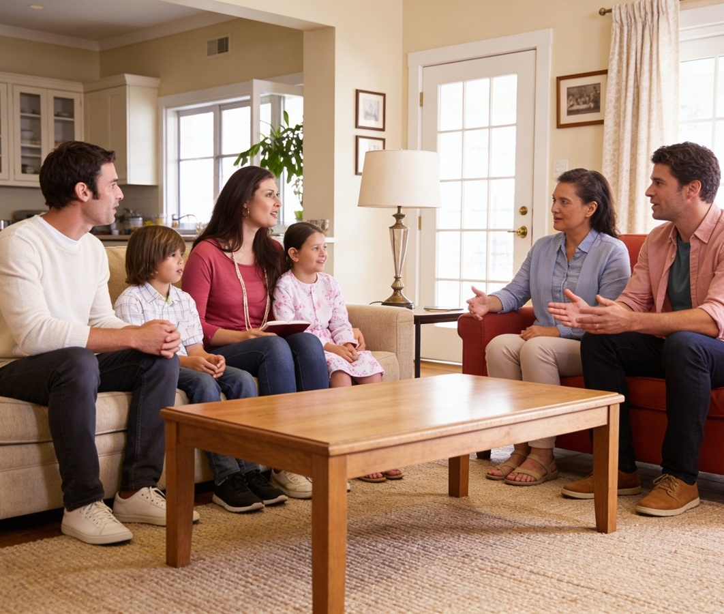

ʻOKU MAU KUMI ʻA E TOKOTAHA NAʻE MAVAHE
“Pea te u tūtuuʻi ʻakinautolu ʻi he lotolotonga ʻoe kakai; pea te nau manatuʻi au, ʻi he ngaahi fonua mamaʻo; pea ʻe moʻui ʻakinautolu, pea mo ʻenau fānau, pea ʻe toe tafoki mai.” (Sakalaia10:9)
Ko hotau mali; homa foha; homa ʻofefine; ko hotau kaumeʻa; hotau kaungaʻapi; ko e tuongaʻane pe tuofefine ko ia naʻe faʻa tangutu ʻi he sea ko ia... ʻI he ʻaho ʻe taha naʻa nau lotu fakataha mo kimautolu, ka ko ʻeni, ʻoku nau ʻi fe?
ʻOku lahi e ngaahi ʻuhinga ʻoku mavahe ai ʻa e kakai mei he siasi. ʻOku ʻikai ui kitautolu ke tau fakamauʻi ʻenau ngaahi ʻuhinga, fakaangaʻi ʻenau ngaahi taumuʻa, pe fakangaloʻi pe kinautolu.
Ko hotau fatongia ke ʻalu ʻo kumi kinautolu pea fakafoki mai kinautolu ki he takanga. ʻE anga fefe haʻatau fai ʻeni? ʻUluaki, ʻaki ʻa e lotu. Ua, ʻaki ʻetau hoko ko ha faʻifaʻitakiʻanga ʻo e ʻofa mo e angaʻofa kiate kinautolu.
ʻE lava ʻe he fakamoʻoni ki hoʻo moʻui, hoʻo ngaahi toʻonga, lea, mo e lotu maʻa ha taha kuo he mei he ʻOtua ʻo liliu lahi ʻene moʻui mo honau kahaʻu.

Slide 12

“Mahalo naʻe mei tuku ʻe he ʻOtua ʻa e popoaki ʻo e ongoongolelei, mo e ngaue kotoa ʻo e ngaue ʻofa, ki he kau ʻangelo fakalangi. Naʻa Ne mei fakaʻaongaʻi ha ngaahi founga kehe ke fakahoko ʻaki ʻEne taumuʻa. Ka ʻi Heʻene ʻofa taʻefakangatangata naʻa Ne fili ai ke tau hoko ko e kaunga-ngaue mo Ia, mo Kalaisi pea mo e kau ʻangelo, koeʻuhi ke tau lava ʻo vahevahe ʻa e tapuaki, ʻa e fiefia, mo e langaki moʻui fakalaumalie, ʻa ia ʻoku maʻu mei he ngaue taʻesiokita ko ʻeni. […]
Kapau te ke ʻalu ʻo ngaue ʻo hange ko e palani ʻa Kalaisi ke maʻu ʻe Heʻene kau akonga, pea maʻu ha ngaahi laumalie maʻana, te ke ongoʻi ʻa e fie maʻu ke toe loloto ange ʻa e aʻusia mo ha ʻilo lahi ange ki he ngaahi meʻa fakalangi, pea te ke fiekaia mo fieinua ki he maʻoniʻoni. Te ke tautapa ki he ʻOtua, pea ʻe fakamalohia hoʻo tui, pea ʻe inu ʻe ho laumalie ha ngaahi vai loloto ange ʻi he vaitupu ʻo e fakamoʻui. Ko e fetaulaki mo e fakafepakí mo e ngaahi ʻ ahiʻahí te ne tataki koe ki he Tohi Tapú mo e lotú. Te ke tupulaki ʻi he ʻaloʻofa mo e ʻilo kia Kalaisi, pea te ke fakatupulaki ha aʻusia lelei”
EGW (Ko e Hala kia Kalaisi, p. 79-80)

