Slide 1

KĀTOA PĒ
KE FAKAONGOONGOLELEI AI ’A E 'OTUA
Lesoni 5 ki he ʻaho 1 ʻo ʻAokosi, 2026

Slide 2

(1 Kolinito 10:31)
“Ko ia kapau ʻoku mou kai, pe inu, pe ko e hā ʻae meʻa ʻoku mou fai, fai kotoa pē ke fakaongolelei ai ʻae ʻOtua. ”

Slide 3
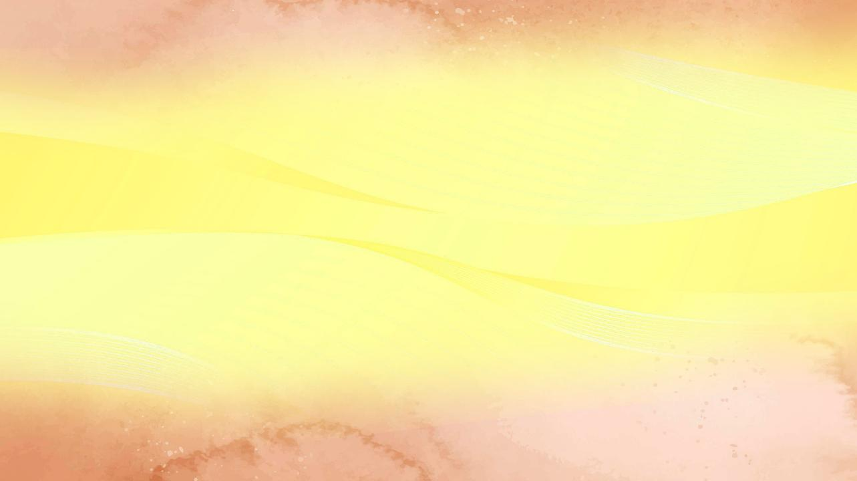

Kamata meia 1 Kolinito 7, ‘oku fakatapui ai ‘e Paula ia ke ne tali ‘a e ngaahi fehu’i hokohoko na’e fekau’i atu ‘e he kakai Kolinito kiate ia ‘i he tohi (1 Kol.7:1a)
1 Kolinito 8
Meʻakai naʻe feilaulauʻi ki he ngaahi tamapua
(ʻIlo mo e ʻofa)
1 Kolinito 9
ʻOku fakaʻikaiʻi ʻe Paula ʻene ngaahi totonu
(Ko e ngaahi totonu ʻo e ongoongolelei)
1 Kolinito 10:1-13
Fakatokanga fekauʻaki mo e tauhi tamapua
(Ngaahi lesoni mei he kuohili)
1 Kolinito 10:14-22
Ko e ipu ʻa e ʻEiki mo e ipu ʻo e kau tevolo
(Liʻaki ʻa e tauhi tamapua)
1 Kolinito 10:23-33
Fai ʻa e meʻa kotoa pe ke fakalangilangiʻi ai ʻa e ʻOtua
(Ko e ha ʻoku fakalao mo e meʻa ʻoku taau)
Koe‘uhi ko e ‘uhinga ko ení, neongo ‘oku fekau‘aki tefito ‘a e vahe 8 ki he 10 mo e tauhi ‘aitolí, ‘oku fakafetongi ‘e Paula ‘a e ngaahi kaveinga ‘e ni‘ihi ‘o ‘ikai ha fekau‘aki hā mahino mo e angahala pau ko ení.
Neongo ia, ʻoku ne feinga ke fakakau ha meʻa ʻoku faitatau ai ʻi he kaveinga takitaha: ʻa e ʻofa mo e fefakaʻapaʻapaʻaki, ʻa ia ʻoku totonu ke ne tataki ʻa e siasi ki he uouangataha.
ʻOku fakamamafaʻi ʻe Paula ʻa e fie maʻu ke fai ʻa e meʻa kotoa pe ʻoku fai ʻi he siasi, pe ʻi he moʻui fakafoʻituitui, ke fakalangilangiʻi ʻa e ʻOtua.

Slide 4





ʻILO MO E ʻOFA
1 Kolinito 8 (Meʻakai ʻoku feilaulauʻi ki he ngaahi tamapua)
"Ka ʻoku fuolahi ʻa e ʻilo kae langa hake ʻa e ʻofa." (1 Kolinito 8:1b)
ʻOku "vahevahe" ʻe Paula ʻa e siasi ki ha kulupu ʻe ua: ko e "malohi" mo e "vaivai".
1 Kolinito 8:4-7a
ʻ Oku mahinoʻi ʻ e he mālohí ko e meʻa noa pē ʻ a e ngaahi ʻ aitolí, he ʻ oku taha pē ʻ a e ʻ Otua moʻoní.
ʻOku teʻeki ai ke mahino ki he vaivai ʻa e poini ko ʻeni.
1 Kolinito 8:7b
ʻOku kai ʻe he kau malohi ʻa e kakanoʻi manu ʻoku feilaulauʻaki ki he ngaahi tamapua koeʻuhi he ʻoku nau ʻiloʻi he ʻikai lava ʻe he ngaahi tamapua ʻo fakaʻuliʻi ʻa e meʻakai.
ʻOku tui ʻa e vaivai ʻoku nau faiangahala kapau te nau kai ʻa e kakanoʻi manu ko ia.
Ka ʻe lava ʻe he kau malohi, ʻo fakafou ʻi heʻenau ʻilo mo e faʻifaʻitakiʻanga, ʻo fakatupu ʻa e vaivai ke to (1 Kolinito 8:10). Ko e ʻofa ki hono tokoua, kuo pau ke mapuleʻi ia ʻe he malohi (1 Kolinito 8:11-13).
ʻOku totonu ke fakamuʻomuʻa ʻe he kau Kalisitiane ʻa e ʻofa ʻi he taimi ʻoku hoko ai ʻa e ʻilo ko ha maka tukiaʻanga ki he tokoua "vaivai" (ʻi he founga ʻo e tupulaki).

Slide 5


KO E NGAAHI TOTONU ʻO E ONGOONGOLELEI
1 Kolinito 9 (Fakaʻikaiʻi ʻe Paula ʻene ngaahi totonu)
"Pea kuo tuʻutuʻuni ʻe he ʻEiki ke pehē foki, ke ʻilonga ʻakinautolu ʻoku malangaʻaki ʻae ongoongolelei, ke nau maʻu ʻi he ongoongolelei ʻae meʻa ki he sino." (1 Kolinito 9:14)
Naʻe fakaʻikaiʻi ʻe Paula ha totonu ʻe tolu koeʻuhi ko ʻene ʻofa ki he vaivai:
⁕ Totonu ke fafangaʻi ʻe he haʻofanga (1 Kolinito 9:4)
⁕ Totonu ke ʻalu fakataha mo hono uaifi (1 Kolinito 9:5)
⁕ Totonu ke ʻoua ʻe fai ha ngaue angamaheni ki hono tokangaʻi (1 Kolinito 9:6)
ʻ Oku fakaʻikaiʻi ʻ e Paula ʻ a ʻ ene totonu ʻ i he tuʻunga ko ha ʻ apositoló ke poupouʻi ia ʻ e he ngaahi siasi ʻ okú ne ngāue ki aí, ʻ o hangē ko ia naʻe fai ʻ e he kau ʻ apositolo kehé.
Ko e founga angamaheni ʻ i he lotolotonga ʻ o e kau ʻ apositoló ke nau fononga mo honau ngaahi uaifí ke tokangaʻi kinautolu mo tokoniʻi kinautolu ʻ i heʻenau ngāue fakafaifekaú. ʻE maʻu ʻe he fefine ko ʻeni, hange ko hono husepaniti, ʻa e totonu ke poupouʻi ia ʻe he siasi.
ʻOku fie maʻu ʻe Paula ke ngaueʻi ʻene moʻui ke fakaʻehiʻehi mei he fakakaukau ʻa e kakai ʻoku ne fie maʻu ke fakaʻaongaʻi ʻene kau fanongo, pea ke fakaʻaliʻali kiate kinautolu ʻa e taʻesiokita.
Neongo naʻe fakamahinoʻi ʻe Sisu ko kinautolu ʻoku nau malangaʻi ʻa e ongoongolelei ʻoku totonu ke nau moʻui mei he ongoongolelei, ka naʻe fakatou fakafisingaʻi ʻeni ʻe Paula mo Panepasa koeʻuhi ke ʻoua naʻa taʻofi ʻa e kakai tui (1Kolinito 9:12-14; Lk. 10:7)

Slide 6










NGAAHI LESONI MEI HE KUOHILI
1 Kolinito 10:1-13 (Fakatokanga ki he tauhi tamapua)
“Pea ʻoua naʻa mou tauhi tamapua, ʻo hangē ko honau niʻihi; ʻo tatau mo ia kuo tohi, “Naʻe nofo hifo ʻae kakai ke kai mo inu, pea tutuʻu hake ʻo meʻe.”” (1Kolinito 10:7)
Ko e meʻa ʻoku tau aʻusia ʻi he ʻEkesotosi, ʻa ia ʻoku mahino fakalaumalie, ʻoku faitatau ia mo kitautolu. ʻOku hange ʻa e kolosi ʻi he tahi ko ʻetau fuakava ʻi he papitaiso (1 Kolinito 10:1-2).
Ko e meʻakai mo e inu naʻa nau maʻu ʻi he toafa ʻoku hange ia ko ʻetau kau ki he Lotu Maʻoniʻoni, ʻa ia ʻoku tau kai mo inu fakalaumalie ai ʻa e sino mo e taʻataʻa ʻo Sisuu (1 Kolinito 10:3-4).
Tokanga! Neongo ʻ enau hokosiá, naʻe tō ʻ a e kau ʻ Isilelí ki he ngaahi angahala mamafa, ʻ o kau ai ʻ a e tauhi ʻ aitolí mo e ʻ ulungaanga taʻetāú. Tuku ke ʻoua naʻa hoko ʻa e meʻa tatau kiate kitautolu! (1 Kolinito 10:5-10).
Ko ia ʻoku fakaʻosi ai ʻe he ʻaposetolo ʻa e konga ko ʻeni ʻaki ha faleʻi malohi: "Ko ia, kapau ʻoku ke pehe ʻoku ke tuʻu maʻu, tokanga telia naʻa ke to" (1 Kolinito 10:12).

Slide 7



LIʻAKI ʻA E TAʻEʻOFA
1 Kolinito 10:14-22 (Ko e ipu ʻa e ʻEiki mo e ipu ʻo e kau tevolo)
“Ko ia, ko hoku kāinga ʻofeina, puna mei he tauhi tamapua.” (1 Kolinito 10:14)
Kapau ʻe lava ke kai taʻe hohaʻa ʻa e meʻakai ʻoku feilaulauʻi ki he ngaahi tamapua, ko e ha ʻoku faleʻi ai ia ʻe Paula ʻi he 1 Kolinito 10:20?
Ko e meʻa kehe ke kai kakanoʻi manu ʻi ʻapi, taʻe ʻi ai ha halaia, pea ko e meʻa kehe ia ke fai ia lolotonga ha katoanga fakapuleʻanga ʻoku lotu ai ki he ngaahi ʻotua. ʻI heʻene kau ʻi he ngaahi katoanga pehee, ʻoku fakaʻikaiʻi ai ʻe he tokotaha tui ʻenau tui pea tali ʻa e lotu ki he ʻotua tamapua.
ʻI heʻetau maʻu ʻa e Lotu Maʻoniʻoni ʻoku tau hoko ai ko e konga ʻo e sino ʻo Kalaisi (ko e siasi), ka ʻi heʻetau kau ʻi he ngaahi ouau tauhi tamapua, ʻoku tau kau ai mo e kau tevolo
(1 Kolinito 10:16-20).
He ʻikai ke tau lava ʻo toʻo ʻa e ipu ʻo e Lotu Maʻoniʻoni, ʻo fakahikihikiʻi ʻa Sisu, pea – ʻi he taimi tatau – toʻo mei he ipu ʻoku fakahikihikiʻi ʻa e kau tevolo (1 Kolinito 10:21).

Slide 8
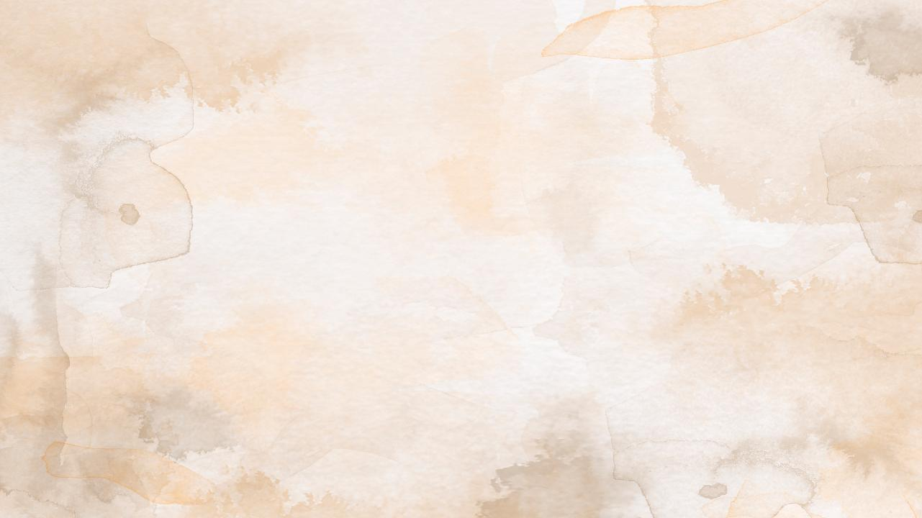


KO E HA ʻOKU FAKALAO MO E MEʻA ʻOKU TAAU
1 Kolinito 10:23-33 (Fai ʻa e meʻa kotoa pe ke fakalangilangiʻi ai ʻa e ʻOtua)
“Ko ia kapau ʻoku mou kai, pe inu, pe ko e hā ʻae meʻa ʻoku mou fai, fai kotoa pē ke fakaongolelei ai ʻae ʻOtua..” (1 Kolinito 10:31)
"ʻOku ngofua ʻa e meʻa kotoa pe, ka ʻoku ʻikai ʻaonga ʻa e meʻa kotoa pe" (1 Kolinito 10:23).
Sipinga pau ʻe ua:
Naʻe fakatau atu ʻe he falekoloa fasi manu ʻa e meʻakai naʻe feilaulauʻi ki he ngaahi ʻaitoli mo e meʻakai naʻe teʻeki ai ke feilaulauʻaki. Naʻe pau ke ʻ eke ʻ e he tokotaha tuí fekauʻaki mo hono tupuʻangá koeʻuhi ke ʻ oua naʻa ne ʻ omai ʻ a e fakakaukau naʻá ne vakai ki ai ʻ oku taʻefakalao ke kai ʻa e faʻahinga kakanoʻi manu ko iá (1 Kolinito 10:25)
Naʻe fakaafeʻi ʻe ha tokotaha taʻetui ha taha tui ke kai. Naʻe kai taʻe fehuʻia ʻa e tokotaha tui (ʻoku ngofua ʻa e meʻa kotoa pe kiate ia). Ka naʻe pehe ʻe he tokotaha talitali, naʻe ʻoatu ʻa e kakanoʻi manu ki ha tamapua. Ko ia ai, koeʻuhi ke ʻoua naʻa fakaʻitaʻi ʻa e konisēnisi ʻo e tokotaha talitali, naʻe lau ʻoku taʻefeʻunga ki he tokotaha tuí ke ne kai ʻa e kakanoʻi manu ko iá (1 Kolinito 10:27-29).
Ko e tefitoʻi moʻoni ʻo e ngaahi fakahinohino ko ʻeni ʻoku ua foki: ke fakafetaʻi ki he ʻOtua ʻi he meʻa kotoa pe (1 Kolinito 10:31); pea ke fekumi ki he lelei ʻa e niʻihi kehe (1 Kolinito 10:24, 32)
ʻA ia, ke ʻofa ki he ʻOtua ʻo lahi ange ʻi he meʻa kotoa pe pea mo ho kaungaʻapi ʻo hange pe ko koe (hange ko e kole ʻa Sisu ki he talavou koloaʻia)

Slide 9

“Naʻe naʻinaʻi ʻa e ʻaposetolo ki he kakai Kolinitoo, "Ko ia ia ʻoku ne mahalo ʻoku ne tuʻu, ke ne tokanga telia naʻa ne hinga." Kapau te nau hoko ʻo polepole mo loto-falala, ʻo ʻikai ke nau leʻo mo lotu, te nau to ki he angahala mamafa, ʻo ui kiate kinautolu ʻa e houhau ʻo e ʻOtua. […]
Naʻe naʻinaʻi ʻ a Paula ki hono fanga tokouá ke nau ʻ eke hifo kiate kinautolu pe ko e hā ʻ a e tākiekina ʻ e heʻenau ngaahi leá mo e ngāué ki he niʻihi kehé pea ke ʻ oua naʻa nau fai ha meʻa, neongo ʻ ene taʻehalaia, ʻ a ia ʻ e hā ngali te ne fakangofua ʻ a e tauhi ʻ aitolí pe fakaʻitaʻi ʻ a e ngaahi veiveiua ʻ a e faʻahinga ʻ oku vaivai nai ʻ i he tuí. "Ko ia, tatau ai pe pe ʻoku mou kai, pe inu, pe ko ha meʻa pe ʻoku mou fai, fai ʻa e meʻa kotoa pe ke fakalangilangiʻi ai ʻa e ʻOtua. ʻOua naʻa fai ha kovi ki he kau Siu, pe ki he kau Senitaile, pe ki he siasi ʻo e ʻOtua."
EGW (Ko e Ngaue ʻa e Kau ʻApositolo, p. 316)

